Slide 1

Representation Learning
Zion Steiner

Slide 2
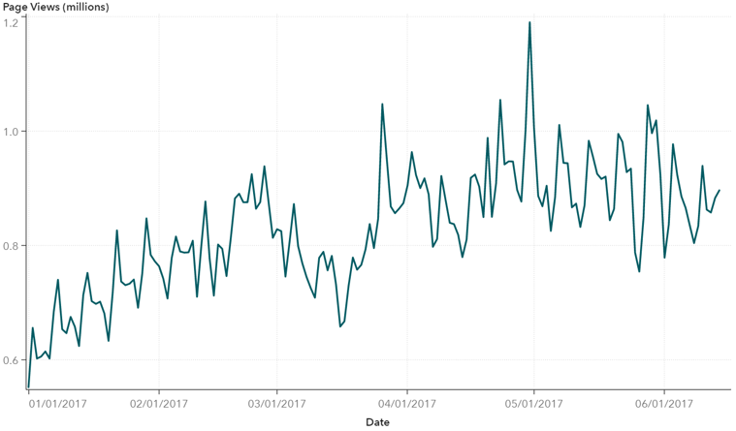
Synopsis
Representation learning: learning useful data mappings
Can be task specific (ResNet layers)
Can be task agnostic (TimeNet)
Fi | xed | size | arr | a | y

Slide 3
Advantages
Dimensionality Reduction
Feature engineering
Fixed length representations

Slide 4
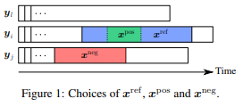
CNN Encoder
Architecture: stacked dilated causal 1D convolutions
Input: [samples, ts_len, 1]
Output: [samples, fixed_len, 1]
Loss: triplet loss adapted to timeseries
arXiv:1901.10738

Slide 5


Slide 6
Timenet
Architecture: RNN sequence autoencoder
Input: [samples, ts_len, 1]
Output: [samples, fixed_len, 1]
Loss: timeseries reconstruction MSE
Encoder
Decoder
Representation
arXiv:1706.08838

Slide 7
Determine Representation Transferability
How well do representations learned from one dataset apply to another?
How does training dataset composition affect this?
Measure effect of dataset size on representation quality
Measure diversity of dataset on representation quality

Slide 8
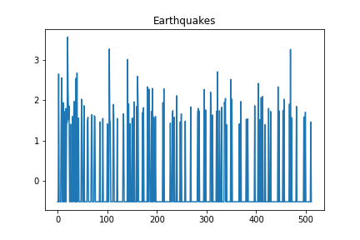
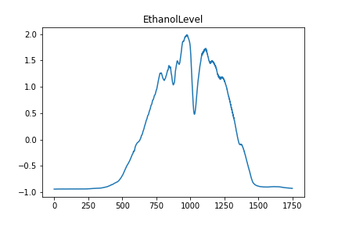
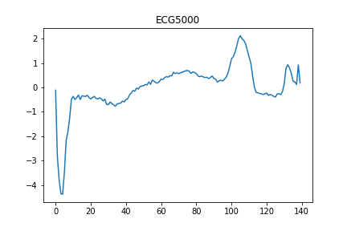
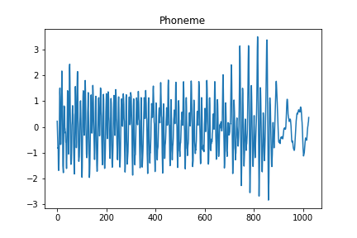
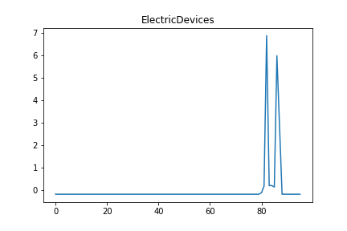
UCR Datasets

Slide 9
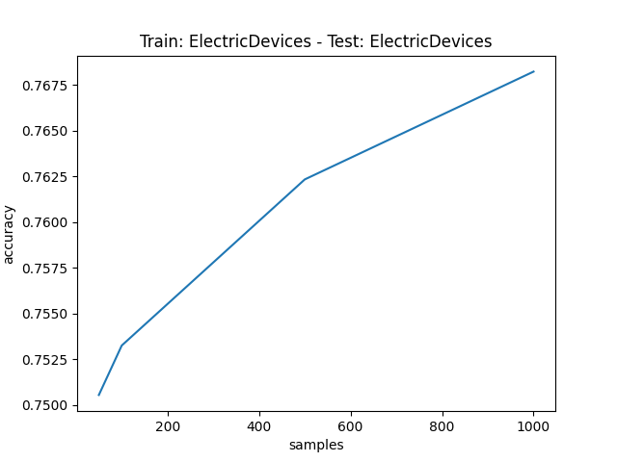
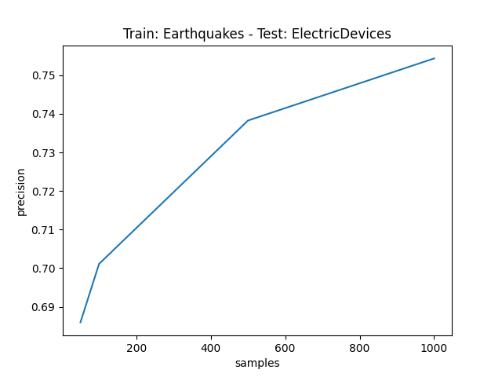
Effect of Size

Slide 10
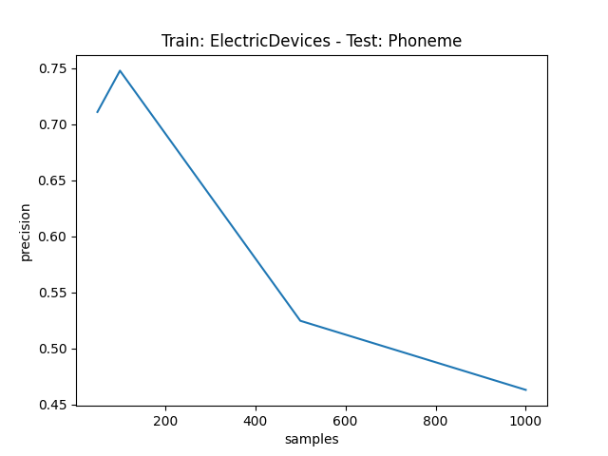
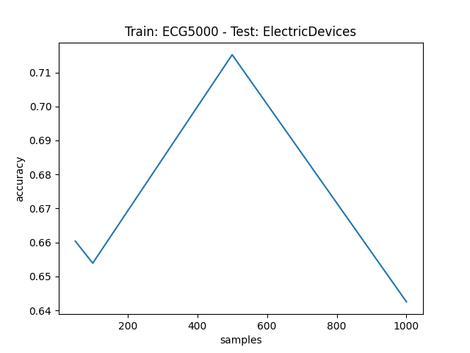

Slide 11
Dataset | Corr(samples, accuracy)
ElectricDevices | 0.019
EthanolLevel | -0.005
Phoneme | 0.00067
ECG5000 | 0.004
Earthquakes | 0.012

Slide 12
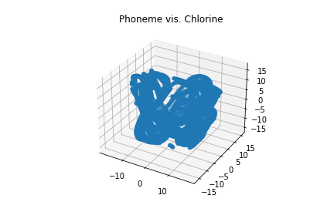
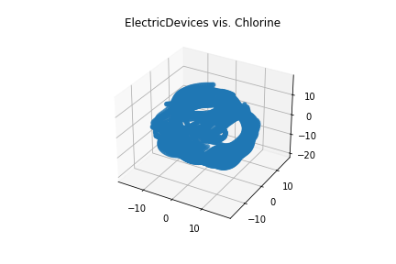
T-SNE
Non-deterministic visualization

Slide 13
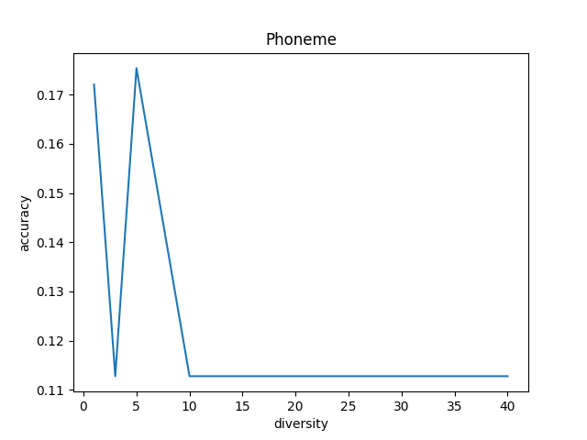
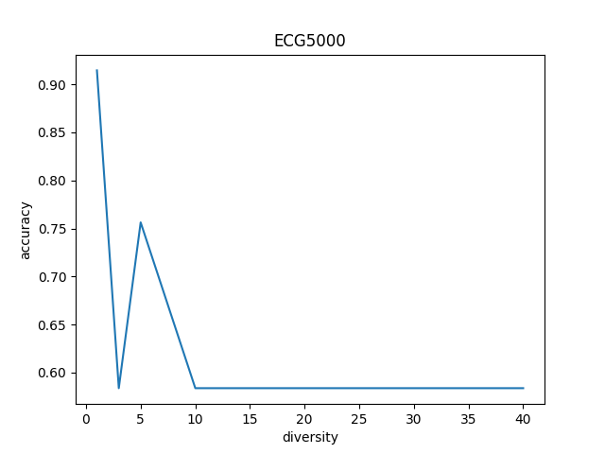
Effect of Diversity

Slide 14
Effect of Diversity
Dataset | Corr(diversity, accuracy)
ElectricDevices | -0.522
EthanolLevel | -0.057
Phoneme | -0.529
ECG5000 | -0.527
Earthquakes | 0

Slide 15
ToDo
Timenet results
Do encodings learned from a diverse dataset work better than if trained on single dataset?
Better on single dataset?
Better on all datasets?
Is dataset diversity within-type more useful that mixed-type?
Effect of number of classes per dataset?

Slide 16
Challenges of Comparing
Different optimal training regimen

Slide 17
Future Work
Representation quality for clustering
TS generation

