Slide 1
Who Survived the Titanic?
A Data Story with Insights

Slide 2
Introduction
We explore Titanic passenger data to understand survival patterns. Key question: Who had the best chance of survival?

Slide 3
Questions & Hypothesis
Q1: Did class affect survival? Q2: Were women and children more likely to survive? Q3: Did age play a role? Hypothesis: Survival was influenced by gender and class.

Slide 4
Dataset Overview
• Rows: 891 passengers in full dataset • Features: Age, Sex, Passenger Class, Survival • Mix of categorical & numeric data.

Slide 5
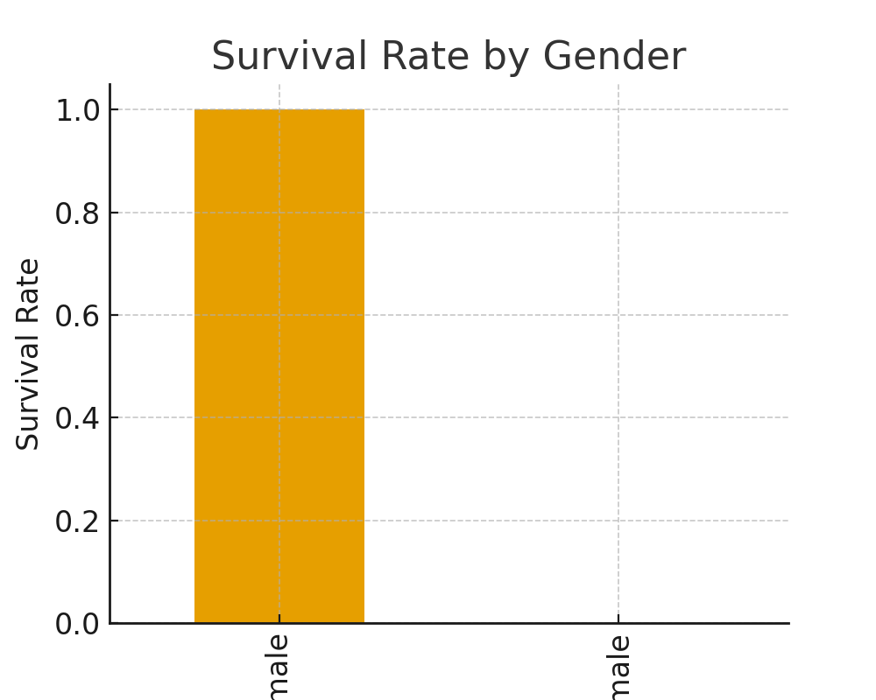
Survival by Gender

Slide 6
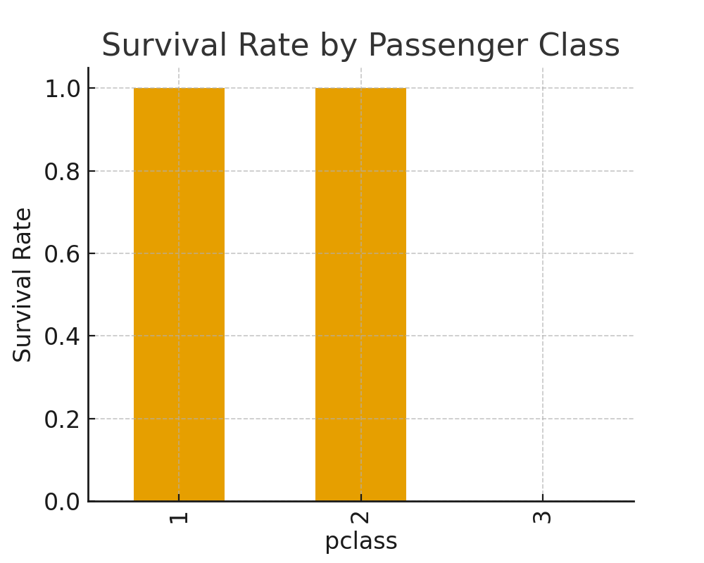
Survival by Passenger Class

Slide 7
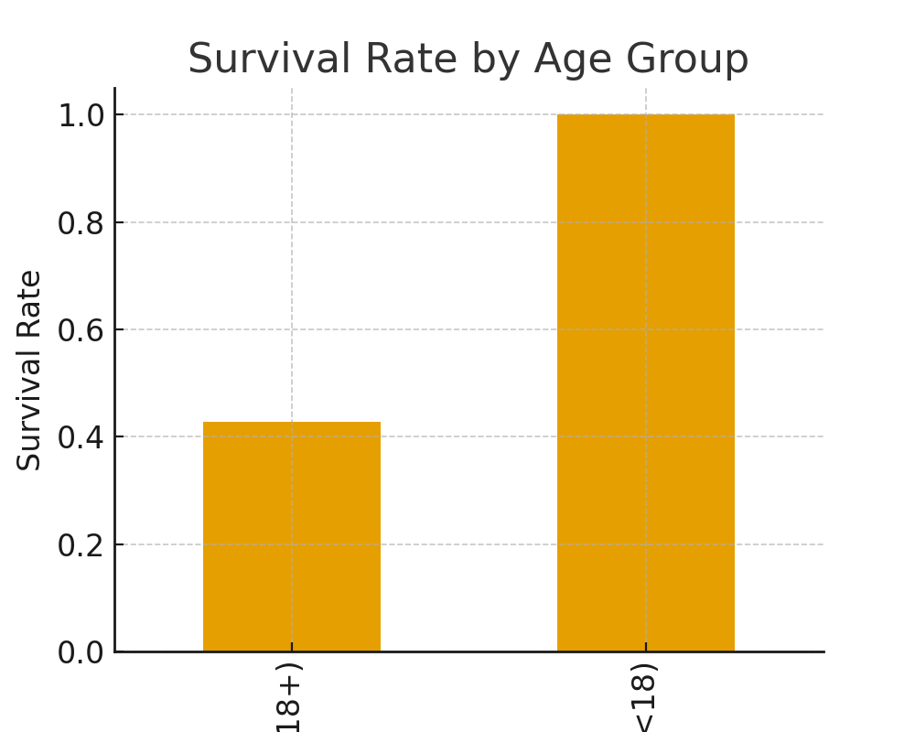
Survival by Age Group

Slide 8
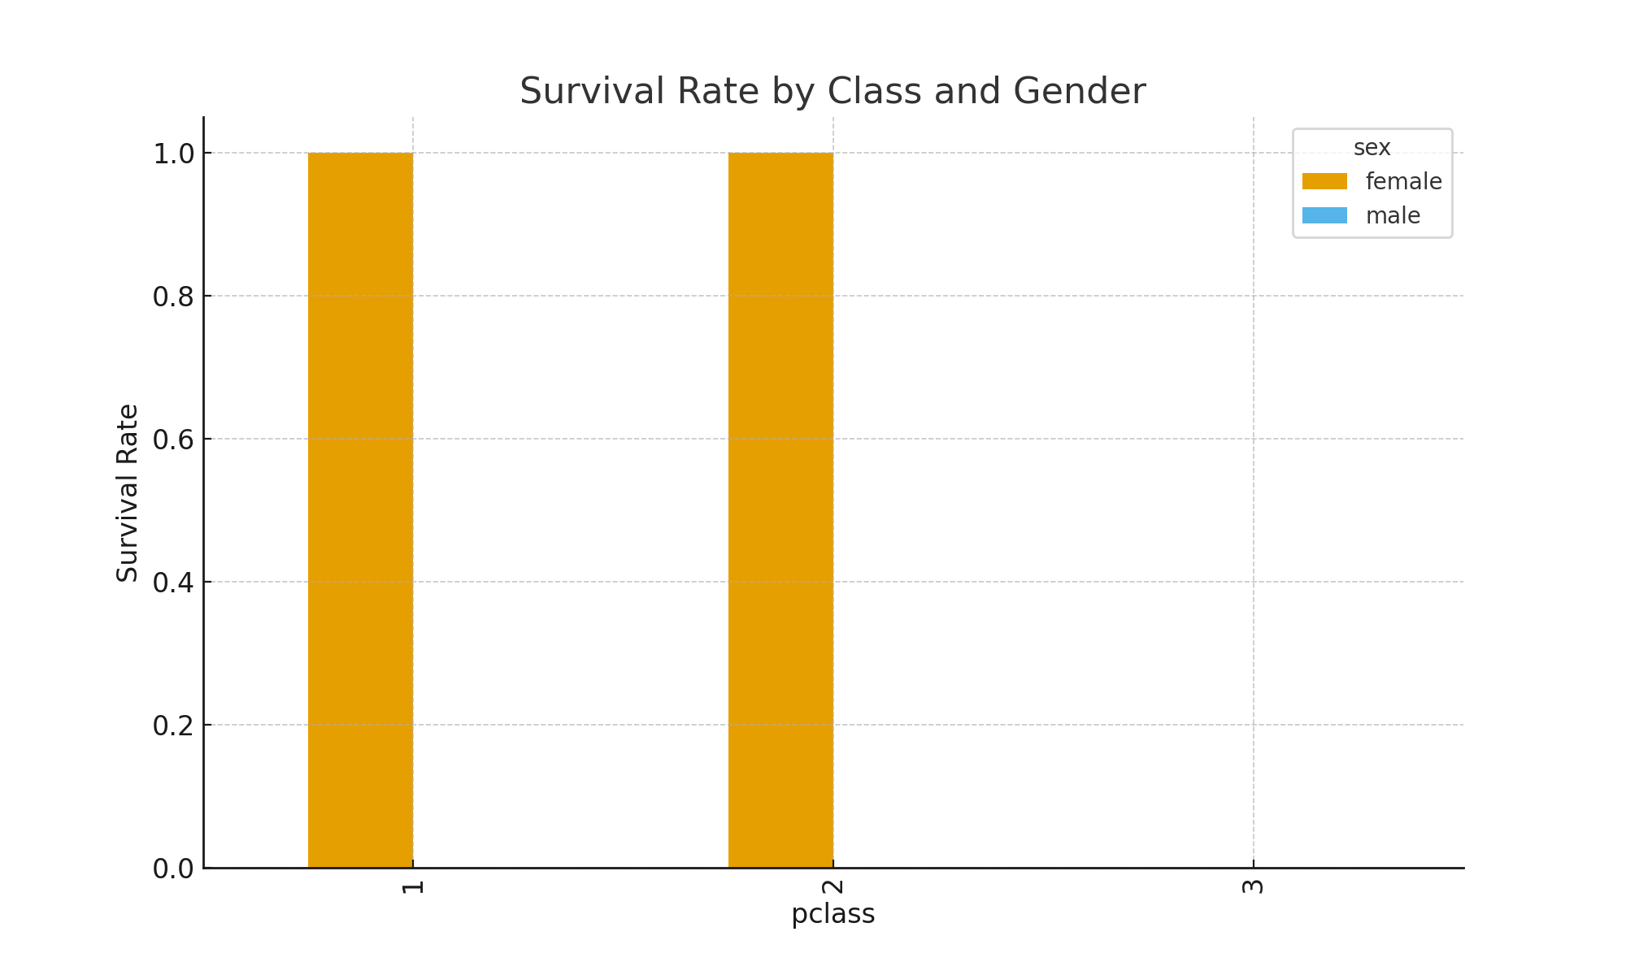
Survival by Gender + Class

Slide 9
Conclusion
• Women survived at much higher rates than men. • First-class passengers had better survival chances. • Children slightly more likely to survive than adults. Hypothesis confirmed: gender & class strongly affected survival.

Slide 10
Next Steps
• Analyze family size, fare, and embarkation port. • Build predictive models to estimate survival likelihood. • Explore broader social implications.

