Slide 1
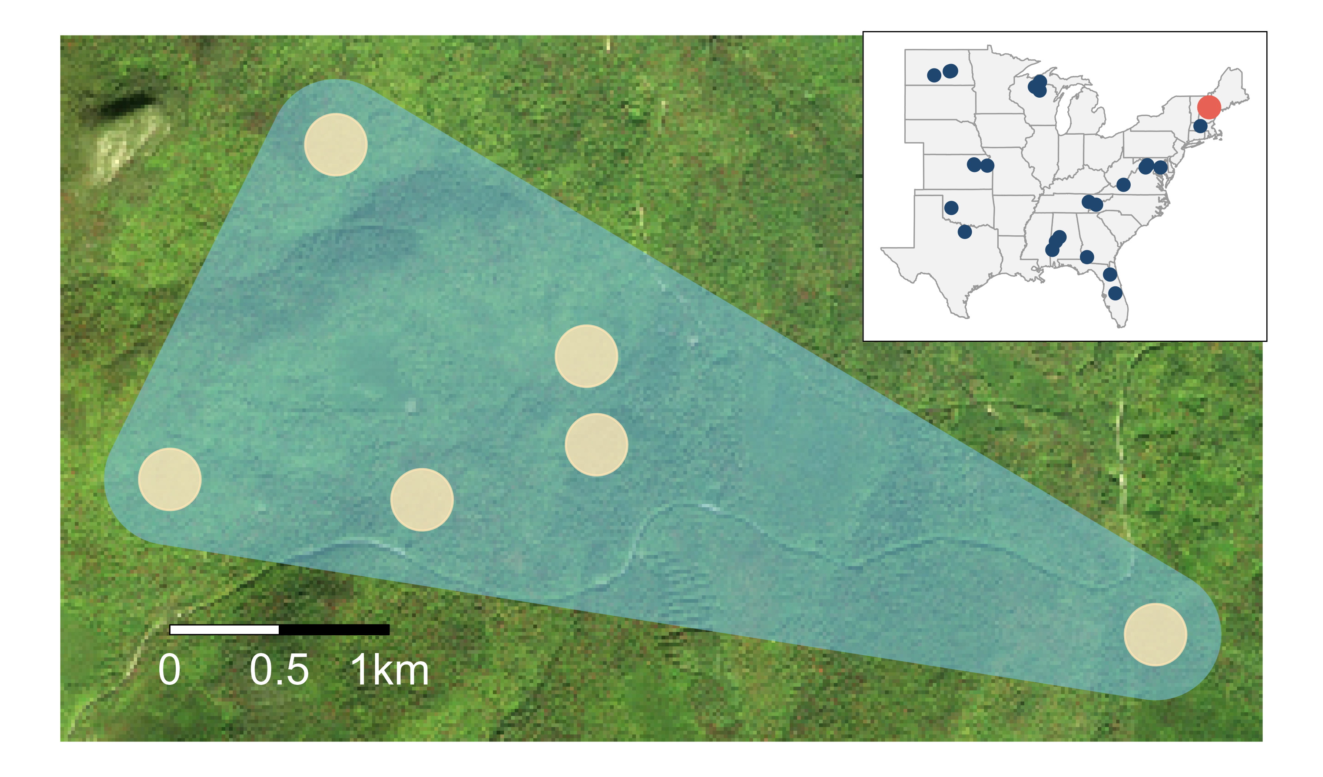
Trapping array
Local community
Metacommunity

