Slide 1
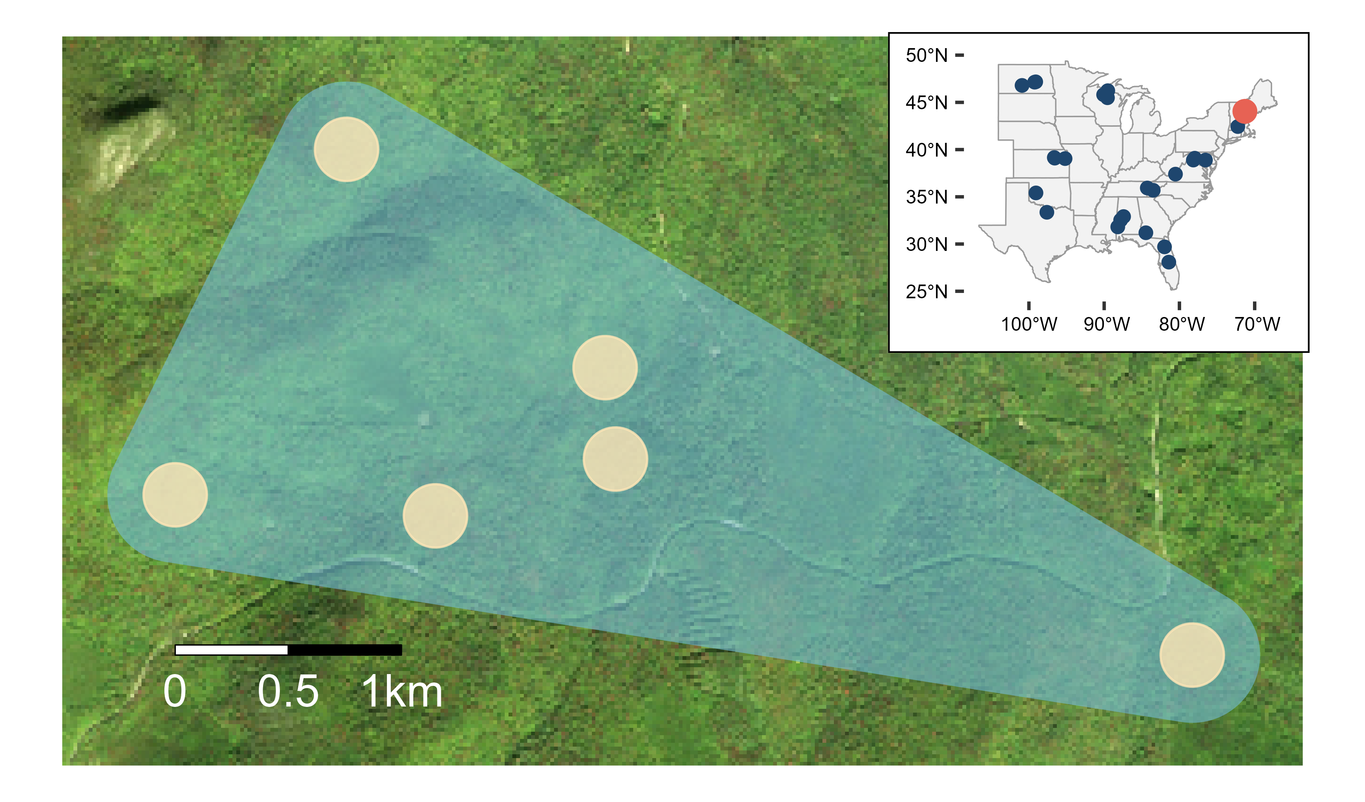
N
Trapping array
Local community
Metacommunity

