Slide 1
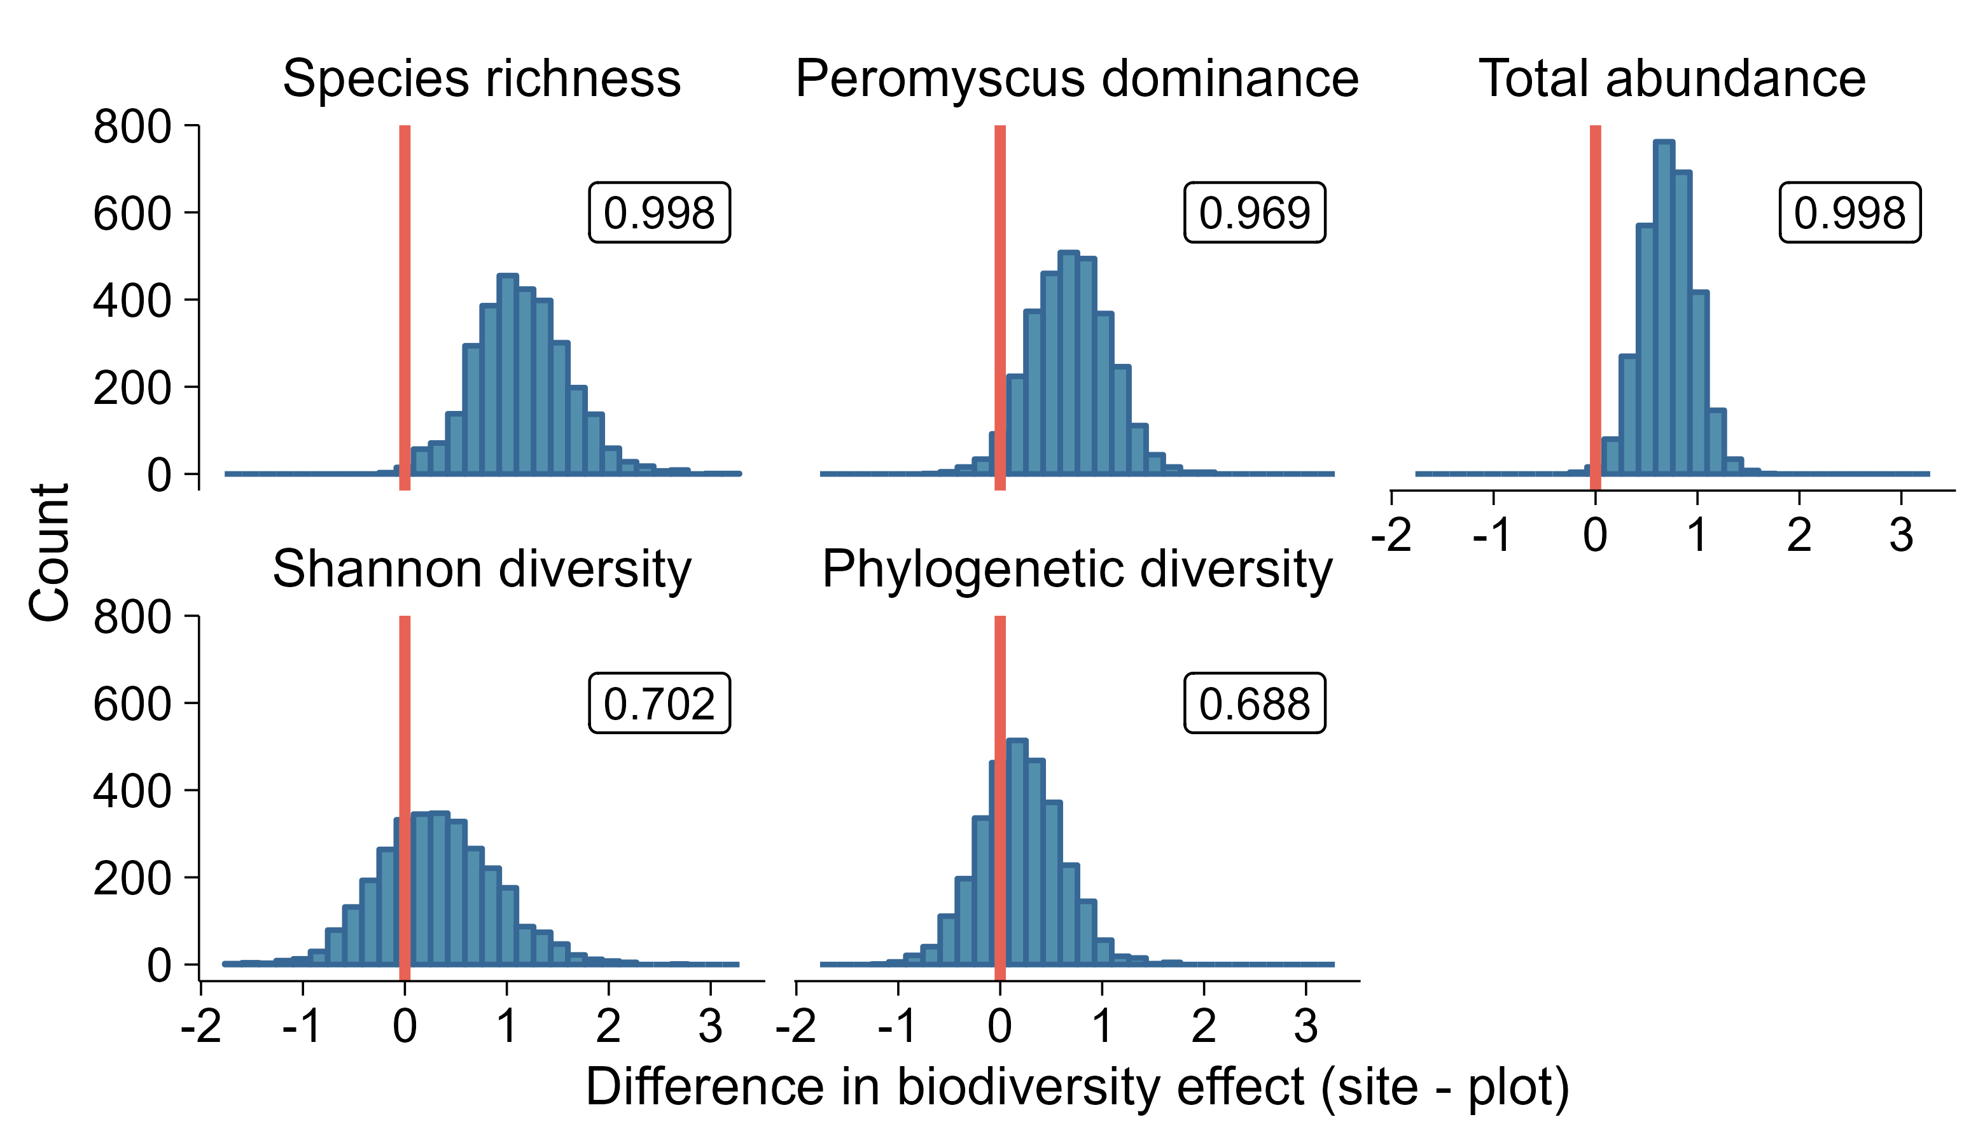
Right of red line: slope for metacommunity diversity has a larger value than slope for local community diversity.

