Slide 1

Penguin Challenge!!!!
Notes:
So this is the penguin challenge!
Everyone is going to split up into groups of 3 or 4 and everyone will get a datasheet and a clicker
There won’t be enough time for everyone to count every colony, so you’ll have to split them up

Slide 2
Penguin Challenge!!!!
Goal: estimate the total number of penguins in all of the colonies
Notes:
So this is the penguin challenge!
Everyone is going to split up into groups of 3 or 4 and everyone will get a datasheet and a clicker
There won’t be enough time for everyone to count every colony, so you’ll have to split them up

Slide 3

Estimate: making a careful guess based on available information when an exact answer is difficult to get.
Penguin Challenge!!!!
Goal: estimate the total number of penguins in all of the colonies
Notes:
So this is the penguin challenge!
Everyone is going to split up into groups of 3 or 4 and everyone will get a datasheet and a clicker
There won’t be enough time for everyone to count every colony, so you’ll have to split them up

Slide 4
Estimate: making a careful guess based on available information when an exact answer is difficult to get.
Penguin Challenge!!!!
Goal: estimate the total number of penguins in all of the colonies
PROTOCOL to count the penguins in a colony
Notes:
So this is the penguin challenge!
Everyone is going to split up into groups of 3 or 4 and everyone will get a datasheet and a clicker
There won’t be enough time for everyone to count every colony, so you’ll have to split them up

Slide 5
Protocol: set of clear rules or steps that everyone follows to make sure something is done the same way.
Estimate: making a careful guess based on available information when an exact answer is difficult to get.
Penguin Challenge!!!!
Goal: estimate the total number of penguins in all of the colonies
PROTOCOL to count the penguins in a colony
Notes:
So this is the penguin challenge!
Everyone is going to split up into groups of 3 or 4 and everyone will get a datasheet and a clicker
There won’t be enough time for everyone to count every colony, so you’ll have to split them up

Slide 6
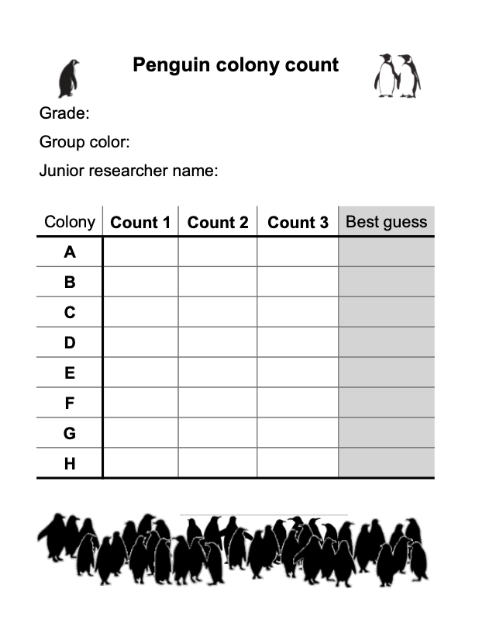

4
blue
Sally M.
Step 1: Write your grade, group color, and name on your data sheet. Your group color is the same color as your clicker.

Slide 7



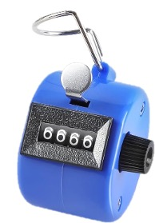
Step 2: Walk around a colony. Using your clicker, count the number of penguins in the colony.
Start point
Colony
Notes:
demonstrate

Slide 8
4
blue
Sally M.
Start point
Colony
Step 3: Record the number you count on your data sheet. You will write this number in column called “Count 1” the row letter that matches the colony you counted.

Slide 9
4
blue
Sally M.
Start point
Colony
Step 4: Repeat! This time, write the number that you count in column called “Count 2”.

Slide 10
4
blue
Sally M.
Start point
Colony
Step 5: Repeat! This time, write the number that you count in column called “Count 3”.

Slide 11
4
blue
Sally M.
Start point
Colony
x 3 times!!!

Slide 12
4
blue
Sally M.
Start point
Colony
Step 6: Write down your best guess for how many penguins are in the colony. This is not a total! If you got different numbers for each of the 3 counts you did, you will have to decide on 1 number you think is the best guess.
x 3 times!!!
Notes:
Now, this is not a total! You are going to have to find a way to decide which of the three counts you did was the best.
Be creative with this!

Slide 13
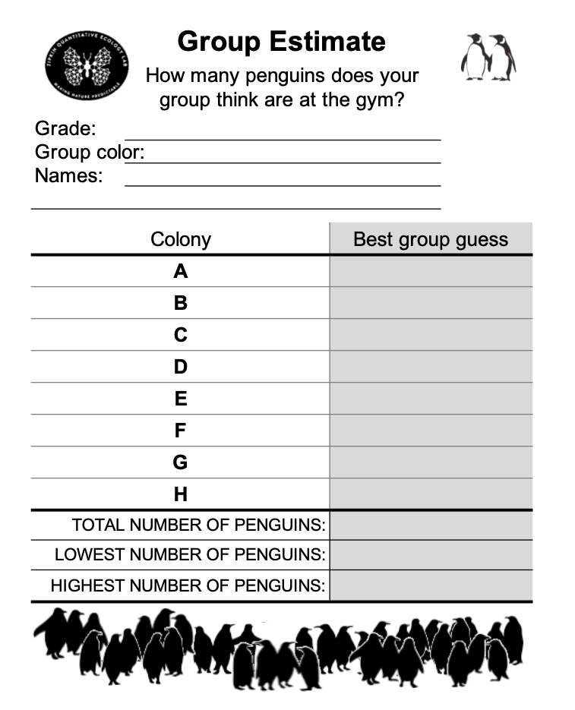
Step 7: As a team, decide on what you think the best guess is for the number of penguins in each colony. Write these estimates down in the "Best group guess" column on your Group Estimate worksheet. If you have different numbers than your teammates, be creative in selecting your best group guess!

Slide 14
Step 8: Add up the best guess for each colony. This will be your estimate! Write this estimate down on the Group Estimates worksheet next to "TOTAL NUMBER OF PENGUINS". Do this as a group using your calculators, or ask for help with the math.

Slide 15
Step 9: As a group, decide on a reasonable number that you think could be the lowest and highest number of penguins. Write these down on the Group Estimates worksheet next to "LOWEST" and "HIGHEST NUMBER OF PENGUINS". These are also known as the minimum and maximum.

Slide 16
Tips and tricks!
If you mess up, don't start over! Just keep going!
Don't count in your head, just use the clicker!
There might be too many colonies for each of you to count every single one, so you’ll have to split up the colonies among your group members. TEAM WORK!
Think about which might be hardest … these colonies might take longer to count!
Don’t touch the penguins!

Slide 17
PROTOCOL
Fill out heading on data sheet.
Walk around a colony. Using your clicker, count the number of penguins.
Write the number of penguins you count on your data sheet in “Count 1” column and the row letter that matches the colony you counted.
Repeat! This time, write the number that you count in column called “Count 2”.
Repeat! This time, write the number that you count in column called “Count 3”.
Write down your best guess for how many penguins are in the colony. This is not a total! If you counted different numbers for each of the 3 counts you did, you will have to decide on 1 number you think is the best guess.
Once all colonies have been counted, write down the “best guess” for each colony on the group worksheet. Do this as a group! If you have different numbers, you will have to decide on 1 number you think is the best guess for the colony.
Add up the best guess for each colony. This will be your estimate! Write this estimate down on the Group Estimates worksheet next to "TOTAL NUMBER OF PENGUINS". Do this as a group.
As a group, decide on a reasonable number that you think could be the lowest and highest number of penguins. Write these down on the Group Estimates worksheet next to "LOWEST" and "HIGHEST NUMBER OF PENGUINS".
Notes:
So this is the penguin challenge!
Everyone is going to split up into groups of 3 or 4 and everyone will get a datasheet and a clicker
There won’t be enough time for everyone to count every colony, so you’ll have to split them up

Slide 18
CONGRATULATIONS!!!!
YOU'VE COMPLETED THE PENGUIN CHALLENGE!
Notes:
So this is the penguin challenge!
Everyone is going to split up into groups of 3 or 4 and everyone will get a datasheet and a clicker
There won’t be enough time for everyone to count every colony, so you’ll have to split them up

Slide 19
Penguin Challenge: Wrap-Up Questions
How many penguins do you think there are?
Why do we count each colony 3 times, not just 1 time?
What was the most challenging part of this exercise?
If you had different numbers for different counts, how did you decide on an estimate?
What was the coolest thing you learned today??
Notes:
Get together in teams of 3 or 4
Goal: to figure out how many penguins there are in this room
You will get a worksheet to fill out with your count from each colony
So, you have to use the protocol to estimate the total number of penguins in all of the different colonies

