Slide 1
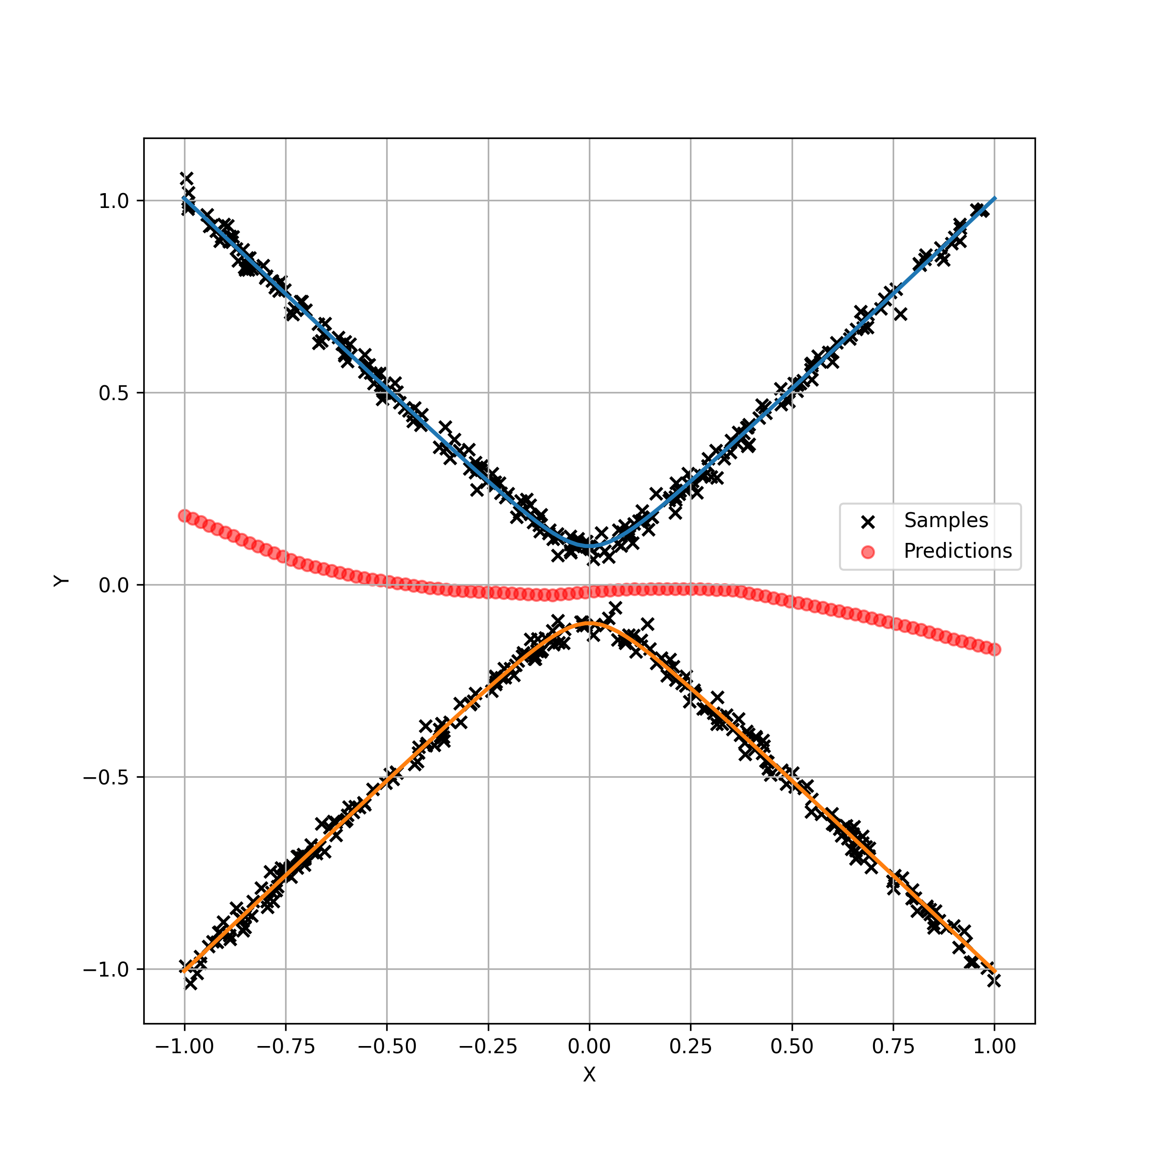
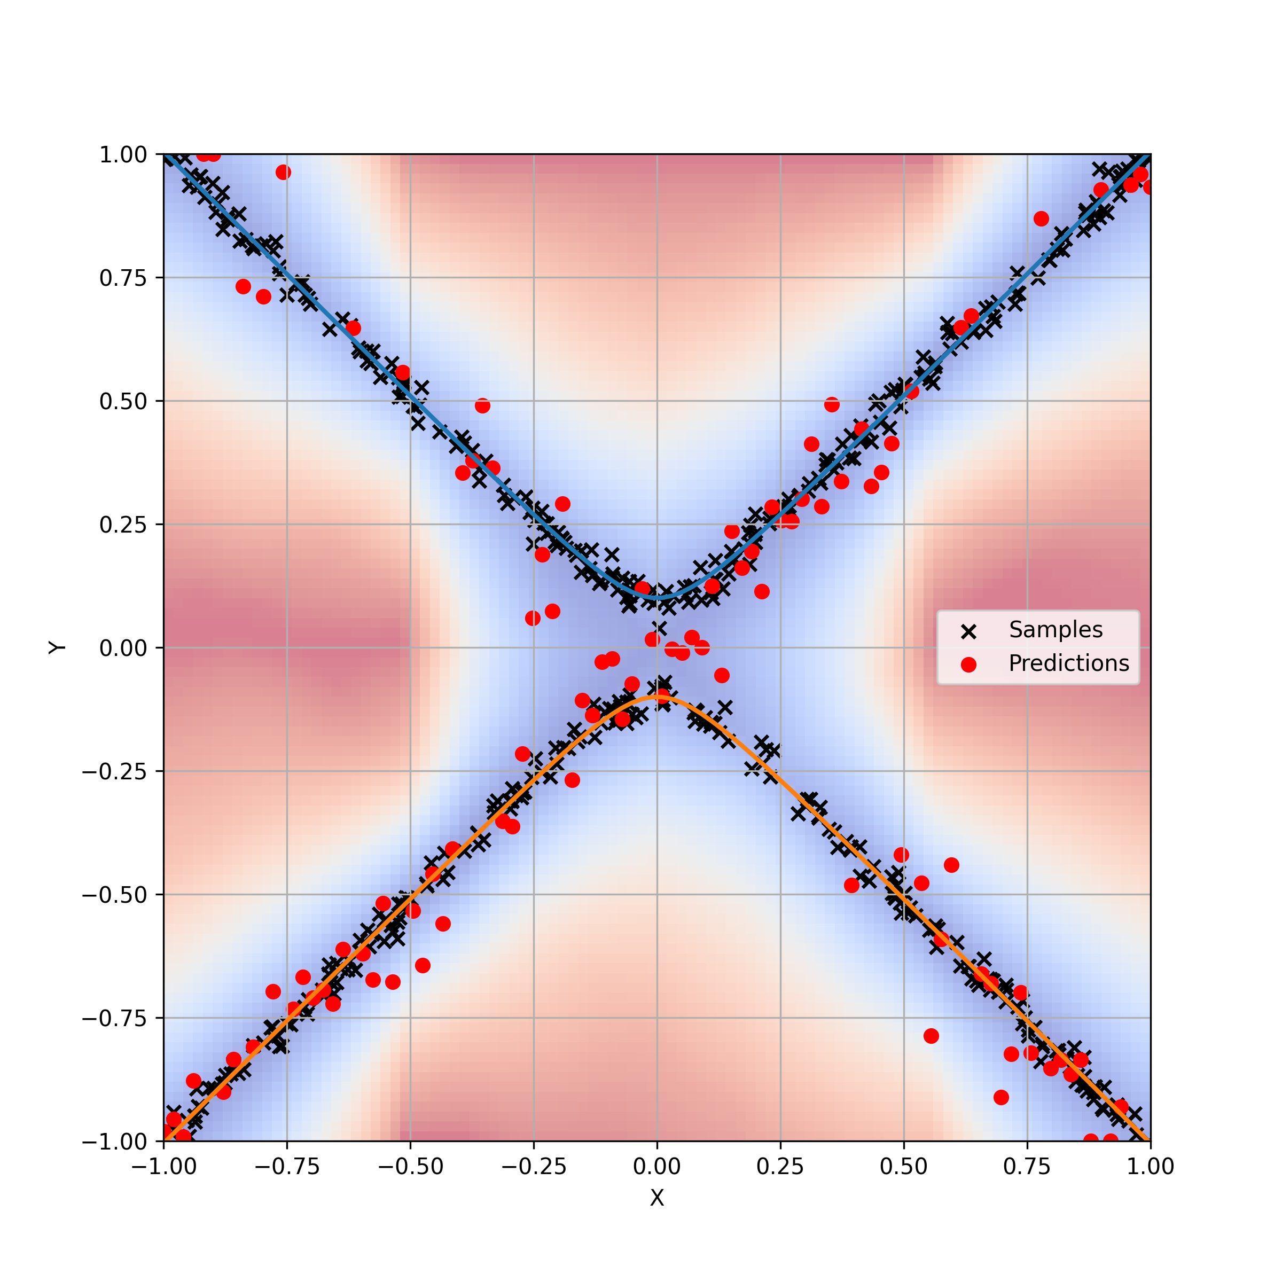
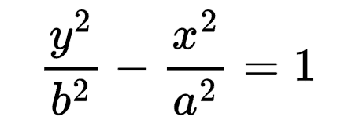
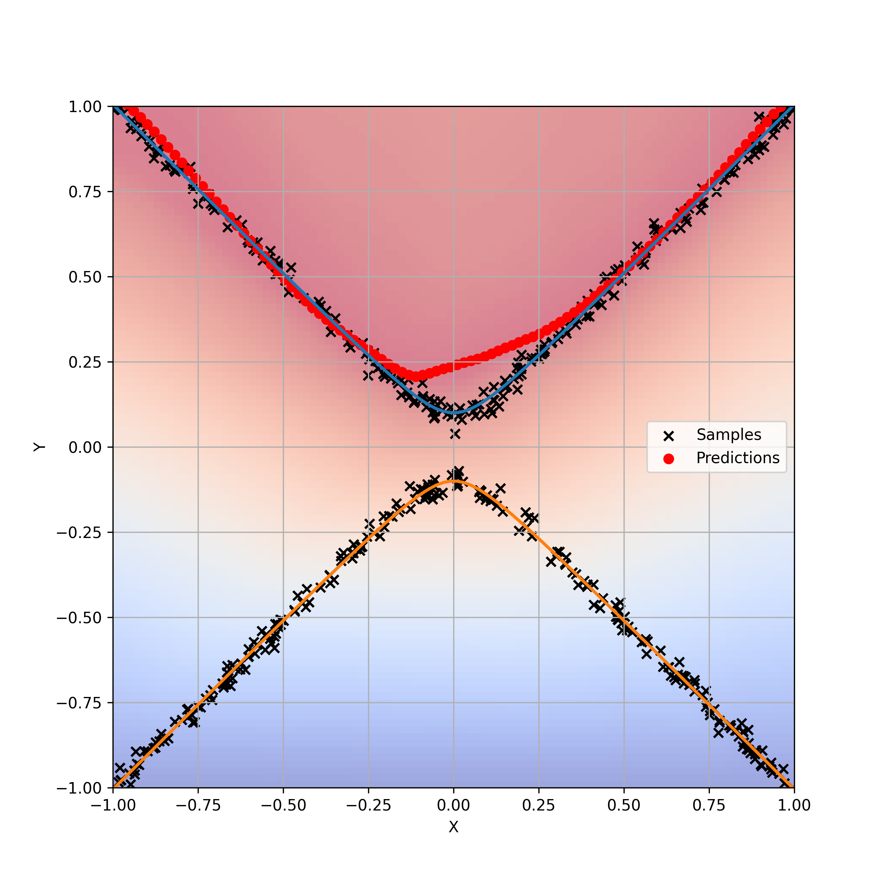
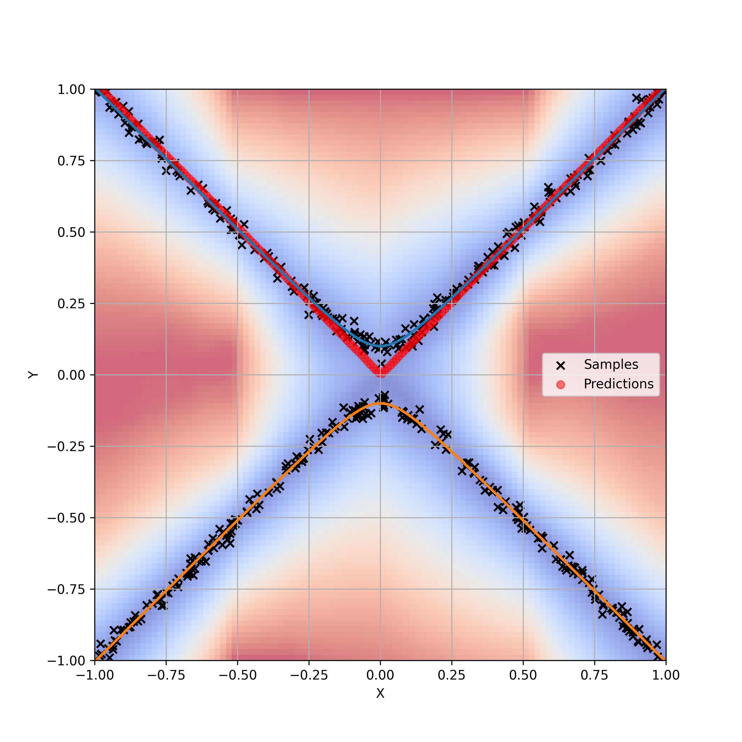

MSE-MLP
EBM
Hyperbola
Randomly sample 500 points with synthetic gaussian noise.
All model backbones use a ReLU-MLP with a hidden size of 64.
GAN
EBGAN-BC
Shown density is

Slide 2
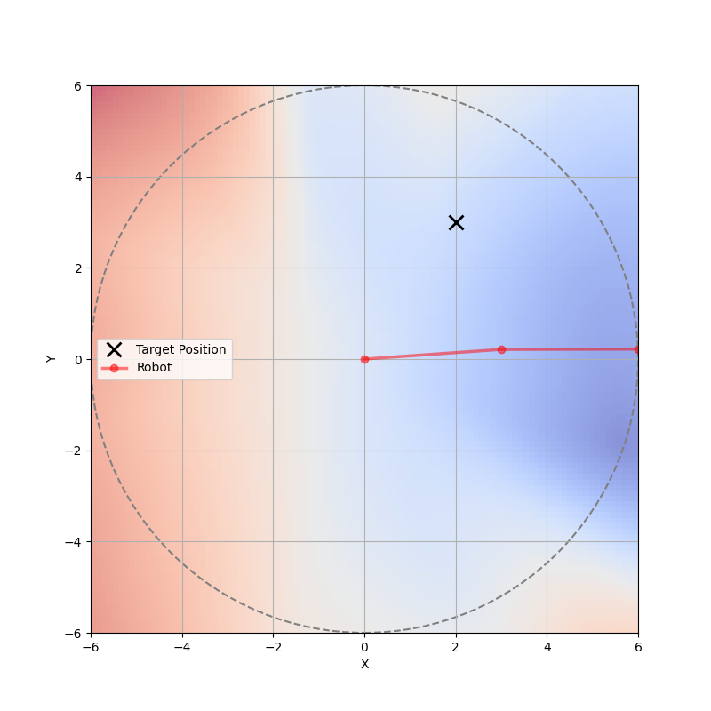
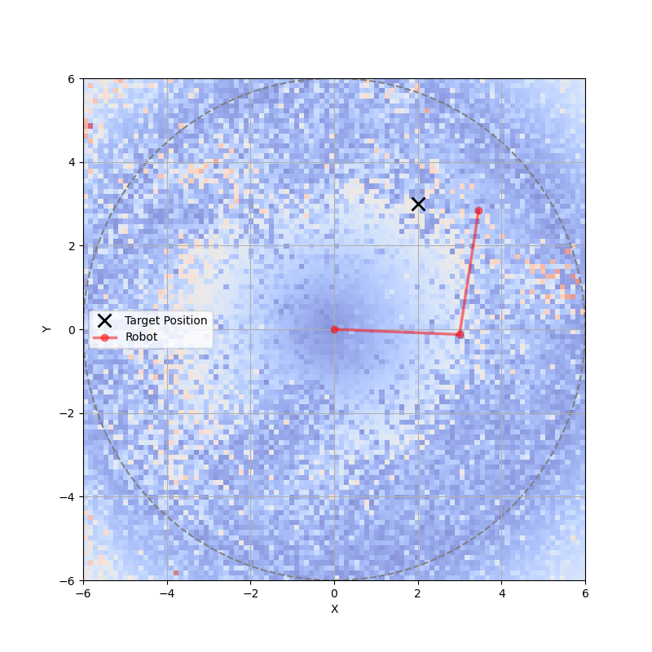
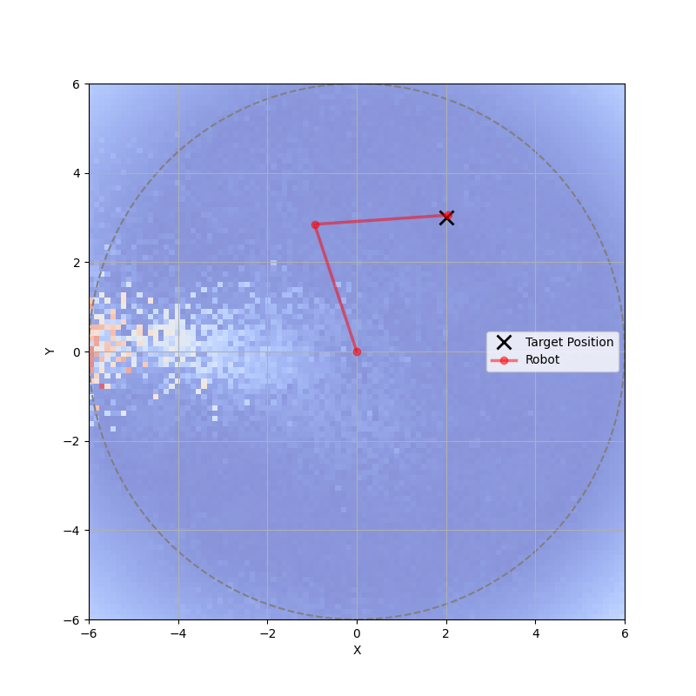


MSE-MLP
EBM
GAN
Two-Link Arm IK
Randomly sample 2,000 IK solutions.
Shown density is the error

Slide 3
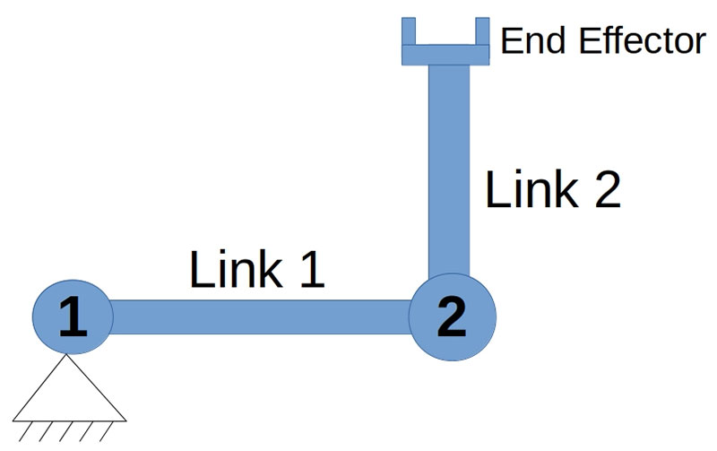
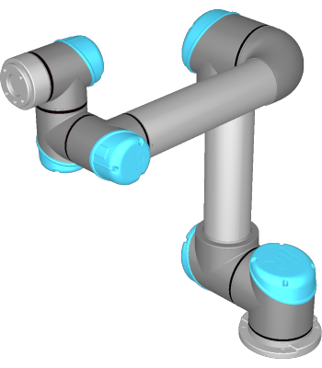
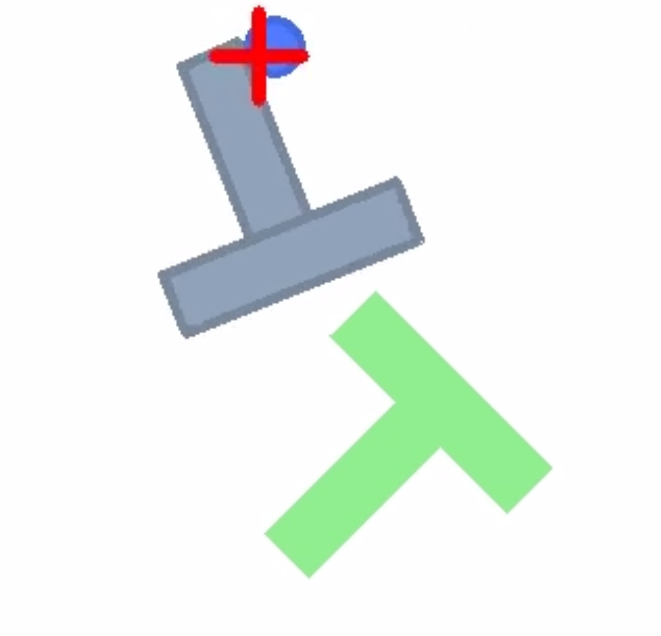
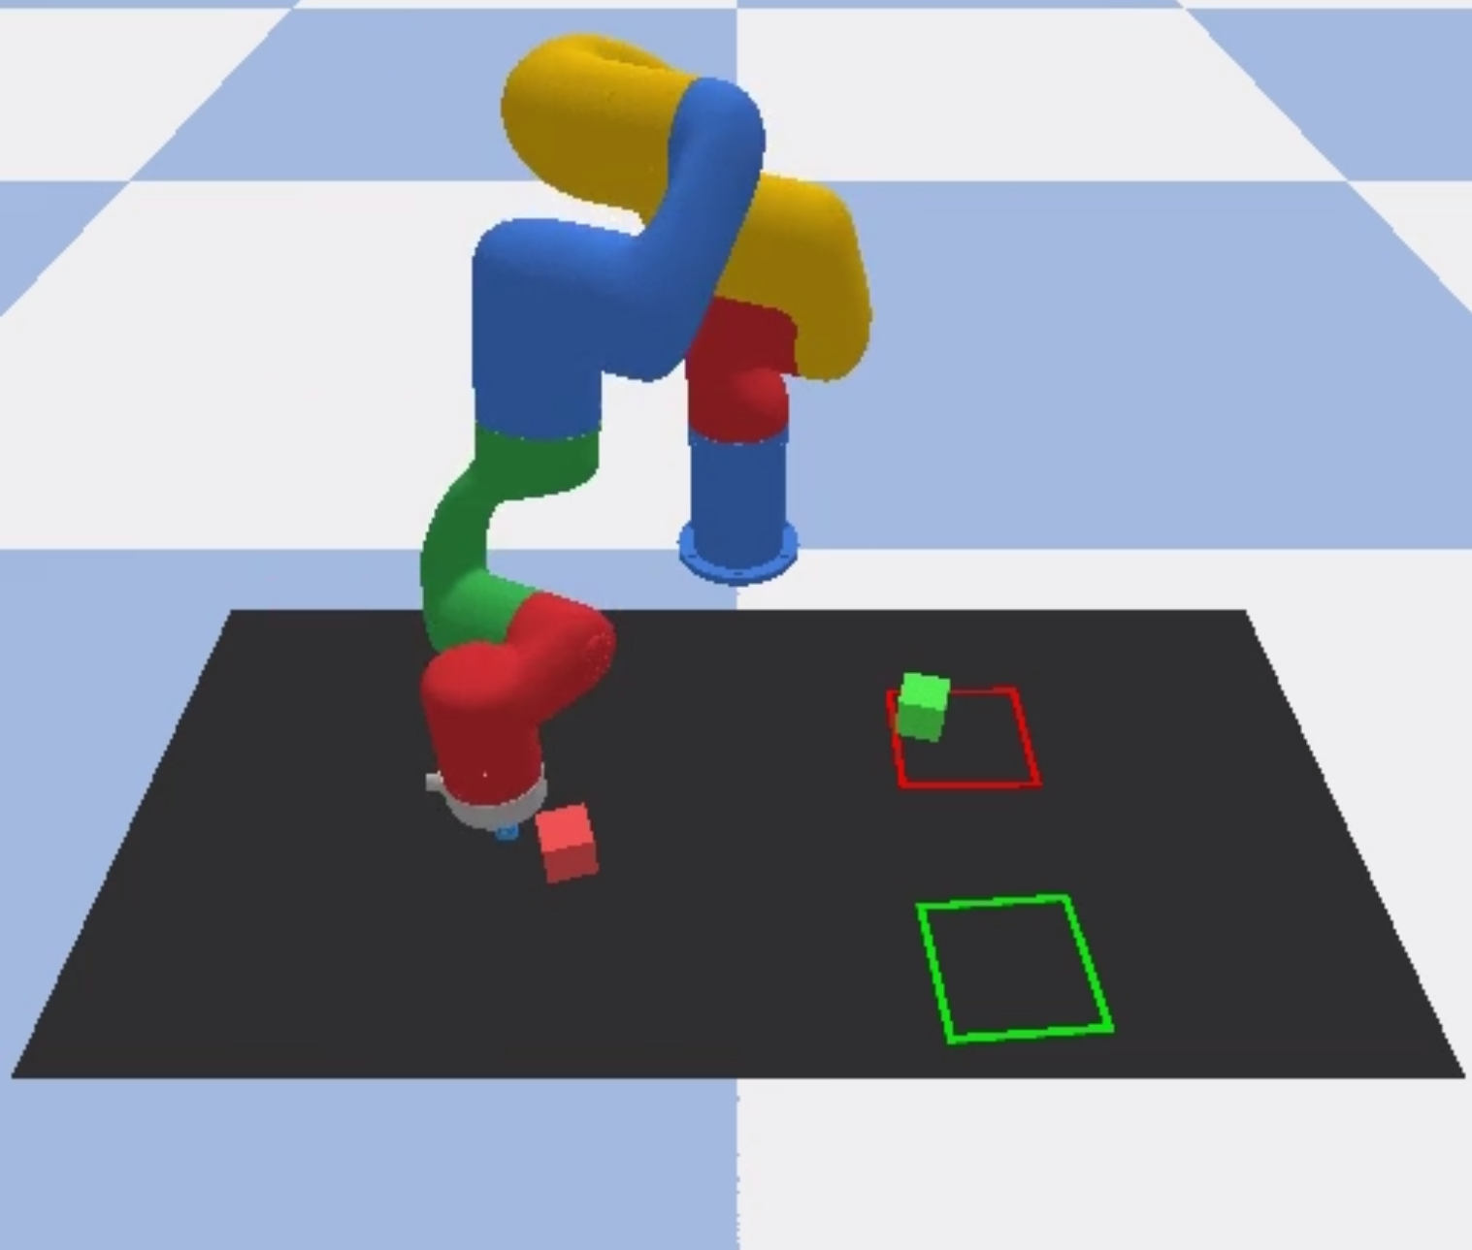
IK: 2 Link Robot
IK: UR5 Robot
Push-T
Block Push

