Slide 1
Pathway & Go term analysis
20190828
Zheng et al. 2017 , T cell scRNAseqof Liver cancer. C4-CD8-LAYN cluster
20180905

Slide 2
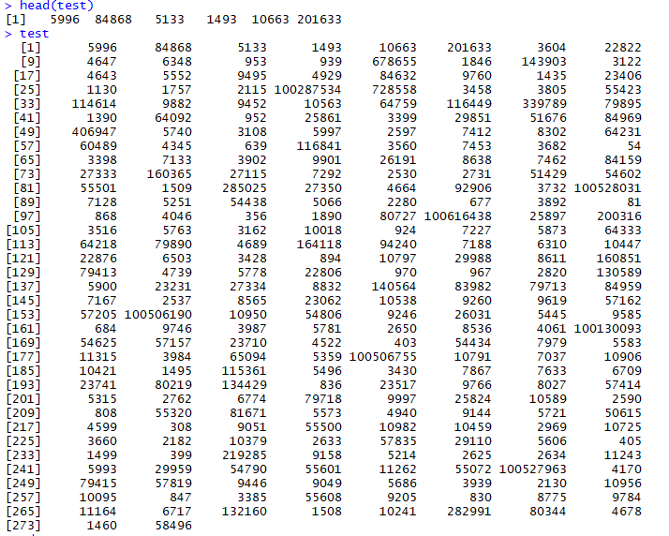
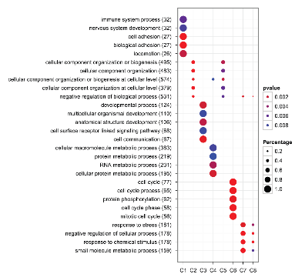
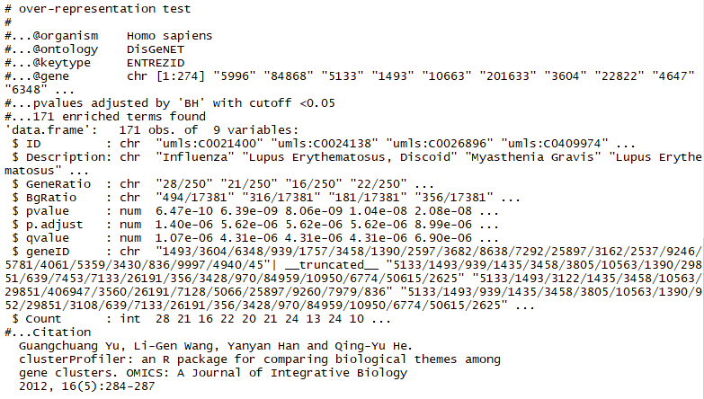
Pathway analysis – Scheme (20180828)
Extract EntrezID (274 genes)
Over-representation test (e.g. 250 genes – depending on geneset)
Visualization
Table S2
Zheng et al., 2017
List of signature genes in each cluster
(C4-CD8-LAYN)
DOSE – DisGeNET, DO
clusterProfiler – GO, KEGG
enrichPlot
ggplot2
Limitation of the whole approach: ALL gene set analysis is knowledge-based. Novel genes and known genes with novel function will not be considered in the pathway analysis

Slide 3
Pathway analysis: over-representation analysis (ORA)
Over-representation analysis (ORA) - completed
DisGenNET – Disease
DO ontology - Disease
KEGG - Pathway
GO ontology – Cellular Component, Molecular Function, Biological Process
Limitations: ORA treats each gene equally! (No fold change or significance are considered for representation)
Analysis requires fold-changes or p-values as input (FCS)
GSEA and others
Comment: It does not require an arbitrary threshold for dividing expression data into significant and non-significant pool, but require whole gene expression dataset

Slide 4
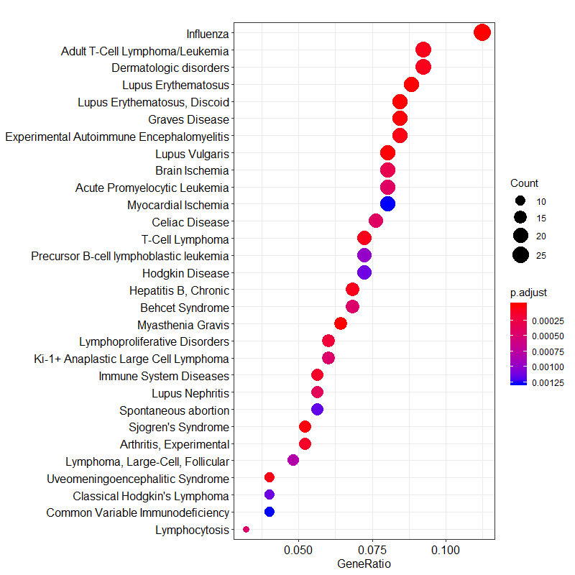
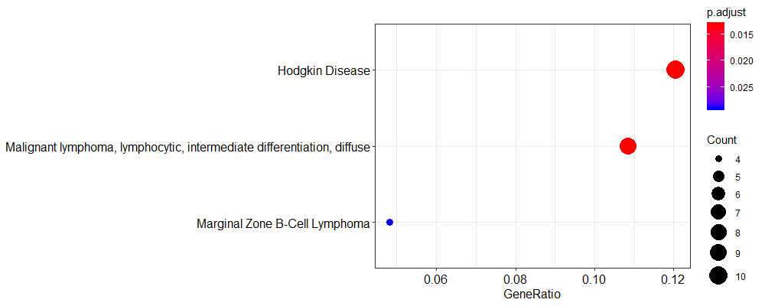
Analysis: Over-representation test
C4-CD8-LAYN (Input: 274 genes)
DisGeNET Ontology
C1-CD8-LEF1 (Input: 101 genes)

Slide 5
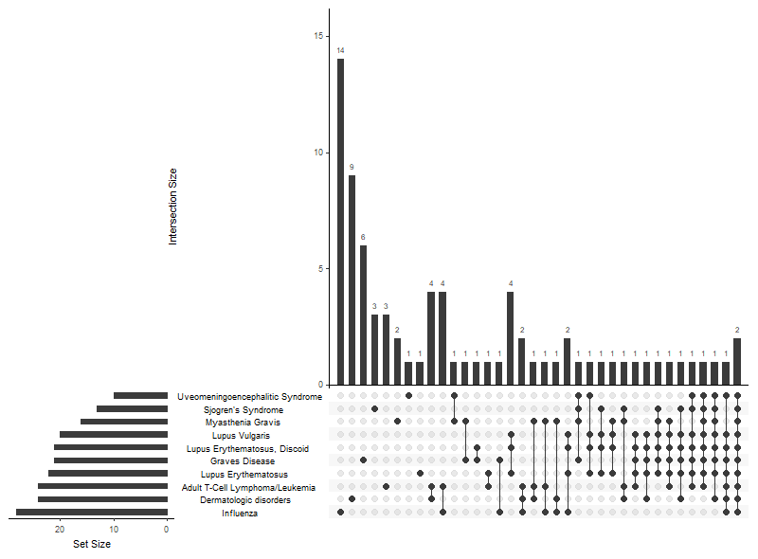
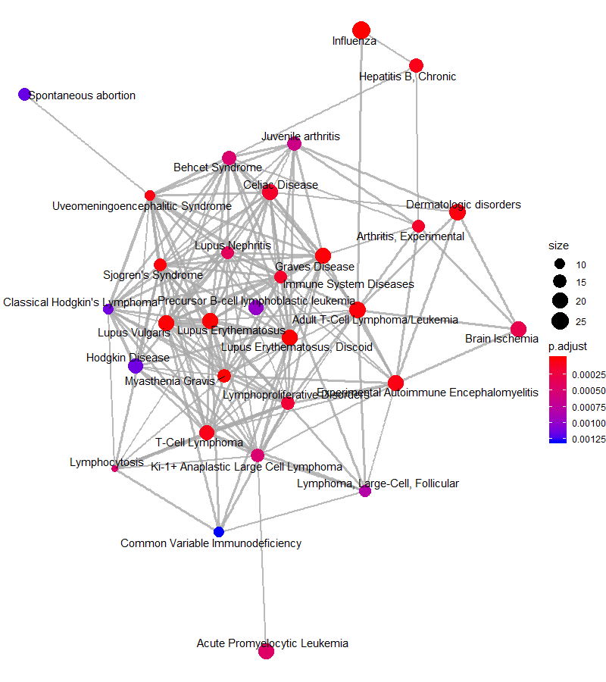
Analysis: Visualization
Upset plot
Enrichment Map

Slide 6
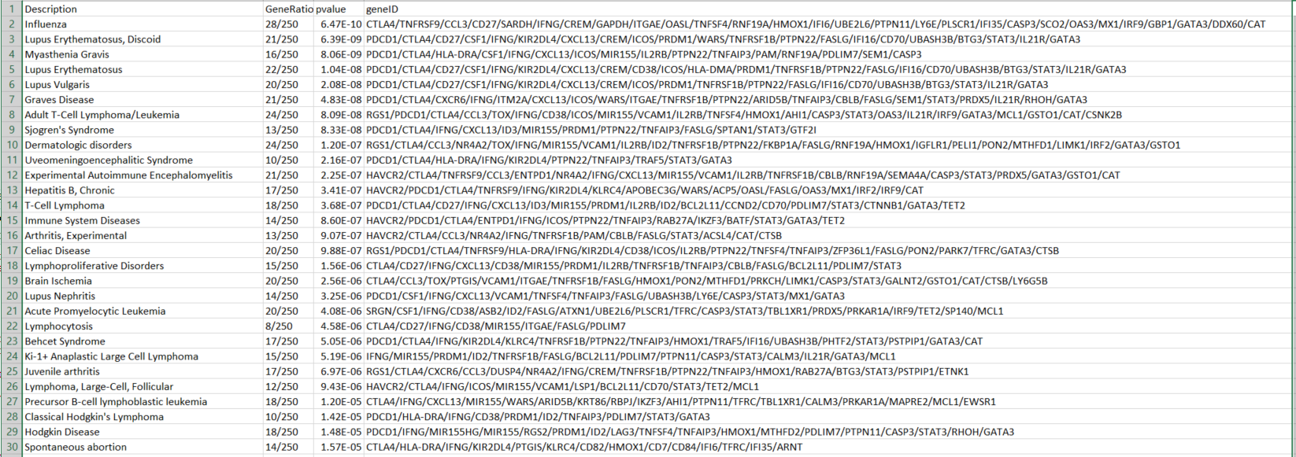
Analysis: Top Gene List (DisGeNet)
Caution 1 : Only “upregulated genes” were defined as signature genes to start with, but loss of function mutation etc could define select gene as “geneset”
Caution 2 : Each pathway was treated independently – a gene can function in multiple pathway so identified pathways were frequently overlapped → Obscure true source of signals

Slide 7
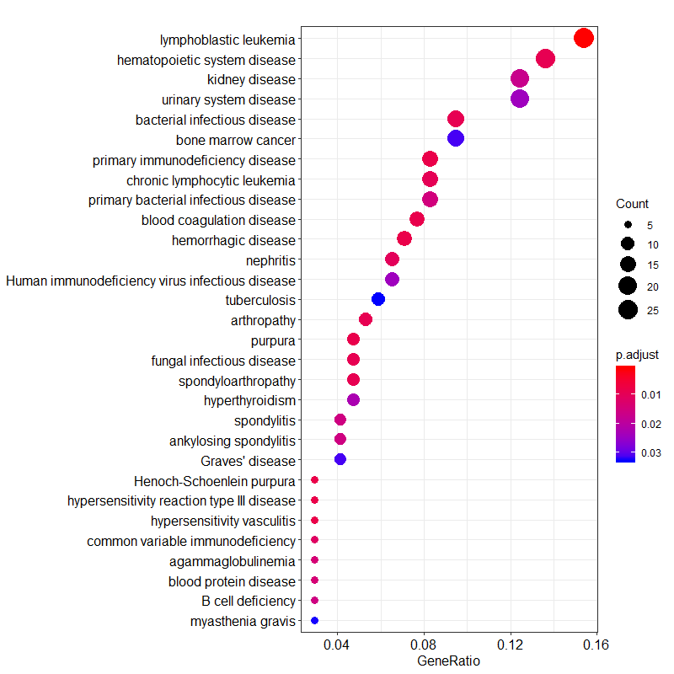
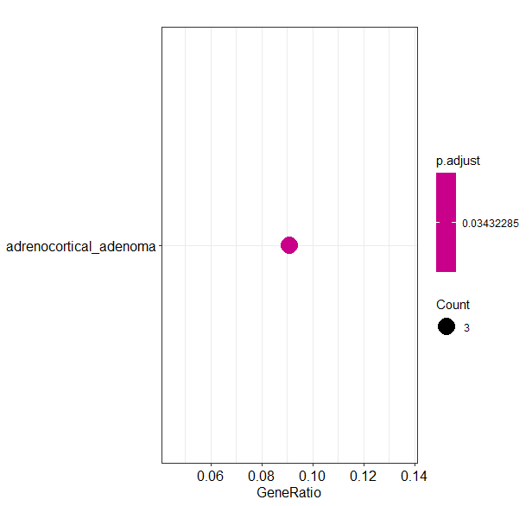
Analysis: DO term analysis
DisGeNET
DO Term
Network of Cancer Gene (NCG) Database
– top 30 pathway, only one as significant
Commonly Enriched Genesets:
Infectious disease, Leukemia/Lymphoma, Autoimmune disease, Graves Disease/hyperthyroidism, Blood Vessle (Ischemia ←→Purpura/hemorrhagic/Behcet Syndrome)

Slide 8
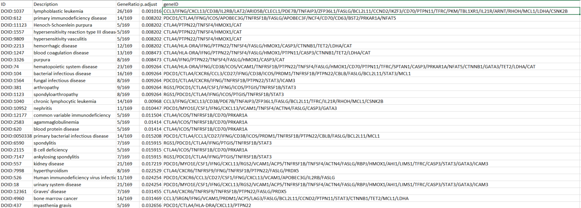
Analysis: Top Gene List (DO term)

Slide 9
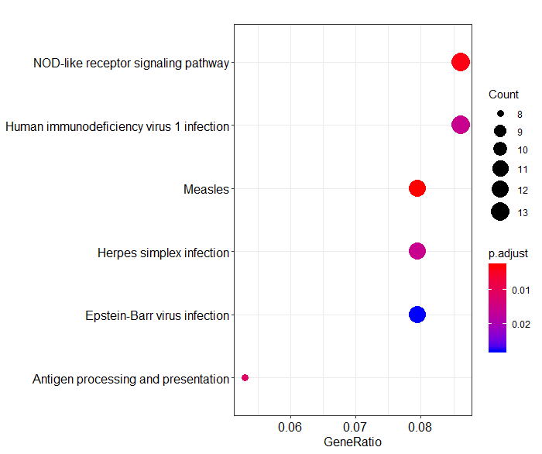
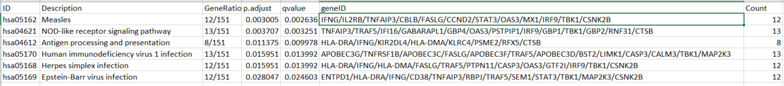
Analysis: KEGG analysis
KEGG
C4-CD8-LAYN (Input: 274 genes)

Slide 10
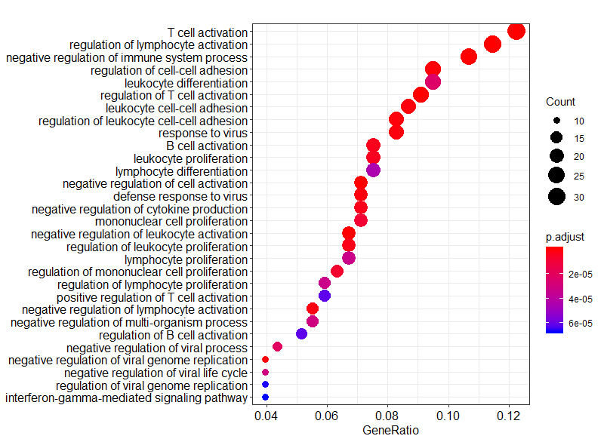
Analysis: GO – Biological Process
C4-CD8-LAYN (Input: 274 genes)

Slide 11
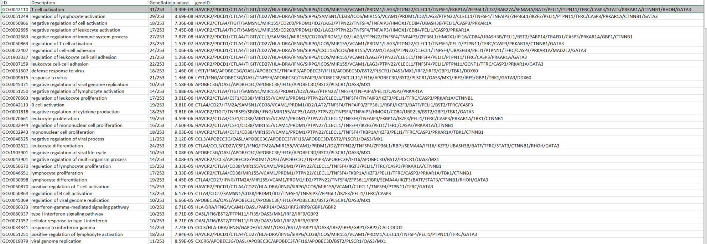
Analysis: GO – Biological Process
C4-CD8-LAYN (Input: 274 genes)

Slide 12
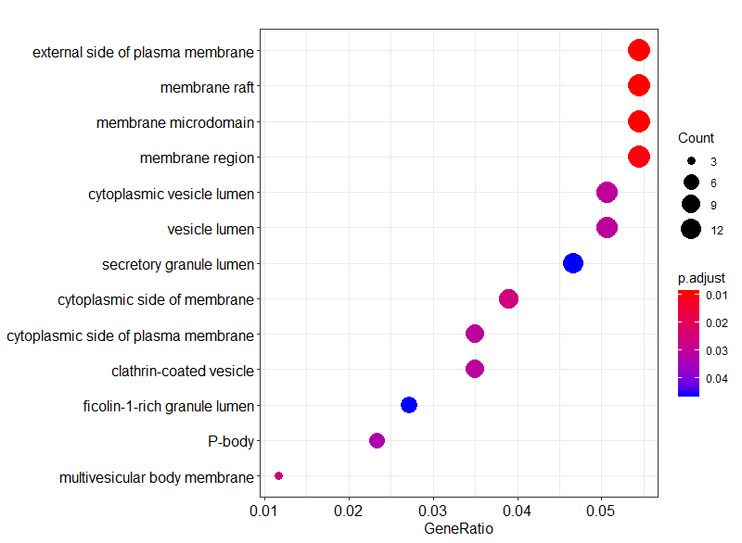
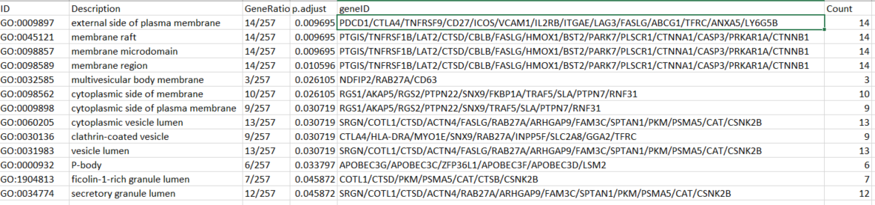
Analysis: GO – Cellular component
C4-CD8-LAYN (Input: 274 genes)

Slide 13
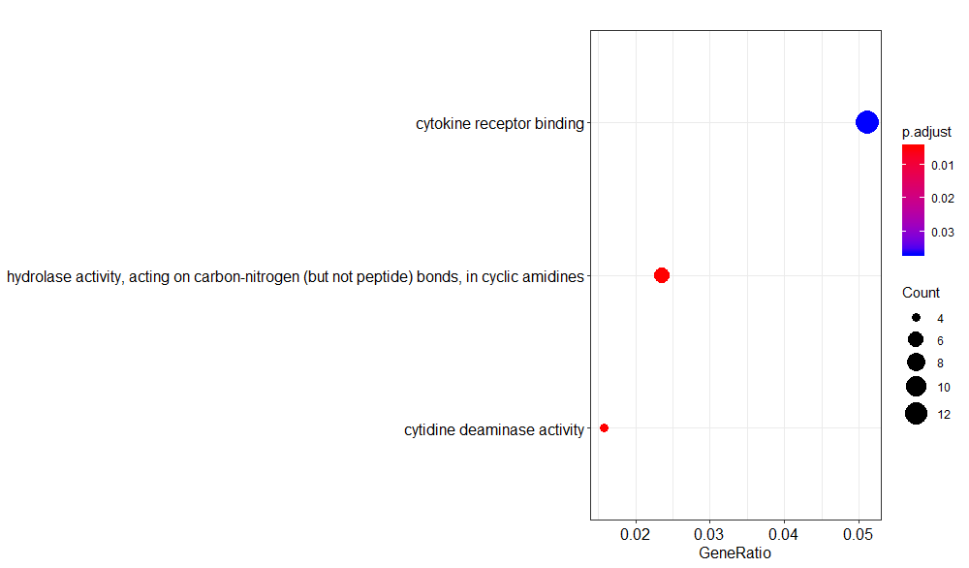
Analysis: GO – molecular function
C4-CD8-LAYN (Input: 274 genes)

Slide 14
Ongoing pathway Analysis (Future plan)
Advanced analysis with fold changes & p-values inclusion
Modified GSEA analysis using partial list of gene set might be doable
Without triplicate input? – Maybe I can manually add calculated statistics.
I have only partial list of gene expression – How rank is determined?
Sorting genes expressed on cell surfaces
Came up with potential target to follow

