Slide 1
Tissue enrichment analysis and candidate selection
Zheng et al. 2017 , T cell scRNAseq of Liver cancer. C4-CD8-LAYN cluster
20180905

Slide 2
How to extract useful information from Public datasets?
Normalization issue (batch effect), Analyze from raw datasets
Access to cluster
(Takes 2-3 months?)
scRNAseq of TIL in different cancer (our group)
Cancer database
scRNAseq of liver infiltrated T cells
Bulk RNA-seq from TIL
No public TIL RNA-seq data from liver cancer
Bulk RNA-seq from various tissue
Public dataset available.
GTEx project (Science 2015)
-Tissue-based map/ ProteinAtlas (Science 2015)
- The Cancer Genome Atlas (TCGA)
- The Encyclopedia of DNA Elements (ENCODE)
- NIH Roadmap Epigenomics Mapping Consortium

Slide 3
IDEA / Experimental Design
Looking for single targets both expressed in Liver cancer and C4-CD8-LAYN
C4-CD8-LAYN
Gene X: Overexpression compromise CD8 function
A “single” Inhibitor with “dual” function:
By acting on both CD8 T cells and liver cancers
Hepatocytes or liver cancer
Gene X:
Expressed specifically in hepatocytes (not in other tissue).
Oncogenic when overexpressed

Slide 4
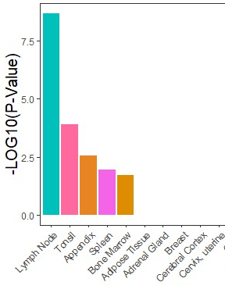
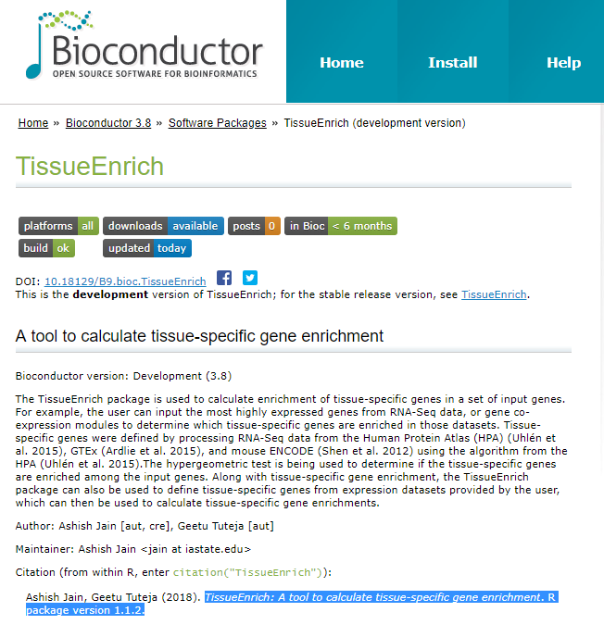
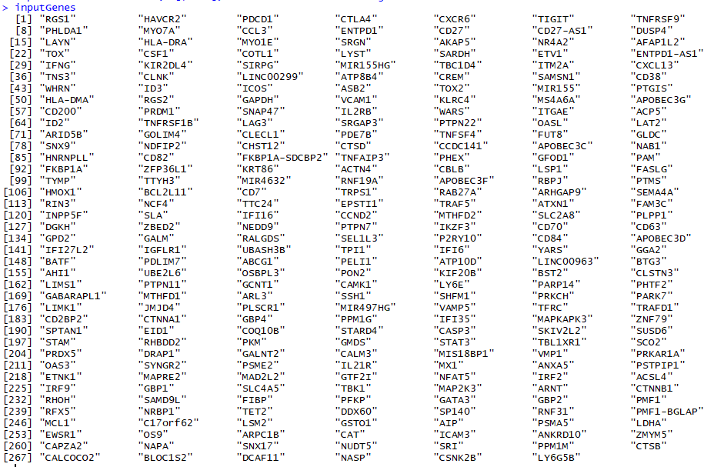
Tissue Enrichment analysis – Scheme (20180901)
Extract GeneID (272 genes)
Tissue Enrichment Analysis
Visualization
Table S2
Zheng et al., 2017
2 entrez ID were not assigned with gene name (“NA”)
Human RNA-seq dataset
List of signature genes in each cluster
(C4-CD8-LAYN)
R package – TissueEnrich
(Human Protein Atlas / GTEx / ENCODE)
enrichPlot
ggplot2
Question: From 274 genes identified in C4-CD8-LAYN cluster, are there any common genes that are enriched in primary liver or liver cancers?
Notes:
The TissueEnrich package is used to calculate enrichment of tissue-specific genes in a set of input genes. For example, the user can input the most highly expressed genes from RNA-Seq data, or gene co-expression modules to determine which tissue-specific genes are enriched in those datasets. Tissue-specific genes were defined by processing RNA-Seq data from the Human Protein Atlas (HPA) (Uhlén et al. 2015), GTEx (Ardlie et al. 2015), and mouse ENCODE (Shen et al. 2012) using the algorithm from the HPA (Uhlén et al. 2015). The hypergeometric test is being used to determine if the tissue-specific genes are enriched among the input genes. Along with tissue-specific gene enrichment, the TissueEnrich package can also be used to define tissue-specific genes from expression datasets provided by the user, which can then be used to calculate tissue-specific gene enrichments.

Slide 5
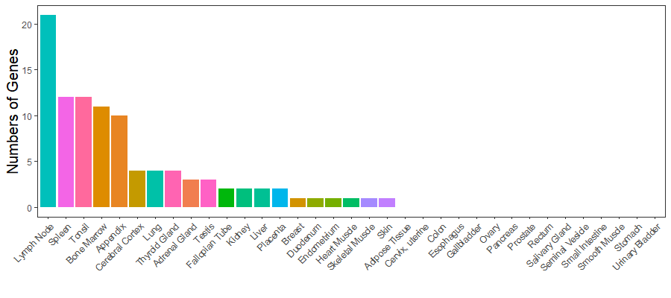
Tissue specific expression of 274 genes enriched in C4-CD8-LAYN
20+ genes were specific to lymph node, 2 to liver and 200+ genes were relatively universal, which are probably not good drug targets
LAYN was not identified as tissue specific gene

Slide 6
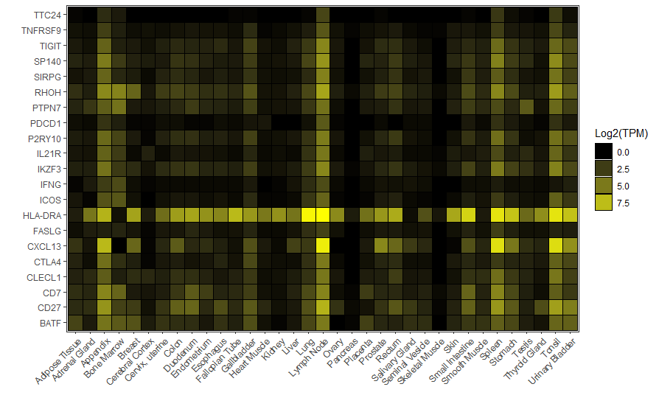
21 Lymph node specific genes
(1) Lymph node, spleen, appendix and bone marrow partially shared gene list
(2) LAYN was not identified as enriched genes from any tissues. Probably because LAYN is activation/exhaustion specific, not because universal expression.
(3) These could be potential genes to follow if trying to target only immune cells.

Slide 7
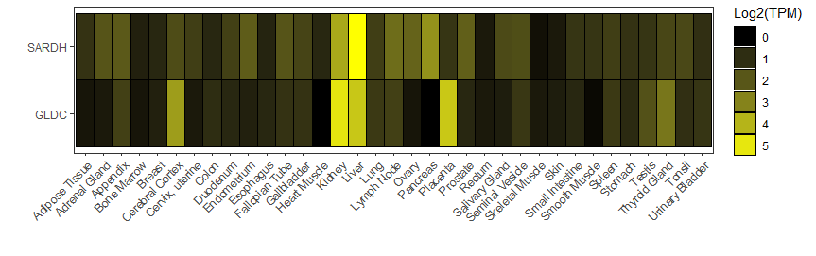
Two liver specific genes
Liver specific genes that were commonly expressed in C4-CD8-LAYN cluster:
SARDH and GLDC
Plan: Validate this results using mouse tissue with qRT-PCR
(Perfusion → liver, lung, heart, lymph node, spleen, bone marrow, Thymus, and Kidney) : Do I need animal protocol for this?

Slide 8
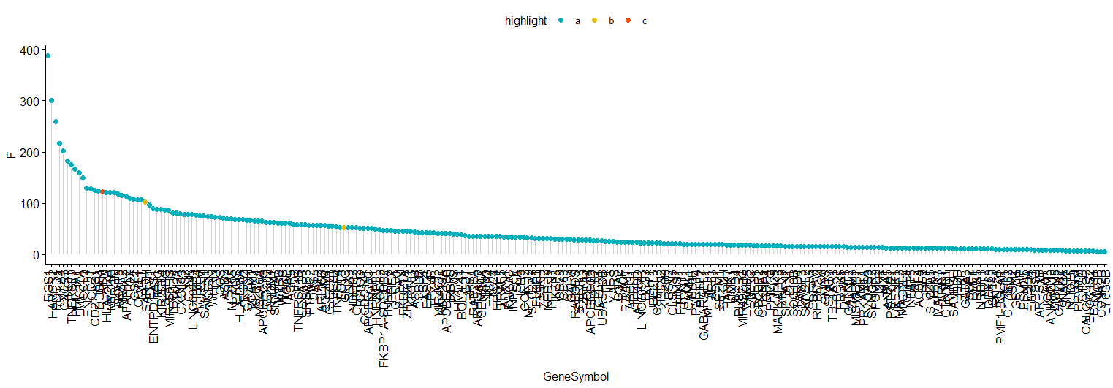
Fold Changes of Targets of interests
C4-CD8-LAYN (272 genes, two NAs were excluded)
What is F value?
LAYN (122)
SARDH (102)
GLDC (53)

Slide 9
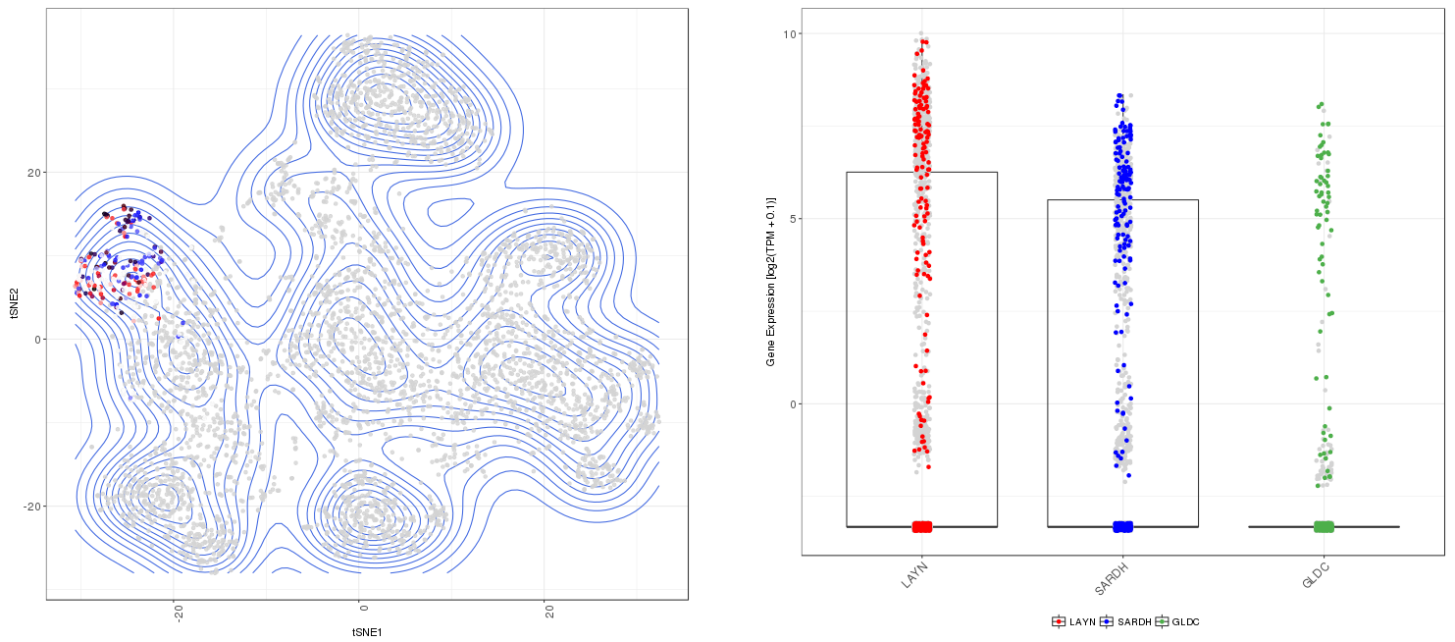
Three gene expression in C4-CD8-LAYN cluster (Liver)

Slide 10
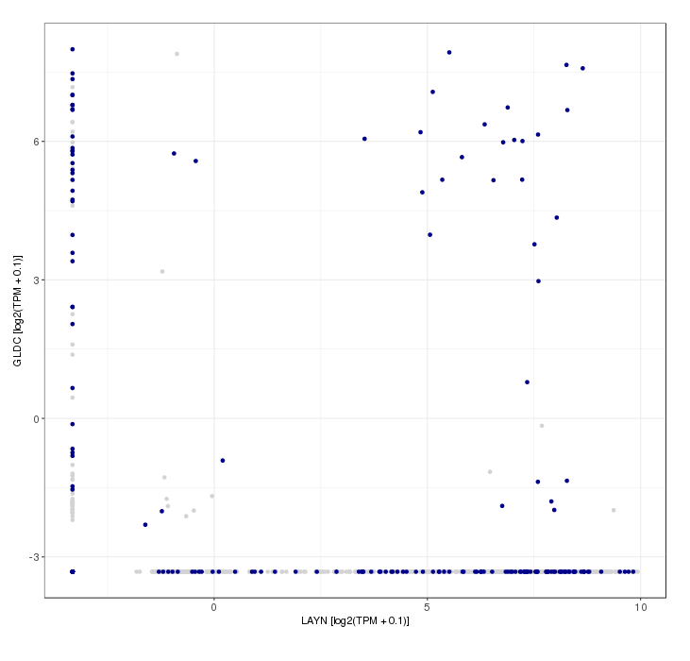
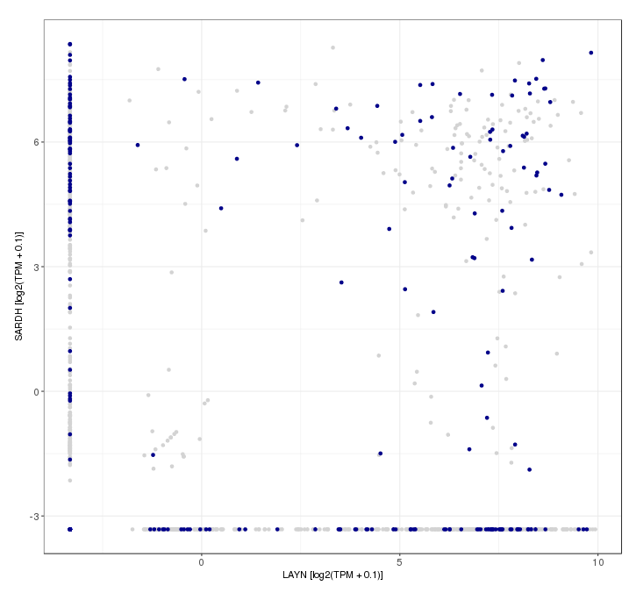
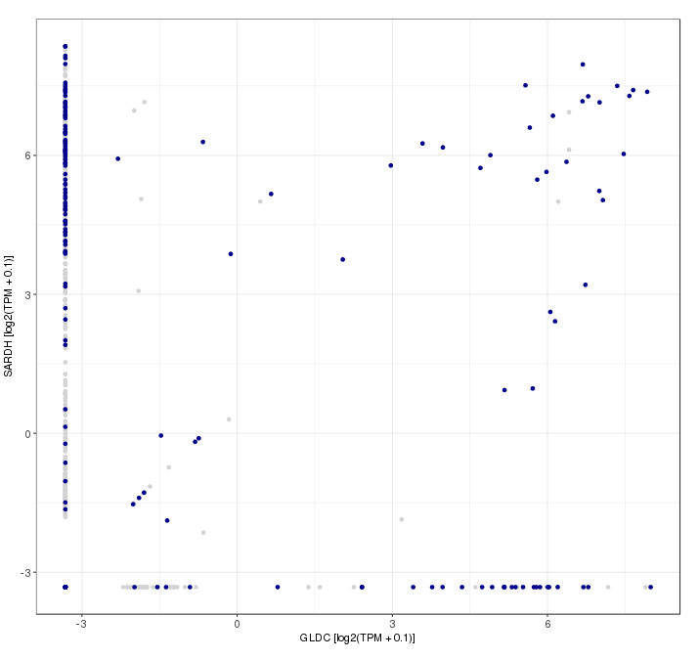
Co-expression profile of LAYN, SARdh and gldc
Poor co-expression? Detection issue?

Slide 11
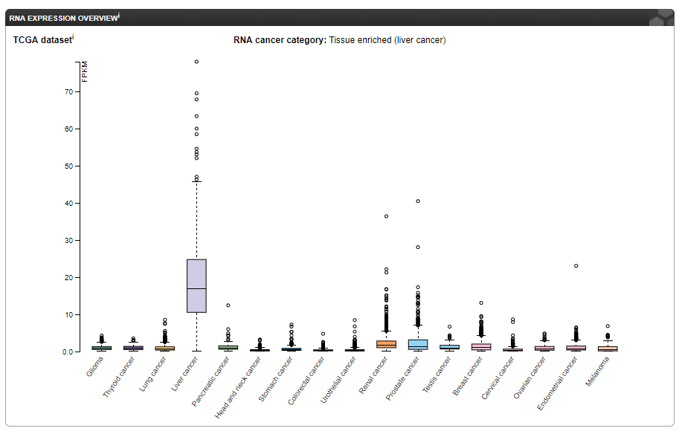
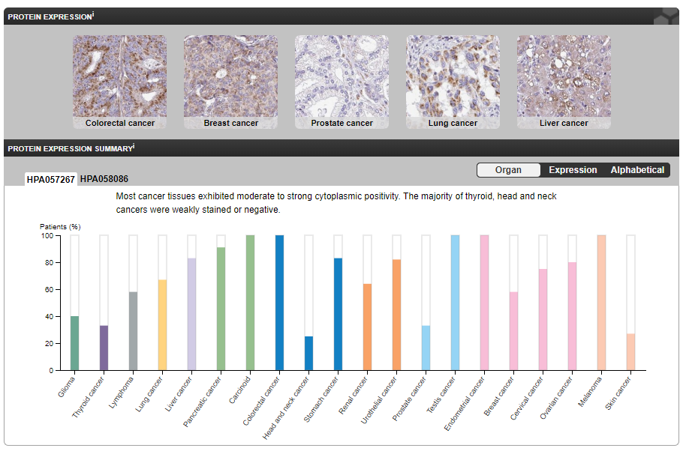
SARDH expression in Cancer (The Human Protein Atlas)
10~30 copies per cells

Slide 12
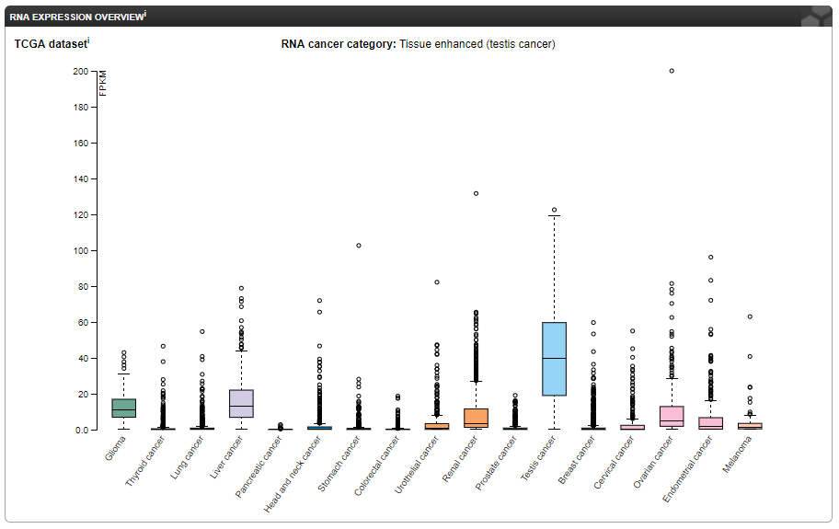
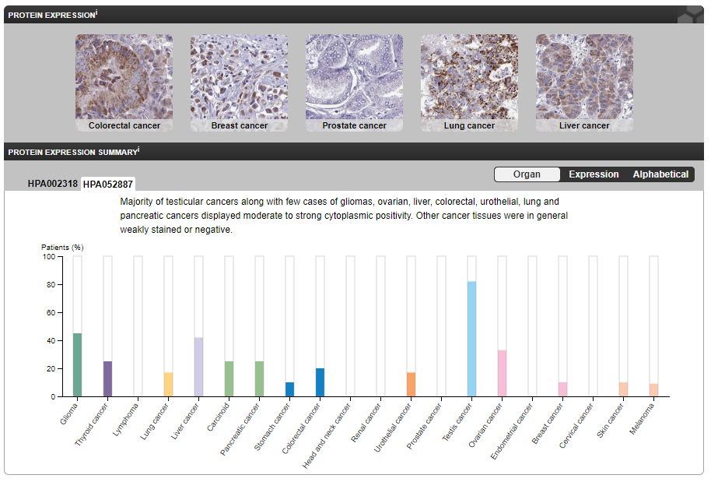
GLDC expression in Cancer (The Human Protein Atlas)
Without comparison with adjacent normal tissue, this inter-tissue comparison does not mean much.
We can just naively say these two genes are at least expressed in liver cancer, and relatively liver cancer specific.

Slide 13
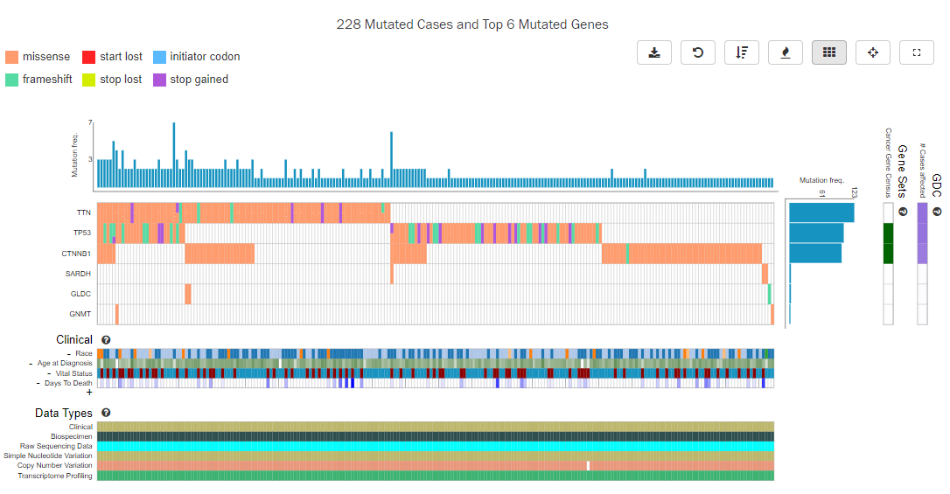
SARDH and GLDC mutation in liver cancer (TCGA)
TTN, TP53, CTNNb1 are the top 3 genes frequently mutated genes in liver.
SARDH, GLDC and GNMT are rarely mutated in liver cancer.
- SARDH P383T (two cases)
- SARDH P118L
- GLDC A454S
- GLDC V322E
- GLDC L207Hfs*25(frameshift)
- GNMT R157Q
- GNMT A230D

Slide 14
Advanced TCGA analysis (Future Plan)
IDEA: Phenotype could be from “expression” not by “mutations” in CDS
TCGA datasets:
Level 1 – Raw Data
Level 2 – Processed Data
Level 3 – Segmented or Interpreted Data
Level 4 – Region of Interest Data
Data access: TCGA data portal (Level 1-3, TCGAbiolinks in R), Firehorse (Level 3 and 4, RTGCAtoolbox in R)
DNA Methylation and RNA-seq data is available from TCGA database but not accessible from Web

Slide 15
Advanced TCGA Analysis – Methylation and expression datasets
Download: Liver cancer RNA-seq dataset → I need to normalize by myself
Download: Methylation dataset
Integrated analysis of methylation and expression → “Starburst plot” with gene name. Does SARDH and GLDC is overexpressed? Correlated with methylation status?
Survival analysis → Which categories? Does it really meaningful?
Question: What should I compare with? Different subtypes of HCC? Compare stages (IV vs I)? I need something to compare to

Slide 16
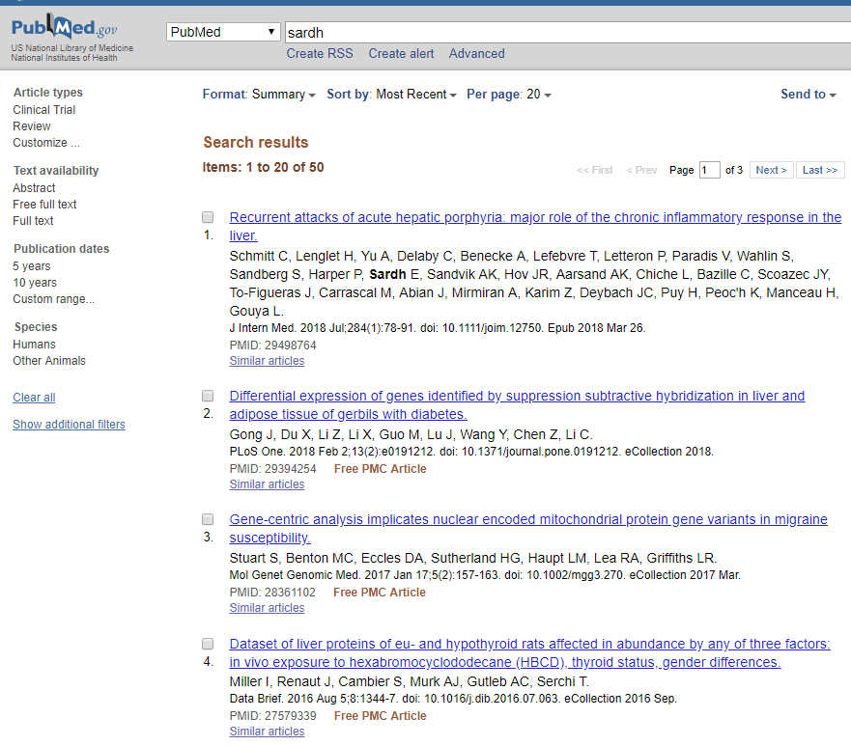
SARDh in literature
Only 41 literatures in Pubmed.
(poorly) associated with sarcosinemia and prostate cancer.

Slide 17
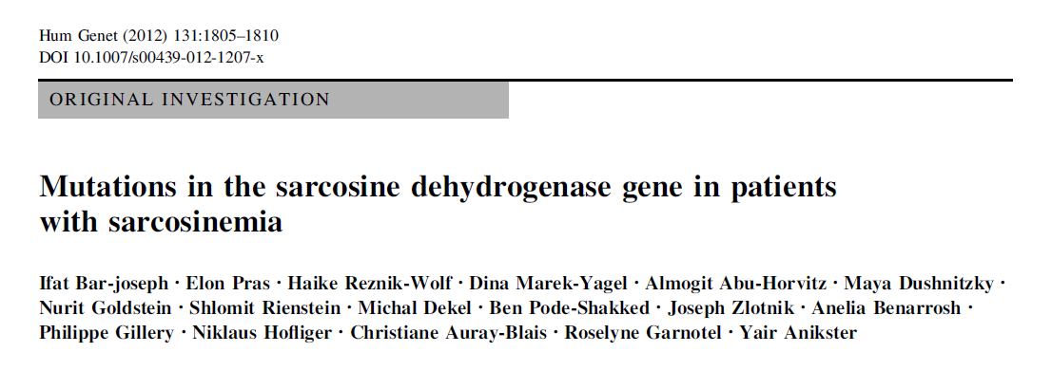
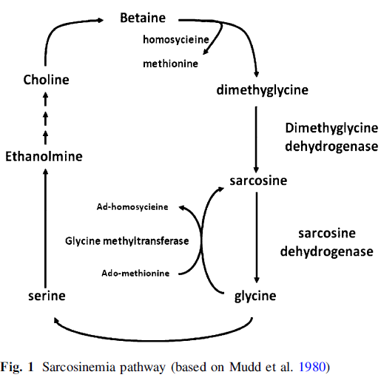
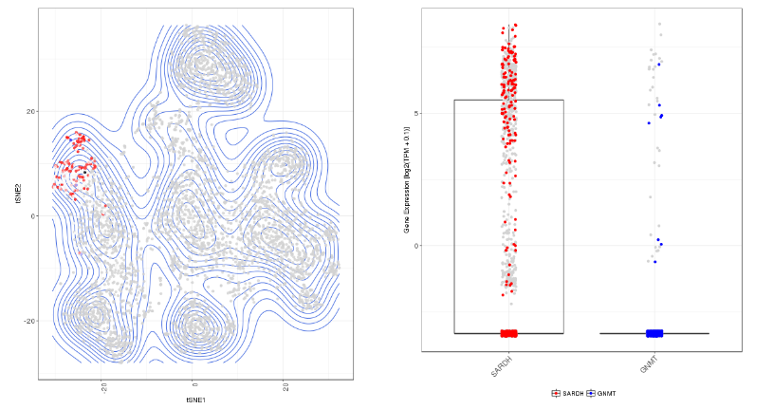
SARDH-GNMT homeostasis
C4-CD8-LAYN in liver dataset
Among 6 family with Sarcosinemia (Increased level of sarcosine) investigated, four families contains four different mutations (P287L,V71F, R723X, R514X) or a uniparental disomy in the region of SARDH gene. None of them were matched with mutations found in TCGA.
GNMT
SARDH
Caution: It could be simple detection problem
Prediction: Cells in C4-CD8-LAYN → Glycine (or downstream such as serine) accumulation and sarcosine depletion

Slide 18
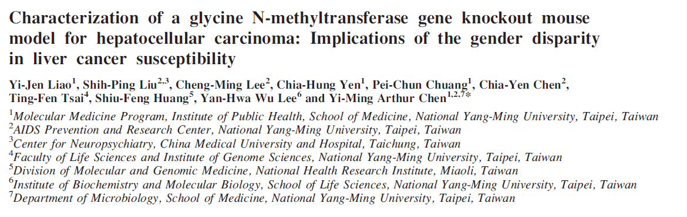
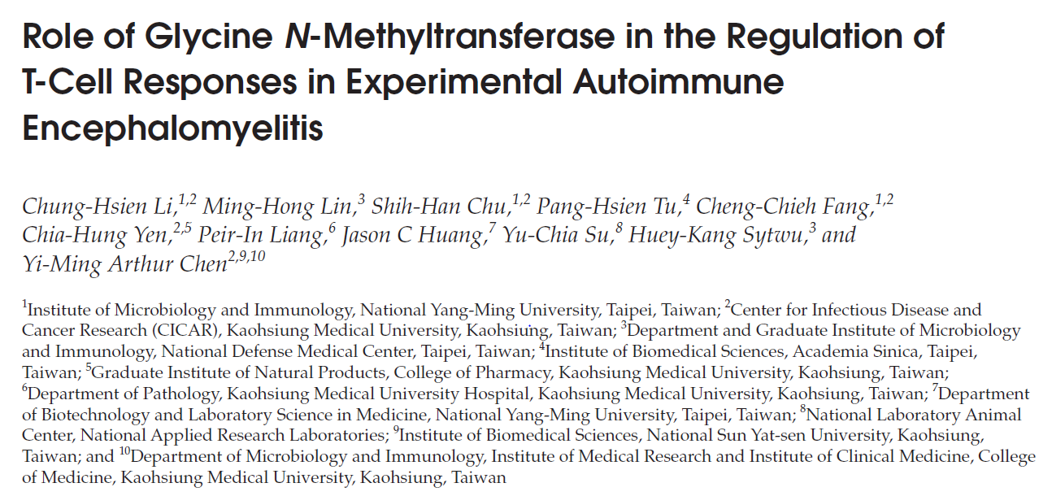
GNMT knock-out in HCC and T cells
GNMT -/- presumably phenocopies SARDH overexpression
GNMT -/- caused spontaneous HCC.
GNMT -/- defective T cells response in EAE, lower IFNg and IL-17A production, MOG induced Th17 was inhibited but Treg numbers were increased.
Proposed mechanism: GNMT→mTORC1→T cell activation

Slide 19
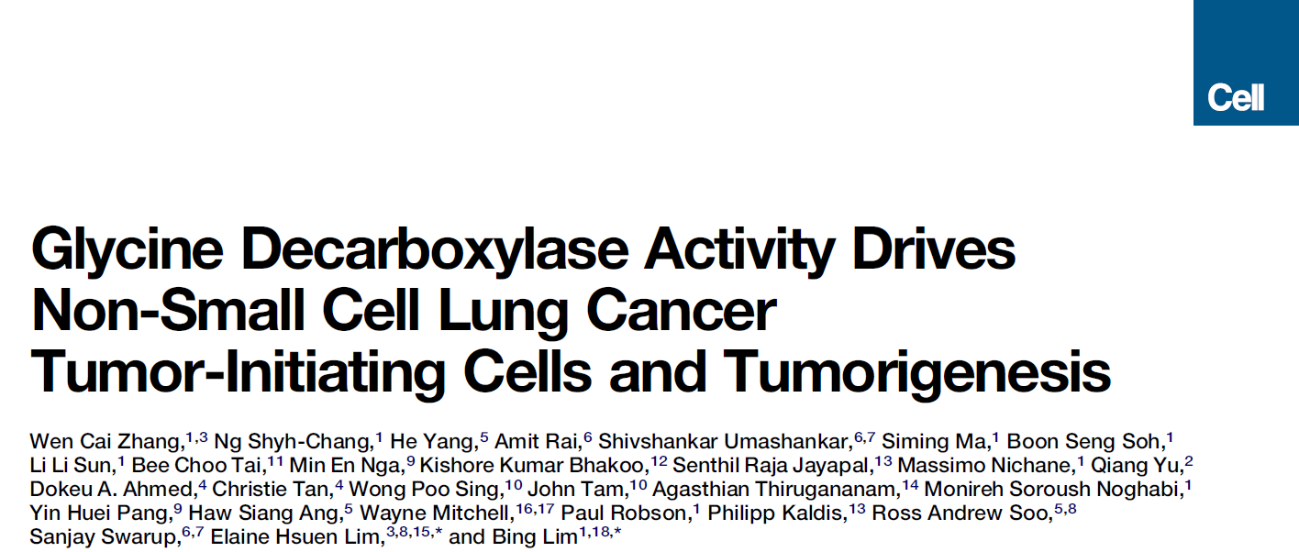
GLDC in literature
GLDC promotes cellular transformation in NSCLC,
Via glycolysis and glycine/serine metabolism → pyrimidine metabolism to regulate cancer proliferation
GLDC is generally overexpressed in many different cancers including liver

Slide 20
Future Plan
Advanced TCGA analysis
A few more candidates as backup
Amgen Body Map analysis
Read literatures

