Slide 1
Sep 788 & Sep789 Course Project Visual Object Tracking
Jianshen Wang, Sai Kantamuneni, Wenda Jiang, Ziqi Dou

Slide 2
Objectives
Visual Object detection
Detect objects in images
Visual Object Tracking
Track and predict the position of the detected object
Performance Comparison
YOLOv5+DeepSORT vs. SiamMask
Compare 2 different deep learning object tracking approaches

Slide 3
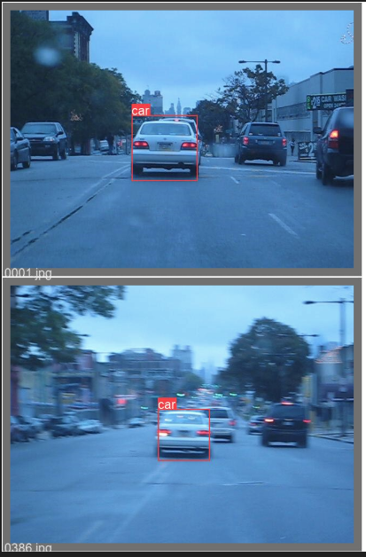
Data
BlurCar2 dataset from Visual Tracking Benchmark
585 images – 585 continuous frames from a video
1 car
Ground truth file
Bounding box coordinates
Conversion required
Contains challenging aspects
Scale Variation
Motion Blur
Fast Motion

Slide 4
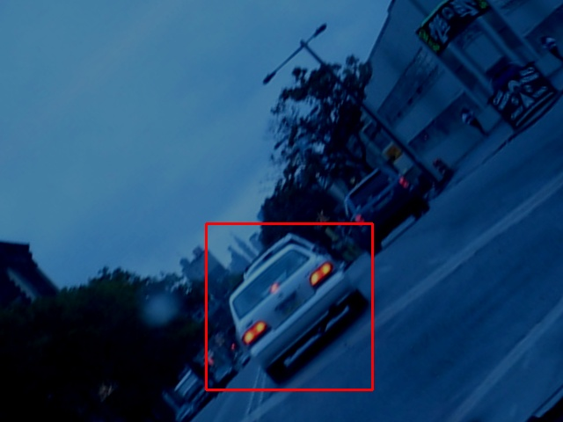
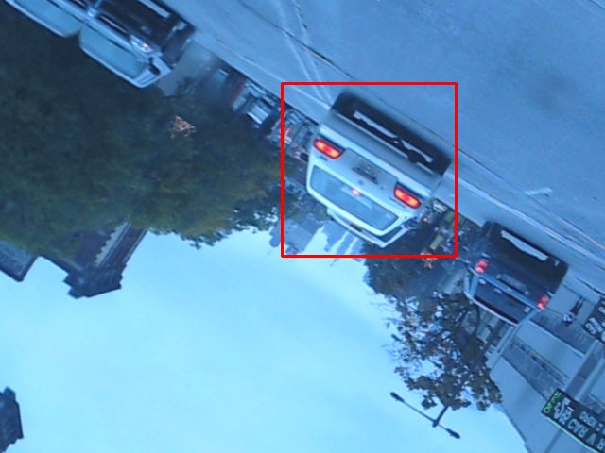
Data Augmentation
To achieve better accuracy in machine models, the original dataset is augmented using the Albumentations Library in Python.
The following augmentations were performed:
a. Horizontal Flip
b. Vertical Flip
c. Rotation
d. Brightness Contrast
The bounding boxes were retained even after performing the augmentation.

Slide 5
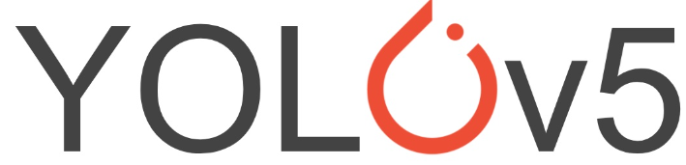
Model
Detection model
YOLOv5
YOLOv6
Tracking Model
DeepSORT
SiamMask

Slide 6
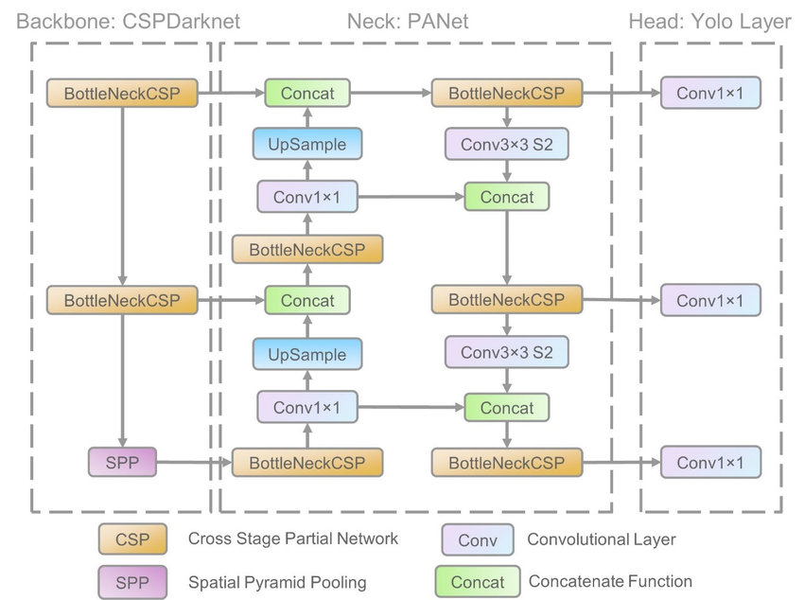
YOLOv5
Backbone: CSPDarknet
CSPx2, SPPx1
Speed & Accuracy
Neck: PANet
FPN structure
Localization of objects
Head: Yolo Layer
72x72, 36x36, 18x18
Multi-scale prediction
Notes:
Backbone
The Backbone in YOLOv5 consists of two CSP and a SPP. The CSP is used for resolving the problem of repeated gradient values in the backbone section, and also adds the gradient changes to the feature map. This approach can reduce the size of the backbone and improve the model speed, by having less parameters. Also, it can improve the model overall accuracy.
Neck
The neck section in YOLOv5 is using the PANet . The PANet uses FPN structure with optimized gradient flow from bottom to top, which will improve the propagation in basic features. The adaptive feature pooling can encourage any useful feature in its feature level to feed to the subnetwork directly. In short, PANet improves the location information flow in low level sub networks, therefore benefits the localization of objects.
Head
The head of the YOLO networks has three levels of the convolutional network outputs. The levels are 72x72, 36x36, 18x18. The difference in those output sizes makes the YOLOv5 network able to adapt to multi-scale prediction , such as small, medium, and large objects. In out experiments, the car dataset has a relatively constant medium object size, so the YOLOv5 can also adapt to the car dataset. Wang, C.Y.; Mark Liao, H.Y.; Wu, Y.H.; Chen, P.Y.; Hsieh, J.W.; Yeh, I.H. CSPNet: A new backbone that can enhance learning
capability of cnn. In Proceedings of the IEEE Conference on Computer Vision and Pattern Recognition (CVPR 2020),
Washington, DC, USA, 14–19 June 2020; pp. 390–391
. Wang, K.; Liew, J.H.; Zou, Y.; Zhou, D.; Feng, J. Panet: Few-shot image semantic segmentation with prototype alignment. In
Proceedings of the IEEE International Conference on Computer Vision (ICCV 2019), Seoul, Korea, 20–26 October 2019; pp. 9197–
9206.
Redmon, J.; Farhadi, A. Yolov3: An incremental improvement. arXiv 2018, arXiv: 1804.02767.

Slide 7
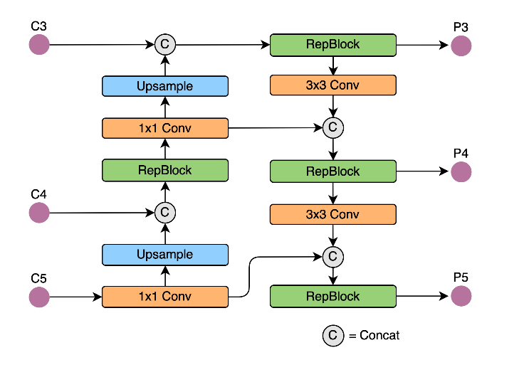
YOLOv6
Similar to YOLOv5
Backbone area
RepBlock
Better hardware efficiency
Better multi-scale feature fusion

Slide 8
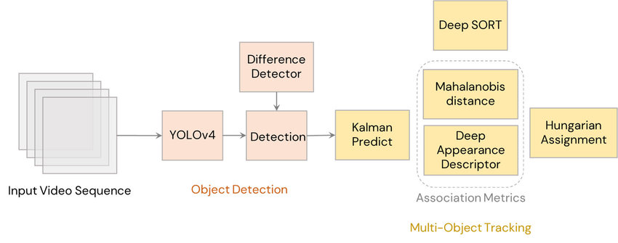

DeepSORT
Estimating tracks
Define features - bounding box coordinates, velocities
Keep a number of successful associated frames
Age for each track
Assignment Problem
Mahalanobis distance
Consine distance
$Cost=λ d_{Mahalanobis}+\left(1−λ\right)d_{Cosine}$
Matching cascade
Solve uncertainty of tracking under occlusions
Combat effect of Mahalanobis distance
Deep appearance descriptor
Provide object detection function
Used CNN trained with human tracking dataset

Slide 9
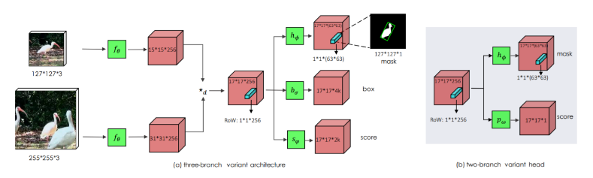
SiamMask
SiamMask is a deep learning model architecture which performs both Visual Object Tracking (VOT) and Video Object Segmentation (VOS). Given the location of the object in the first frame of the sequence, the aim of VOT is to estimate an object's position in subsequent frames with the best possible accuracy.
SiamMask takes as input a single object bounding box for initialization and outputs segmentation mask and object bounding box for each subsequent frames of a video. SiamMask improves over its Siamese-network based algorithm by adding a new branch to produce a pixel-wise binary mask. As shown above, there is a three-branch variant and a two-branch variant.
Notes:
as for the Backbone: SiamMask uses ResNet-50 as backbone. The architecture shown below uses the first 4 stages of ResNet, adjust layer and depth-wise cross-correlation resulting in a feature map of size 17×17.

Slide 10
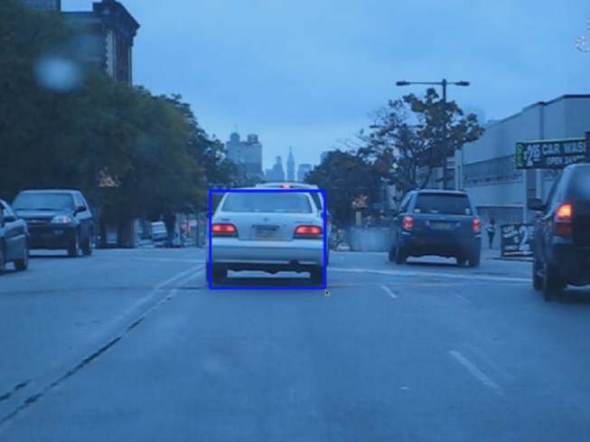
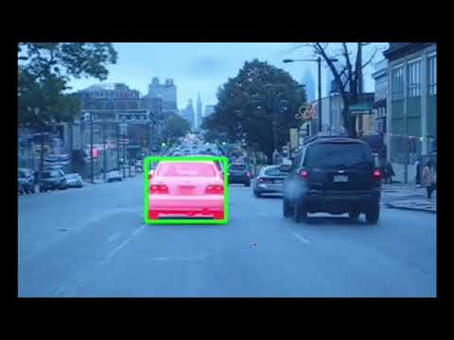
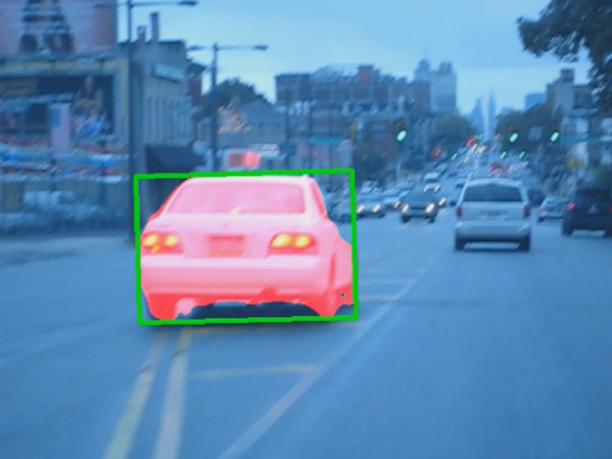
SiamMask
Initial frame
final frame
Blurcar2 test result video
Notes:
On the left, we manually give a bounding box in the first frame, and the siammask algorithm can locate the target in the following frames, as shown in this video
As we can see, the algorithm gives a good tracking results under the shaked camera view
Ok I think that’s enough, next we will discuss some results

Slide 11
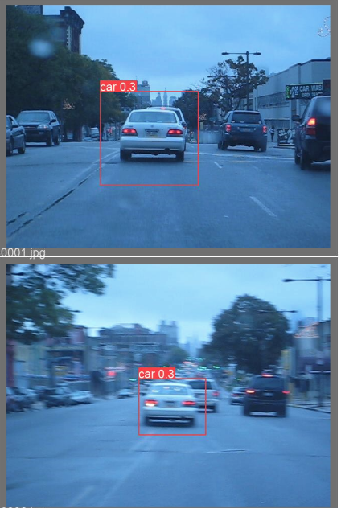
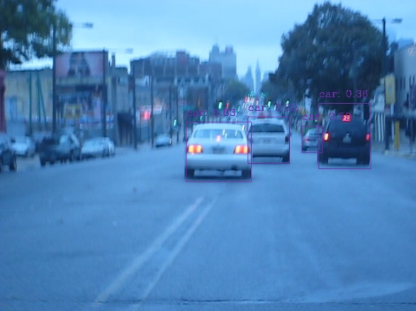
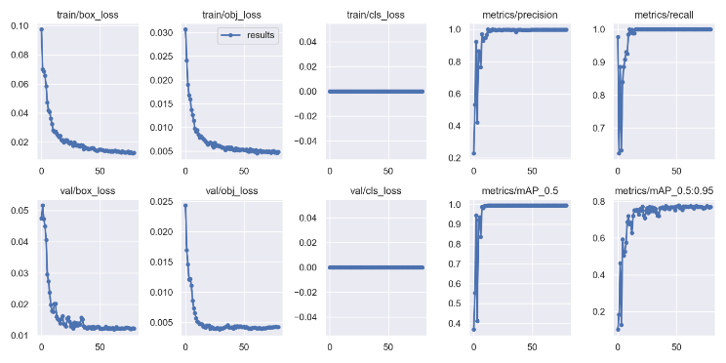
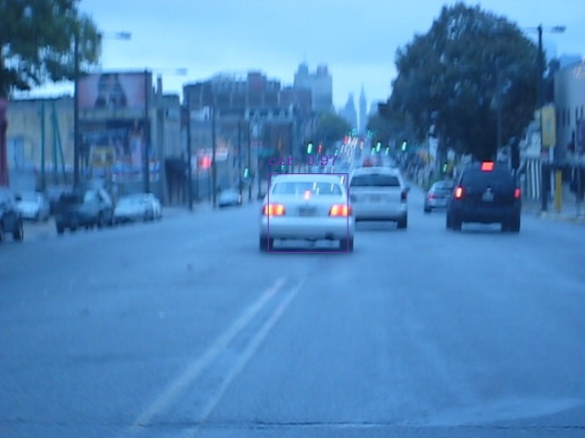
Result
YOLO

Slide 12
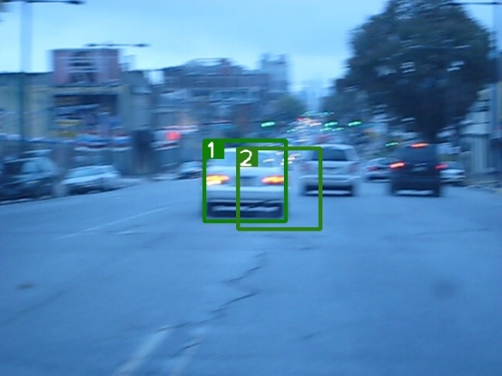
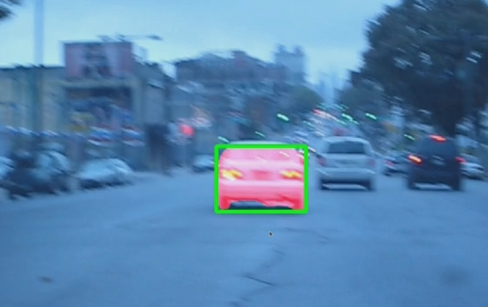
Result
YOLOv5+DeepSORT vs. SiamMask

Slide 13
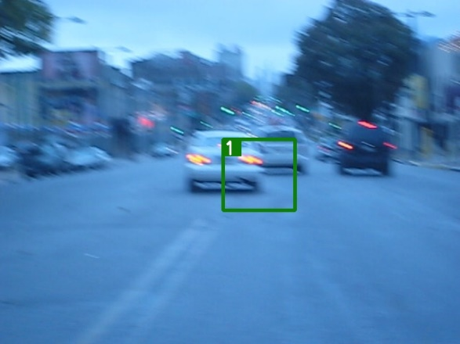
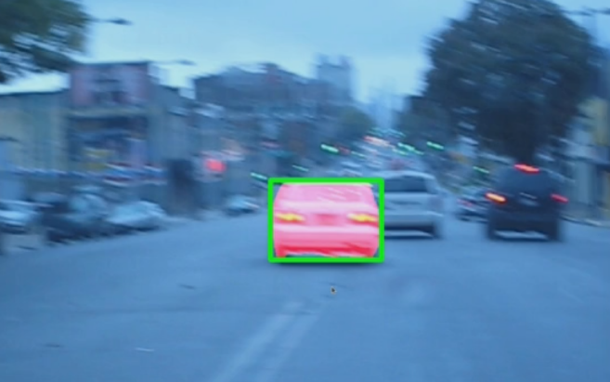
Result
YOLOv5+DeepSORT vs. SiamMask

Slide 14
Discussion
Problems
YOLO+DeepSORT is for MOT, SiamMask is for SOT
Low data quality
None standardized annotation for the SiamMask approach
Future Improvements
Further tune the hyperparameters
Object-specific optimization (code structure modification)

Slide 15
Thank You

