Slide 1


Optimizing Proactive Inspections
McCourt School of Public Policy Data Science for Public Policy Program

Slide 2
Acknowledgements
DCRA
Director Ernest Chapprah
Tomash Bukowiecki
Anthony Clark
Abiola Ijaola
Peter Nyabagosi
Garret Whitescarver
Georgetown University
NaLette Brodnax
Christopher Murphy
Jinia Sarkar
Heidi Tseu
Massive Data Institute
McCourt DSPP Students
Jean Landry Binam Keyanfe
Lixue Chen
Chandler Dawson
Zachary Gozlan
Douglas Hummel-Price
Yining Li
Ziqi Niu
Madeline Pickens
Andrea Cristina Quevedo Acuna
George Schoeffel
Harsh Sharda
Neha Tiwari
Lily Yue

Slide 3
Project Timeline
Meeting with DCRA Office of Data Innovation
Meeting with Garret Whitescarver, Deputy Chief Building Official
Insight Competition
Three in-class labs, exploring the data and deriving insights
August 28
September 23
October -- November
November 18

Slide 4

Overview
How can DCRA optimize proactive inspections of
licensed properties?

Slide 5
How Properties are Currently Selected for Inspection
Licensed properties with more than three units
Properties not inspected in the last four years
Random selection by ward

Slide 6
Potential Issues with Current Selection Method
DCRA resources may not be focused on problem areas
Owners have minimum incentive to improve properties if they have been inspected in the last four years

Slide 7
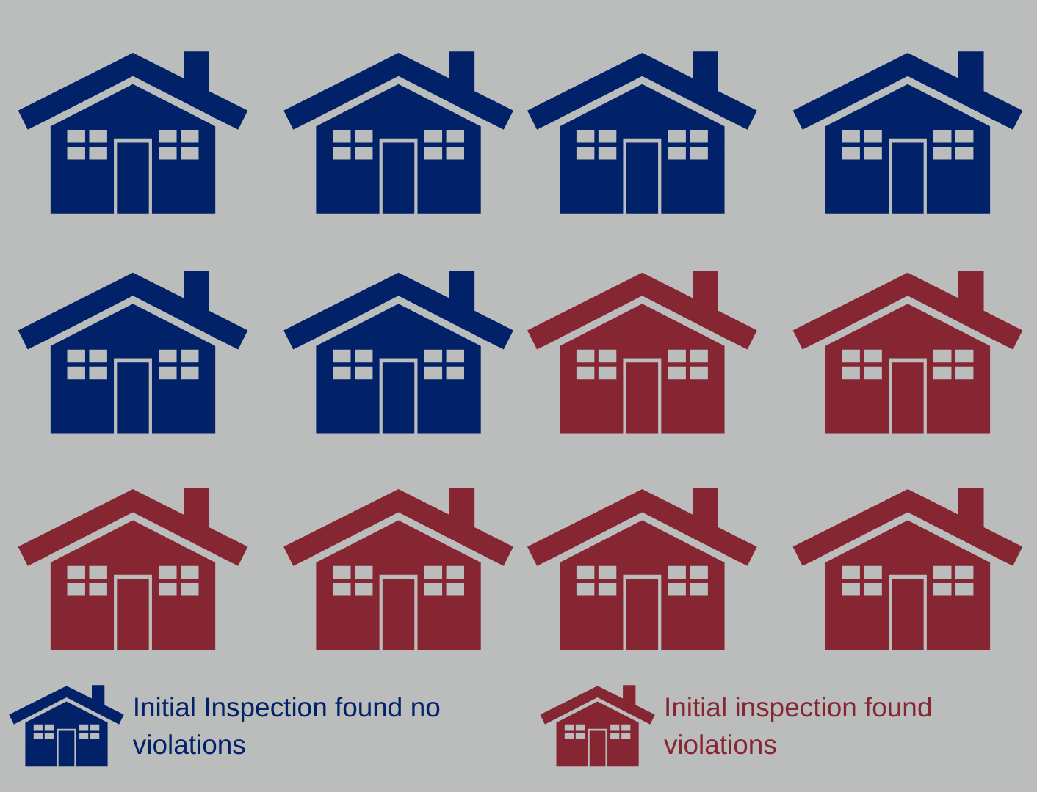
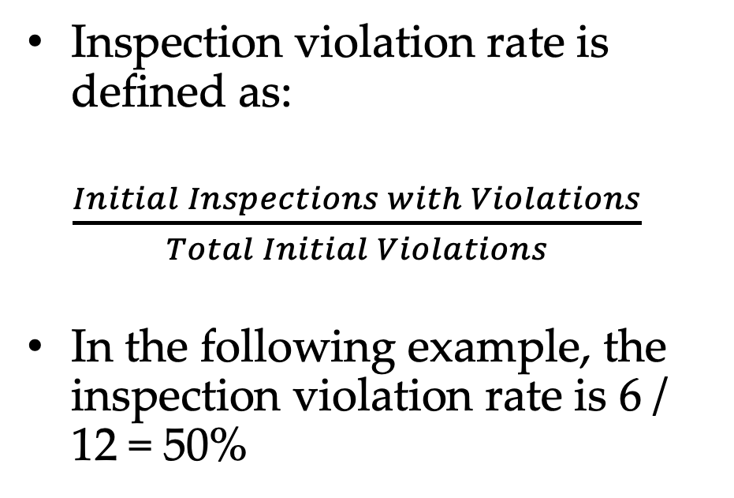
Inspection Violation Rate as Measure of DCRA Success
Inspection violation rate is defined as:
$\frac{Initial Inspections with Violations}{Total Initial Violations}$
In the following example, the inspection violation rate is 6 / 12 = 50%

Slide 8
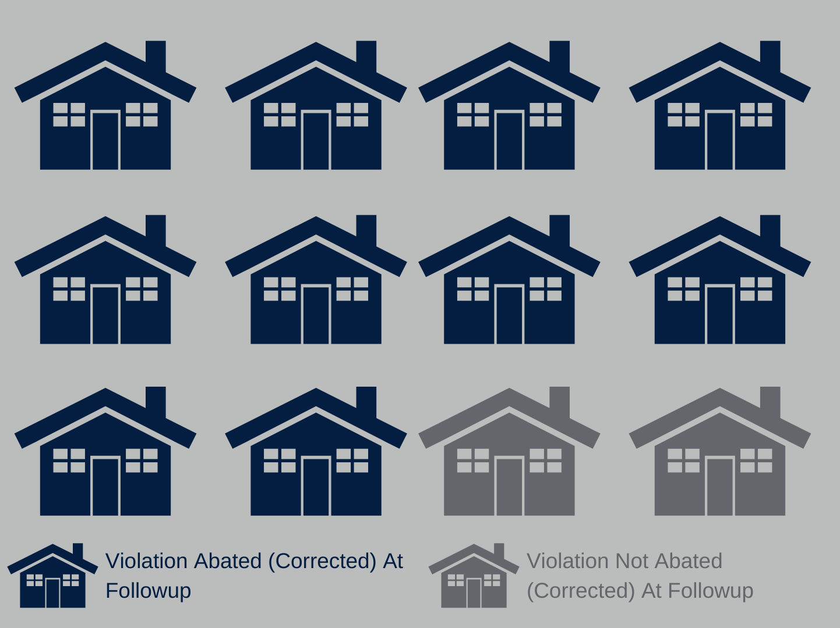

Compliance Rate as Measure of DCRA Success
NOV Compliance Rate is defined as:
$\frac{Total Violations Corrected at Follow−Up}{Total Follow−Up Inspections}$
In the following example, the compliance rate is 10 / 12 = 83 %

Slide 9
Data Overview
DCRA data
Proactive inspections
Complaint-based inspections
Violation severity data (for both proactive and complaint-based)
Residential license data
Computer-Assisted Mass Appraisal data
Property characteristics for commercial, condo, residential

Slide 10
Proposed Selection Approaches
Choose properties on basis of:
Violation history
Complaint severity
Property characteristics
License characteristics

Slide 11
Insights (1/3)
Analysis of Complaint Inspection Data:
Inspection History

Slide 12
Initial Violation Rate (IVR) Trends
Highest IVR in 2017
Decreasing IVR after 2017
Why?
Year | Proactive Inspections | Inspection Violation Rate
2016 | 561 | 53.8%
2017 | 2,736 | 70.6%
2018 | 2,267 | 56.0%
2019 | 2,231 | 52.7%
Bulleted Text Style Title— Helvetica Neue 20pt Bold

Slide 13
Higher IVR when properties with complaints inspected
Year 2017 had highest IVR and highest number of address IDs in common between proactive and reactive inspections
Insight: Properties with history of complaints more likely to have violations
Year | Proactive Inspections | Inspection Violation Rate | Complaint Inspections
2016 | 561 | 53.8% | 1,815
2017 | 2,736 | 70.6% | 7,491
2018 | 2,267 | 56.0% | 6,637
2019 | 2,231 | 52.7% | 6,637
Bulleted Text Style Title— Helvetica Neue 20pt Bold

Slide 14
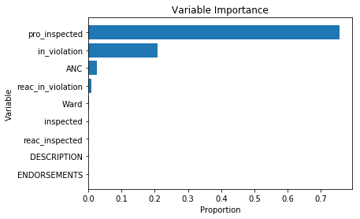
Use complaint history to predict violations
Key takeaway: Use inspection history to assign proactive inspections
Variables
Reactive inspection of property due to a complaint (since 2015)
Proactive inspection of property (since 2015)
Property was inspected whether proactive or reactive (since 2015)
Result: 98% prediction accuracy
Bulleted Text Style Title— Helvetica Neue 20pt Bold

Slide 15
Insights (2/3)
Analysis of Complaint Inspection Data:
Complaint Severity

Slide 16
Text Analysis Goals
Comparing -- Examine similarity
Clustering -- Identify groups
Summarizing -- Show important topics or themes
We do this by turning our words into tokens, or data objects that hold information for each word
Bulleted Text Style Title— Helvetica Neue 20pt Bold

Slide 17
Text Analysis Example
Sample Text:
The DCRA data had about eight thousand observations.
Step 1: Clean
the dcra data had about eight thousand observations
Step 2: Remove Stopwords
dcra data eight thousand observations
Step 3: Tokenize
[‘dcra’, ’data’, ’eight’, ’thousand’, ’observations’]
Bulleted Text Style Title— Helvetica Neue 20pt Bold

Slide 18
DCRA Example
Example Complaint:
Rust on floor and railing on the 4th floor with water damage in the kitchen with peeling paint on the wall
Management: Random Land Company
123-456-7890 Mr. John Doe
Anonymous Caller
Bulleted Text Style Title— Helvetica Neue 20pt Bold

Slide 19
Reduce complexity of complaint text
Rust, floor, railing, 4th, floor, water, damage, kitchen, peeling, paint, wall, Management, Random Land Company, 123-456-7890, Mr. John Doe, Anonymous, Caller
Steps
Remove Numbers
Remove Names
Remove unnecessary information
Outcome: rust, floor, railing, water, damage, kitchen, peeling, paint, wall
Next Step: Analyze terms to identify topics that appear frequently
Bulleted Text Style Title— Helvetica Neue 20pt Bold

Slide 20
Interpreting the Topics
 | Word 1 | Word 2 | Word 3 | Word 4 | Word 5
Topic 1 | basement | flood | sewer | rain | electrical
Topic 2 | need | bug | home | vacant | bed
Topic 3 | door | defective | work | paint | window
Topic 4 | infestation | multiple | water | work | mouse
Topic 5 | leak | ceiling | water | bathroom | damage
Topic 6 | heat | dcra | jep | possible | inspect
Topic 7 | water | hot | remove | electricity | emergency
Bulleted Text Style Title— Helvetica Neue 20pt Bold

Slide 21
Categorizing Complaints
Topics | % of Complaints
Water leaks coming from a ceiling or outside causing structural issues like collapsed ceilings | 28%
Degradation of the condition of the living space | 12%
Broken safety equipment or entry point, like windows and doors | 16%
Infestation of bugs or rats within a unit | 17%
Water issues with the roof or basement of a building, including flooding | 6%
Issues regarding the heat of a living space | 12%
Problems comings from utilities | 9%
Bulleted Text Style Title— Helvetica Neue 20pt Bold

Slide 22
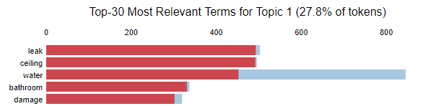
Visualizing the Topics
Key takeaway: Utilize text in complaints in combination with inspection history to identify properties with a history of certain types of complaints
Bulleted Text Style Title— Helvetica Neue 20pt Bold

Slide 23
Insights (3/3)
Analysis of Business License and Property Data

Slide 24
Techniques & Datasets
The business license/property analyses use the following techniques:
Principal Components Analysis (PCA),
Regression (e.g., OLS and Logistic Regression)
Predictive Modeling (e.g., Random Forest)
The analyses use the following datasets:
Proactive Inspections
Residential Licenses
Violation Data (Count, Fines, Severity)
Computer-Assisted Mass Appraisal

Slide 25
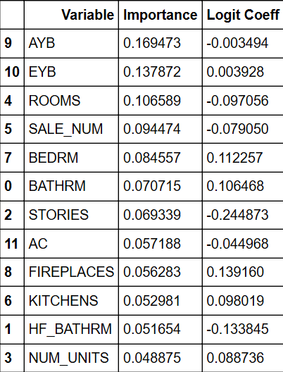
Result 1: Actual Year Built
The selection algorithm could weight properties to more frequently target buildings based on construction and renovation dates
AYB-- actual year built
EYB-- effective year built (factors in renovation)

Slide 26
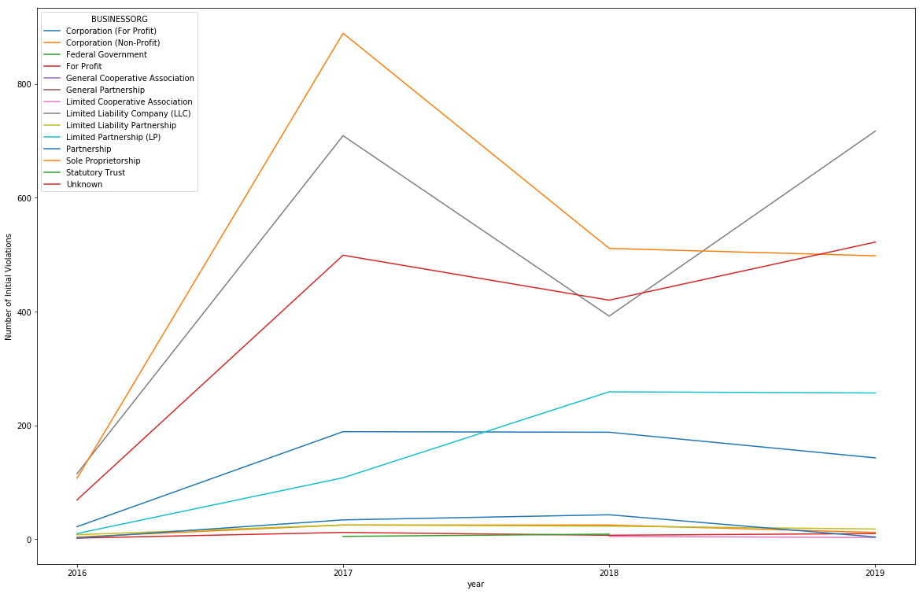

Result 2: Ownership Type
Top 3 categories for the number of violations found:
Sole Proprietorship
Limited Liability Partnership
Unknown
Sole Proprietorship
LLC
Unknown
Notes:
The ownership of the property matters in terms of the number of violation. Sole Proprietorship, Limited Liability Partnership, and unknown owned properties are the top three categories in terms of number of violations found.

Slide 27
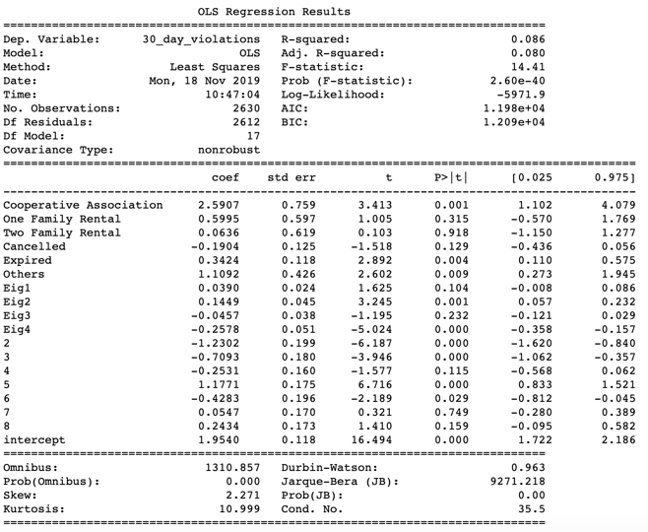
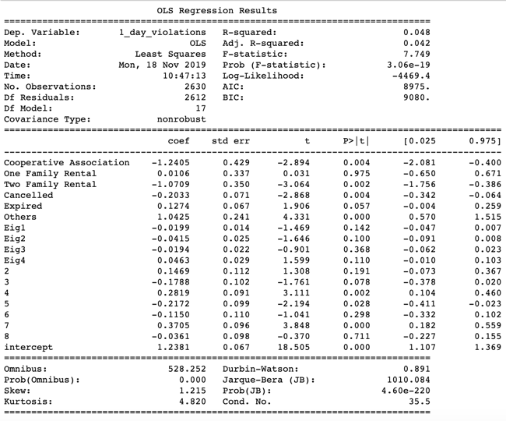
Result 3: Business License Description
OLS Regression Results for 30-day violations
Compared to apartment, cooperative association is more likely to have 30-day violations, but is less likely to have 1-day violations.
Two family rentals are less likely to have 1-day violations compared to apartment.
OLS Regression Results for 1-day violations

Slide 28
Result 3: Business license status matters
OLS Regression Results for 30-day violations
Compared to active status, properties with expired licenses are more likely to have 30-day violations.
Compared to active status, properties with cancelled licenses are less likely to have 1-day violations.
OLS Regression Results for 1-day violations

Slide 29
Next Steps
Implementing a New Proactive Inspection Selection Algorithm

Slide 30

Probability Fundamentals
The probability that event X will occur is a numerical measure that represents how likely or unlikely a given event is to occur.
For example:
With a fair six-sided die, each side is equally likely to come up, so the probability for each is 1 in 6.

Slide 31

Unweighted Probability
Think of putting names into a hat, and then pulling one name out. Each name is equally likely to be drawn, so we consider this probability to be unweighted.
Unweighted probabilities work well in situations where each “name in the hat” should have an equal chance of being selected.

Slide 32
Weighted Probabilities
Weighted probabilities, by contrast, account for situations in which some names should be more likely than others.
For example, the NBA draft uses a weighted lottery system to give teams that performed poorly the previous season a greater chance to draft better players. This prevents a dominate team from building on their advantage.
For the names in a hat situation, this is analogous to adding some names to the hat more frequently than others.
Bulleted Text Style Title— Helvetica Neue 20pt Bold

Slide 33
Weighting in DCRA Context
Property | Chance Property is Selected
Property 0 | 10%
Property 1 | 10%
Property 2 | 10%
Property 3 | 10%
Property 4 | 10%
Property 5 | 10%
Property 6 | 10%
Property 7 | 10%
Property 8 | 10%
Property 9 | 10%
Let’s say DCRA is selecting one property to inspect from a group of ten properties.
When the selection is random, each one has an equal chance of being selected.

Slide 34
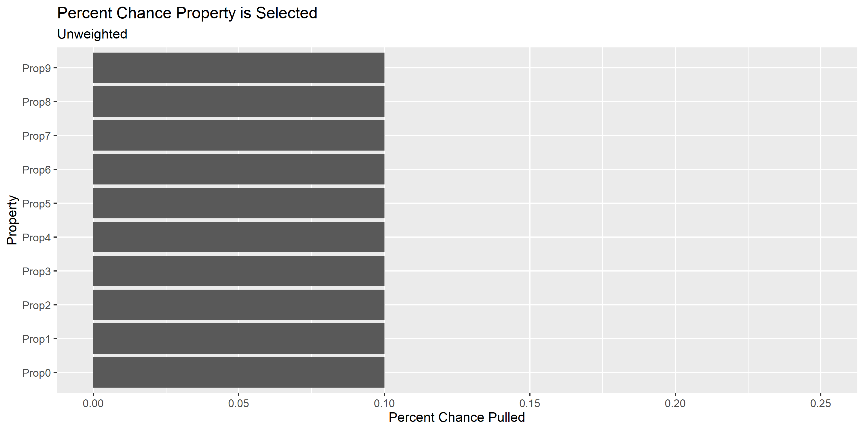

Slide 35
Weighting in DCRA Context
But if we factor in what we know based on past outcomes, we can make it so that properties that look more like properties where violations were found are more likely to be selected for the inspection.
Let’s say here, we know that certain properties are in zip codes where DCRA finds violations frequently; older buildings are more likely to have violations; and certain homes are built from cheaper building materials.
Property | Zip Code History | Year Built | Building Material
Property 0 | Normal | 1900 | Standard
Property 1 | Normal | 1900 | Cheap, Flammable Wood
Property 2 | Few Violations | 1950 | Standard
Property 3 | Few Violations | 1960 | Cheap, Flammable Wood
Property 4 | Normal | 1910 | Standard
Property 5 | Normal | 1925 | Cheap, Flammable Wood
Property 6 | Many Violations | 1945 | Standard
Property 7 | Many Violations | 1950 | Cheap, Flammable Wood
Property 8 | Normal | 1970 | Standard
Property 9 | Normal | 1980 | Cheap, Flammable Wood

Slide 36
Weighting in DCRA Context
By weighting these characteristics, we can make it so that properties with more “warning signs” are more likely – but still not guaranteed - to be chosen for inspection:
Property | Weighted Chance Property is Selected | Zip Code History | Year Built | Building Material
Property 0 | 12.9% | Normal | 1900 | Standard
Property 1 | 4.3% | Normal | 1900 | Cheap, Flammable Wood
Property 2 | 12.9% | Few Violations | 1950 | Standard
Property 3 | 4.5% | Few Violations | 1960 | Cheap, Flammable Wood
Property 4 | 13.2% | Normal | 1910 | Standard
Property 5 | 4.9% | Normal | 1925 | Cheap, Flammable Wood
Property 6 | 17.0% | Many Violations | 1945 | Standard
Property 7 | 8.6% | Many Violations | 1950 | Cheap, Flammable Wood
Property 8 | 14.9% | Normal | 1970 | Standard
Property 9 | 6.6% | Normal | 1980 | Cheap, Flammable Wood

Slide 37
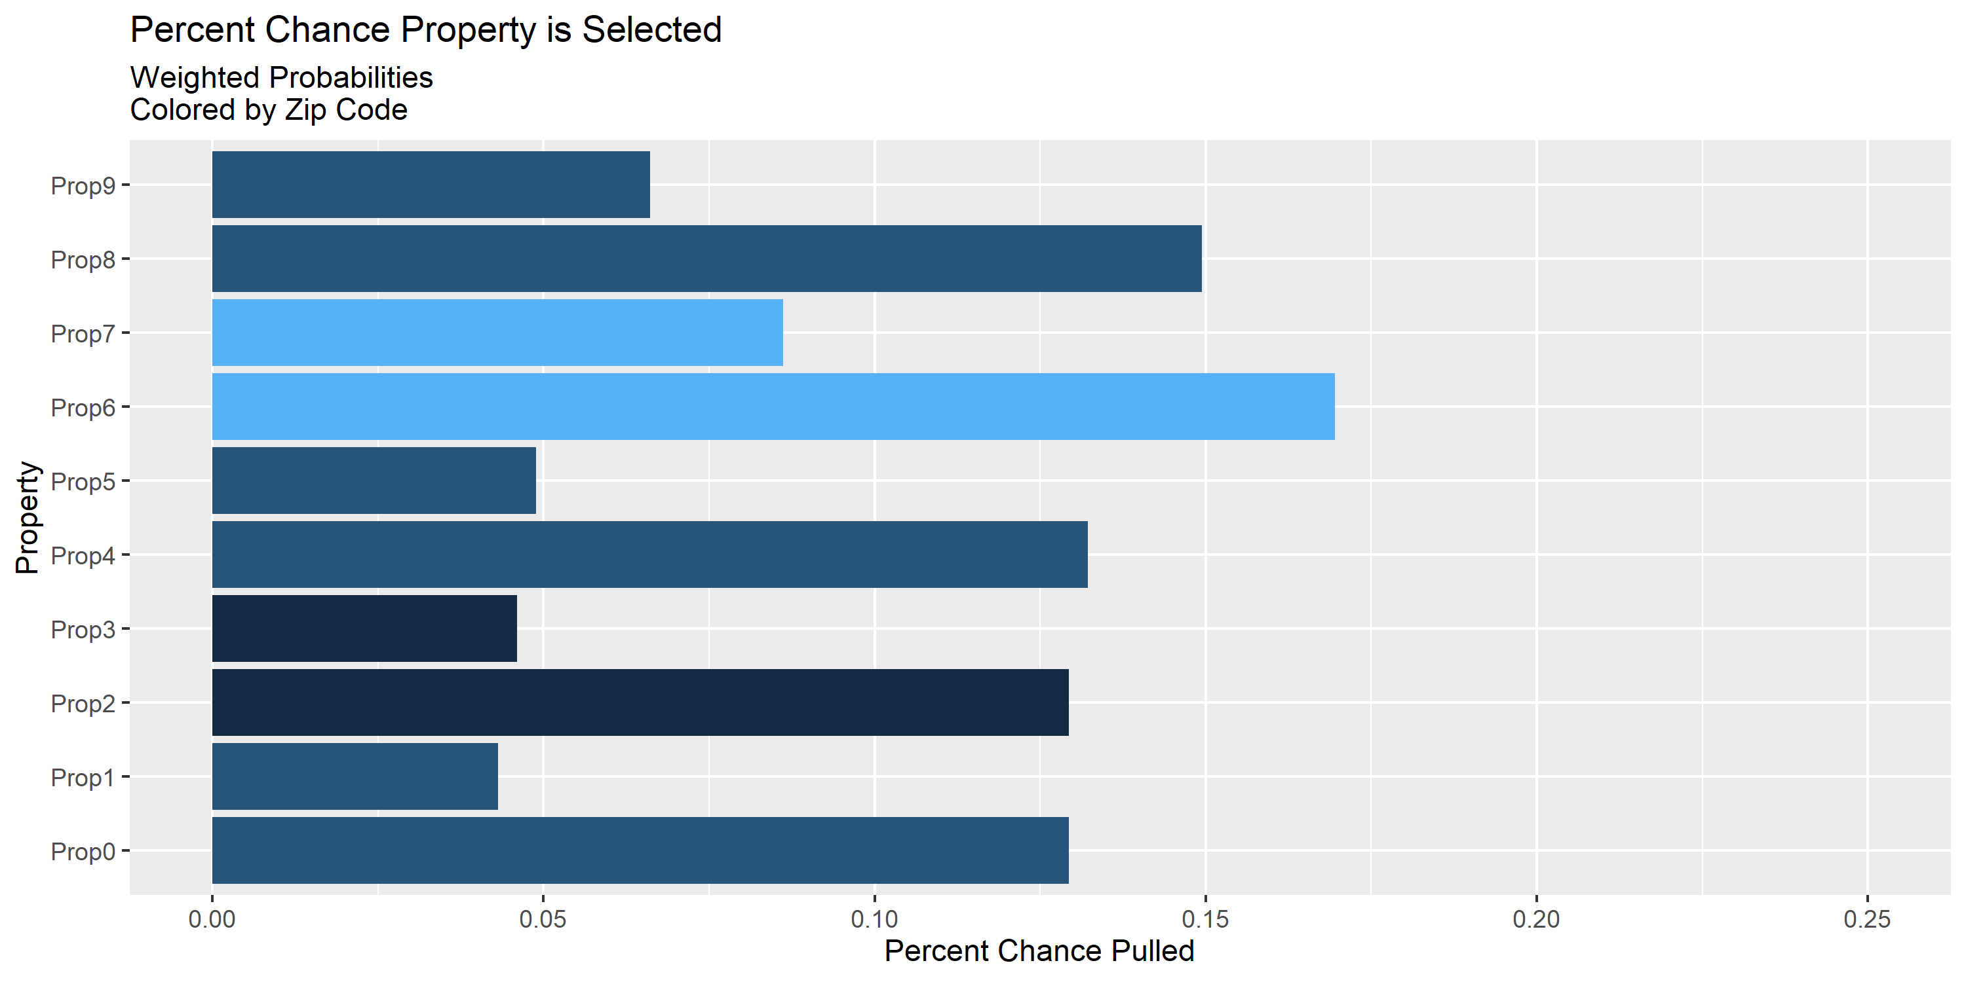
Using slightly more advanced techniques, we can make judgments between the weights, such that, say, zip code sways things some…

Slide 38
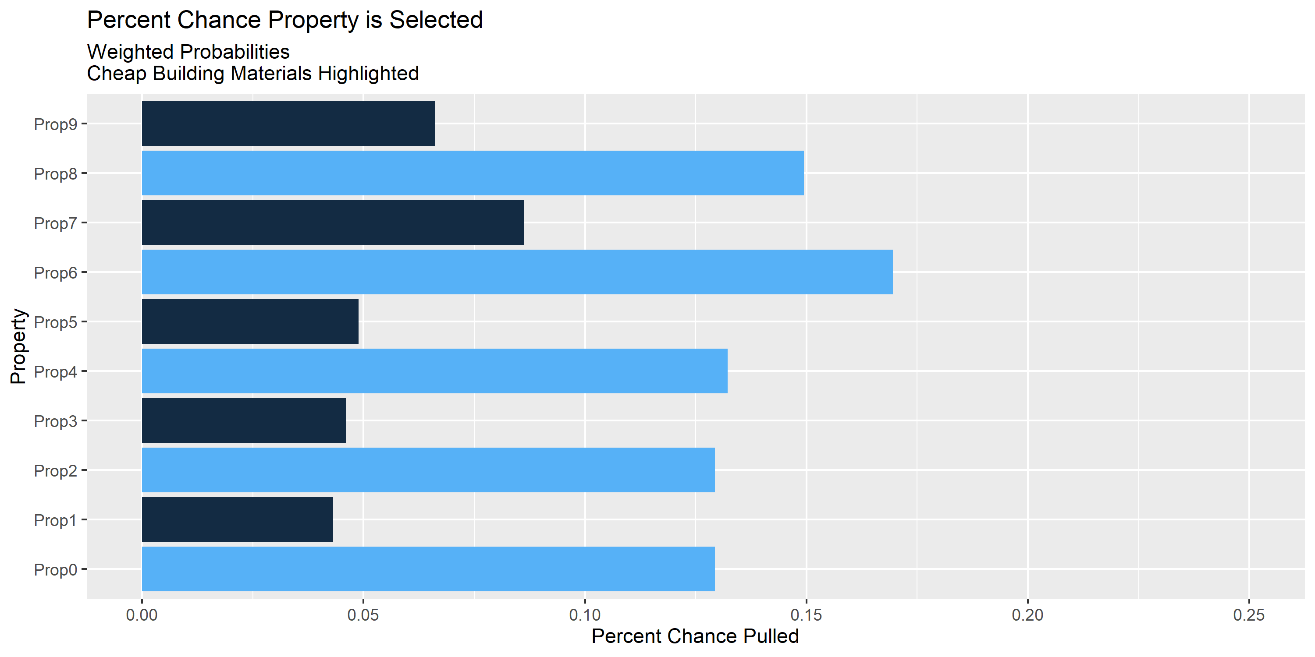
…but an unsafe building material sways things more.

Slide 39
Summary of Recommendations
Apply weighted probabilities to properties on the basis of
History of prior violations (proactive and reactive)
History of complaints with particular topics or keywords
Older construction or recent renovation
Expired license status
Owned by a sole proprietor or LLC
Licensed as an apartment or cooperative association

Slide 40
Questions?

