Slide 1
A naïve RISC-V CPU
January 4, 2020
Wu Runzhe

Slide 2
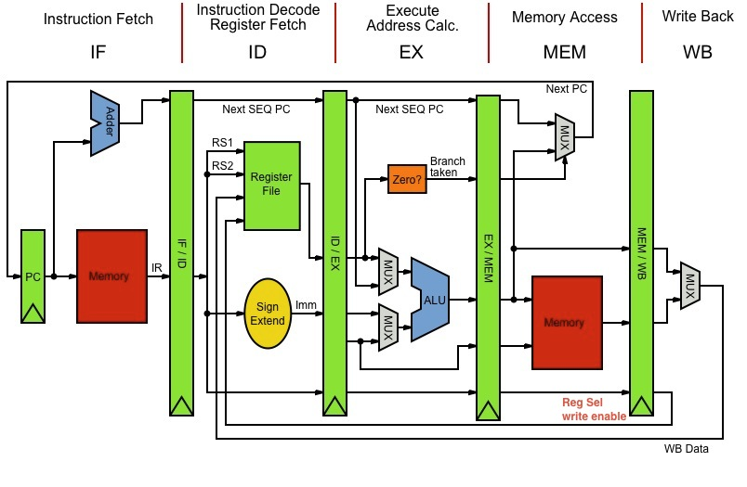
Now let’s talk about the general design
A standard 5-stage pipeline with data forwarding

Slide 3
Instruction Cache
Without I-cache?
5~6 cycles to fetch an instruction
So pipeline what?
Fake pipeline

Slide 4
Instruction Cache
A direct mapping I-cache
1,024 bytes
256 instructions
Supports consecutive hits
one instruction per cycle
A victim cache
Sounds great
But actually useless

Slide 5
Data Cache
A direct mapping D-cache
64 bytes
Why so small
Useless
Write through
1 byte, 2 bytes, 4 bytes

Slide 6
Branch Prediction
Tournament Predictor
Global Predictor & Local Predictor
A selector
Branch Target Buffer
Predict at stage IF
Correct
No stall
Incorrect
Recover in stage EX by stalling 1 cycle

Slide 7
Memory controller
To resolve structural hazard
Stage MEM priority over stage IF
Stage IF
Memory controller
RAM
Stage MEM

Slide 8
Performance
130 MHz, all test cases passed
pi.c: 0.996875 s
When higher than 130 MHz
pi.c can still be passed
bulgarian.c failed
Due to bad uart buffer?

Slide 9

Now let’s focus on the details

Slide 10
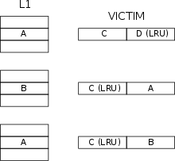
Victim cache

Slide 11
Victim cache
A small and fully associative cache that stores all the blocks evicted from some cache
It does little to reduce miss rate
Because I-cache is large enough
Speed up ≈ 1

Slide 12
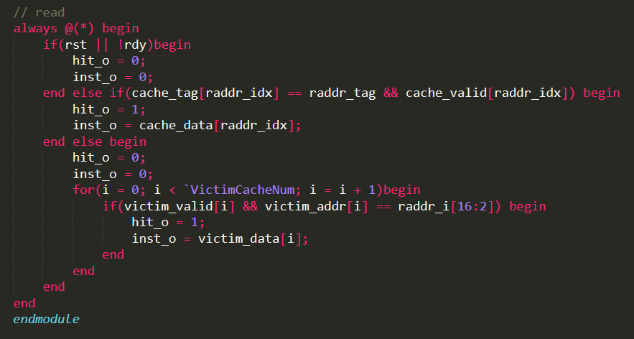
Victim cache

Slide 13
Tournament Predictor
2 predictors: 1 based on global information and 1 based on local information, and combine with a selector
Global Predictor 4K entries, indexed by the history of the last 12 branches; each entry in the global predictor is a standard 2-bit saturating counter
Local Predictor 32 entries, indexed by the address of the branch instruction; each entry is a standard 2-bit saturating counter

Slide 14
Tournament Predictor
Selector
A 2-bit saturating counter
0 stands for global predictor
1 stands for local predictor
When a prediction produced by some predictor is correct, we should attach more importance to it.
Otherwise we should incline to the other predictor.

Slide 15

Pipelined <-> Not pipelined
About debugging
A register named “avoid_data_hazard” to stall some specific cycles after an instruction is fetched in stage IF
“avoid_data_hazard” = 0
Pipelined
“avoid_data_hazard” > 9
Not pipelined

Slide 16
Thank You!

