Slide 1







2019 Stack overflow developer survey
Chua Ziqing
27/8/2024

Slide 2



OUTLINE
Executive Summary
Introduction
Methodology
Results
Visualization – Charts
Dashboard
Discussion
Findings & Implications
Conclusion
Appendix

Slide 3

EXECUTIVE SUMMARY
Introduction to data & Analysis goals
Methodology
Data collection
Data Analysis
Data visualizations
Result findings & Visualization of data
Discussion on findings
Final conlclusion

Slide 4

INTRODUCTION
Stack Overflow’s annual Developer Survey provides a comprehensive view of the global developer community
The survey gathered responses from over 90,000 developers worldwide
Understand trends and challenges in the tech industry
Respondent demographics is not able to represent the entire community
Majority of respondents were from United States, India
Male dominated

Slide 5

METHODOLOGY
Data collection
Data wrangling
Exploratory data analysis
Observe data distribution
Handle outliers
Explore correlations
Data visualization
Graphs and charts
Dashboards

Slide 6
RESULTS

Slide 7
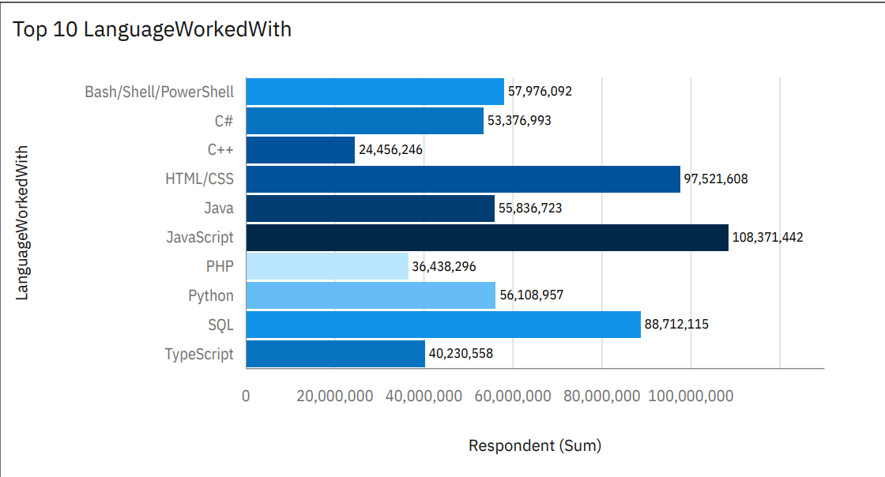
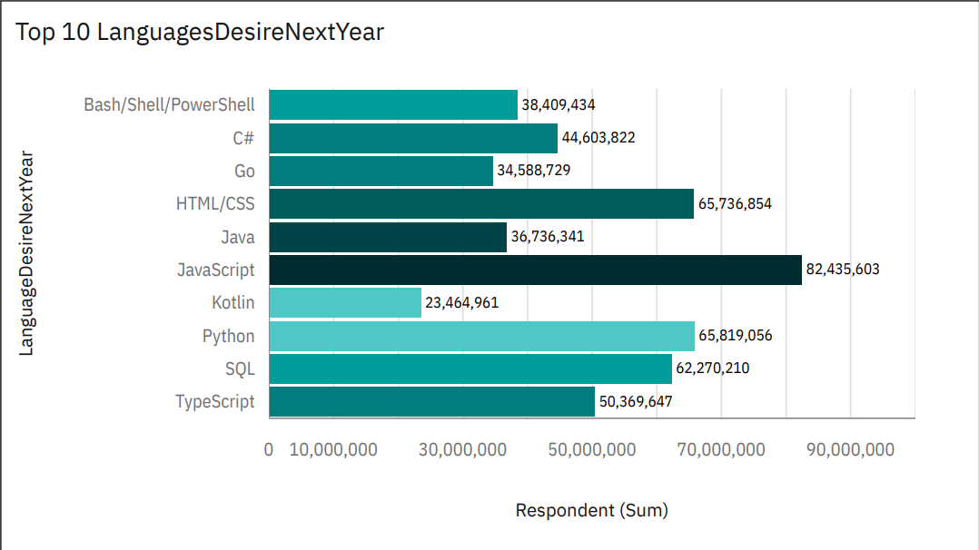
PROGRAMMING LANGUAGE TRENDS
Current Year
Next Year

Slide 8
PROGRAMMING LANGUAGE TRENDS - FINDINGS & IMPLICATIONS
Findings
Javascript is the most popular language
Python is the fastest growing
Kotlin & Go – not in top 10 this year but in top 10 desired next year
Implications
Developers might be changing over from html or Javascript to growing languages such as Python

Slide 9
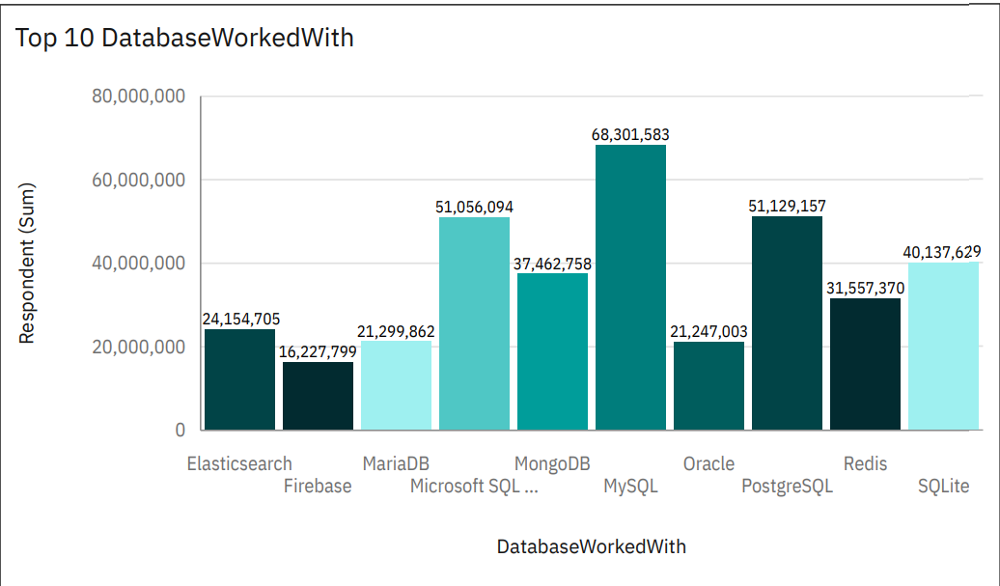
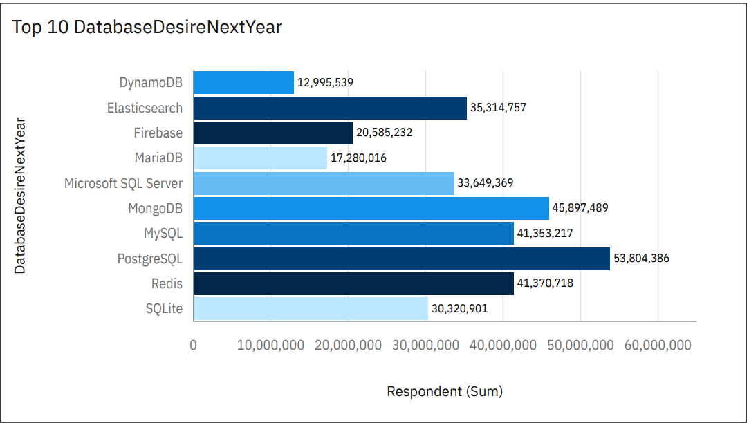
DATABASE TRENDS
Current Year
Next Year

Slide 10
DATABASE TRENDS - FINDINGS & IMPLICATIONS
Findings
MySQL is the most popular
Postgre SQL, MongoDB are most desired
Lack of interest in Microsoft SQL server & SQL lite
Implications
Microsoft SQL server & SQL lite losing out to stronger databases such as MySQL

Slide 11

DASHBOARD
https://github.com/ziqing800/IBM-Data-Analyst-capstone-project/blob/main/IBM%20Data%20Analytics%20Capstone%20Project%20visualizations.pdf

Slide 12
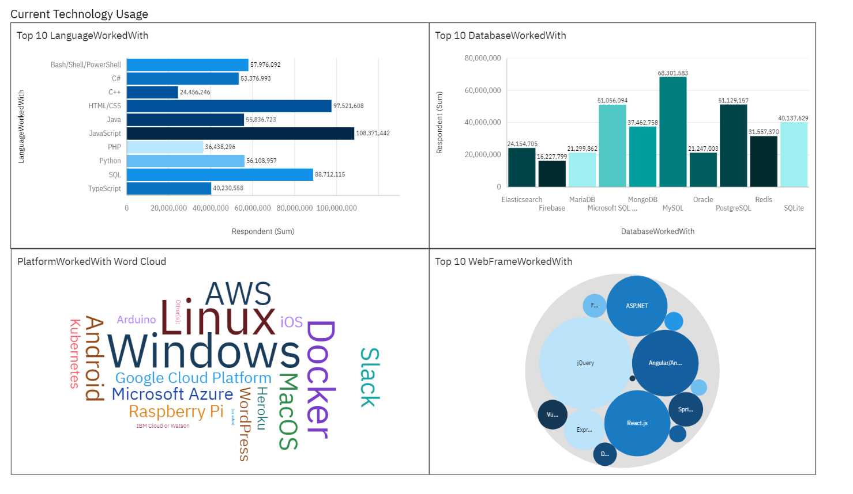
DASHBOARD TAB 1

Slide 13
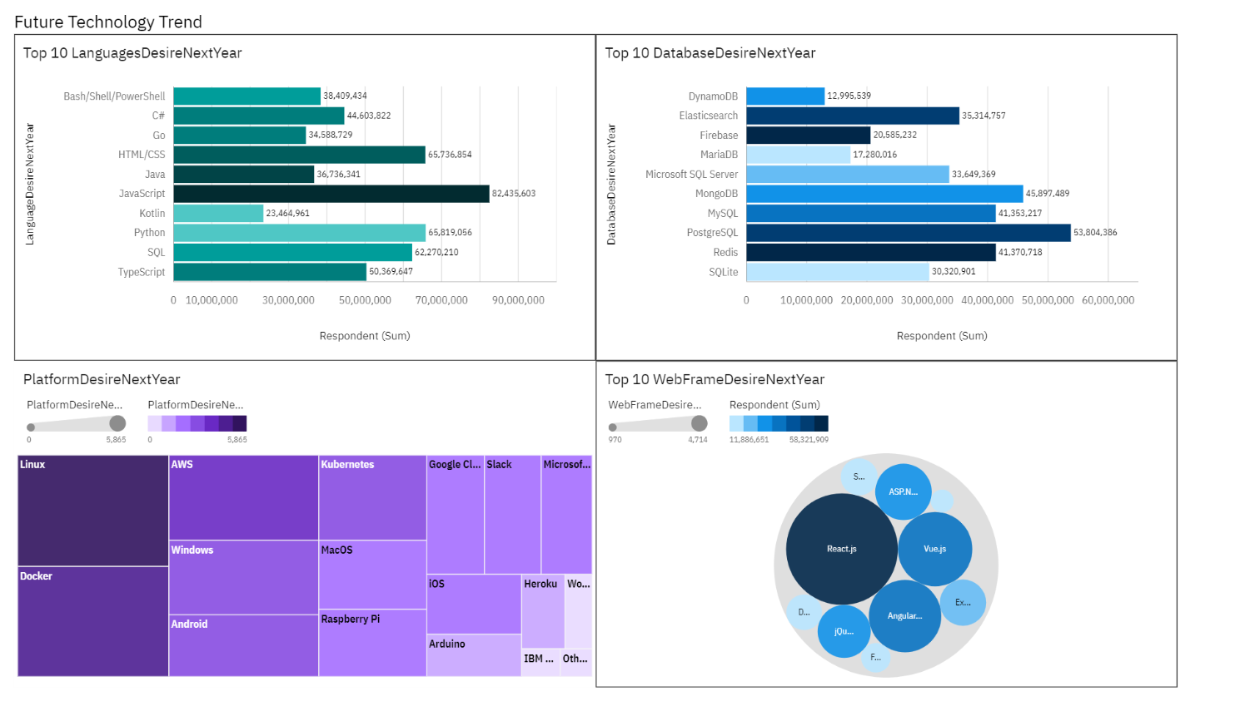
DASHBOARD TAB 2

Slide 14
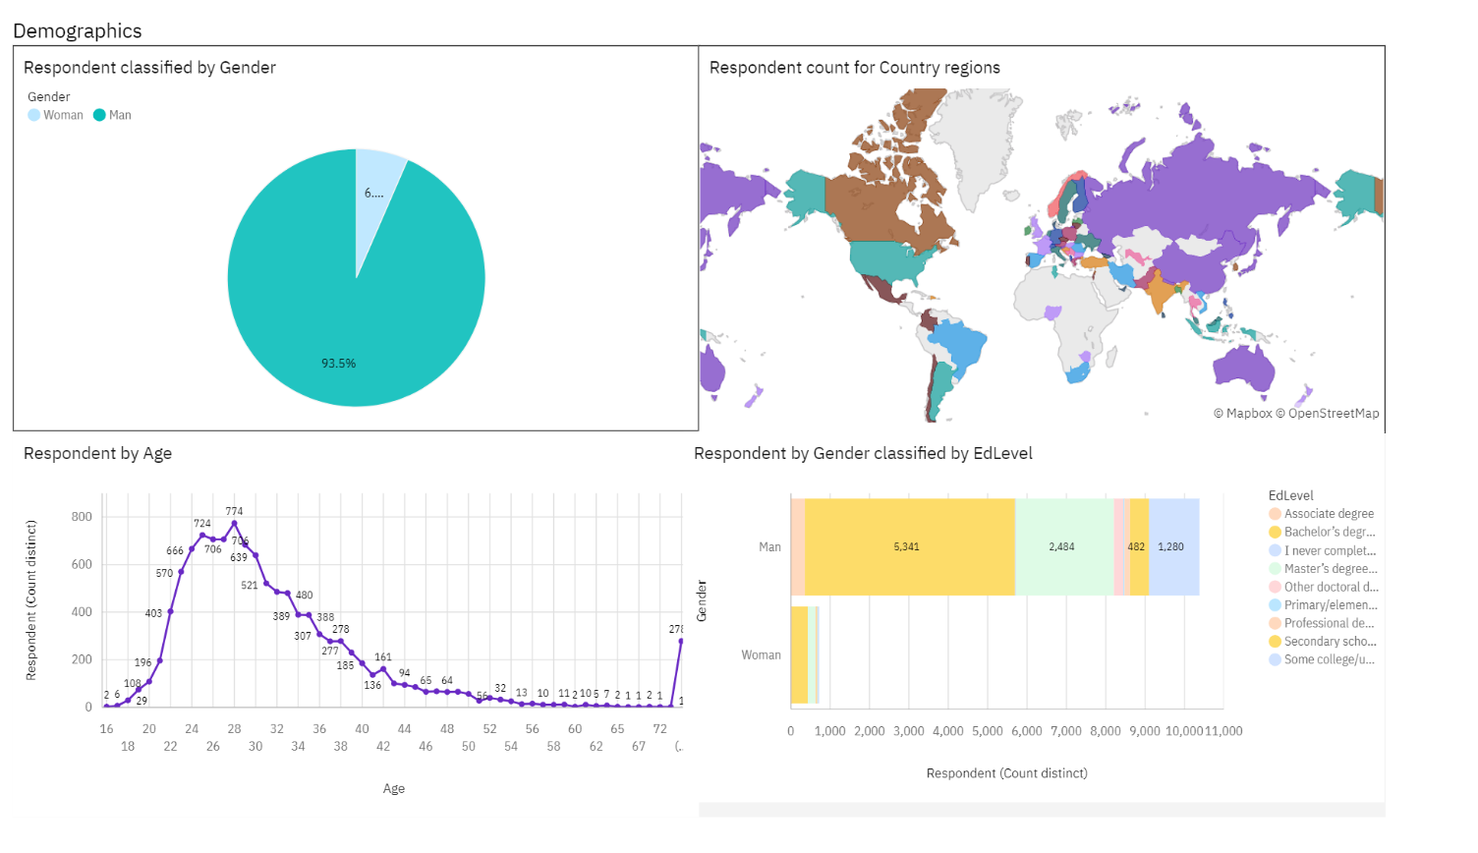
DASHBOARD TAB 3

Slide 15
DISCUSSION

Slide 16
OVERALL FINDINGS & IMPLICATIONS
Findings
Approximately 94% of developers are male
Developers are mostly located in developed countries
Javascript is the most widely used language
MySQL is the fastest growing database
Implications
Significant gender imbalance in tech industry
May lead to homogenized workplace culture
Diverse perspectives and ideas are underrepresented
Platforms may not be easily accessible for developers in less developed countries

Slide 17

CONCLUSION
Understand the demographics of developers
There is a need to make platforms more accessible to developers of different genders and from less developed countries
Further analysis to understand characteristics of popular language and database

Slide 18

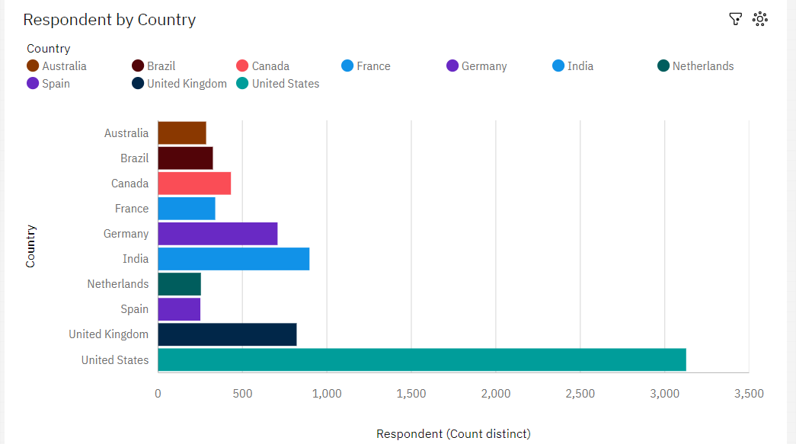
APPENDIX

Slide 19
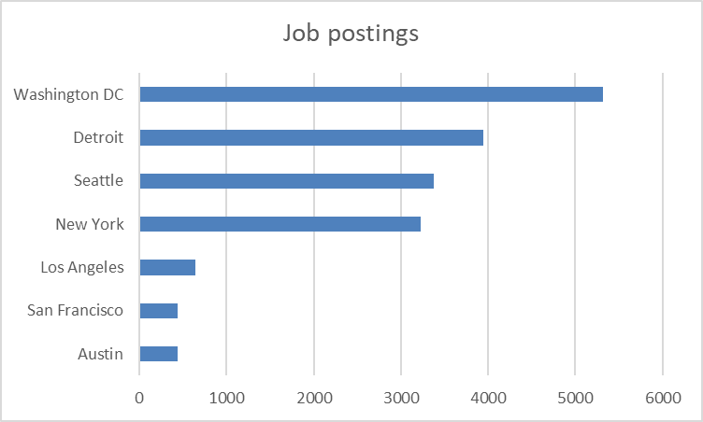
JOB POSTINGS

Slide 20
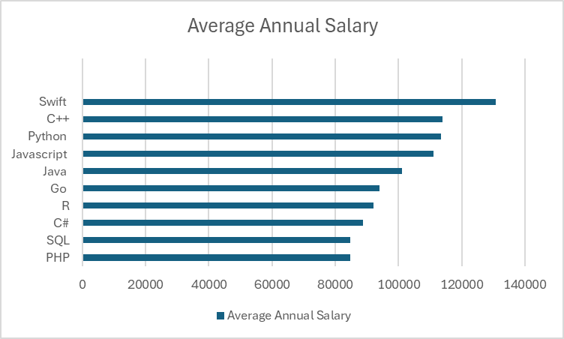
POPULAR LANGUAGES

