Slide 1
Parameterschätzung Übung 6
August. 3, Stuttgart

Slide 2
Purpose
Estimate total water storage anomaly with measured precipitation, evapotranspiration, discharge and existing TWSA using kalman filter.
Especially the data gap between GRACE and
GRACE -FO

Slide 3
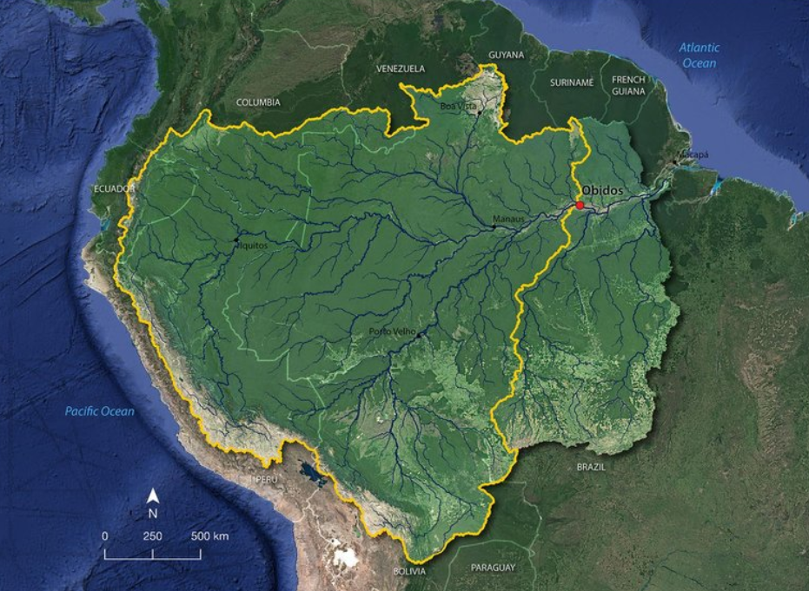
Study Area

Slide 4
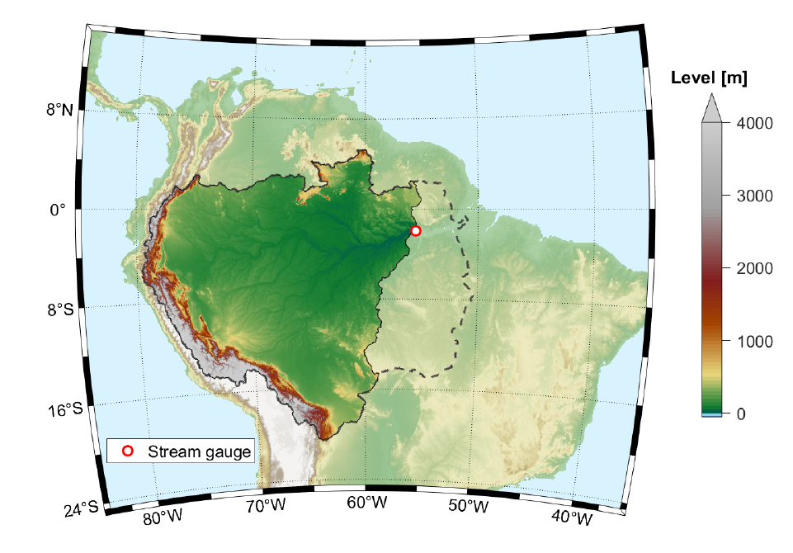
Dataset
TWSA from JPL (Jan 2003 to Nov 2020)
P, ET (Jan 2003 to Nov 2019)
Discharge (Feb 1968 to Nov 2019)

Slide 5
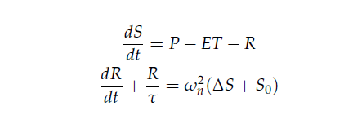



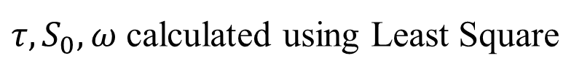
Method
$τ,S_{0}, ω$ calculated using Least Square

Slide 6


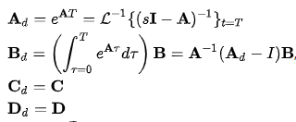
Method
Where:

Slide 7


Method
State transition model
Observation model
or

Slide 8
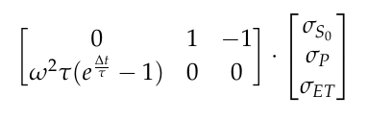
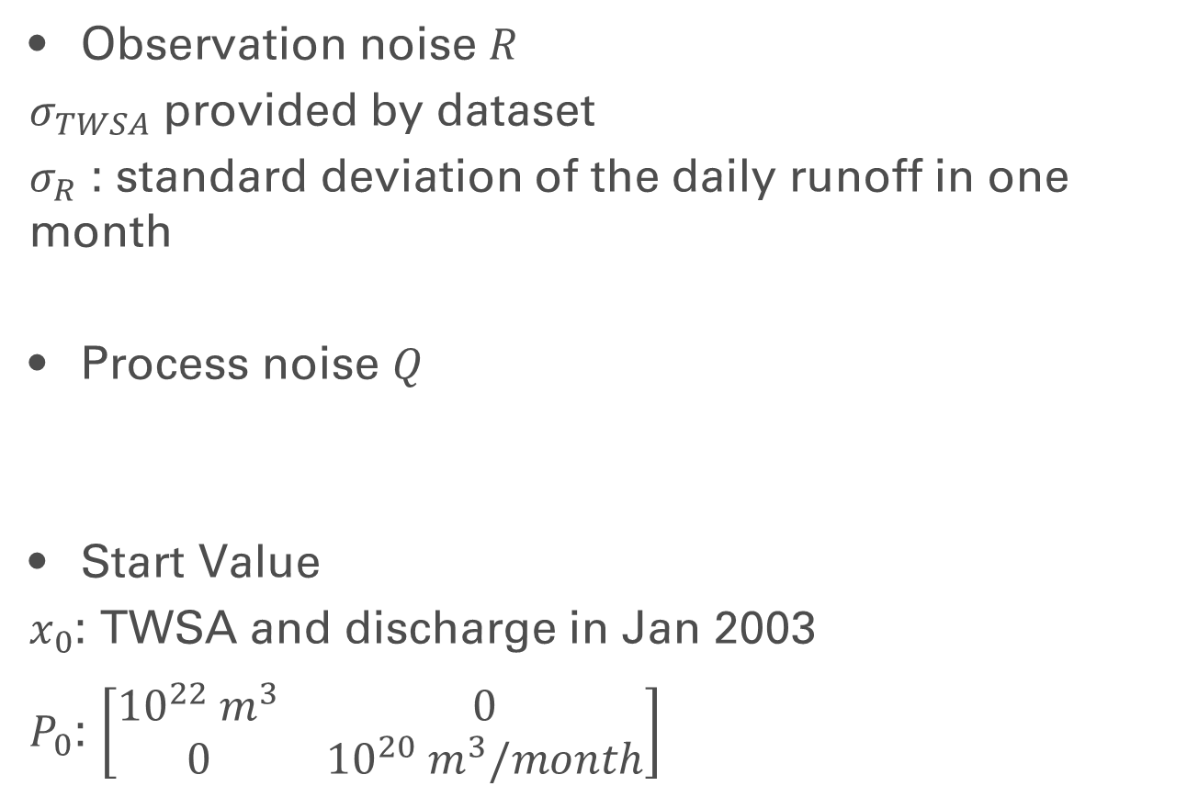
Method
Observation noise $R$
$σ_{TWSA}$ provided by dataset
$σ_{R}$ : standard deviation of the daily runoff in one month
Process noise $Q$
Start Value
$x_{0}$: TWSA and discharge in Jan 2003
$P_{0}$: $\left[\begin{matrix}{10}^{22} m^{3} & 0 \\ 0 & {10}^{20} m^{3}/month\end{matrix}\right]$

Slide 9
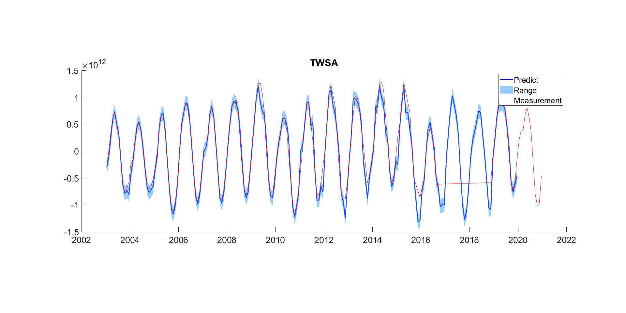
Result
TWSA

Slide 10
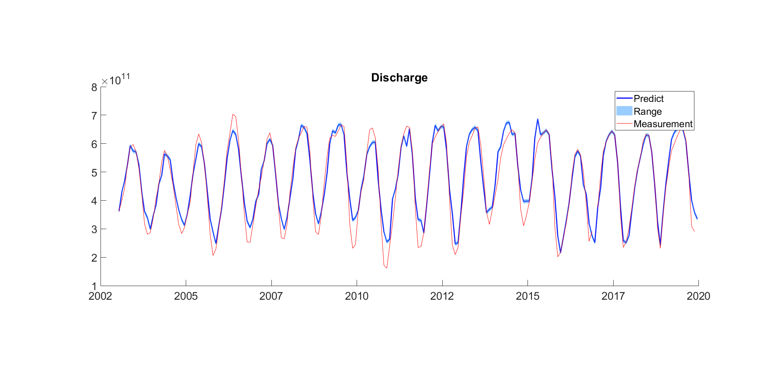
Result
Discharge

