Slide 1
Seafloor Geodesy Monterey GSSM Pressure
July. 15, Stuttgart

Slide 2
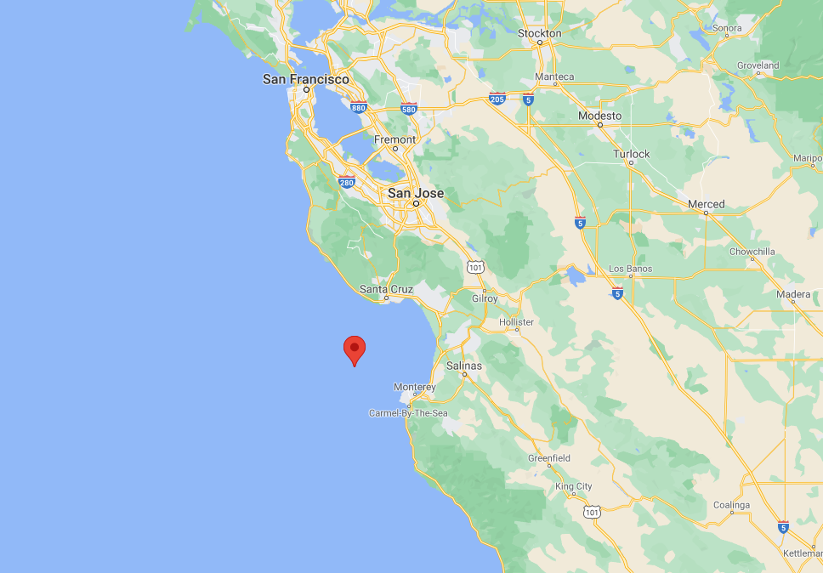
Location
Depth: 887 m

Slide 3
Data Source
30 Months (Jun.2017 – Jan 2020)
2 A-0-A calibrated Pressure Gauge
Pressures in hpa
1 Accelerator
Acceleration in 3 direction
1 Thermometer
Temperature
1 Barometer
Pressure in Housing

Slide 4
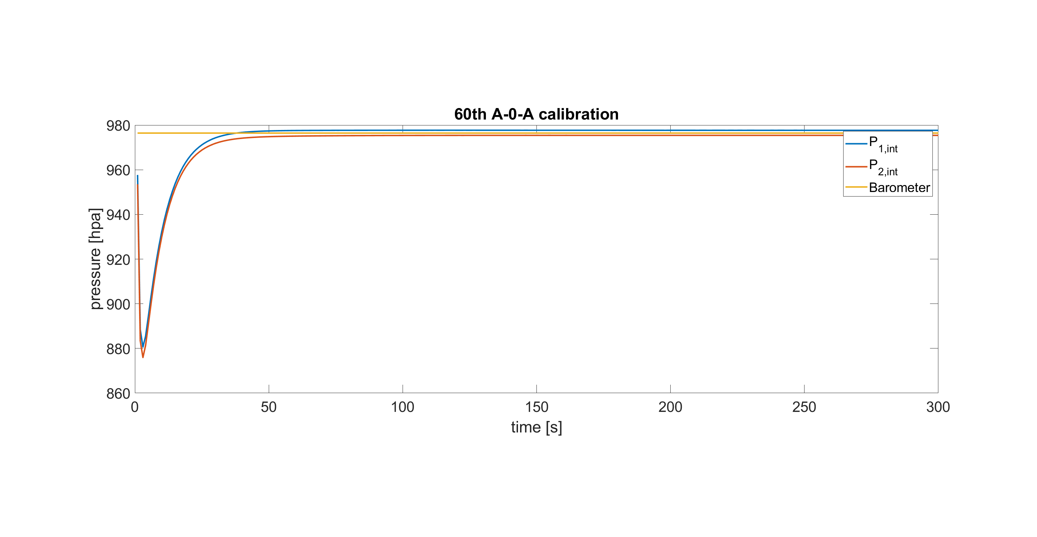
A-0-A Calibration
Total 154 A-0-A Calibrations
Example

Slide 5
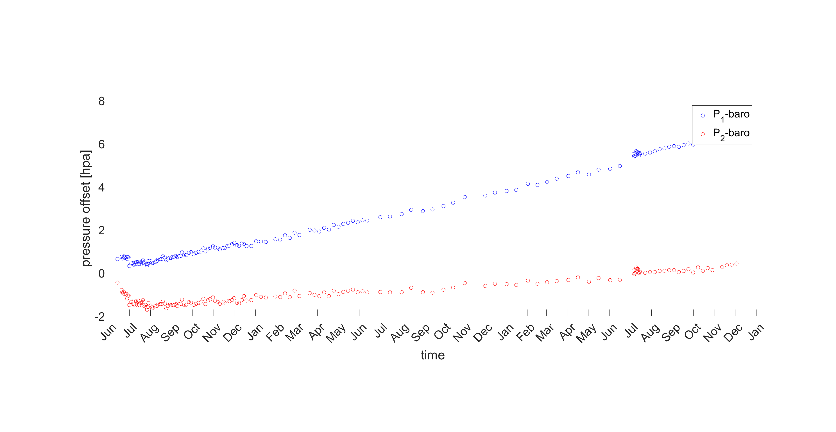
A-0-A Calibration

Slide 6
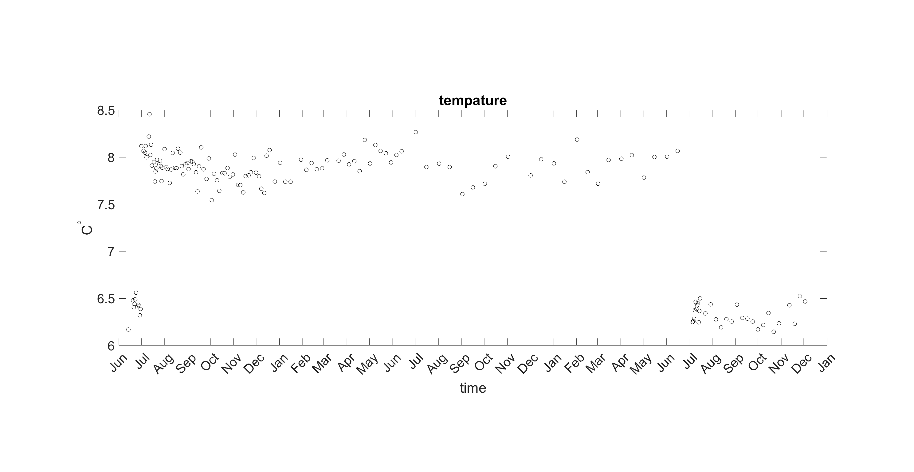
Temperature

Slide 7
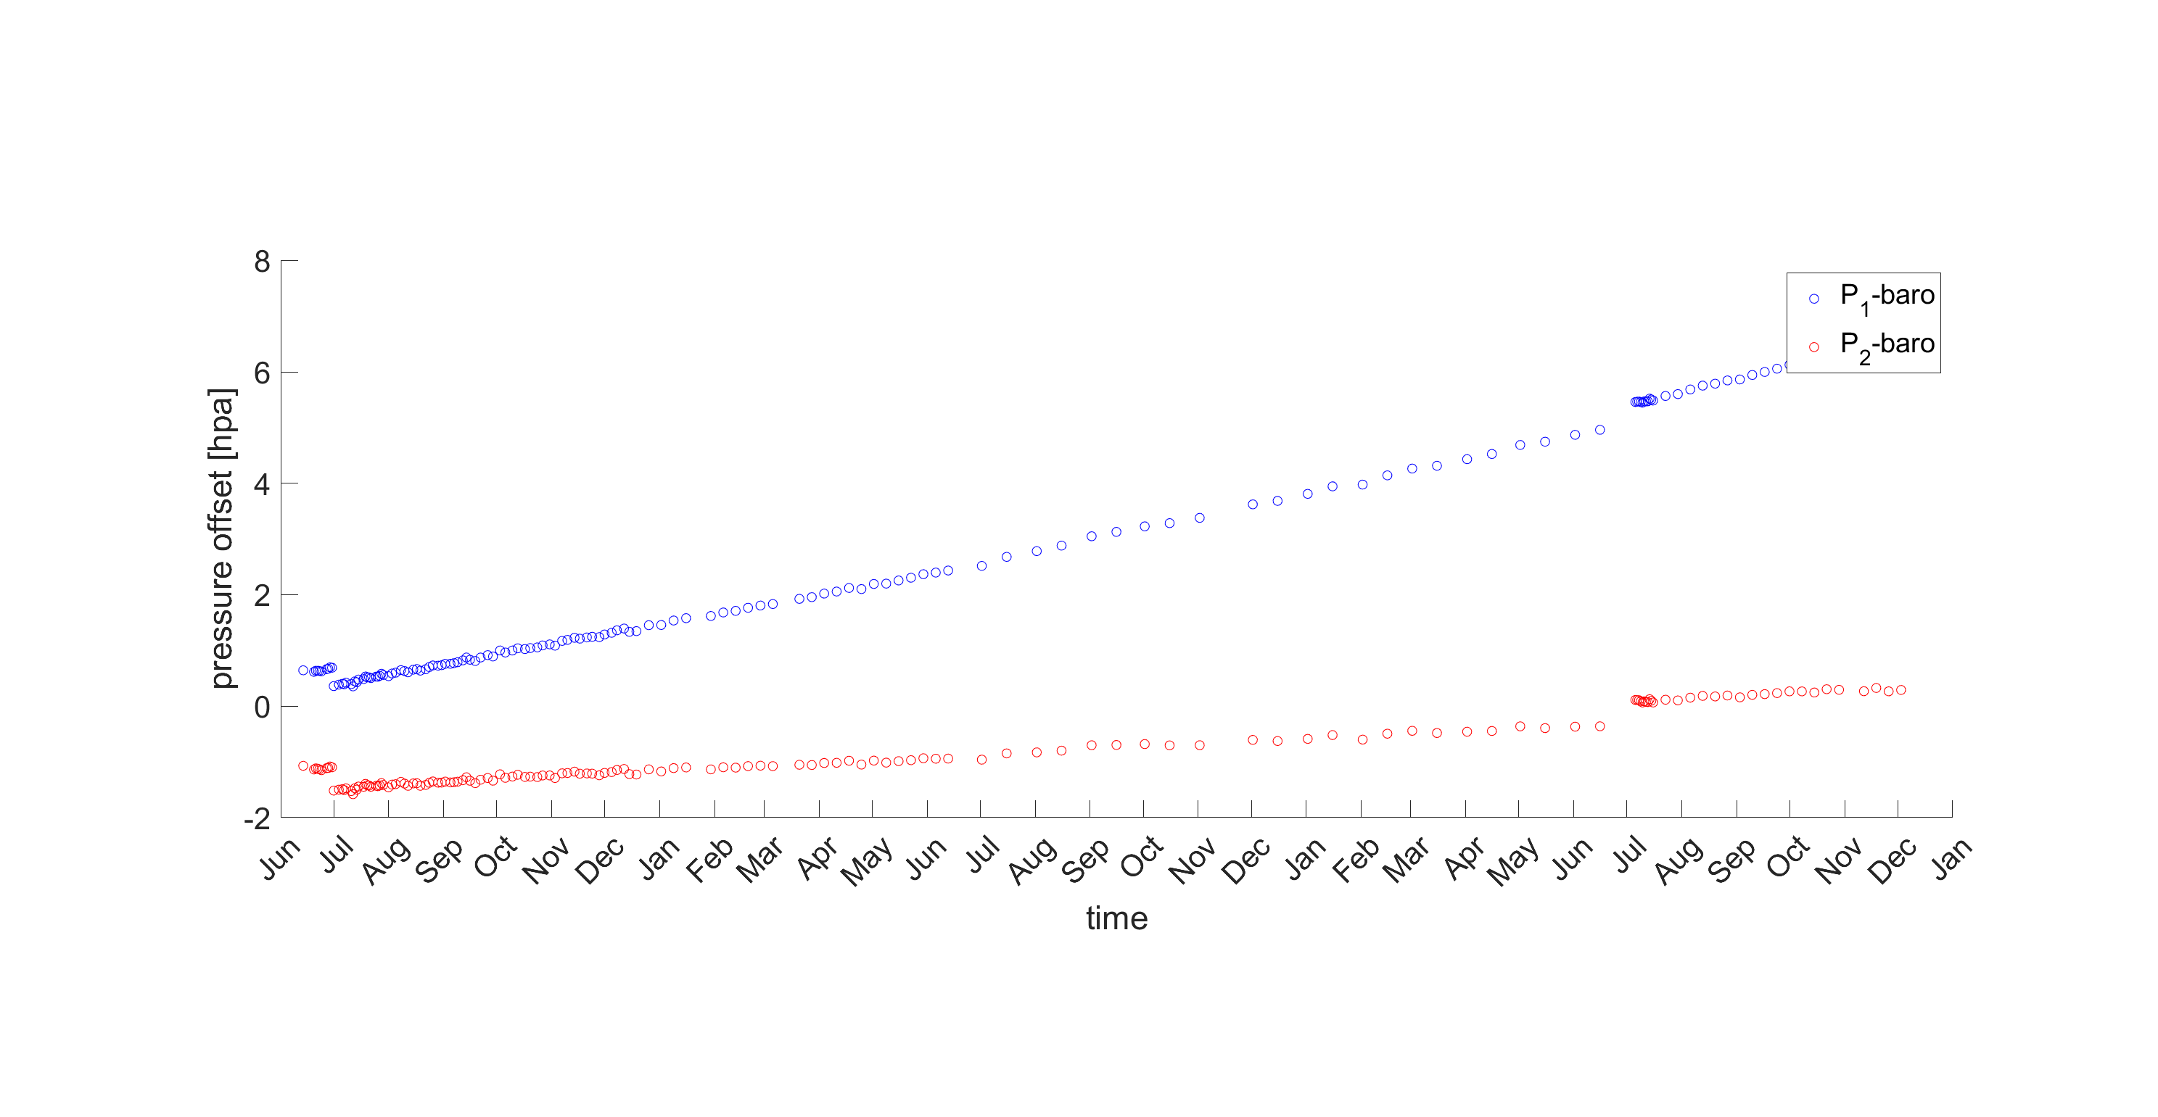

A-0-A Calibration
$p\left(t\right)=a\left(e^{−t−t_{0}}\right)+bt+c+d(T −T_{ref})$
$t_{0}=351 day$ for gauge 1 and $t_{0}=759 day$ for gauge 2

Slide 8
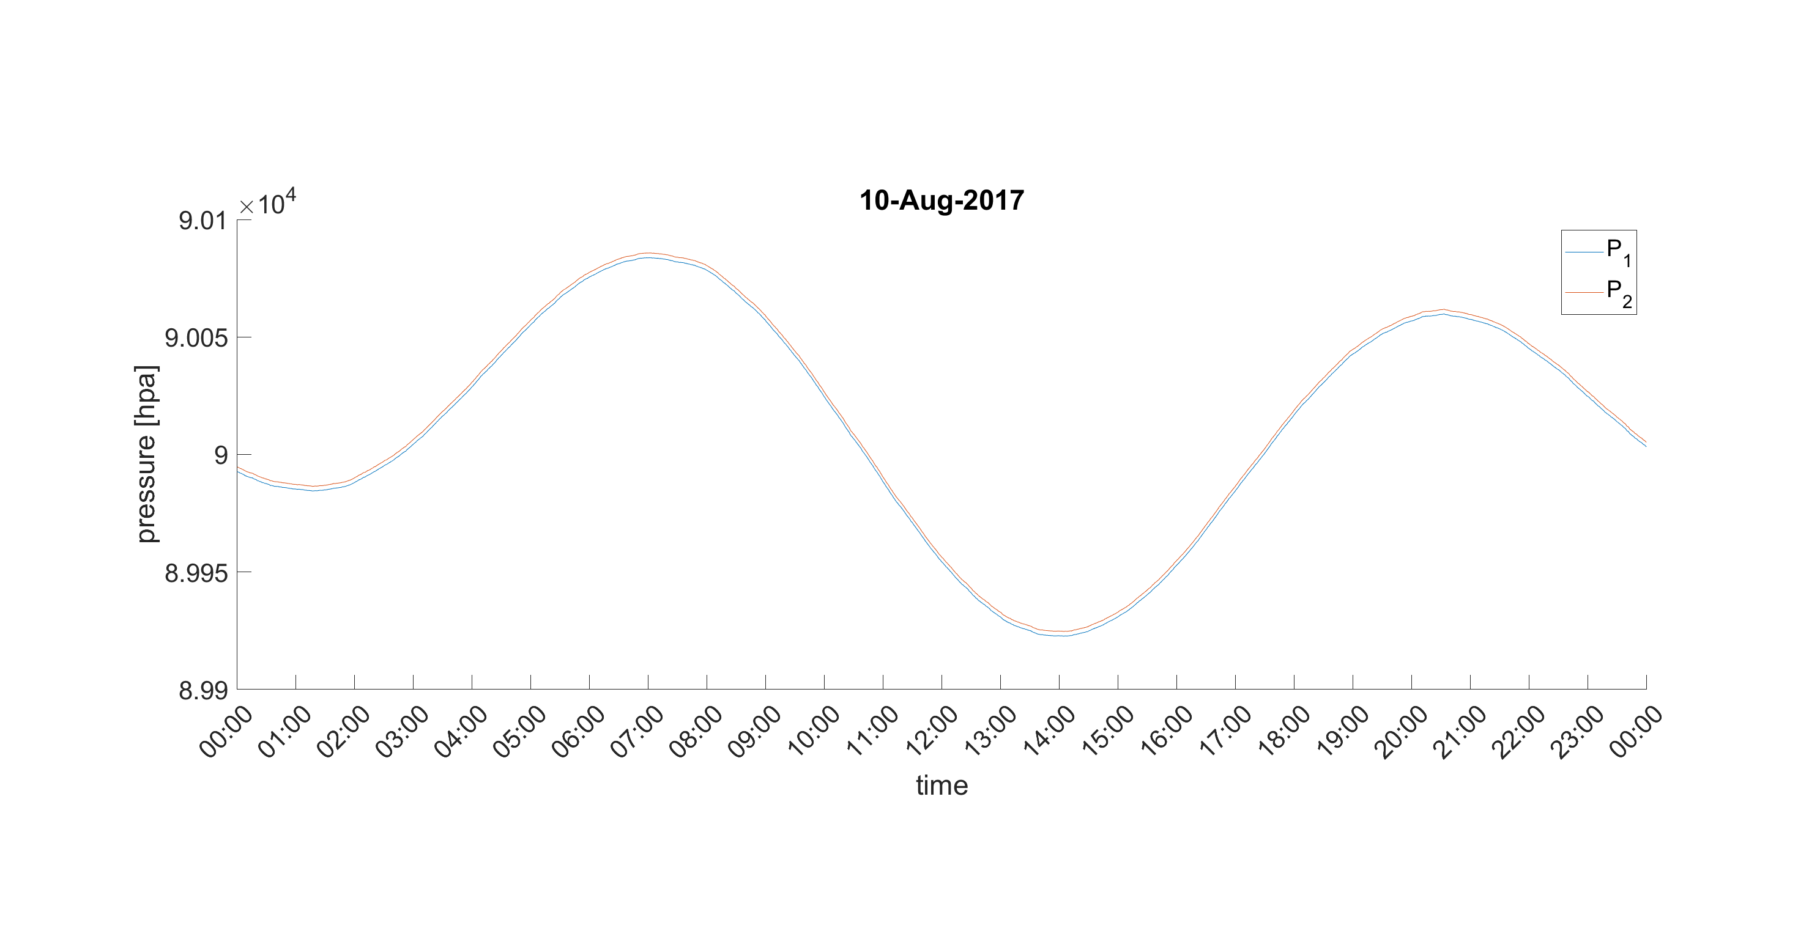
Pressure in one day

Slide 9
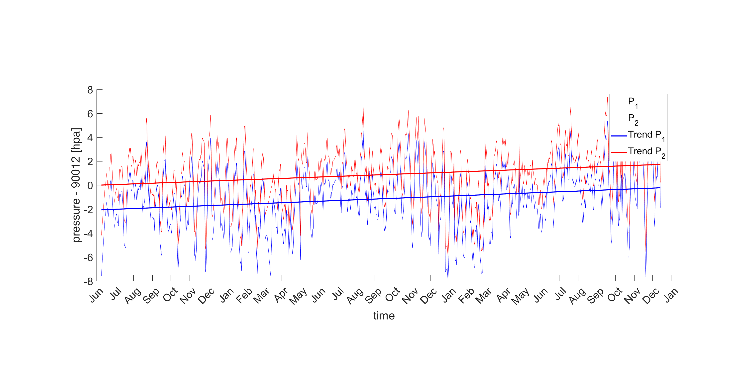
Pressure after A-0-A calibration
Trend for p1: 0.723 hpa/year and for p2: 0.686/year

Slide 10
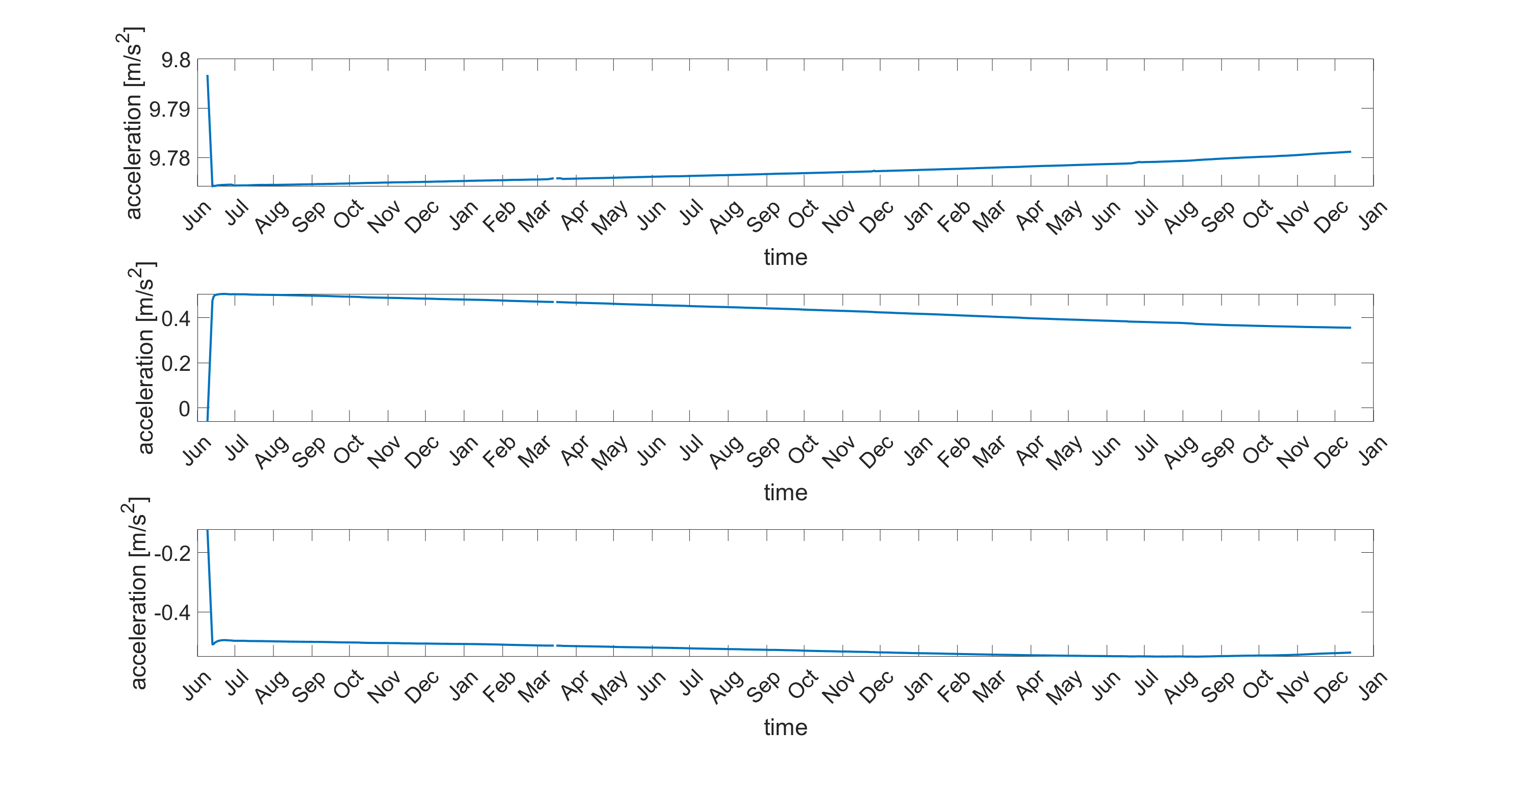
Tilt

Slide 11
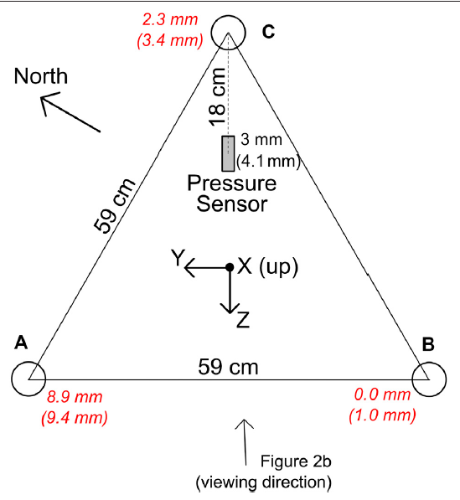
Tilt
One leg subsidence by nearly 1 cm
0. 3 hpa over the experiment

Slide 12
Another Effects
Tide -> Low-Pass Godin filter
Not implemented here
Changes in oil reservoir level
Counting clock drift
Minimum subsidence
Trend for p1: 0.561 hpa/year and for p2: 0.525/year
0.1 hpa over experiment

Slide 13
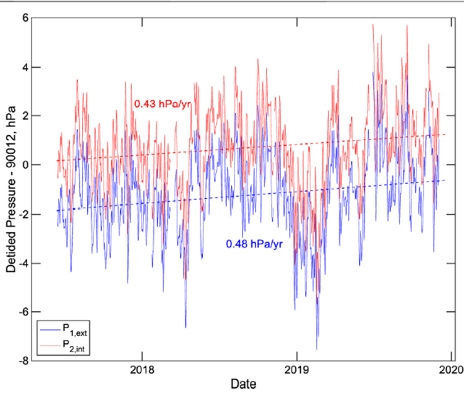
Pressure after A-0-A calibration
Trend for p1: 0.561 hpa/year and for p2: 0.525 hpa/year

Slide 14
Discussion
This trend of increasing pressure are consistent with the trend with the trend expected from the El Niño Southern Oscillation. This effect is not a result of density structure but is related partly to variations in local wind stress moving water toward or away from the coast and partly due to the effects of coast trapped waves generated by wind stresses elsewhere. The first winter of the GSSM deployment coincided with weak La Niña event from October 2017-March 2018 while the latter parts of the deployment coincided with weak El Niño conditions from October 2018-June 2109 and November-December 2019.

