Slide 1
Seafloor Geodesy Monterey GSSM Pressure
June. 24, Stuttgart

Slide 2
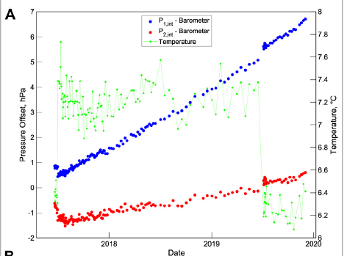
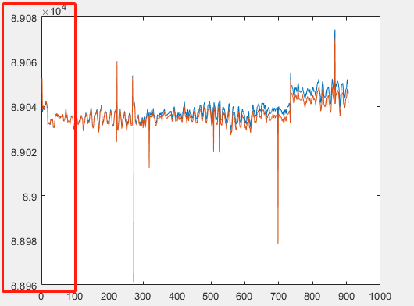
Possible Unit Problem
Pressure offset = Gauge Pressure - Barometer

Slide 3
Geodetic and Seismic Sensor Module (GSSM)
Too much NaN or Outlier in one day -> not using this day. (1350 from 1440 as threshold)
1350 from 1440 as threshold
34 days are filtered out.
Calculate the mean pressure of a single day

Slide 4
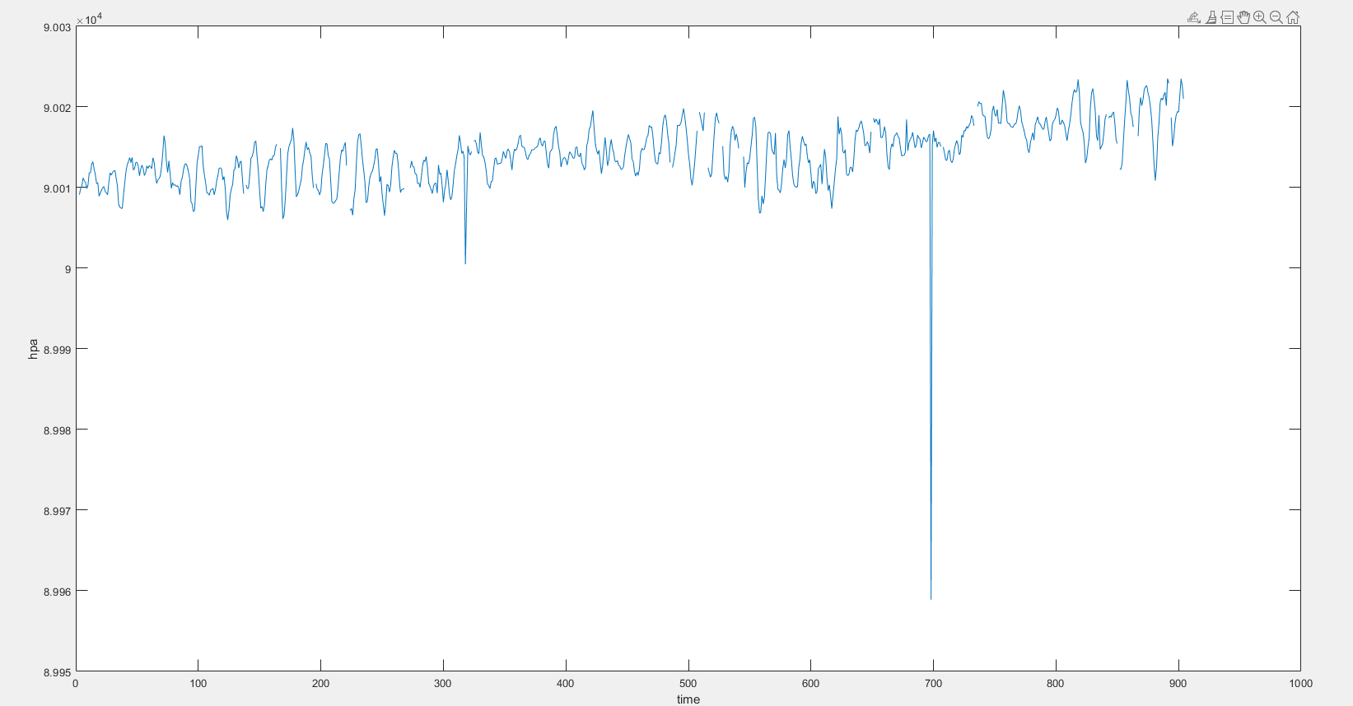
Geodetic and Seismic Sensor Module (GSSM)
Mean Pressure Time Series
Maybe fixiable after corrections

Slide 5
Geodetic and Seismic Sensor Module (GSSM)
Interpolating the time series
Line fitting using least square.

Slide 6
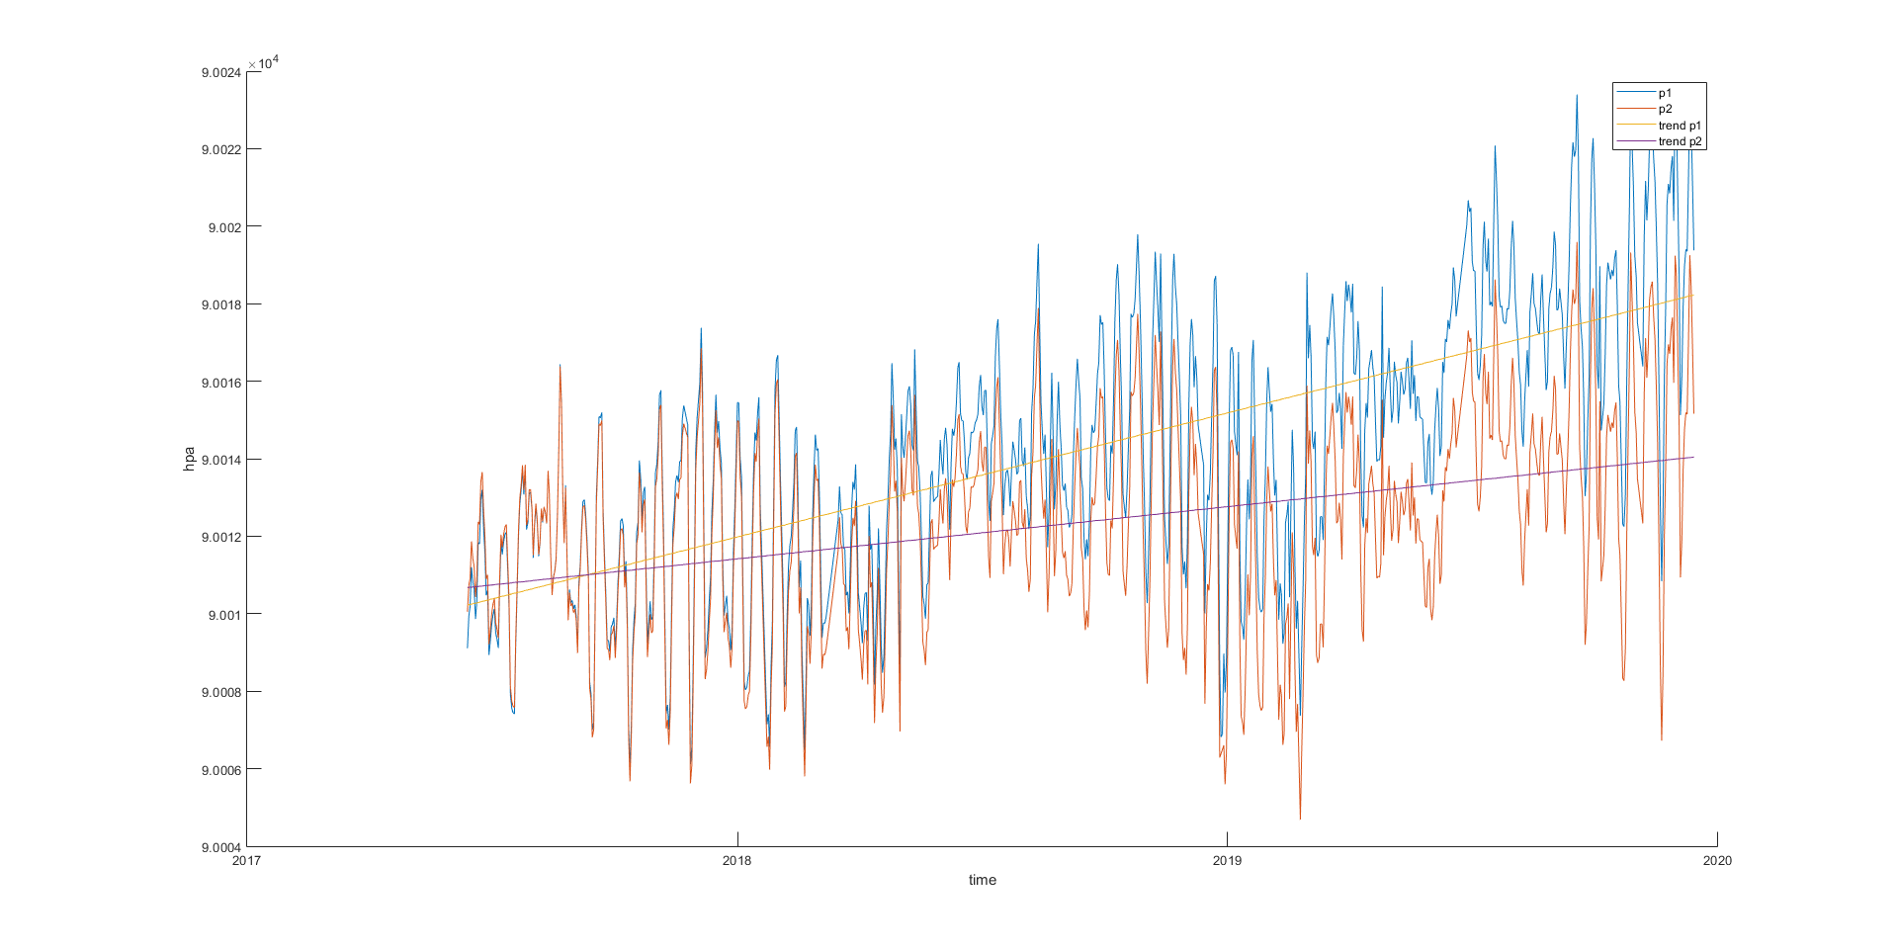
Geodetic and Seismic Sensor Module (GSSM)

Slide 7
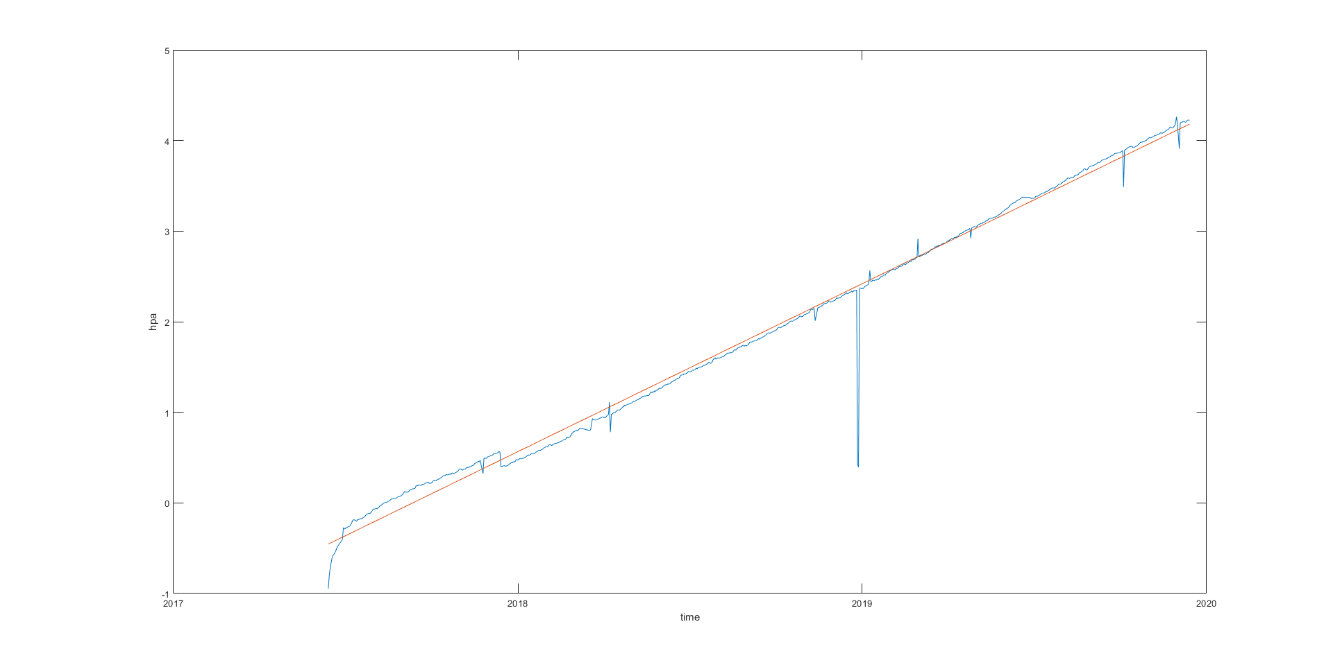
Geodetic and Seismic Sensor Module (GSSM)
Difference between p1 and p2

