Slide 1

UK High Education Rank Study
Ziqing Yu
02.02.2024

Slide 2
Business Goal
Find the positive impact on guardian UK university ranking
Predict next year’s ranking
How to make university more attractive for new students
Notes:
Positive Faktoren; Vorhersagen
Hinteres Ziel, attraktiv

Slide 3
Analytical Approach
Is this university practical for me?
Entry tariff
Tuition fee
Distance from home
Is this university good in compare with other unis?
Which major do I want to study
What can I learn during the study
How’s the environment
Do I get recognized by the companies after study

Slide 4
Data requirements & collections
Average entry tariff
Tuition fee
University location
Guardian Rank
General evaluation of the University
Evaluation of the teaching
Recognition by corporation
Number of students
All above in different major

Slide 5
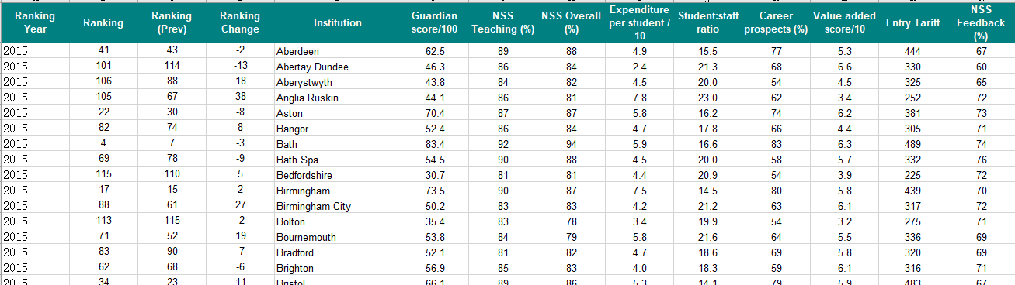
Data Understanding
Data is given in a excel table

Slide 6
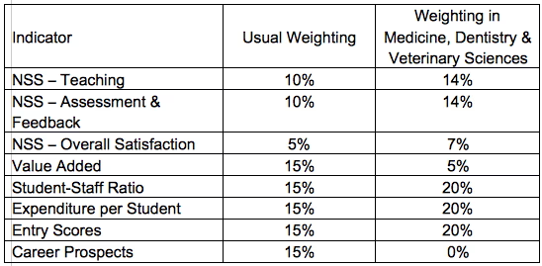
Data Understanding
Guardian Rank
Ranked by guardian score
Gaurdian Score (2015)
Source: https://www.theguardian.com/education/2014/jun/03/methodology-of-the-guardian-university-guide-2015
Notes:
Gewicht Mittelwerte

Slide 7
Data Understanding
NSS Teaching
final year first degree students were asked the extent to which they agreed with four positive statements regarding their experience of teaching in their department.
NSS Feedback
Students were also asked for their perception of five statements regarding the way in which their efforts were assessed and how helpful any feedback was.
NSS Overall
Students also answer a single question which encompasses all aspects of their courses.
Source: https://www.theguardian.com/education/2014/jun/03/methodology-of-the-guardian-university-guide-2015

Slide 8
Data Understanding
Expenditure per student
The amount of money that an institution spends providing a subject (not including the costs of academic staff, since these are already counted in the SSR) is divided by the volume of students learning the subject to derive this measure. Added to this figure is the amount of money the institution has spent on Academic Services – which includes library & computing facilities – over the past two years, divided by the total volume of students enrolled at the university in those years. Within each department, at least 30 (FTE) students have been enrolled in 2012/13 for the expenditure per student to be calculated. Smaller departments must have had 20 FTE in 2012/13 and at least 30 FTE in total across 2011/12 and 2012/13 in order for a two-year average to be calculated. Year-on-year inconsistency or extreme values can also cause suppression (or spreading) of results.
Source: https://www.theguardian.com/education/2014/jun/03/methodology-of-the-guardian-university-guide-2015

Slide 9
Data Understanding
Student:staff ratio
compare the number of staff teaching a subject with the number of students studying it, to get a ratio
Career prospect
The employability of graduates is assessed by looking at the proportion of graduates who find graduate-level employment, and/or study at an HE or Professional level, within 6 months of graduation.
Entry Tariff
Average Tariffs are determined by taking the total tariff points of 1st year 1st degree full time entrants who were aged under 20 at the start of their course, and subtracting the tariffs ascribed to Key Skills, Core Skills and to ‘SQA intermediate 2’.
Source: https://www.theguardian.com/education/2014/jun/03/methodology-of-the-guardian-university-guide-2015

Slide 10
Data Understanding
Value added
Based upon a sophisticated indexing methodology that tracks students from enrolment to graduation, qualifications upon entry are compared with the award that a student receives at the end of their studies. Each full time student is given a probability of achieving a 1st or 2:1, based on the qualifications that they enter with.
Source: https://www.theguardian.com/education/2014/jun/03/methodology-of-the-guardian-university-guide-2015

Slide 11
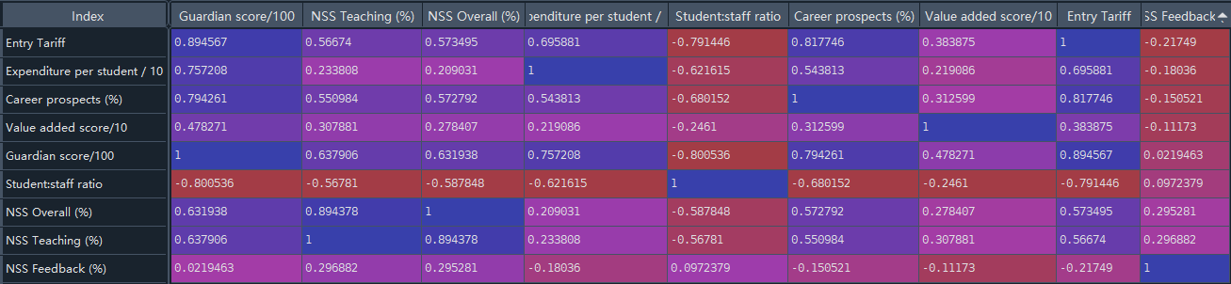
Data Understanding
Factors are not independent from each other
NSS overall has a correlation of 0.89 (of -1 to 1) with NSS Teaching but only 0.3 with NSS Feedback
The correlation between NSS overall and Student Staff ratio is -0.59, there is no obvious correlation between NSS feed back and student staff ratio

Slide 12
Data Preparation
A Software is developed using python
Pandas
Numby
Matplotlib
PySimpleGUI
Github Repo: https://github.com/ziqing97/BilligenceCaseStudyUkUni

Slide 13
Data preparation
Error/Inconsistency Correction
Falmouth (2013,2014) was renamed as UC Falmouth (2015) in the table
In some cases, “Ranking (Prev)” don’t equal to “Ranking” in previous year (Falmouth, Leeds Trinity, UC Suffolk)
Missing Year
Newport (2013) and Glamorgan(2013) merge to South Wales (2015), in 2014 no data
Buckingham (2015)
Newman University College (2015)
St Mark and St John (2013,2015)
Trinity Saint David (2015)

Slide 14
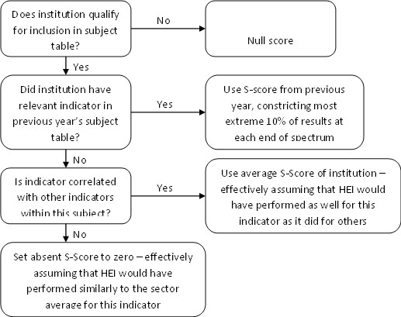
Data Preparation
Missing Data -> remain null
Source: https://www.theguardian.com/education/2014/jun/03/methodology-of-the-guardian-university-guide-2015

Slide 15
Evaluation
Example: Edinburgh: Rank 18 in 2015
Advantage by Ranking
High Entry Tariff
High Spend per student
Disadvantage by Ranking
NSS Comment not good, especially in “Feedback”
Notes:
Eingangs note

Slide 16
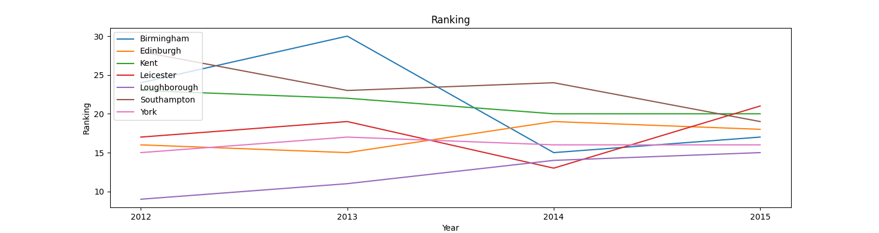
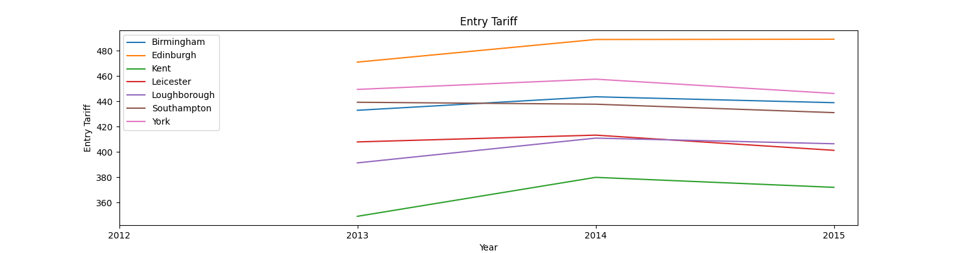
Evaluation
Notes:
Trend für diese Faktoren für diese Unis gezeichnet

Slide 17
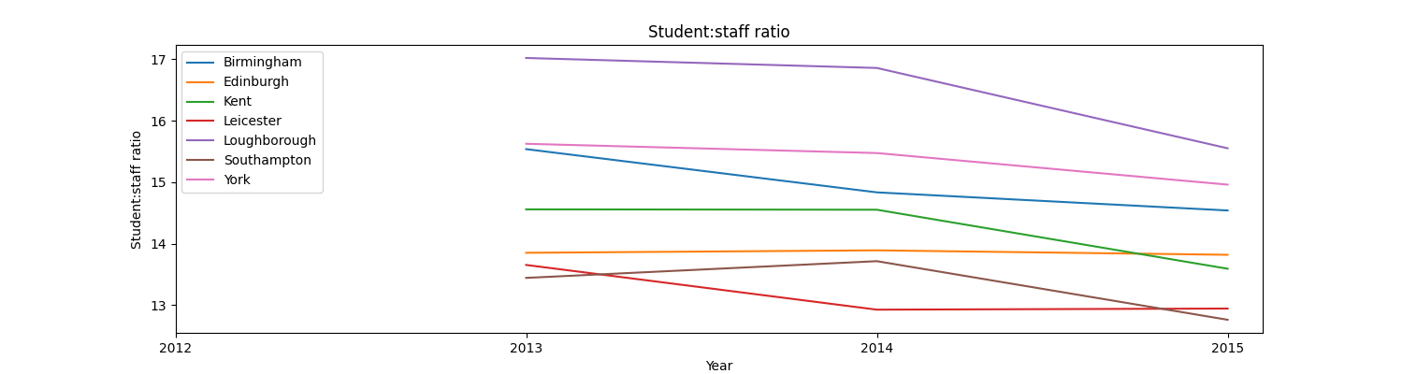
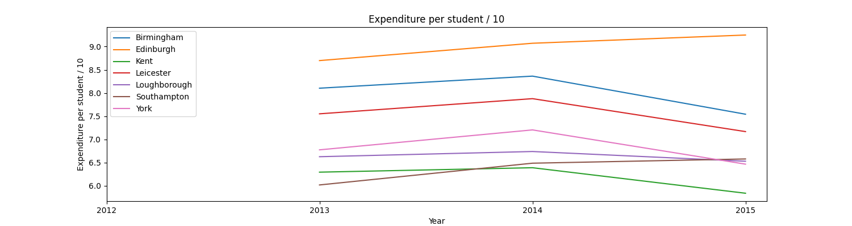
Evaluation
Notes:
Alle versuchen diese verhältnis zu verringen

Slide 18
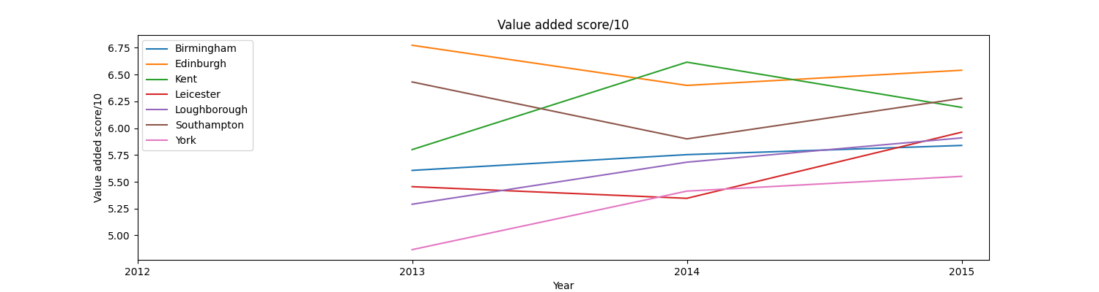
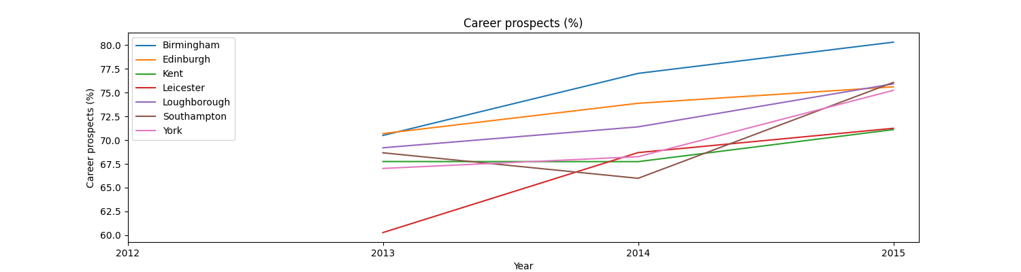
Evaluation
Notes:
Value added auch gut gemacht, aber nicht sehr deutlich
Career, haben auch alle verbessert

Slide 19
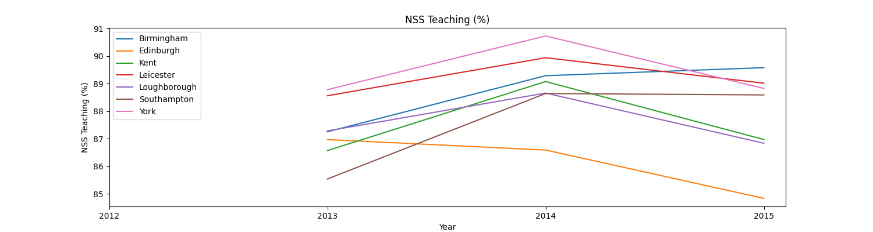
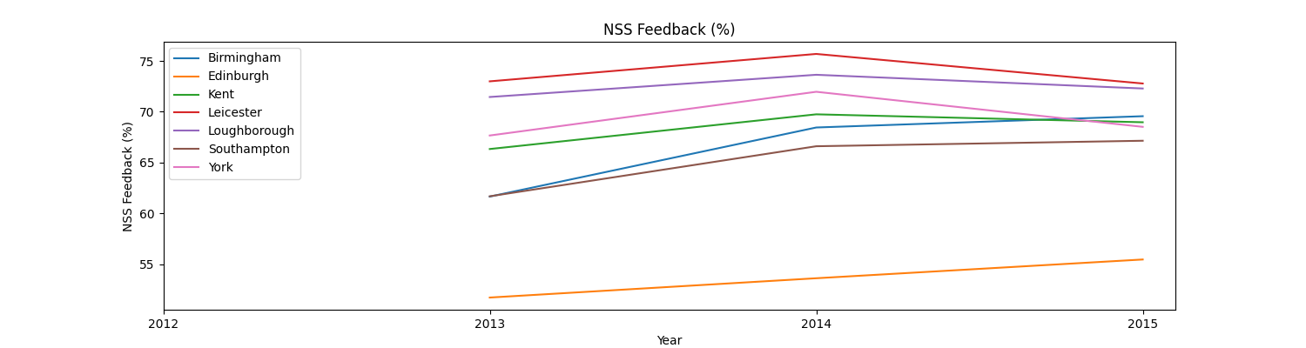
Evaluation

Slide 20
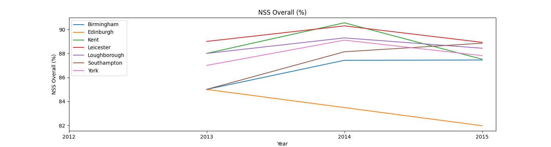
Evaluation
Notes:
Schlecht und schlechter

Slide 21
Evaluation
Student satisfaction not optimal and getting worse
Competitor Focused improving performance on
“Value Added”
“Career Prospect”
“Student:Staff ratio”
Should not rely on “Entry Tariff”
Spend is the key advantage
Notes:
Gegner
Verlassen
Halten
2019, continue

Slide 22
Recommendation
Collect data that help us understand what influence the Student satisfaction
To Understand the whole apply process in UK
Use Machine Leaning to build the prediction model
Notes:
Gleiche Tablle in China und Deutschland

