Slide 1
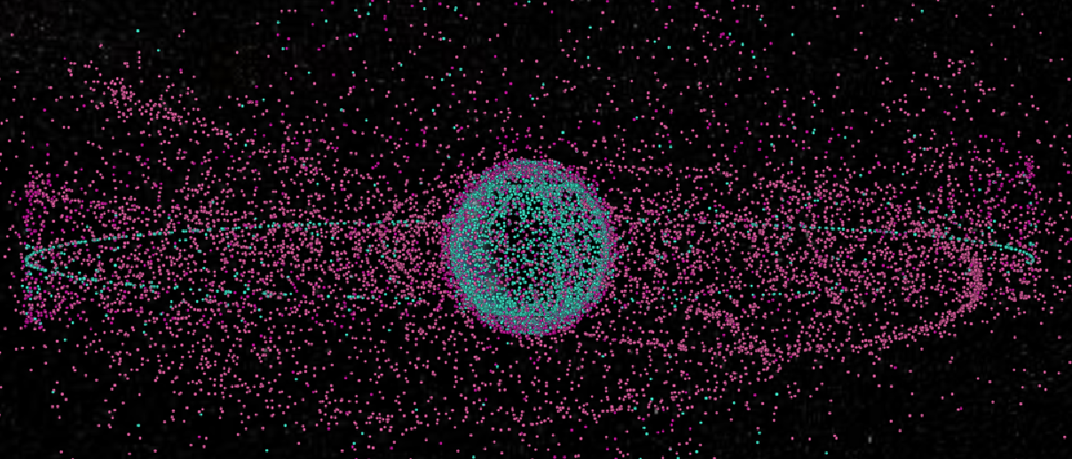
Space Debris
Jiaxin Liu
Torben Blei
Phillip Schollmeier
Ziqing Yu
03. February 2023, Stuttgart

