Slide 1
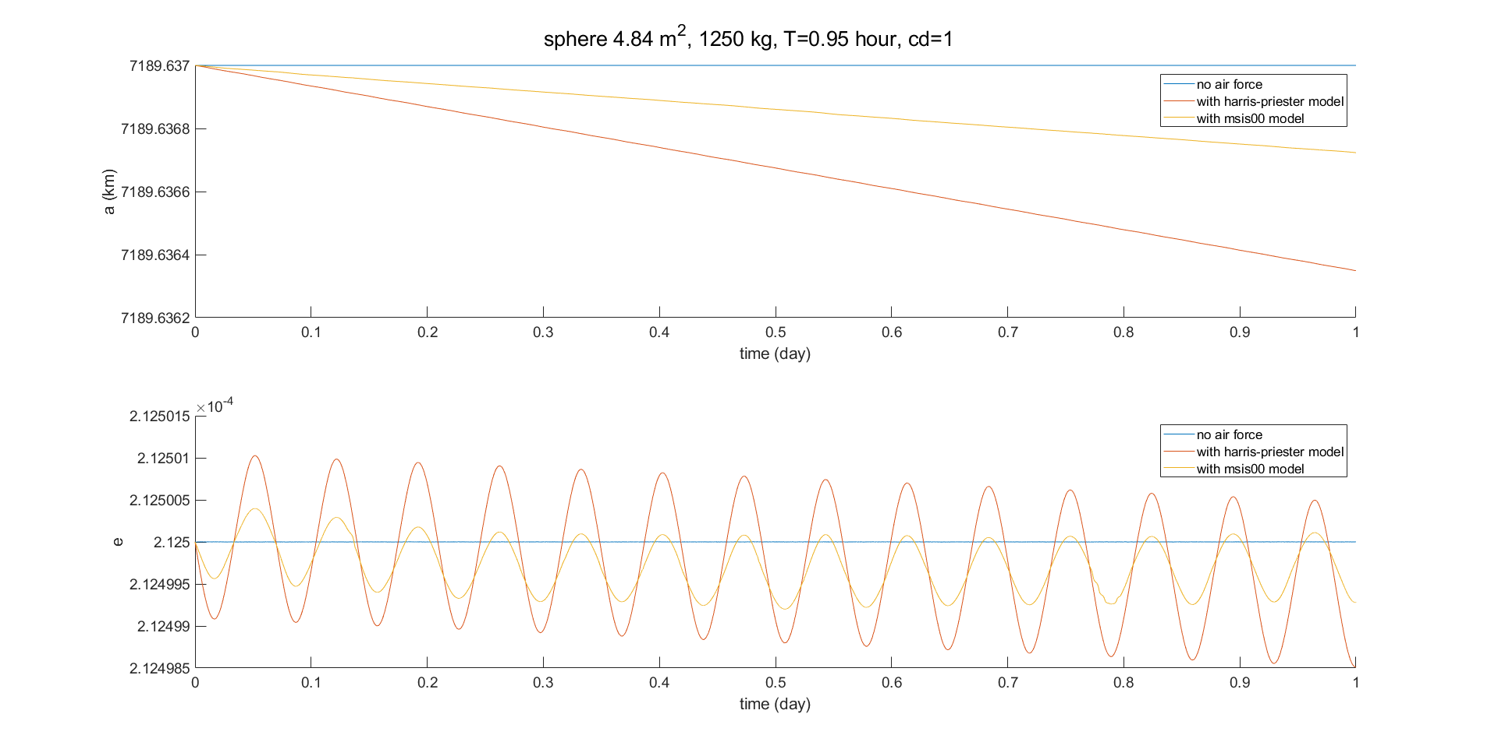
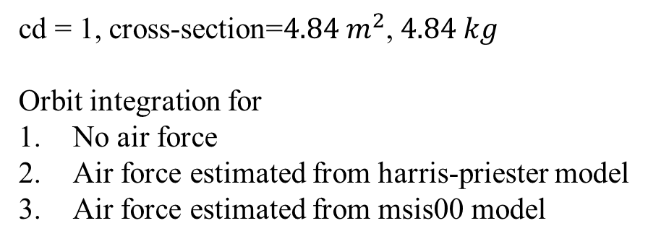
Compare 2 atmosphere model
cd = 1, cross-section=${4.84 m}^{2}$, $4.84 kg$
Orbit integration for
No air force
Air force estimated from harris-priester model
Air force estimated from msis00 model

