Slide 1
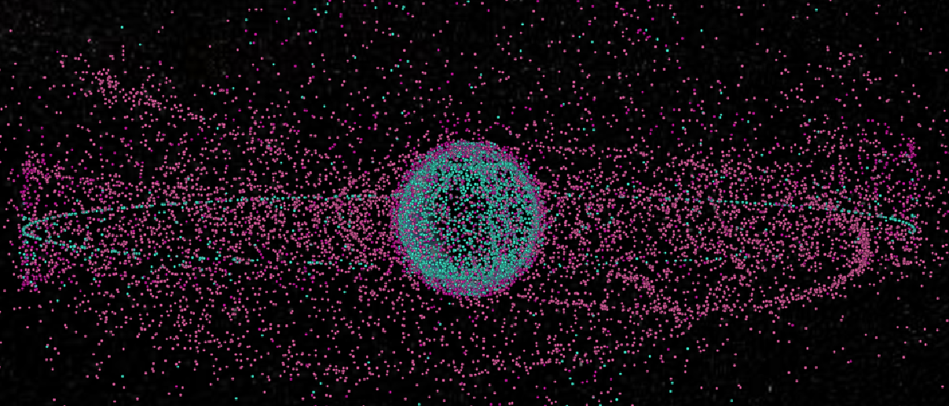
Space Debris
Jiaxin Liu
Torben Blei
Phillip Schollmeier
Ziqing Yu
03. February 2023, Stuttgart

Slide 2
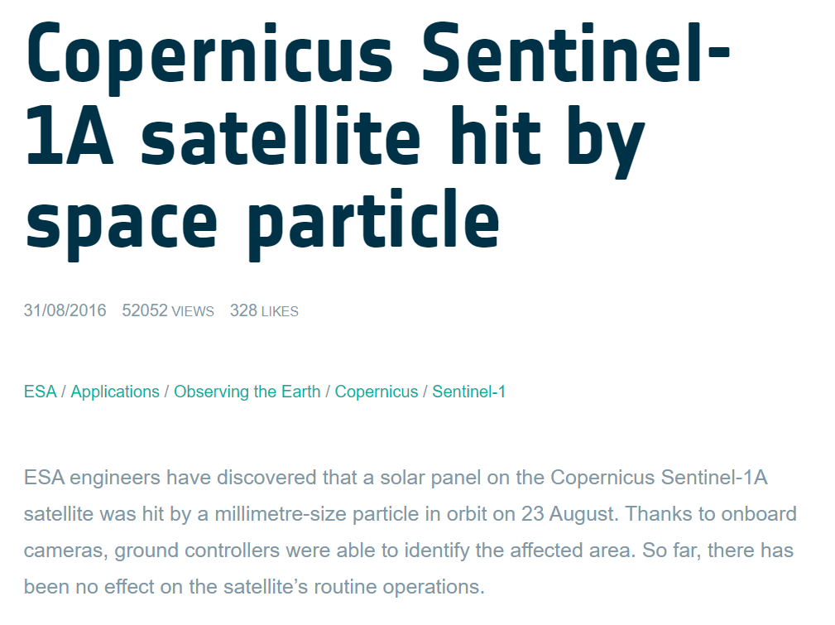
Why we are interested

Slide 3
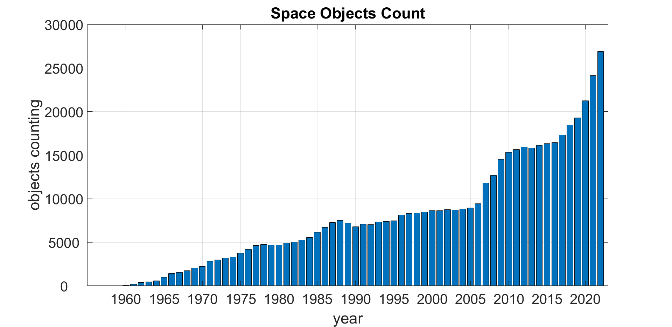
Objects counting

Slide 4
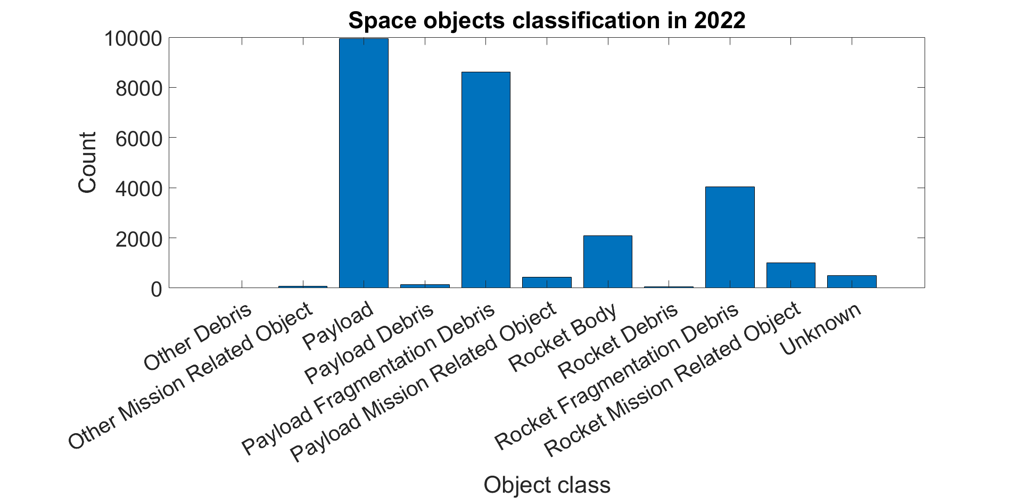
Objects classification in 2022

Slide 5
For Jiaxin

Slide 6
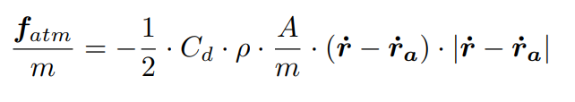
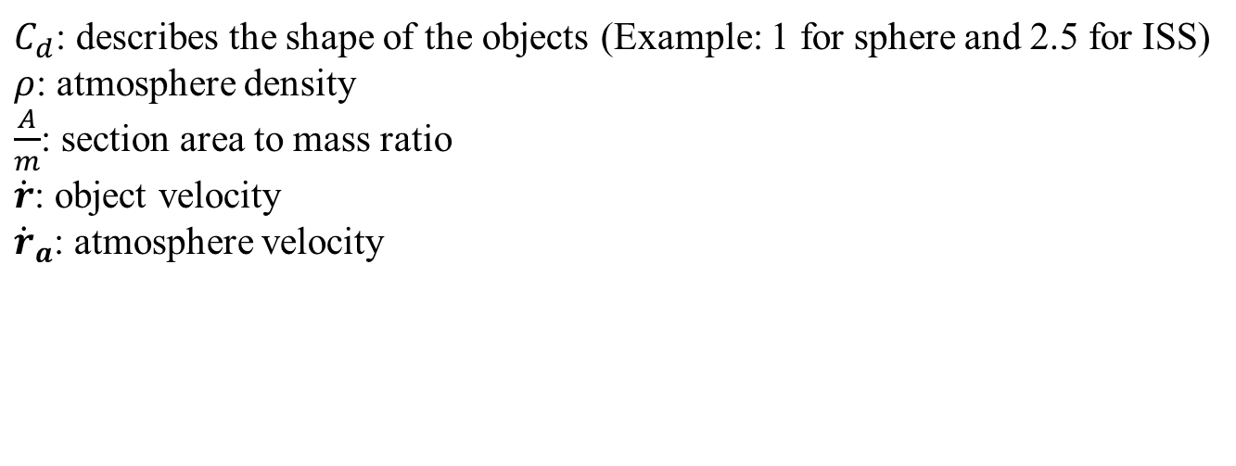
Atmospheric influence
$C_{d}$: describes the shape of the objects (Example: 1 for sphere and 2.5 for ISS)
$ρ$: atmosphere density
$\frac{A}{m}$: section area to mass ratio
$\dot{r}$: object velocity
${\dot{r}}_{a}$: atmosphere velocity

Slide 7
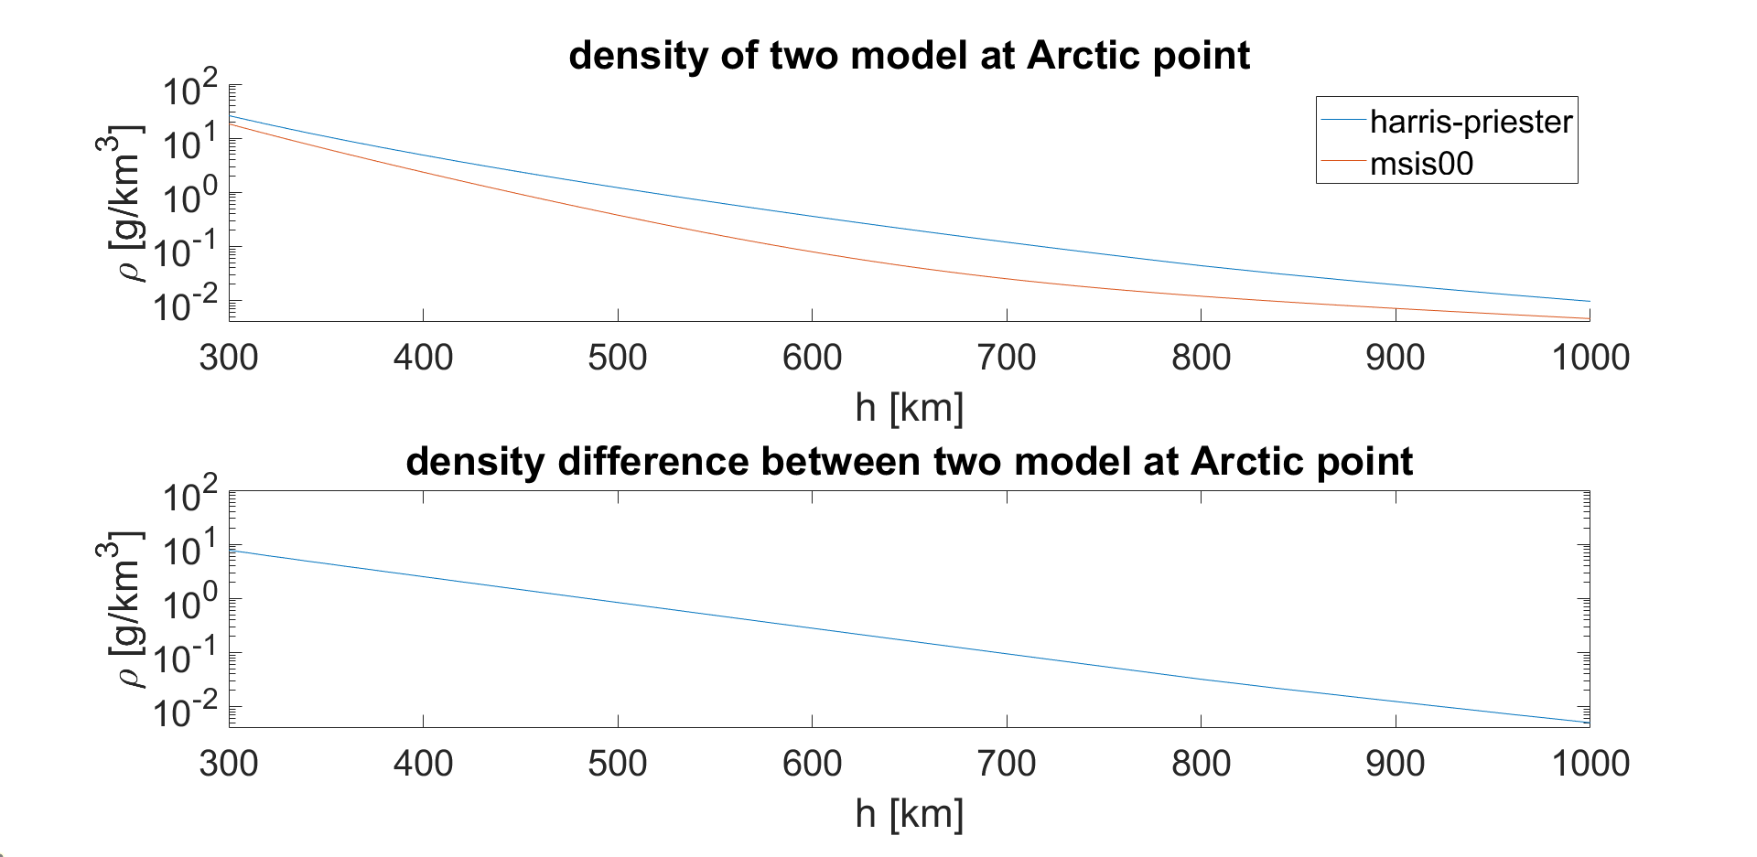
Atmosphere model compare

Slide 8
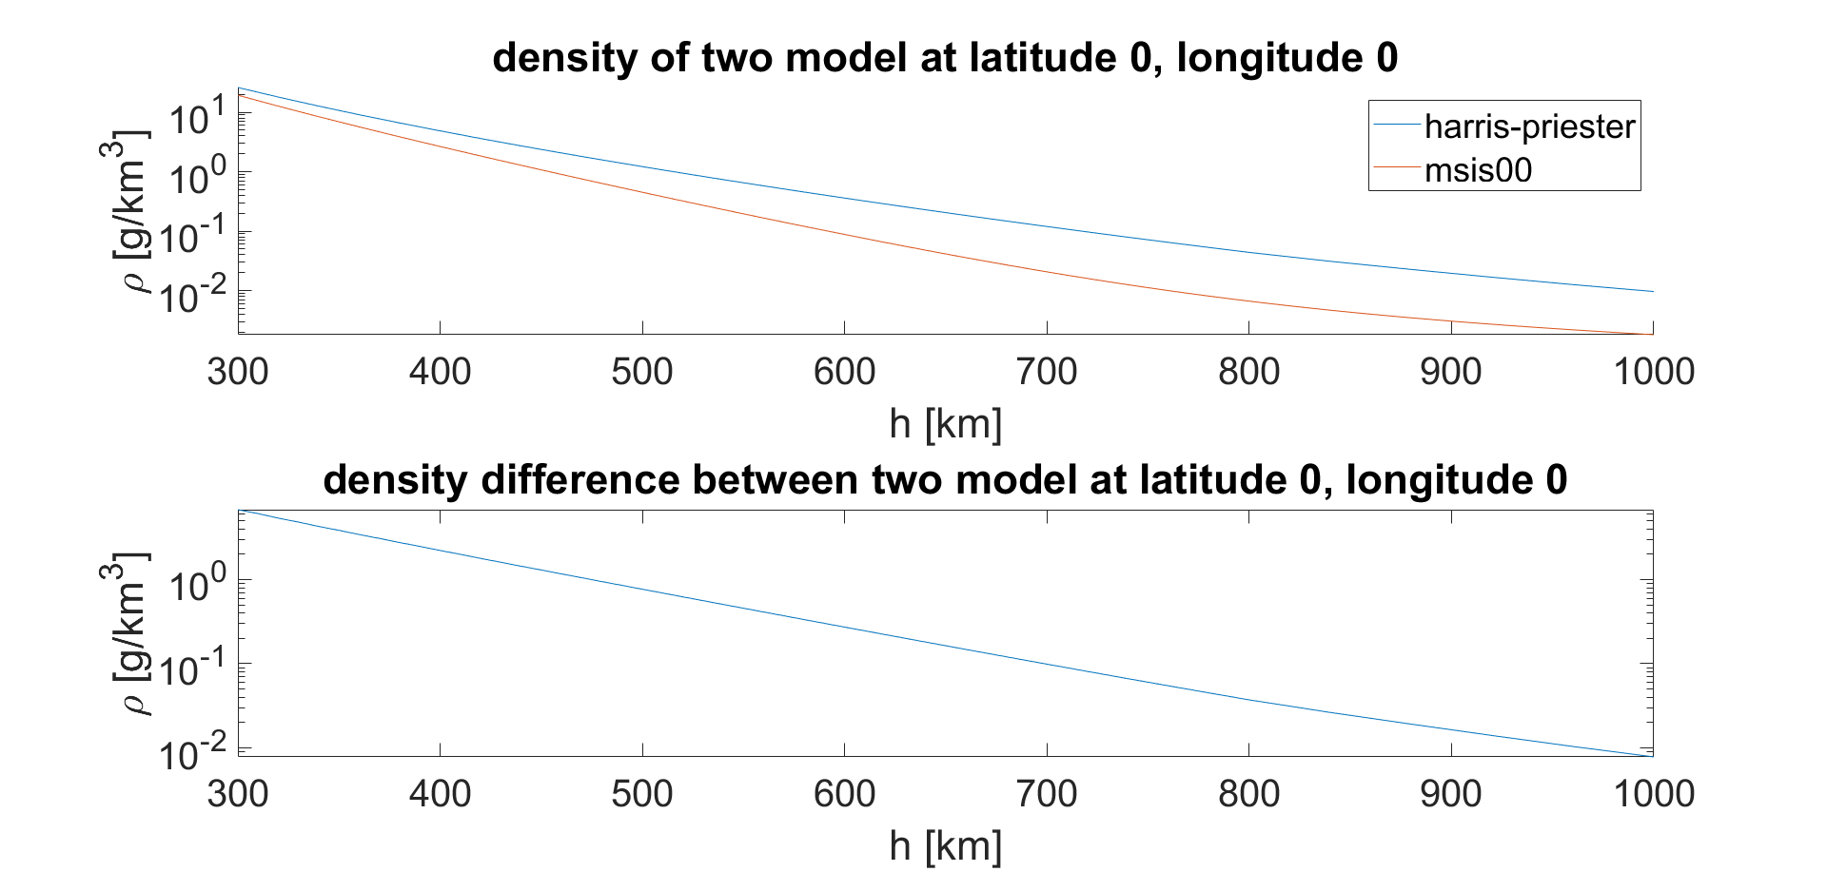
Atmosphere model compare

Slide 9
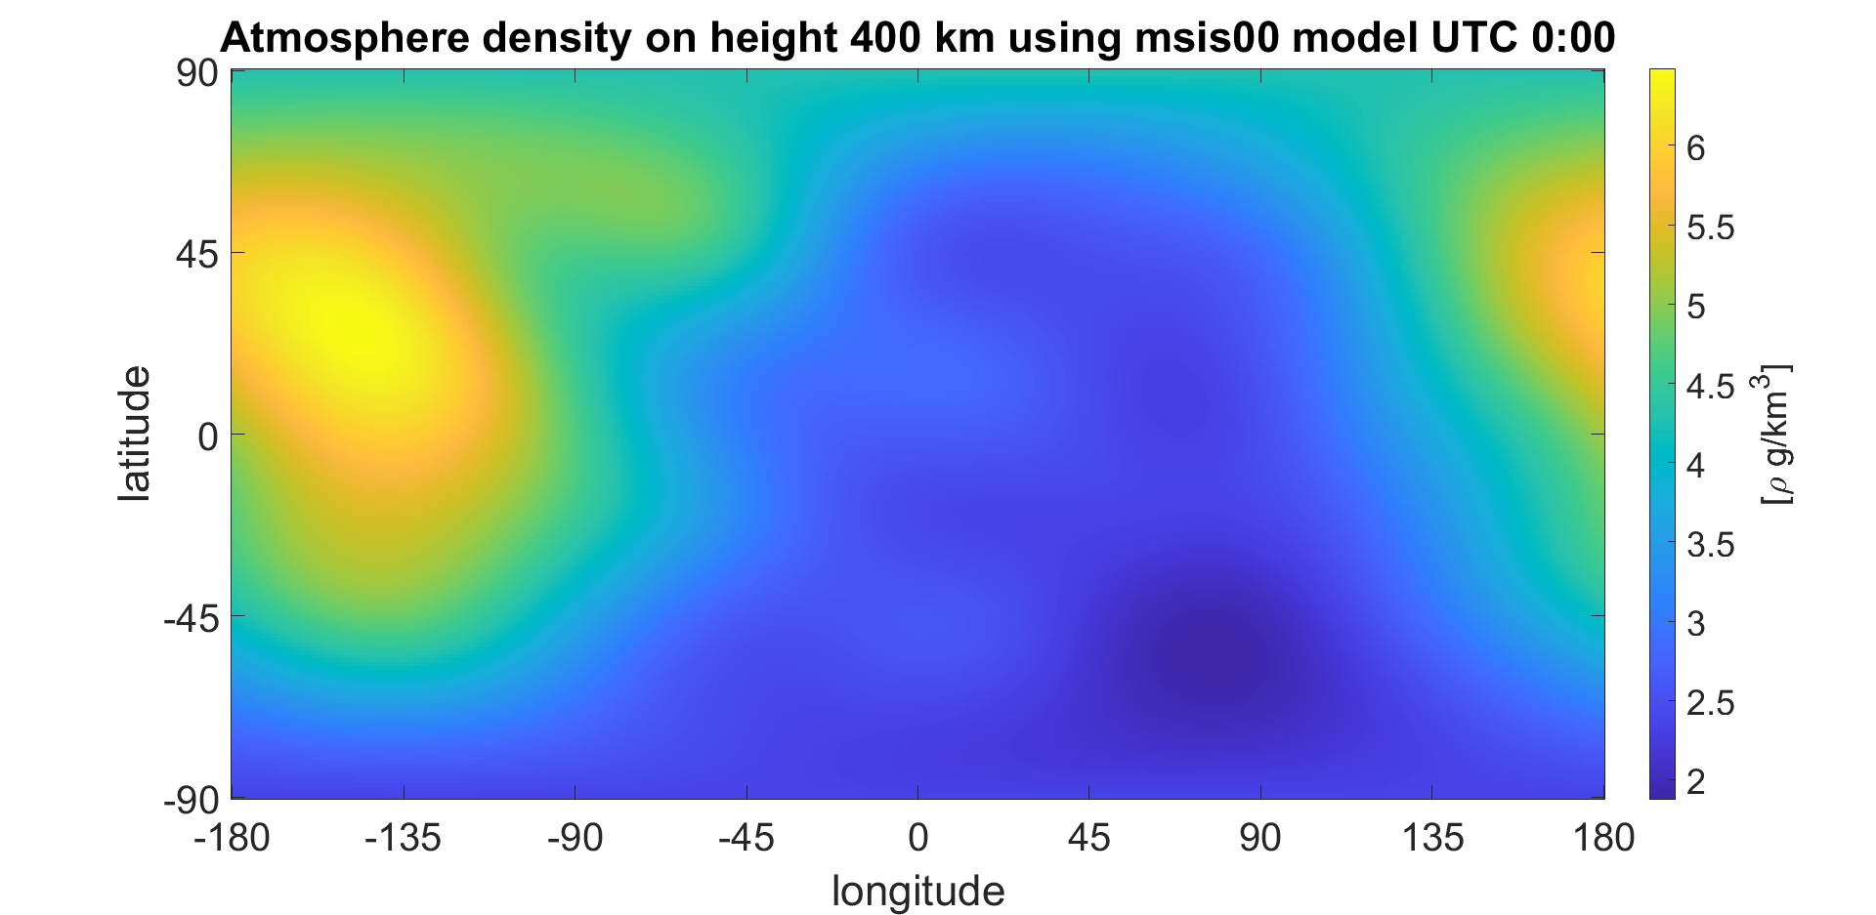
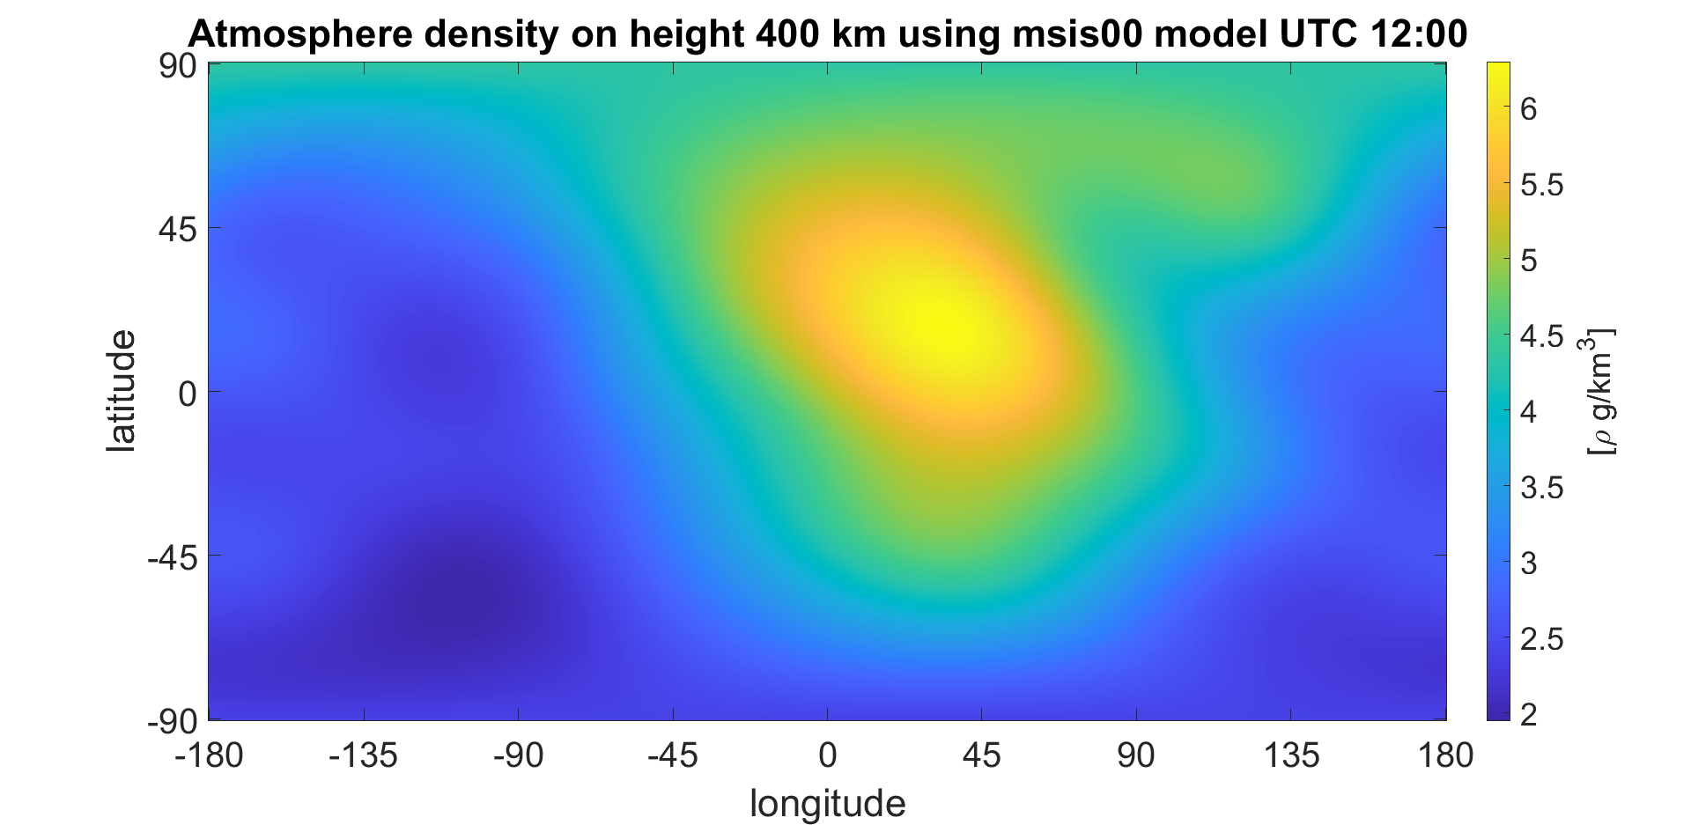
msise00 model

Slide 10
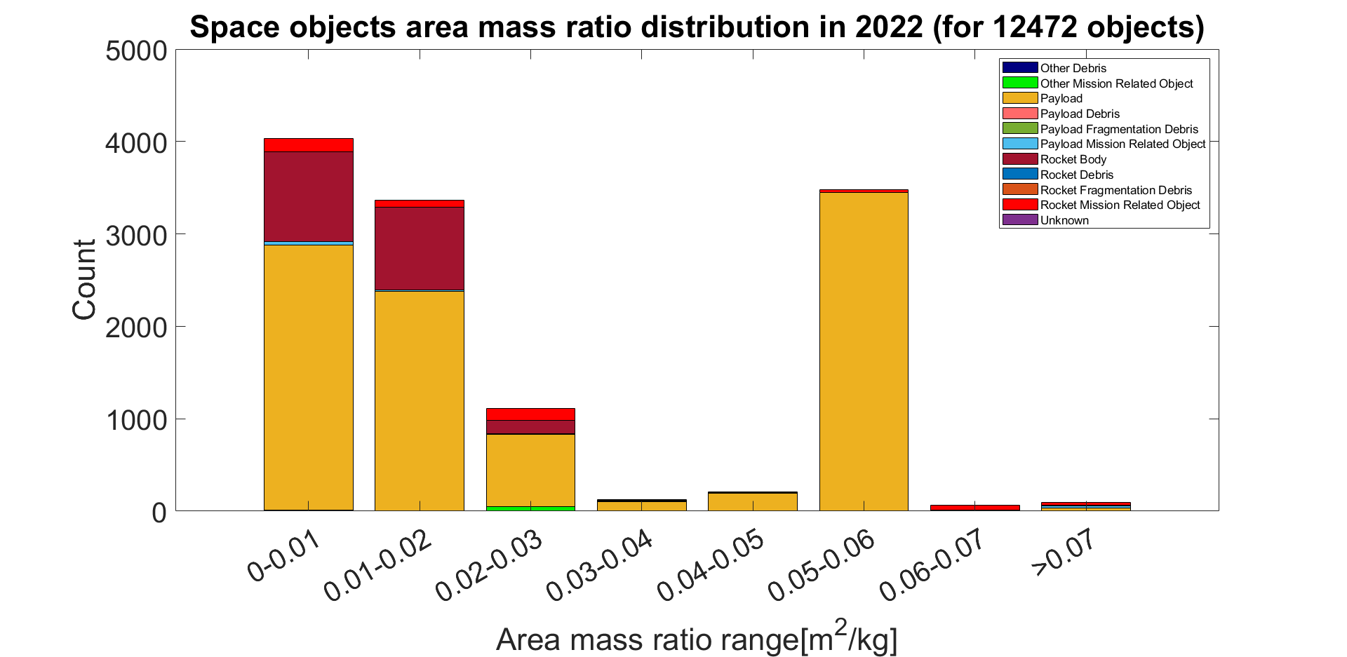
Area to mass ratio distribution
Though there are more than 20 000 objects in 2022,
only 12472 of them are know with section area and mass

Slide 11
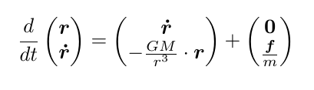
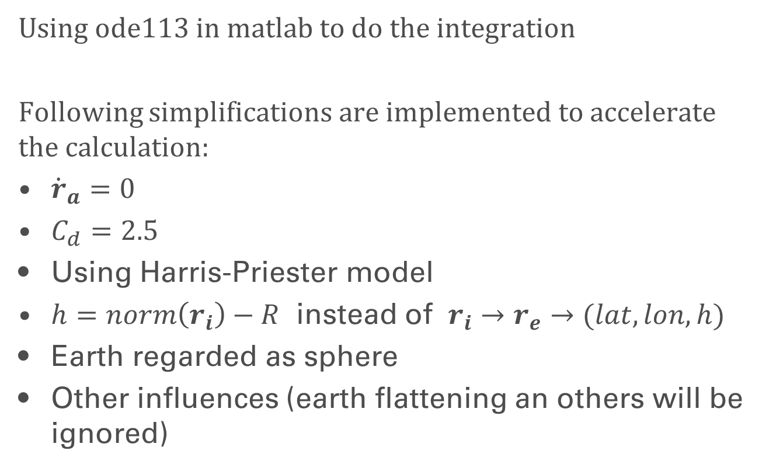
Integration and simplification
Using ode113 in matlab to do the integration
Following simplifications are implemented to accelerate the calculation:
${\dot{r}}_{a}=0$
$C_{d}=2.5$
Using Harris-Priester model
$h=norm\left(r_{i}\right)−R$ instead of $r_{i}→r_{e}→(lat,lon,h)$
Earth regarded as sphere
Other influences (earth flattening an others will be ignored)

Slide 12
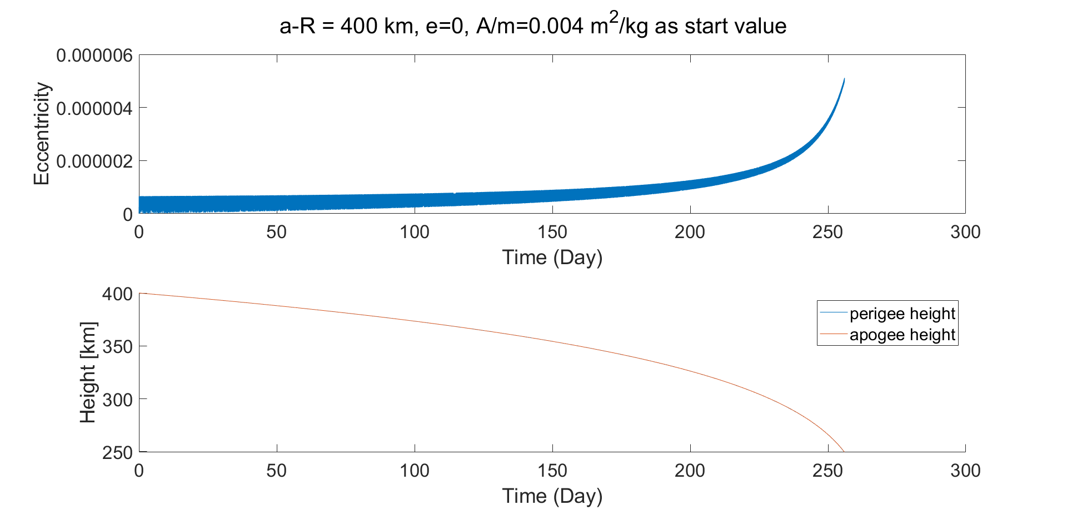
Integration Result for circular orbit

Slide 13
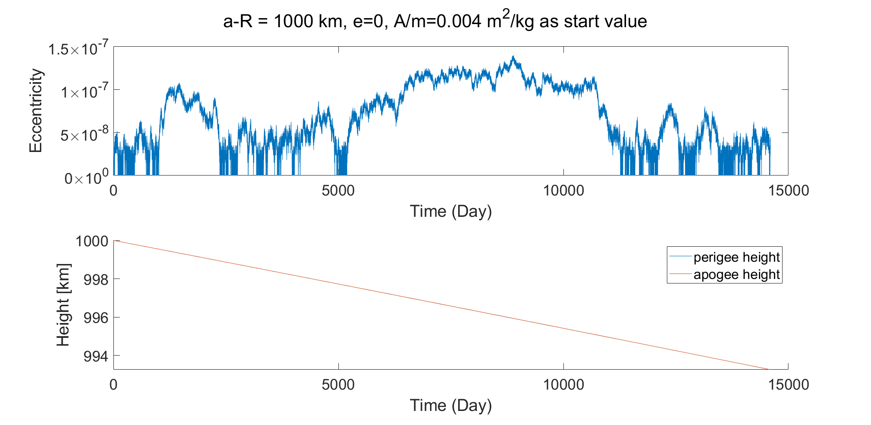
Integration Result for circular orbit

Slide 14
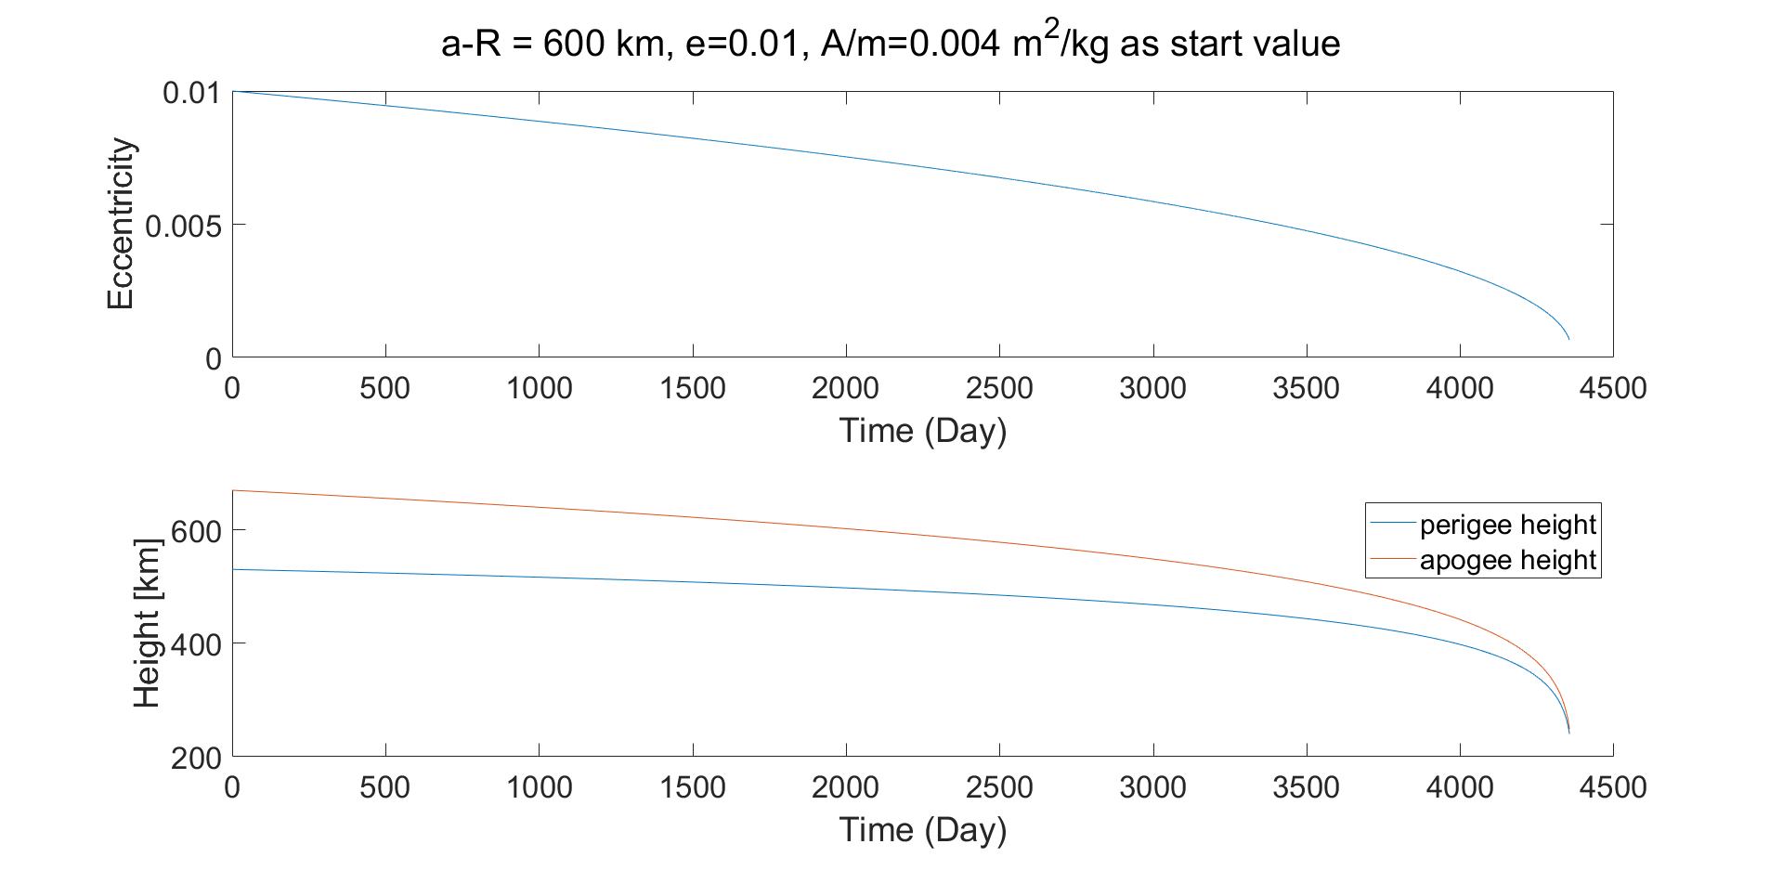
Integration Result for ellipsoidal orbit

Slide 15
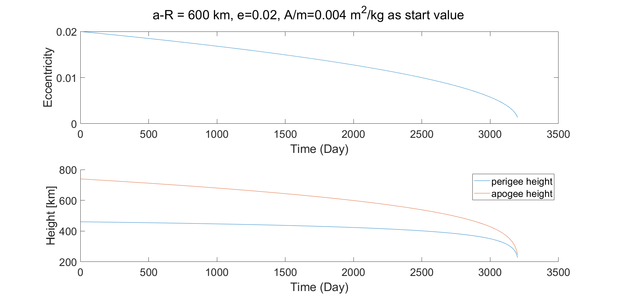
Integration Result for ellipsoidal orbit

Slide 16
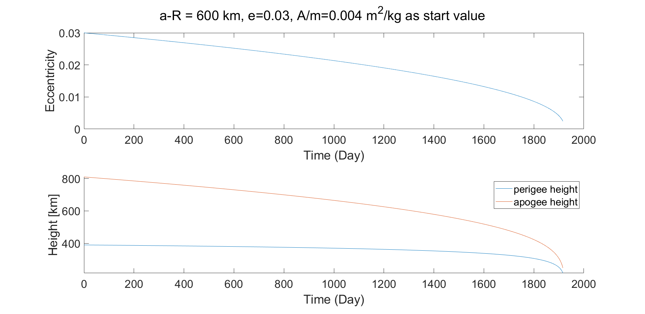
Integration Result for ellipsoidal orbit

Slide 17
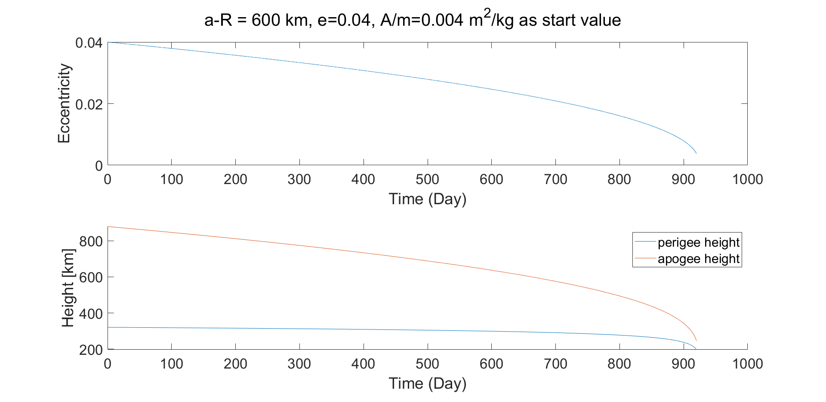
Integration Result for ellipsoidal orbit

Slide 18
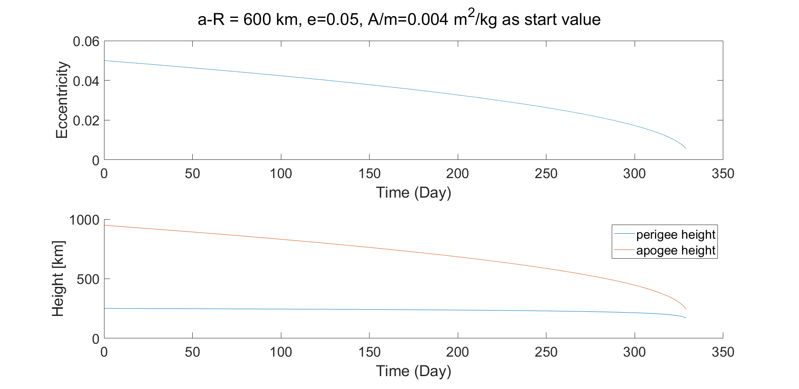
Integration Result for ellipsoidal orbit

Slide 19
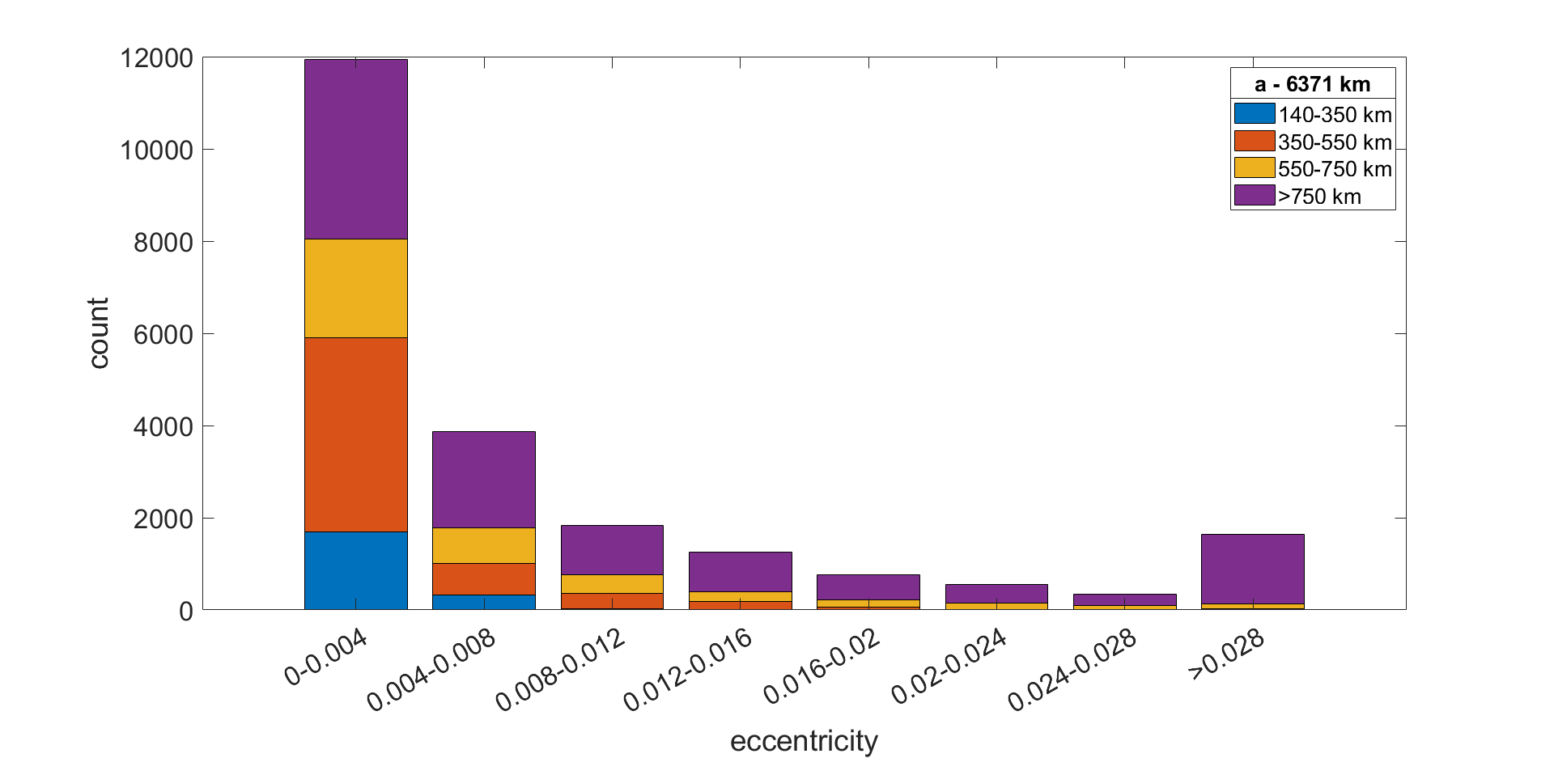
Eccentricity and long half axis distribution

Slide 20
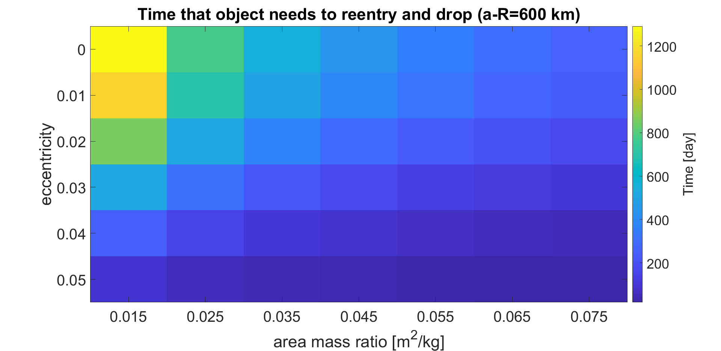
Time for reentry with different parameters

