Slide 1
Frozen Orbit Beispiele
Torben Blei
Jiaxin Liu
Philipp Schollmeier
Ziqing Yu
22. November 2022, Stuttgart

Slide 2
Data Source
TLE documentation: https://www.space-track.org/documentation#/tle
TLE data download from: https://www.space-track.org/#/gp

Slide 3
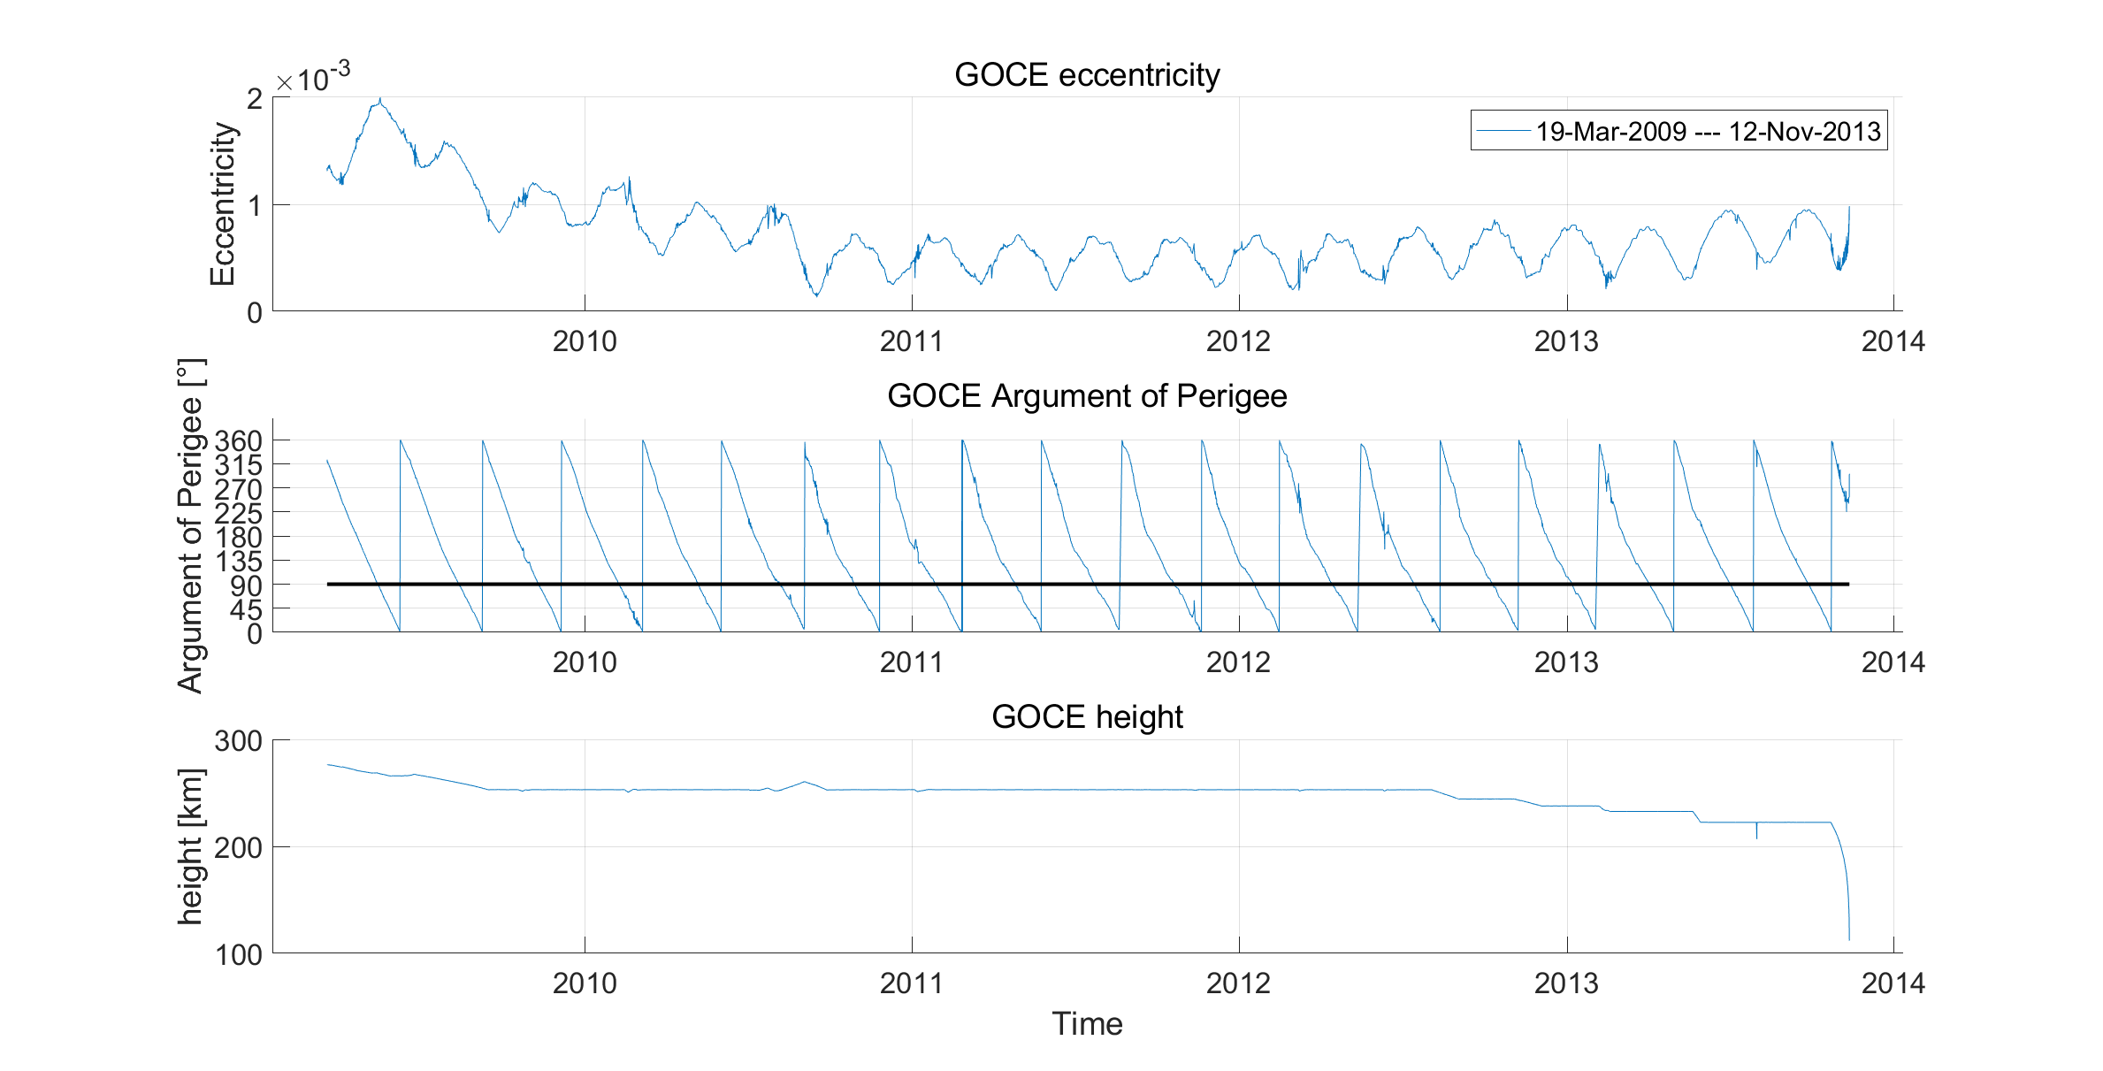
GOCE

Slide 4
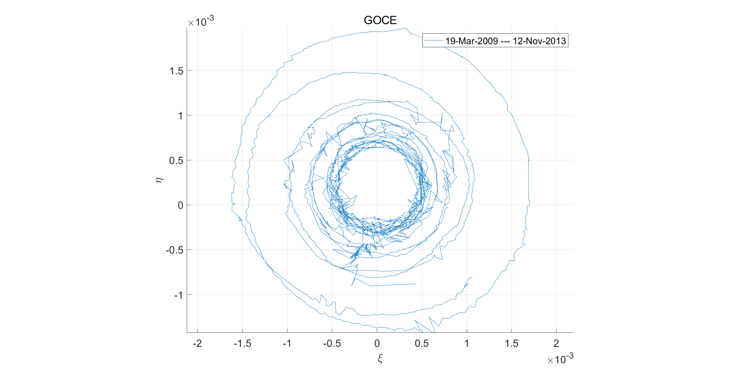
GOCE

Slide 5
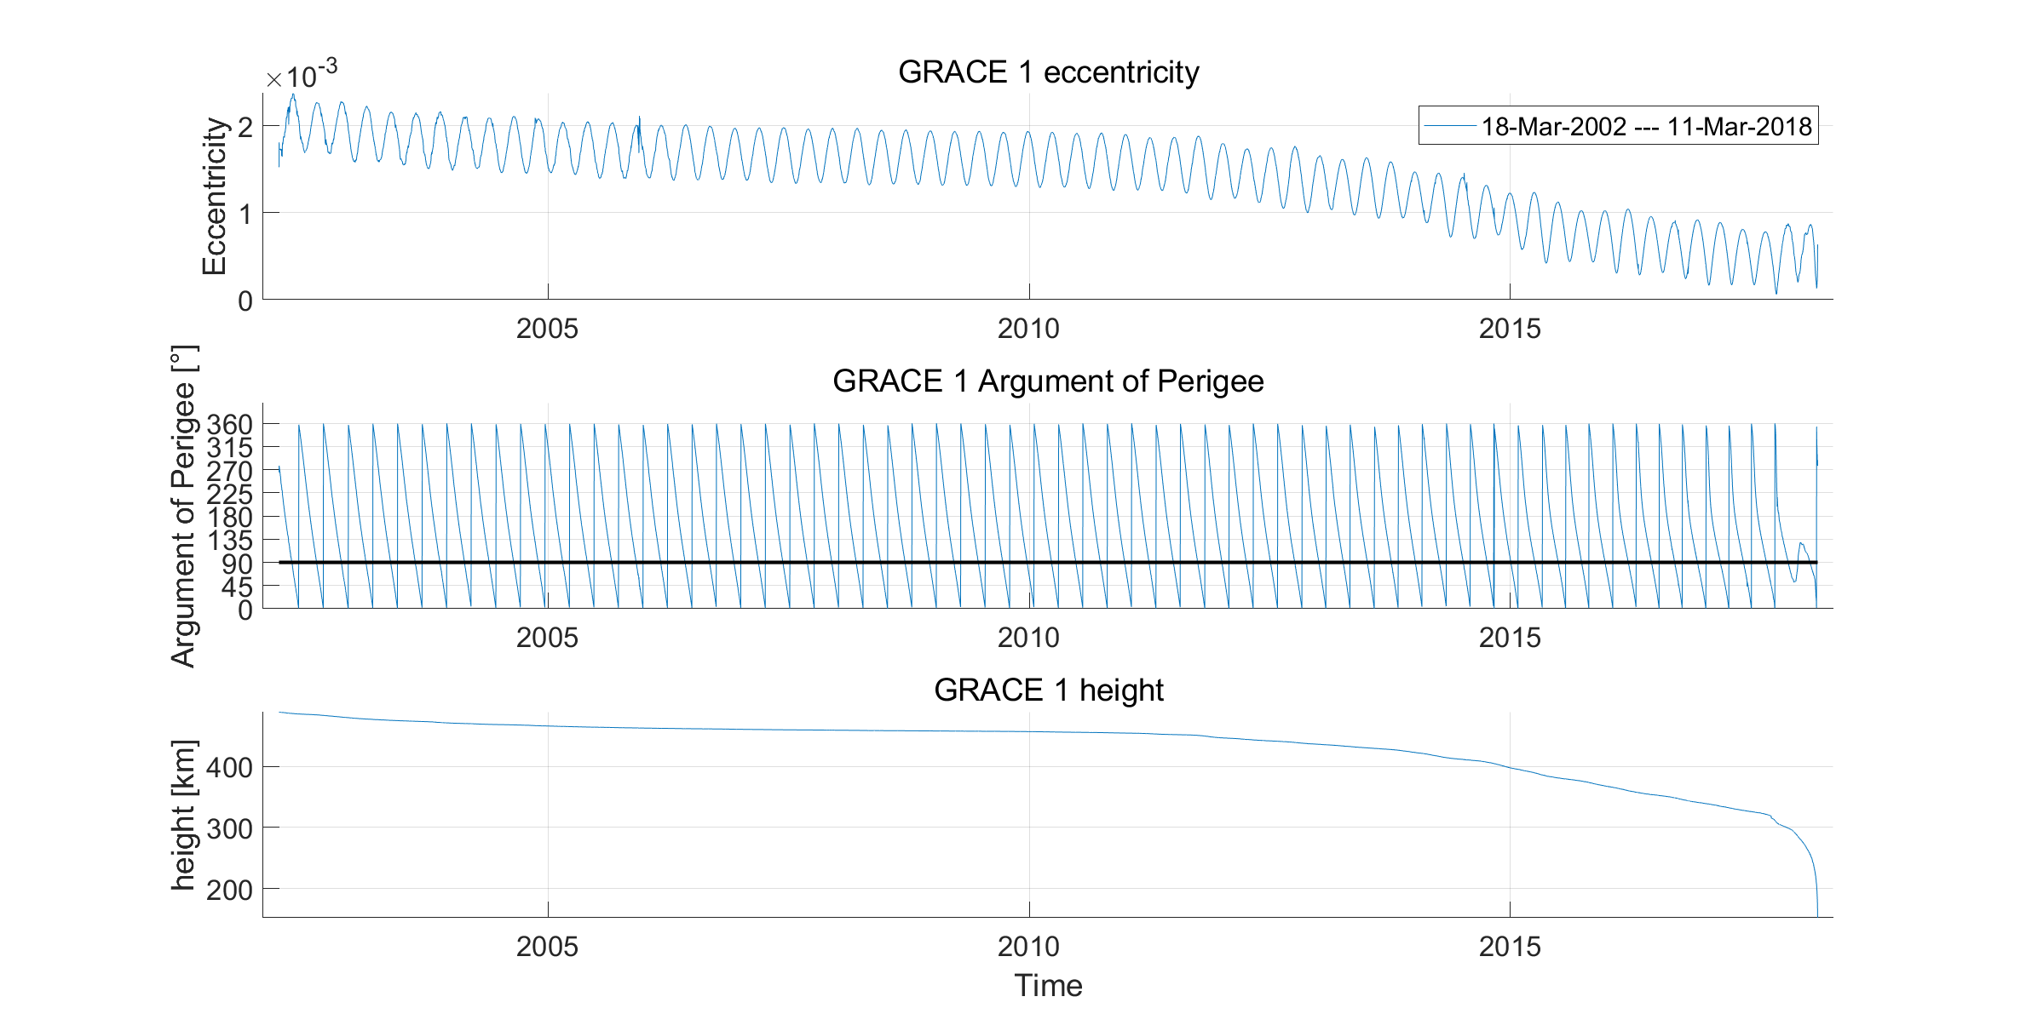
GRACE-1

Slide 6
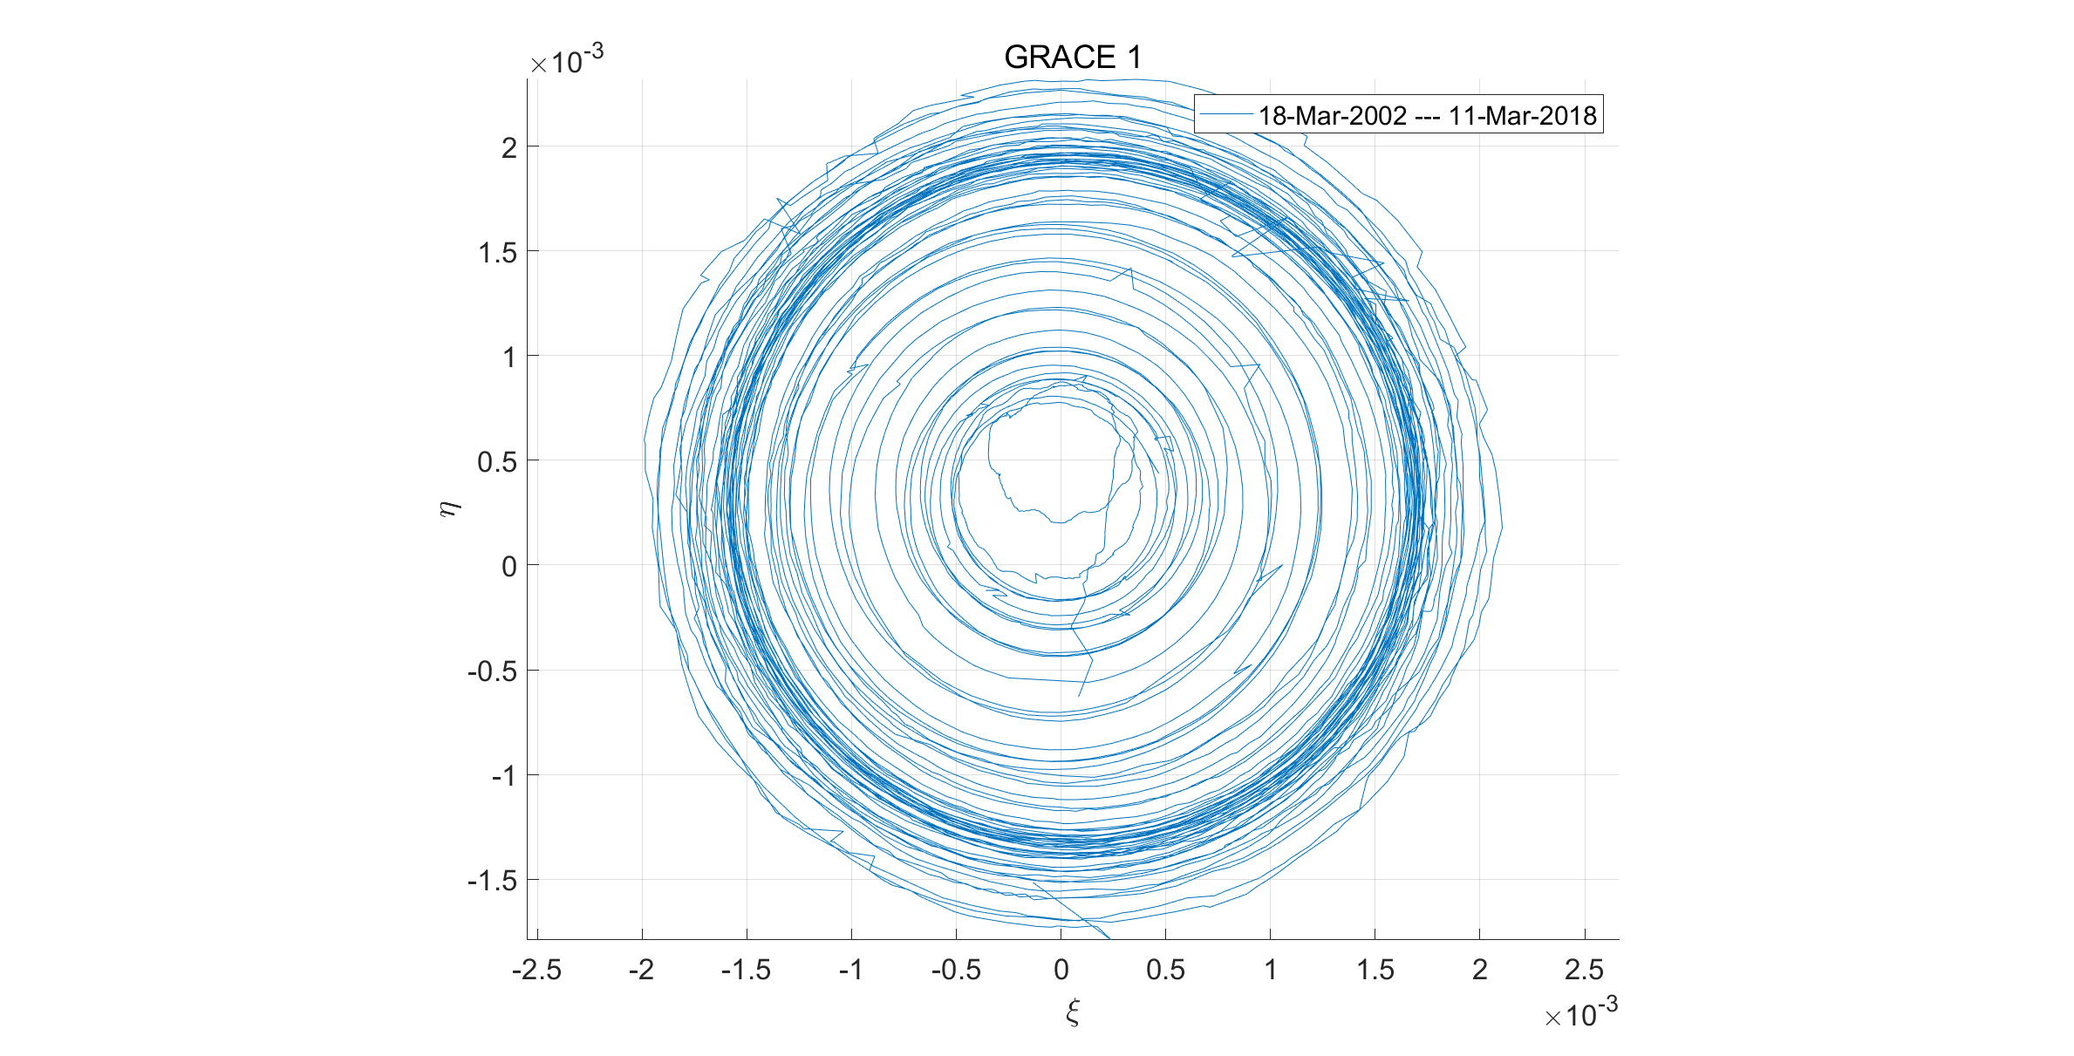
GRACE-1

Slide 7
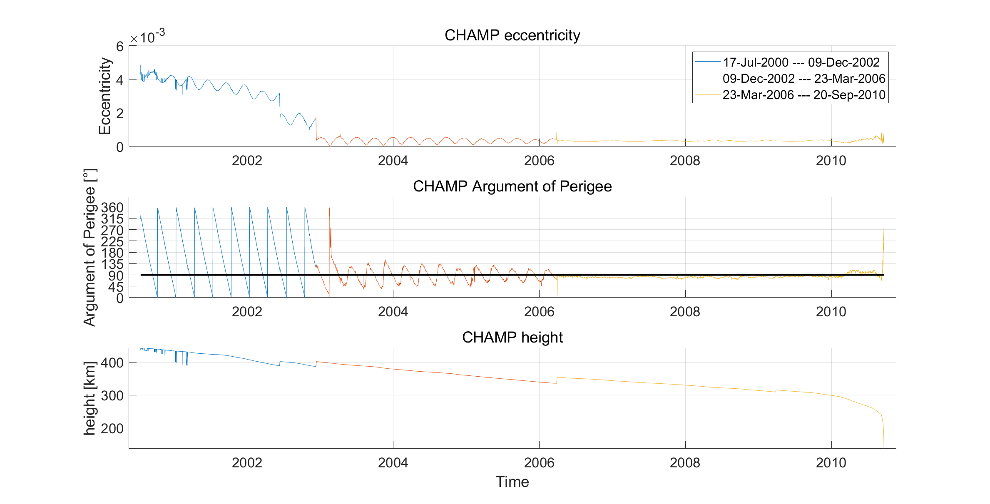
CHAMP

Slide 8
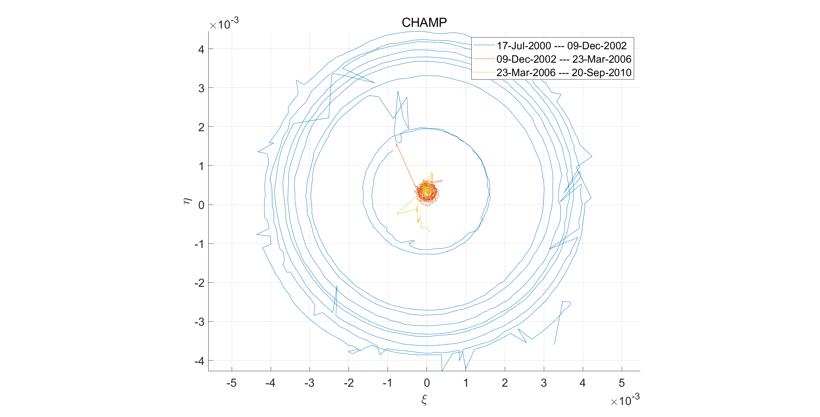
CHAMP

Slide 9
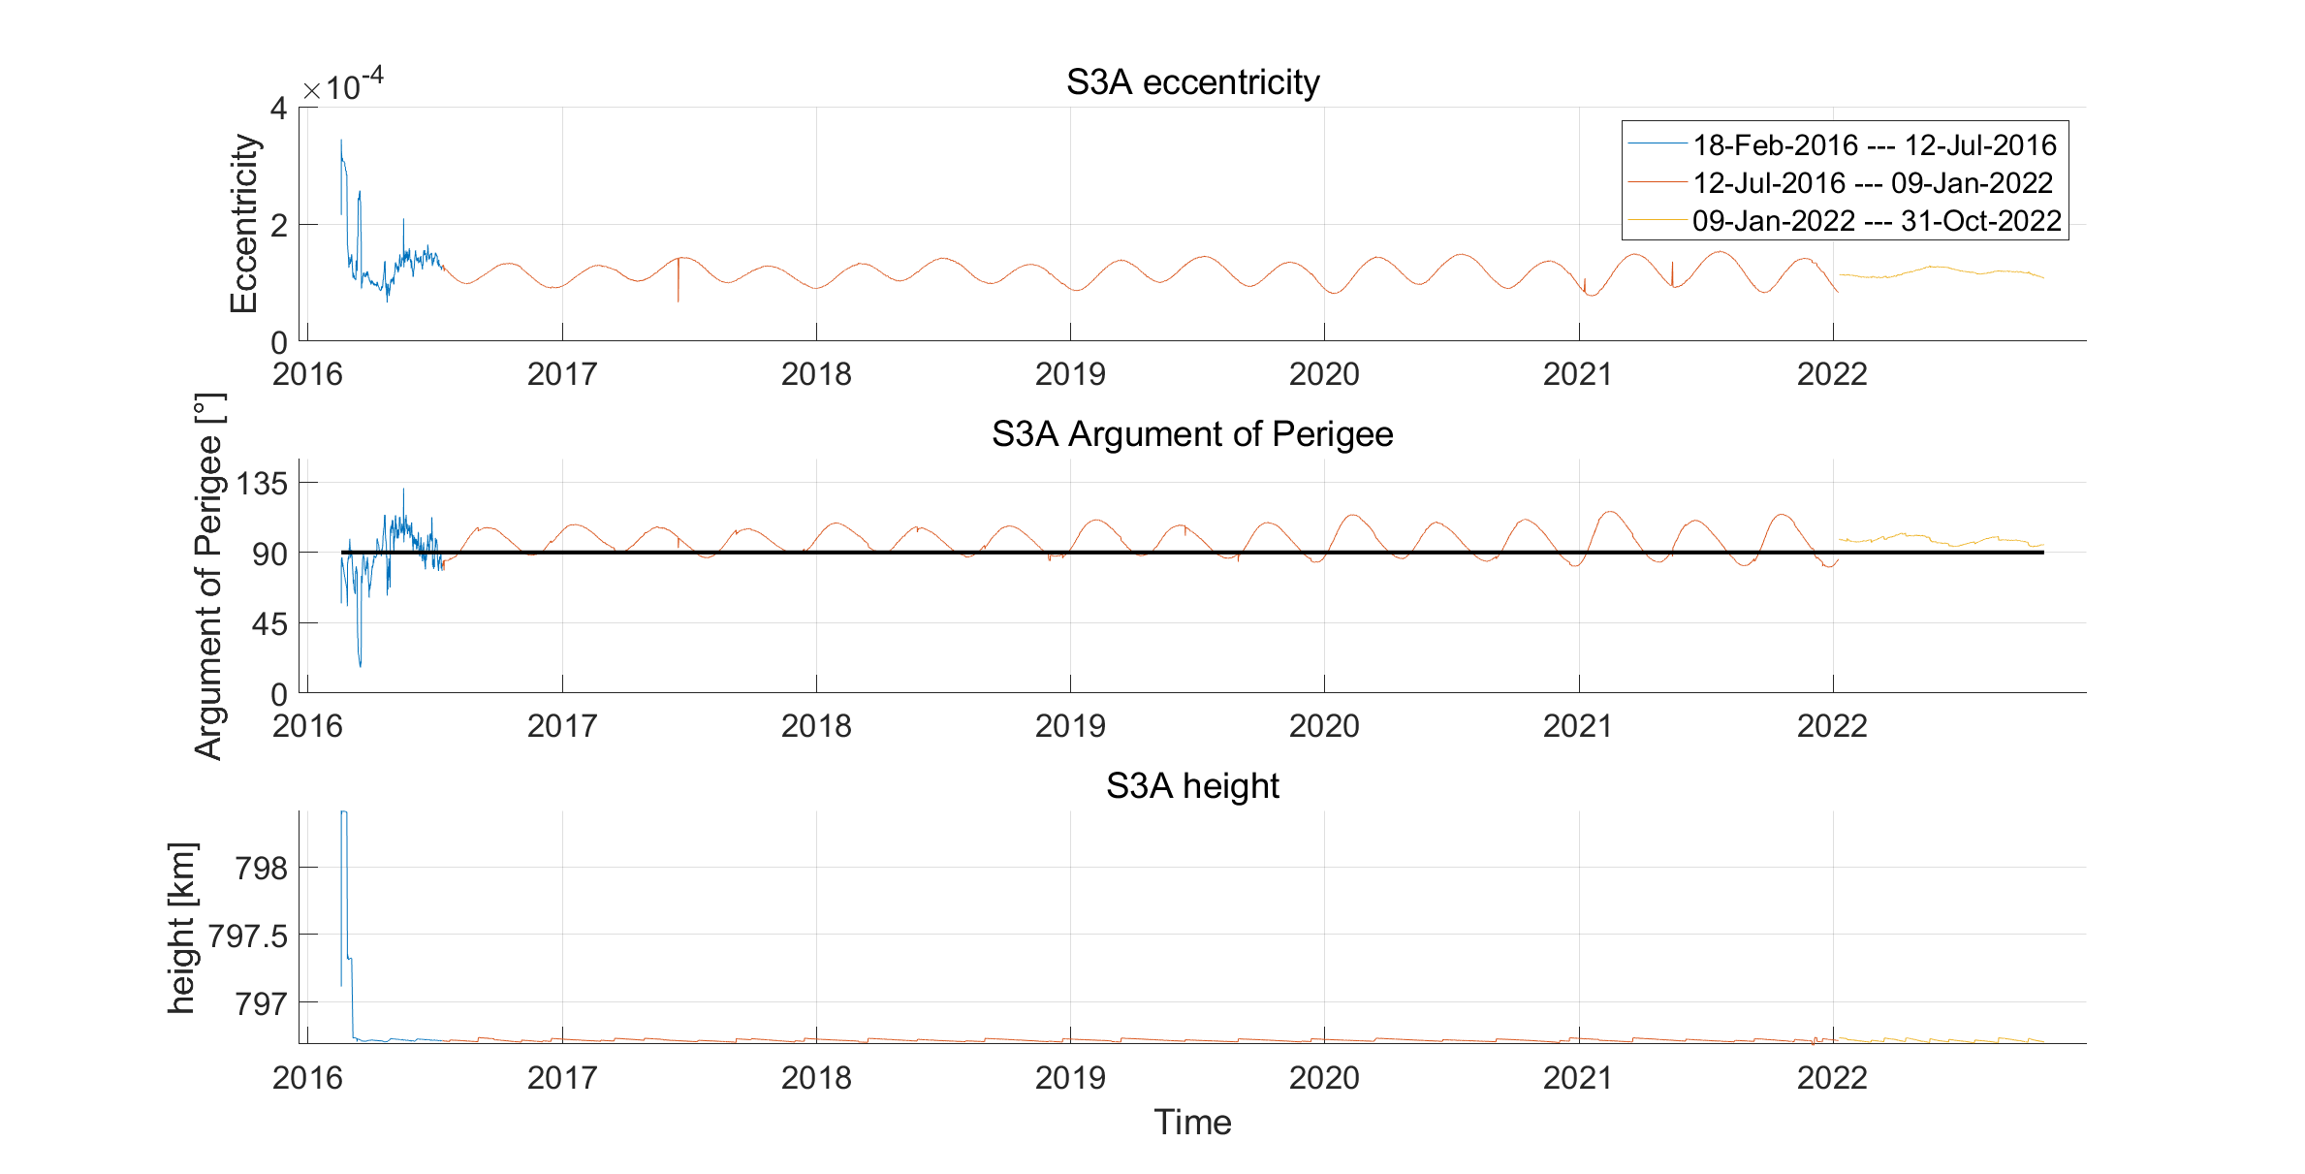
Sentinel-3A

Slide 10
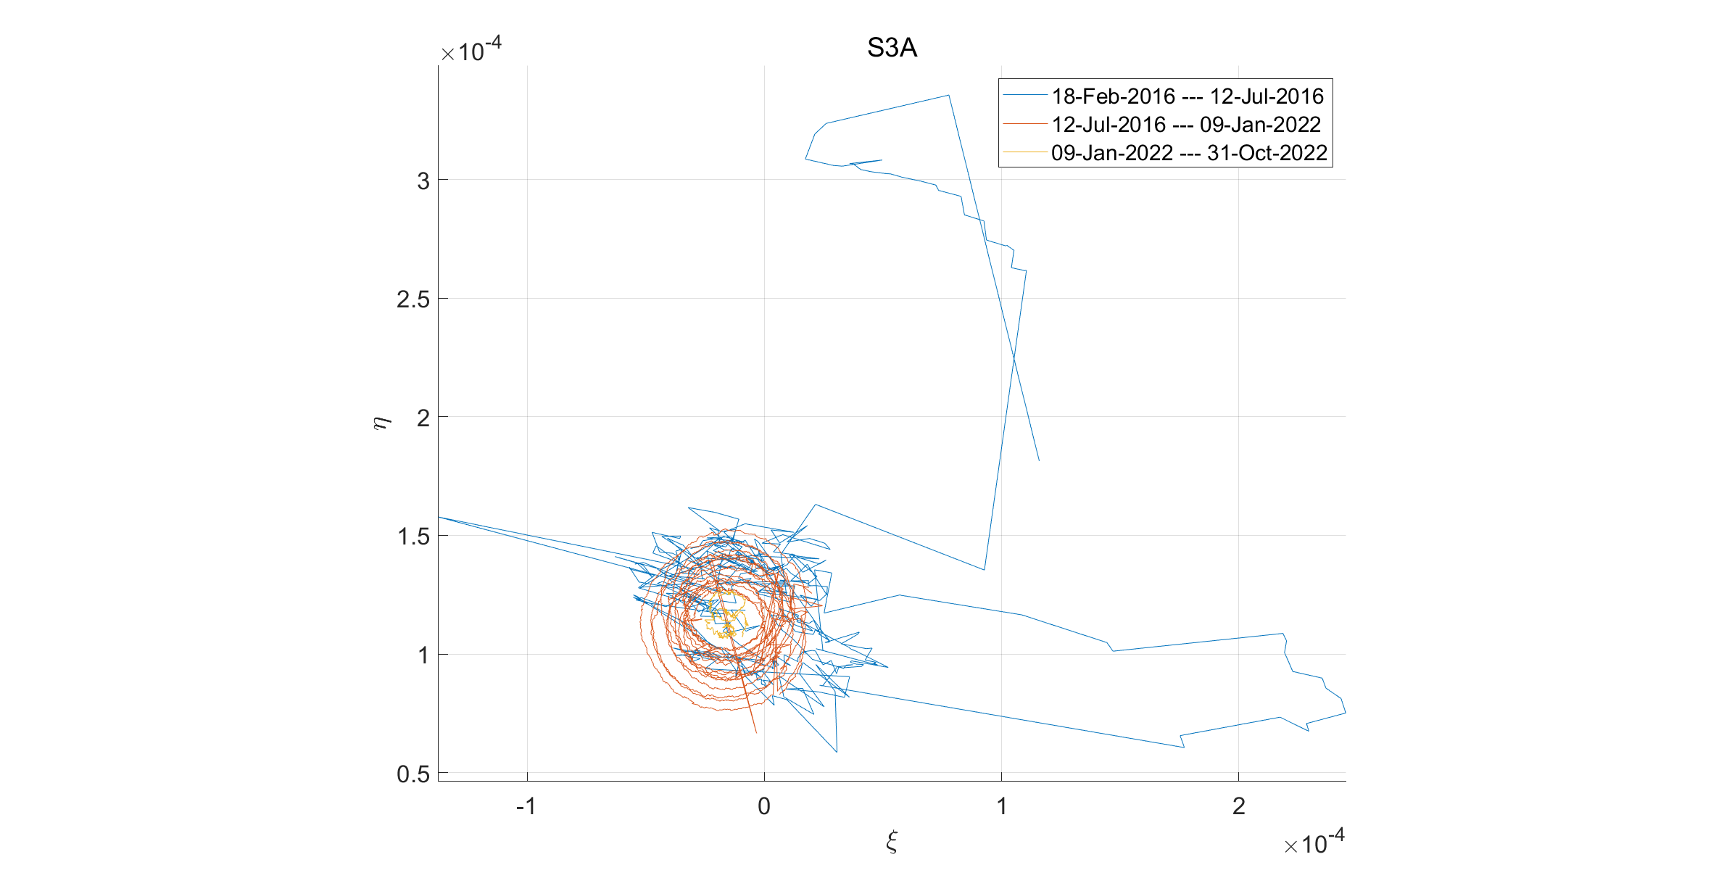
Sentinel-3A

Slide 11
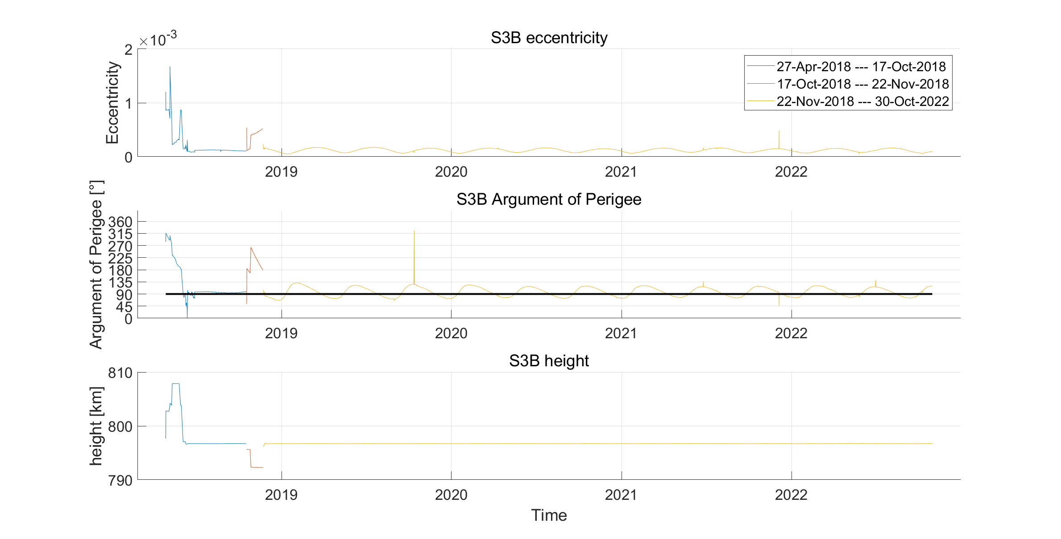
Sentinel-3B
1. Commissioning phase
2. Move Sentinel-3B to its expected nominal orbital position 140 degree in front
of Sentinel-3A
3. Releasing data
Source: https://sentinel.esa.int/documents/247904/3358207/Sentinel-3-Mission-Status-Report-20-November-2018

Slide 12
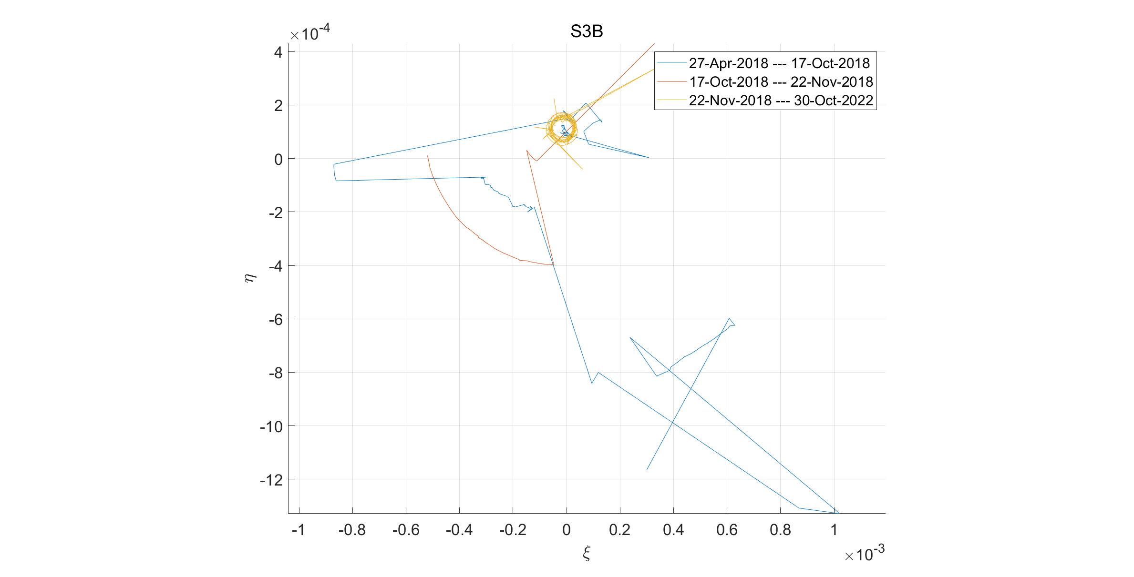
Sentinel-3B

Slide 13
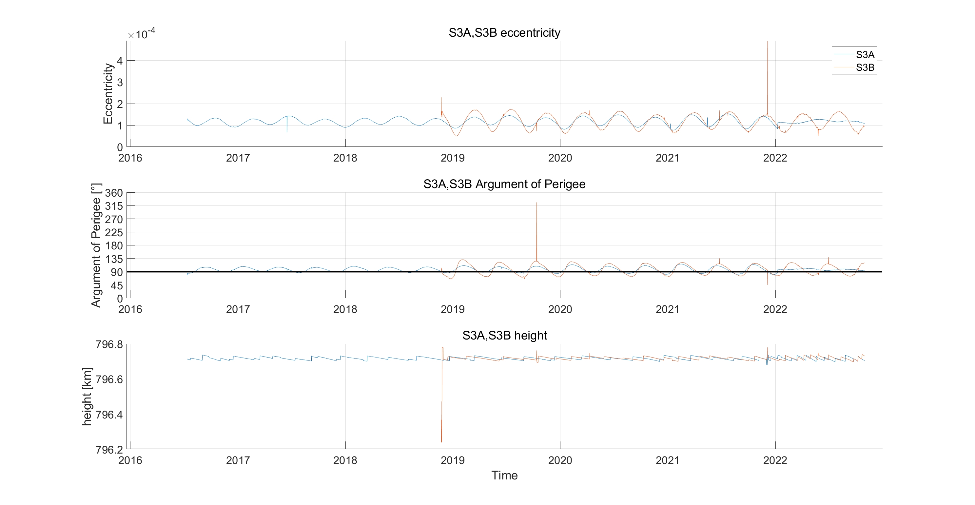
Sentinel-3 Vergleich
*The commissioning phase of both satellites are removed

Slide 14
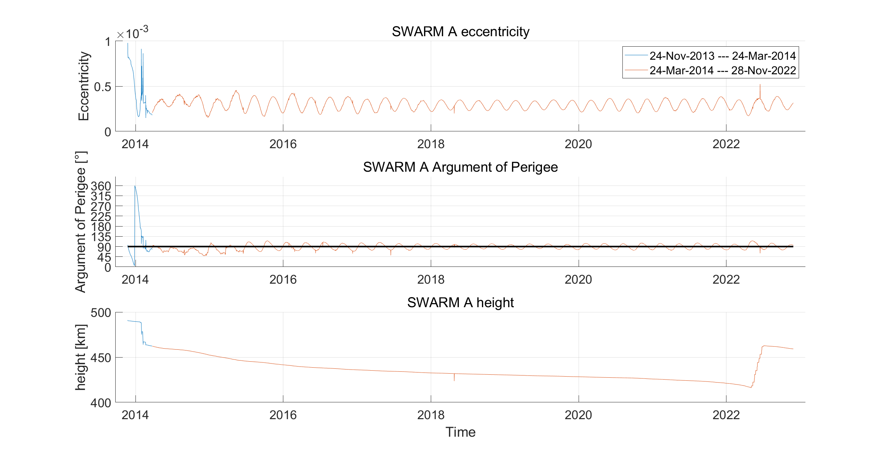
SWARM-A

Slide 15
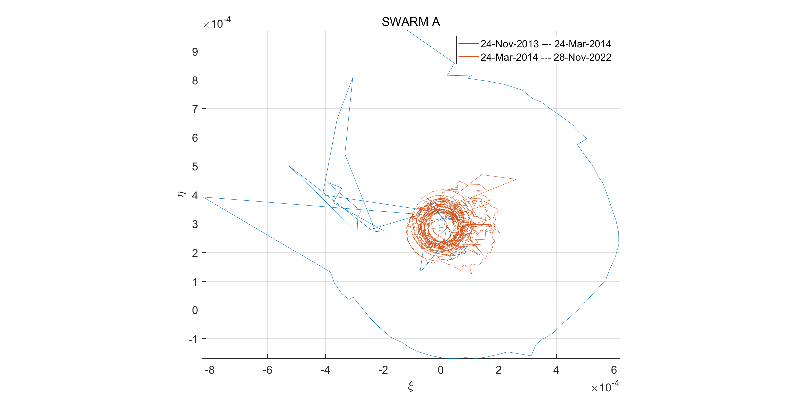
SWARM-A

Slide 16
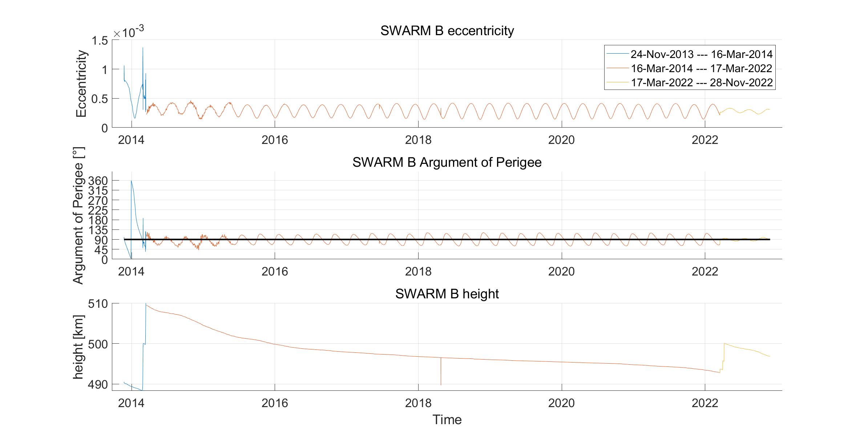
SWARM-B

Slide 17
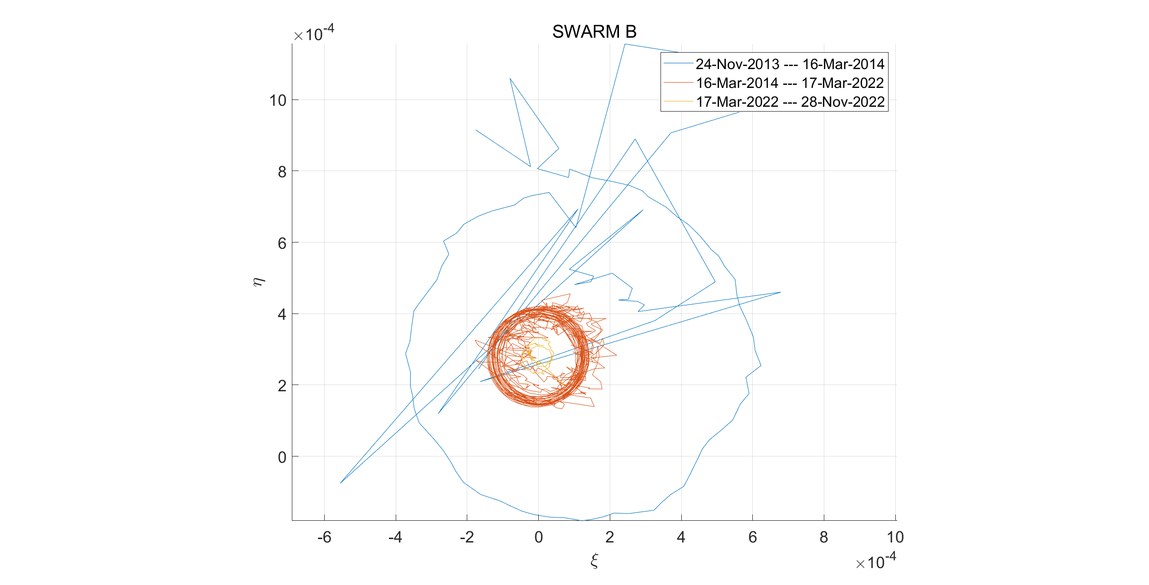
SWARM-B

Slide 18
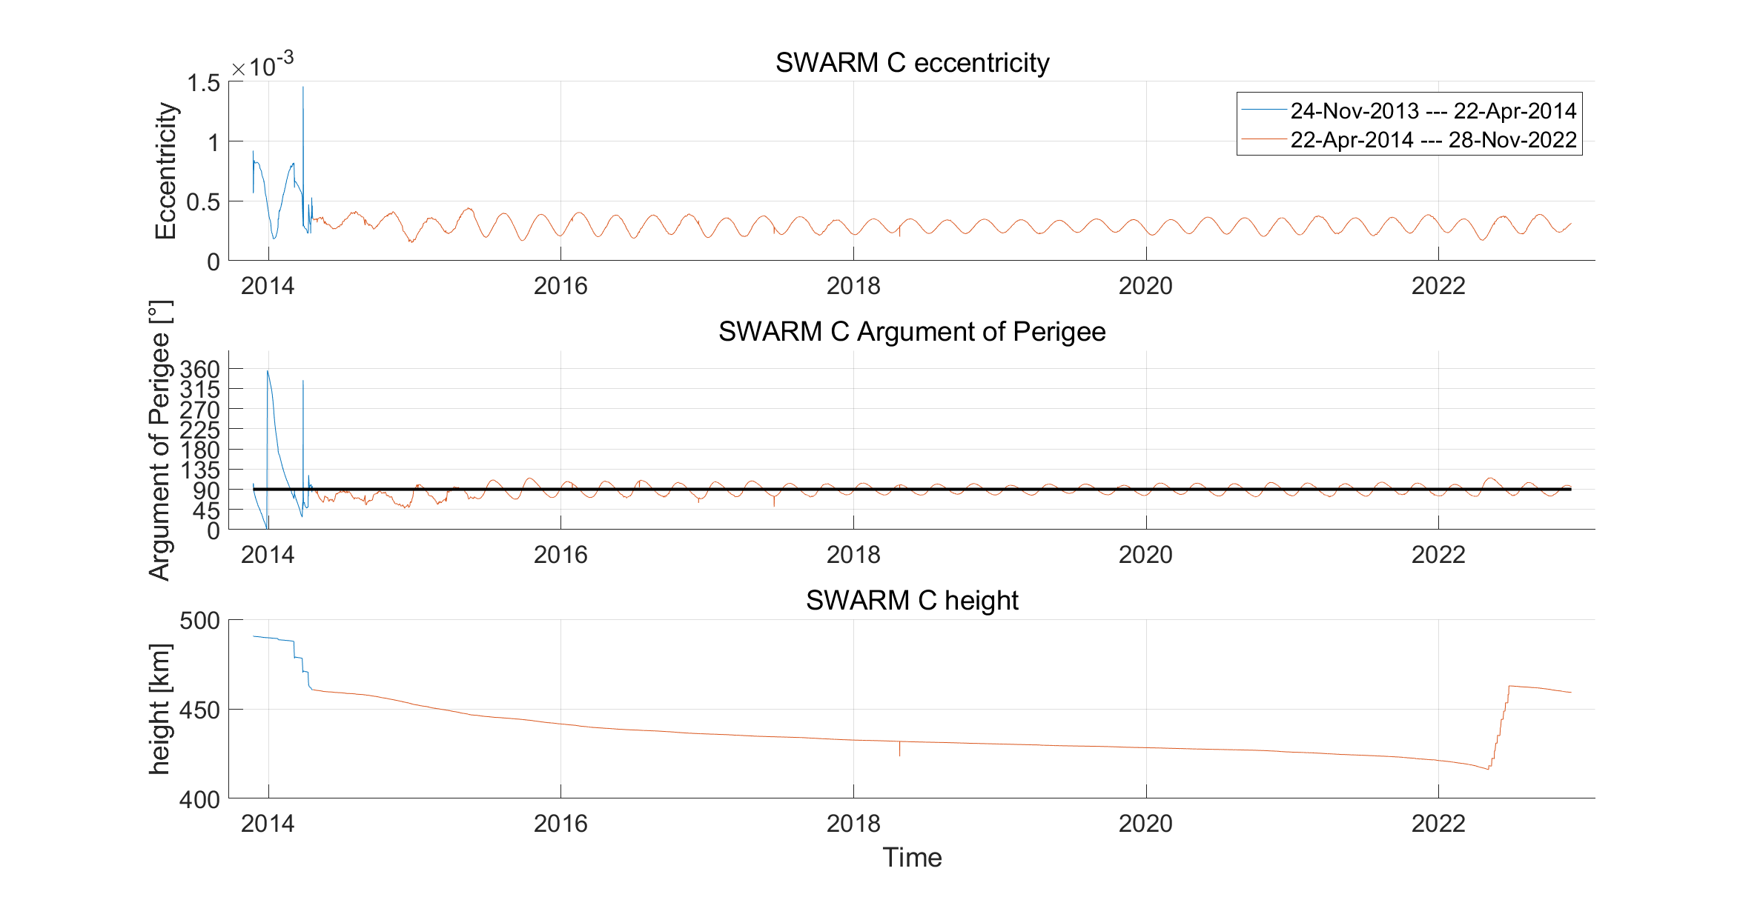
SWARM-C

Slide 19
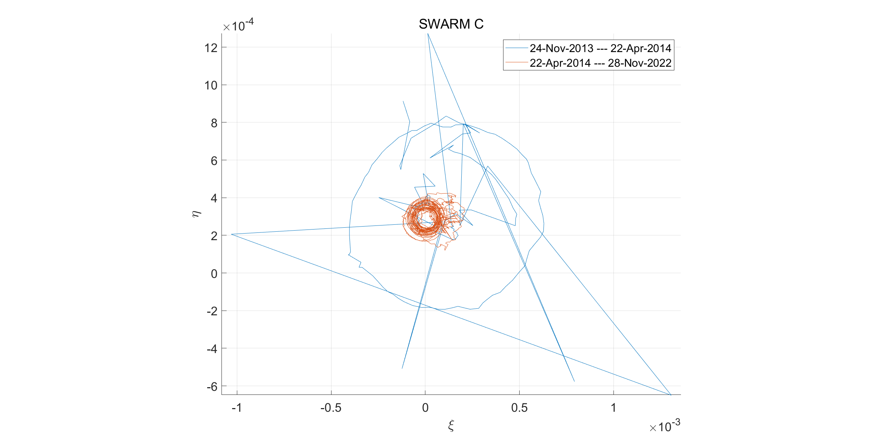
SWARM-C

Slide 20
SWARM Mission
Swarm A and C form the lower pair of satellites flying side-by-side (1.4° separation in longitude at the equator) at an altitude of 462 km (initial altitude) and at 87.35° inclination angle, whereas Swarm B is cruising at a higher orbit of 511 km (initial altitude) and at 87.75° inclination angle.
Source: https://earth.esa.int/eogateway/missions/swarm/description

Slide 21
Raising the orbit
With the increasing solar activity of solar cycle 25, the Earth’s atmosphere is expanding leading to higher density and stronger decay of the orbits. Without an orbit raise of Swarm A and C they would re-enter in 2024, so a first sequence of manoeuvres is planned between 3rd May and 8th July 2022, raising their altitude by about 45 km.
If not adjusted the orbital plane of Swarm B will be coplanar with A and C, which is undesirable for mapping the lithosphere. To avoid this it is necessary to reduce or increase the relative rotation after they are perpendicular
Source: https://earth.esa.int/eogateway/eogateway/missions/swarm/constellation-and-orbit-evolution

Slide 22
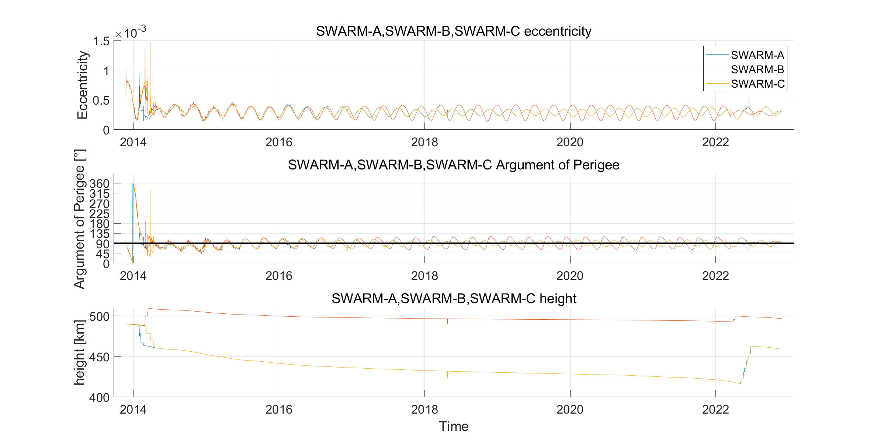
SWARM

Slide 23
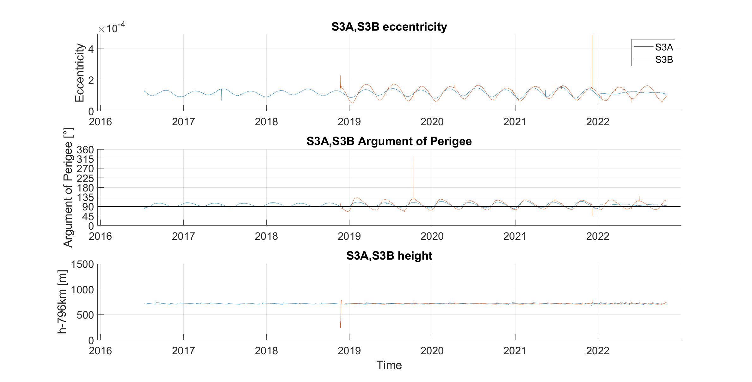
Sentinel 3A und B

Slide 24
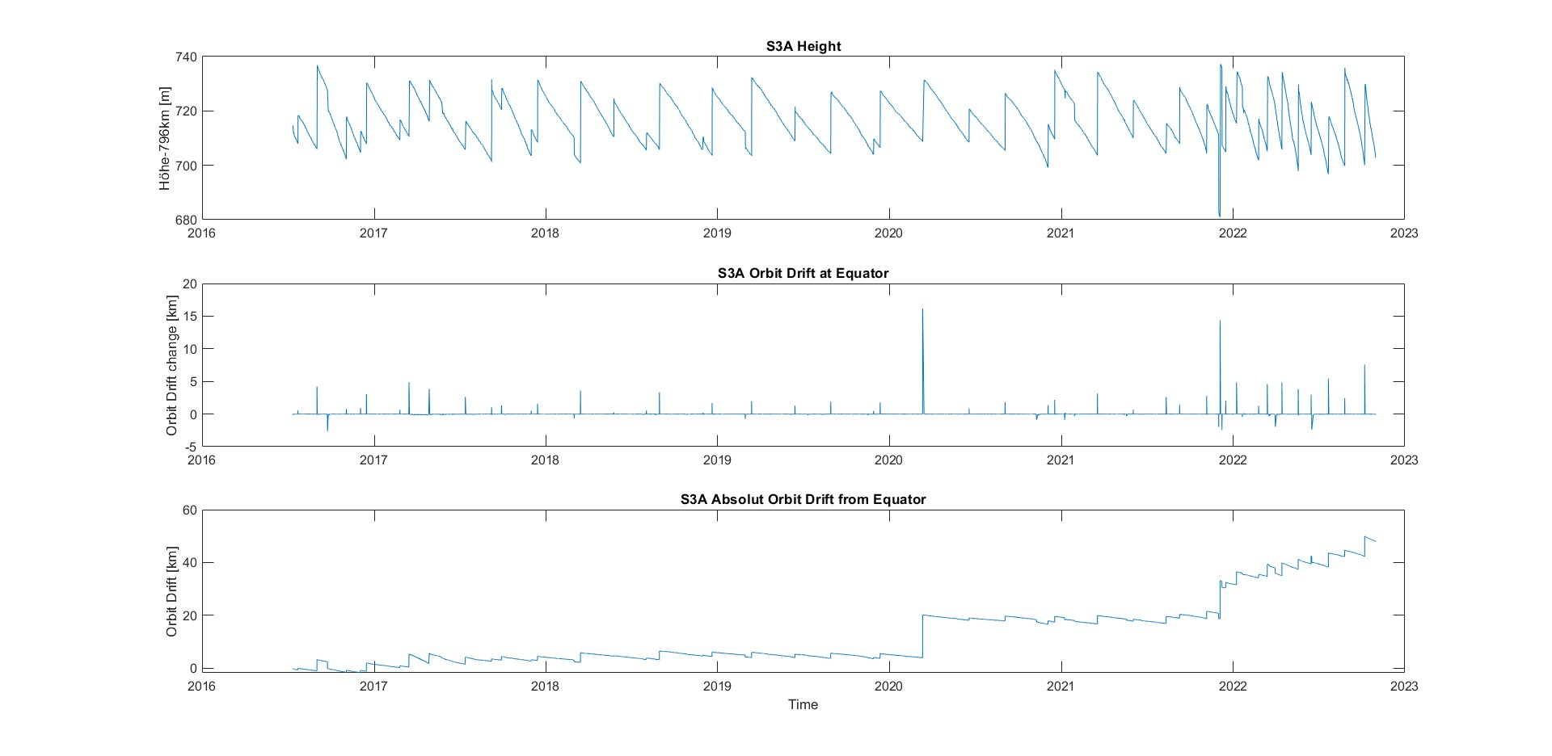
Höhe und Orbit Drift Sentinel 3A

Slide 25
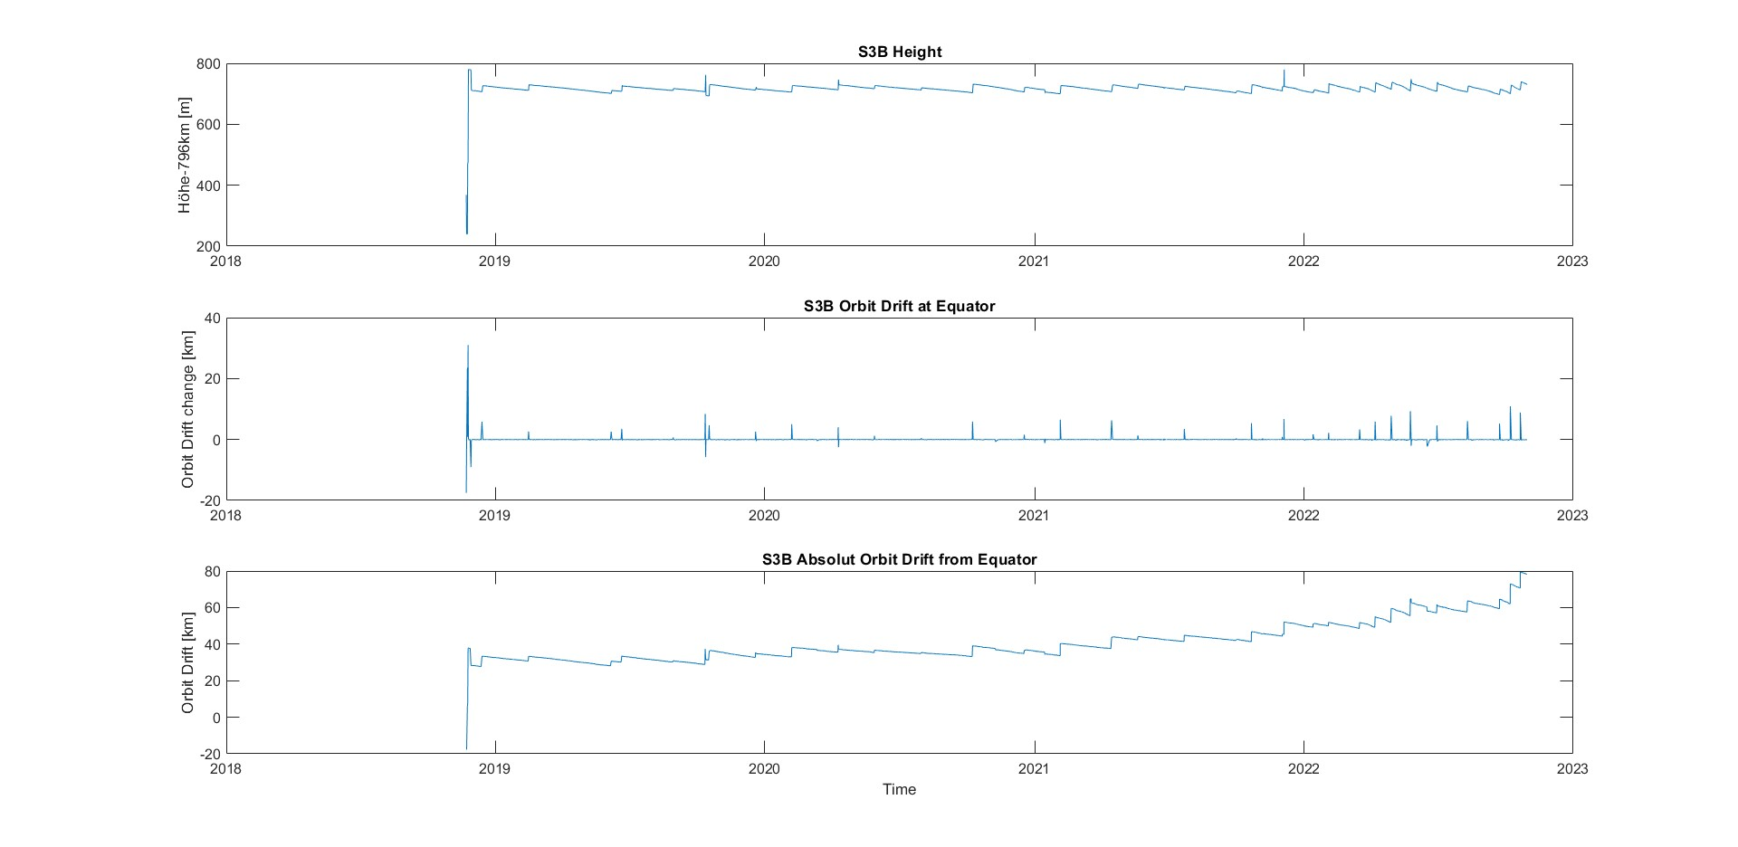
Höhe und Orbit Drift Sentinel 3B

Slide 26
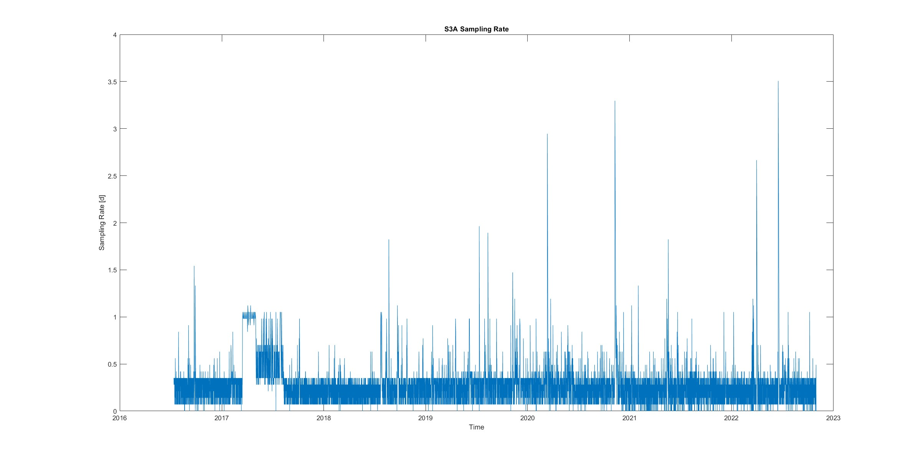
Sentinel 3A Sampling Rate

Slide 27
Thank you very much!

