Slide 1
Orbit integration
Jiaxin Liu
Ziqing Yu
24. January 2023, Stuttgart

Slide 2
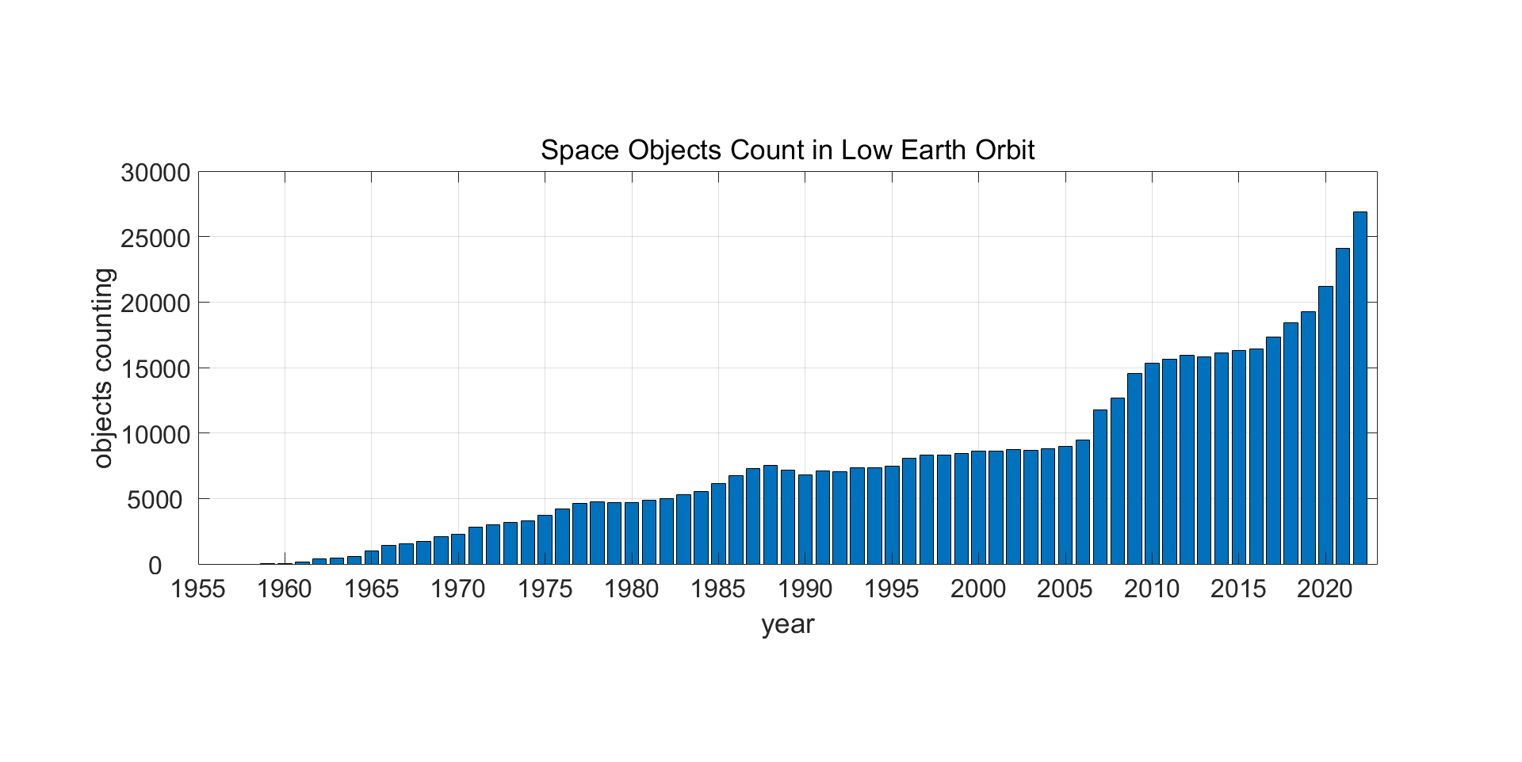
Objects counting

Slide 3
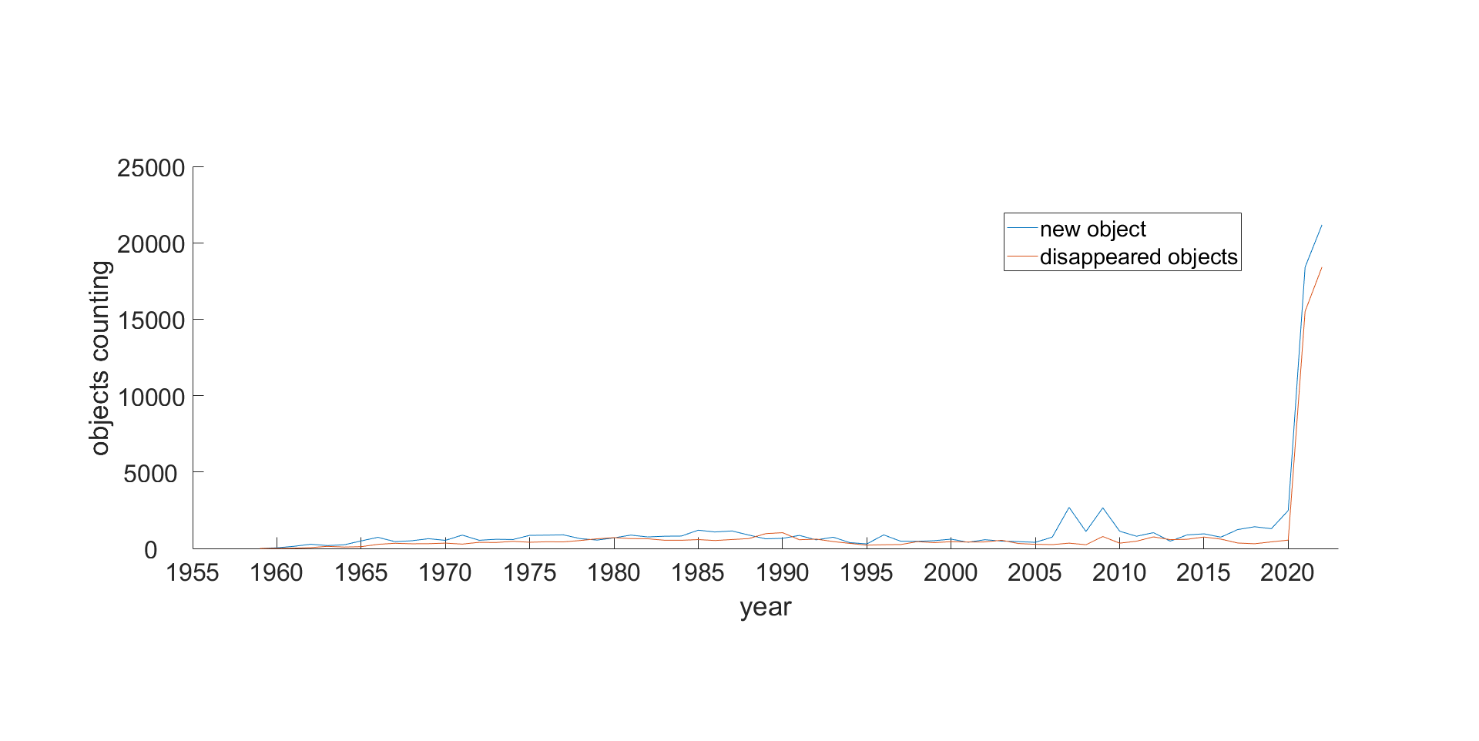
New and disappeared objects

Slide 4
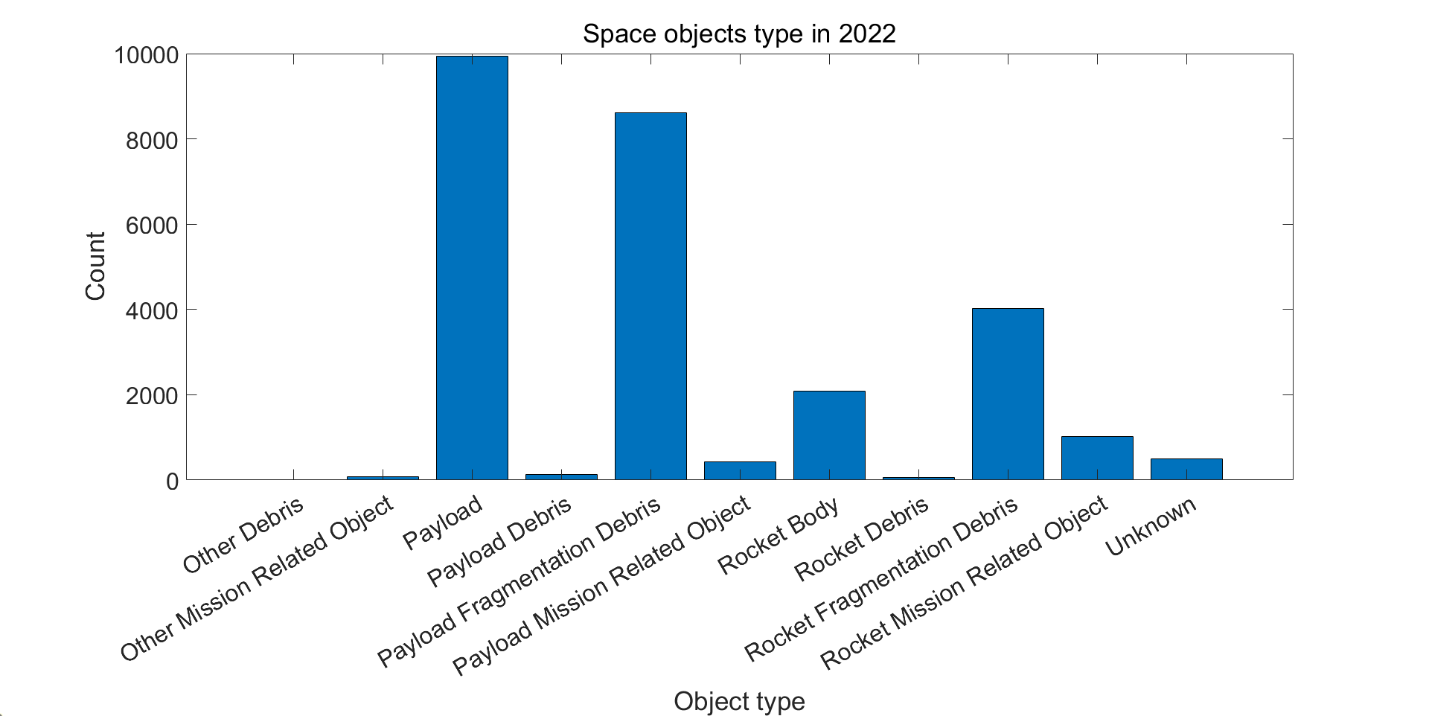
Objects classification in 2022

Slide 5
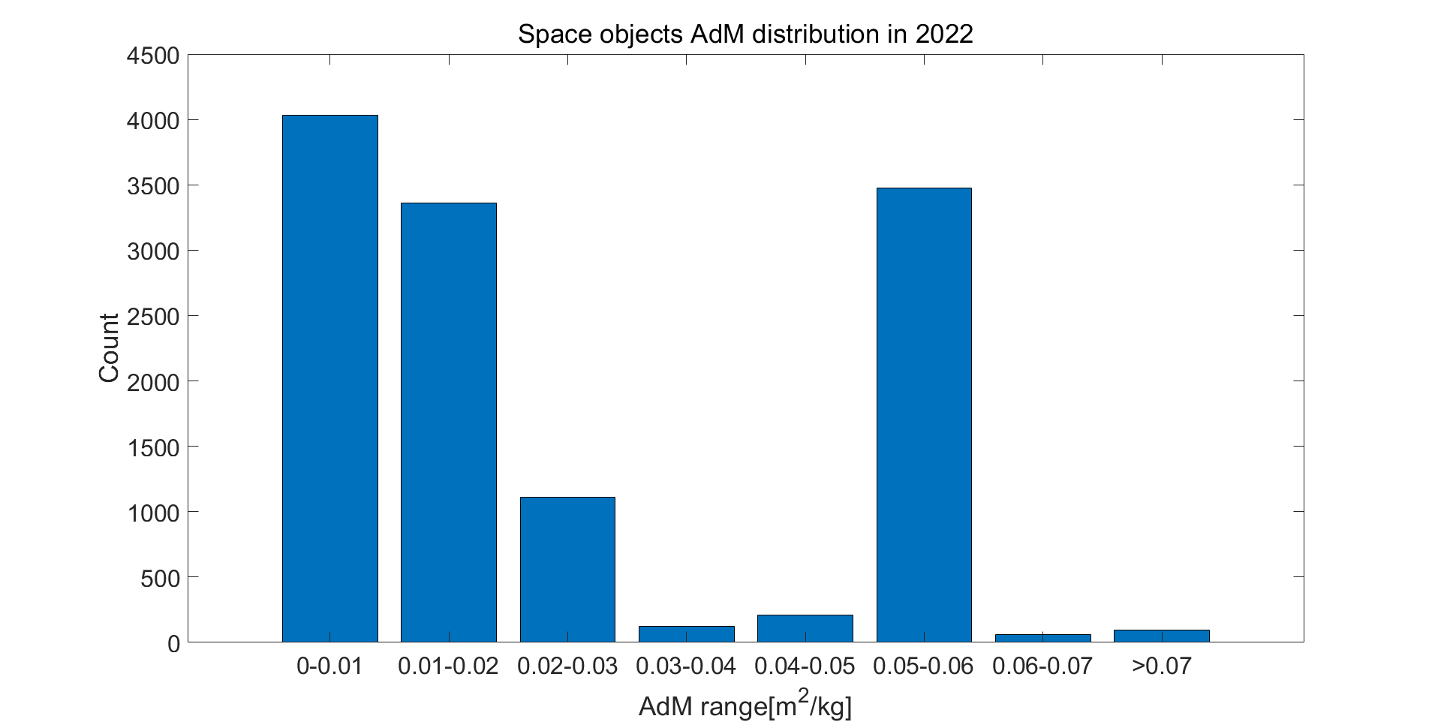
Objects AdM distribution
AdM: average section area / mass

Slide 6
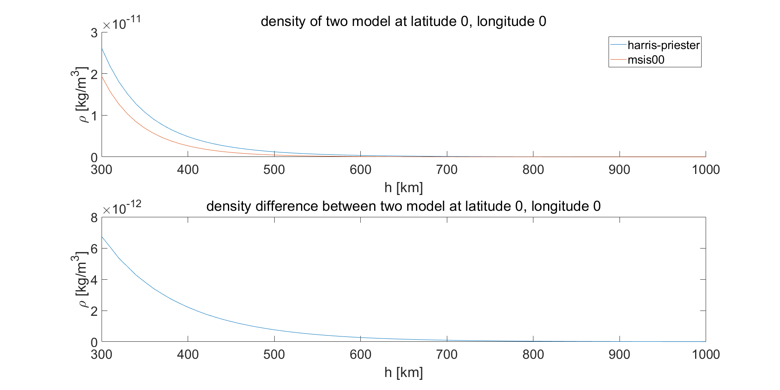
Density compare (Equator)

Slide 7
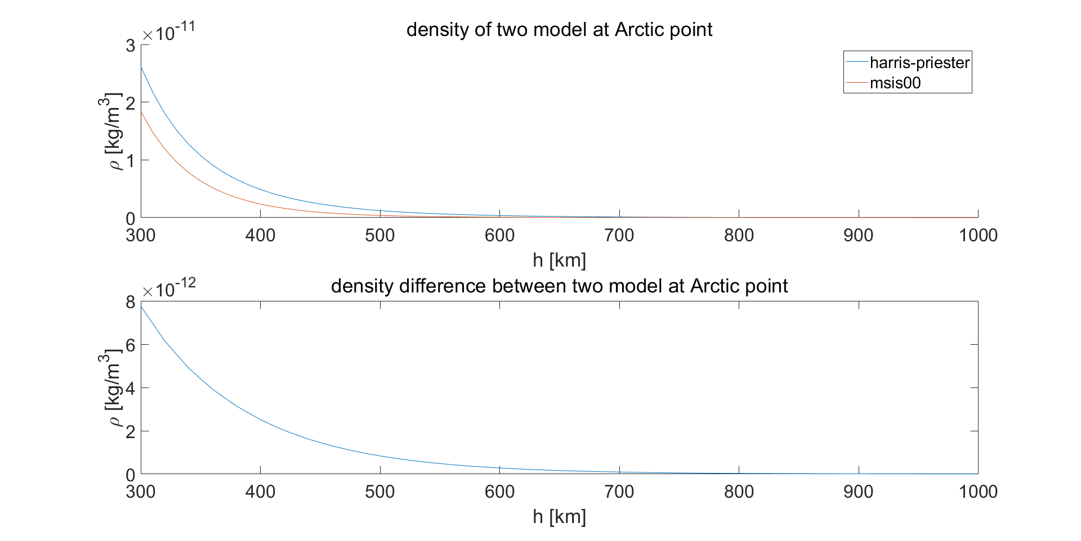
Density compare (Arctic point)

Slide 8
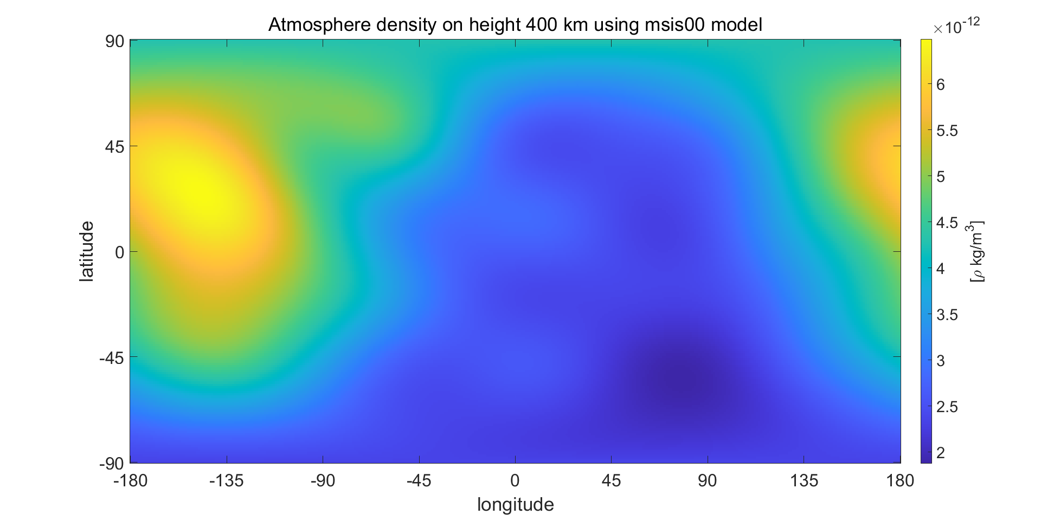
Density from msis00 at 400 km

Slide 9

Simplify the calculation
Using Harris-Priester model
Earth be regarded as sphere
$h=norm\left(r_{i}\right)−R$ instead of $r_{i}→r_{e}→(lat,lon,h)$

Slide 10
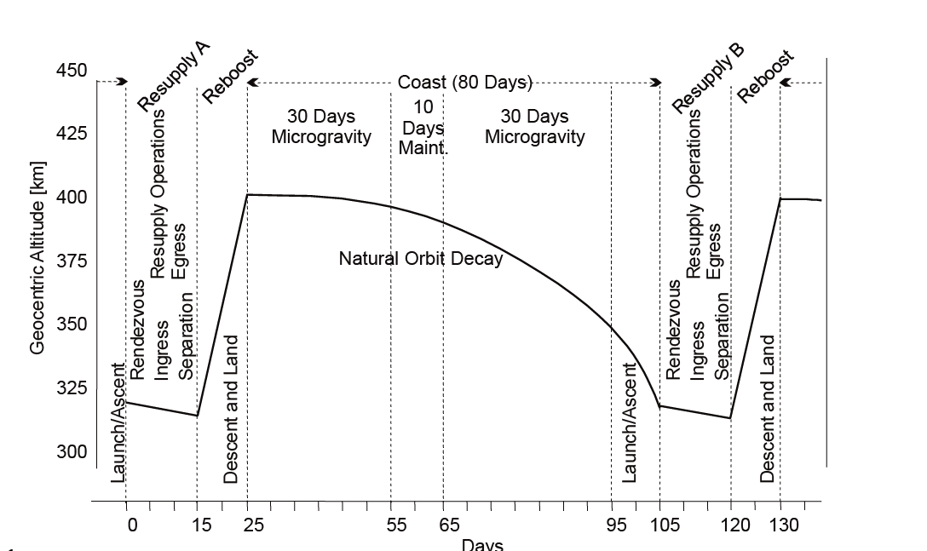
ISS orbit manuever

Slide 11

Orbit integration parameter
Section area: $5{ m}^{2}$
Mass: 1250 $kg$

Slide 12
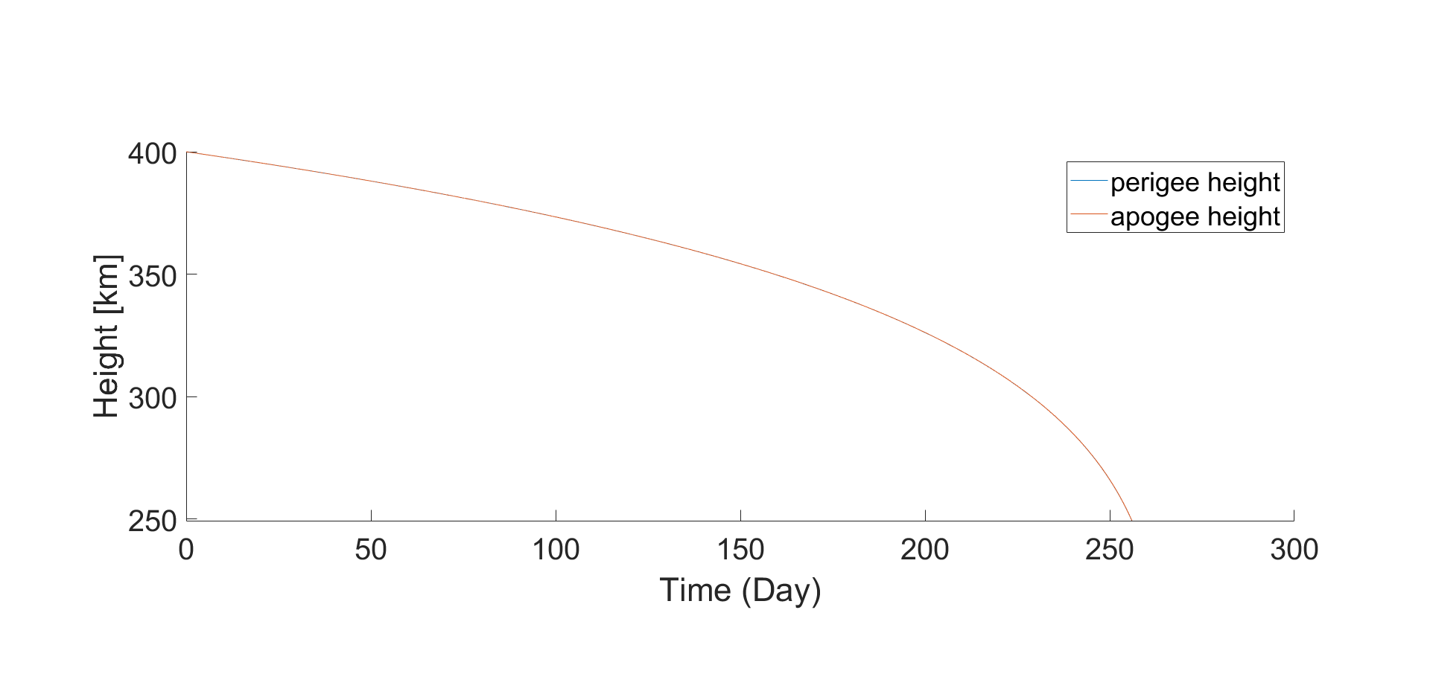
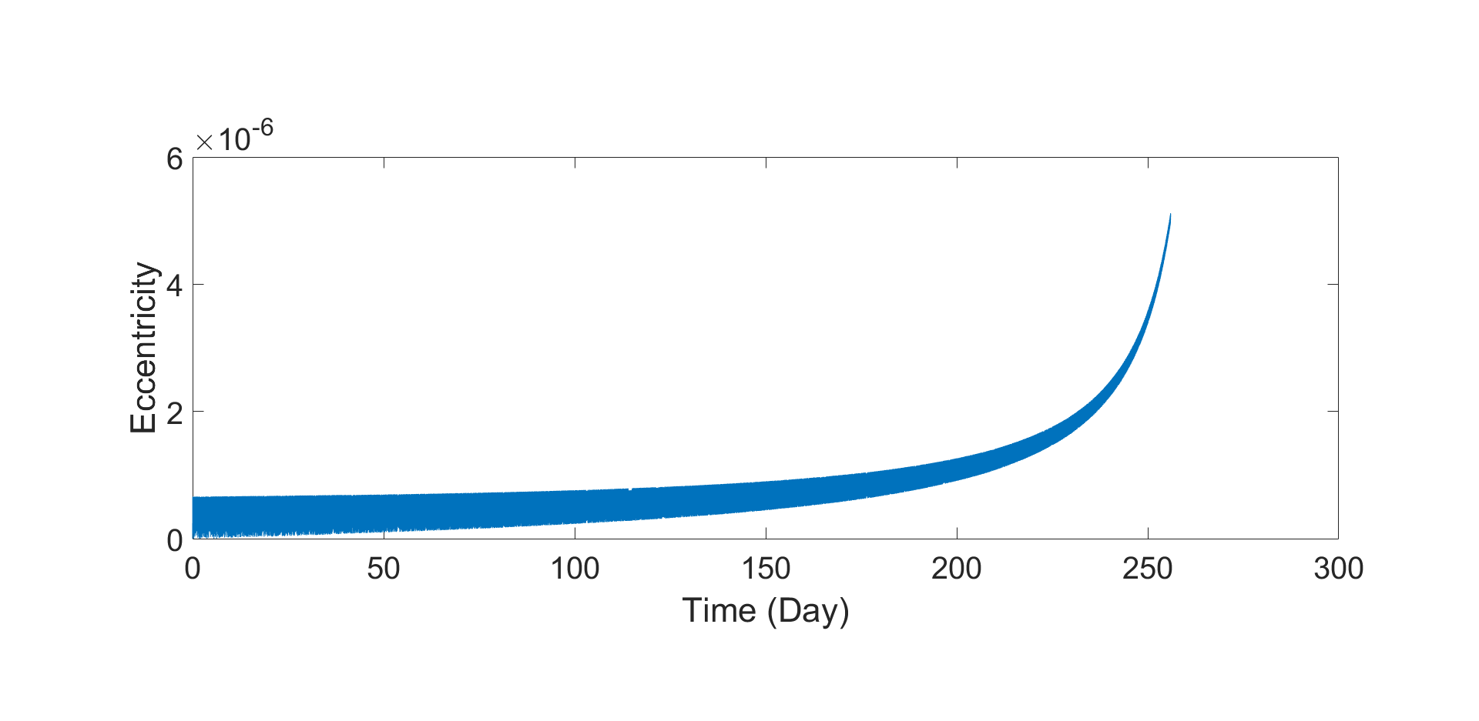
a - R = 400 km, e = 0

Slide 13
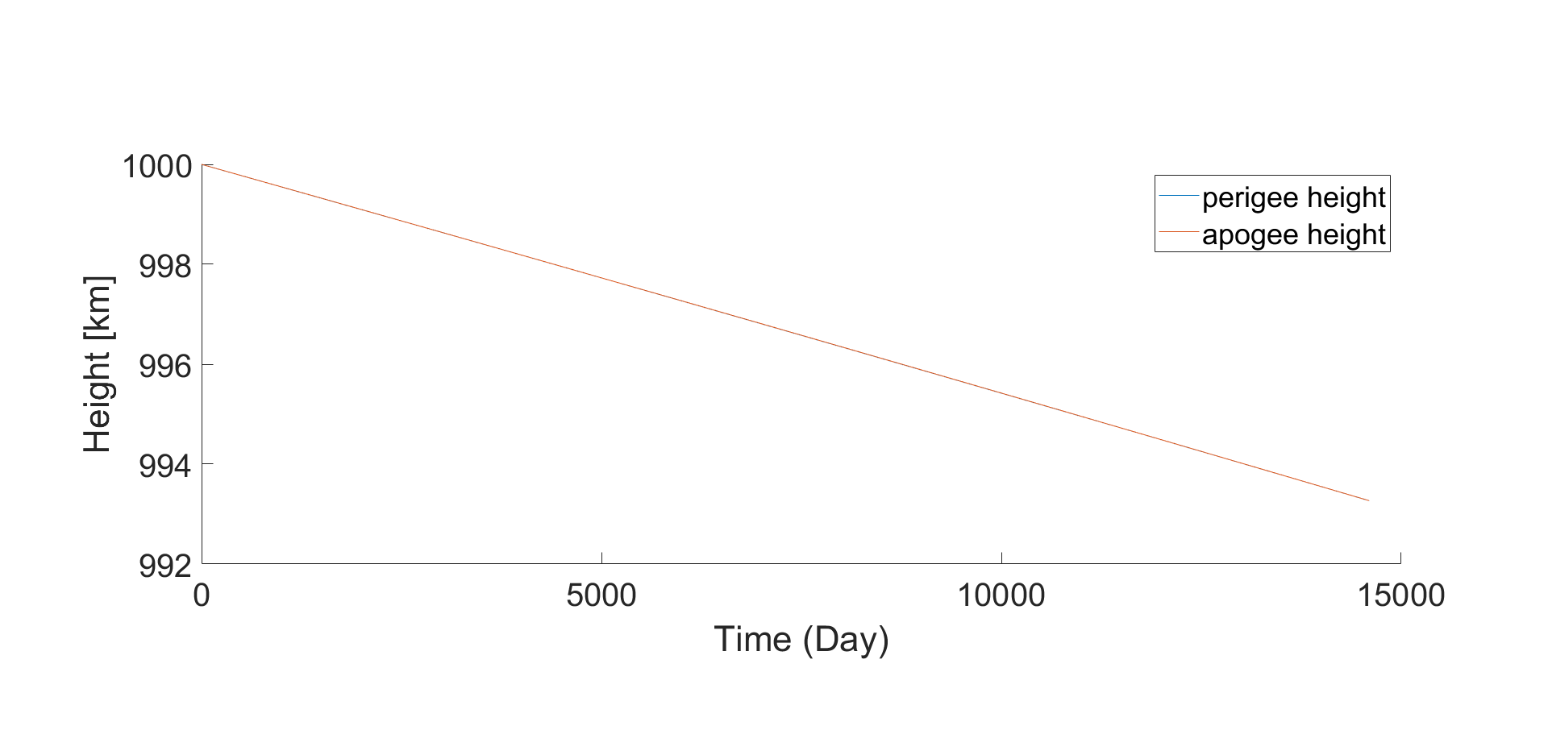
a - R = 400 km, e = 0

Slide 14
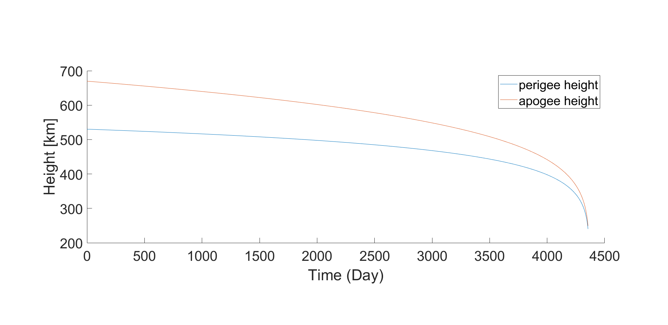
a - R = 600 km, e = 0.01

Slide 15
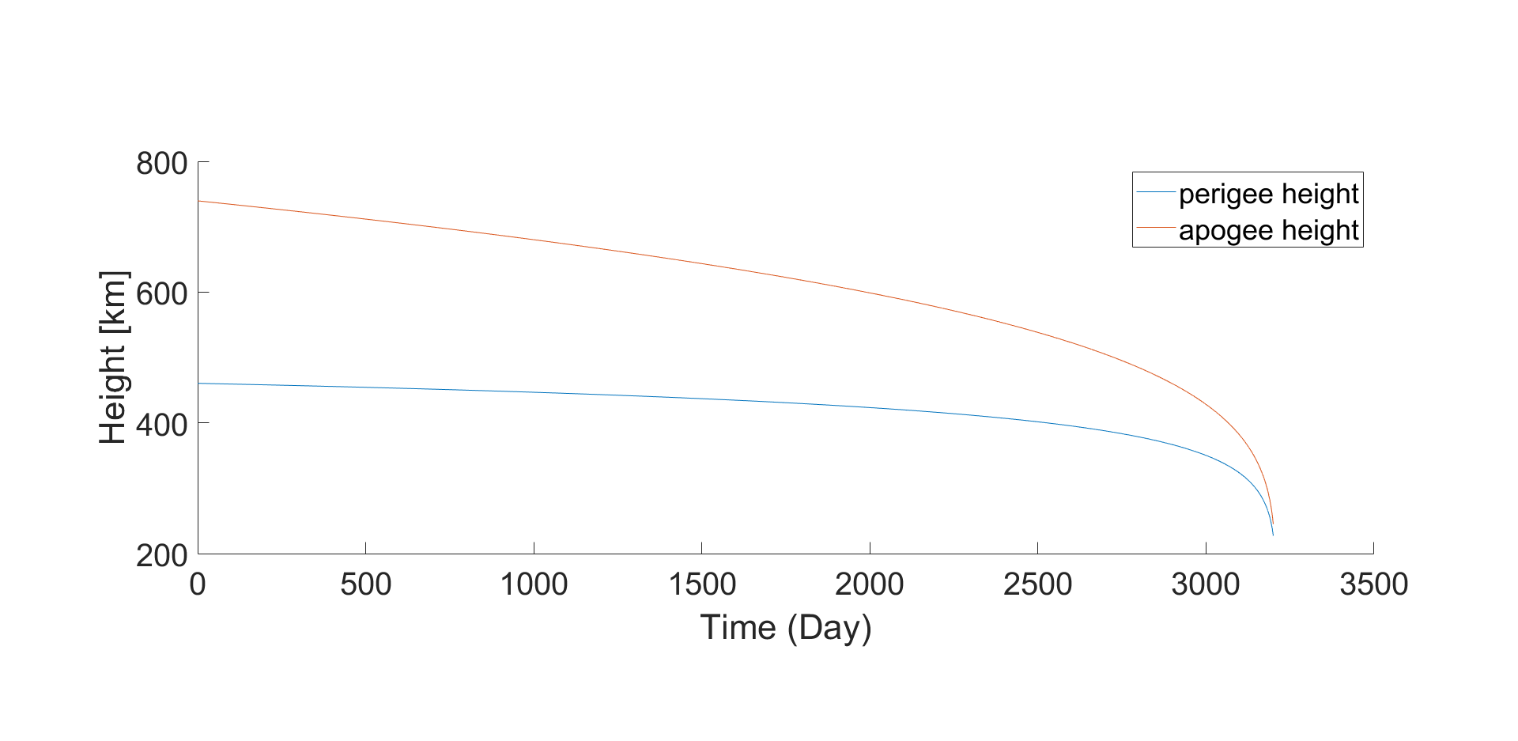
a - R = 600 km, e = 0.02

Slide 16
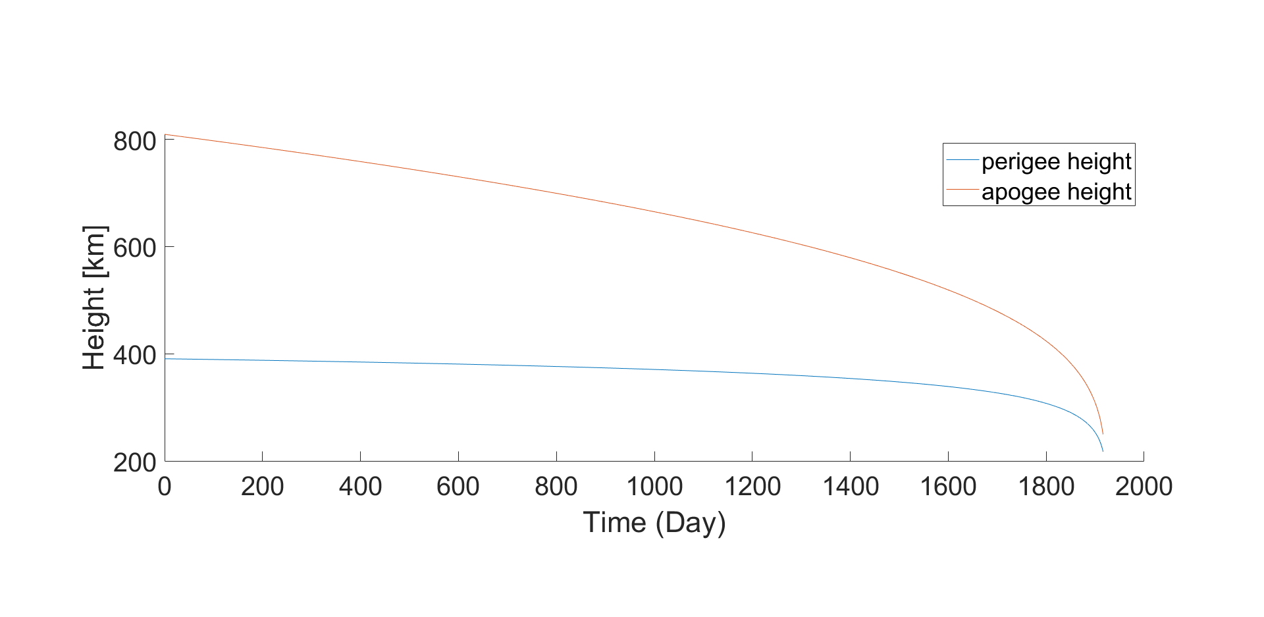
a - R = 600 km, e = 0.03

Slide 17
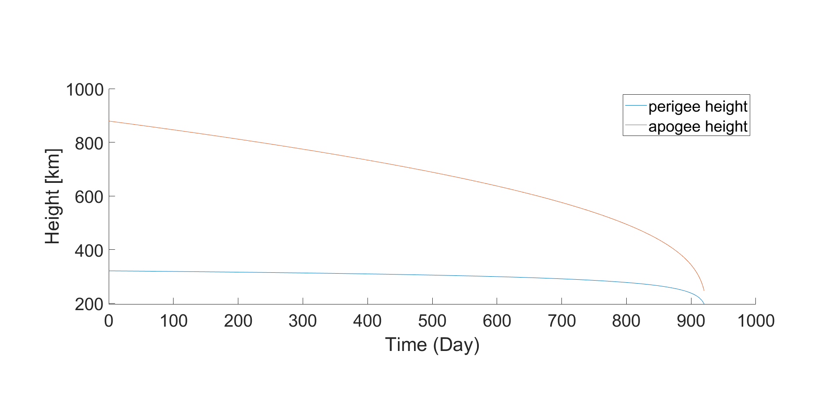
a - R = 600 km, e = 0.04

Slide 18
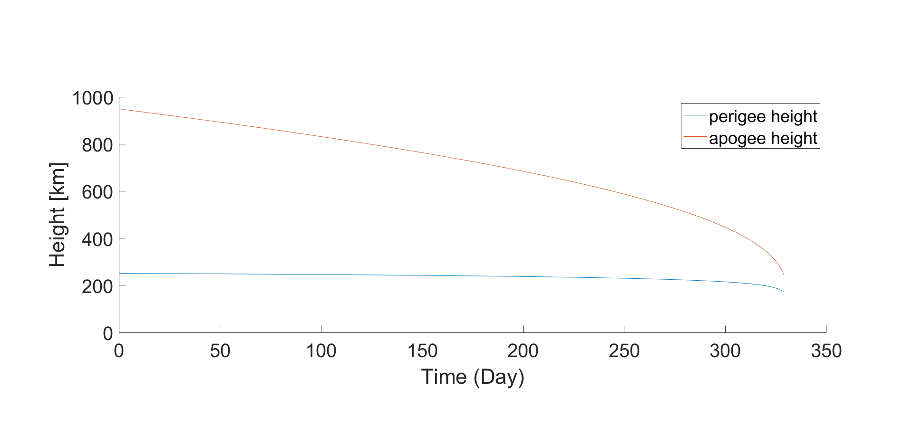
a - R = 600 km, e = 0.05

