Slide 1
Orbit integration
Jiaxin Liu
Ziqing Yu
24. January 2023, Stuttgart

Slide 2
Validate the methods
To simplify the process, other issues like earth flattening would be ignored.
We did the orbit integration using the similar settings from the Segel paper:
mass = 140kg, area = 25m^2, cd=2.5
using harris-priester model

Slide 3
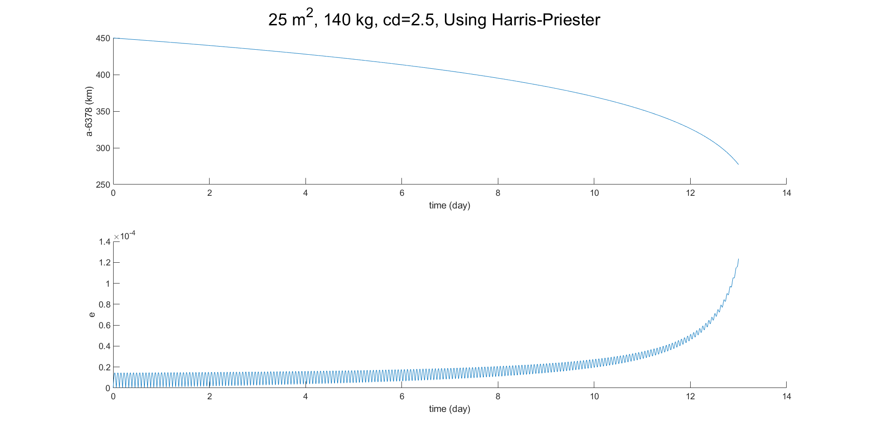
The decreasing trend of the height is similar to the paper showed us.

Slide 4
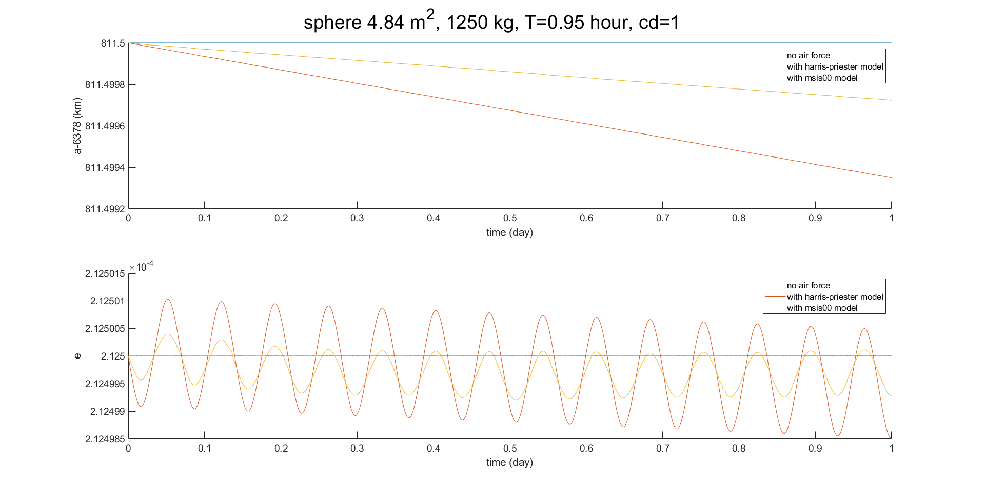
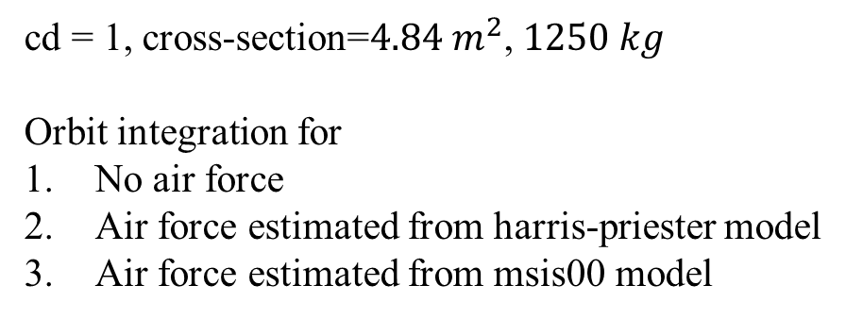
Compare 2 atmosphere model
cd = 1, cross-section=${4.84 m}^{2}$, $1250 kg$
Orbit integration for
No air force
Air force estimated from harris-priester model
Air force estimated from msis00 model

Slide 5
Compare 2 model
The height and the eccentricity decrease with different speed in one day
using 2 different atmosphere model.
It took a long time to use the msis00 in the integration.

Slide 6
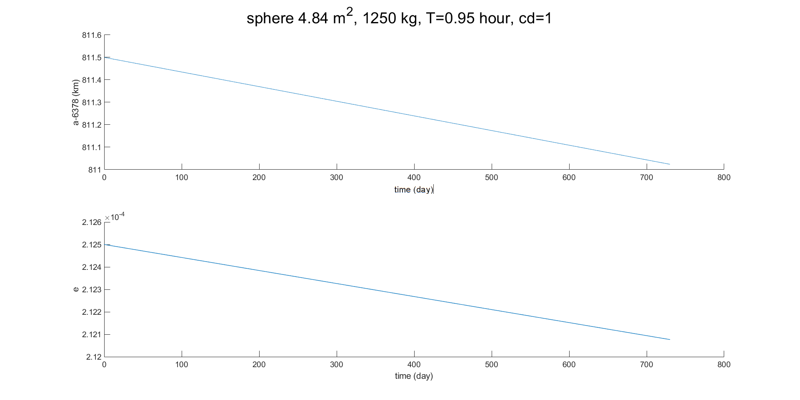
2 year integration
Thus, to save time, we use the atmosphere density from harris-priester model.
It can be seen that the long half axis has dropped by 0.5 km in 2 years and
eccentricity has also slightly decreased, though the orbit is already near a circle

