Slide 1
Frozen Orbit Beispiele
Torben Blei
Jiaxin Liu
Philipp Schollmeier
Ziqing Yu
November. 11, Stuttgart

Slide 2
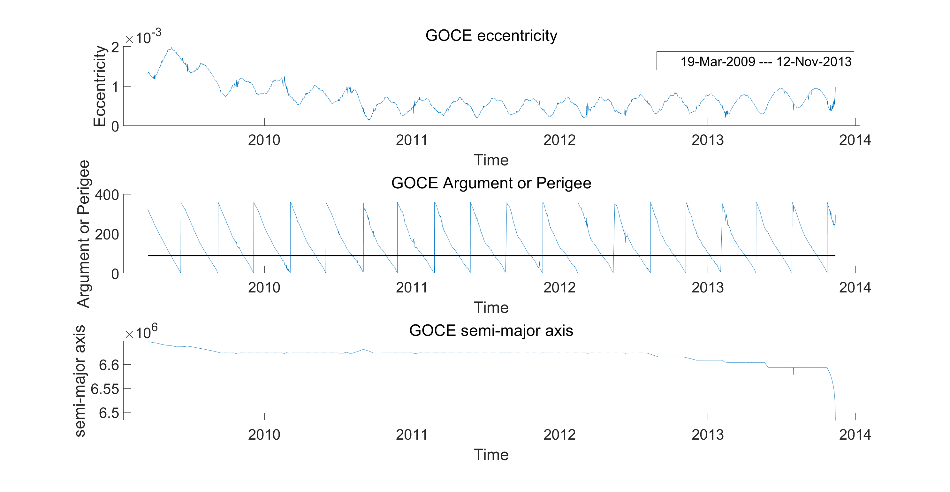
GOCE

Slide 3
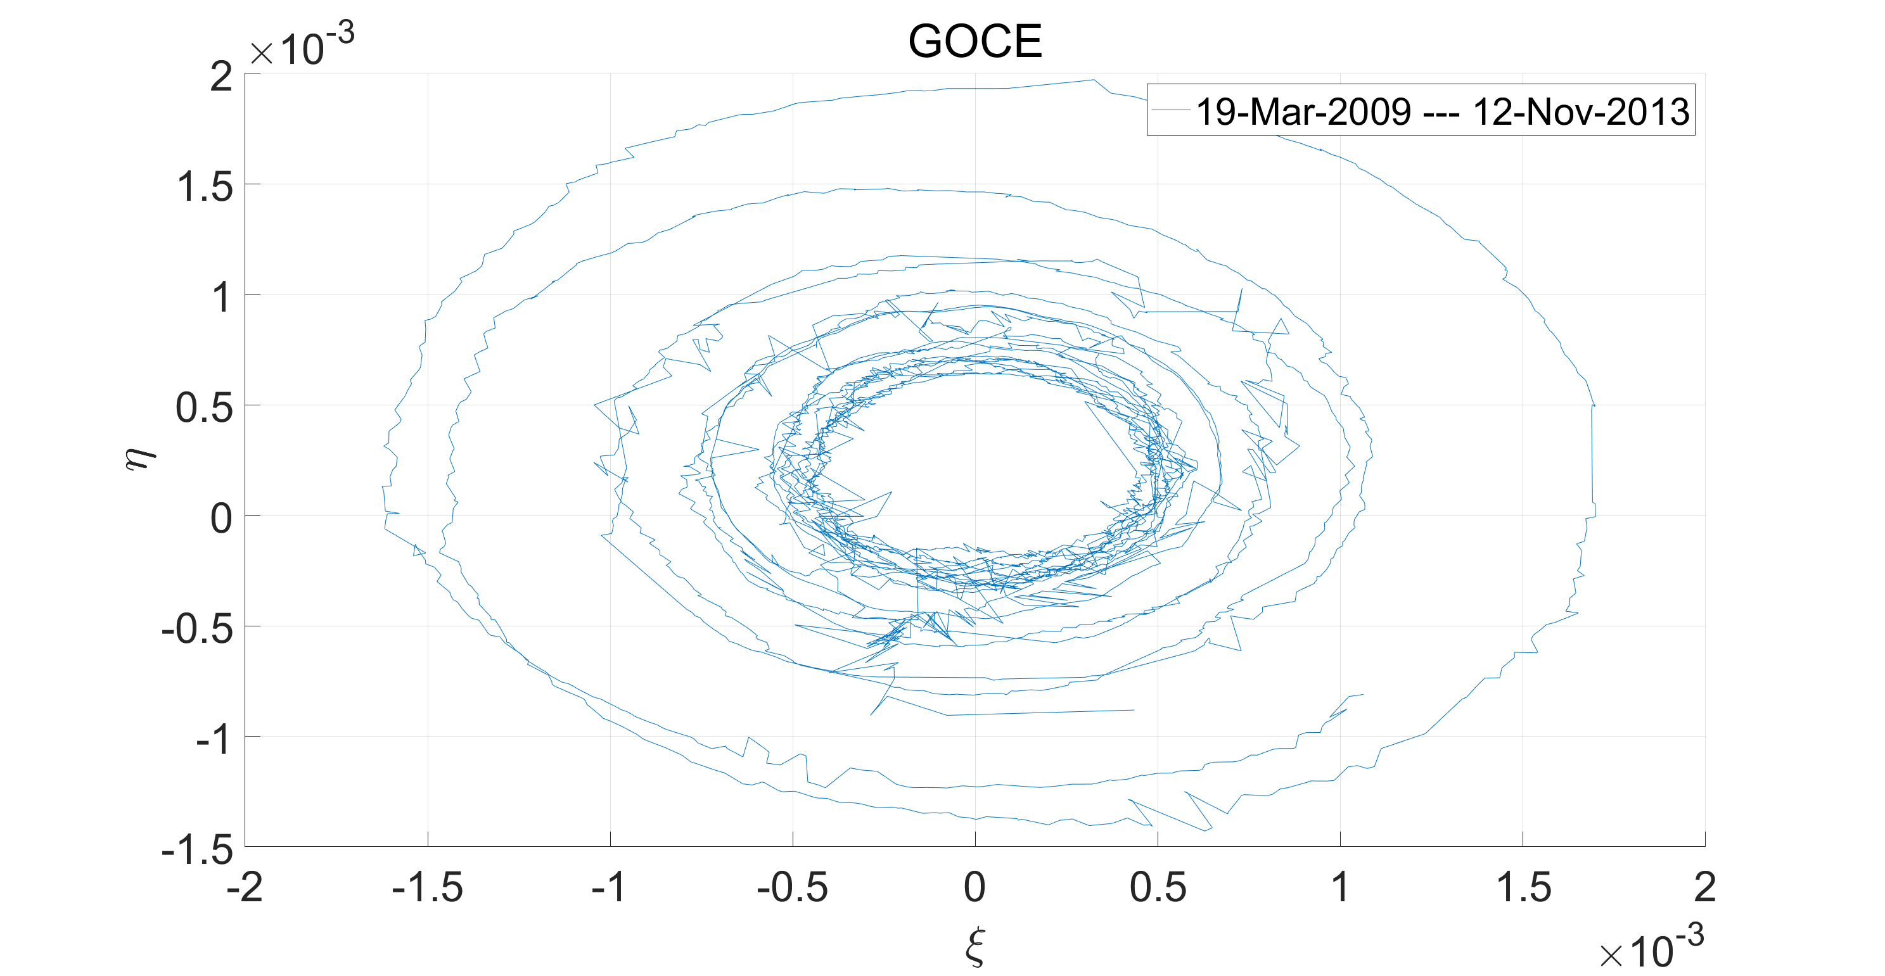
GOCE

Slide 4
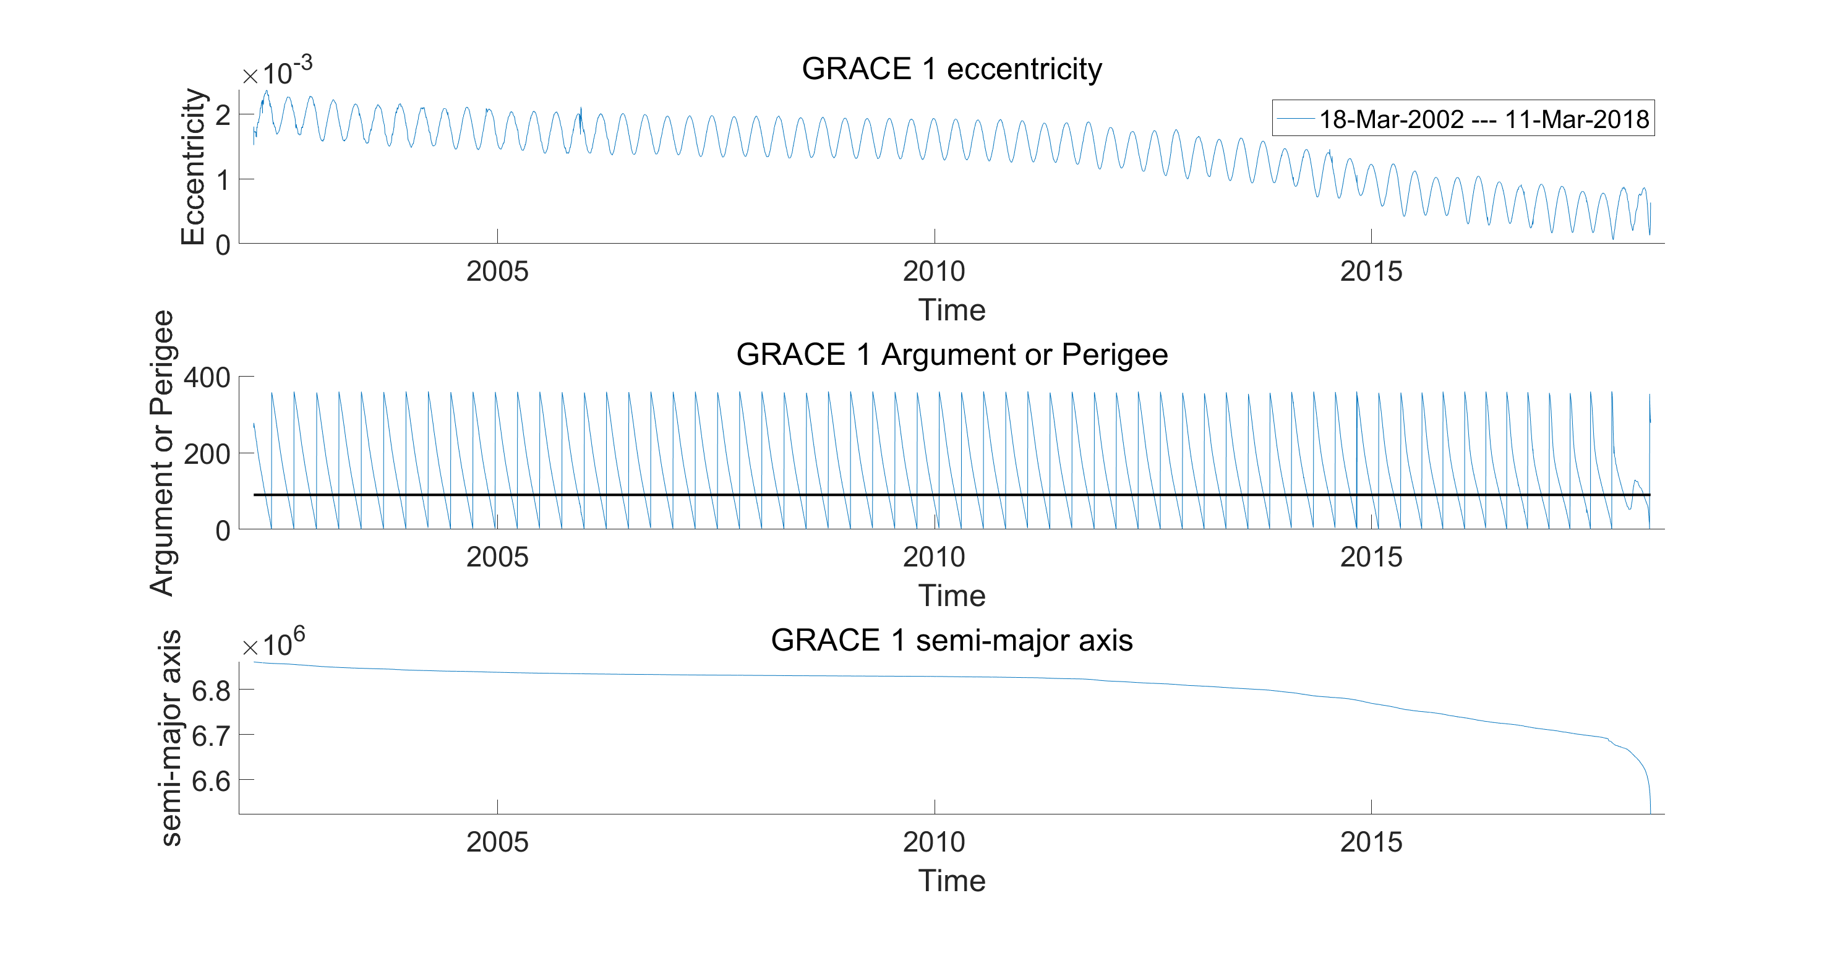
GRACE-1

Slide 5
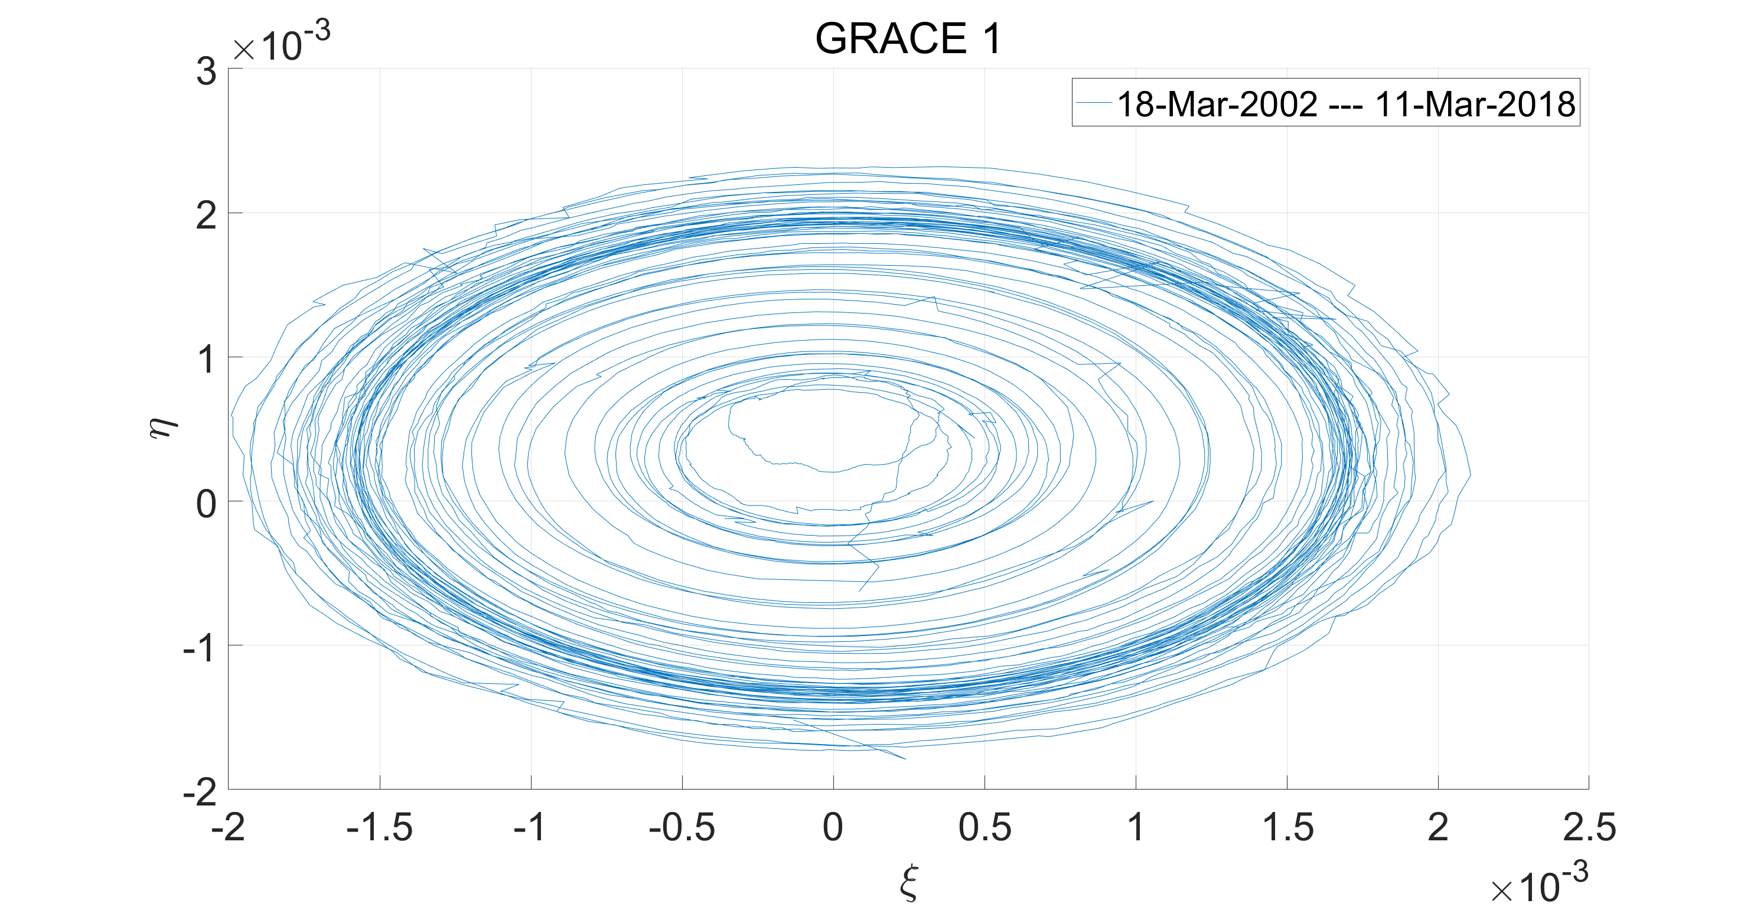
GRACE-1

Slide 6
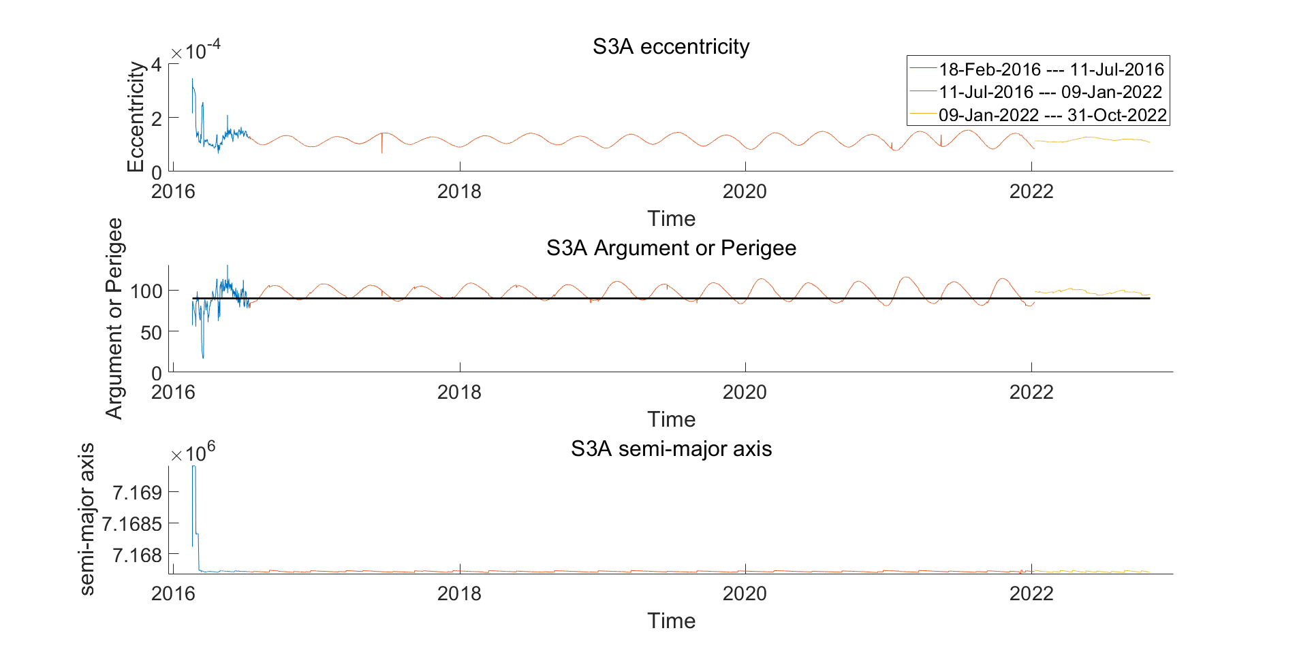
Sentinel-3A

Slide 7
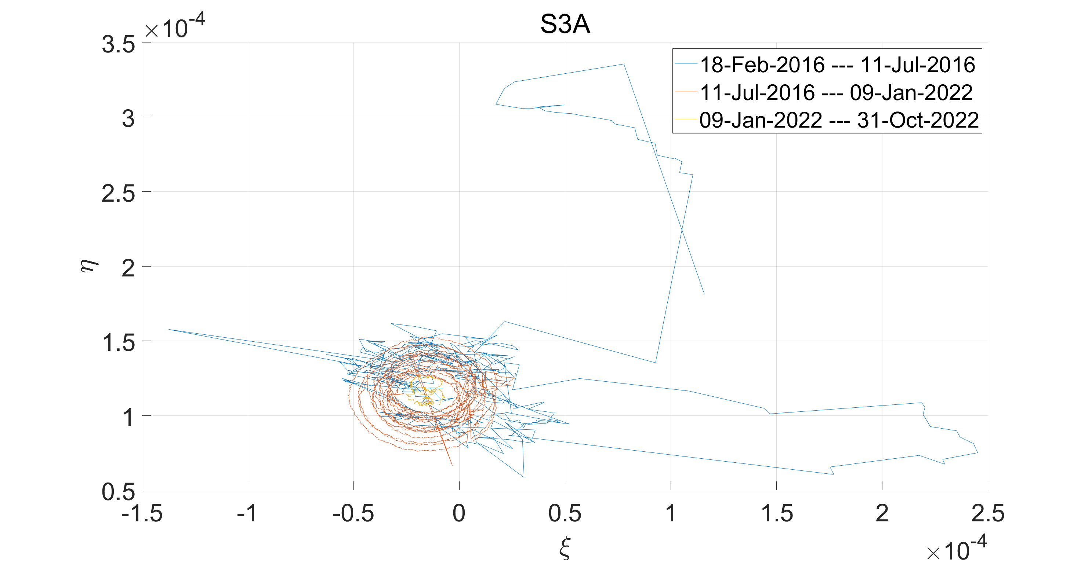
Sentinel-3A

Slide 8
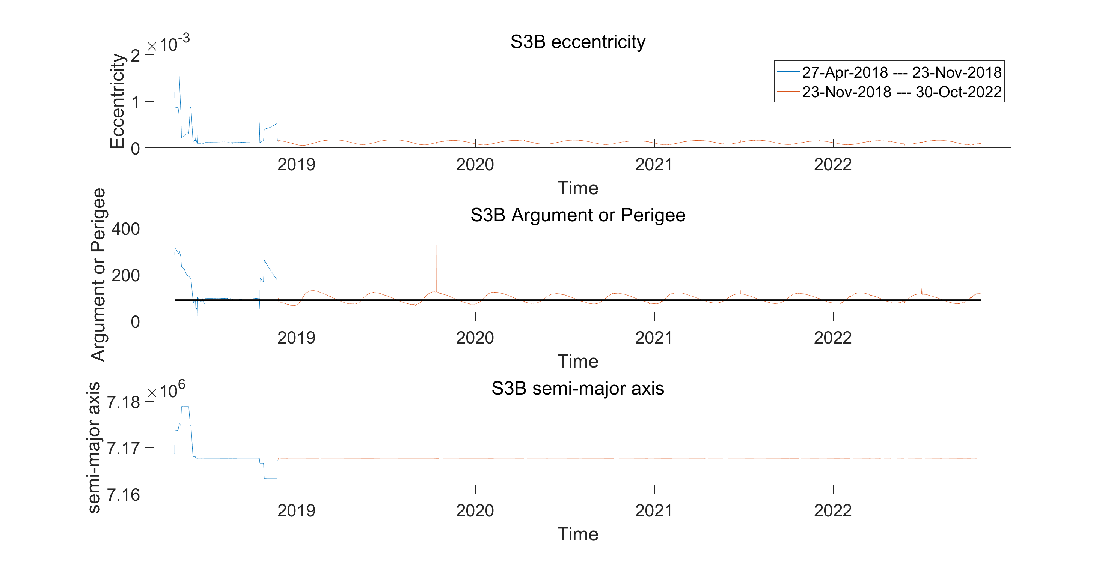
Sentinel-3B

Slide 9
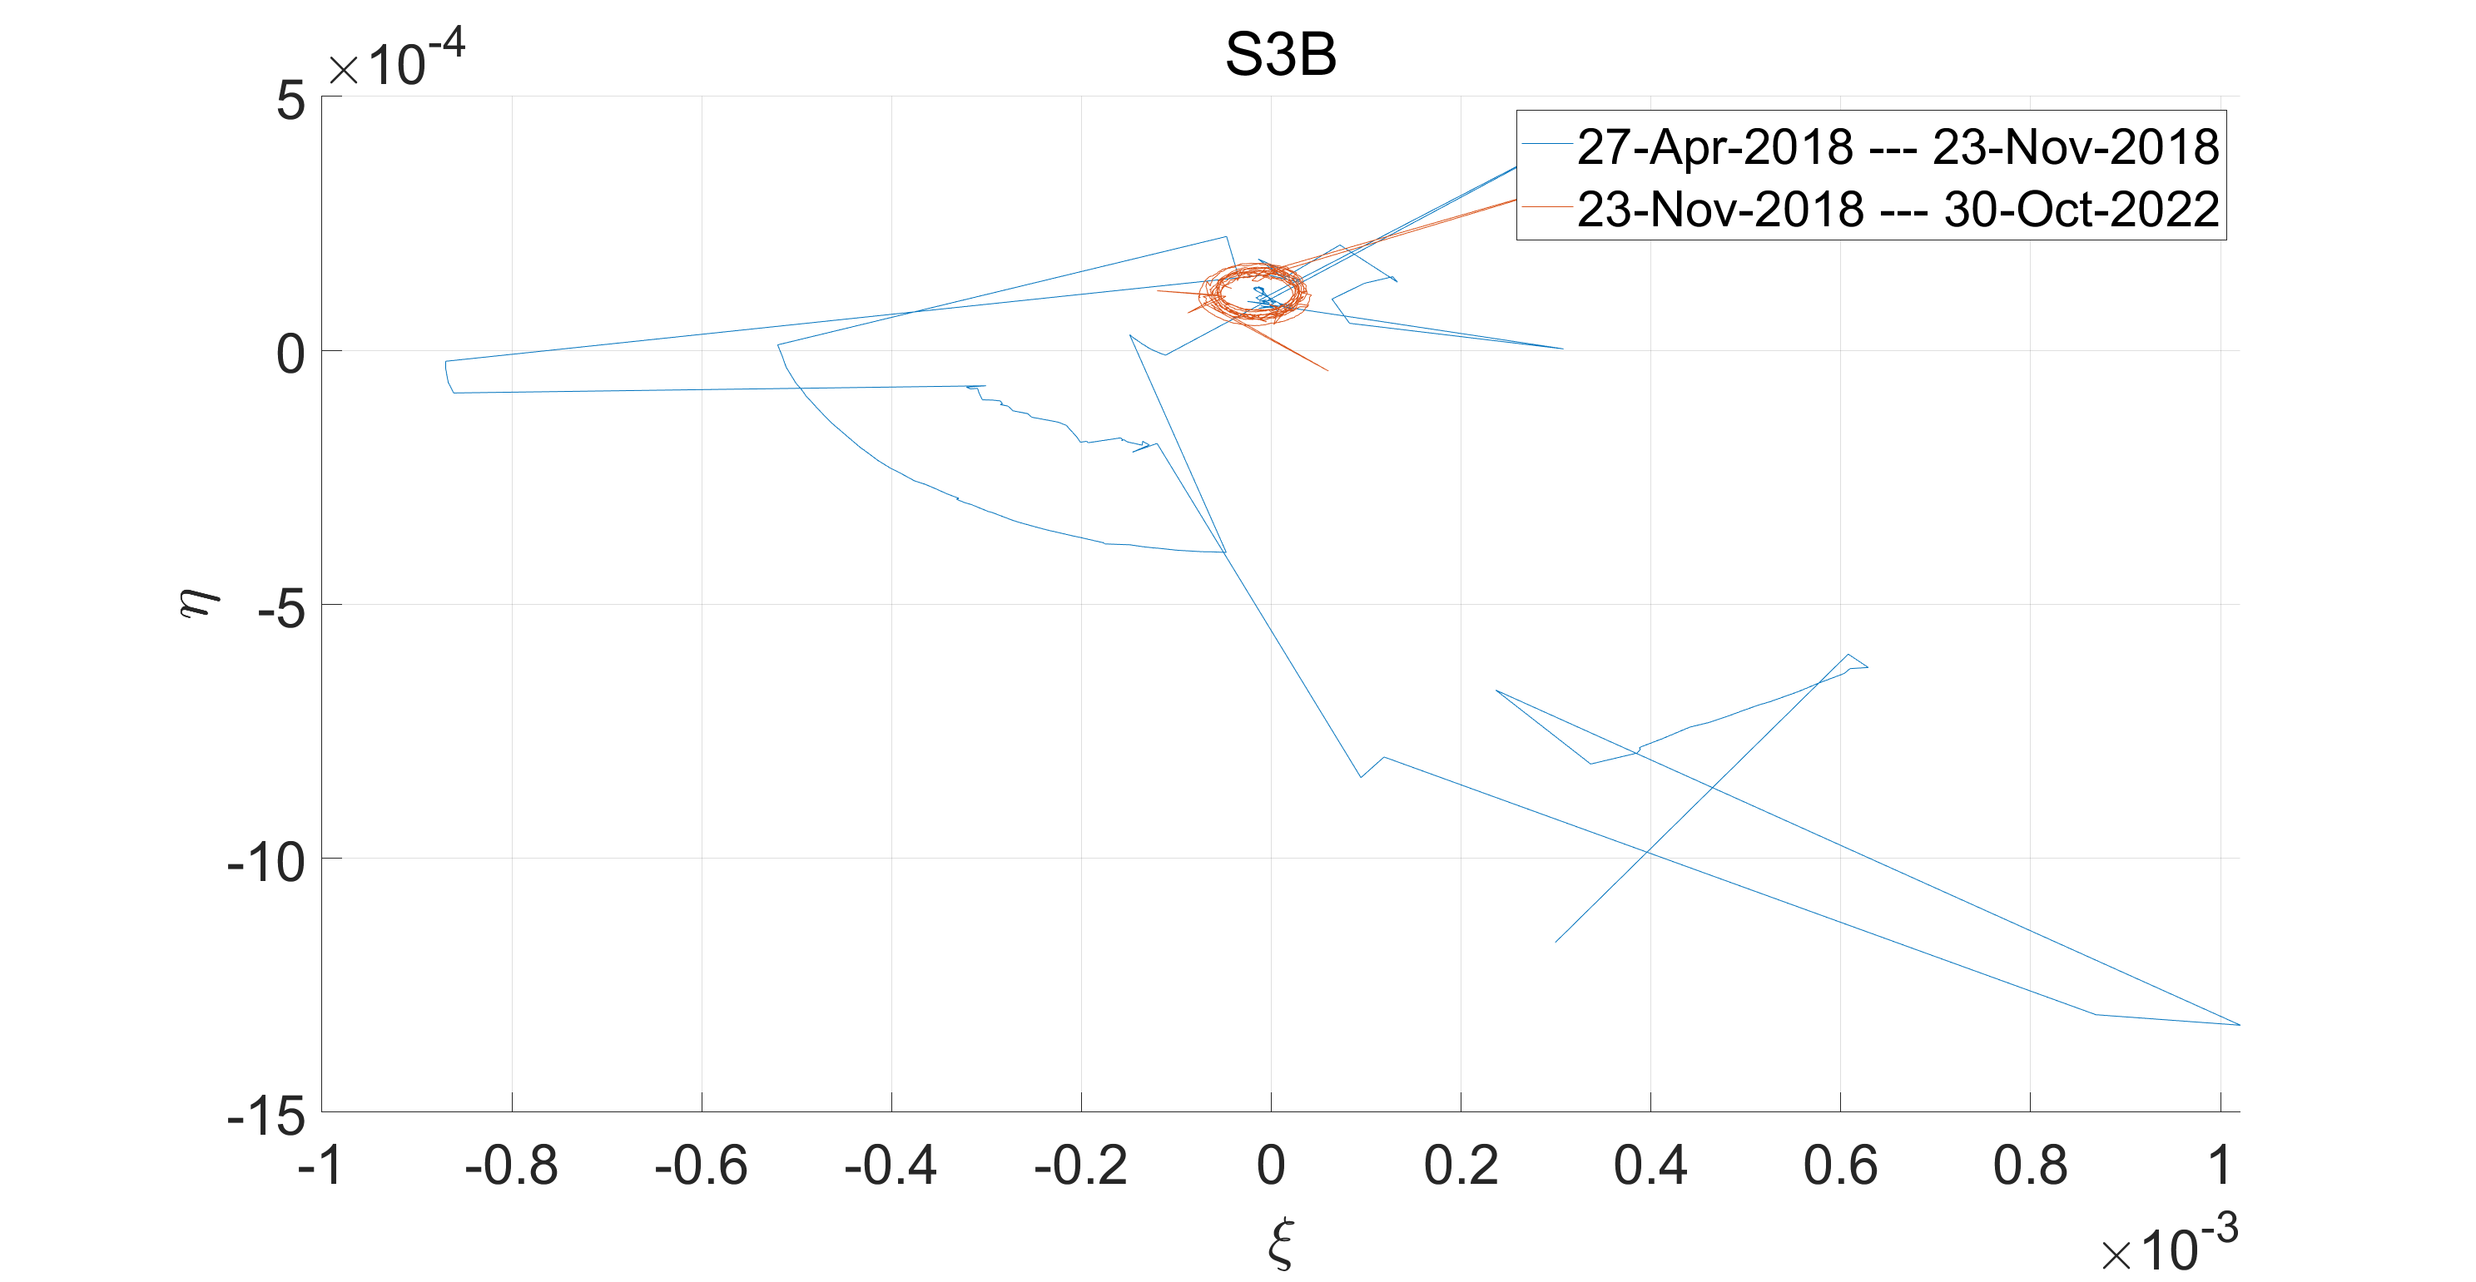
Sentinel-3B

Slide 10
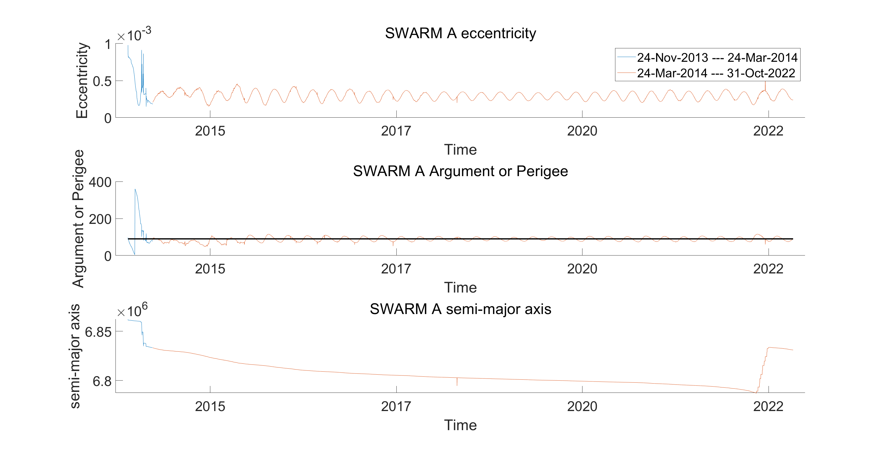
SWARM-A

Slide 11
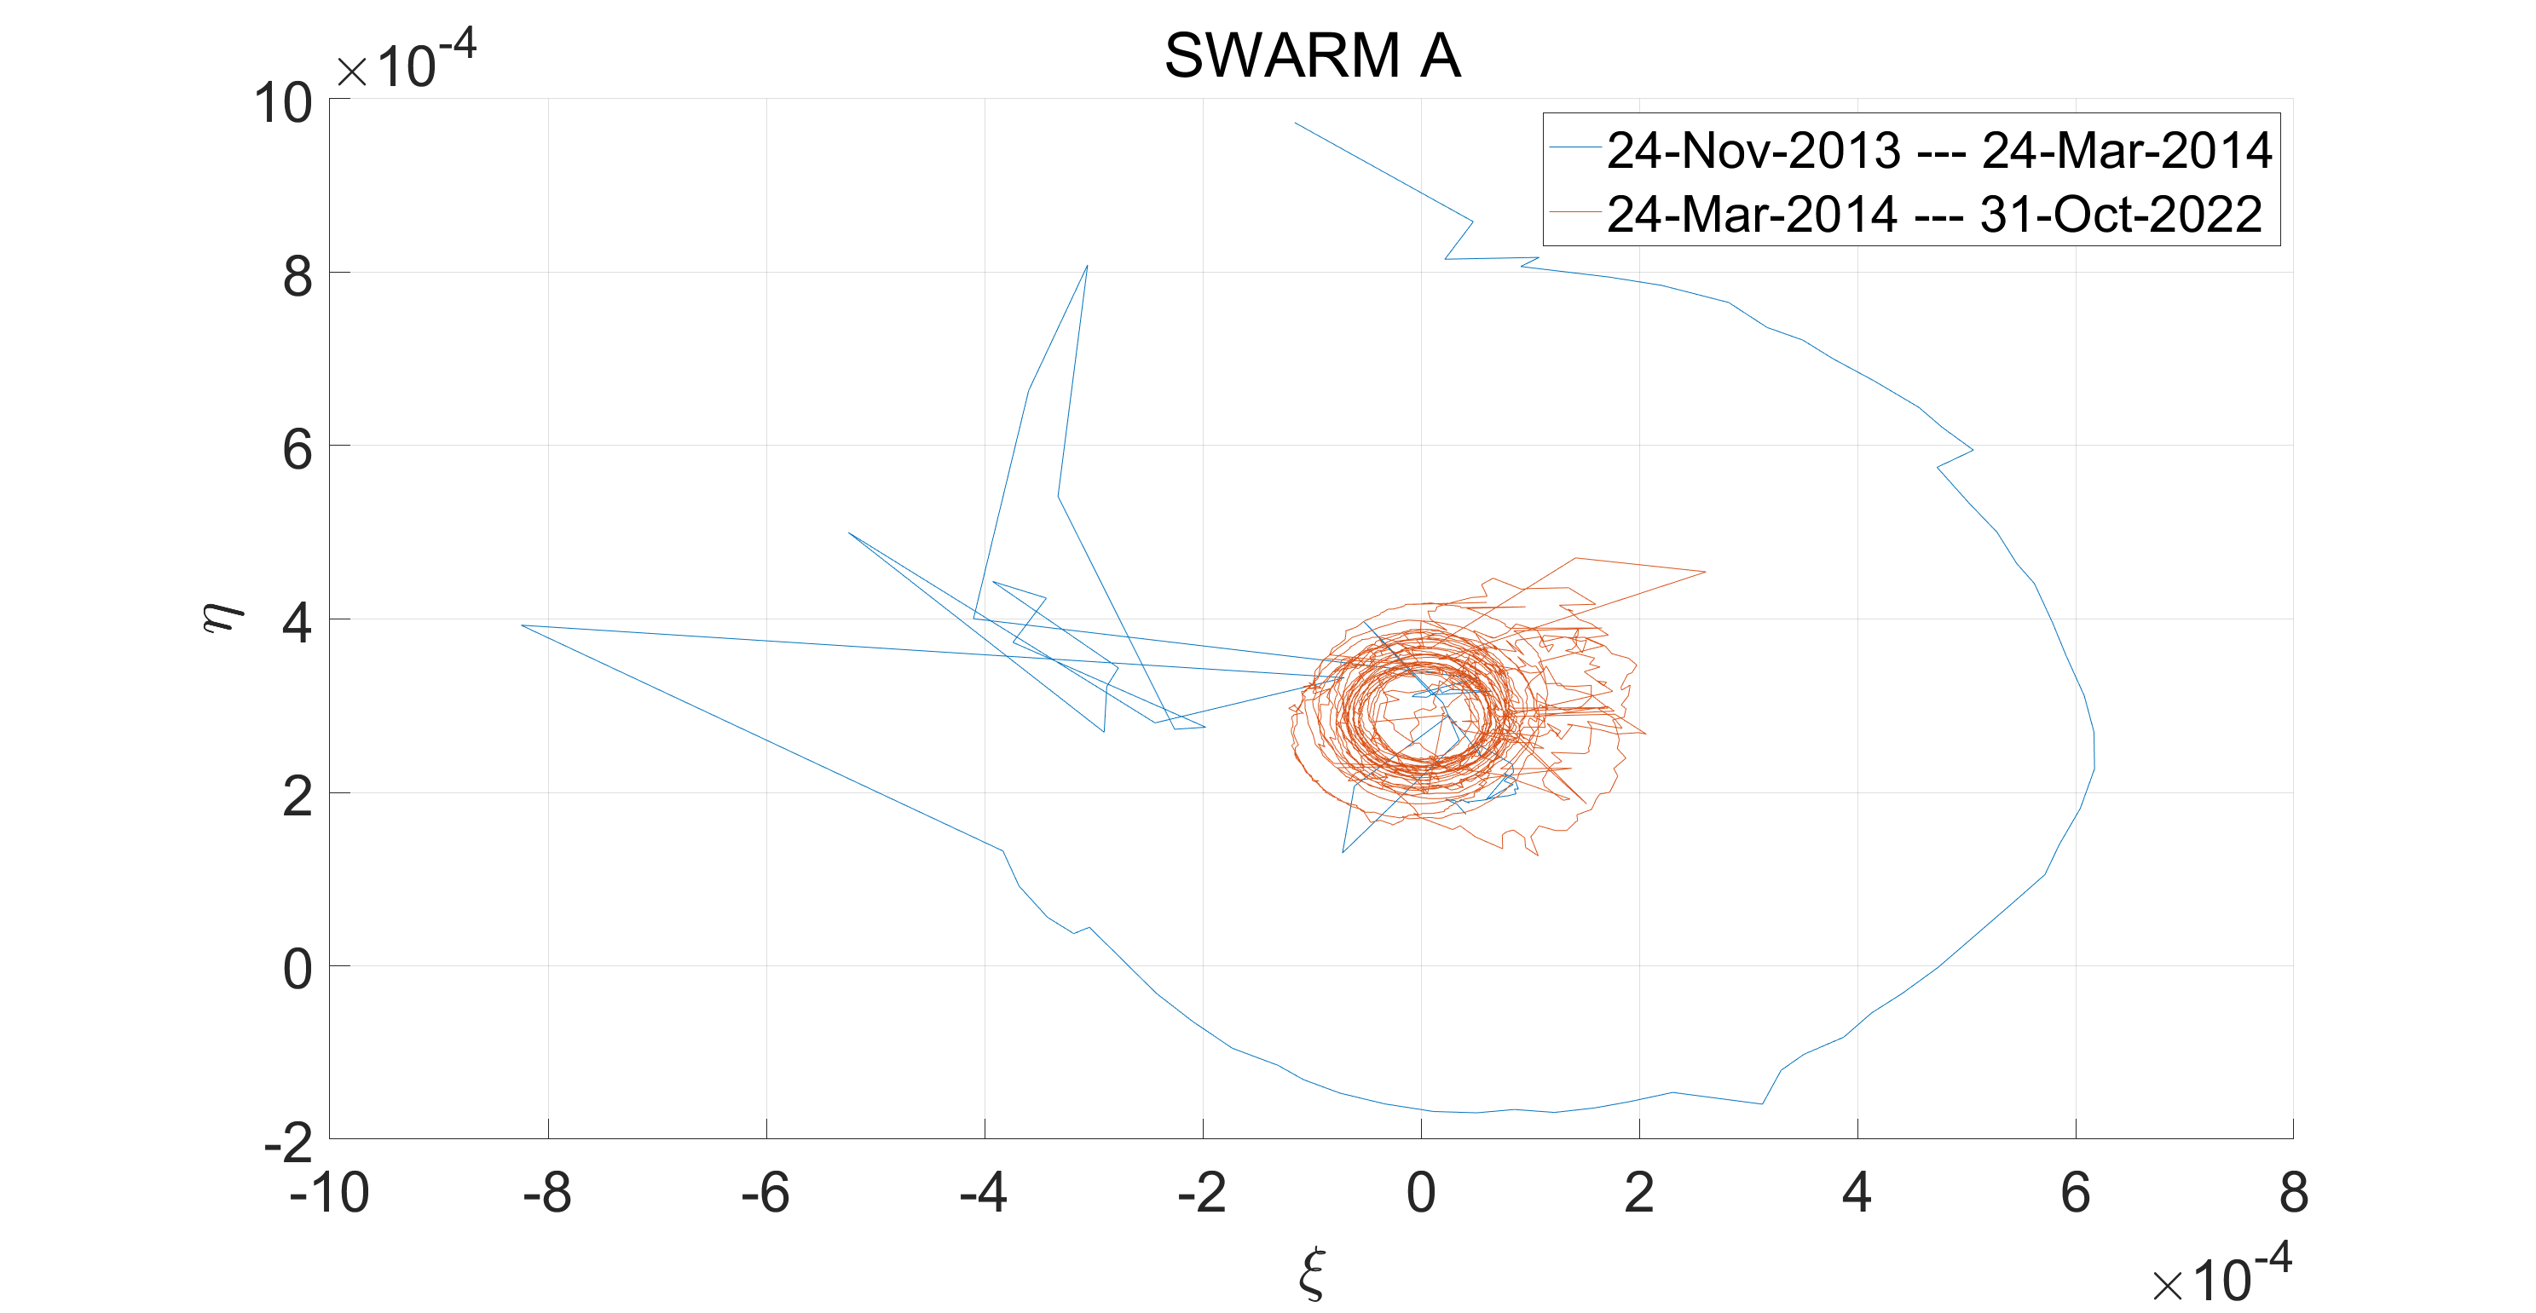
SWARM-A

Slide 12
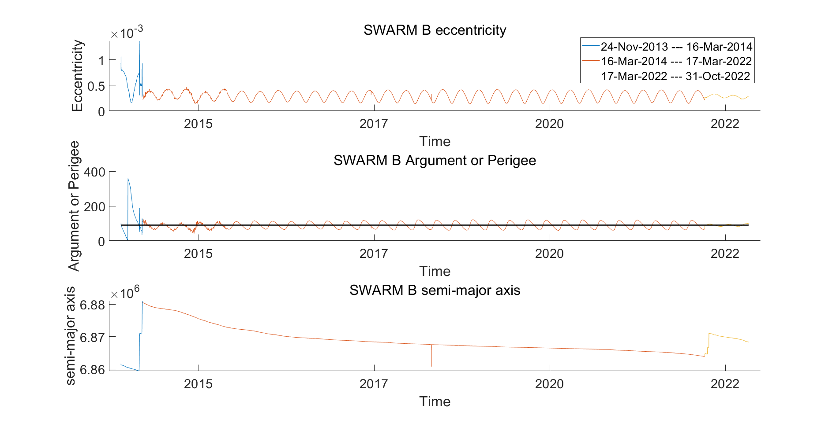
SWARM-B

Slide 13
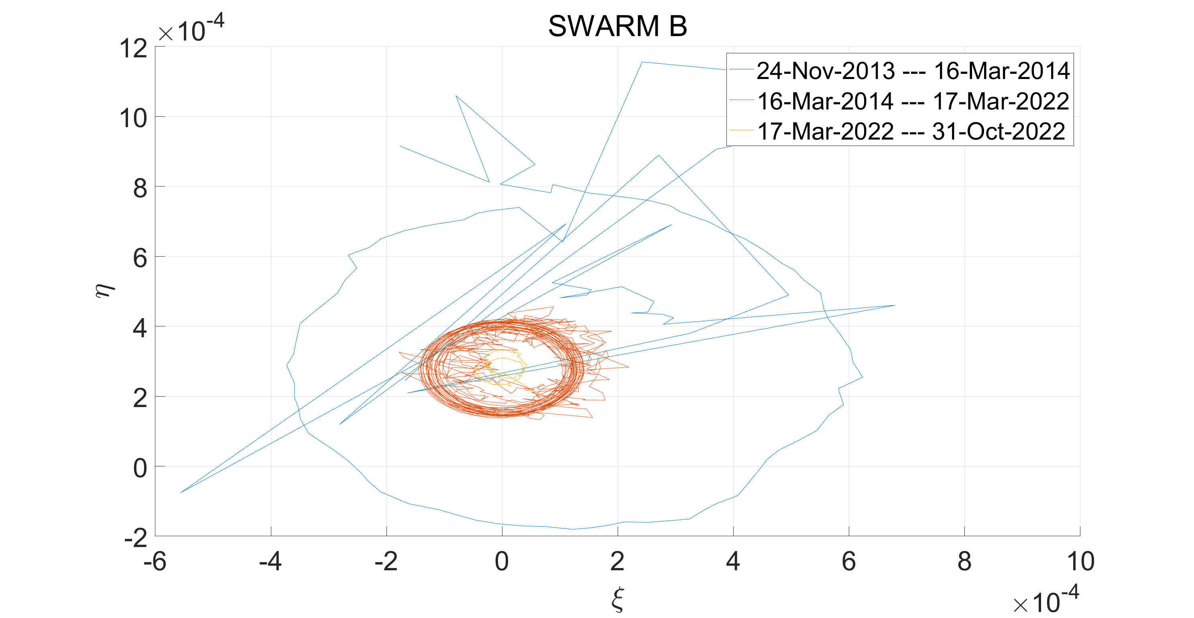
SWARM-B

Slide 14
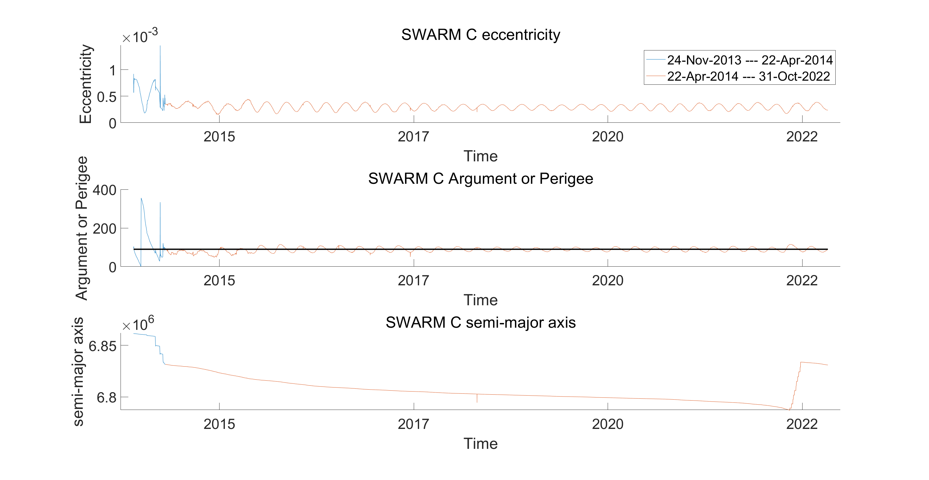
SWARM-C

Slide 15
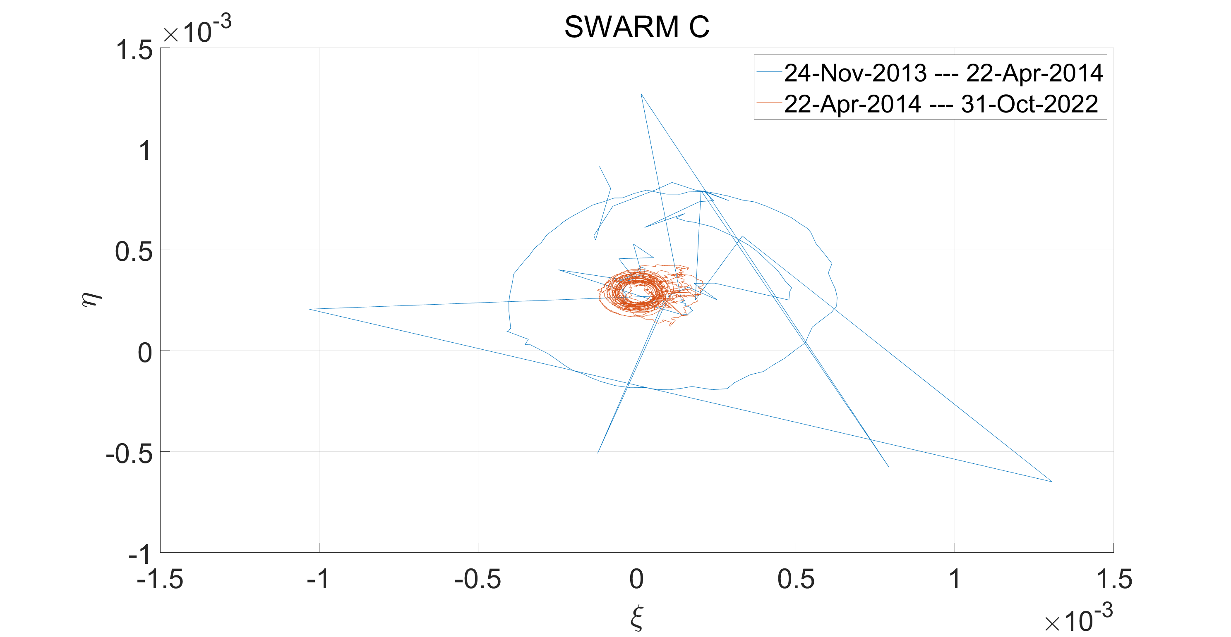
SWARM-C

Slide 16
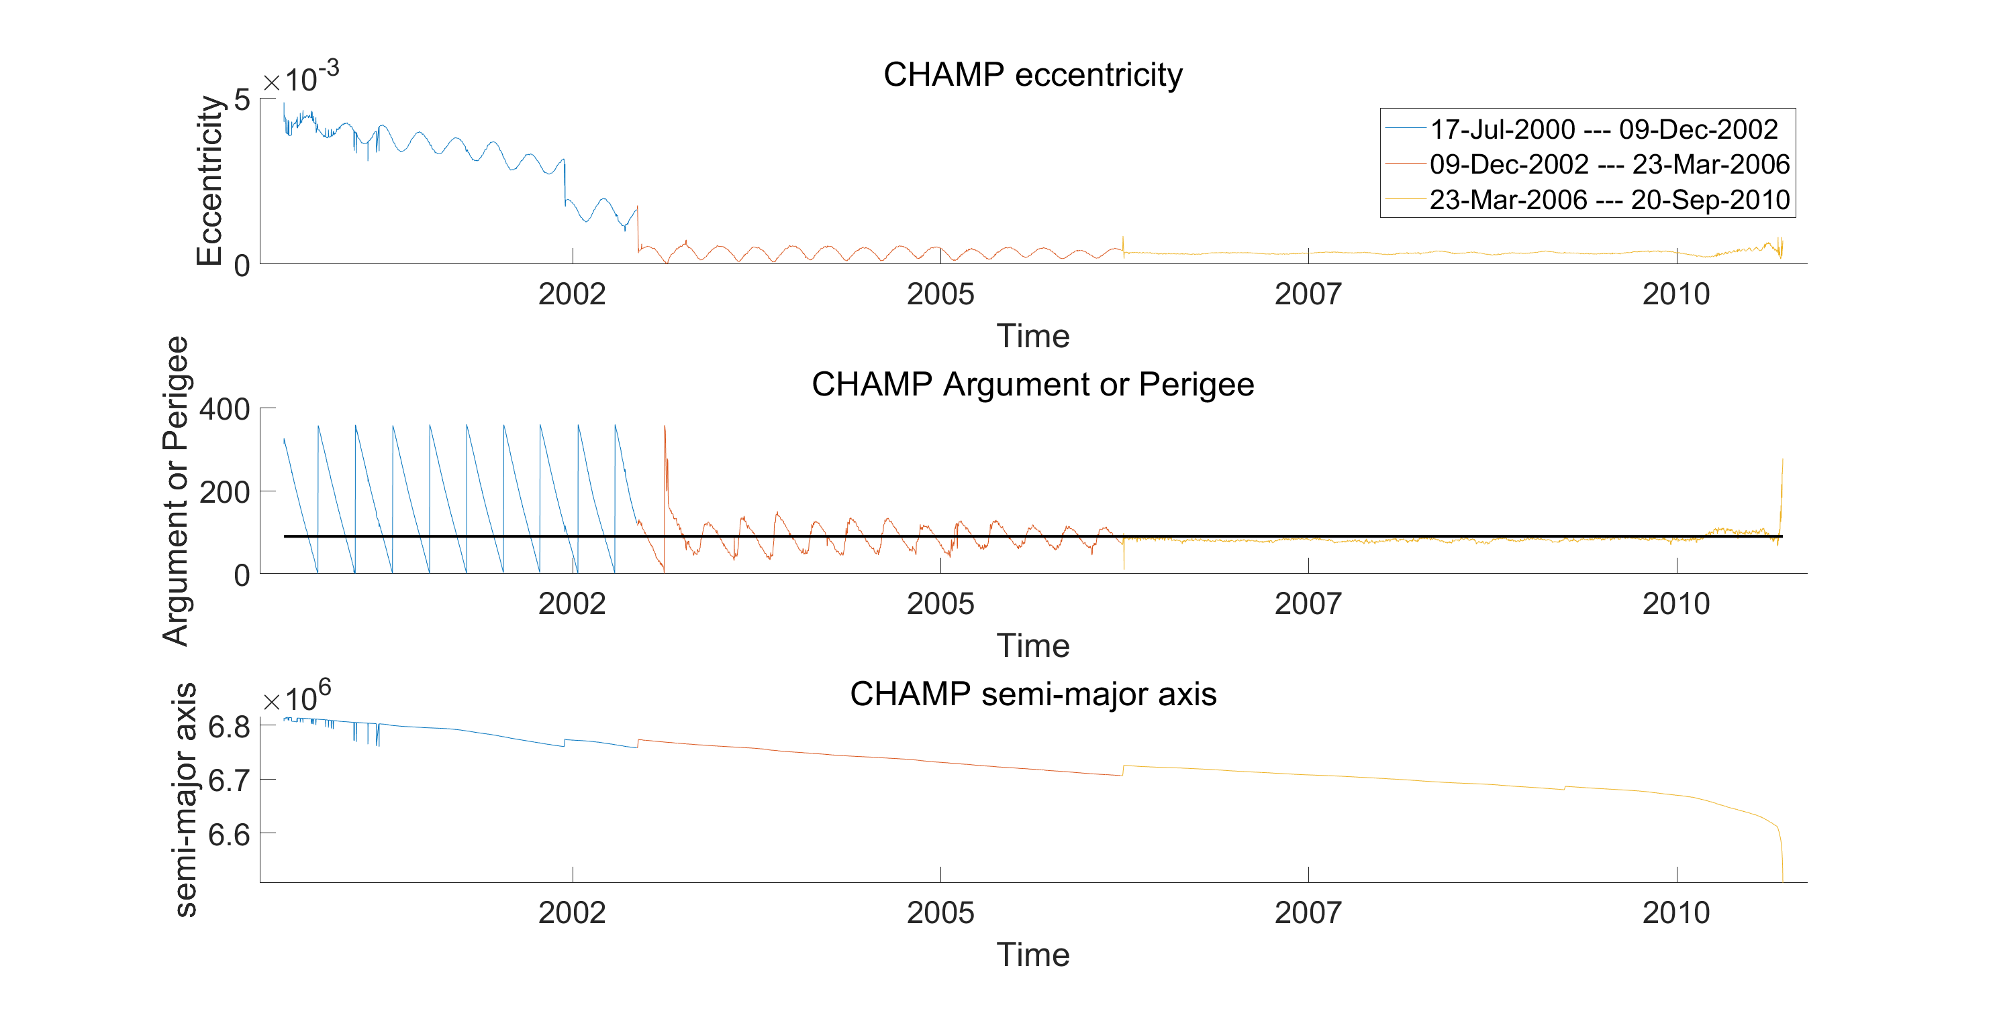
CHAMP

Slide 17
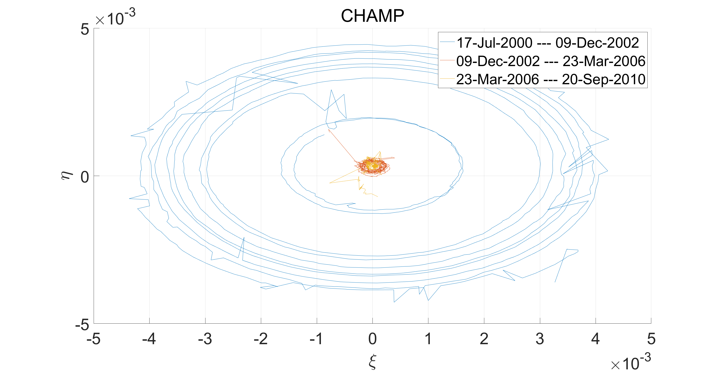
CHAMP

Slide 18
Thank you very much!

