Slide 1


Slide 2

Agenda
1. Development of DeSCa
2. Development of DeSMoS

Slide 3






- The EMPOWeRED Project - Educate, Monitor and Predict Outcomes With REsearch in Dengue
(7 Dec 2020 – 6 Dec 2022)
Dengue Self-Monitoring System
Dengue Severity Prognostication
Dengue Self-Care
DeSCa
DeSMoS
DeSProg
Empowering Patients with Dengue to Seek Evidence-Based Health Information for Self-Care Using A Gamified Patient Education Tool – the DeSCa Study
Development and Evaluation of a Dengue Self-monitoring System to Reduce Treatment Delay in Malaysia – the DeSMoS Study
Improving Dengue Severity Prognostication using Artificial Intelligence – the DeSProg Study

Slide 4
Progress Update: DeSCa

Slide 5
Milestones: DeSCa
Development and pilot testing of the gamification-based educational tool for evidence-based dengue self-care and reduce delay in help seeking
16 Feb – 15 May 2022 (3 months)
Requirements
Content – Questions bank
Development
16 May – 15 June 2022
System Testing

Slide 6
Requirements
To develop a mobile phone app running on the Android operating system.
The app must consist of a Dengue Learning function. There will be 7 modules (quiz - with a total of 50 questions). User will answer 1 question at a time and the correct answer will be given before moving to the next question. The gamification approach will be used (Progress bars, badges). Questions will be provided.
The app must consist of a Nearest Hospital function (google map) to allow user to find the nearest hospital.
The app must be able to link to the Dengue Hotspot (Embed the contents of the iDengue website’s map and data - details will be provided).
The app must have the FAQs page. Contents will be provided.
The app must have the Extra resources page (hyperlinks to other resources)
Admin Module (Web)
The app must have an analytics function to summarise users score in quiz.

Slide 7
Progress Update: DeSMoS

Slide 8
Milestones: DeSMoS
Development of the self-monitoring system (unified software development process)
16 Feb – 15 May 2022
Requirements
Development
16 May – 15 June 2022
System Testing

Slide 9
Requirements
To develop a mobile phone app running on the Android operating system.
Patient Module
The app must consist of a patient login function.
The app must allow the patient to can key in their temperature, blood pressure, pulse rate, hemoglobin, hematocrit, white cells and platelet. These should be able to appear in chart format.
The app must allow the patients to view their status on the dashboard.
The app must consist of a symptom diary function that allow the patients to enter their symptoms. After the symptoms are entered, there will be an incorporated decision tree that feedback the patient to seek medical attention immediately OR safe to stay home.
The app must consist of a checklist of self-care tasks to do. Patients need to complete daily tasks and the reminder will pop up 3 times a day. (Example, drink water, taking medicine, and etc)

Slide 10
Requirements
Admin Module
The app must have an analytics function to summarise patients’ data and details.

Slide 11
Non Functional Requirements
The app must have a widget-style home page (refer attachment).
The app must have DUAL language. (BM/BI)
The app must be secure, and the patient data must be protected.
Include disclaimer before using the app (must be assessed by doctor first)

Slide 12
Others
The app must be hosted and running for 2 years.
All source codes must be given to the University of Malaya team at the end of the project.
https://marvelapp.com/prototype/669g1ij/screen/80596077
https://pub.dev/packages/timelines

Slide 13
Development Team
Tan Chun Fang
Tan Chun Rong
Yeow Zi Qin
Weekly Meeting with Ang Tan Fong

Slide 14
Target User
Basic User
Public (DeSCa)
Patient (DeSMoS)
Get approval before can access
Administrador
Register Full Name & IC
Dashboard
Data Export
Approval of Dengue

Slide 15


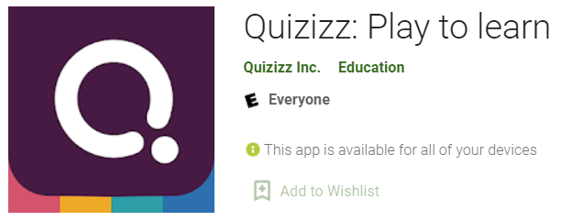

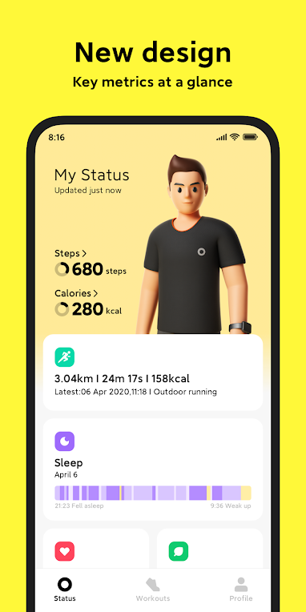
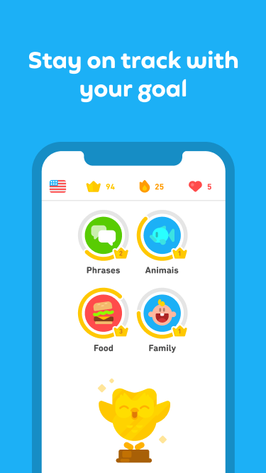
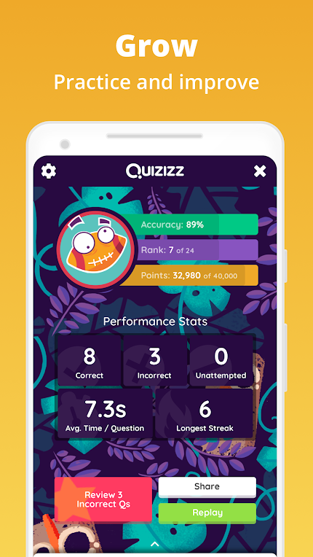
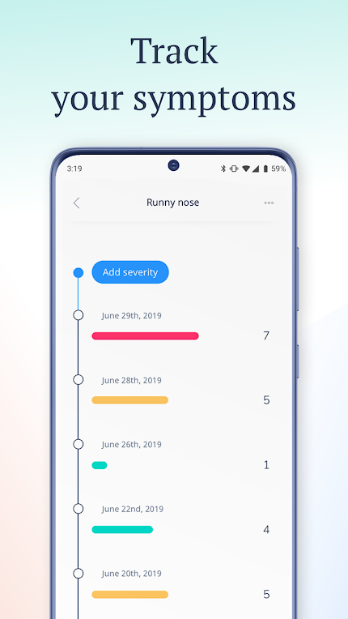
App Design Inspiration

Slide 16
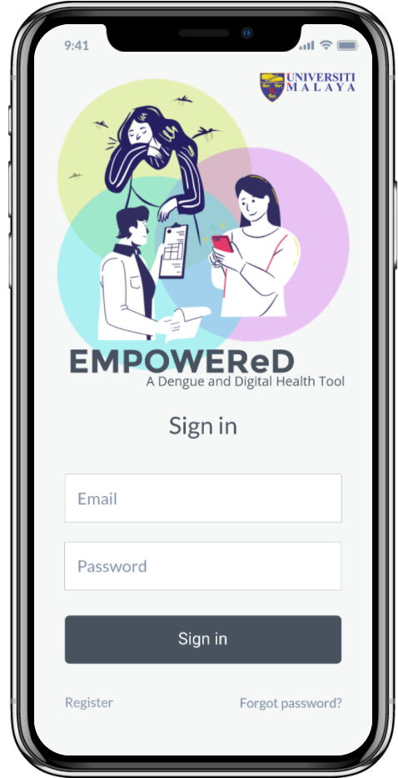
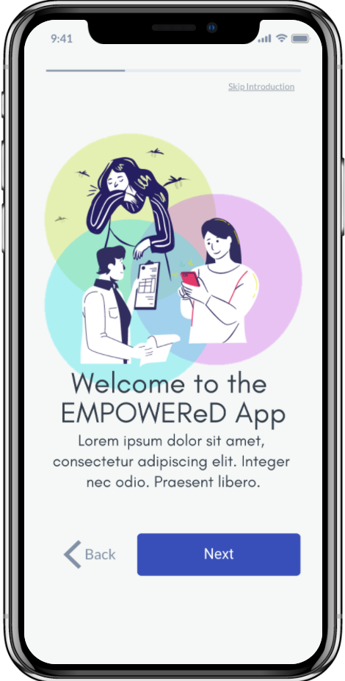
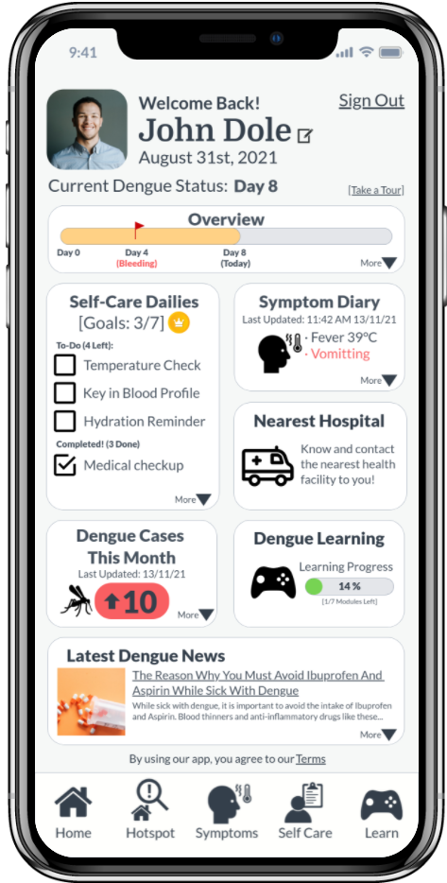
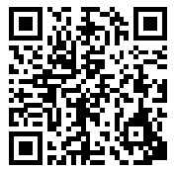
App Landing Page
Access our mock-up here!

Slide 17
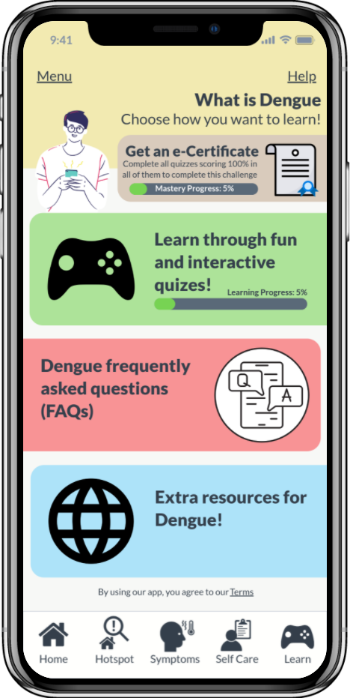
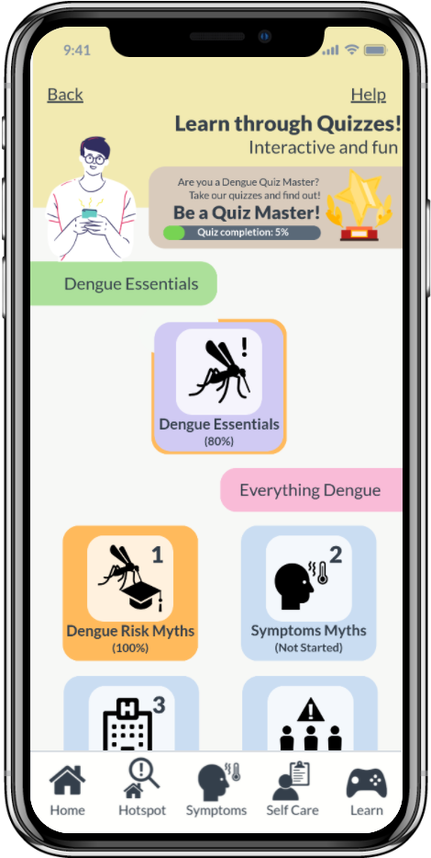
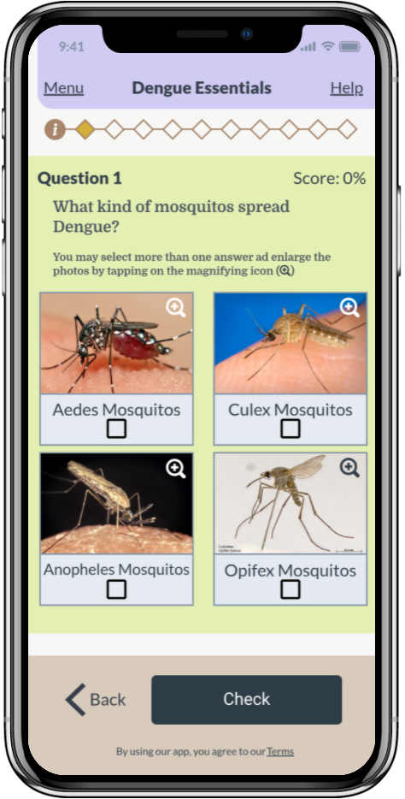
Dengue Learning Quiz
Access our mock-up here!

Slide 18
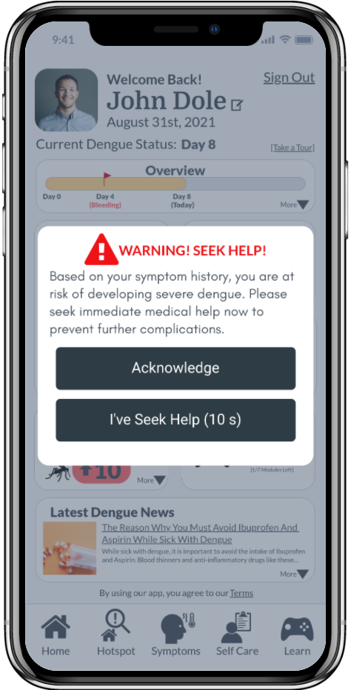
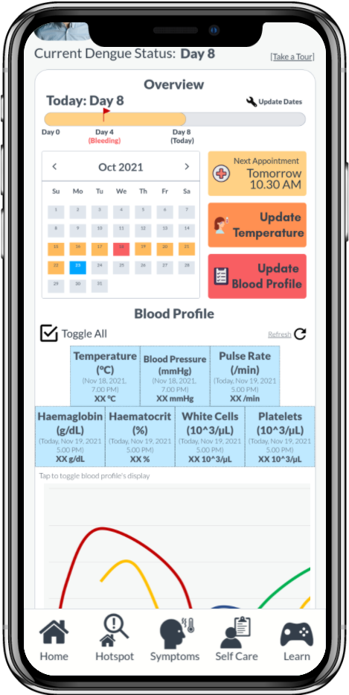
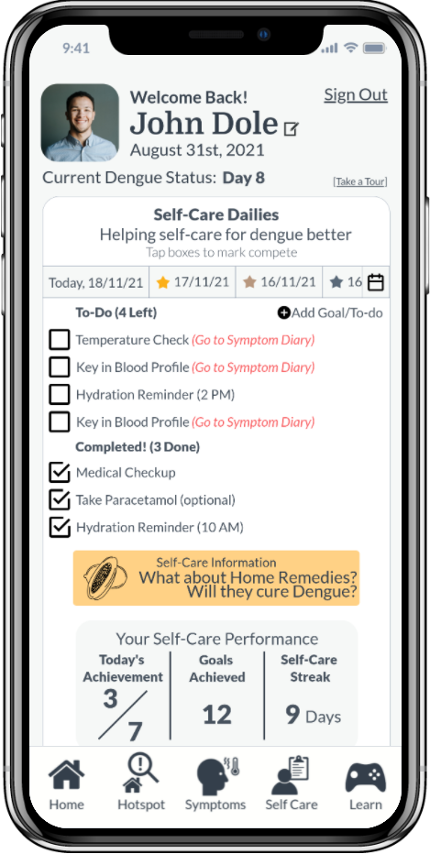
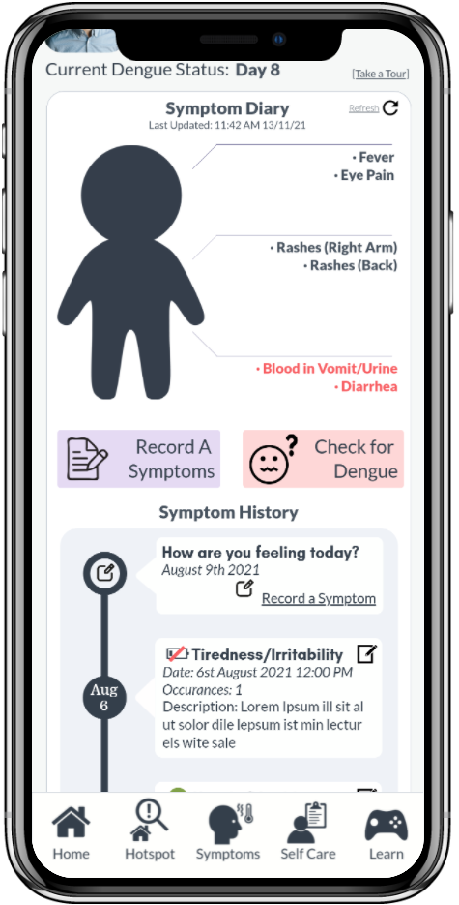
Dengue Self-Care
Access our mock-up here!

Slide 19
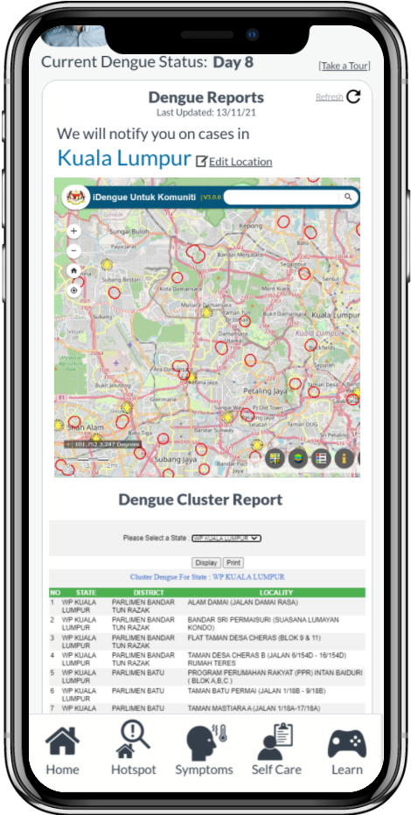
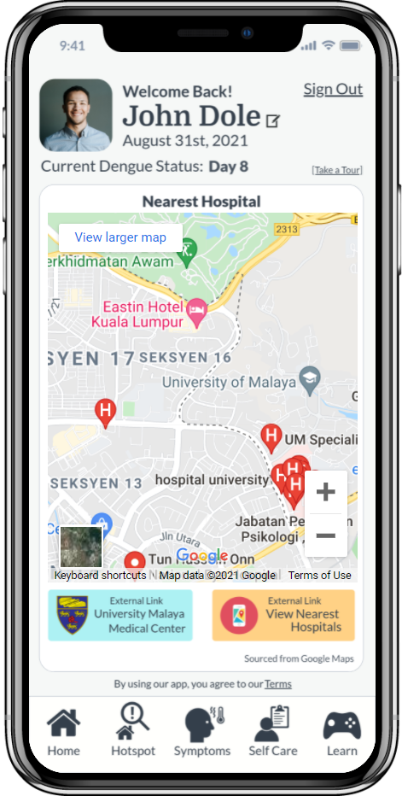
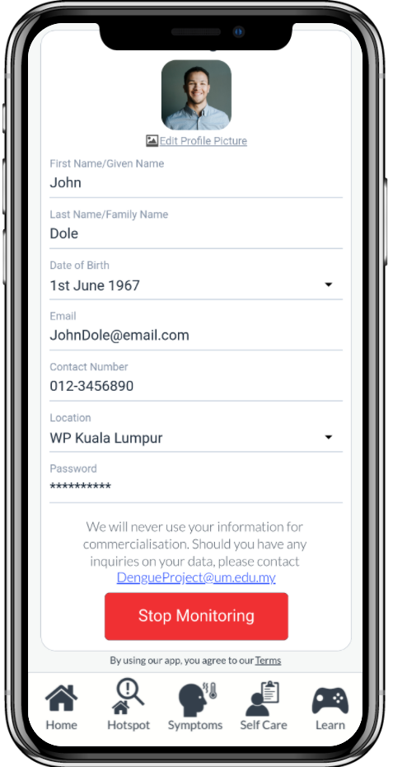
Dengue Hotspot/Hospital Finder/Settings
Access our mock-up here!

Slide 20
Thank you!

