Slide 1
Neural Network Optimizers on Keras
By:
Vignesh Murali
Ziqing Lu
Ritvik Reddy

Slide 2
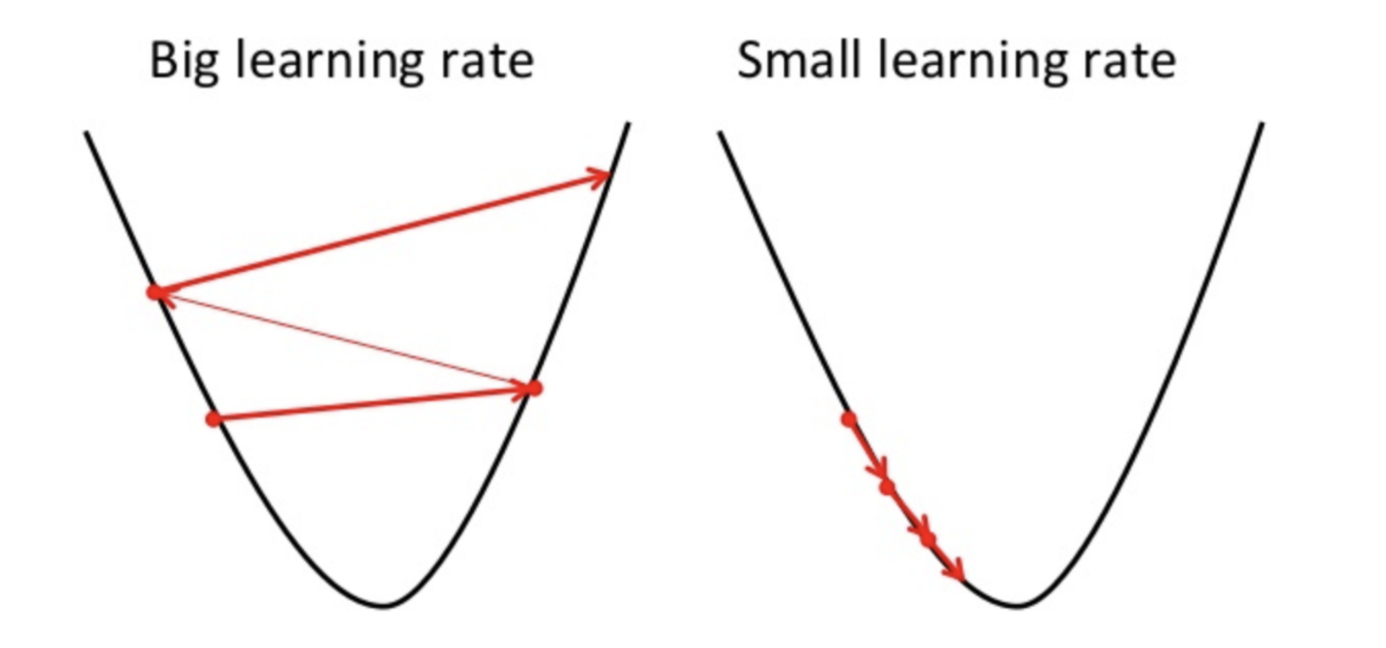
Optimizer determines the step we take when searching for weights
w new = w old - Learning Rate * J(w old)
Notes:
what exactly is an optimizer? when a neural network trains a model, it adjusts weights repeatedly to reduce errors. so an optimizer shapes and moulds the model to improve performance by using the loss function as a guiding force which helps determine whether the network is taking a step towards the solution or not.

Slide 3
Experiment Settings
Base Model:
Cifar 10 CNN Classifier
Optimizers:
SGD, SGD with Momentum, Adagrad, Adadelta, RMSprop, Adam, Adamax
Learning Rate:
0.01, 0.001, 0.0001
Notes:
The learning rate determines the rate at which the weights are changed. If learning rate is too high we might skip the optimal value for weights to minimize error, if learning rate is too low training might take too much time. We need to find a value somewhere in between.

Slide 4
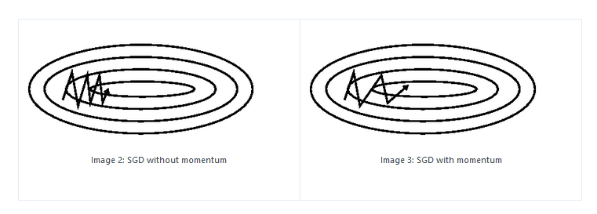
SGD (Stochastic Gradient Descent)
Best Model In Experiment:
Learning Rate: 0.01
Accuracy: 0.85
Notes:
Gradient is measure of change. Gradient denotes how changes in weights affects the loss function. We adjust each weight based on its gradient and we repeat the process till loss function is lowest. SGD is when we use random subsets of training examples for gradient descent.
Momentum helps accelerate the gradient in the right direction and averaging out any oscillations to improve performance of training.
The momentum term increases for dimensions whose gradients point in the same directions and reduces updates for dimensions whose gradients change directions. As a result, we gain faster convergence and reduced oscillation.

Slide 5
Adagrad (Adaptive Gradient)
Adaptive Learning Rate
Accelerate moving along more gently sloped direction
Best Model In Experiment:
Learning Rate: 0.01
Accuracy: 0.803
Notes:
Adagrad is a more advanced machine learning technique (relative to SGD which uses fixed learning rate for all features) which performs gradient descent with a variable learning rate. Contains a diagonal matrix which has previous gradients. Node weights which have historically had large gradients are given large gradients, whilst node weights that have historically had small gradients are given small gradients.
Adagrad thus improves on SGD by giving weights historically accurate learning rates, instead of satisfying itself with a single learning rate for all nodes.

Slide 6
RMSprop
Adaptive Learning Rate
Accelerate moving along more gently sloped direction
Different from Adagrad:
Weigh the more recent gradient updates more than the less recent ones
Best Model In Experiment:
Learning Rate: 0.0001
Accuracy: 0.738

Slide 7
Adadelta
Adaptive Learning Rate
Accelerate moving along more gently sloped direction
Different from Adagrad:
Weigh the more recent gradient updates more than the less recent ones
Best Model In Experiment:
Learning Rate: 0.01
Accuracy: 0.626
Notes:
Adadelta [22] is an extension of Adagrad that seeks to reduce its aggressive, monotonically decreasing learning rate. Instead of accumulating all past squared gradients, Adadelta restricts the window of accumulated past gradients to some fixed size w.
With Adadelta, we do not even need to set a default learning rate, as it has been eliminated from the update rule.

Slide 8
Adam (adaptive momentum)
MOMENTUM + RMSprop
The comprehensive one:
Applies adaptive learning rate and momentum method
Best Model In Experiment:
Learning Rate: 0.0001
Accuracy: 0.836

Slide 9
Adamax
MOMENTUM + RMSprop
The comprehensive one:
Applies adaptive learning rate and momentum method
Different from Adam:
Less susceptible to noise in the gradients, making the algorithm more robust
Best Model In Experiment:
Learning Rate: 0.001
Accuracy: 0.851
Notes:
WHY Adamax Performs Better?
gt is completely ignored when it's close to zero. This means that u1, u2, ..., un are influenced by fewer gradients and this makes the algorithm less susceptible to noise in the gradients making the algorithm more robust

Slide 10
Conclusion 1 : optimizer with adaptive learning rate and momentum outperformed others
Optimizer | Best Model Accuracy | Learning Rate | Strategy
SGD | 0.829 | 0.01 | -
SGD w/ Nesterov Momentum | 0.808 | 0.01 | Momentum
Adagrad | 0.803 | 0.01 | Adaptive Learning Rate
Adadelta | 0.626 | 0.01 | Adaptive Learning Rate
RMSprop | 0.738 | 0.0001 | Adaptive Learning Rate
Adam | 0.836 | 0.0001 | Adaptive Learning Rate + Momentum
Adamax | 0.851 | 0.001 | Adaptive Learning Rate + Momentum

Slide 11
Optimizer performance on different surfaces
Notes:
Long Valley
Algos without scaling based on gradient information really struggle to break symmetry here - SGD gets nowhere and Nesterov Accelerated Gradient / Momentum exhibits oscillations until they build up velocity in the optimization direction.
Beale's function Algos that scale step size based on the gradient quickly break symmetry and begin descent.
Due to the large initial gradient, velocity based techniques shoot off and bounce around - adagrad almost goes unstable for the same reason. Algos that scale gradients/step sizes like adadelta and RMSProp proceed more like accelerated SGD and handle large gradients with more stability.

Slide 12
Conclusion 2: testing with different learning rate gives us direction for learning rate tuning
Optimizer | Trend Of Accuracy | Trend Of Learning Rate (0.01, 0.001, 0.0001)
SGD
Adagrad
Adadelta
RMSprop
Adam
Adamax | No consistent trend observed with tested learning rates

Slide 13
THANK YOU!
Major Reference: https://arxiv.org/pdf/1609.04747.pdf

