Slide 1

CSC577
SOFTWARE ENGINEERING: THEORIES AND PRINCIPLES
LAB: 041 – WORKING WITH USE CASE DIAGRAM

Slide 2
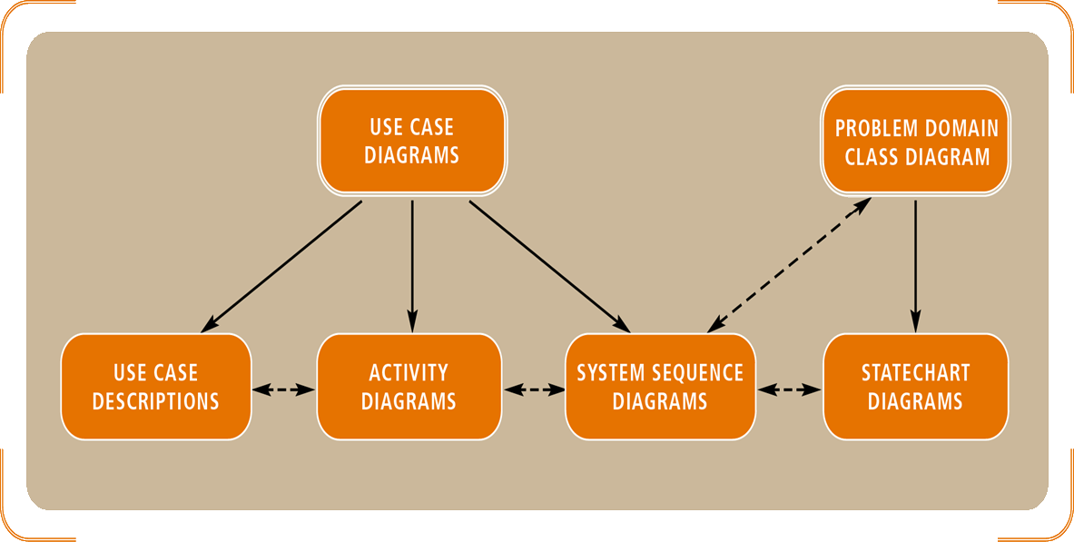
WHERE WERE WE?
2/14

Slide 3
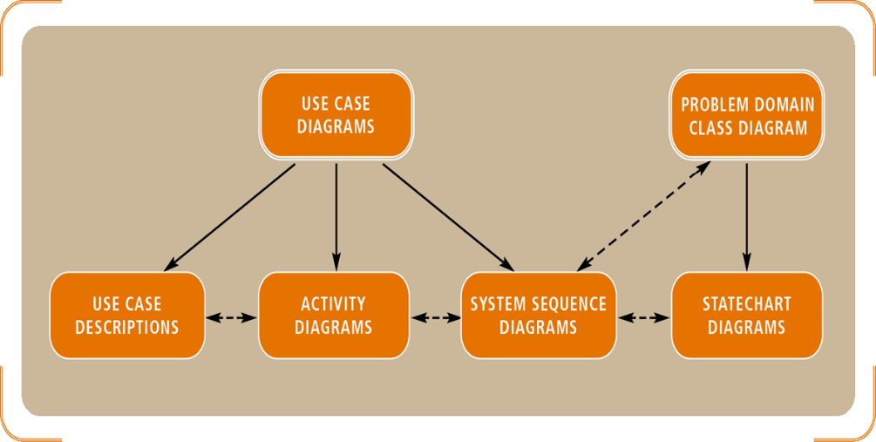
FUNCTIONAL REQUIREMENTS & USE CASES
3/14
Functional requirements capture the intended behavior of the system
This behavior can be expressed as services, tasks or functions of the system
Use case is a model of these functional requirements

Slide 4
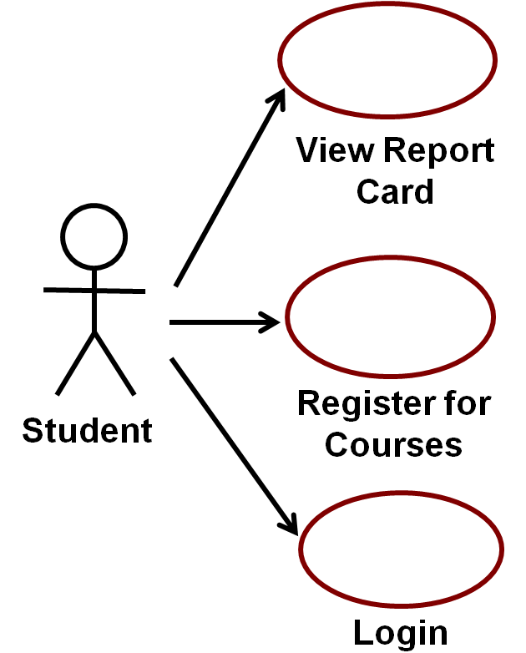
USE CASE DIAGRAM
4/14
A model that describes a system’s functional requirements in terms of use cases
A model that describe the interactions between the users (actors) & the system itself
Simply… think it is main functions of a system performs for users – “usage cases” of using the system

Slide 5
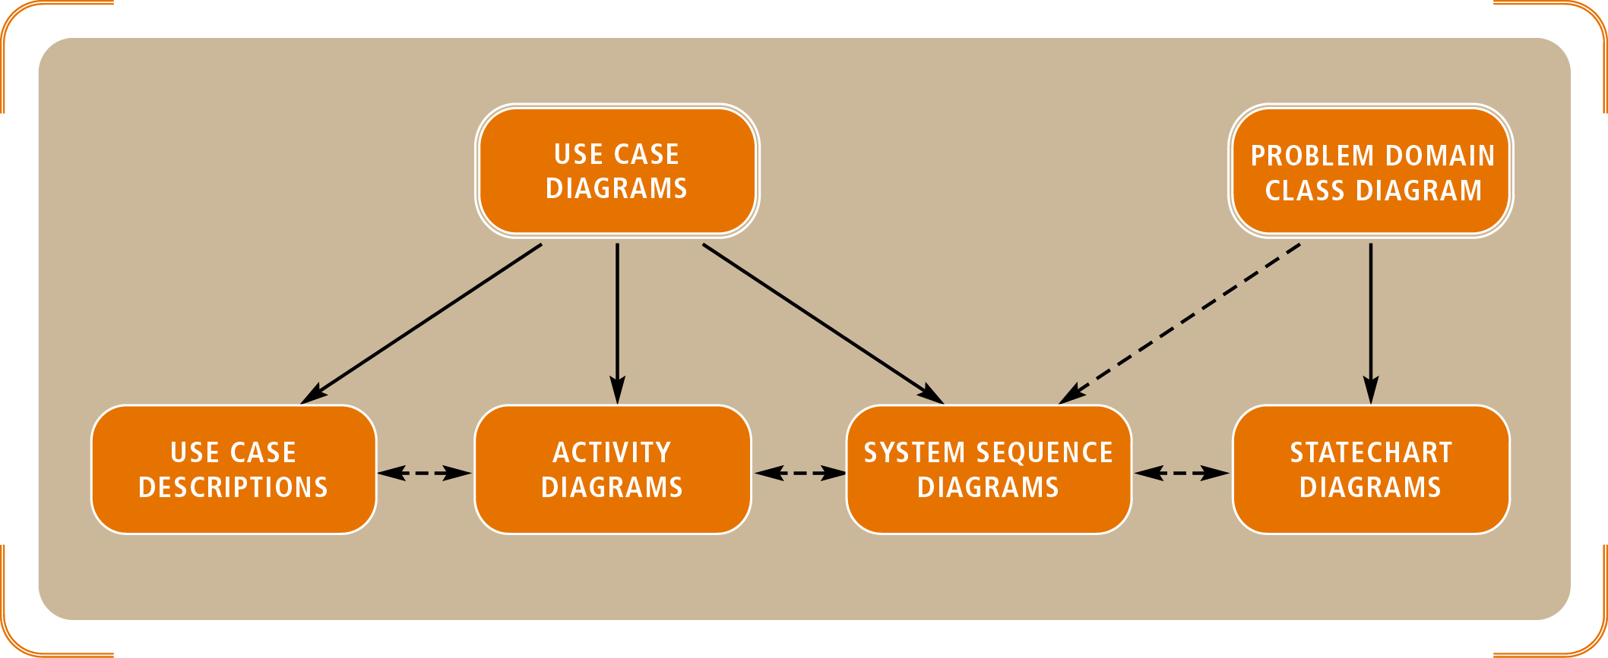
USE CASE DIAGRAM & SYSTEM DOCUMENTATION
5/14
Use case helps to model system (functional) requirements
Easy for users to understand

Slide 6
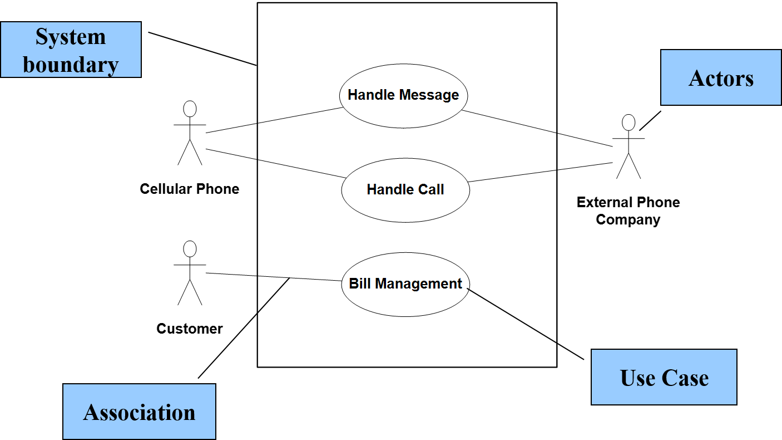
USE CASE DIAGRAM ELEMENTS
6/14

Slide 7
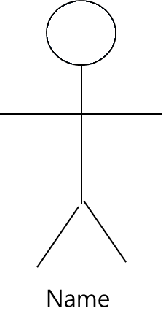
USE CASE DIAGRAM ELEMENTS: ACTOR
7/14
Actor is someone/something interacting with use case (system function). Named by noun
Similar to the concept of user, but a user can play different roles; (example: a professor can be instructor and researcher – plays 2 roles with two systems)
Actor triggers use case
Actor has responsibility toward the system (inputs), and Actor have expectations from the system (outputs)

Slide 8
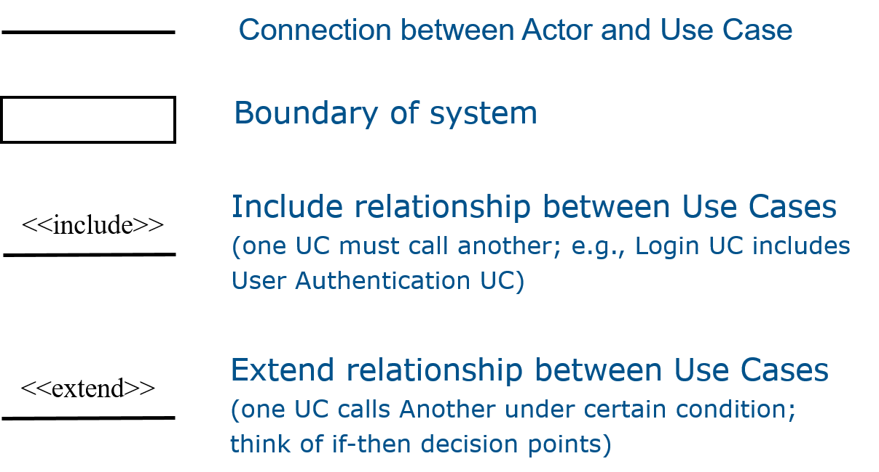
USE CASE DIAGRAM ELEMENTS: OTHERS
8/14

Slide 9
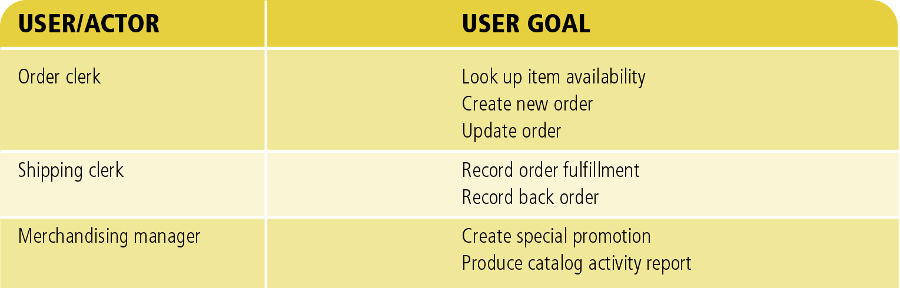
USE CASE DIAGRAM ELEMENTS: USE CASE
9/14
System function (process – automated or manual). Named by verb.
Each Actor must be linked to a use case, while some use cases may not be linked to actors.
Do something
= Use Case

Slide 10
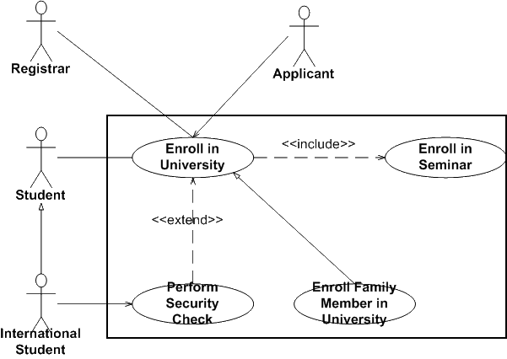
INCLUDE RELATIONSHIP
10/14
A standard association that linked to a mandatory use case
Example: to Authorize Car Loan (standard use case), a clerk must run Check Client’s Credit History (include use case).
The standard UC includes the mandatory UC (use the verb to figure direction arrow).
Standard use case can NOT execute without the include case → tight coupling
Note: UML Version 1 calls this “uses” relationship

Slide 11
EXTEND RELATIONSHIP
11/14
An association that links an optional use case to a standard use case.
Example: Register Course (standard use case) may have Register for Special Class (extend use case) – class for non-standard students, in unusual time, with special topics, requiring extra fees…)
The optional UC extends the standard UC
Standard use case can execute without the extend case → loose coupling

Slide 12
HOW TO CREATE USE CASE DIAGRAM
12/14
List all possible actors
Think of humans, machines, external systems, devices, sensors, organization unit,…
List main system functions (use cases)
Think of business events demanding system’s response users’ goals/needs to be accomplished via the system
Create, Read, Update, Delete (CRUD) data tasks
Draw ovals around the function labels
Draw system boundary
Draw actors and connect them with use cases
Specify include and extend relationships between use cases

Slide 13

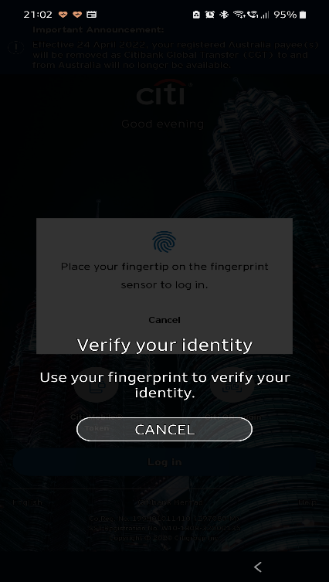

LAB’S CASE STUDY
13/14

Slide 14
THANK YOU…

