Slide 1


Slide 2
Introduction
How do movie costs, box office receipts, and other elements like runtime, IMDb rating, and votes relate to one another?
What is the difference between movie genres in terms of income, duration, and IMDb score?
What patterns may be seen per genre and how has the quantity of film releases changed over time?
Which genres perform well both in terms of production count and profitability?
To make data-driven decisions about production costs, genre selection, and marketing tactics, industry stakeholders (producers, marketers, and studios) must have a thorough understanding of these elements. The entertainment business may become more focused and efficient by analyzing trends in film production to find patterns in audience preferences and profitability.

Slide 3
Dataset
name: Title of the movie.
rating: Movie rating (e.g., R, PG, etc.).
genre: Genre of the movie
year: Year of release.
released: Release date and location.
score: IMDb score of the movie.
votes: Number of IMDb votes.
director: Director of the movie.
writer: Writer(s) of the movie.
star: Main star of the movie.
country: Country of production.
budget: Budget of the movie (in dollars).
gross: Gross revenue of the movie (in dollars).
company: Production company.
runtime: Runtime of the movie.

Slide 4


Slide 5
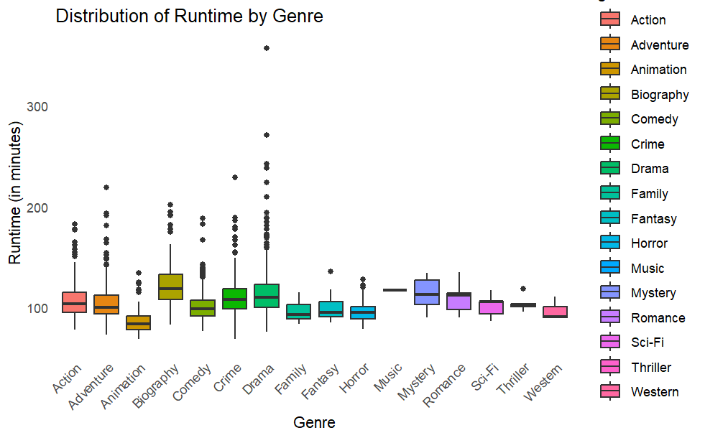

Slide 6
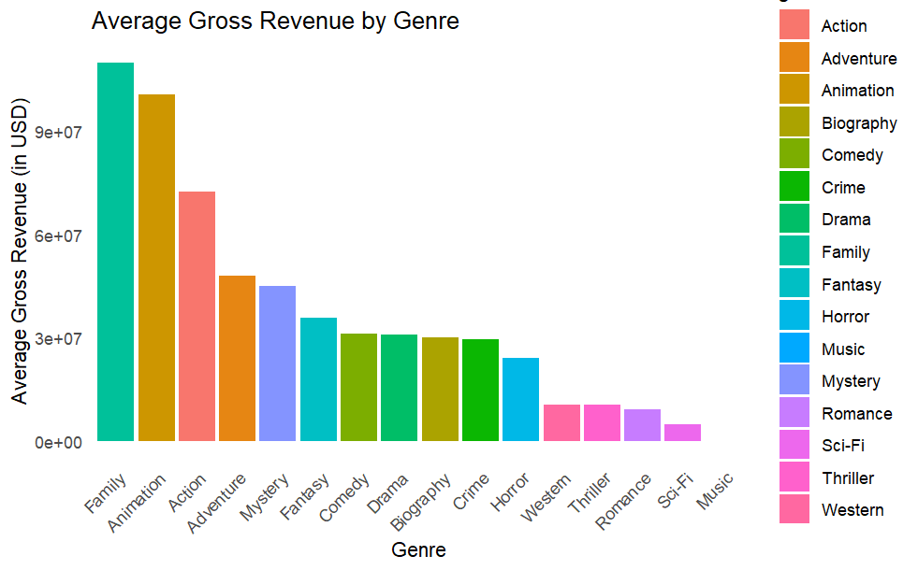

Slide 7
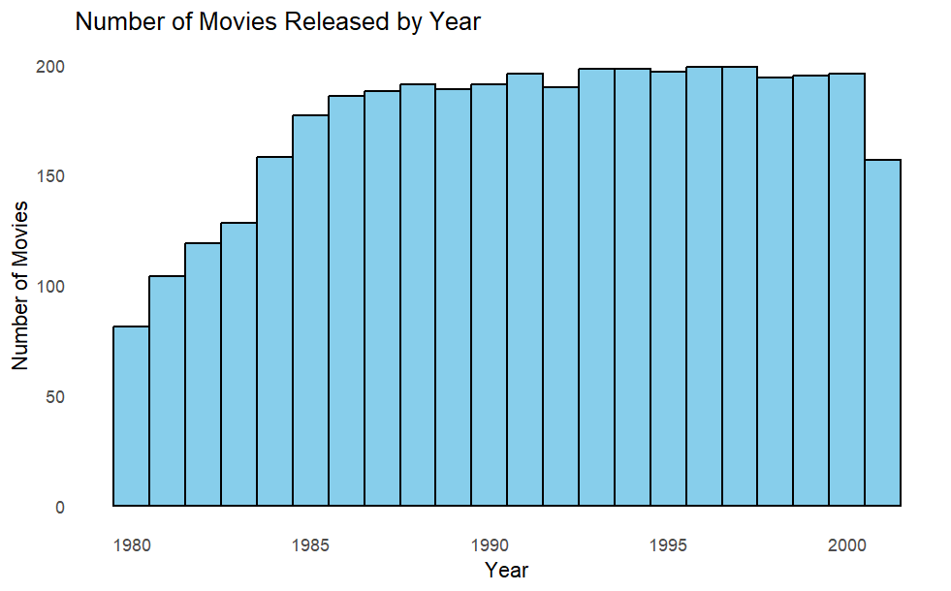

Slide 8
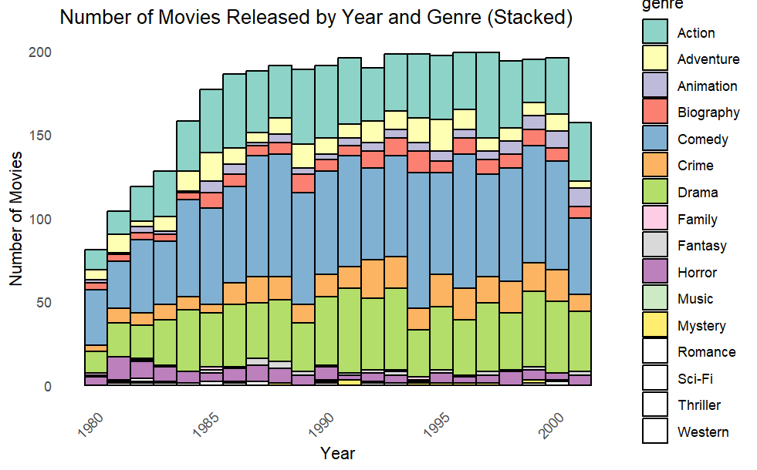

Slide 9
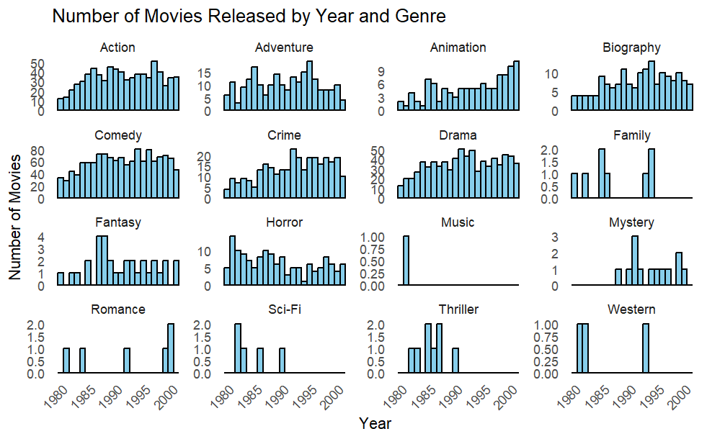

Slide 10
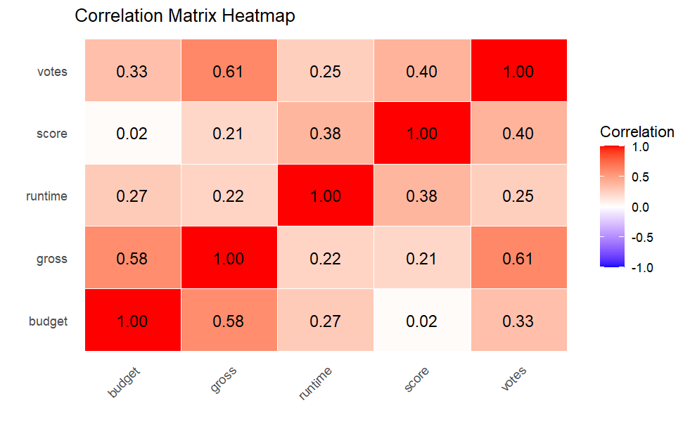

Slide 11
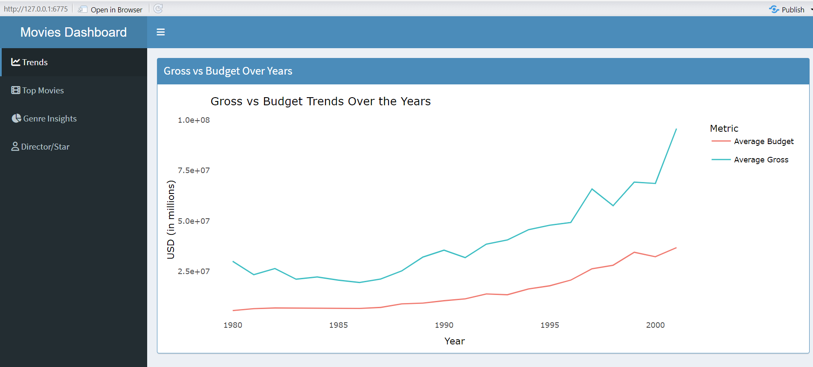

Slide 12
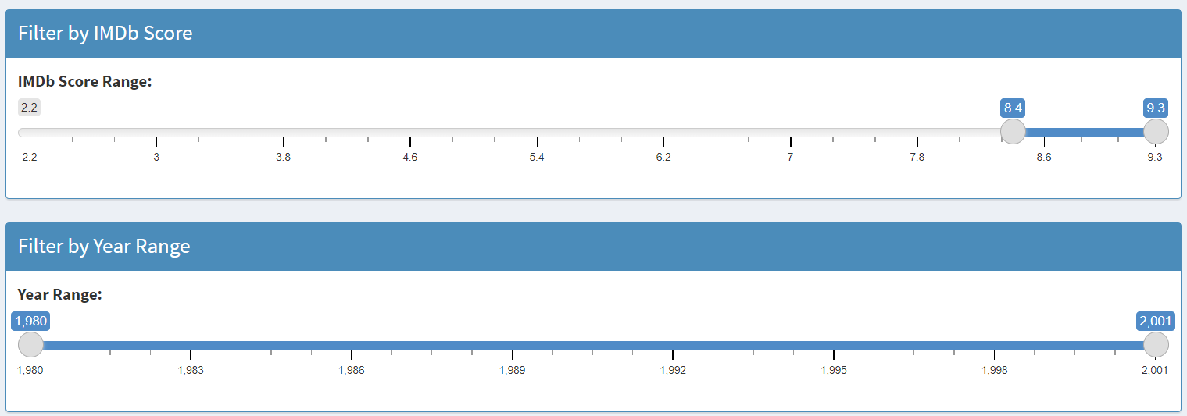

Slide 13
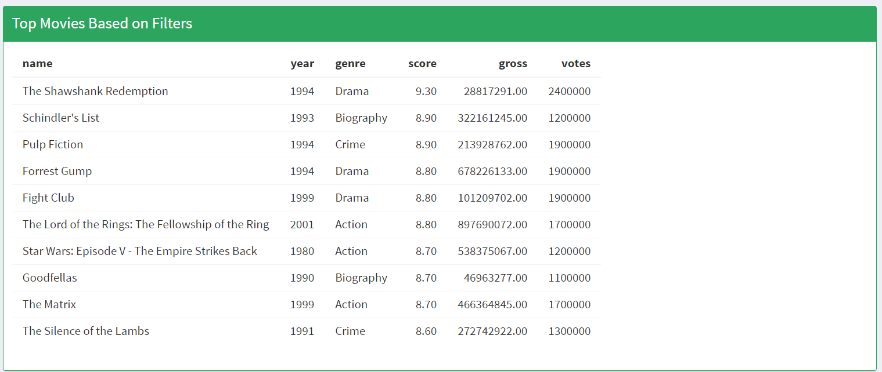

Slide 14
