Slide 1

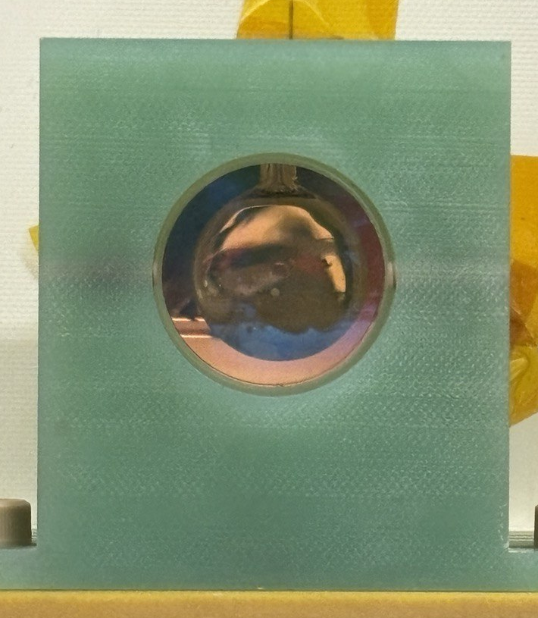
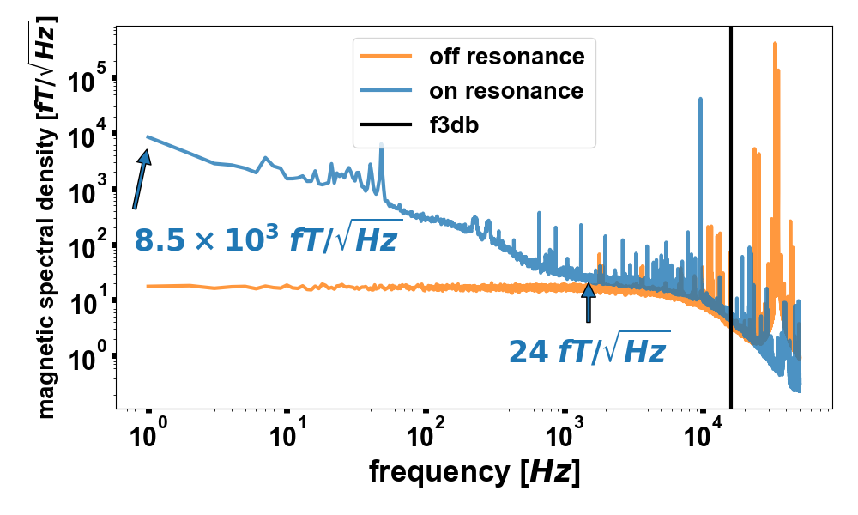
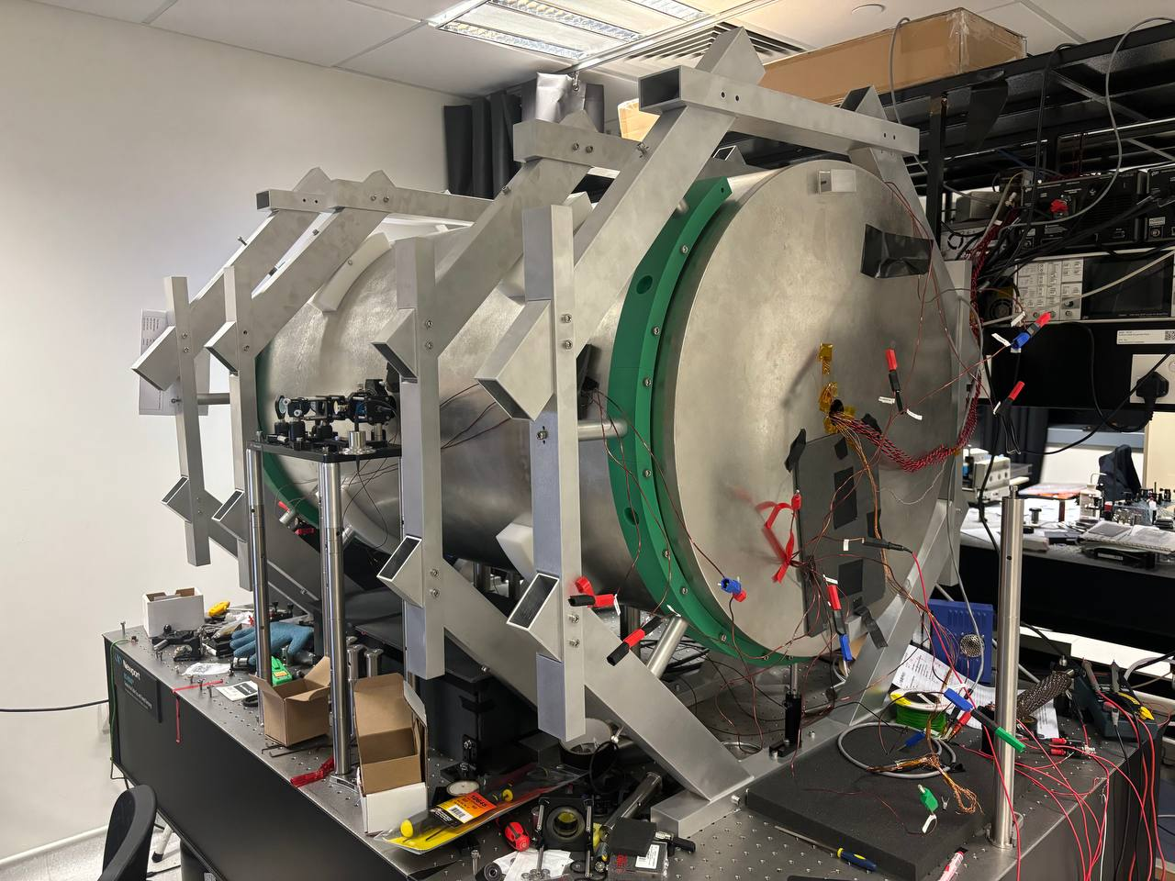
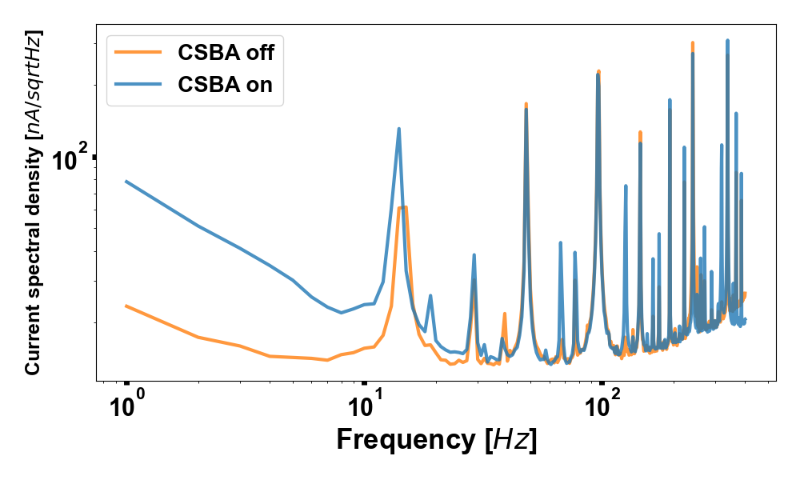
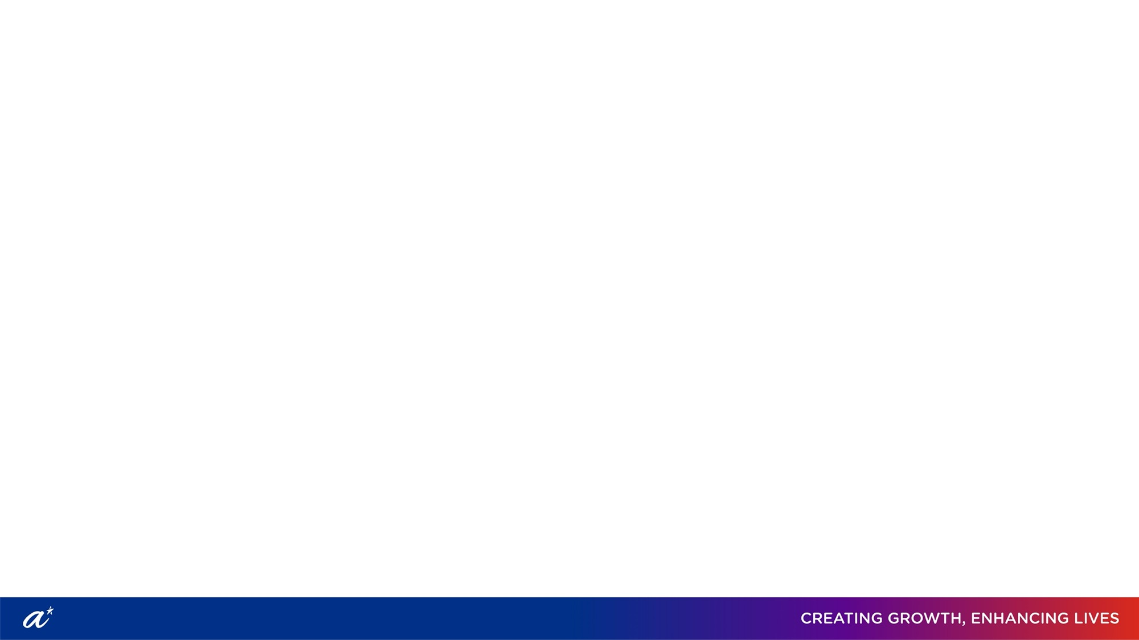
Building a scalar magnetometer capable of femtotesla-sensitive measurement
M. Zirdi Syukur, Md. Danial Afiq, Junyi Lee
Alkali atomic vapor magnetometers
Measurement that uses the Zeeman splitting of atomic spin states due to B-fields.
Applications in geomagnetic surveys, fundamental physics, Nuclear magnetic
resonance (NMR), Magnetic resonance imaging (MRI), Nuclear Quadrupole
Resonance (NQR) technologies, and more!
Capable of sensitivities as low as 10 fT/sqrt(Hz) on top of an applied 10 uT field.
An effective 1parts per billion signal to noise.
Current sensitivity is about 2.4x larger; low-frequency noise is currently dominated by current source.
Figure 1. A side view of the thermal vapor cell in-situ. We use potassium as our atom of choice. The cell also contains helium as a buffer gas and nitrogen for quenching.
Figure 2. A magnetic field sensitivity measurement by applying a ~ dc 10 uT field and performing an amplitude spectral density measurement on the lock-in amplified probe-beam polarization rotation at the resonance frequency of the atoms.
Figure 3. The atomic magnetometer and the mu-metal for magnetic shielding.
Optimizing the magnetometer’s performance
Degaussed the shields to maximize shielding from external fields.
Optimized lock-in settings like its gain distribution (input voltage range and sensitivity).
Found optimal balance between pumping power and excitation along transverse direction to narrow the magnetic resonance (more sensitive, but less dynamic range in open loop operation).
The next steps: further optimizations
Gradiometric measurements
2 probe beams can subtract the common mode 1/f noise across vapor cell.
Better signal processing
Aliasing can be completely removed by processing the digital outputs directly.
Better probing
Larger beam sizes interact with more atoms and can improve the sensitivity by up to 2x.
Optimizing probe detuning can further optimize our signal-to-noise-ratio.
Noisy current source
75 nA/sqrt(Hz) noise at 1 Hz, but should be
< 0.4 nA/sqrt(Hz). We intend to build our own!
Figure 4. Current spectral density of current source, as measured across a 4.6 ohm resistor and amplified. The many discrete peaks are noise in the measurement system.

