Slide 1


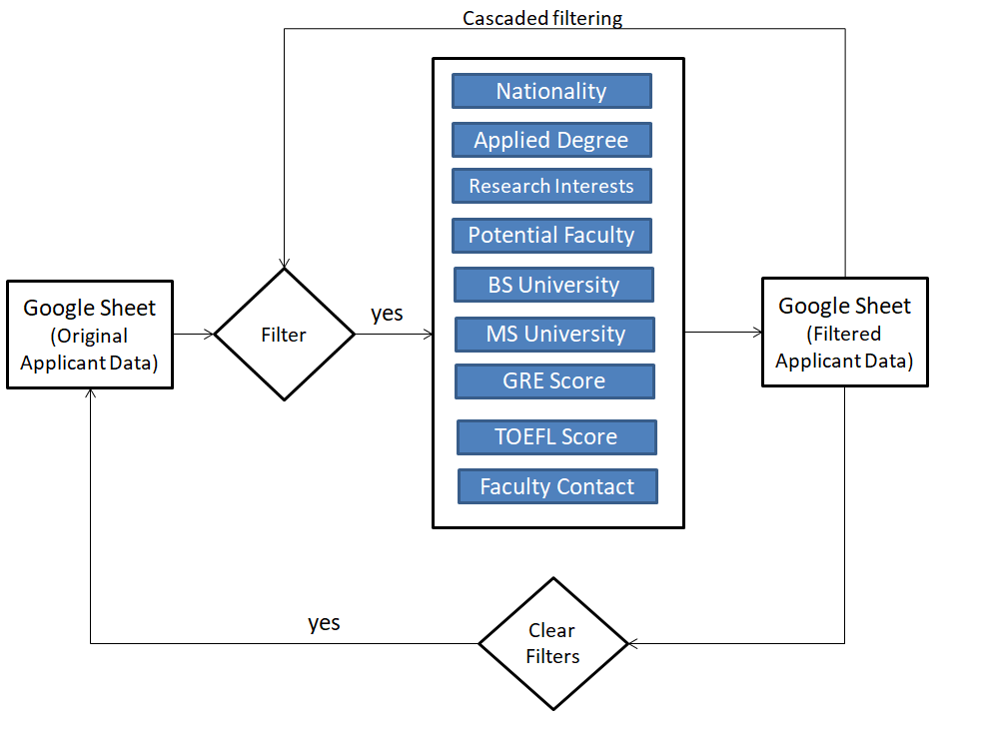
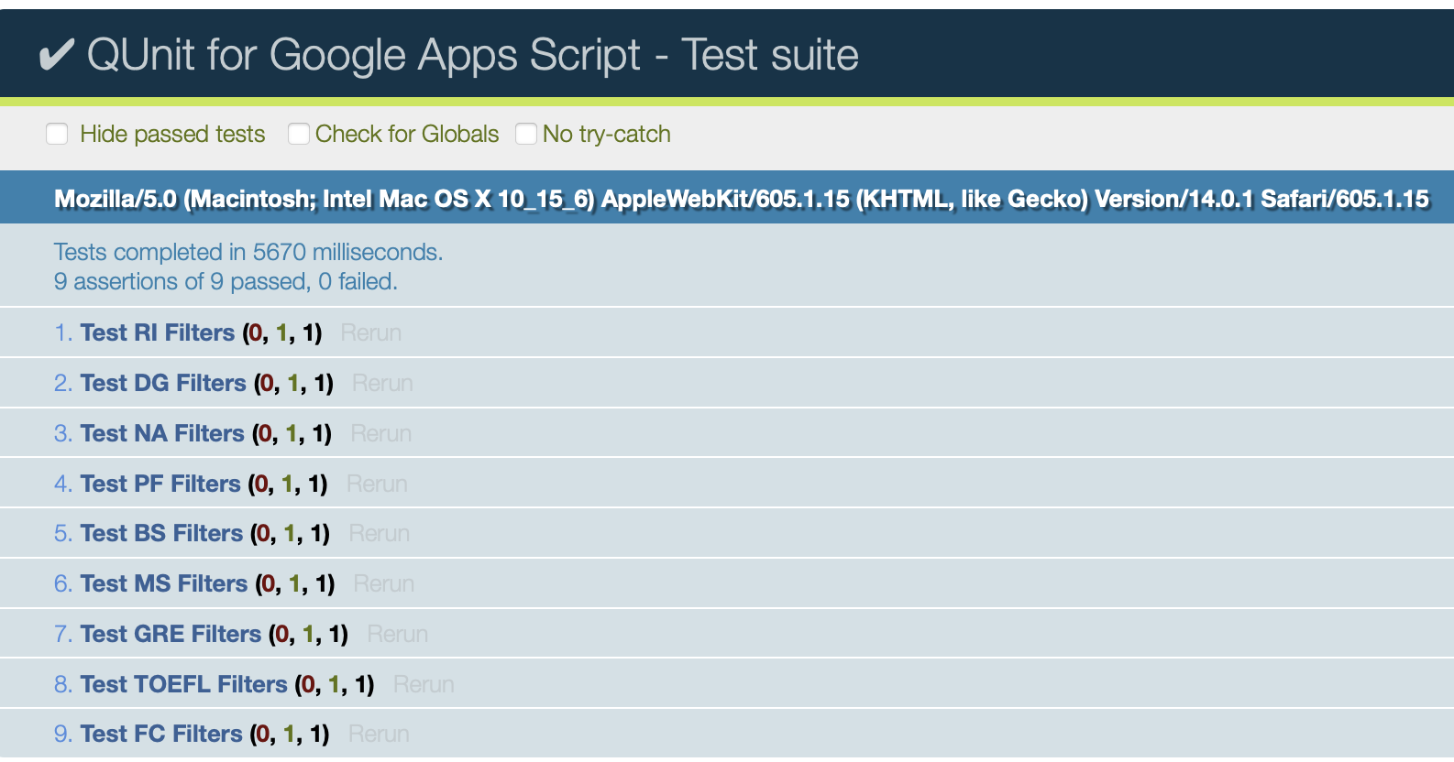
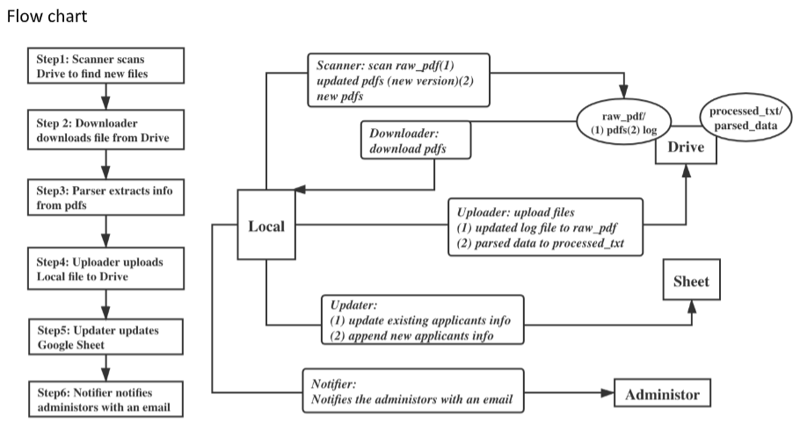
CSCE 606 PhD Admission System
Zirui Wang, Yihao Xie, Ryuki Kobayashi,
Gayathri Krishna, Jinjin Jiang, Mohit Sharma
Advisor: Prof Walker, Prof Ahmed
Use case 1
Problem Description
Use case 2
When the user uploads a file for a new applicant
It takes long time to parse application form one by one.
We want more features in Google sheet to smooth the reviewing
When the user applies
a filter on a column
Filter’s sidebar gets populated using the index.html file.
Form.html provides the skeleton.
Javascript.html calls the process function back in the google script.
Filtered rows are displayed as per the query parameters.
Filters can be further applied on previous results.
Download the new file.
Extract relevant fields.
Upload extracted info into drive.
Insert new data into sheet.
Use case 3
Use case 4
When the user replaces an existing applicant’s data with a new file.
When a potential faculty is nominated by another faculty
Download the updated file.
Extract updated fields.
Upload updated info into drive.
Update corresponding row in the sheet.
Search the faculty’s address on the table
Check if the email has been sent or not
If not sent yet, an email including the applicants info is sent automatically
Mark the status as “sent”
Flowcharts
Security & testing
All filter functions tested with Qunit
Minimized the scope of access
Conclusion
Meet all requirements from the customer
Using different techniques to ensure quality and security

