Slide 1
Bat Reproductive Timing & Seasonal Phenology
Using acoustic detector data to understand
when and where little brown bats are most active

Slide 2
Research Question & Key Ideas
Research question: When does bat activity peak across the season, and how does it vary by location?
Acoustic data = recordings from detectors that capture bat calls at night.
Myotis detections = number of bat-call files recorded (higher = more activity).
Phenology = timing of seasonal events (spring arrival → summer peak → fall decline).

Slide 3
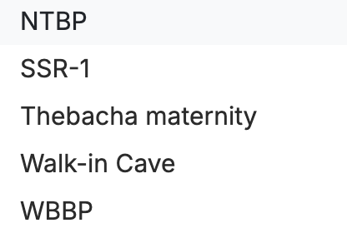
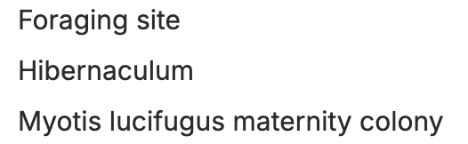
Key Terms: Site Codes & Site Types
Site (e.g., NTBP, SSR-1)
Site type (habitat role)
A short label for one detector location.
Codes help researchers track where recordings came from.
Some sites are descriptive names (e.g., “Walk-in Cave”, “Thebacha maternity”).
Foraging site: where bats feed on insects at night.
Hibernaculum: winter shelter where bats hibernate (usually low activity).
Maternity colony: summer roost where females give birth and raise pups (often high activity).

Slide 4
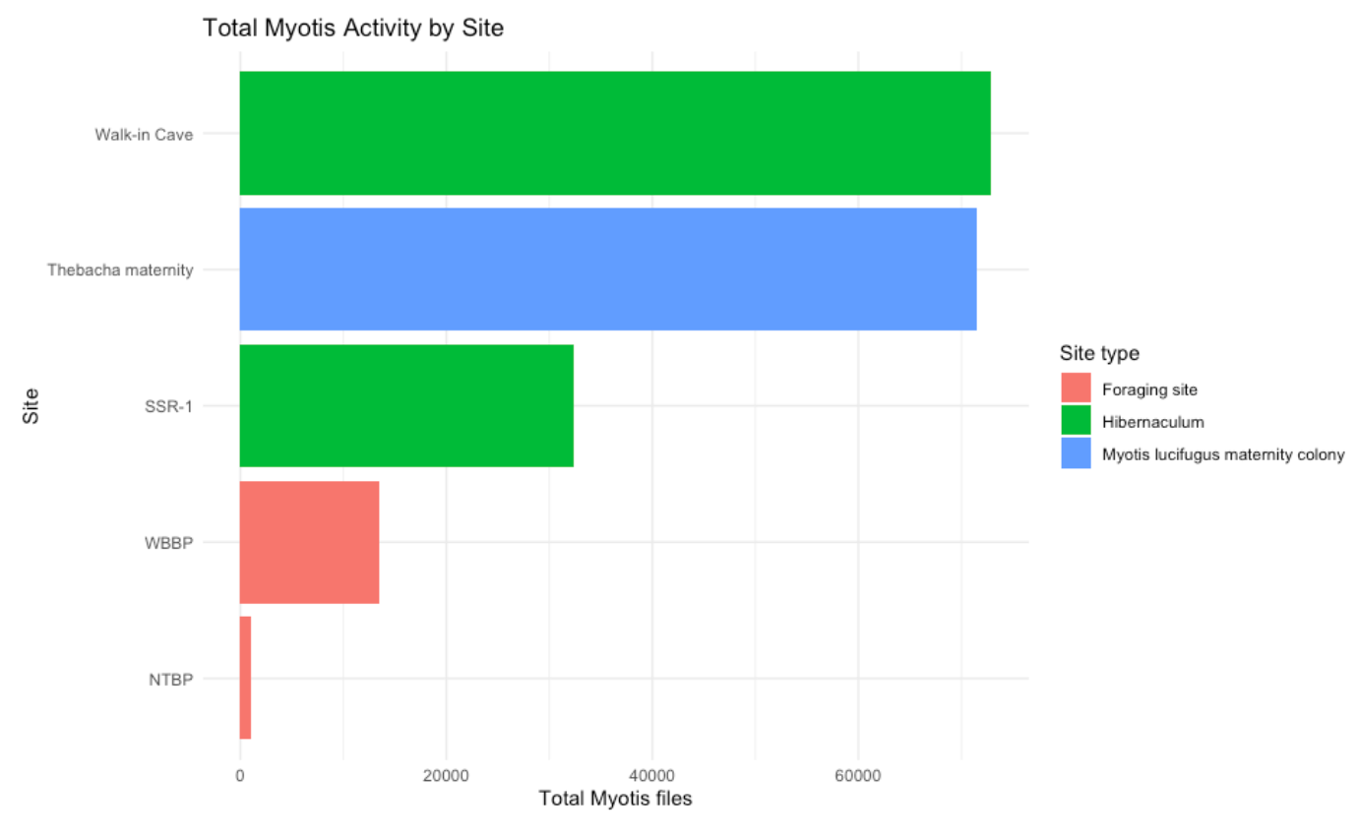
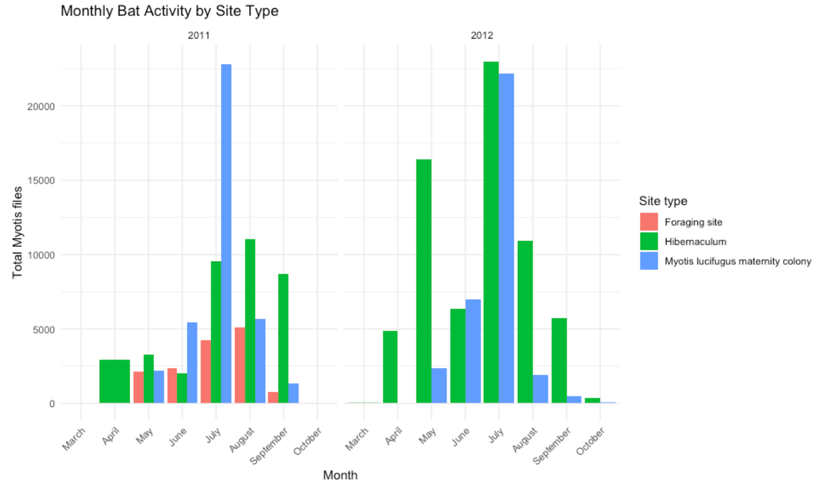
What We Built
Graph 1: Monthly totals — shows when activity is highest during the year.
Graph 2: Site / site type comparison — shows where activity is highest.
Interactive Shiny app — filter by site, site type, and year to explore patterns quickly.

Slide 5
Shiny App Demo: How to Read It
Filters: choose Site, Site type, and Year to narrow the dataset.
Nightly plot: shows day-by-day activity changes (spikes = more detections).
Monthly plot: summarizes the seasonal pattern (easy to spot peak months).
Goal: connect patterns to biology (feeding, maternity season, and winter dormancy).
Shiny App

