Slide 1
LECTURE 4
Planning and Conducting Meetings
Writing Minutes of Meeting

Slide 2
What is a meeting?
Do you like meetings?
What is the purpose of meetings?
Who should attend meetings?
How do you conduct an effective meeting?

Slide 3
What is a Meeting?
Meeting
A scheduled gathering of group members for a structured discussion guided by a designated chairperson

Slide 4
Planning and Participating in Productive Meetings
Meetings consist of three or more individuals who gather to pool information, solicit feedback, clarify policy, seek consensus, and solve problems.
Meetings are opportunities to demonstrate your leadership, communication, and problem solving skills.
Make meetings efficient, satisfying and productive.

Slide 5
Types of meetings
Staff meetings
Regular meetings
Called (special) meetings
Adjourned meetings
Annual meetings
Board meetings
Sub committee meetings
Ad hoc meetings
Public meetings
Interpersonal meetings
Annual General Meetings (AGM)

Slide 6
Deciding Whether a Meeting is Necessary
No meetings should be called unless:
the topic is important
it can’t wait
requires an exchange of ideas.
If the flow of information is one way and doesn’t need immediate attention, then don’t schedule for a meeting. Send an email, memo or letter.
Don’t call for a meeting because there is a lost of productivity of all people attending.

Slide 7
Setting Up Meetings

Slide 8
1. Selecting Participants
The number of participants is determined by the purpose of the meeting.
Also attending should be people who will be responsible for implementing the decision and groups who will benefit from the decision.
Purpose | Ideal Size
Intensive problem solving Problem identification Information reviews and presentation Motivational | 5 or fewer 10 or fewer 30 or fewer Unlimited

Slide 9
2. Prepare an Agenda
Before you call for a meeting, decide on the agenda for the meeting.
Make a list of objectives and items to be discussed during the meeting.
Distribute an agenda of topics least two days in advance of a meeting.
Limit the agenda to keep the meeting productive.
The narrower the focus, the greater the chances for success.

Slide 10
Include these in the agenda:
Date and place of meeting
Start time and end time
Brief description of each topic, in order of priority, including the names of individuals who are responsible for performing some action.
Proposed allotment of time for each topic.
Any pre-meeting preparation expected of participants.
Include any reports or materials that participants should read in advance.
You might also include a copy of the previous meetings.

Slide 11
3. Prepare Practicalities
If the duration of the meeting is going to be an hour, make sure that there is a schedule break.
Try to have the restrooms close to the meeting venue so that members need not take a long time to go back and forth to the restrooms.
Prepare writing aids for members if necessary – pens, papers and etc.

Slide 12
Techniques for Conducting an Effective Meeting

Slide 13
What makes an effective meeting?
Have an objective and a purpose
Plan the meeting
Set goals
Follow through and do evaluation after a meeting.

Slide 14
Getting the Meeting Started
Start meetings on time and open with a brief introduction – even if some are not here yet.
Open the meeting with:
Goal and length of the meeting.
Background of topic or problems
Possible solutions and constraints
Tentative agenda
Ground rules to be followed.

Slide 15
Moving the Meeting Along
The purpose of the meeting is to exchange views, not to hear one person talking.
“Thanks, for that perspective, John, but please hold your net point while we now hear how Ann would response to that.”
Keep the meeting moving by avoiding issues that sidetrack the group.
“Folks, we are getting off track here. Forgive me but I need to bring us back to the central issue of…”

Slide 16
Dealing with Conflict
When a conflict develops between two members, allow each to make a complete case before the group.
While other group members give their full attention to them.
Let each one question the other.
Then, the leader should summarize what was said and the group should offer comments.

Slide 17
Handling Dysfunctional Group Members
Lay down the rules in an opening statement.
Give specific overall summary of topics, time allotment and expected behaviour.
Seat potentially dysfunctional members strategically.
Seat a difficult group member next to the leader.
Make sure this person is not seated in a power point, such as at the end of the table or across from the leader.

Slide 18
Avoid direct eye contact.
Direct eye contact is a nonverbal sign that encourages talking.
Thus, when asking a question to a group, look only at those whom you wish to answer.
Assign dysfunctional members specific tasks.
Ask the person to be the recorder.
Ask members to speak in a specific order.
Make sure everyone gets a chance to speak.

Slide 19
Interrupt monopolizers
If a difficult member dominates a discussion, wait for the person to pause then break in. Ask someone else for an opinion.
Encourage nontalkers
Give them positive feedback.
Ask them questions which you know they have the information.
Give praise and encouragement
Give praise and encourage to those who seem to need it.

Slide 20
Ending with a Plan
End the meeting at the agreed time or earlier if possible.
The leader should end the meeting with a summary of accomplishments and a review of action items; follow by reminding participants of their assigned task.

Slide 21
Ending with a Plan
No one should leave the meeting without a full understanding of what was accomplished.
The leader should conclude by asking the group to set a time for the next meeting.
The leader should also thank the participants for attending.

Slide 22
Following Up Actively
If minutes were taken, they should be distributed within a couple of days after the meeting.
The leader may need to call or e-mail people to remind them of their assignments and also volunteer to help them if necessary.

Slide 23
Role of a Chairperson
Plan the agenda
Follow the agenda – item by item
Move the discussion along
Control those who speak too much
Encourage members to participate
Control time
Summarise and conclude the discussions

Slide 24
Role of a Participant
Follow the agenda
Participate in the meeting
Avoid domineering the meeting
Cooperate with other members
Be courteous.

Slide 25
The Do’s and Don’ts When Attending a Meeting
DO’s
Listen attentively
Encourage all members to speak
Concentrate on the positive elements & eliminate negative ones
Stay focus on the main objectives and goals of the meeting
Contribute in the meeting
DON’Ts
Arrive late for the meeting
Leave early without a reason
Demonstrate poor body language

Slide 26
Business Etiquette Guidelines
Prepare well for the meetings. If you are using statistics, reports or figures, distribute them prior to the meetings.
Be punctual and dress appropriately to display a sense of professionalism.
Do not interrupt the meeting. Switch off your mobile phone.
If there is a seating pattern, please ask if you are unsure.

Slide 27
Allow more senior persons to contribute their viewpoints first.
Avoid interrupting members even if you feel a strong disagreement.
Respond to it with permission of the chairman.
Be brief and relevant when you want to contribute to the discussed matter.
Matters discussed at any meetings should be treated confidentially.

Slide 28
The Language of Meetings

Slide 29
Chairing the Meeting
Opening the Meeting:
Right, shall we get started?
If we are all here, let’s start.
I think we should make a start.
Let’s get down to business, shall we?
Moving on:
Now let’s move on to the first point
Shall we move on
Let’s move on.
Can we go on now to…

Slide 30
Chairing the Meeting
Keeping to the Point:
I’m afraid that’s outside the scope of this meeting.
Please keep to the point.
You’re getting off the point.
Could you stick to the subject, please?
Controlling the Meeting:
One at a time please.
We can’t all speak at once. John first, then David.
Please listen to others.
I shall have to call you to order, Miss Susan.

Slide 31
Asking for Opinions
What do you think?
What’s your opinion?
What are your views on this, Steven?
I’d like to hear your views on…
Where exactly do you stand on this issue?
I wonder if you’d like to comment, Mr. Lim?

Slide 32
Giving Opinions
I think we should…
Why don’t we…
As I see it,…
How about…?
I suggest we…
In my opinion…

Slide 33
Agreeing
I agree.
Absolutely!
Exactly!
That’s how I feel.
I couldn’t agree more.
I’m in total agreement.

Slide 34
Disagreeing
I don’t agree.
I don’t think so.
That’s not true!
I totally disagree with you.
I’m afraid…
I agree to a point but…

Slide 35
Asking for Clarification
What do you mean by…?
I don’t quite follow you. Could you go over again?
I’m not with you.
Sorry?
Are you saying that…?
Am I correct in assuming that…?

Slide 36
Interrupting
Sorry to interrupt, but…
I wonder if I could add something here.
May I interrupt for a moment?
I don’t want to interrupt, but…
Excuse me, but I’d just like to point out that…
Could I say something about…?

Slide 37
Closing the Meeting
Well, I think that covers everything.
Right, I declare the meeting is closed.
That’s all for today. Thank you.
That concludes our business for today.
Thank you.

Slide 38
A Checklist for Meetings
Preparation: Before the Meeting
Define the objectives and the desired results
Work out an agenda
Decide on the participants
Determine the location and the time
Arrange for light refreshments
Determine seating needs
Conduct: During the Meeting
Begin and end the meeting on time
Begin the meeting by reaffirming the objective and purpose
State the ground rules of the meeting

Slide 39
Control the meeting by following the agenda
Encourage participants to take part
Reach decisions on each item discussed
Sum up decisions and actions as well as recommendations at the end of the meeting
Follow-Up: After the Meeting
Circulate the meeting’s notes or minutes on a timely basis
Monitor and evaluate the outcomes of the meeting
Take and follow-up action which was agreed in the meeting

Slide 40
Minutes of Meeting
Minutes are a written record of what took place at a meeting.
An accurate written record is essential not only for those who attend the meeting but also for those who were absent.
Minutes should be written in the past tense using third person and reported speech.

Slide 41
What are minutes?
short notes taken to provide a record of a conference or a meeting
permanent and formal record of what happened
summary of discussion and action items

Slide 42
What do minutes contain?
key points of discussions
actions to be taken
assignments given
deadlines

Slide 43
Minutes help you check:
if you have stuck to what has been decided
if you have completed your tasks in due time
if you have taken proper actions
if you have progressed with your task
if your participation has been active
which ideas you have contributed

Slide 44
Minutes help the evaluator to find out:
what was discussed in a meeting
who was involved in the discussion
if the meeting was efficient, and progress achieved
responsibilities for implementing certain actions
deadlines

Slide 45
What to Include in the Minutes
Name of the group
Date and place of meeting
Names of attending members
Name of the chair
Names of absent members
Time the meeting was called to order
Time the meeting adjourned
Name of person preparing the minutes
Summary of discussion and decisions including action items

Slide 46
Writing Minutes of Meetings
Elements to be included in a minutes:
Heading (including where and when the meeting was held)
Present (who was there)
Apologies of Absence
Minutes of the previous meeting (note any corrections and state the minutes were accepted as a true record of the meeting [with the above corrections, where applicable])
Statements of what actually occurred at the meeting
Any Other Business (AOB)
Who was the chairperson and who the secretary
The time the meeting adjourned and when the next meeting is to take place

Slide 47
Taking Minutes
Write clear statements that summarize the meeting’s main ideas and actions.
Word decisions, motions, action items, and deadlines exactly as the group makes them.
If in doubt, ask the group for clarification.
Attach the agenda and any reports to the final copy of the minutes.

Slide 48
Guidelines for Taking Minutes
Report the facts and all sides of a discussion accurately.
_________________________________
_________________________________
_________________________________
Always keep in mind that the minutes are a public record of the meeting.

Slide 49
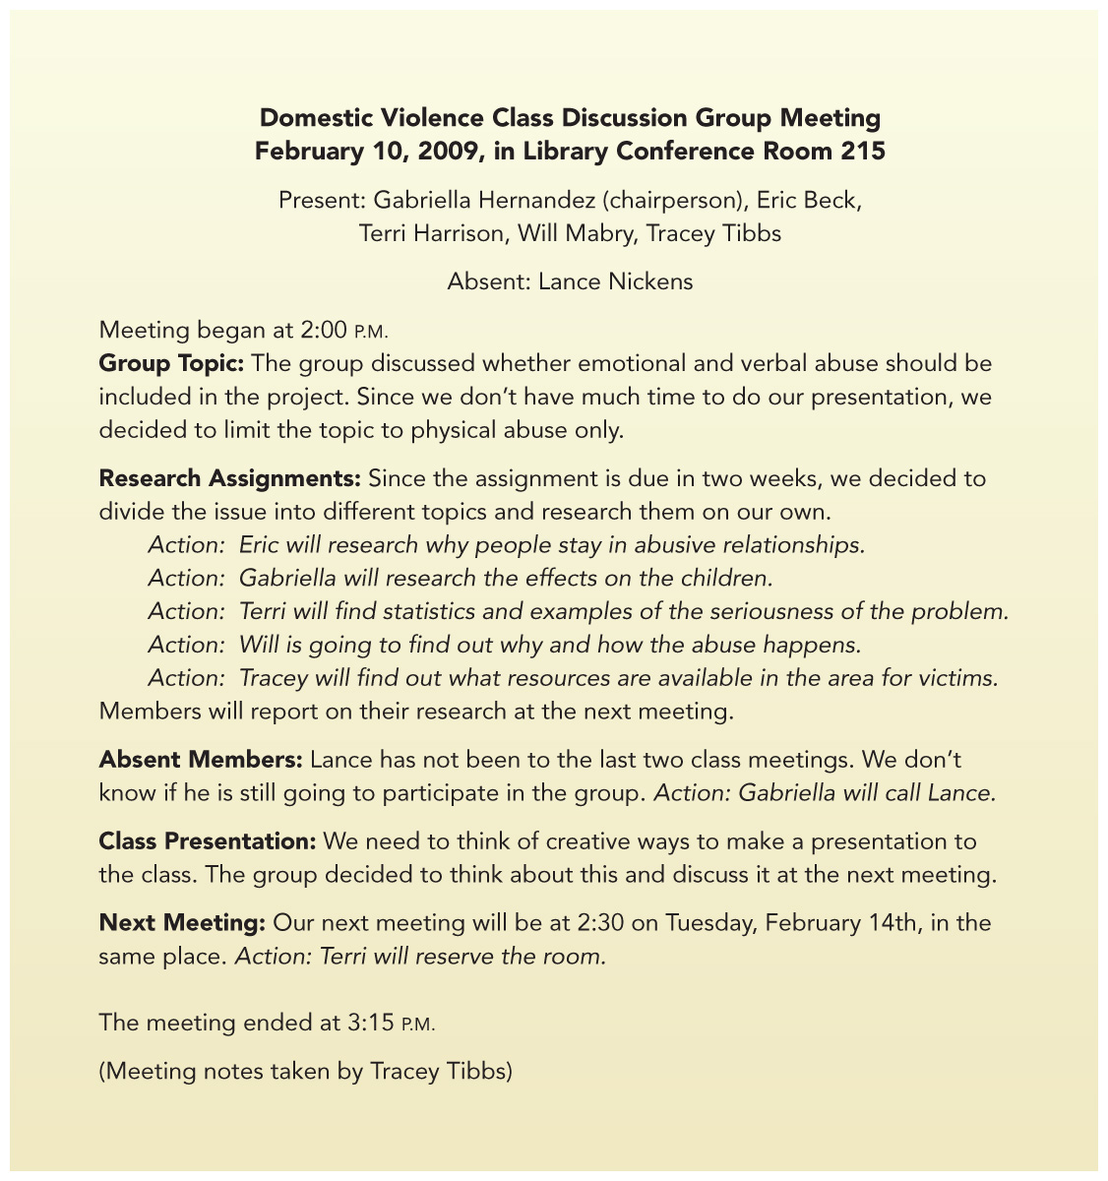
Sample of Informal Minutes

Slide 50
Post-Meeting Evaluation
Was the meeting’s goal clear?
Was the agenda useful and followed?
How prepared were group members?
Did everyone have an equal chance to participate?
Did members listen effectively and consider different points of view?
Were assignments and deadlines made clear by the end of the meeting?

Slide 51
Additional Evaluation Questions
What other evaluation questions would you add to those on the previous slide?
Example: Did the meeting begin and end on time?
Example: ________________________
Example: ________________________
Example: ________________________

Slide 52
Meeting Terminology
Ad hoc: from Latin, meaning ‘for the purpose of’, as for example, when a sub-committee is set up specially to organise a site-visit.
Adjourn: to hold a meeting over until a later date.
Agenda: a schedule of items drawn up for discussion at a meeting.
AGM: Annual General Meeting. All members are usually eligible to attend.
Apologies: excuses given in advance for inability to attend meeting.

Slide 53
Collective responsibility: a convention by which all committee members agrees to abide by a majority decision.
Consensus: agreed by general consent, no formal vote being taken.
Convene: to call a meeting
Eject: to remove someone (by force if necessary) from a meeting
Execute: to act upon taken decision
Motion: the name given to a “proposal” when it is being discussed at a meeting

Slide 54
Opposer: one who speaks against a motion
AOB: (Any other business), items left over from a previous meeting, or item discussed after the main business of a meeting
Proxy (proxy vote) : on behalf of another person
Quorum: the number of people needed to be in attendance for a meeting to be legitimate and so commence
Resolution: motion which has been passed, used after decision has been reached

Slide 55
The End

