Slide 1
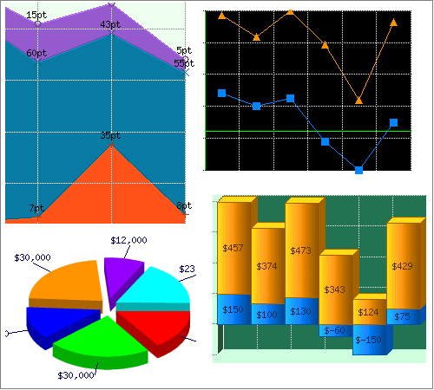

Graphs

Slide 2
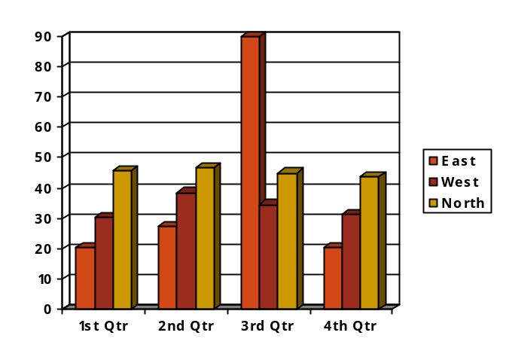


?
Column Graph
Picture
?
Visuals
?
?
Diagram
Drawing

Slide 3


Types of Visuals
Visuals consist of the following elements:
drawings
figures
pictures
symbols
charts/graphs
tables

Slide 4

Graphics as Visuals
When creating a visual:
graphics may be selected to present true and accurate pictures of written information for credibility
When labelling graphics:
a suitable title is created to indicate its content
clear labels/information are written on each axis, column or row to identify purpose and main concepts
a legend is shown as a guide to the chart
however, too much information clutters up a graph

Slide 5
Labelling Graphics
Tips to labelling graphics
Title of a visual - complete and clear enough to indicate its content.
e.g. Which title is clearer and more complete?
a) Number of cars sold in a month.
b) Number of cars sold in the month of March by
week.
Titles - at the top centre of the graph.
Headings, Labels and Legends - clear.
Legends (keys) - within the frame of the graph (where possible).
Labels and Legends - phrased consistently.
For multiple visuals, ‘Figure Titles’ - placed at the top or bottom of visuals.

Slide 6
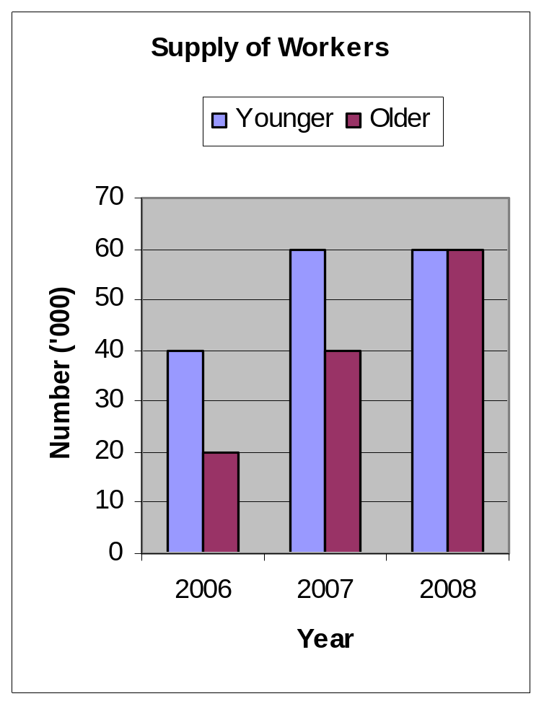
LABELLING OF A GRAPH
Title
Legend
Y-axis Label
Y-axis
X-axis Label
X-axis

Slide 7
Types of Visuals
Important /RegularTypes
Tables / tabulated data:
Functions
present facts and figures
compare large amounts of data easily
emphasise similarities or differences
easier to find specific figures than from a string of sentences

Slide 8
TABLE
Number of Cars Sold for the Month of February by Week
Week No. | Number of Cars Sold
 | Kancil | MyVi
1 | 20 | 30
2 | 37 | 55
3 | 13 | 20
4 | 10 | 0

Slide 9
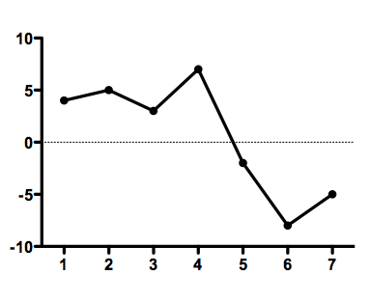
Types of Visuals
2. Line Graphs:
Functions
show changes through time
e.g. 1. Increase in height of
a growing child
2. Growth in annual company
assets
indicate trends:
e.g. 1. Changes in Government in a
country.
2. Changes in women’s fashion
trends

Slide 10
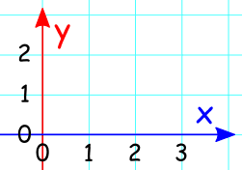
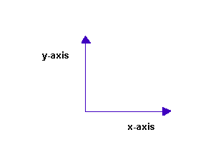
Types of Visuals
Characteristics of a line graph
A line graph has two axes:
Horizontal axis (x-axis)
Vertical axis (y-axis)
The data are plotted as points
connected by a segment of a line.
Two or more items on the graph are
shown using contrasting lines or
different colours.

Slide 11
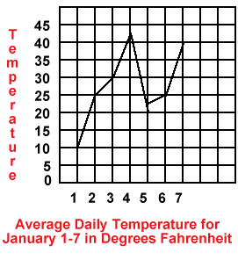
Line Graph
Average Daily Temperature for Days 1 – 7 in Degrees Fahrenheit
Day | Temperature
1 | 10
2 | 25
3 | 30
4 | 42
5 | 23
6 | 25
7 | 40
Notes:
1. This graph shows the temperatures during the period of a
Week Month Year
2. The temperatures in the beginning of the week were rising or falling?
Rising Falling
3. There was the least amount of change between days
6 and 7
5 and 6
1 and two
4. If freezing is 32 degrees, which day was above freezing?
Day 1
Day 2
Day 4
5. When was the greatest drop in temperatures between?
Days 1 and 2
Days 3 and 4
Days 4 and 51. This graph shows the temperatures during the period of a
Week Month Year
2. The temperatures in the beginning of the week were rising or falling?
Rising Falling
3. There was the least amount of change between days
6 and 7
5 and 6
1 and two
4. If freezing is 32 degrees, which day was above freezing?
Day 1
Day 2
Day 4
5. When was the greatest drop in temperatures between?
Days 1 and 2
Days 3 and 4
Days 4 and 5

Slide 12
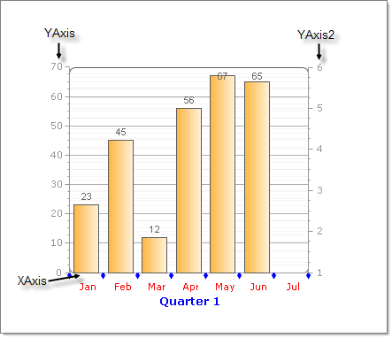
Types of Visuals
3. Column Graphs/Bar Graphs
Functions:
show changes from one time period to the next
compare one item with another
Characteristics:
columns – single, grouped or stacked
may be displayed vertically (Column Graph) or horizontally (Bar Graph)

Slide 13
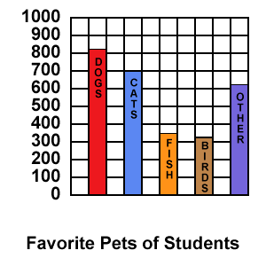
COLUMN GRAPH
Favourite Pets of Students
DOGS | CATS | FISH | BIRDS | OTHERS
820 | 700 | 350 | 320 | 615

Slide 14
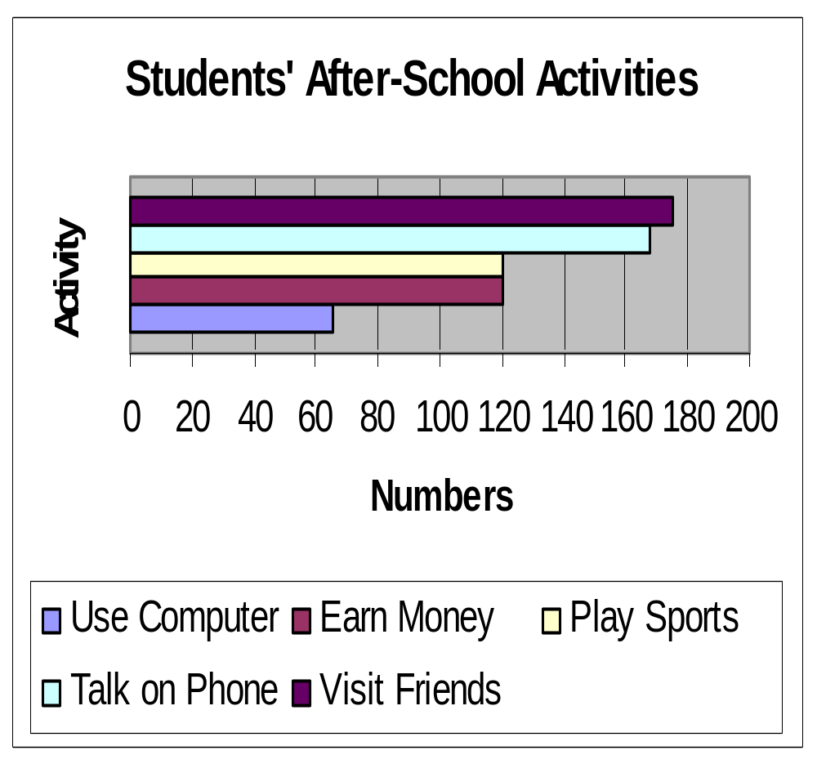
BAR GRAPH
Activity | Number
Visit Friends | 175
Talk on Phone | 168
Play Sports | 120
Earn Money | 120
Use Computer | 65

Slide 15
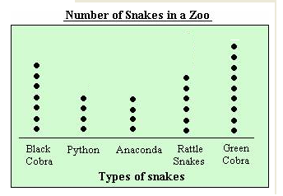
Types of Visuals
4. Dot Graphs
used in place of bar graphs
present six or more variables
make information easier to read

Slide 16
DOT GRAPH
Proportion of Crimes using Weapons
Murder |  |  | ----------------------------
Attempted murder |  |  | ---------------------------------------
Assault |  |  | -----
Sexual assault
Kidnapping/adduction |  |  | ----------
Robbery |  |  | --------------------
 |  |  | | | | | 0 20 40 60 80
 | 1999 | 2000
Source: Recorded Crime, Australia 1999, 2000

Slide 17
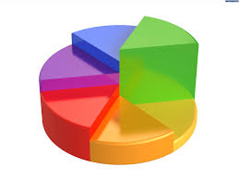
Types of Visuals
5. Pie Charts
Functions:
show the parts or divisions of a whole
unit in a circle
compare or emphasize proportion of
each part
used only when a few parts need to
be shown (e.g. five or six).
Each part is called a segment

Slide 18
PIE CHART
Percentage of Hours per Day spent on Activities
ACTIVITY | %
H/Work | 8
Sleep | 25
Job | 17
Meals | 8
School | 25
Games | 17

Slide 19
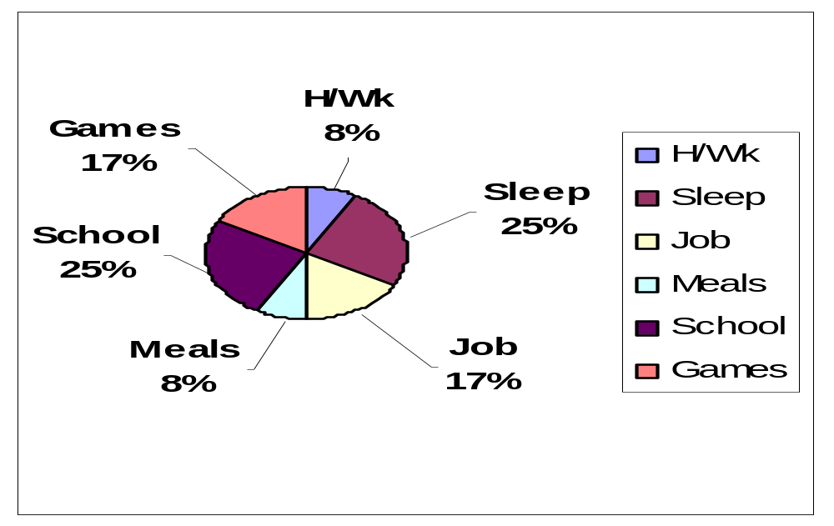
PIE CHART
Percentage of Hours per Day spent on Activities

Slide 20
Types of Visuals
6. Gannt Charts
Function:
Are actually horizontal bar graphs used for planning activities and schedules
show comparison between scheduled work and accomplished (actual) work in relation to time
e.g. a proposed plan for organising:
a) a company annual dinner and dance
b) a charity bazaar
c) seminar, conference or house
renovation

Slide 21
Gantt Charts
Gantt chart is a type of bar chart, developed by Henry Gantt. Gantt charts
illustrate a project schedule.
illustrate the start and finish dates of the terminal elements and summary elements of a project.
are now a common charting technique

Slide 22
Gantt Charts
Terminal elements and summary elements comprise the work breakdown structure of the project.
Some Gantt charts also show the dependency relationships between activities.
Gantt charts can be used to show current schedule status using percent-complete shadings and a vertical line.

Slide 23
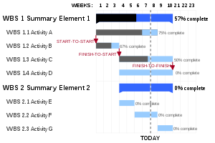
Gantt Chart

Slide 24
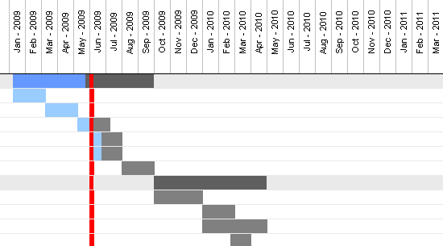
Gantt Chart

Slide 25
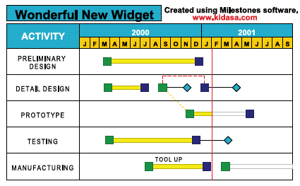

Slide 26
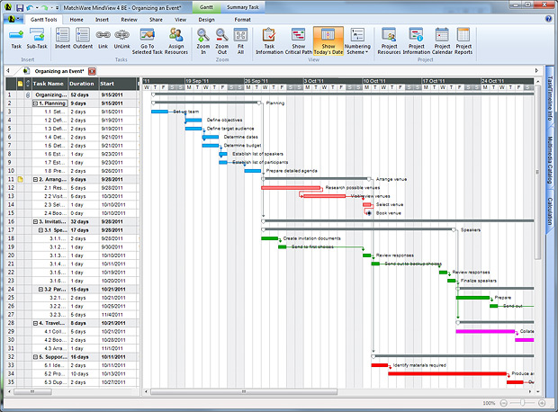

Slide 27
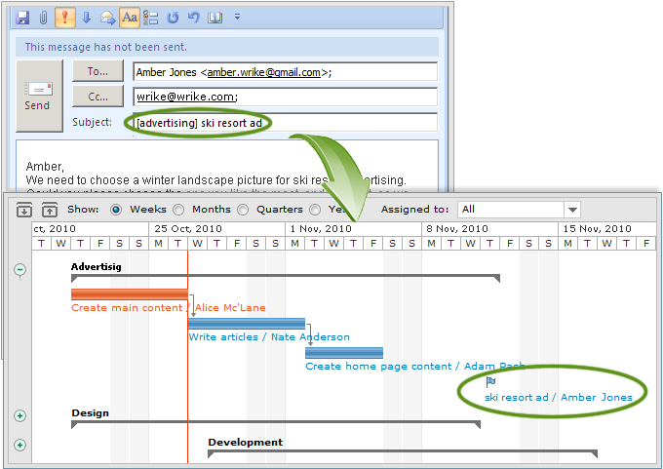

Slide 28
Gantt Chart
In recognition of Henry Gannt’s contributions, the Henry Laurence Gantt Medal is awarded for distinguished achievement in management and in community service.
This chart is also used in Information Technology to represent data that has been collected.

Slide 29

American mechanical engineer and management consultant who is most famous for developing the Gantt chart in the 1910s.

Slide 30
Types of Visuals
7. Flow Charts/Organizational Charts
Function:
Show sequence of decisions, steps or
instructions involved in a process
Show hierarchy of positions in an organization
Useful in the task of achieving or simplifying a procedure

Slide 31
FLOW CHART
At plantations :
- cutting
loading onto lorries
transported to factories
PROCESS
OF
CANNING PINEAPPLES
(4) Packaging / transportation
-cans put into boxes
stored / shelved
transported to shops / ports
(2) At the factory :
- cutting
cleaning
(3) Canning process :
syrup added
sterilization
cans sealed

Slide 32
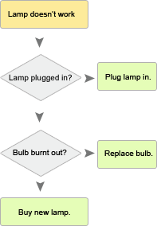

Slide 33
8. Cosmographs
Show parts of a whole
Similar to a pie chart
Less numerical
More graphic

Slide 34
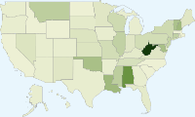
Cosmograph

Slide 35
VISUALS
Why are visuals used?
Visuals (sometimes called Graphics):
support instructions/convey a message without words
create interest/add clarity to instructions
by making business texts easier to read using
drawings, figures, pictures, charts, tables and
graphs
reinforce the main point/show the total picture - by presenting a compact summary of the main points of a verbal text as a visual aid

Slide 36
WHY USE VISUAL AIDS?
Supplementary Notes

Slide 37
DESCRIBING, HIGHLIGHTING & INTERPRETING
Describing
Visuals allow the audience to see what the writer or speaker is explaining.
To a person reading or listening to a set of instructions, visuals can be very helpful in understanding the procedure.
Visuals can portray the procedure as a whole as well as particular aspects of the procedure.
Highlighting Important Points
Frequently, you also need a visual aid to bring out an important point or summarize data.

Slide 38
Interpreting Information Accurately
Visuals also help in making exact amounts of information easy to see and this allows the reader to interpret the data much more quickly.
For example, let’s read the following paragraph:
The loamy sand soil texture has a pH of 5.65, organic matter capacity is 4.03.The sandy clay loam soil texture has a pH of 6.1% and organic matter capacity 4.03 megs. The sandy loam soil soil texture has a pH of 5.63 and organic matter capacity is 4.08 megs. The soil loam texture has a pH of 5.6% and organic matter capacity is 3.7 megs.
You will find that it is nearly impossible to scan quickly since the organization of the paragraph does not help the reader to accurately identify, compare or understand the information.

Slide 39
In contrast, the following table presents the information in a visually accessible way, enabling the reader to compare and interpret the data much more quickly.
Even though both the paragraph and the table present the same information, interpreting the information presented in the table is much easier, as shown in Table 1.1.

Slide 40
Table 1.1: Details on Types of Soil
Types of Soil | pH (%) | Organic Matter Capacity (megs)
Loamy sand soil texture | 5.65 | 4.03
Sandy clay loam soil texture | 6.1 | 4.03
Sandy loam soil texture | 5.63 | 4.08
Loam soil texture | 5.6 | 3.7

Slide 41

Tables, however, emphasize the discrete rather than the continuous and make it very difficult to show trends or direction in the data.
Thus, for maximum visual impact, tables should probably be a last choice as a visual aid and used only when it is important to provide a great deal of information with precision in a very small space.

Slide 42
Some of the other common types of visuals found in scientific and technical texts are
Graphs, flowcharts, exploded views, maps, photographs, and representative drawings (sometimes to scale).
Each has its own kind of information but all have one characteristic in common:
providing information, usually details, that are tedious to read in solid text, or is difficult or impossible to describe accurately in words alone.
Notes:
Found in scientific and technical texts are
graphs, flowcharts, exploded views, maps, photographsand representative drawings (sometimes to scale). Each has its own kind of information but all have one characteristic in common: providing information, usually details, that are tedious to read in solid text, or is difficult or impossible to describe accurately in words alone.

Slide 43
Understanding that each visual has a purpose makes selecting and using them within documents much easier and more effective as illustrated in Table 1.2 :
TYPES | PURPOSE
Tables | Usually give numerical detail. Useful for comparison.
Pie Charts | Best illustrates the various percentages that make up a whole. Useful for comparison.
Bar Graphs | Provides numerical detail but less precise because designed to show relationships quickly. Useful for showing trends over time.
Flow Charts | Provides similar information as tables and graphs and also shows the stages of a process or a procedure.
Exploded Views & Representative Drawings | Visual physical description as they give the spatial relationships of the parts of an object or a device.
Photographs | More realistic than drawing. Useful when reader needs a more exact representation. Covers a wide range of information – from blown-up fine detail, such as textures, to great sweeps of land.

Slide 44
However, without some kind of text explanation, there is hardly any visual that can provide information with the same clarity and precision that well written scientific and technical texts do.

Slide 45
EXPLAINING IT CLEARLY: INCORPORATING VISUALS IN TEXT
Although visual aids are important parts of a document that may make reading and understanding the information that is being presented easier, they are almost always a complement to the written text and not a substitute for it.
Placement and Labeling in Writing
Visual aids must be convenient for the reader to use.
A hard-to-find visual aid that lacks a title and identification of its major parts is useless.

Slide 46
Placement
Visual aids appear as appendices or attachments for three major reasons:
  1. They may be too big and bulky to be included in a discussion
  2. They may show information that a reader needs throughout the entire piece of writing
  3. Visual aids may present information not immediately relevant for the reader but may be very important for later readers

Slide 47
Labeling
Most visual aids should be identified with a title and a number.
The (various) parts should also be appropriately labeled.
These two types of labeling help readers easily and quickly relate visual aids to their discussion.
Several considerations are important in labeling visual aids as presented in the following table.

Slide 48
Table 1.3: Guide in Labeling Visual Aids
Clearly Stated Title | Visual aids should have clear titles. Sometimes the title identifies the type of visual aid as well as its content. Example: Figure 3 : Interview Evaluation Sheet
Number | Visual aids are numbered consecutively through the text. Usually tables and figures are numbered separately. Example: Figure 1, Figure 2, Table 1, Figure 3, Table 2 as they appear in the text.
Correctly Placed Title | According to most style manuals, tables should have their numbers and titles at the top. On the other hand, figures should have their identification at the bottom.
Parts Identified | Besides the title and number, the visual aid should have its parts clearly labeled. On a graph, the vertical and horizontal lines should be named. On a drawing, the parts should be named.

Slide 49
Talking about the Visuals
Once you have decided to use a visual aid in a particular spot in the text, you must integrate it so that it seems to belong there.
The visual aid needs to be tied to the text and explained since it appears in the text and must make sense to readers.
The easiest way to integrate a visual aid with the text is to explain its main points and any special implications a reader should note.
Visual aids that accompany written or oral presentation must first be introduced and then discussed.

Slide 50
(a) The Introduction
The introduction is usually a general statement explaining what the visual aid shows.
In writing, the introduction includes a number for the visual aid.
In an oral presentation, a number is not usually necessary. Instead of referring to a number, the speaker simply points to the table or figure.
Here are some examples of introductions:
- This graph shows that oil production has increased …
- As you can see, oil production has increased …
- As shown in Figure 2-1, oil production has increased
- Figure2-1 shows that oil production has increased …
- When you compare the production of petrol and
diesel, you can see that petrol is more popular
among the people in ...

Slide 51
(b) Language
Refer to the visual in the textual explanation.
In referring to the visual, use such pointers as:
- See Figure 2
- As illustrated in the following diagram
- Table 1 indicates the pertinent factors.
Use correct terminology in referring to visuals.
Tables are referred to as tables; all other visuals are usually referred to as figures.
Examples are:
    As the graph in Figure 4 indicates …
    Note the position of the motorcycle in Figure 8
    Study the amounts of salary increase shown in
    Table 3

Slide 52
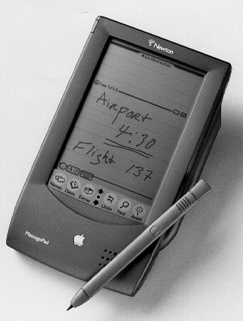
(c) Purpose of Description
You must be clear of the purpose of your description. Know what you have to describe or explain and keep to the point.
Take the example of the following variations in the method of describing a PDA (Personal Device Assistant).
as an instructional aid
    written description
    parts named and functions shown
    diagram of parts
    limited maintenance advice
as a specification
    dimensions
    details of working parts
    operation and maintenance

Slide 53
in a trade journal
    description of main features
    emphasis on advantages over other
    models
    (c)test information
    (d)comments upon suitability
in an advertisement
    outline of main features
    emphasis of features that have selling appeal

Slide 54
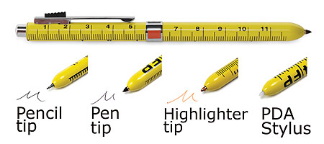
(d) Order of Description
There are no hard and fast rules for the order of description of a visual.
However, it would help if we could structure the description in a certain way.
For an exploded view or object, here are some possible ways:
From left to right, following conventional type
movement
Example: Describing the general appearance of a machine with detailed reference

Slide 55
(d) Order of Description
(ii) From the general to the detailed, or the reverse
Example: Describing the general appearance
of a machine before explaining
details, fittings, accessories
(iii) In the order in which components are assembled
Example: Describing machinery for manuals
(iv) By division into functional parts
Example: Describing an internal combustion
engine in the systems of ignition.
Fuel; cooling; lubrication; mechanical

Slide 56
View 1
Exploded views are often a good way of showing detail.
The animation below shows the pens being disassembled and then reassembled.
In an exploded drawing the pens would only be drawn with all the parts disassembled (taken apart).
It is important to recognise that all the parts are in line with each other, drawn usually along a centre line which is drawn through the entire centre of the design.

Slide 57
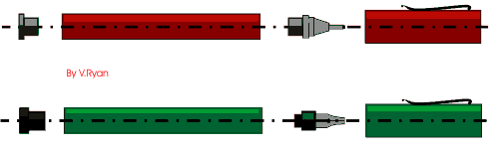

Slide 58
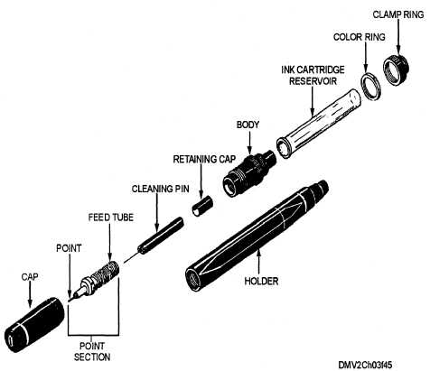

Slide 59
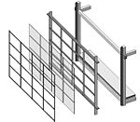
View 3

Slide 60
This is an example of a joint for wood called a comb or finger joint.
In an exploded drawing the joint would be drawn disassembled (taken apart).
In this way it is possible to see how the joints looks before it is glued together.
An exploded view can make designs and ideas easier to explain especially when adding detailed notes.
The animation shows the joint being disassembled and then reassembled.

Slide 61
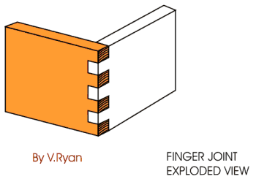
View 4

