Slide 1
Lecture 7
Creative and Persuasive Documents
Notices, advertisements, flyers, brochures

Slide 2
Notices
Most organizations have notice boards at prominent places throughout the office.
These are used to bring special items to the attention of all staff.
The information must be displayed attractively so that it gains attention and co-operation.

Slide 3
Notices may be posted about:
New procedures
Social events
Advertisements for internal appointment
Reports on matters of interest
Reminders of company procedures

Slide 4
Advertisements
Most organizations advertise in newspapers, magazines or trade journals to reach out to a wide and sometimes specific market.
Advertisements may be placed to:
-advertise vacant posts
-announce special events or functions
-promote products and services
-publicize changes in the organization

Slide 5
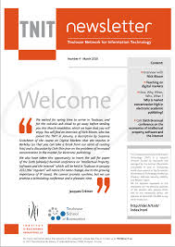

Publicity materials
- Press release
- Newsletters

Slide 6
Newsletters
A newsletter is one of the best ways to keep your name in front of the eyes of your clients, your associates, and others that may be in your target market.
A newsletter allows you to show them that you are more than just someone who is looking for projects to work on
And a newsletter shows that you are willing to pass on information that will help them run their own businesses
Think about how many newsletters you read each week or month.
Do you enjoy getting and reading it?
Do you find the articles and other information in the newsletter helpful?
Do you know who or what company produces it?

Slide 7
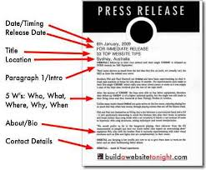

Slide 8
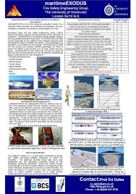


Flyers, brochures, leaflets and information sheets
Many types of leaflets and info sheets are produced in the market these days.
They are useful to convey information to a large number of people.

Slide 9

Flyers, brochures, leaflets and information sheets
Handed out at shopping centres, public areas to be picked up or delivered to your mail box or advertised online
Sometimes displayed in newspapers and magazines

Slide 10

Brochures
and Leaflets
persuade

Slide 11
To persuade
you need to use
FEEL GOOD WORDS
friendly
ATTRACTIVE
welcoming
picturesque
peaceful
calm
EXCITING

Slide 12
Designing Skills
The design skills for all these documents are very similar. These AIDA principles are very useful guidelines:
Attention
Interest
Desire
Action

Slide 13
Attention
You must attract the reader’s attention:
-use the company logo
-compose specific headings
-put special information in boxes/
sections
-use sub-headings/ numbered
points/bullets

Slide 14
Interest
Get the reader’s interest by mentioning something that will appeal to them:
-be persuasive
-use simple language, short
sentences

Slide 15
Desire
Arouse the reader’s desire to buy, to attend, to find out more or to contact the writer:
-make everything sound
interesting
-point out the benefits

Slide 16
Action
Make the audience want to do something after reading the notice or advertisement

Slide 17
Checklist
Include a company logo, prominently displayed if appropriate
Compose a catchy headline to give the gist to the contents
Use spacing carefully to give attention to special items
Use sub-headings and shaded sections to attract attention

Slide 18
Checklist
Use numbered bullets and points to categorise information.
Use persuasive language and convincing writing skills to make everything sound useful, exciting, interesting or beneficial
Aim for your documents to stand out when alongside with many others
Ensure your display is eye-catching, attractive and effective

Slide 19
Checklist
State the action that you want the reader to take and if necessary include:
-name
-telephone number
-e-mail address
-website
Etc.

Slide 21
To inform
you need to
ORGANISE
YOUR INFORMATION
HEADINGS
LOVELY
LEE-ON-THE-SOLENT
e.g.
Sub-headings
LEISURE
Bullet points
Walking along our spectacular coast
Bird-watching at our beautiful reserve
Cycling our many cycle paths

Slide 22
REMEMBER TO USE
BOSSY VERBS
(IMPERATIVES)
EXPLORE
our lovely coastline
VISIT
numerous nearby attractions
EXPERIENCE
the joy of windsurfing and jet-skiing
STROLL
along the lovely promenade

Slide 23
Rhetorical questions????
Use some
(Questions used for effect which do not need an answer)
Fancy a great holiday break?
Are you interested
in our maritime history?
Why not come to Lee-on-Solent?

Slide 24


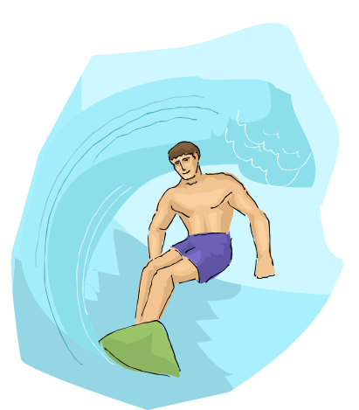


ADD SOME
PICTURES
A picture paints a thousand words

Slide 25
Active voice VS Passive voice
Use the active voice in writing persuasive documents because
-it makes your writing clearer
-it minimizes the distance between you
and the reader
-it reflects direct information

Slide 26
Rewrite these sentences using active voice:
Example:
1. The seminar will be conducted by Robert Sim.
Active voice: Robert Sim will conduct the seminar
2. The ball is kicked by Ali.
Active voice: Ali kicked the ball.

Slide 27
Rewrite these sentences using active voice:
Your thoughtful suggestions are accepted graciously.
The leak was fixed by the plumber.
Arrangements have been made for the conference to be held at the Hilton Hotel.
The design of our new systems was simplified by the use of hydraulics.

Slide 28
HOWEVER
You may use passive voice sentences when you are writing
Minutes of meetings
e.g. Mr. Jones reported that the
photocopier had broken down for the
third time in a month.
2. When tact is important
e.g. A serious mistake was made.

Slide 29


Slide 30
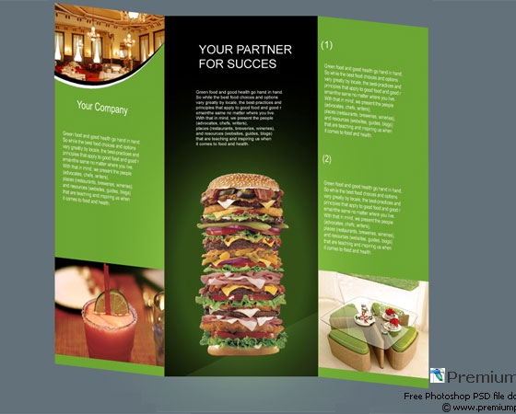

Slide 31


