Slide 1

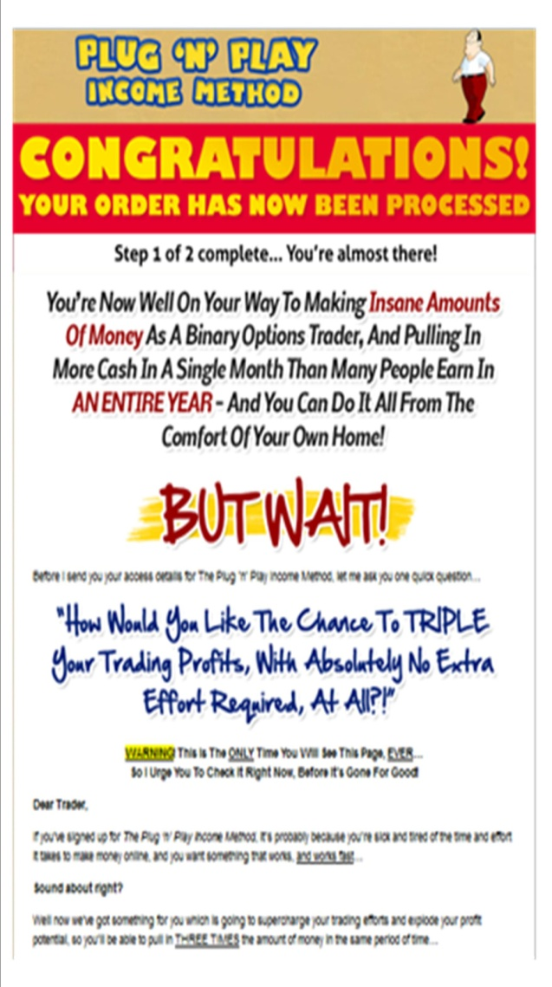

SALES LETTERS
Lecture 8

Slide 2
SALES LETTERS
Aims to sell particular goods or services to selected types of customers.
Purpose is to persuade readers that they need what you are trying to sell, and persuade them to buy it.
You take something attractive and make it seem necessary, or you take something necessary and make it seem attractive.

Slide 3
SALES LETTERS
They aim to motivate readers to act by gaining their attention and interest and prompting their desire and action.
Arouse interest
Create desire
Carry conviction /develop claim
Induce action/persuade

Slide 4
AROUSE INTEREST
Layout, print, colour could attract attention
Tell readers what and why you are writing
May begin with a question, an instruction or a quotation. (lead-ins)

Slide 5
.
AN ANECDOTE
It’s late at night, the service stations are closed, and you’ve just had a blowout on Highway 35. Don’t worry. Our new Tire-Right will solve your problems!
A QUESTION
“Where will I get the money for my kid’s college education?” “How am I going to afford to retire?” “Will my insurance cover all medical bills?” You’ve asked yourself these questions. Our estate planning video has the answers.
A QUOTATION
“Omit needles words,” technical writers say. If you can’t, let us help you. Write now, our new office communications service, can help you write your in-house newsletters—clearly and concisely.
DATA
You’re not alone. In fact, if you’re at least 25 years old, you’re in the majority. Today, 51 percent of our students are older than 25, so why not enroll now? Our college offers the nontraditional student many benefits.

Slide 6

CREATE DESIRE
Knowing what will appeal to the reader and how it will appeal to him.
If the reader is a lay person, clear description must be given.
Study the product and then select those features which make it superior to others of its kind.
Special features should be stressed from from the reader’s point of view.

Slide 7
Mattress…
Comfort or appreciation of a good, deep revitalising sleep
Life insurance…
- Reader’s sense of responsibility to family
An electronic scanner for medical practice…
- Listing and explanation of the functions and technological superiority of the product

Slide 8

CARRY CONVICTION / DEVELOP ASSERTIONS
Convince the reader that the product is what you claim it to be.
Support by evidence – facts, opinions.
Invite the reader to your factory or showroom
Offer to send goods on approval
Provide guarantee
Quote your 100 years of experience in the field
Give testimony from satisfied customers
AVOID FALSE OR EXAGERRATED
CLAIMS

Slide 9
INDUCE ACTION
Persuade the reader to take the action you want. Do something to make the reader act.
Reader wants to know the way ahead / next step
SUGGESTION:
Give directions (with a map) to your business location
Provide a tear-out to send back for further information
Supply a self-addressed, stamped envelope for customer response
Offer a discount within a given period of time
Give your name or customer-contact name and a phone number (toll-free if possible)
THE LESS EFFORT REQUIRED FROM THE READER, THE MORE ACTIVATED THEY ARE—THE LETTER HAS SERVED ITS PURPOSE

Slide 10
MORE TIPS …
Use adjectives to create a vivid picture
Use verbs to give your letter punch
‘You’ approach
Format for reader-friendly ease of access.
Highlight through white spaces, underlining, boldface, bullets, numbering etc.
Imply urgency—now, today, soon, don’t delay to force immediate action

Slide 11
Dear home-maker
YOU DESERVE A BREAK!
Do you ever tire of these long, tedious, thankless tasks? The hours spent slaving over the stove? The frantic, flustered rushes to bring in the washing when the rain starts? The dreary, daily mopping?
Do you ever tell yourself, ‘There must be more life than this?’
You’re right, and by investing in electroworld time and labour-saving appliances, you will begin to discover all those wonderful things in life that you have until now only dreamt about.
Automatic washing machines that dry as well as wash
Tumble driers for those wet, wet days
Microwave ovens for effortless, quick cooking
and many other wonderful things to take the slavery out of home-making
Call at any of our showrooms today for a demonstration of how we can help to take the slavery out of your life.
We look forward to meeting you

Slide 12





