Slide 1
LECTURE 9
Letters
Enquiry/Request
Complaint
Adjustment

Slide 2
TYPES OF LETTERS
ACCEPTANCE
ADJUSTMENT
COMPLAINT/CLAIM
CREDIT
ENQUIRY/REQUEST
ORDER
SALES

Slide 3
REQUEST/ENQUIRY LETTERS
To request information, services or products.
What is wanted
Who wants it
Why it is wanted
How will it be used
List of a few clear, direct questions
Deadline for necessary action
Expression of appreciation

Slide 4
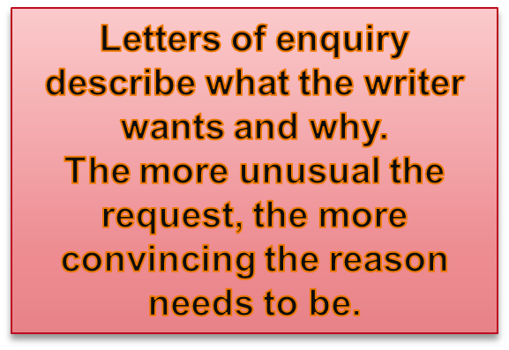

The purpose of this form is to obtain information from the reader. If the reader is expecting the letter, the writer’s task is easy.
If the reader is not expecting your letter, then it is more difficult. In this case, following these four guidelines will be helpful:
  State your purpose
  List your questions or requested action
  Offer something in return to encourage action
  Follow up with a thank you note, e-mail, or phone call to the person who helped you with your request

Slide 5
It is important to recognize that a well-written letter of inquiry is crucial to securing funding for your project.
The letter of inquiry should be brief—no more than three pages—and must be a succinct but thorough presentation of the need or problem you have identified, the proposed solution, and your organization's qualifications for implementing that solution.
The letter of inquiry should be addressed to the appropriate contact person at a foundation or to its CEO and should be sent by regular mail.
This type of letter is often written to suppliers you have not done business with before. Such a letter often asks for a brochure, catalogue or price list. It is sometimes considered useful to give some details of your business, and also where or how you heard of the supplier's name and address.
You should always address your letter “Dear Sirs”, “Dear Sir or Madam” – in this way you are writing to a company. If you address it to an individual, it may mean delay if the person is away or ill.

Slide 6
Organizing Direct Requests
Three-part Direct Pattern for Requests and Responses:
Opening Front loaded with the main idea 2.Say immediately why you are writing. | Body Explain your request or response Provide details 3.Consider using lists, headings, or columns. | Closing Be specific and courteous State what action you want taken 3.Provide end date.

Slide 7


A.Q.Electronics Ltd.
Calle Estoril 1701
Barselona
10 November 2014
Standart Office Furniture Ltd.
Cantley Rd
London SW4 9HX
Great Britain
Dear Sirs
REQUEST FOR INFORMATION ON TW37
We have read an article in “Office News” about your range of visible record system filing cabinets. We are interested in introducing a modern filing system in our main office. We also wish to install an electronic system for the storage and retrieval of data.
Please send us price list and catalogues of your manual and electronic data processing systems, quoting your price f.o.b. London if possible. We are particularly interested in type TW37, so we would be grateful if you would enclose more detailed information about this particular model.
We look forward to hearing from you soon.
Yours faithfully
J. Rodriguez
Office Manager
Letters of
Inquiry generally are 2-3 pages;
oftentimes, the foundation will indicate a page limit.
Do not go
over that limit!

Slide 8


This should inform the reader that this is an enquiry or request
Enquiry about Textbooks
Request for Brochure
Query about Website
Question regarding Product Components
EXAMPLE

Slide 9

This should tell the reader what you want
The introduction serves as the executive
summary for the letter of inquiry and includes the name of your organization, the amount needed or requested, and a description of the project.
The qualifications of project staff, a brief description of evaluative methodology, and a timetable (schedule) are also included here

Slide 10


Please send me...
Could you please send me...
(for things that the organization offers to send)
I would be grateful if you could tell me…
(for things that are not normally offered)
I am writing to enquire whether…
I would be grateful if you could…
(to see if something is possible)
I would especially like to know…
Could you send me more details…
( + a more detailed request)
Could you also…
I would also like to know...
Could you tell me whether...
( + an additional enquiry or request)
EXAMPLE

Slide 11

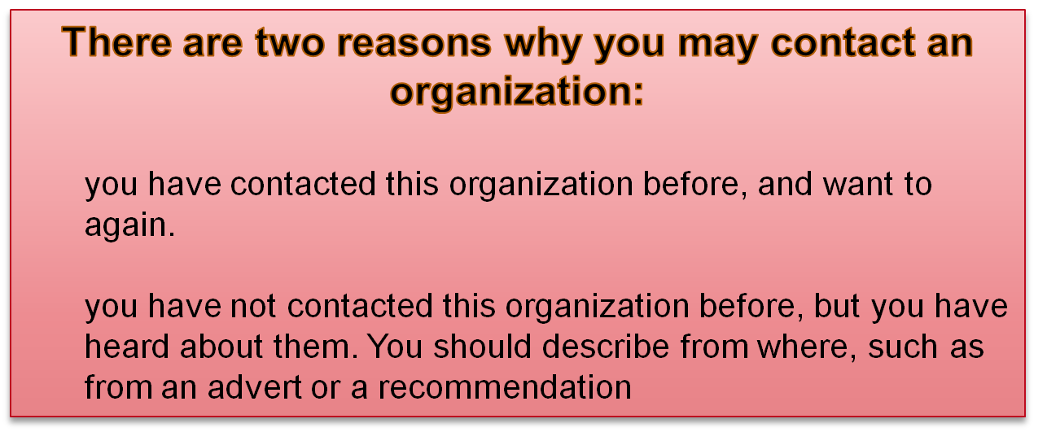
This paragraph tells the reader why you are contacting his or her organization, and gives further details of the enquiry

Slide 12


This paragraph should contain a polite expression and/or an expression of thanks to the reader.
The degree of politeness (and therefore the length), depends on how unusual or difficult your request is.
Possible language includes:
  Thanks. (For a very informal and normal enquiry or request)
  I look forward to hearing from you.
  I am looking forward to hearing from you.
  Thank you for your assistance.
  Thank you very much for your kind assistance.
  I appreciate that this is an unusual request, but I would be very grateful for any help you could provide. I look forward to hearing from you.
If you think the reader might have further questions, you can suggest that he or she contact you.

Slide 13
For Complex Requests...
1.In requesting several items or answers, use an itemized list
2.Limit questions to those reflecting the main idea--
☹ What is the price range on the machine?
☺ What is the price for 20-Cup ElectroPerk coffee pot?
3.Omit questions you can answer independently
4.Limit each question to one topic
☹ Does it come with attachments?
Do attachments cost extra?
Is the machine hard to use?
☺ What attachments, if any, are included in the purchased
price?

Slide 14
When Writing Direct Request Letters...
Get right to the point | Interested and cooperative
Include necessary details | Date Offer to make purchase* Description of goods -- catalog number -- quantity; color; size; -- price, & amount due Delivery and billing address(es) Shipping arrangements Payment details
Give a detailed description for unusual, nonstandard order | Specifications Drawings
Keep copy of the order on file | For future reference
*Ex: I must purchase a new office coffee pot within the next two weeks, so I will appreciate hearing from you by…

Slide 15
Requesting Routine Information and Action
B. To other businesses:
A. In response to advertisements
  Fill out and return response card, if available
  If not, write requesting information and mentioning where you saw it
  Including handling fee if required
B. For other product inquires
  Describe request
  Indicate reader benefit in complying with request
  Make compliance easy
C. For claims and adjustments

Slide 16
Asking for Information or Action
Rule 1: Open with a question or a polite
request.
E.g. Could you please answer the following
questions about your payroll service.
(punctuate this polite command with a period instead of a question mark.)

Slide 17
Asking for Information or Action
Rule 2: Explain your purpose and provide
details; Maintain a courteous tone, spell out what needs to be done, and focus on reader benefits.
E.g. To ensure that you receive the exact
sweater you want, please send us
your color choice.

Slide 18
Asking for Information or Action
Rule 3: End the letter courteously. If a date is important, set a deadline and explain why.
Avoid overused endings such as:
× Thank you for your cooperation. (trite)
× Thank you in advance for . . . (presumptuous)
× If you have any questions, do not hesitate to call
me.(suggests that you do not make yourself clear)

Slide 19
Asking for Information or Action
(Sample Letter: First draft)
Dear Ms. Ivorson:
Our insurance rates will be increased soon if we don't install security devices on our computer equipment. We have considered some local suppliers, but none had exactly what we wanted. | Starts with background information and explanation instead of request.
We need a device that can be used to secure separate computer components at a workstation including a computer, keyboard, and monitor. We currently own 18 computers, keyboards, and monitors, along with six printers. | Fails to organize information into logical order.

Slide 20
Asking for Information or Action
We wonder if professionals are needed to install your security devices. We are also interested in whether the devices can be easily removed when we need to move equipment around. We are, of course, very interested in price and quantity discounts, if you offer them. | Confuse readers by jumping around many topics. Fail to ask Specific questions.
Thank you for your attention to this matter. | Ends with cliché. Fails to reveal what to do and when to do it.

Slide 21
Asking for Information or Action
(Revised Version)
Please could you provide information and recommendations regarding security equipment to prevent the theft of office computers, keyboards, monitors, and printers. | Introduces purpose immediately
Our office has 18 computer workstations and 6 printers that we must secure to desks or counters. Answers to the following questions will help us select the best devices for our purposes. | Explains need for information

Slide 22
Asking for Information or Action
What device would you recommend that can secure a workstation consisting of a computer, monitor, and keyboard? What expertise and equipment are required to install and remove the security device? How much is each device? Do you offer quantity discounts, and if so, how much? | Groups open- Ended questions into list for quick comprehension and best feedback
Because our insurance rates will be increased if the equipment is not secured before April 1, we would appreciate your response by February 16. | Courteously provide end date and reason

Slide 23
__________Better Widget Makers, Inc.__________
5555 Widget Avenue
Silver City, CO 80456
26 September 2014
Mr. Russ Hamilton
Vice President, Sales and Marketing
Golden Bread Company
123 Loaf Street
Silver City CO 80451
Dear Mr. Hamilton:
Construction on the new employee cafeteria at Better Widget Makers, Inc. is nearing
completion and I am looking for a supplier capable of fulfilling our weekly bakery needs.
Do you have an information packet that would help me project the cost of doing business
with your company? We will need daily deliveries of pastries, pies, dinner rolls and
sandwich bread. Our facility operates 24/7, Monday through Friday, with a flextime
workforce of 1,500 employees. To complete my operational budget I will need the
following information:
      • Wholesale price sheets
      • Quantity cost breaks
      • Annual contract discounts
      • Delivery and or any other service charges.
To submit my proposal to the finance committee at their October 20th meeting I will need
to receive your information by the 10th. I will also need to meet with you after reviewing
the requested materials. Please call me for an appointment at your earliest convenience.
My personal extension is 216-8080, # 29.
In keeping with long-standing policy we would like to place this contract locally. I look
forward to working with you and am hopeful that the Golden Bread Company can fulfill
our needs.
Sincerely,
Ida Mae Knott
Purchasing Agent

Slide 24


Acknowledging receipt of an enquiry/request
Thank you for your letter of … regarding / concerning / in connection with …
I refer to your enquiry about / relating to…
I have received your letter of… requesting information about …
We would like to thank you for enquiring about ...
Explaining action taken as a consequence of the enquiry
I have (reviewed our available stock) …
We held a meeting on 21 October to discuss possible solutions.
I have checked/looked into/investigated (the possible approaches) …

Slide 25

The best choice would be … since …
I highly recommend … as / due to the fact that …
…would probably be more suitable because…
… seems to suit you better although …
Perhaps you should choose … even though…
I suggest that you (should) choose …
I recommend this item since …
In view of the fact that …, I would strongly recommend … as …
Making suggestions / justifying recommendations / pointing out pros and cons / hedging

Slide 26

While I appreciate your firm’s need for this information, I regret that …
It will not be possible to … for legal reasons. We are bound to …
Your proposal is of interest to us, and we have had consultations about it.
However, we feel that it will not be in our interests to … for reasons of (privacy).
We are concerned that …
Apologizing and rejecting proposals
Stipulating action requested or to be taken
We shall arrange for … by …at the latest.
I shall see to it that …
Our company will arrange for …

Slide 27

I hope this suggestion/information will be useful to you.
I hope this information will prove useful to you.
I hope that this information will help you to make decisions on your order.
I look forward to hearing from you.
I look forward to receiving your confirmation of …
I look forward to doing business with your company in the future …
Please feel free to contact me again if you have any further queries on …
Do contact me at 27615432 if you need further information.
Please do not hesitate to contact me at 27615432 if I can be of further assistance.
Establishing goodwill and suggesting contact

Slide 28

Everlong Batteries 171, Choi Hung Road Hung Hom, Hong Kong Tel/Fax 2235 2449 8 November 2014 Mr J Wong Purchasing Officer Fortune Goods 317 Orchard Road Singapore Dear Mr Wong Enquiry about Batteries Thank you for your letter of Thursday, 6 November regarding making copies of the sample battery you sent us. I have investigated the situation and found that your specifications are exactly the same as the design of a proprietary camera battery manufactured by a large Japanese electronics company. We feel that it would not be in our interests to supply this type of battery. However, I would like to thank you for considering our company as your supplier. I look forward to doing business with your company in the future Yours sincerely David Choi David Choi Distributions Manager
Notice these sentences in which the writer thanks his correspondent for an inquiry: Pay attention that we “inquire” about general information, and “request” an object or a statement.

Slide 29
“YOU approach”
Helpful to indicate how readers can benefit by sharing his or her knowledge and services.
Compare:
Would you consider addressing our group…
I would like you to speak
Would you send me information about…
I need information on…

Slide 30
PARTS OF A REQUEST LETTER
OPENING – Engage attention and to establish purpose of letter.
E.g.
My company is planning to purchase 30 new tractors by the end of the year. Your 2013 tractor with the onboard computer might be the answer to our problems. In addition to sending us a picture brochure of the CP95 tractor, could you also answer the following questions about your vehicle?
(sentence 1&2 – explain reason of writing;
last sentence – explains what you want)

Slide 31
PARTS OF A REQUEST LETTER
BODY – Details for the recipient to respond
Ask precise questions or list/tabulate specific topics of enquiry: 1., 2., 3., etc. Must QUANTIFY.
Compare:
“specifications for machines”
“specifications for the 12R403B Copier”
“Will the roofing material cover a large surface?”
“Will the roofing material cover 150’ x 180’ ?”

Slide 32
PARTS OF A REQUEST LETTER
CLOSING – Deadline for necessary action
Explain why you need answers by the date given.
E.g.
Please send the above information by November 15. This will allow my shop supervisor to study the manuals and arrange for a test drive prior to our board of directors meeting on December 1.
DO NOT INCLUDE THE PHRASE
THANKING YOU IN ADVANCE

Slide 33
COMPLAINT LETTER
REASONS:
wrong goods received
poor service
unsatisfactory quality of goods
late delivery
damaged goods
prices not as agreed, etc.

Slide 34
TYPES OF COMPLAINTS
Complaints concerning goods
(refer to handouts)
Complaints concerning delivery
(refer to handouts)
Complaints concerning service
Personal complaints

Slide 35
EXTRACTS FROM COMPLAINT LETTERS
I am writing to express my profoundest dissatisfaction with the treatment I have received from your staff. My visit to your premise last Saturday was certainly the worst experience I have ever had in a bank. I do not believe that banks cannot recruit staff who are better able to deal with customers.

Slide 36
2.You obviously did not take care in packaging the goods prior to shipment. There is no question in my mind that your company must be held liable for the damage sustained.

Slide 37
3. Despite several letters which we have sent to you regarding dust and debris caused by the renovations to your building, we have not had the courtesy of a reply, let alone any attempt to clean the pavement outside our premises. If this letter does not cause you to take any action, we shall commence legal proceedings against you.

Slide 38
4. On examining the consignment I discovered that you had sent us 200 copies of the book Freedom at Midnight instead of Freedom at Dawn. This is an extremely irritating mistake on your part because we have many unsold copies of the former, but several customers have requested the latter. Kindly arrange to take back the wrong consignment and send us the books we ordered as soon as possible.

Slide 39
APPROPRIATE? INAPPROPRIATE? WHY?
I am writing because I am angry at your total inability to carry out my simplest order.
I am afraid that my instructions have not been carried out as I had requested.
Would you kindly have the decency to give me an answer to my three letters?
I should appreciate a reply to my previous letters.

Slide 40
I wish to complain about……
I would like to draw your attention to……
Your speed in requesting payment is most laudable, but I refuse to part with a cent until you have delivered every item.
I have received your bill, but am withholding payment until the complete order has been delivered.
The insulting behaviour of your staff has caused me to write this letter of complaint.
I regret to write to you about the behaviour of your staff.

Slide 41
Sample of the
Introduction
Body
Conclusion
of a complaint letter.

Slide 42
INTRODUCTION (EXAMPLE)
On June15, you shipped 36 XYZ digital oscilloscopes (copies of invoice #3492 are enclosed) to my company. Several of our customers have since complained that the o-scopes are malfunctioning.

Slide 43
DISCUSSION (EXAMPLE)
The following occurred after we delivered the o-scopes to three of our customers.
June 20 – AAA Electronics stated that two of their five o-scopes were malfunctioning, giving incorrect readings.
June 25 – Richards Electronics, Inc., said three of their o-scopes were incorrectly calibrated.
July 5 – Five of ABC Computers’ o-scopes would not interface with their computers.
These ten o-scopes need to be repaired. You should also send service technicians to troubleshoot our clients’ other o-scopes to avoid future problems.

Slide 44
CONCLUSION (EXAMPLE)
You can reach me at 469-8200 from 8.00a.m. to 5.00p.m., Monday through Friday. Thank you for your help. After working with your company for the past eight years, I have been impressed with the way you stand behind your products. I know you will help us with these defective o-scopes.

Slide 45
LETTER OF ADJUSTMENT
Reply/response to letter of complaint.
Types: totally justified
(100% yes)
totally unjustified
(100% no)
partial adjustment
POINT IS TO RETAIN THE CUSTOMERS’ GOODWILL!!!

Slide 46
I am very sorry that you have been disappointed by our service. We were definitely in the wrong and we sincerely apologize for the inconvenience which you have to suffer because of the negligence of our staff.
If justified … but is it ok to write this way?

Slide 47
If unjustified or trivial
I must point out that the damage to the goods in transit is no concern of ours whatsoever. Your proposal to hold us liable is totally absurd.

Slide 48
THE FIVE A’S
Acknowledge
Accept
Account
Action
Assurance

Slide 49
100% yes letter with 5A’s
Thank you for calling our attention to your problem. We will be happy to replace your defective oscilloscopes.
I have looked into your order and discovered the cause of the problem. The oscilloscopes were damaged during shipment. They were stacked too high, which led to breakage while handling. I have met with the carrier, who agrees that the packages were handled improperly.
In two days’ time, I will be sending you a service technician to check on your other o-scopes from this order.
Acme has worked with your company for many years, and we look forward to continuing this business relationship.
We apologize for the inconvenience and give you our assurance that we shall do all we can to prevent a recurrence.
Should you require any further clarification, please call me at 392-8270.

