Slide 1
Simple List Implementation Using Array
6
1
3
10
15
21
...
...
Kept in alphabetical or numeric order
No space between elements
Problem:
  Expansion and Insertion
1

Slide 2
Expansion and Insertion
6
1
3
10
15
21
...
Copy old array, leave space for new value
1
3
6
10
15
21
...

Slide 3
Disadvantages of array implementation
Lots of memory needs to be allocated.
Lots of copying needs to be done.

Slide 4
Contiguous Storage vs. Linked Storage
Contiguous Storage – arrays
  Static Variables, and known list size.
  Are declared and named while writing program.
  Space for them exists as long as the program in which they are declared are running.
Linked Storage – pointers and linked lists
  Dynamic Variables
  Can be created or destroyed during execution of the program in which they are declared.

Slide 5

From Wikipedia, the free encyclopedia
In computer science, a linked list is a data structure that consists of a sequence of data records such that in each record there is a field that contains a reference (i.e., a link) to the next record in the sequence.
FIGURE 1 A linked list whose nodes contain two fields: an integer value and a link to the next node

Slide 6
Basic concepts of Linked Lists
Each record of a linked list is often called an element or node.
The field of each node that contains the address of the next node is usually called the next link or next pointer.
The remaining fields are known as the data, information, value, or payload fields.

Slide 7

Linear and circular lists
FIGURE 2 A circular linked list

Slide 8
Singly-, doubly-, and multiply-linked lists
FIGURE 3 A singly-linked list whose nodes contain two fields: an integer value and a link to the next node
FIGURE 4 A doubly-linked list whose nodes contain three fields: an integer value, the link forward to the next node, and the link backward to the previous node

Slide 9
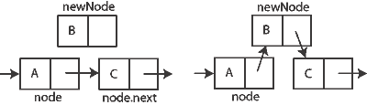
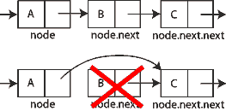
Inserting and Deleting Element
FIGURE 5 Inserting a node after an existing node in a singly linked list
FIGURE 6 Removing the node after a given node

Slide 10
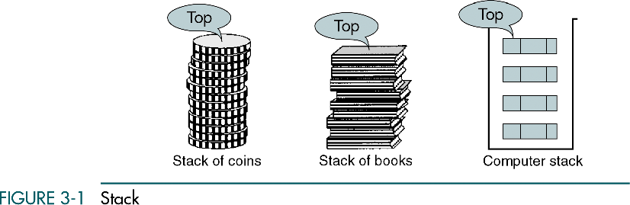
Data Structures: A Pseudocode Approach with C

Slide 11
Basic Stack Operations
The stack concept is introduced and three basic stack operations are discussed.
Push
Pop
Stack Top
Data Structures: A Pseudocode Approach with C

Slide 12
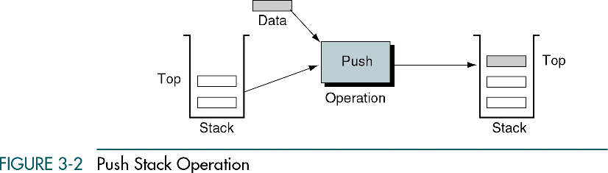
Data Structures: A Pseudocode Approach with C

Slide 13
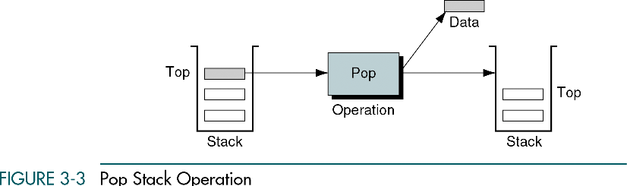
Data Structures: A Pseudocode Approach with C

Slide 14
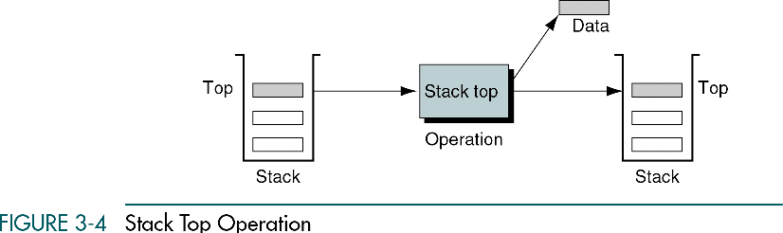
Data Structures: A Pseudocode Approach with C

Slide 15
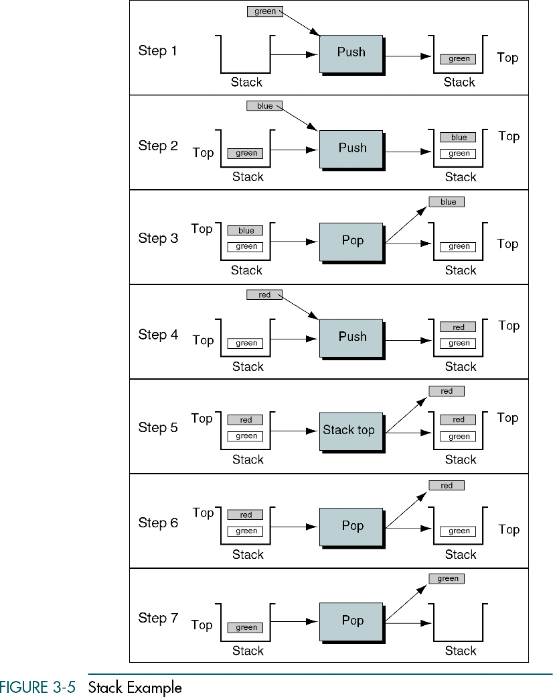
Data Structures: A Pseudocode Approach with C

Slide 16
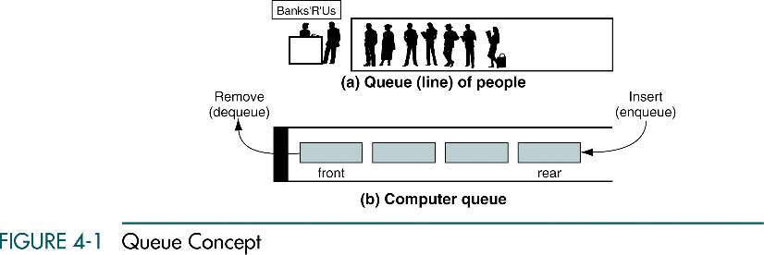
Data Structures: A Pseudocode Approach with C

Slide 17
Queue Operations
This section discusses the four basic queue operations. Using diagrammatic figures, it shows how each of them work. It concludes with a comprehensive example that demonstrates each operation.
Enqueue
Dequeue
Queue Front
Queue Rear
Queue Example
Data Structures: A Pseudocode Approach with C

Slide 18
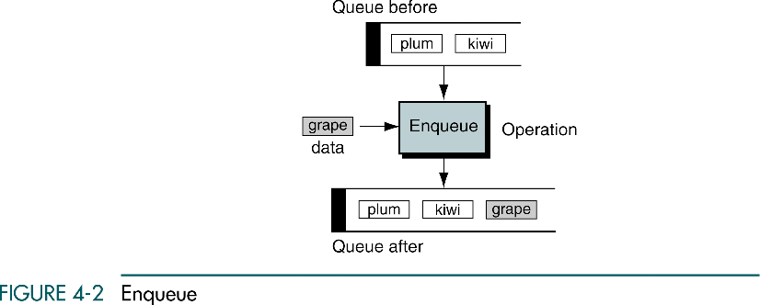
Data Structures: A Pseudocode Approach with C

Slide 19
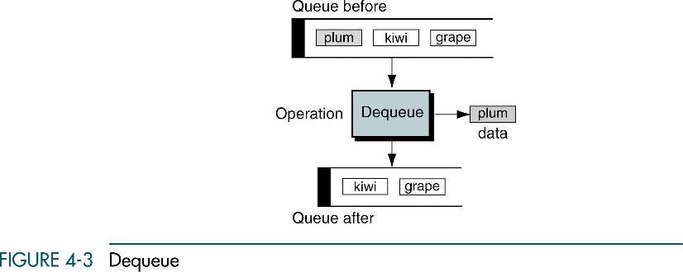
Data Structures: A Pseudocode Approach with C

Slide 20
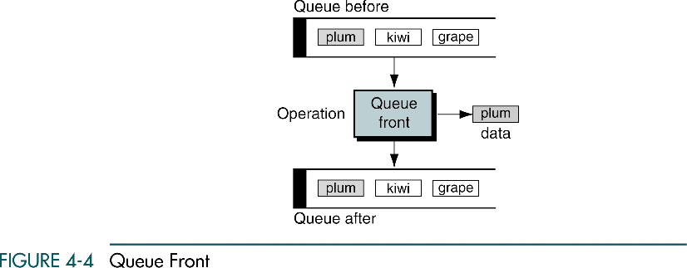
Data Structures: A Pseudocode Approach with C

Slide 21
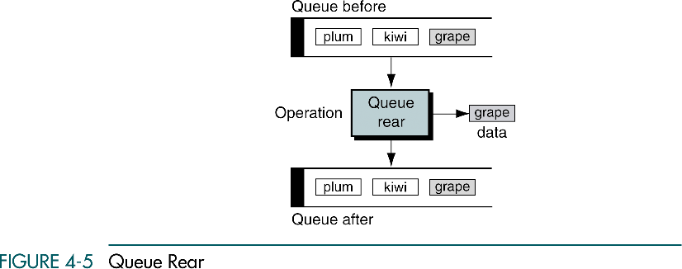
Data Structures: A Pseudocode Approach with C

Slide 22
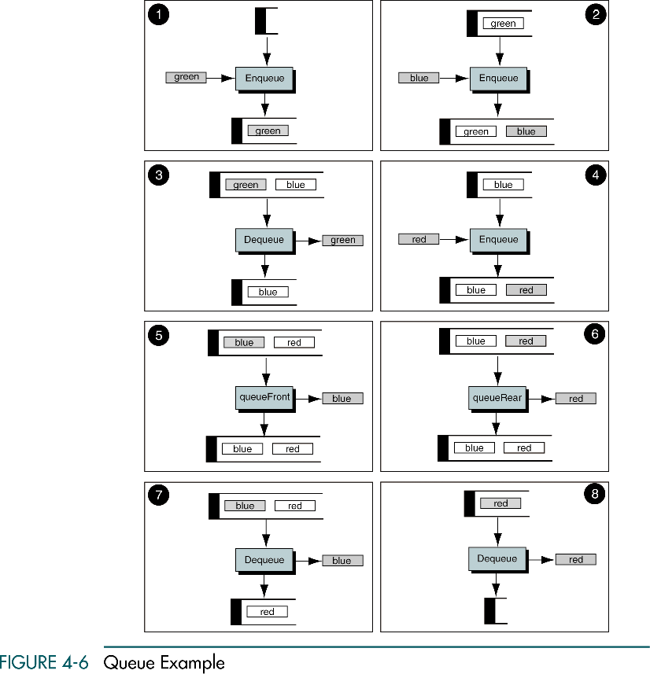
Data Structures: A Pseudocode Approach with C

Slide 23
(Continued)
Data Structures: A Pseudocode Approach with C

