Slide 1
Chapter 22 Lists, Stacks, Queues, and Priority Queues

Slide 2
Objectives
To explore the relationship between interfaces and classes in the Java Collections Framework hierarchy (§22.2).
To use the common methods defined in the Collection interface for operating collections (§22.2).
To use the Iterator interface to traverse the elements in a collection (§22.3).
To use a for-each loop to traverse the elements in a collection (§22.3).
To explore how and when to use ArrayList or LinkedList to store elements (§22.4).
To compare elements using the Comparable interface and the Comparator interface (§22.5).
To use the static utility methods in the Collections class for sorting, searching, shuffling lists, and finding the largest and smallest element in collections (§22.6).
To develop a multiple bouncing balls application using ArrayList (§22.7).
To distinguish between Vector and ArrayList and to use the Stack class for creating stacks (§22.8).
To explore the relationships among Collection, Queue, LinkedList, and PriorityQueue and to create priority queues using the PriorityQueue class (§22.9).
To use stacks to write a program to evaluate expressions (§22.10).

Slide 3
Introduction
Choosing the best data structures and algorithms for a particular task is one of the keys to developing high-performance software.
A data structures is a collection of data organised in some fashion. The structure not only stores data but also supports operations for accessing and manipulating the data.

Slide 4
Java Collection Framework hierarchy
A collection is a container object that holds a group of objects, often referred to as elements. The Java Collections Framework supports three types of collections, named sets, lists, and maps.

Slide 5
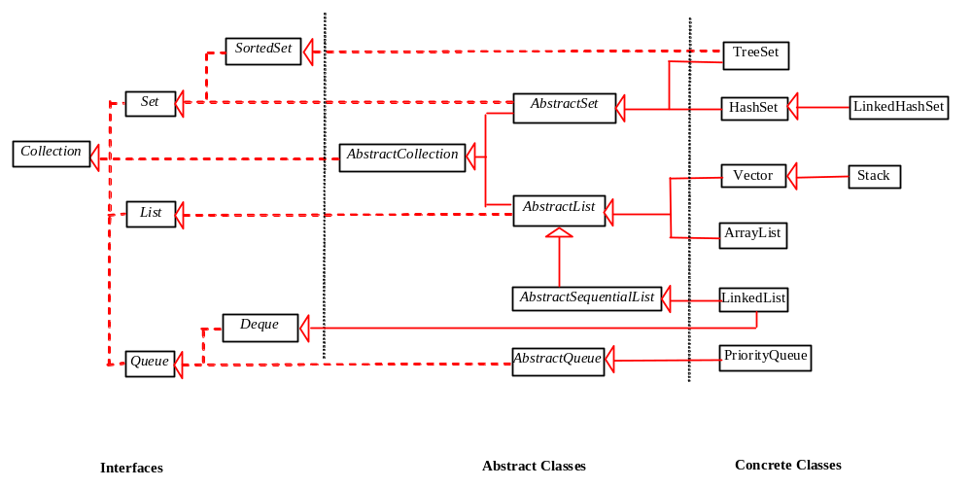
Java Collection Framework hierarchy, cont.
Set and List are subinterfaces of Collection.

Slide 6
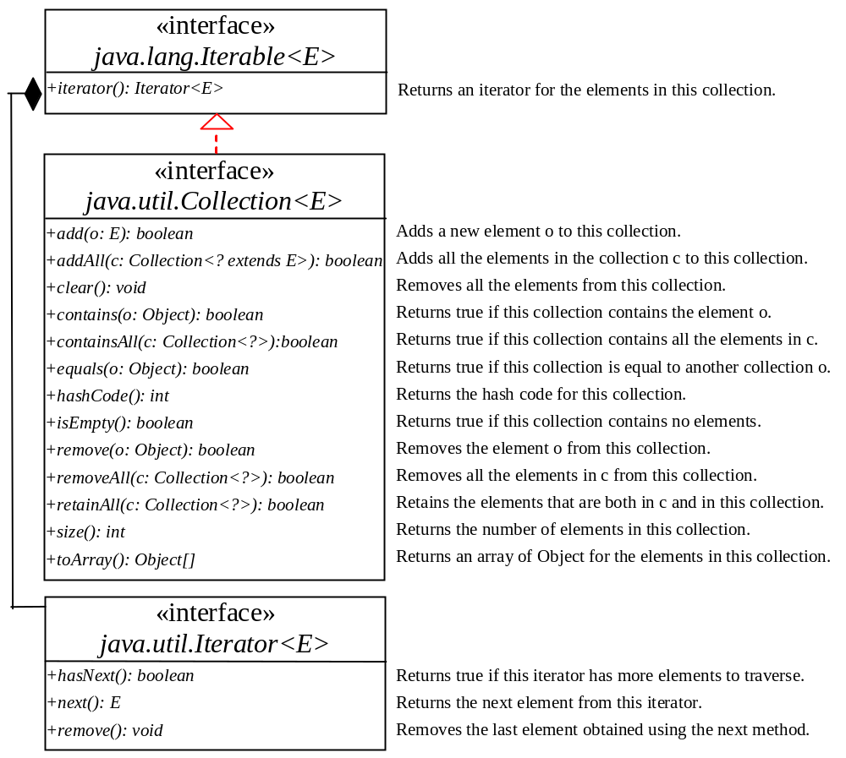
The Collection Interface
The Collection interface is the root interface for manipulating a collection of objects.

Slide 7
Note
All the interfaces and classes defined in the Java Collections Framework are grouped in the java.util package.

Slide 8
Design Guide (1)
The design of the Java Collection Framework is an excellent example of using interfaces, abstract classes, and concrete classes.
Interfaces – define the framework
Abstract classes – provide partial implementation
Concrete classes – implement the interfaces with concrete data structures.

Slide 9
Design Guide (2)
Some of the methods in the Collection interface cannot be implemented in the concrete subclass. In this case, the method would throw java.lang.UnsupportedOperationException, a subclass of RuntimeException. Good design to be used:
public void someMethod() {
throw new UnsupportedOperationException
("Method not supported");
}

Slide 10
Example: Using Collection
This example creates a concrete collection object using ArrayList, and invokes the methods defined in the Collection interface.
TestCollection
Run

Slide 11
Iterators
Each collection has an Iterator object that can be used to traverse all the elements in the collection.
It’s to used to walk through a data structure without having to expose the details of how data is stored in the data structure.

Slide 12
Example: Using Iterator
This example shows how to obtain an iterator for the collection and uses the iterator to traverse all the elements in the collection.
TestIterator
Run

Slide 13
The List Interface
A set stores non-duplicate elements. To allow duplicate elements to be stored in a collection, you need to use a list. A list can not only store duplicate elements, but can also allow the user to specify where the element is stored. The user can access the element by index.

Slide 14
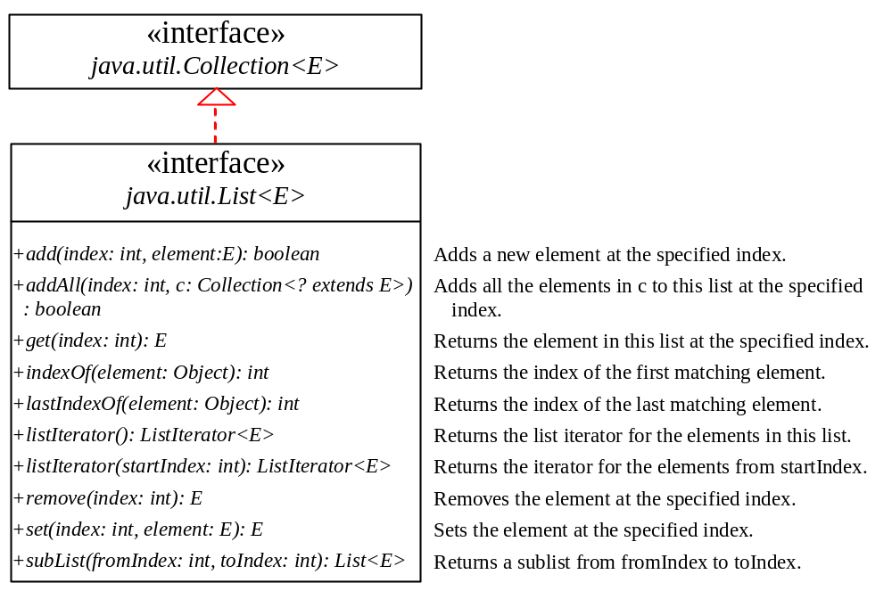
The List Interface, cont.

Slide 15
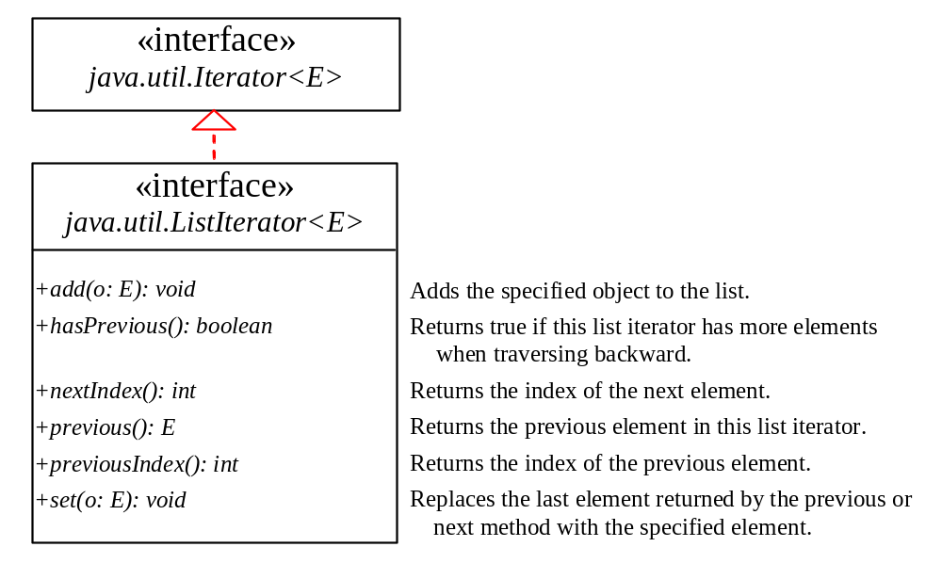
The List Iterator

Slide 16
ArrayList and LinkedList
The ArrayList class and the LinkedList class are concrete implementations of the List interface.
Which of the two classes you use depends on your specific needs.
  If you need to support random access through an index without inserting or removing elements from any place other than the end, ArrayList offers the most efficient collection.
  If, however, your application requires the insertion or deletion of elements from any place in the list, you should choose LinkedList.
  A list can grow or shrink dynamically; An array is fixed once it is created.
  (Refer to additional slide)

Slide 17
ArrayList
The array is dynamically created.
If the capacity of the array is exceeded, a larger new array is created and all the elements from the current array are copied to the new array.

Slide 18
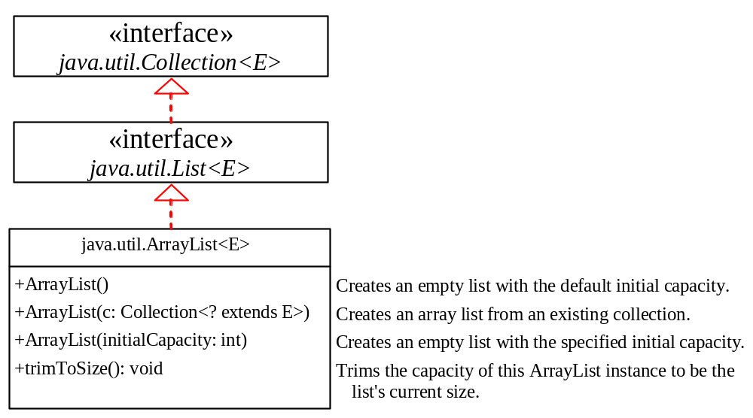
java.util.ArrayList

Slide 19
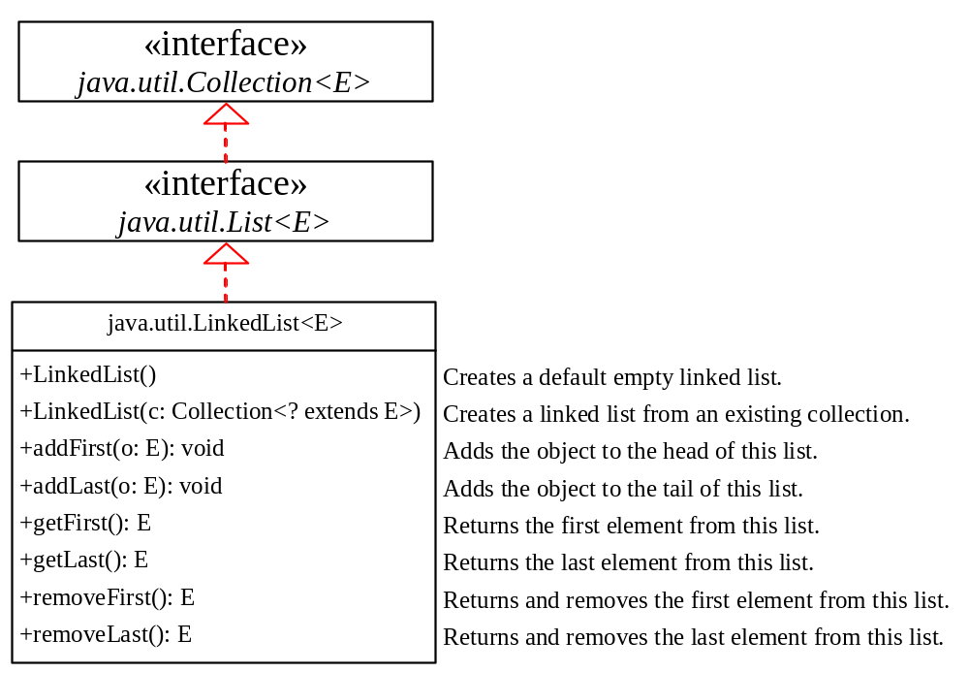
java.util.LinkedList

Slide 20
Example: Using ArrayList and LinkedList
This example creates an array list filled with numbers, and inserts new elements into the specified location in the list. The example also creates a linked list from the array list, inserts and removes the elements from the list. Finally, the example traverses the list forward and backward.
TestArrayAndLinkedList
Run

Slide 21
The Comparator Interface
Sometimes you want to insert elements of different types into a tree set. The elements may not be instances of Comparable or are not comparable. You can define a comparator to compare these elements. To do so, create a class that implements the java.util.Comparator interface. The Comparator interface has two methods, compare and equals.

Slide 22
Comparable vs. Comparator
Normally, if the objects of a class have natural order (e.g., String, Date), let the class implement the Comparable interface.
The Comparator interface is more flexible in the sense that it enables you to define a new class that contains the compare(Object, Object) method to compare two objects of other classes.

Slide 23
The Comparator Interface
public int compare(Object element1, Object element2)
Returns a negative value if element1 is less than element2, a positive value if element1 is greater than element2, and zero if they are equal.
public boolean equals(Object element)
Returns true if the specified object is also a comparator and imposes the same ordering as this comparator.
GeometricObjectComparator
Run
TestComparator

Slide 24
The Collections Class
The Collections class contains various static methods for operating on collections and maps, for creating synchronized collection classes, and for creating read-only collection classes.

Slide 25
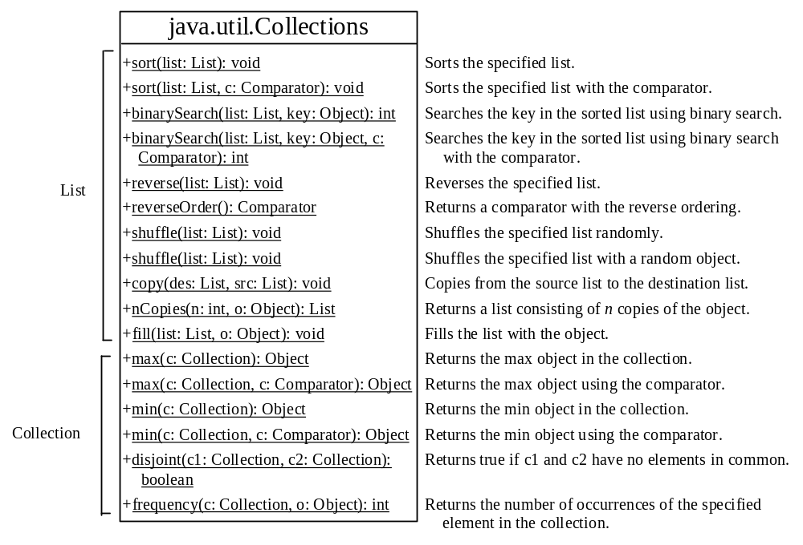
The Collections Class UML Diagram

Slide 26
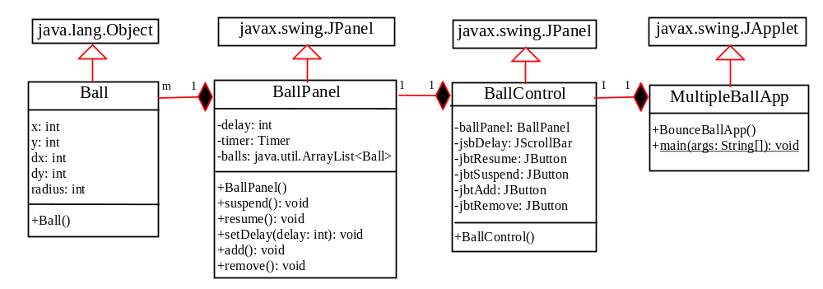
Case Study: Multiple Bouncing Balls
MultipleBallApp
Run

Slide 27
The Vector and Stack Classes
The Java Collections Framework was introduced with Java 2. Several data structures were supported prior to Java 2. Among them are the Vector class and the Stack class. These classes were redesigned to fit into the Java Collections Framework, but their old-style methods are retained for compatibility. This section introduces the Vector class and the Stack class.

Slide 28
The Vector Class
In Java 2, Vector is the same as ArrayList, except that Vector contains the synchronized methods for accessing and modifying the vector. None of the new collection data structures introduced so far are synchronized. If synchronization is required, you can use the synchronized versions of the collection classes. These classes are introduced later in the section, “The Collections Class.”

Slide 29
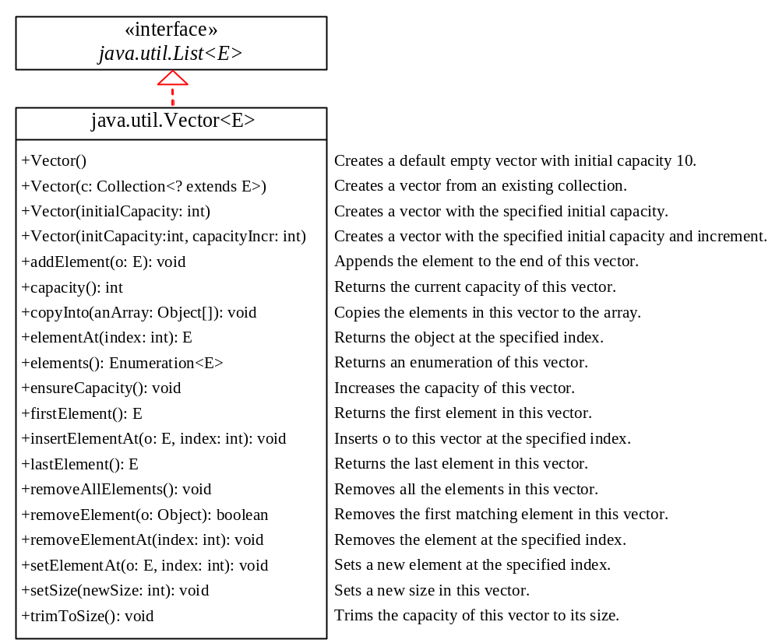
The Vector Class, cont.

Slide 30
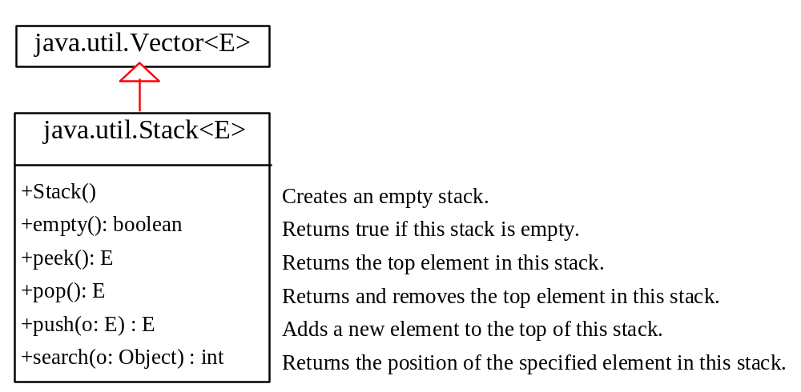
The Stack Class
The Stack class represents a last-in-first-out stack of objects. The elements are accessed only from the top of the stack. You can retrieve, insert, or remove an element from the top of the stack.

Slide 31
Queues and Priority Queues
A queue is a first-in/first-out data structure. Elements are appended to the end of the queue and are removed from the beginning of the queue. In a priority queue, elements are assigned priorities. When accessing elements, the element with the highest priority is removed first.

Slide 32
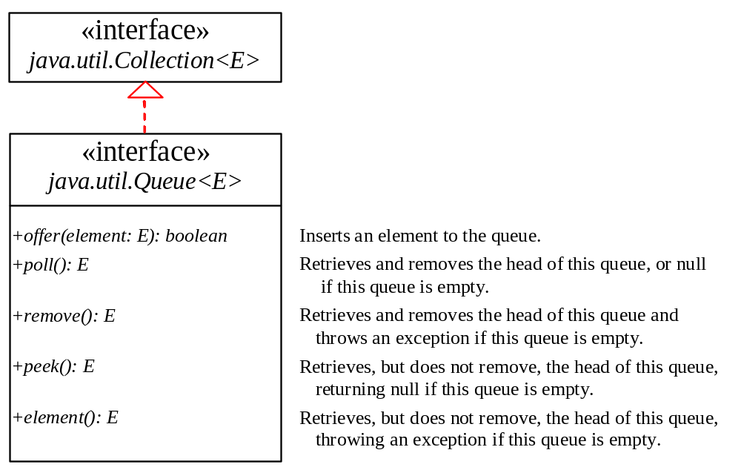
The Queue Interface
TestQueue
Run

Slide 33
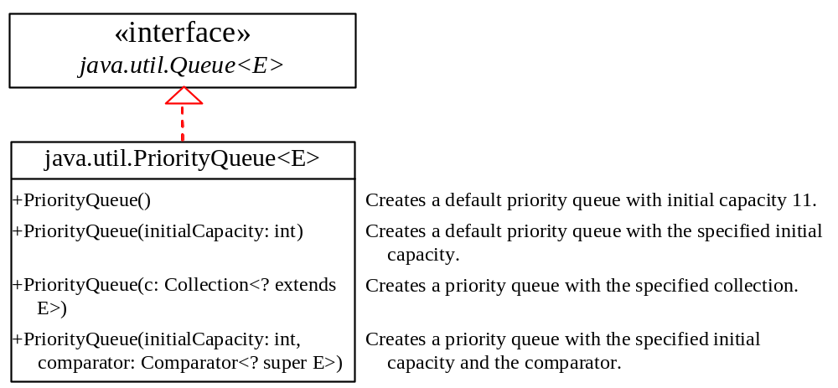
The PriorityQueue Class
PriorityQueueDemo
Run

Slide 34
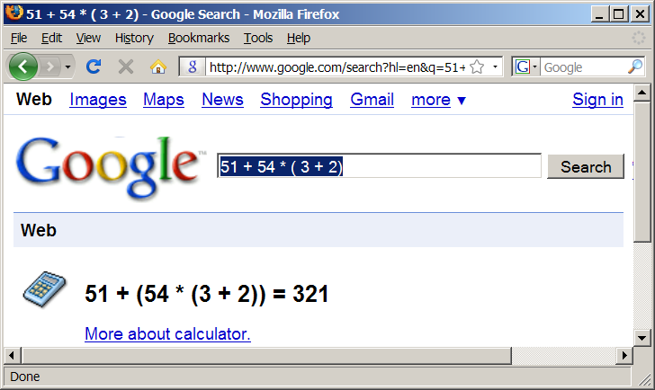
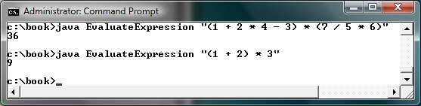
Case Study: Evaluating Expressions
Stacks can be used to evaluate expressions.
Evaluate Expression

Slide 35
Case Study: Evaluating Expressions
Phase 1: Scanning the expression
1.1 If the extracted item is an operand, push it to operandStack.
1.2 If the extracted item is + or - operator, process all the operators at the top of operatorStack and push the extracted operator to operatorStack.
1.3 If the extracted item is * or / operator, process all the * or / operators at the top of operatorStack and push the extracted operator to operatorStack.
1.4 If the extracted item is ( symbol, push it to operatorStack.
1.5 If the extracted item is ) symbol, repeatedly process the operators from the top of operatorStack until seeing the ( symbol on the stack.
Phase 2: Clearing the stack
  Repeatedly process the operators from the top of operatorStack until operatorStack is empty

