Slide 1
Algorithm Efficiency
To design and implement algorithms, programmers must have a basic understanding of what constitutes good, efficient algorithms. In this section we discuss and develop several principles that are used to analyze algorithms.
Linear Loops
Logarithmic Loops
Nested Loops
Big-O Notation
Standard Measurement of Efficiency

Slide 2
Introduction To Algorithms Analysis
An important question is: How efficient is an algorithm or piece of code in terms of:
  CPU (time) usage
  memory usage
  disk usage
  network usage

Slide 3
Continue……
Need to differentiate between:
  Performance: how much time/memory/disk/... is actually used when a program is run. This depends on the machine, compiler, etc. as well as the code.
  Complexity: how do the resource requirements of a program or algorithm scale, i.e., what happens as the size of the problem being solved gets larger.
Complexity affects performance but not the other way around.

Slide 4
Continue……
When determining the complexity of a method, the exact number of operations that are performed can be ignored; instead, have to determine how the number of operations relates to the problem size.
For example, if the problem size doubles, does the number of operations stay the same? Or double? Or increase in some other way such as exponentially?

Slide 5
Continue……
In algorithm analysis, we need to figure out how well an algorithm performs with respect to time and space usage regardless of all the other influences.
In other words, the environment within which a program runs is fixed and try to analyze the running time independently of the environment.
The goal here is to compare the time and space complexity of different algorithms for a given input.

Slide 6
Continue……
Thus, we need a methodology for analyzing the running times of algorithms that:
  Takes into account all possible inputs.
  Allows us to evaluate the relative efficiency of any two algorithms in a way this is independent from the hardware and software environment.
  Can be performed by studying a high-level description of the algorithm without actually implementing it or running experiments on it.

Slide 7
Big-O Example: Code Comparison
Example:
Try to take a few minutes to write a method that inputs an integer N and calculates the sum of all integers in the range of 1 to N.

Slide 8
Big-O Example: Code Comparison
How many have a solution that would run in linear time?
int calculateSum(int N)
{
int totalSum = 0;
for(i = 1; i <= N; i++)
totalSum += i;
    return (totalSum);
}
This solution is
comparable to
ringing up each
can of soda
separately.

Slide 9
Big-O Example: Code Comparison
A solution that would run in constant time would use the formula: N × (N + 1)
2
This solution is
comparable to
ringing up one
can of soda to get
the price and
multiplying the no.
of cans by
that price.
int calculateSum(int N)
{
int totalSum = 0;
totalSum = (N * (N + 1)) / 2;
return (totalSum);
}

Slide 10
Definition of Big-O Notation
Big-O notation is a theoretical measure of the execution of an algorithm, usually the time or memory needed, given the problem size n, which is usually the number of items.
The importance of this measure is useful in trying to decide whether an algorithm is adequate, or a better implementation is needed, or the algorithm will always be too slow on a big enough input and etc.

Slide 11
Continue……
Big-O notation gives an upper bound on the growth rate of the running time of an algorithm.
It allows us to ignore constant factors and lower order terms and focus on the main components that affect growth.
The O stands for “order”. Order refers to the growth rate of a function.
It represents the running time needed to solve the computational steps.

Slide 12
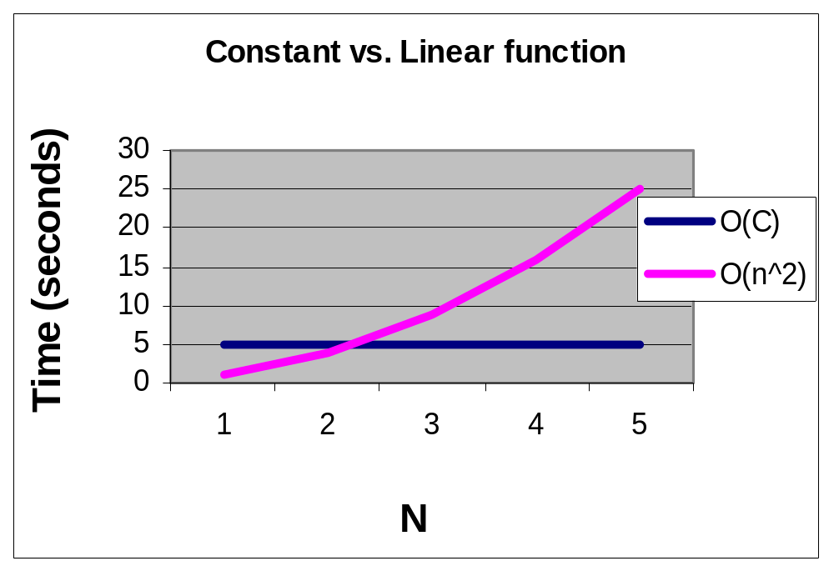
Constant vs. Linear function

Slide 13
Algorithm Efficiency
Linear Loops
  Example 1: efficiency = f(n) = n
      for (i = 0; i < 1000; i++)
      application code
  Example 2: efficiency = f(n) = n / 2
      for (i = 0; i < 1000; i += 2)
      application code

Slide 14
Algorithm Efficiency (cont…)
Logarithmic Loops
  The controlling variable is multiplied or divided in each iteration.
  Multiply Loops
      for (i = 0; i <= 1000; i *= 2)
      application code
  Divide Loops
      for (i = 1000; i >= 1; i /= 2)
      application code

Slide 15
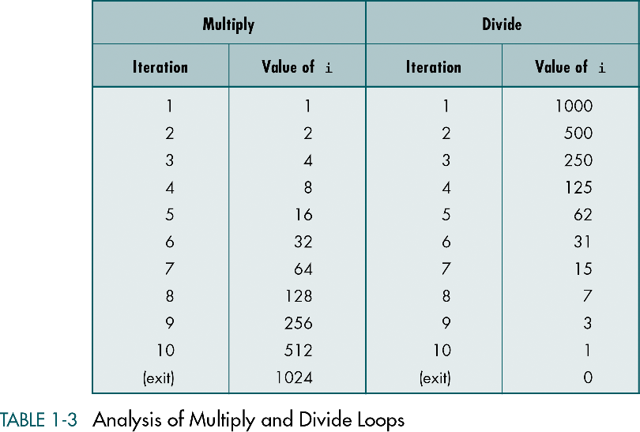

Slide 16
Algorithm Efficiency (cont…)
Logarithmic Loops (cont…)
  The loop continues while the condition shown below is true:
    multiply 2 ^{Iterations} <= 1000
    divide 1000 / 2^{Iterations} >= 1
  Generalizing the analysis, we get f(n) = log n

Slide 17
Algorithm Efficiency (cont…)
Linear Logarithmic
  The inner loop is a loop that multiplies. To see the multiply loop, look at the update expression in the inner loop.
      for (i = 0; i <= 10; i++)
      for (j = 1; j <= 10; j *= 2)
      application code
  This gives us 10log10 which is generalized as f(n) = n log n

Slide 18
Algorithm Efficiency (cont…)
Quadratic
  The number of times the inner loop executes is the same as the outer loop.
      for (i = 0; i <= 10; i++)
      for (j = 1; j <= 10; j++)
      application code
  This gives us 10 × 10, the square of the loops. The formula generalizes to f(n) = n²

Slide 19
Algorithm Efficiency (cont…)
Dependent Quadratic
  The number of iterations of the inner loop depends on the outer loop.
      for (i = 0; i <= 10; i++)
      for (j = 0; j <= i; j++)
      application code
  Inner loop is executed only once the first iteration, twice the second iteration, three times the third iteration, and so forth.

Slide 20
Algorithm Efficiency (cont…)
Dependent Quadratic (cont.)
  The number of iterations in the body of the inner loop is calculated as shown below:
      1 + 2 + 3 + …… + 9 + 10 = 55
  Average is 55 / 10 = 5.5 which is the same as the number if iterations (10) plus 1 divided by 2. This calculation is generalized to (n + 1) / 2
  The formula is ( inner loop × outer loop )
  f(n) = n × (n + 1) / 2

Slide 21
Big-O Notation
The big-O notation can be derived from f(n) using the following steps:
  In each term, set the coefficient of the term to one.
  Keep the largest term in the function and discard the others.

Slide 22
Derivation Example
Calculate the big-O notation for
f(n) = n × (n + 1) / 2 = n² / 2 + n / 2
Remove all coefficients: n² + n
Remove the smaller factors: n²
Thus, in big-O notation:
O(f(n)) = O(n²)

Slide 23
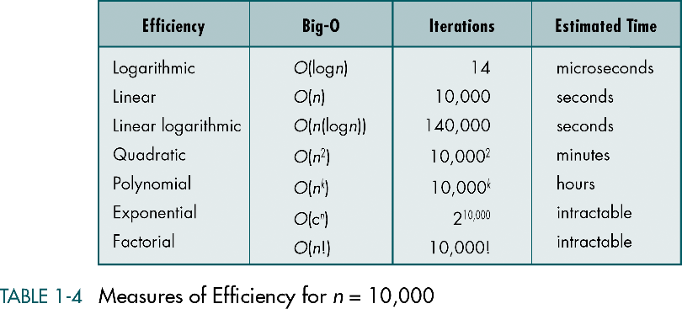

Slide 24
