Slide 1
Chapter 30 Graphs and Applications

Slide 2
Objectives
To model real-world problems using graphs (§30.1).
To describe the graph terminologies: vertices, edges, simple graphs, weighted/unweighted graphs, and directed/undirected graphs (§30.2).
To represent vertices and edges using lists, edge arrays, edge objects, adjacency matrices, and adjacency lists (§30.3).
To model graphs using the Graph interface, the AbstractGraph class, and the UnweightedGraph class (§30.4).
To display graphs visually (§30.5).
To represent the traversal of a graph using the AbstractGraph.Tree class (§30.6).
To design and implement depth-first search (§30.7).
To design and implement breadth-first search (§30.9).

Slide 3
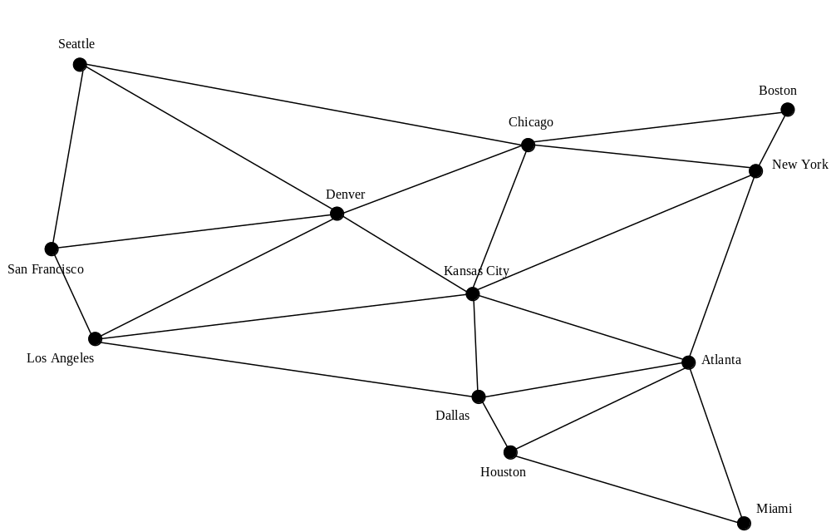
Modeling Using Graphs
A graph can be used to model the flights between the cities, where the vertices represent cities and the edges represent the flights between two adjacent cities.

Slide 4
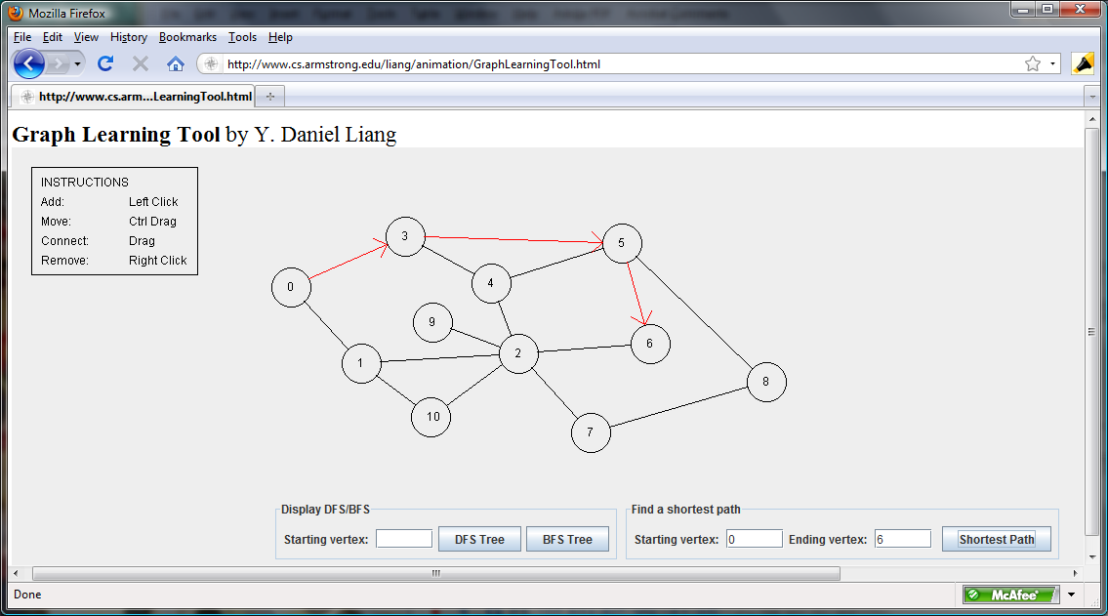
Weighted Graph Animation
www.cs.armstrong.edu/liang/animation/GraphLearningTool.html

Slide 5
Graph Theory
Graph problems are often solved using algorithms. Graph algorithms have many applications in various areas, such as in computer science, mathematics, biology, engineering, economics, genetics, and social sciences.
The algorithms:
  Ch30: depth-first search and breadth-first search
  Ch31: minimum spanning tree and shortest paths in weighted graphs

Slide 6
Additional Note: Basic Graph Terminologies
A graph is a collection of nodes, called vertices, and a collection of segments, called lines, connecting pairs of vertices. In Basic Concepts we develop the terminology and structure for graphs. In addition to the graph definitions, discussion points include:
Directed and Undirected Graphs
Cycles and Loops
Data Structures: A Pseudocode Approach with C, Second Edition

Slide 7
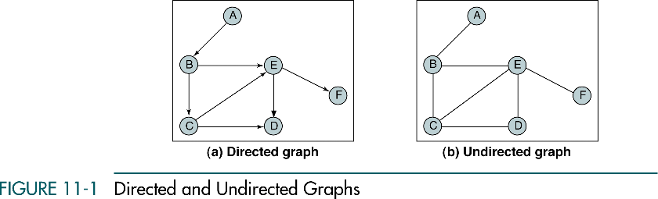
Data Structures: A Pseudocode Approach with C, Second Edition

Slide 8
Note
Graphs may be directed or undirected.
In a directed graph, each line, called an arc,
has a direction indicating how it may be traversed.
In an undirected graph, the line is known as an edge,
and it may be traversed in either direction.
Data Structures: A Pseudocode Approach with C, Second Edition

Slide 9
Note
A graph is a collection of nodes, called vertices,
and line segments, called arcs or edges,
that connect pairs of nodes.
Data Structures: A Pseudocode Approach with C, Second Edition

Slide 10
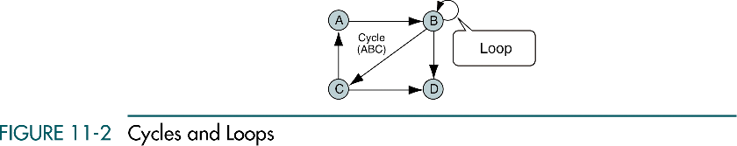
Data Structures: A Pseudocode Approach with C, Second Edition

Slide 11
Representing Graphs
Representing a graph is to store its vertices and edges in a program. The data structure for storing a graph is arrays or lists:
Representing Vertices
Representing Edges: Edge Array
Representing Edges: Edge Objects
Representing Edges: Adjacency Matrices
Representing Edges: Adjacency Lists

Slide 12
Representing Vertices
The vertices can be stored in an array or a list.
Example 1:
  String[] vertices = {“Seattle”, “San Francisco”, “Los Angles”, “Denver”, “Kansas City”, “Chicago”, … , “Dallas”, “Houston”};
Note that the vertices can be objects of any type. Refer to next slide.

Slide 13
Representing Vertices (cont.)
Example 2:
City city0 = new City(“Seattle”, 608660, “MikeMcGinn”);
…
City city11 = new City(“Houston”, 2099451, “Annise Parker”);
City[] vertices = {city0, city1, … , city11};
public class City {
private String cityName;
private int population;
private String mayor;
public City(String cityName, int population, String mayor) {
this.cityName = cityName;
this.population = population;
this.mayor = mayor;
}
// get and set methods are omitted here.
}

Slide 14
Representing Edges: Edge Array
The edges can be represented using a two-dimensional array.
Example:
  int[ ][ ] edges = {{0, 1}, {0, 3} {0, 5},
  {1, 0}, {1, 2}, {1, 3},
  … …
  {11, 8}, {11, 9}, {11, 10}
  };

Slide 15
Representing Edges: Edge Object
Another way to represent the edges is to define edges as objects and store the edges in an ArrayList.
Example:
  public class Edge {
  int u, v;
  public Edge(int u, int v) {
  this.u = u;
  this.v = v;
  }
  List<Edge> list = new ArrayList<Edge>();
  list.add(new Edge(0, 1));
  list.add(new Edge(0, 3));
  …

Slide 16
Representing Edges: Adjacency Matrix
int[][] adjacencyMatrix = {
{0, 1, 0, 1, 0, 1, 0, 0, 0, 0, 0, 0}, // Seattle
{1, 0, 1, 1, 0, 0, 0, 0, 0, 0, 0, 0}, // San Francisco
{0, 1, 0, 1, 1, 1, 0, 0, 0, 0, 0, 0}, // Los Angeles
{1, 1, 1, 0, 1, 1, 0, 0, 0, 0, 0, 0}, // Denver
{0, 0, 1, 1, 0, 1, 0, 1, 1, 0, 1, 0}, // Kansas City
{1, 0, 0, 1, 1, 0, 1, 1, 0, 0, 0, 0}, // Chicago
{0, 0, 0, 0, 0, 1, 0, 1, 0, 0, 0, 0}, // Boston
{0, 0, 0, 0, 1, 1, 1, 0, 1, 0, 0, 0}, // New York
{0, 0, 0, 1, 1, 0, 0, 1, 0, 1, 1, 1}, // Atlanta
{0, 0, 0, 0, 0, 0, 0, 0, 1, 0, 0, 1}, // Miami
{0, 0, 1, 0, 1, 0, 0, 0, 1, 0, 0, 1}, // Dallas
{0, 0, 0, 0, 0, 0, 0, 0, 1, 1, 1, 0} // Houston
};

Slide 17
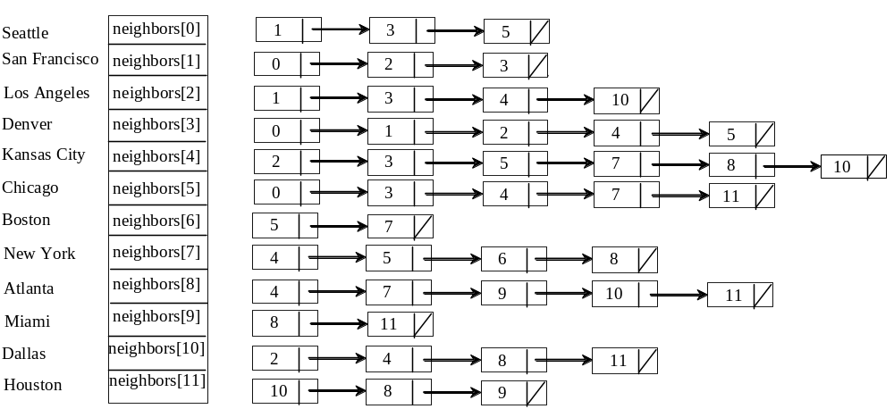
Representing Edges: Adjacency List
List<Integer>[] neighbors = new LinkedList<Integer>[12];

Slide 18
Additional Note: Graph Storage Structures
To represent a graph, we need to store two sets. The first set represents the vertices of the graph, and the second set represents the edges or arcs. The two most common structures used to store these sets are arrays and linked lists.
Adjacency Matrix
Adjacency List
Data Structures: A Pseudocode Approach with C, Second Edition

Slide 19
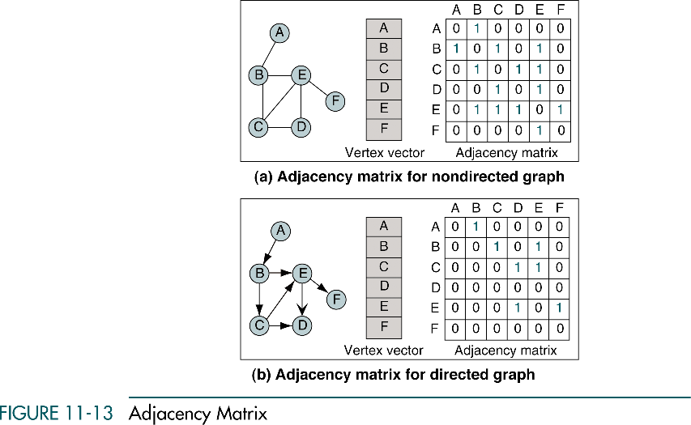
Data Structures: A Pseudocode Approach with C, Second Edition

Slide 20
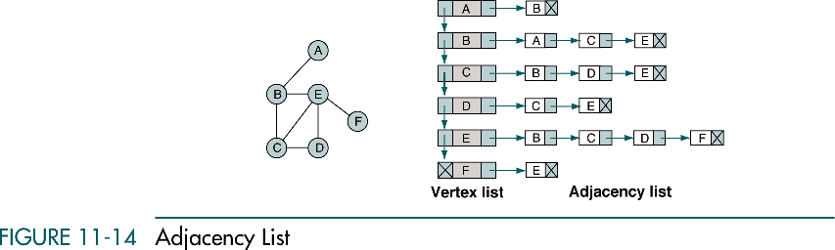
Data Structures: A Pseudocode Approach with C, Second Edition

Slide 21
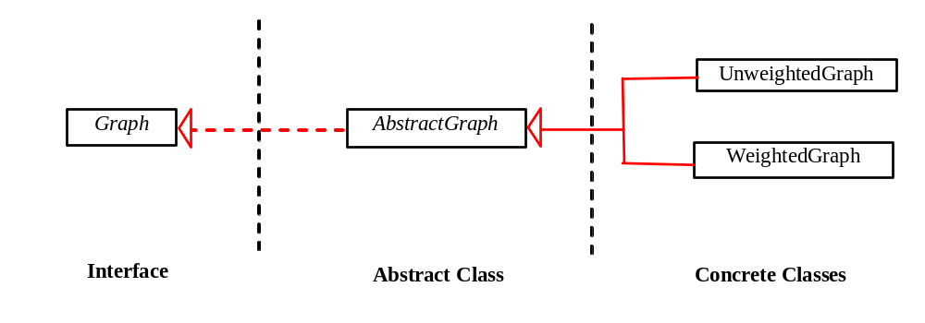
Modeling Graphs

Slide 22
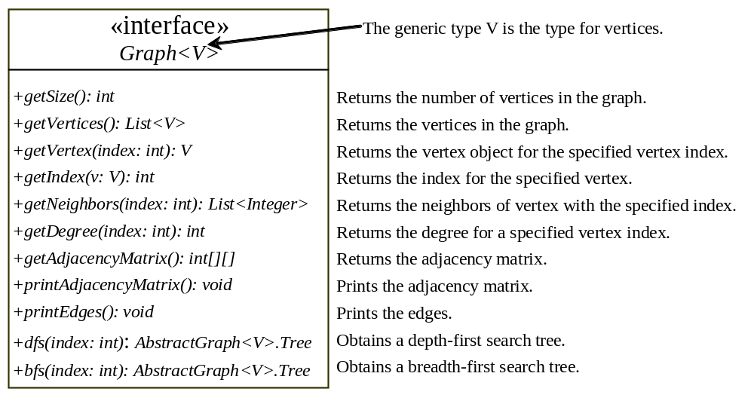

Slide 23
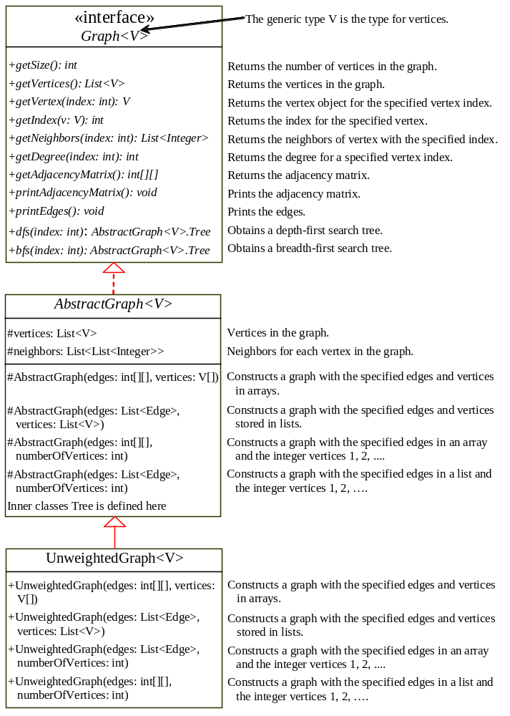
Graph
AbstractGraph
UnweightedGraph
TestGraph
TestGraph

Slide 24
Graph
AbstractGraph
UnweightedGraph
TestGraph
TestGraph

Slide 25
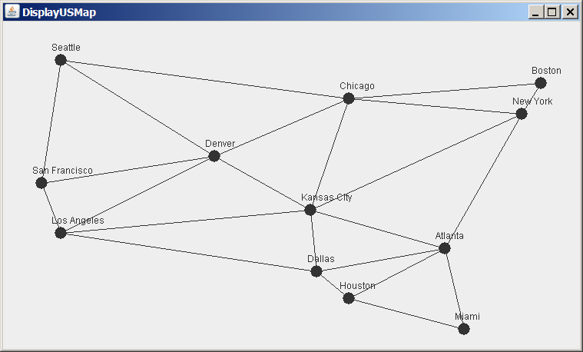
Graph Visualization
Displayable Interface
DisplayUSMap
GraphView
Run

Slide 26
Graph Traversals
Graph traversal is the process of visiting each vertex in the graph exactly once.
Two popular ways: Depth-first search and breadth-first search
Both traversals result in a spanning tree, which can be modeled using a class – AbstractGraph(V).Tree.
AbstractGraph(V).Tree is not defined as a subtype of Tree, as it is not for defining common operations such as searching, inserting, and deleting in a tree

Slide 27
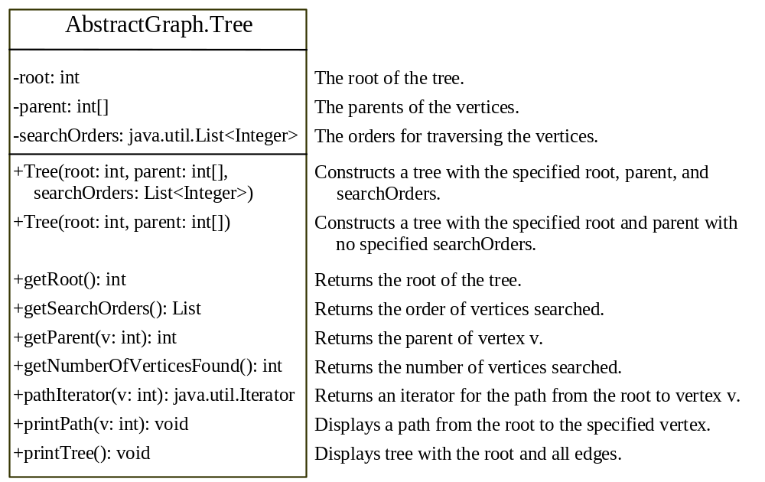
AbstractGraph(V).Tree
A class that describes the nodes with parent-child relationships.
Both searches will result in an instance of the Tree class.

Slide 28
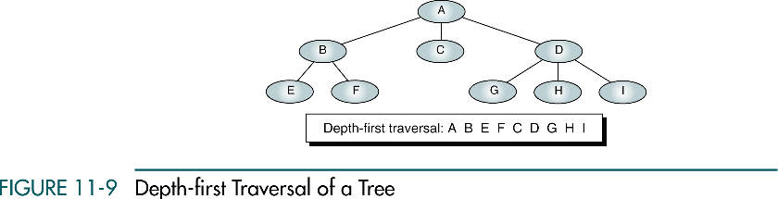
Additional Note: Graph Traversals
Data Structures: A Pseudocode Approach with C, Second Edition

Slide 29
Note
In the depth-first traversal, all of a node’s descendents are processed before moving to an adjacent node.
Computer Science: A Structured Programming Approach Using C

Slide 30
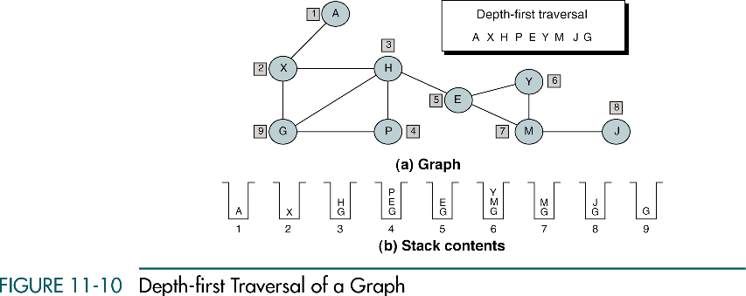
Data Structures: A Pseudocode Approach with C, Second Edition

Slide 31
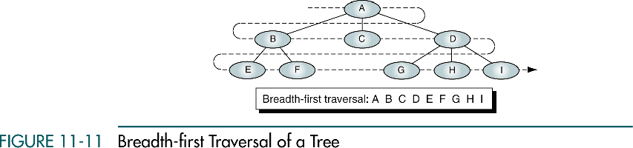
Data Structures: A Pseudocode Approach with C, Second Edition

Slide 32
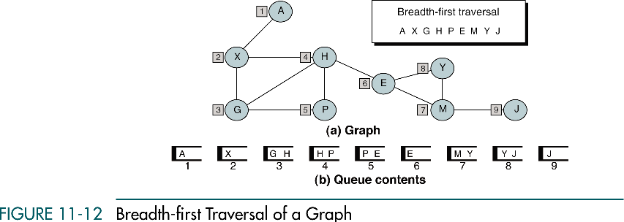
Data Structures: A Pseudocode Approach with C, Second Edition

Slide 33
Note
In the breadth-first traversal, all adjacent
vertices are processed before processing
the descendents of a vertex.
Data Structures: A Pseudocode Approach with C, Second Edition

Slide 34
Depth-First Search
In a graph, the search can start from any vertex.
Starts from a vertex in the graph and visits all vertices in the graph as far as possible before backtracking.
The algorithm (using recursion):
  dfs(vertex v) {
  visit v;
  for each neighbor w of v {
  if (w has not been visited) {
  dfs(w);
  }
  }
  }

Slide 35
Depth-First Search Algorithm
(Using Stack)
dfs(vertex v) {
create an empty stack for storing vertices to be visited;
push v into the stack;
mark v visited;
while (the stack is not empty) {
pop a vertex, say u, from the stack;
process u;
for each neighbor w of u {
if w has not been visited {
push w into the stack;
mark w visited;
}
}
}
}

Slide 36
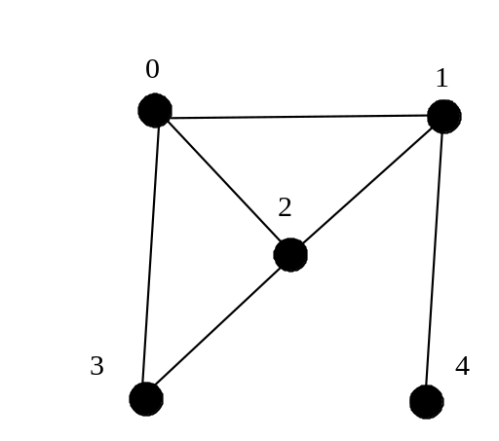
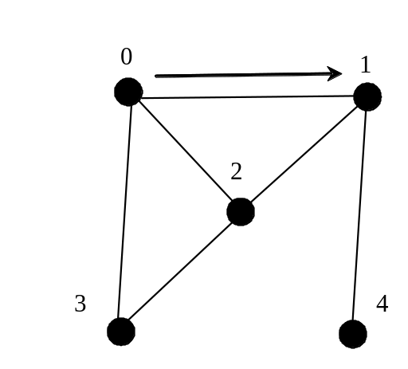
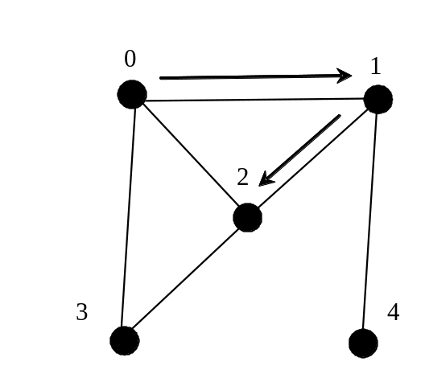
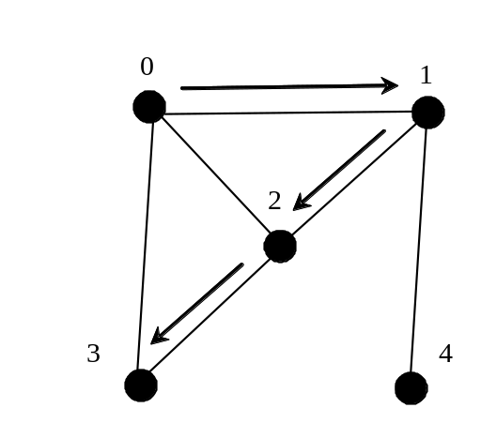
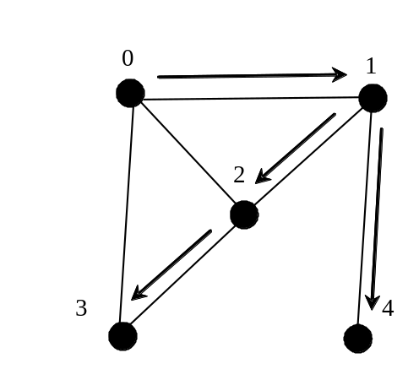
Depth-First Search Example

Slide 37
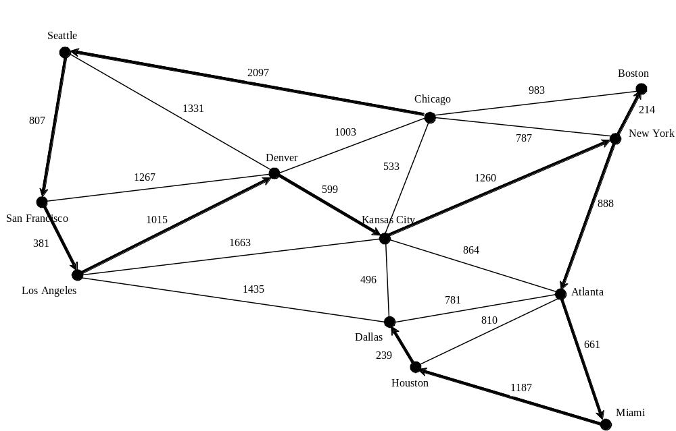
Depth-First Search Example
TestDFS
TestDFS

Slide 38
Breadth-First Search
The vertices are visited level by level.
Starts from a vertex, then all its adjacent vertices, then all the vertices adjacent to those vertices, and so on.
To ensure that each vertex is visited only once, it skips a vertex if it has already been visited.

Slide 39
Breadth-First Search Algorithm
bfs(vertex v) {
create an empty queue for storing vertices to be visited;
add v into the queue;
mark v visited;
while (the queue is not empty) {
dequeue a vertex, say u, from the queue;
process u;
for each neighbor w of u {
if w has not been visited {
add w into the queue;
mark w visited;
}
}
}
}

Slide 40
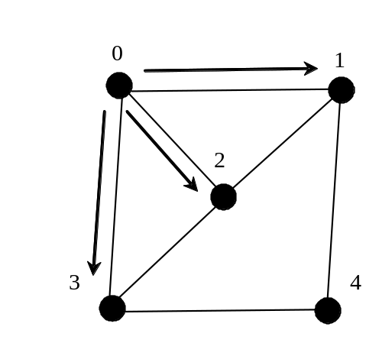
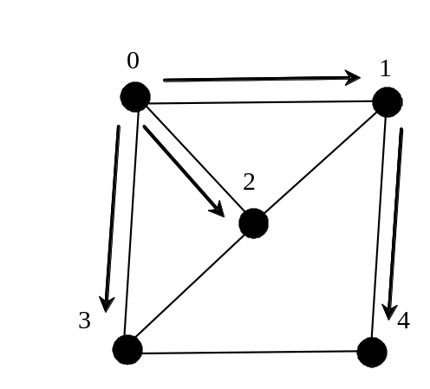
Breadth-First Search Example
Queue: 0
isVisited[0] = true
Queue: 1 2 3
isVisited[1] = true, isVisited[2] = true, isVisited[3] = true
Queue: 2 3 4
isVisited[4] = true

Slide 41
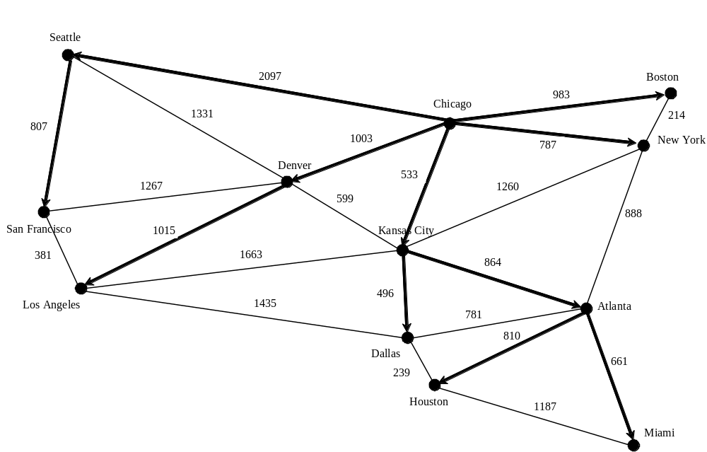
Breadth-First Search Example
TestBFS
TestBFS

