Slide 1
Chapter 31 Weighted Graphs and Applications

Slide 2
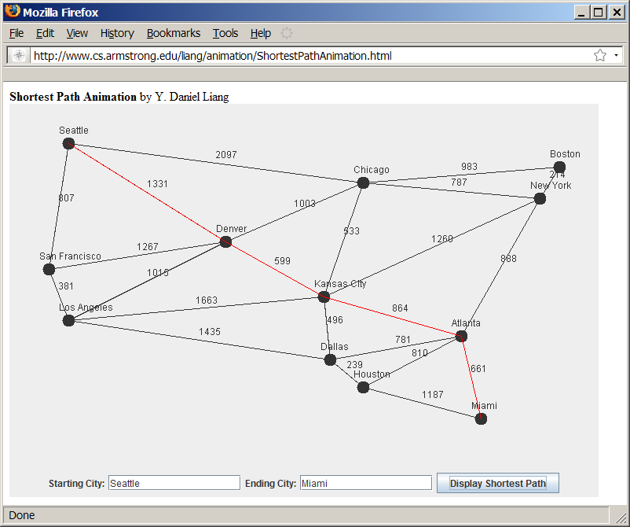
Weighted Graph Animation
www.cs.armstrong.edu/liang/animation/ShortestPathAnimation.html

Slide 3
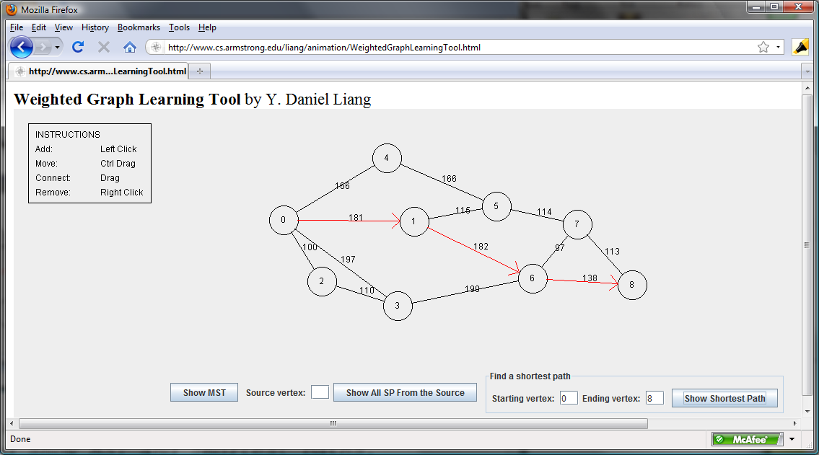
Weighted Graph Animation
www.cs.armstrong.edu/liang/animation/WeightedGraphLearningTool.html

Slide 4
Objectives
To represent weighted edges using adjacency matrices and priority queues (§31.2).
To model weighted graphs using the WeightedGraph class that extends the AbstractGraph class (§31.3).
To design and implement the algorithm for finding a minimum spanning tree (§31.4).
To define the MST class that extends the Tree class (§31.4).
To design and implement the algorithm for finding single-source shortest paths (§31.5).
To define the ShortestPathTree class that extends the Tree class (§31.5).

Slide 5
Representing Weighted Graphs
Often it is desirable to use a priority queue to store weighted edges.
Two types: vertex weighted and edge weighted
Three representations for the edges in weighted graphs:
  Representing Weighted Edges: Edge Array
  Weighted Adjacency Matrices
  Priority Adjacency Lists

Slide 6
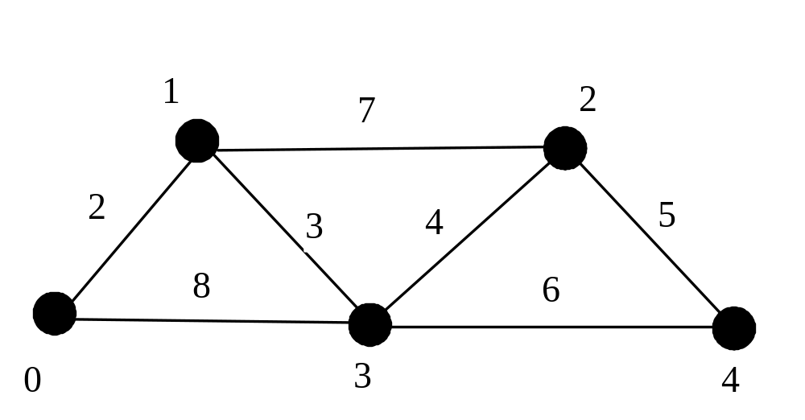
Representing Weighted Edges: Edge Array
int[][] edges = {{0, 1, 2}, {0, 3, 8},
{1, 0, 2}, {1, 2, 7}, {1, 3, 3},
{2, 1, 7}, {2, 3, 4}, {2, 4, 5},
{3, 0, 8}, {3, 1, 3}, {3, 2, 4}, {3, 4, 6},
{4, 2, 5}, {4, 3, 6}
};
{vertex, vertex, weight}

Slide 7
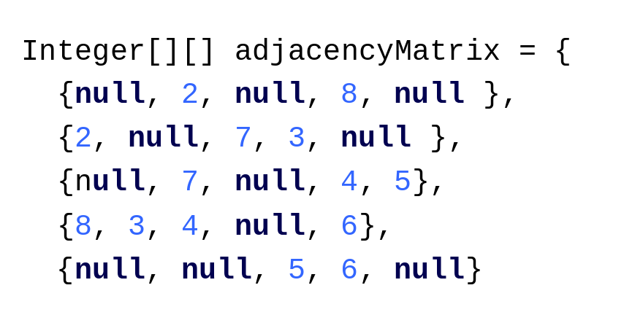
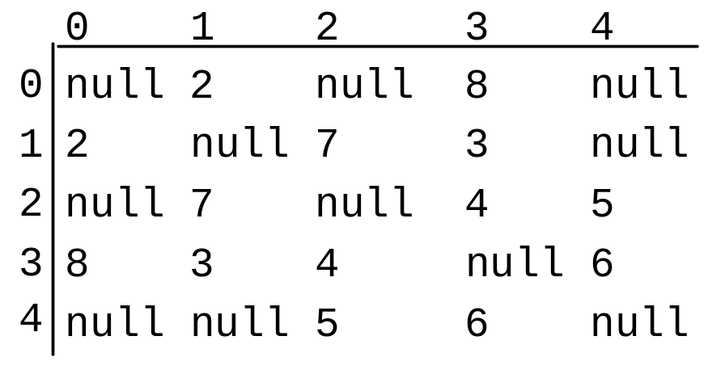
Weighted Adjacency Matrices

Slide 8
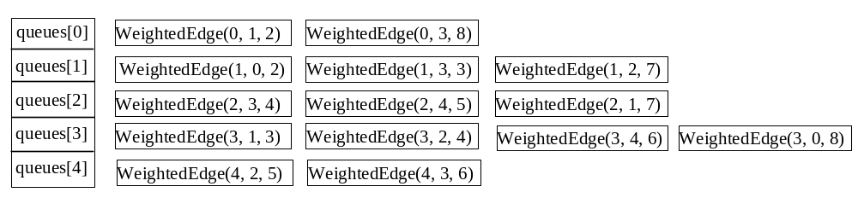
Priority Adjacency Lists
WeightedEdge

Slide 9
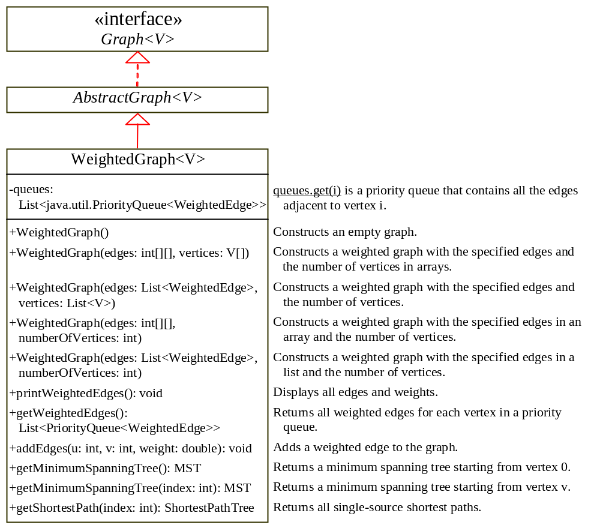
TestWeightedGraph
TestWeightedGraph
Graph
AbstractGraph
WeightedGraph

Slide 10
Minimum Spanning Trees
A minimum spanning tree of a graph is a spanning tree with the minimum total weights.
A graph may have many spanning trees.
Suppose that the edges are weighted. A minimum spanning tree is a spanning tree with the minimum total weights.

Slide 11
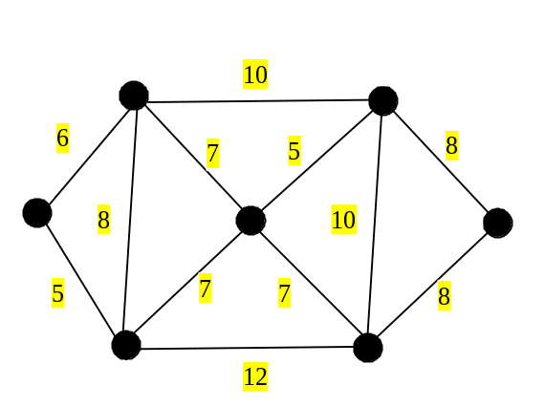
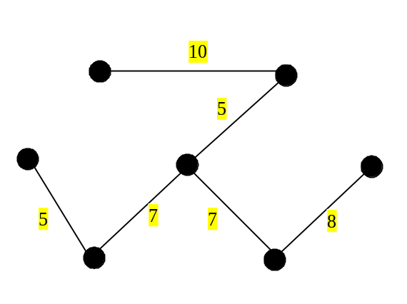
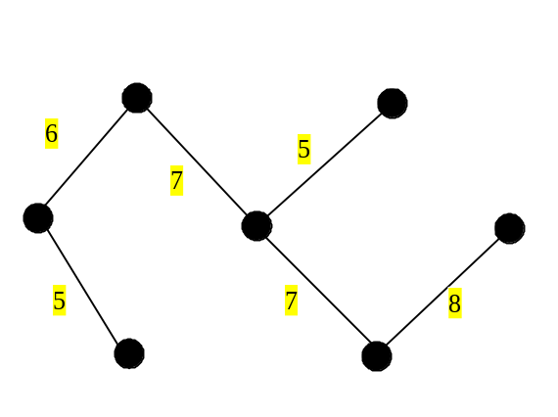
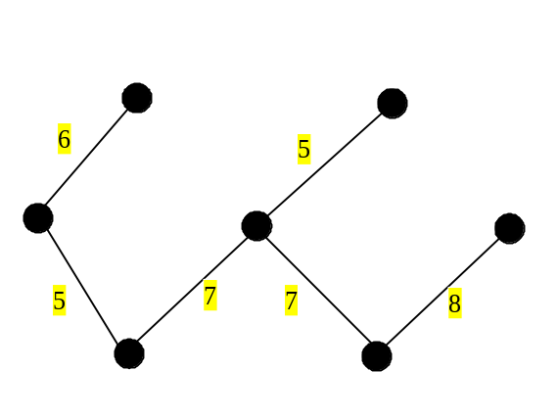
MST Examples
The trees in Figures (b), (c), (d) are spanning trees for the graph in Figure (a). The trees in Figures (c) and (d) are minimum spanning trees.
(a)
(b)
(c)
(d)

Slide 12
MST Application
Consider a company with branches in many cities. The company wants to lease telephone lines to connect all the branches together. The phone company charges different amounts of money to connect different pairs of cities. There are many ways to connect all branches together. The cheapest way is to find a spanning tree with the minimum total rates.

Slide 13
MST Algorithms
Prim’s algorithm (greedy algorithm)
  Starts with a spanning tree T that contains an arbitrary vertex.
  Expands the tree by repeatedly adding a vertex with the lowest-cost edge incident to a vertex already in the tree.

Slide 14
Prim’s MST Algorithm
minimumSpanningTree() {
Let V denote the set of vertices in the graph;
Let T be a set for the vertices in the spanning tree;
Initially, add the starting vertex to T;
while (size of T < n) {
find u in T and v in V – T with
the smallest weight on the edge (u, v);
add v to T;
}
}

Slide 15
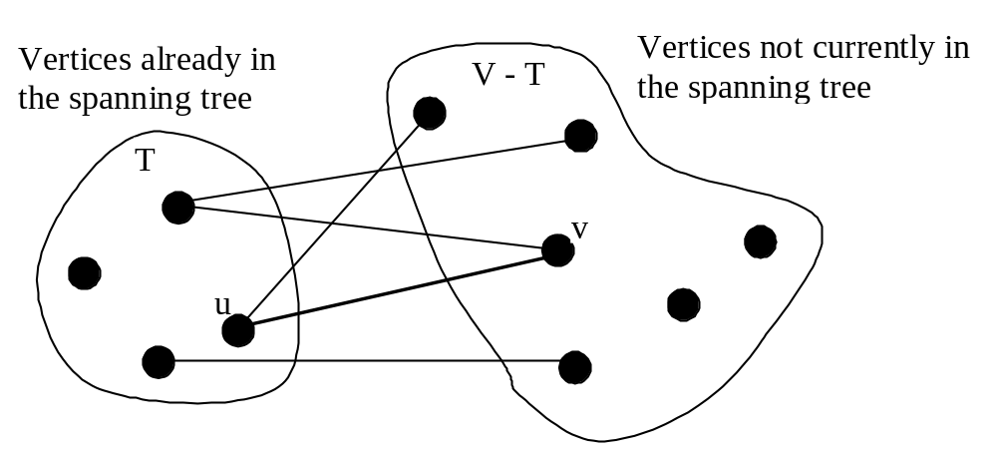
Prim’s MST Algorithm (Cont.)

Slide 16
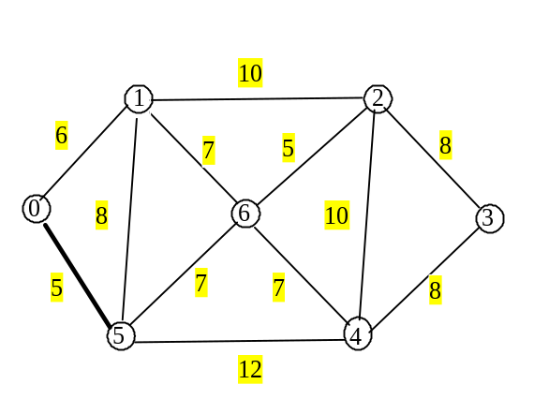
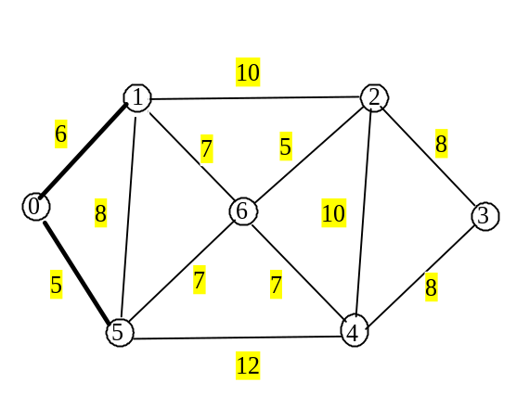
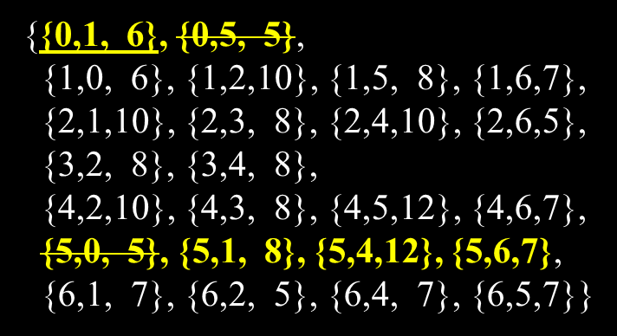
Prim’s MST Algorithm Example (1)
{{0,1, 6}, {0,5, 5},
{1,0, 6}, {1,2,10}, {1,5, 8}, {1,6,7},
{2,1,10}, {2,3, 8}, {2,4,10}, {2,6,5},
{3,2, 8}, {3,4, 8},
{4,2,10}, {4,3, 8}, {4,5,12}, {4,6,7},
{5,0, 5}, {5,1, 8}, {5,4,12}, {5,6,7},
{6,1, 7}, {6,2, 5}, {6,4, 7}, {6,5,7}}

Slide 17
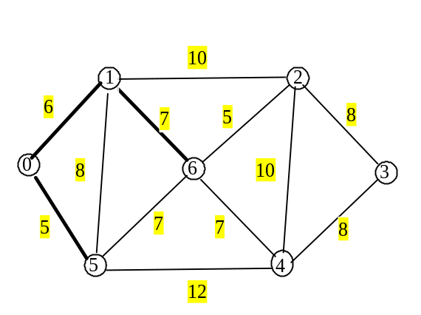
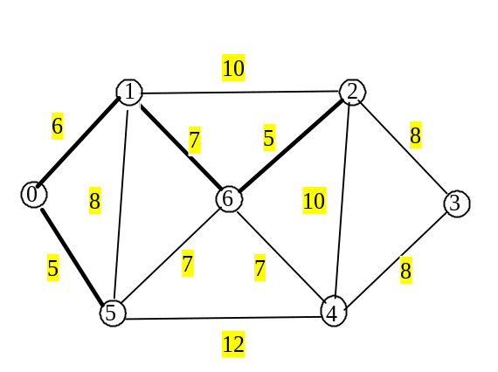
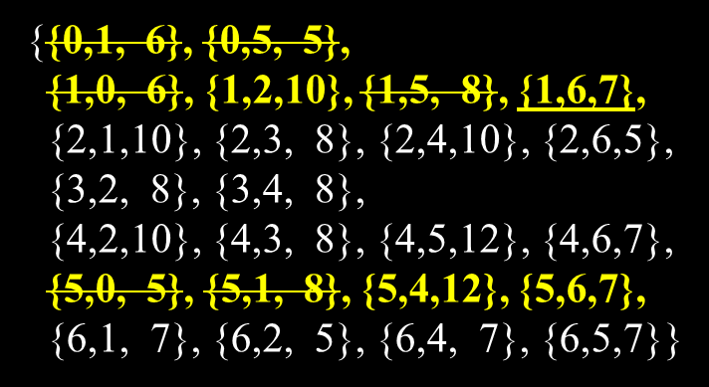
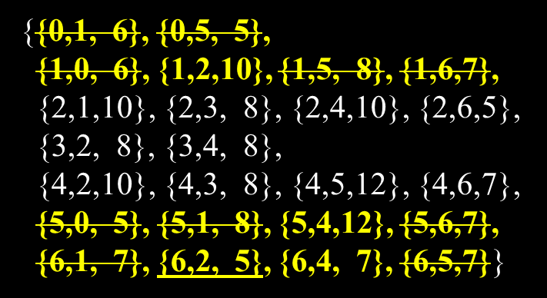
Prim’s MST Algorithm Example (2)

Slide 18
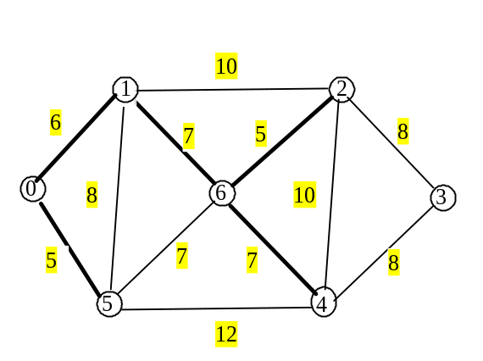
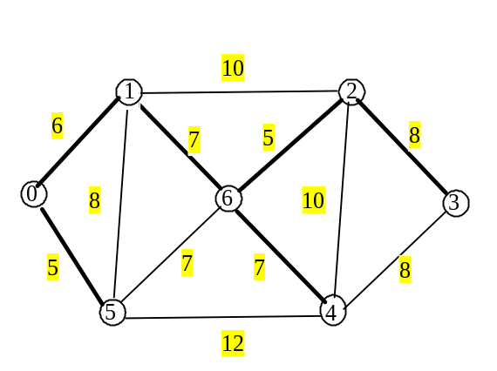
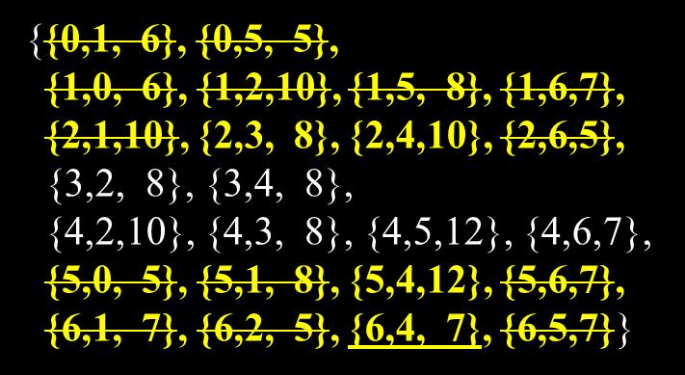
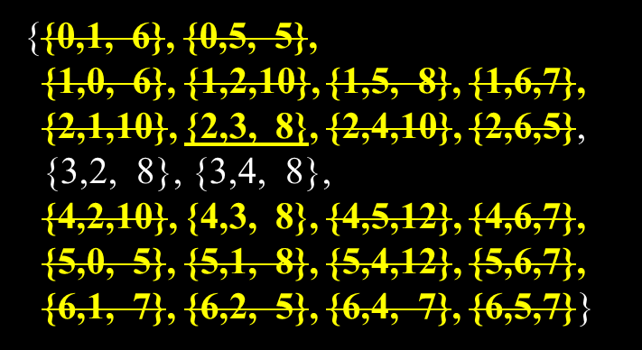
Prim’s MST Algorithm Example

Slide 19
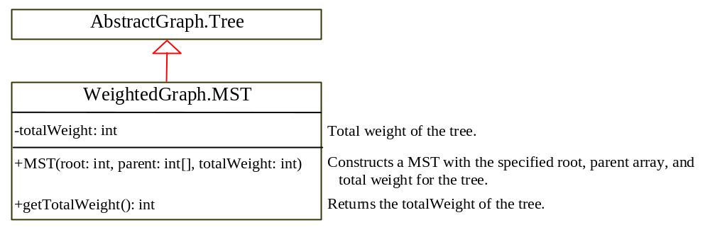
Implementing MST Algorithm

Slide 20
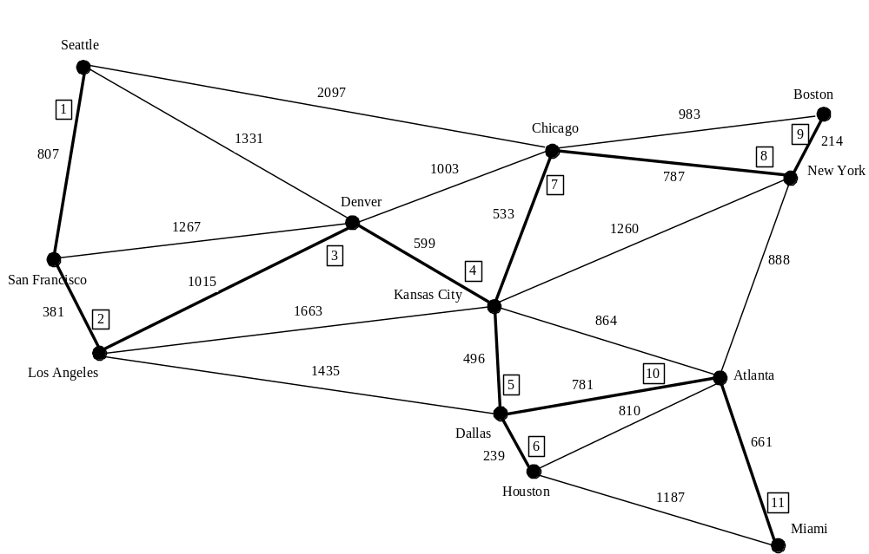
Test MST
TestMinimumSpanningTree
TestMinimumSpanningTree

Slide 21
Shortest Path
The shortest path between two vertices is the path with the minimum total weights.
Used to solve the problem of finding the shortest distance between two cities (vertices) in the graph
Dijkstra’s algorithm:
  known as single-source shortest path algorithm
  Finds the shortest path from u to all vertices.

Slide 22
Single Source Shortest Path Algorithm
shortestPath(s) {
Let V denote the set of vertices in the graph;
Let T be a set that contains the vertices whose
path to s have been found;
Initially T contains source vertex s;
while (size of T < n) {
find v in V – T with the smallest costs[u] + w(u, v)
value among all u in T;
add v to T;
}
}

Slide 23
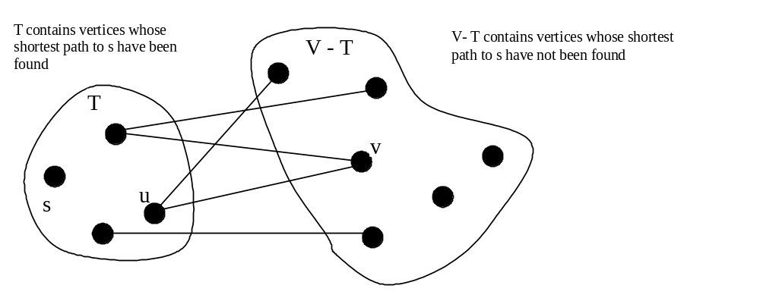
Single Source Shortest Path Algorithm

Slide 24
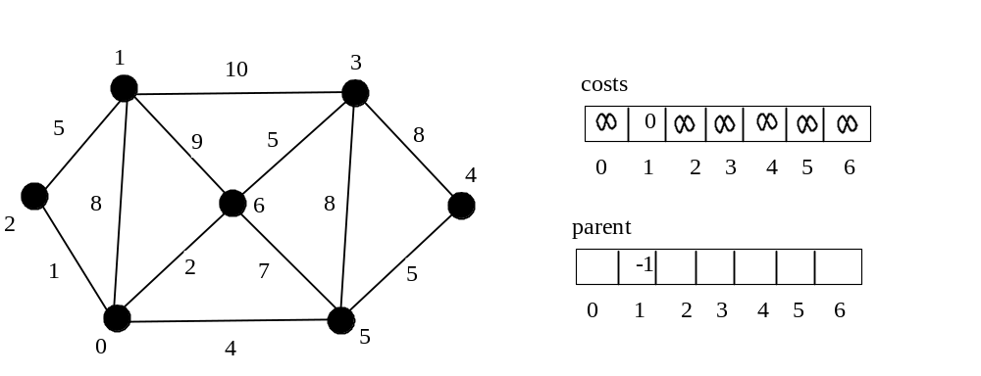
SP Algorithm Example
Suppose the source vertex is 1, cost[1] is 0 and the costs for all other vertices are initially ∞.
Use the parent[i] to denote the parent of i in the path, and set the parent of the source node to -1.

Slide 25
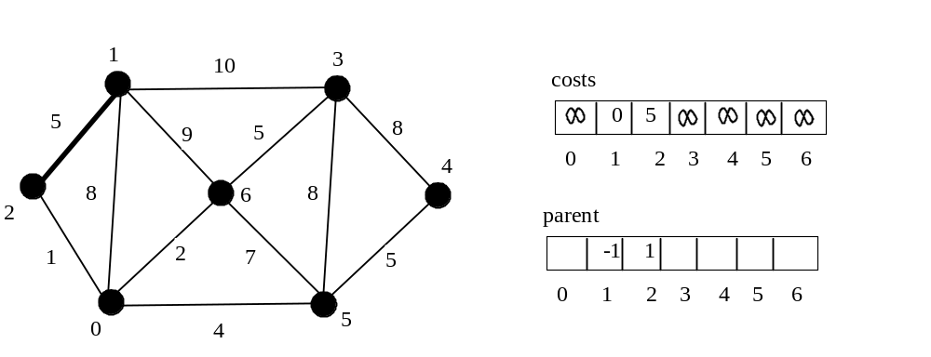
SP Algorithm Example
{{0,1, 8}, {0,2,1}, {0,5, 4}, {0,6,2},
{1,0, 8}, {1,2,5}, {1,3,10}, {1,6,9},
{2,0, 1}, {2,1,5},
{3,1,10}, {3,4,8}, {3,5, 8}, {3,6,5},
{4,3, 8}, {4,5,5},
{5,0, 4}, {5,3,8}, {5,4, 5}, {5,6,7},
{6,0, 2}, {6,1,9}, {6,3, 5}, {6,5,7}}
Possible Path:
1-0(8), 1-2(5), 1-3(10), 1-6(9)

Slide 26
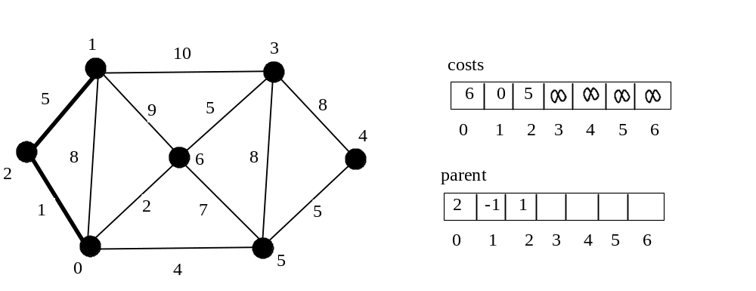

SP Algorithm Example
{{0,1, 8}, {0,2,1}, {0,5, 4}, {0,6,2},
{1,0, 8}, {1,2,5}, {1,3,10}, {1,6,9},
{2,0, 1}, {2,1,5},
{3,1,10}, {3,4,8}, {3,5, 8}, {3,6,5},
{4,3, 8}, {4,5,5},
{5,0, 4}, {5,3,8}, {5,4, 5}, {5,6,7},
{6,0, 2}, {6,1,9}, {6,3, 5}, {6,5,7}}

Slide 27
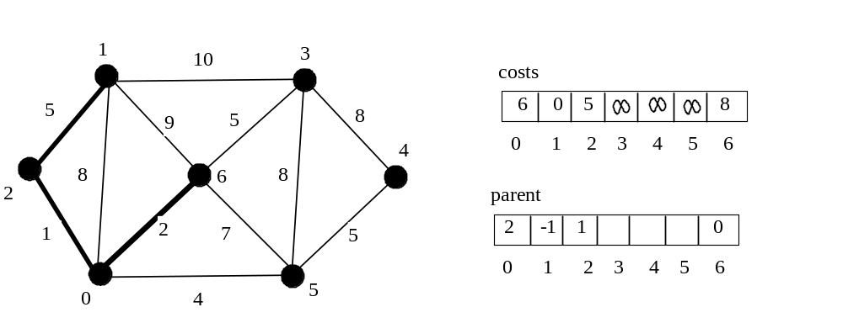
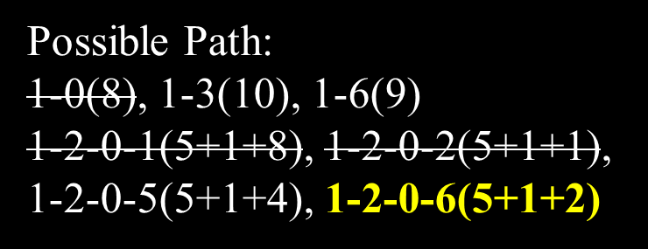
SP Algorithm Example
{{0,1, 8}, {0,2,1}, {0,5, 4}, {0,6,2},
{1,0, 8}, {1,2,5}, {1,3,10}, {1,6,9},
{2,0, 1}, {2,1,5},
{3,1,10}, {3,4,8}, {3,5, 8}, {3,6,5},
{4,3, 8}, {4,5,5},
{5,0, 4}, {5,3,8}, {5,4, 5}, {5,6,7},
{6,0, 2}, {6,1,9}, {6,3, 5}, {6,5,7}}

Slide 28
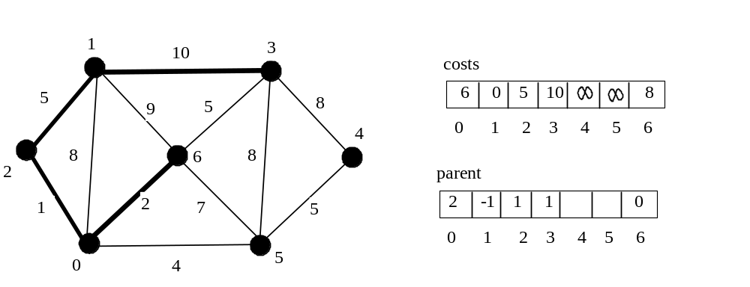

SP Algorithm Example
{{0,1, 8}, {0,2,1}, {0,5, 4}, {0,6,2},
{1,0, 8}, {1,2,5}, {1,3,10}, {1,6,9},
{2,0, 1}, {2,1,5},
{3,1,10}, {3,4,8}, {3,5, 8}, {3,6,5},
{4,3, 8}, {4,5,5},
{5,0, 4}, {5,3,8}, {5,4, 5}, {5,6,7},
{6,0, 2}, {6,1,9}, {6,3, 5}, {6,5,7}}

Slide 29
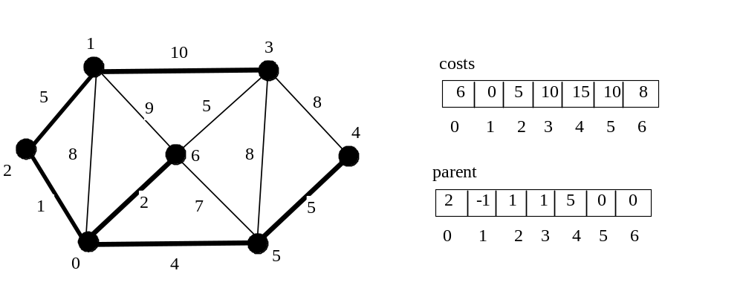
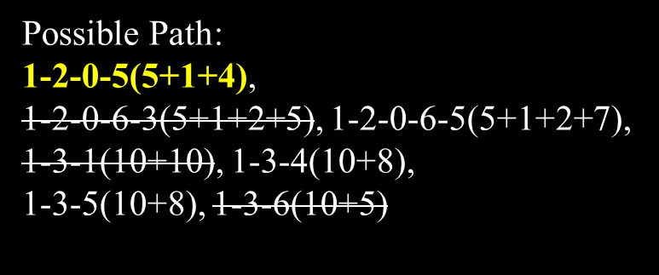
SP Algorithm Example
{{0,1, 8}, {0,2,1}, {0,5, 4}, {0,6,2},
{1,0, 8}, {1,2,5}, {1,3,10}, {1,6,9},
{2,0, 1}, {2,1,5},
{3,1,10}, {3,4,8}, {3,5, 8}, {3,6,5},
{4,3, 8}, {4,5,5},
{5,0, 4}, {5,3,8}, {5,4, 5}, {5,6,7},
{6,0, 2}, {6,1,9}, {6,3, 5}, {6,5,7}}

Slide 30
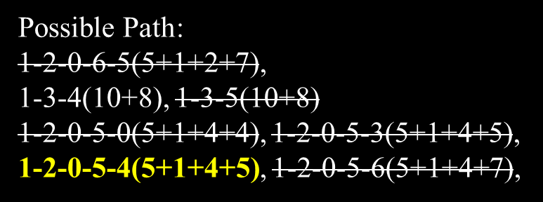
SP Algorithm Example
{{0,1, 8}, {0,2,1}, {0,5, 4}, {0,6,2},
{1,0, 8}, {1,2,5}, {1,3,10}, {1,6,9},
{2,0, 1}, {2,1,5},
{3,1,10}, {3,4,8}, {3,5, 8}, {3,6,5},
{4,3, 8}, {4,5,5},
{5,0, 4}, {5,3,8}, {5,4, 5}, {5,6,7},
{6,0, 2}, {6,1,9}, {6,3, 5}, {6,5,7}}

Slide 31
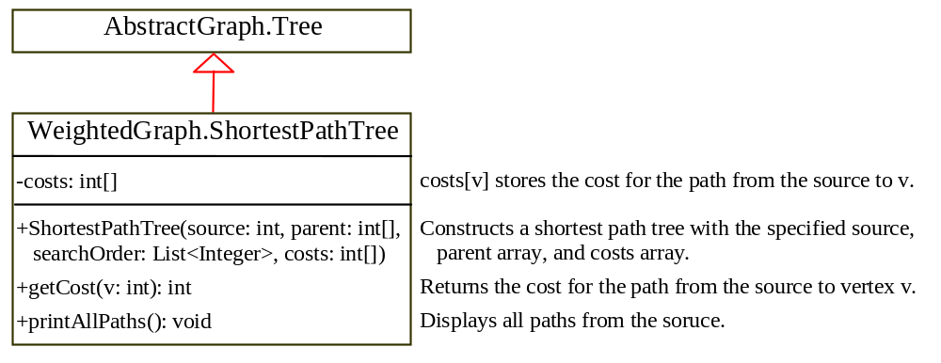
SP Algorithm Implementation
TestShortestPath
TestShortestPath

Slide 32
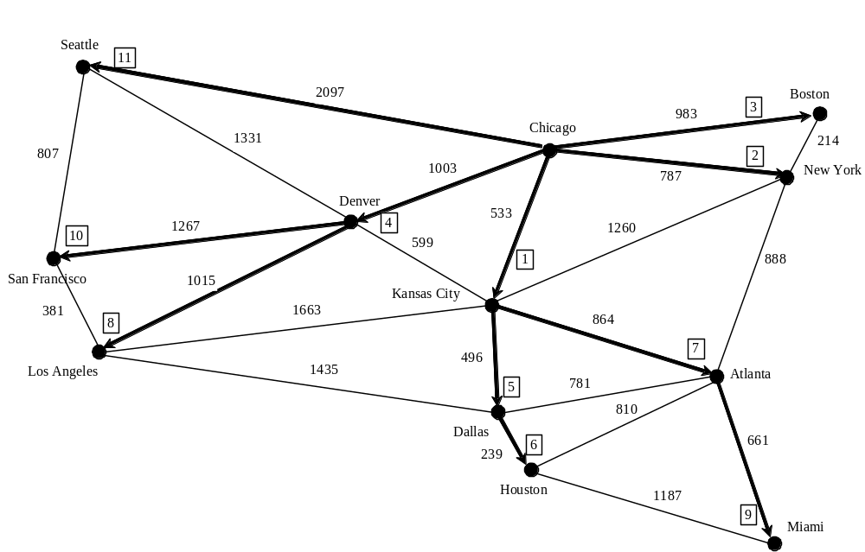
SP Algorithm Example

Slide 33
Shortest Path Animation
www.cs.armstrong.edu/liang/animation/ShortestPathAnimation.html

