Slide 1
UECS 2083/UECS2413
Problem Solving with Data Structures and Algorithms
INTRODUCTION
YEAR AND SEMESTER : 2017 MAY

Slide 2
Contact Details
Lecturer and Tutor : Ms Chean Swee Ling
E-mail address: cheansl@utar.edu.my
Lecturer Office: FE37(1)， Level 8
Consultation Hours:
Thu 2pm – 4pm
Fri 10:30am – 12:30pm
<preferably by appointment 2 days in advance to ensure timeslot is reserved>

Slide 3
Proposed Course Outline
Week | Topic | Practical / Event
1 | Introduction | -
2 | Ch20 Recursion | Practical 1: Revision on OO
3 | Ch21 Generics | Practical 2: Recursion
4 | Ch22 Lists, Stacks, Queues, and Priority Queues | Practical 3: Generics
5 | Ch23 Sets and Maps | Lab Assessment (during prac session) Recursion
6 | Ch26 Implementing Lists, Stacks, Queues, and Priority Queues | Practical 4: Java Collections Framework
7 | Ch27 Binary Search Trees | Practical 5: Lists

Slide 4
Proposed Course Outline
Week | Topic | Practical / Event
8 | Midterm Recursion, Generics, Java Collection Framework and Linked Lists | Practical 6: Stacks and Queues
9 | Ch30 & 31 Graphs | Practical 7: Trees
10 | Ch28 Hashing | Practical 8: Graphs
11 | Quiz Stacks, Queues, Trees and Graphs Ch24 Developing Efficient Algorithms | Practical 9: Data Structures Case Studies
12 | Ch25 Sorting Ch6.10 Searching Arrays | Practical 10: Algo. Analysis and Big-O Notation
13 | Revision | Practical 11: Sorting Practical 12: Searching Submission of Assignment
14 | Revision | Revision

Slide 5
Course Components
Final Exam | : | 50%
Mid-term Test | : | 15%
Quiz | : | 5%
Lab Assessment | : | 10%
Group Assignment | : | 20%
Total | : | 100%

Slide 6
Assessment Plan
Mid-Term Test (15%):
  On Week 8 (tentatively)
  Topics: Recursion, Generics, Java Collection Framework and Linked Lists
Quiz (5%):
  On Week 11 (tentatively)
  Topics: Stacks, Queues, Trees and Graphs
Lab Assessment (10%):
  On Week 5, Recursion
Group Assignment (20%):
  2 persons in one group
  Cover all topics
  Due on Week 13, submit during practical session.
2014 May

Slide 7
Textbooks
There are no prescribed texts for this subject, as no single book adequately covers the material. You may still some benefit from the recommended books below.
The following books will help you to prosper in this subject:
No. | Recommended Texts
1 | Liang, Y.D. (2014). Introduction to Java programming, comprehensive. (10th ed.). Upper Saddle River, NJ: Prentice Hall.
2 | Main, M. (2011). Data structures and other objects using Java. (4th ed.). Boston, MA: Addison Wesley
3 | Goodrich, M. T., & Tamassia, R. (2010). Data structures and algorithms in Java. (5th ed.). Hoboken, NJ: John Wiley & Sons.

Slide 8
Practical and Assessment
Practical exercises or lab assessments will be assigned for each session. And practical assignment and lab assessments are scheduled for completion at various times. The times of completion will be indicated in the question paper and assessment documents. You are expected to prepare carefully for each assessment.
Not all practical classes will be assessed. Each assessed practical will have a marking scheme which is detailed in the assessment documents.
Some assessment preparation will be talked verbally during lectures.

Slide 9
Practical Assessment
Program(s) will be marked for completeness, correctness, programming style, adequate testing and documentation/comments.
You must complete all your program(s) according to the scheduled times of completion. You are also required to demonstrate how to execute your program(s) to your tutor during practical session or upload the program(s) to WBLE by end of the practical session.
It’s your responsibility to prepare well for your demonstration or WBLE upload. You will not receive full mark if you do not submit the complete program(s) that is a reasonable attempt and compiles without error.

Slide 10
Assessed Practical – Hard Copy Submission
You are required to submit a report with hard copy of the program(s) to your tutor after demonstration of your program(s) or after you uploaded your program(s) to WBLE.
Your report should include the sample output(s) of the program(s).
No mark will be given if no report received as proof of submission. The report submitted will be marked for completeness, correctness, presentation style and relevant use of diagrams/tables/graphs, etc.
Do remember to include your personal details (student ID, name, course, tutorial group, etc) in the report that you submit.

Slide 11
Submission of Lab Assessments
Test question(s) released in the beginning of practical session
Upload source code to WBLE by end of practical session
(action by student)
Print source code and screenshots, submit to tutor
(action by student)

Slide 12
Teaching Material On-line
All teaching materials including lecture ppt slides, practical documents, assessment and assignment documents will be available on the web-based learning environment. (http://wble.utar.edu.my).
Please check and download them in a timely manner.
To login to WBLE:
  username: <same as your login name to comp. lab>
  password: <I.C. no. with dash>

Slide 13
Responsibility
You are responsible for your progress.
Every effort is made by teaching staff to convey all the information required for the successful completion of the subject, but you should have the initiative to actively seek information when something is not clear.
Make sure that you understand the requirements of a task, that you know how to execute it, and that you get it marked in a timely manner.

Slide 14
Plagiarism
All submitted works (programming practical and assignment) must be your own work.
You are encouraged to discuss assignment/programming practical with classmates. However, collaboration on coding is not acceptable; direct copying of algorithm or code is not acceptable, and giving copies of your code to other students is not acceptable.

Slide 15
Plagiarism (cont…)
You might be asked questions about the work/code you submit/demonstrate to ensure that you understand it.
Students who copy, and those who knowingly allow their work to be copied by others, will receive ZERO mark for their works.

Slide 16
Introduction
Some factors in data structures and algorithms:
  Different problems.
  Size of data.
  Operations.
  Resources available.
  Programming Languages

Slide 17
Overview of Subject
Data Structures
  Introduction to different types of data structures.
  How to manipulate them.
  How to implement each in code.
Algorithms
  Various algorithms and their implementation.
    Searching
    Sorting
  Complexity of algorithms (analysis on which algorithm is better)

Slide 18
Subject Details
Data Structures And Algorithms
Data Structures
Linked List
Stacks
Queues
Trees
Graphs
Algorithms
Searching
Linear Search
Binary Search
Hash Table
Sorting
Bubble Sort, Selection Sort
Insertion Sort, Merge Sort
Quick Sort, …

Slide 19
Data Structures and Algorithms
Data Structures is concerned with the representation and manipulation of data.
All programs manipulate data. So, all programs represent data in some way.
Data manipulation requires an algorithm.

Slide 20
Data Structures and Algorithms
Algorithm design methods needed to develop programs that do the data manipulation.
The study of data structures and algorithms is fundamental to Computer Science.
One of the aims of good program design would be to ensure that additional requirements are easily handled.

Slide 21
Data Structures and Algorithms
They are essential ingredients to successful problem solving.
  Problem Abstraction
  Algorithms
  Data Structures
  Program implementation

Slide 22
Problem Abstraction
Identify underlying abstract problem without unnecessary details.
Decide on essential attributes of problem.

Slide 23
Abstraction
Some formal way of constructing program.
Decompose a program into suitable small modules, which can themselves be written and tested before being incorporated into larger modules, which are in turn constructed and tested.

Slide 24
Abstraction (cont.)
Procedural abstraction
  Named sequence of instructions that has a specific and limited function
  e.g. date validation routine.
Data abstraction
  Named collection of data that describes an object
  e.g. data types - not interested in how a particular type is implemented on the hardware
Control abstraction
  Implies program control mechanisms without specifying internal details.

Slide 25
Algorithms
Step by step instructions for solving the problem.
Each step clearly implementable in a mechanical way.
It must be correct.
It must terminate.

Slide 26
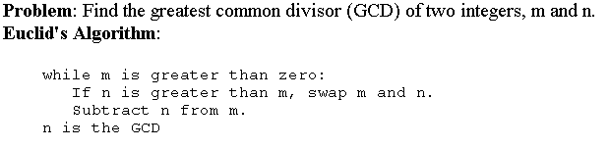
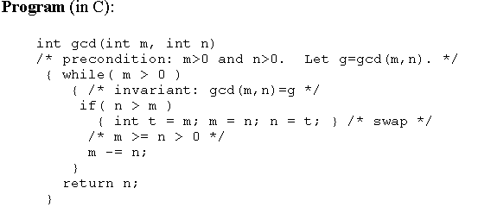
Algorithms – Example
Euclid’s algorithm for Greatest Common Divisor:

Slide 27
Analysis of Algorithms
Time & Space Complexity
  for Best, Average and Worst cases.
Correctness
  Proof of algorithm correctness.
  “An algorithm is correct if it is guaranteed to produce a correct answer to every instance of the problem”- Kingston, Algorithms & Data Structures, Addison-Wesley. 1990
  Require formal specifications of problem.

Slide 28
Data Structures
Abstract structures designed to store data for manipulation by algorithms.
Independent of programming language.
Defines static properties and relations.
Also defines allowable dynamic operations on it.
Specifies only ‘what’ the operations are, not ‘how’ it works.

Slide 29
Elementary Data Structures Examples
Linked Lists
  dynamic size, easily arranged, slow sequence access.
Stacks
  last in first out, related to recursion, can be implemented by linked list or array.
Queues
  first in first out, related to recursion, can be implemented by linked list or array.
Trees
  dynamic size, easily arranged: ordered, binary, search tree.
As many more as you can think of…

Slide 30
Abstract Data Structures
Separates the interface of a data structure from its implementation
Implementation is free to implement using linked lists or arrays or whatever is best. No information is provided on data representation.
Data accessible only through the defined interface (or operations provided in the interface)

Slide 31
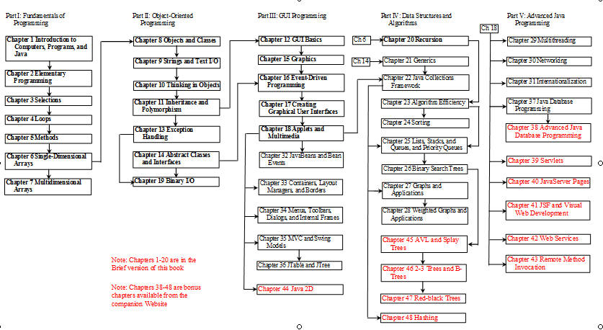
Overview of Main Textbook

