Slide 1
Lecture 1: Introduction to FYP

Slide 2
Introduction
Why Final Year Project
When to choose a project
How to choose a project
Who to get to supervise the project
Notes:
When to choose a project:
An initial list of project proposals (from lecturing staff) will be released.
Students should select a final year project before the end of the third week of term. Where students have not selected a project by the deadline, a project supervisor will be allocated to them in consultation with the relevant course director out of the supervisors who have not yet reached their supervision limits. The chosen supervisor will assign the student a project or help them to specify a project in an area selected by the supervisor.
How to choose a project./what subject may I choose?
Students may either
-select a project from the list of project proposals put forward by the lecturing staff
-or alternatively may propose their own projects. If you have a project proposal of your own and if you are having trouble finding an appropriate supervisor,…
In either case students must get the agreement of a supervisor before they will be considered as having selected a project. Supervisors may require a meeting with the student to discuss the project before accepting a supervision request. Once a supervisor agrees to supervise a project details of the project assignment will be recorded centrally by the supervisor by clicking HERE.
Students may only select a single project, but they may change their minds and select an alternative project before the end of the third week of Term. However, if a student selects a new project, they must notify both the old and new supervisors that their previously chosen project is to be cancelled.
Who to get to supervise the project.
Students should note that each supervisor will only take a limited number of students. Once this limit has been reached a line will be put through their name on the list of potential supervisors. Students should also note that there are only a limited number of supervisors in any area. Hence students are not guaranteed a project in their area of choice.

Slide 3
Why Final Year Project?
The final year project encourages students to bring together their knowledge, learning experience and interest as a single piece of work, and to demonstrate their competency in applying what they have learned throughout their studies.
This unit introduces students to the basics of working on a project, and sets the foundation for working on complex real-life projects.

Slide 4
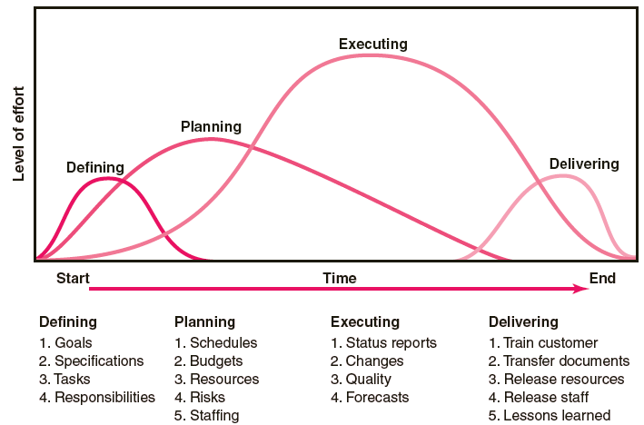
Project Life Cycle

Slide 5
Final Year Project Life Cycle
Defining
  Explore ICT and Engineering trends and development
  Browse through titles proposed by lecturers
  Select a suitable project topic of (YOUR) interest
  Define the scope and project objectives
  Facts finding and literature review
  Verification and benchmarking
Planning
  Identifying resources and cost management
  Time management and scheduling
  Risk management
  Identifying research methods and development tools
  Writing a proposal
Notes:
Project initiation

Slide 6
Final Year Project Life Cycle
Executing
  Conducting research
  Developing the system
  Writing work log and meeting with the supervisor regularly to trace the progress
  Making changes to the plan if necessary
  Controlling the project quality
Delivering
  Finalizing the system or theory developed in the project
  Writing a structural final report (thesis)
  Demonstrating the system and presenting the results to the supervisor
  Finalizing the final report
  Submitting the final report

Slide 7
Research-based FYP
There are several phases for conducting a research
  Phase-1
    Facts finding and select a suitable problem for research
    Literature review (read papers, books, and documentations)
    Understand different approaches proposed in the literature
    to the problem
    Identify research methods and write project proposal
  Phase-2
    Criticize the existing approaches and explain their
    advantages and disadvantages
    Given a case or situation, make your own judgment which
    approach should be used and justify your suggestion
  Phase-3
    Develop general criteria for evaluating different approaches
    to that particular problem
    Come out with your own solution which is able to improve
    the former approaches in some extent
  Phase-4
    Develop a theory for solving the problem (postgraduate level)

Slide 8
Development-based FYP
There are several phases for developing a system
  Phase-1 ( FYP 1 )
    Facts finding and select a suitable topic for system development
    Literature review (read papers, books, and documentations)
    Understand and define the basic and advanced requirements
    of the system
  Phase-2 ( FYP 1 & 2 )
    Identify development tools and write project proposal
  Phase-3 ( FYP 1 & 2 )
    Develop a prototype (FYP1)
    Develop full functional system (FYP2)
  Phase-4 ( FYP 2 )
    Achieve the basic requirements of the system
  Phase-5 ( FYP 2 )
    Further develop and fine tune the system
    Achieve the advanced requirements of the system
  Phase-6
    Develop a system which is commercializable (postgraduate level)

Slide 9
When to choose a project and a project supervisor
ASAP ……… now …….. Why ?????
Students should select a final year project before the end of the 2nd week of term.

Slide 10
How to choose a project/what subject may I choose?
Students may either
  select a project from the list of projects proposed
  or alternatively may propose their own projects
In either case students must get the agreement of a supervisor

Slide 11
What To Do Next?
Should I choose individual project or group project?
  Each and every one in the group project:
    Must submit different individual report even though they are sharing the same project title
    May have first one or two chapters that are similar ( idea similar not text similar) but later parts must have clear distinction among each student’s report
    It is not the responsibility of FYP supervisor to ensure your report is genuine.
Who to get to supervise the project
  Someone whom you will be able to work with and have same interest in the topic

Slide 12
Information to be submitted to possible supervisor
(if suggesting own topic)
Five Basic Elements:
  Executive Summary
    The executive summary is a short, information-packed summary of the proposed project, that include: problem statement, objectives, methodology, implementation, key activities, duration, and budget.
  Introduction
    Define the opportunity or problem. Usually, you need to begin by explaining the situation: what circumstances led to the proposal? State the purpose (make it clear that you are proposing something).
  Project Description or Program
    State explicitly what you propose to do. Include scope statements. Explain your approach to the problem in detail. Objectives.
  Timeline and Milestones
  Budget

