Slide 1
How to Prepare and Make a Presentation for Your Project

Slide 2
Outline
The Purposes of Presentations
Preparing a Presentation
  Tools and Resources
  Time Constraint and Slide Organization
  Slide Design (Visual Aids)
  Practice and Revision
Giving a Presentation
  Appearance
  Presentation Tips
Marking Scheme
Useful Websites

Slide 3
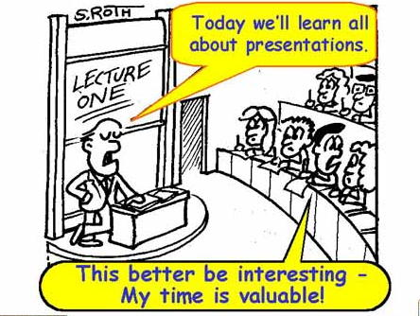
This picture is edited from http://www.matscieng.sunysb.edu/presentations1/Presentations_02.html

Slide 4
The Purposes of Presentations
You want to convince your audience to buy your idea.
  For example, you want to convince your supervisors that your project is worth doing so that they will approve it.
People like to be told things, rather than reading them.
  For example: the television and radio news.
The listeners don't merely want to be informed, they want to be entertained and stimulated as well.
  Those presenters who simply read from their notes are boring.
The ability to give a good presentation is a very important skill, and it can only be developed by practice.
  In the future, you will need this skill from time to time. That’s why you’d better start to develop this skill now!

Slide 5
Before You Start, You Need to Ask
What do you want the audience to do?
  For example - I want my supervisors to approve my proposal.
What does your audience need to know?
  For example - My supervisors need to know the problem we are facing, what's causing it, and how my proposal will solve it.
What does your audience need to feel in order to do that?
  For example - To approve my proposal, my supervisors need to feel convinced with the proposed solutions and project plan.
Why would your audience want to do what you want?
  For example – My supervisors will approve my proposal because my project is well planned and the system to be developed will bring benefits to certain groups of people.

Slide 6
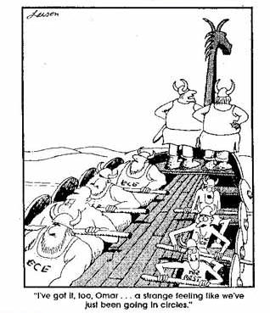
Plan your talk so that you don’t waste time and go around in circles.
This page is edited from http://www.matscieng.sunysb.edu/presentations1/Presentations_07.html

Slide 7
Tools and Resources
Hardware
  Computer
  Projector
  Remotes
  Pointer
Software
  Presentation
  Screen Shots
  Graphs & Charts

Slide 8
How to Start to Create Your Slides?
Write down the main points/ideas.
Try to put them in a natural or logical order.
Estimate a suitable amount of time for each point.
Collect necessary information/statistics/graphs/charts in order to support your points.
Start "fleshing out" your presentation.

Slide 9
Time Constraint
Only a limited amount of time will be given.
For your project 1 presentation
  Roughly, 10 ~ 15 minutes for presentation;
  5 minutes for Q&A;
  totally 15~20 minutes for the whole session.
Estimate about 1 minute per slide.
But you also need to reserve a little slack.

Slide 10
Suggested Slide Organization (assignment #1)
Duration: 5-6 minutes
Title page (1 page, with your name and project title)
Outline/Overview (1 page; 1 minute.)
Background and Problem Statement ( 1~2 pages, 1 minutes)
Literature Review (1 page; 1 minute)
Project Objectives and scope (1 page; 1 minute)
Proposed Solutions : Methods, Tools, and Expected Outcomes (1 page; 1 minute)
Conclusions (1 page; 30 sec - 1 minute)

Slide 11
Suggested Slide Organization
Duration: 15 min (presentation) + 10 min (demonstration)
Title page (1 page, with your name and project title)
Outline/Overview (1 page; 1/2 minute.)
Background and Problem Statement (2~3 pages; 2~3 minutes)
Literature Review (1~2 pages; 1~2 minutes)
Project Objectives and Proposed Solutions (3~4 pages; 3~5 minutes)
Methods, Tools, and Expected Outcomes (2~3 pages; 2~3 minutes)
Conclusions (1 page; 1 minute)
Demonstration of modelling/ prototype (about 10 minutes)

Slide 12
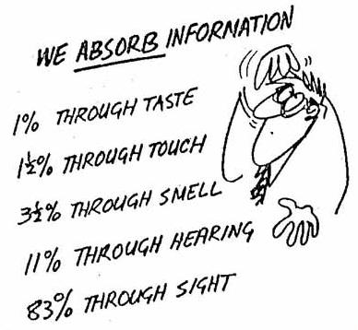
How Information is Absorbed?
This page is edited from http://www.matscieng.sunysb.edu/presentations1/Presentations_09.html

Slide 13
Tips on the Slide Design
Use landscape.
Use large fonts (i.e., ≥ 24 points).
Limit the number of lines to be around 8 lines per page.
Be succinct; full sentences are not necessary.
Use bullets to address your points; but no more than 3 lines per bullet.
It is nice to have visuals on every slide, but don’t make them too complicated.
Notes:
Succinct – expresses facts or ideas clearly and in few words

Slide 14
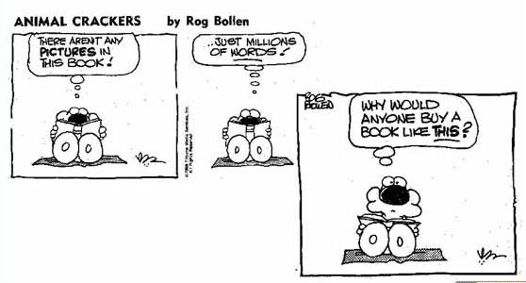
A Picture is Worth a Thousand Words – Use Visuals!
This page is edited from http://www.matscieng.sunysb.edu/presentations1/Presentations_12.html

Slide 15
Tips on the Slide Design (Con’t)
Use strongly contrasting colours.
Make emphasis with bolding, underlining, capitalization, etc.
Try to give a title to each slide.
Titles must be arranged logically.
Number slides – it is easier for the audience to ask questions
Avoid big complicated formulas.
Avoid source codes where possible; if you really need any, make them only very small pieces (e.g., no more than 5 lines).

Slide 16
Tips on the Slide Design (Con’t)
Keep unity of design from slide to slide; use no more than 3 master slides
Use only simple animation
Avoid sounds and fancy transitions.
Avoid switching programs, such as calling up a Web page.
Make your pictures large and clear enough to see.
Make you slides as simple as possible for your audience to follow your points!!

Slide 17
Practice and Revision
Check every point on your slides and see whether they are easy to follow.
Make sure there is no typo and you understand every word.
Create cue cards with key words and phrases, if necessary.
Practice the talk several times.
Do not always read directly from the slides.
Ensure that you properly utilize your allotted time.
If possible, invite your friends to watch and listen to the rehearsal in order to get some feedback.
Prepare answers to the questions that are likely to be asked.

Slide 18
Appearance
First impressions do count!
A coat may not be needed, but do dress nicely and neatly.
No T-shirt, no shorts, no jeans, no slippers.
Not too colourful either, as they may distract your audience.
Avoid linen clothes as they wrinkle.
Avoid white or bright-colour socks.
Look confident but not arrogant.
Smile!

Slide 19
Presentation Tips
Show up early.
When using audio-visual aids to enhance your presentation, be sure all necessary equipment is set up and in good working order prior to the presentation.
It is normal to be a little nervous.
  Even professionals have such feelings.
  If you are too nervous, try to take a deep breath and smile.
  Try to turn the nervousness into enthusiasm.
  Never apologize for being nervous as it may not be noticed until you mention it.

Slide 20
Presentation Tips (Con’t)
Your voice must be clear and loud enough for all your audience to hear.
Do not speak too fast; make sure your audience are able to follow your speed.
Body language is important.
  Standing, walking or moving about with appropriate hand gesture or facial expression.
  Do not sit down or stand still with head down and reading from a prepared speech.
Speak with confidence as if you really believe in what you are saying.

Slide 21
Presentation Tips (Con’t)
Do not read from notes; although it is quite acceptable to glance at your notes infrequently.
If you made an error, correct it, and continue. No need to make excuses or apologize profusely.
Maintain sincere eye contact with your audience.
  Use the 3-second method, e.g. look straight into the eyes of a person in the audience for 3 seconds at a time.
  Have direct eye contact with a number of people in the audience, and every now and then glance at the whole audience while speaking.
  Use your eye contact to make everyone in your audience feel involved.

Slide 22
Presentation Tips (Con’t)
Speak to your audience, listen to their questions, respond to their reactions. Communication is the key to a successful presentation.
Use pauses. Allow yourself and your audience a little time to reflect and think.
A useful technique is to pause and ask
  “Any question?”
  “Is everything clear so far?”
  “Do I need to explain it further?”
This technique is particularly useful if you “really” want to explain something further.

Slide 23
Presentation Tips (Con’t)
Add humour whenever appropriate and possible.
Avoid telling lousy jokes and yet laugh out loud at them.
Keep your audience interested throughout your entire presentation.
Know when to STOP talking. Terminate your presentation with an interesting remark or an appropriate punch line.
Leave your listeners with a positive impression and a sense of completion.
Thank your audience before you step down from the stage

Slide 24
Useful Websites
http://www.matscieng.sunysb.edu/presentations1/
http://www.gordonross.org.uk/Presentation.html
http://www.kevinboone.com/howto_presentation.html
http://www.cs.vu.nl/~ikuz/gnarp2000/Guillaume.html
http://www.wittcom.com/how_to_prepare_a_presentation.htm
http://people.csp.edu/saylor/effective_powerpoint.htm
http://www.aresearchguide.com/3tips.html
http://www.ljlseminars.com/anxiety.htm
http://www.cgl.uwaterloo.ca/~csk/presentations.html

