Slide 1
Literature Review

Slide 2
What is a Literature Review
A literature review is an account of what has been published on a topic by accredited scholars and researchers.
It is often part of the introduction to an essay, research report, or thesis.
In writing the literature review, your purpose is to convey to your reader what knowledge and ideas have been established on a topic, and what their strengths and weaknesses are.
As a piece of writing, the literature review must be defined by a guiding concept (e.g., your research objective, the problem or issue you are discussing, or your argumentative thesis).

Slide 3
Literature/Technical Review
Review of the previous work
Fact finding
Benchmarking
Verification
Potential contributions and/or expected outcomes of your project
… etc.

Slide 4
Literature Review
provide details about the motivation for the project
state why the problem addressed by the dissertation is important
set the scene for the work described in the dissertation
describe what others have done and hence sets a benchmark for the current project
justify the use of specific solution techniques or problem solving procedures in your work

Slide 5
Requirements of Literature Review
Compare and contrast different authors' views on an issue
Group authors who draw similar conclusions,
Criticize aspects of methodology,
Note areas in which authors are in disagreement,
Highlight exemplary studies,
Highlight gaps in research,
Show how your study relates to previous studies,
Show how your study relates to the literature in general,
Conclude by summarizing what the literature says.
Part of the content is from:
http://www.lib.unimelb.edu.au/postgrad/litreview/home.html

Slide 6
Rationale of Literature Review
Define and limit the problem you are working on,
Place your study in a historical perspective,
Avoid unnecessary duplication,
Evaluate promising research methods,
Relate your findings to previous knowledge and suggest further research.
Part of the content is from:
http://www.lib.unimelb.edu.au/postgrad/litreview/home.html

Slide 7
Reading Materials
The first step towards a good literature review is a comprehensive literature search.
You need to make sure you are getting a good range of the available literature in your area of study.
Resources: Library books and digital subscription, WWW search engine, etc.
Make critical reading rather than just flip through the reading materials .
Try to read the abstract and introduction carefully so that you can skip some of the unnecessary reading materials.
Part of the content is from:
http://www.lib.unimelb.edu.au/postgrad/litreview/home.html

Slide 8
Reviewing and Rethinking
It is a good idea to look over your notes the day after you do the reading.
Doing this straight away means that the material is more likely to end up in your long term memory and therefore be more readily retrievable.
A review session also gives you a chance to have another think about the reading material.
Re-read your notes, adding additional comment where necessary.
Double check that you have all the referencing information.
Part of the content is from:
http://www.lib.unimelb.edu.au/postgrad/litreview/home.html

Slide 9
Tips on Literature Review
The "Literature Review" tells your audience (your advisors, off-campus sponsors, or sources of funding) what the state of the art in your topic is.
A very important purpose of the Literature Review is to benchmark, and then highlight the significance of, your project compared with the previous work.
You probably should tackle the "Literature Review" first since mastering it will give you the background you need to write other sections.

Slide 10
Tips on Literature Review (Con’t)
You need to demonstrate that you know the background and context of your topic.
Good questions to answer in this section are:
  What kinds of research have been done before?
  What relevant kinds of studies or techniques need to be mastered to do your project?
  Where is the state of the art today?
  How have others gone about trying to solve problems you want to tackle, and in what ways will your approach build on and vary from previous work?

Slide 11
Tips on Literature Review (Con’t)
Everything in your literature review section should be mentioned in your References.
It's usually a bad sign to see every paragraph beginning with the name of a researcher.

Slide 12
Plagiarism
Because a literature review is based on the work of other authors, you must be very careful to separate an author's evaluation of research from your own.
Plagiarism of ideas occurs when you paraphrase facts or arguments without citation.
Anything you get from a book, even if you write it in your own words, needs to have a citation or footnote.
Plagiarism of words happens when you copy another author exactly without putting the words in quotation marks.
This type of plagiarism may occur in conjunction with plagiarism of ideas, or on its own. Even if you provide citation information, you also need to put the text in quote marks, or you will be plagiarising.
Citations of quotations ought to include page numbers.
Part of the content is from:
http://www.lib.unimelb.edu.au/postgrad/litreview/home.html

Slide 13
Structure of Literature Review
Part of your task in taking notes is to begin the process of arranging ideas.
It is important that the concepts are presented in an order that makes sense in the context of your project.
You need to do some work on planning and structure to ensure that your literature review is a coherent piece of work.
There may be clear divisions in the sets of ideas you want to discuss, in which case your structure may be fairly clear. This is an ideal situation.
In more cases, there will be several different possible structures for your review. Making an outline or plan is a good way to experiment with these different structures. Talk to your supervisor before you make a final decision and start writing.
Part of the content is from:
http://www.lib.unimelb.edu.au/postgrad/litreview/home.html

Slide 14
Tips on Structure
To group authors who draw similar conclusions, you can use linking words such as: also , additionally , again, similarly.
When authors disagree, linking words that indicate contrast will show how you have analysed their work, such as however , conversely , on the other hand , nonetheless
At other times you may want to qualify an author's work (using such words as specifically, usually or generally) or use an example (thus, namely, to illustrate). In this way you ensure that you are synthesising the material, not just describing the work already carried out in your field.
There needs to be a clear relationship between the literature review and the hypothesis and methodology to follow.
At the end of your review, include a summary of what the literature implies. You need to do this in a way that clearly links with your own hypotheses and methodology.
Part of the content is from:
http://www.lib.unimelb.edu.au/postgrad/litreview/home.html

Slide 15
Basic steps in conducting literature review
Assessing sources
  read the text and summarizing the author's main points by making notes, written or mental, annotations, or other means.
    Author: look for citations, articles, and books - what his/her credentials are, and what occupation or position s/he holds.
    Publication and audience : Examine the publication for which the author is writing to determine the author's intended audience, and the publication's reputation, credibility, and target reader/researcher.
This is based on "Integrating Writing: Assessing Sources/Writing a Literature Review,"
(http://www.bothell.washington.edu/writingcenter/writing/reviews).

Slide 16
    Argument/Evidence: Identify the range of evidence (personal opinions or observations, research, case studies, analogies, statistics, facts, quotations, etc.), locate any gaps or inconsistencies in the development of the argument
    Relevance/ consistency:
1. Analyze the text in relation to your question and developing thesis, and in relation to other sources you've been reading.
2. If it supports your thinking, identify the assumptions/biases/perspectives influencing the writer, and how they compare to your own and those of other writers with whom this one agrees.
3. If it is an opposing perspective, identify the assumptions/biases/perspectives influencing the writer, and how they compare to your own and those of other writers with whom this one agrees?
4. Determine how this source contributes to your understanding or to generating new questions in your thinking?
This is based on "Integrating Writing: Assessing Sources/Writing a Literature Review,"
(http://www.bothell.washington.edu/writingcenter/writing/reviews).

Slide 17
2) Developing a matrix
- start identifying the perspectives, schools of thought, sets of variables, etc., that influence the question you're trying to answer.
- want to organize your readings into categories that will help you choose the main arguments in support of and in opposition to your thesis.
Literature Review STUDY SUMMARIES
Author/title | Purpose | Framework | Sample | Design | Variables/ instruments | Results | Controversies, disagreements with other authors | Limitations | Implications for practice, research, theory
You might also find this useful – it’s a quick way to compare studies by variables
Author (s), title | Year | Variable 1 | Variable 2 | Variable 3 | Variable 4
 |  | X | X |  | X
 |  | X | X | X
 |  | X | X |  | X
 |  | X | X | X | X
This is based on "Integrating Writing: Assessing Sources/Writing a Literature Review,"
(http://www.bothell.washington.edu/writingcenter/writing/reviews).
Notes:
Organize your sources by detecting a pattern that helps you explain why one group of sources comes up with one answer and another group comes up with another answer.
Creating a matrix is a very effective way of doing this.

Slide 18
3) Writing a literature review
Describes the kind of search that was conducted
Summarizes, analyzes, and organizes the various responses found in the scholarly conversation regarding the question
Explains why different scholars provide different answers for the same or related questions (i.e. accounts for the debate/tension in the literature)
This is based on "Integrating Writing: Assessing Sources/Writing a Literature Review,"
(http://www.bothell.washington.edu/writingcenter/writing/reviews).

Slide 19
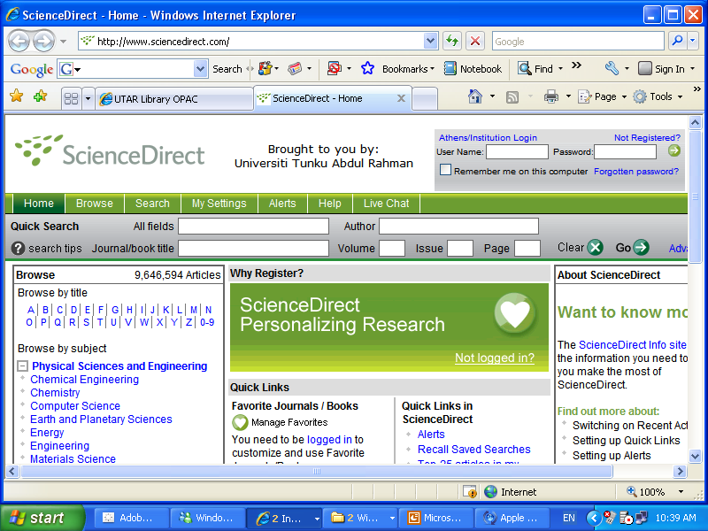
ScienceDirect.com

Slide 20
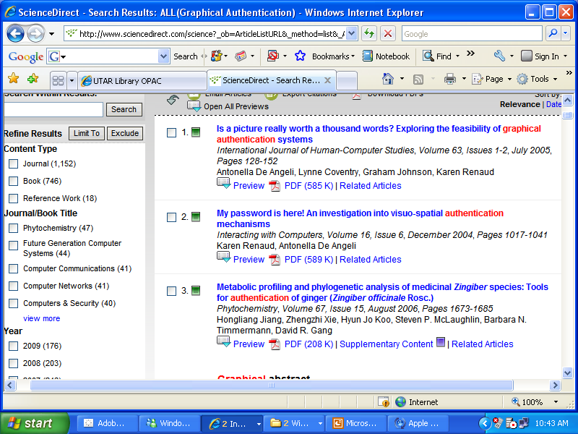
Search by “Graphical Authentication”

Slide 21
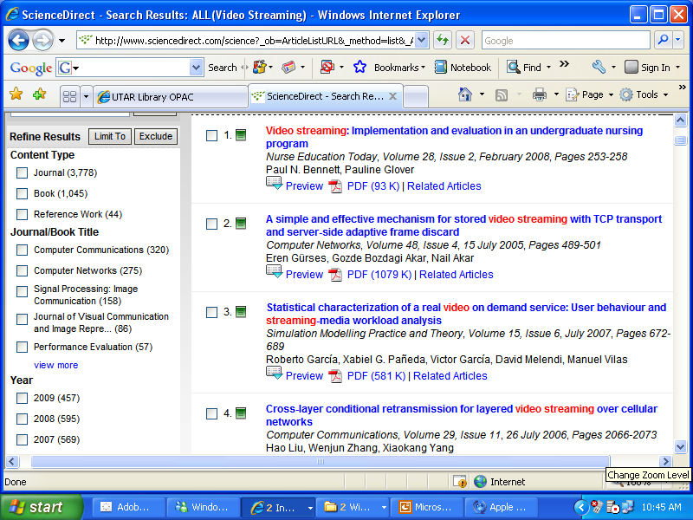
Search by “Video Streaming”

Slide 22
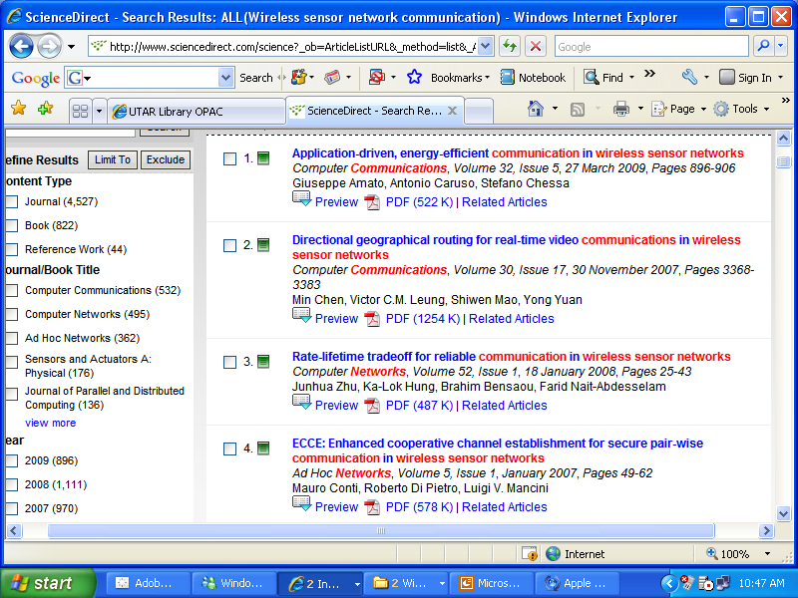
Search by “Wireless Sensor Network Communication”

Slide 23
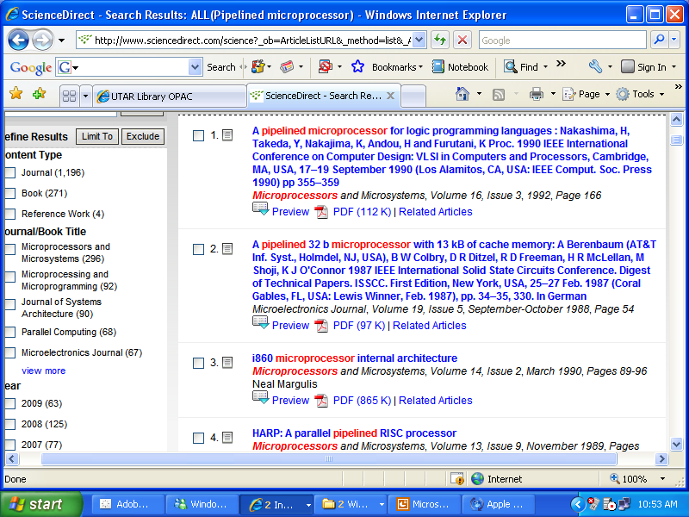
Search by “Pipelined Microprocessor”

Slide 24
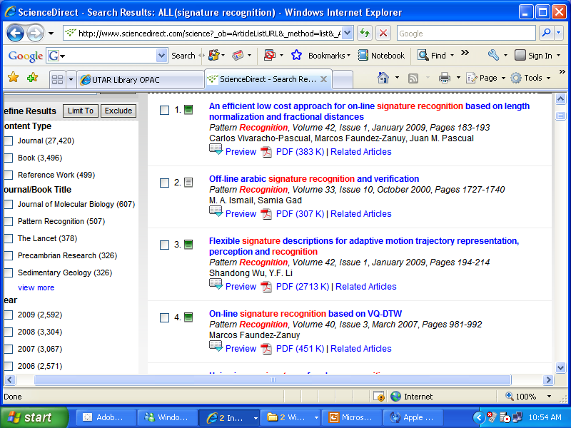
Search by “Signature Recognition”

Slide 25
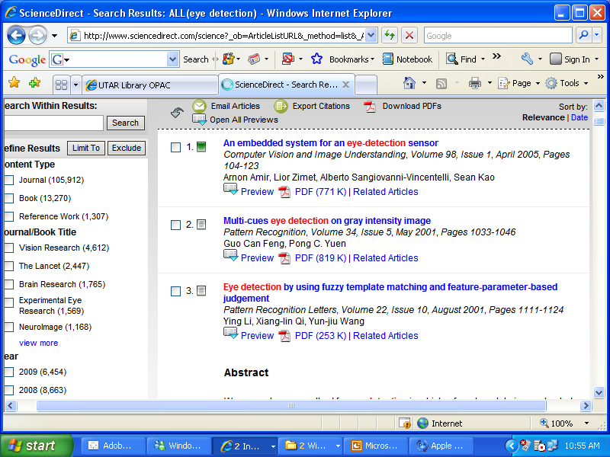
Search by “Eye Detection”

Slide 26
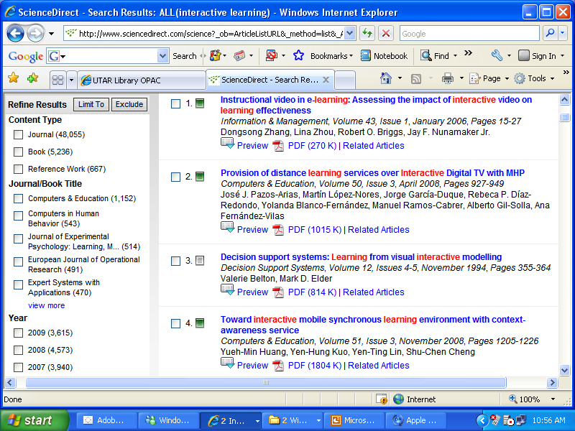
Search by “Interactive Learning”

Slide 27
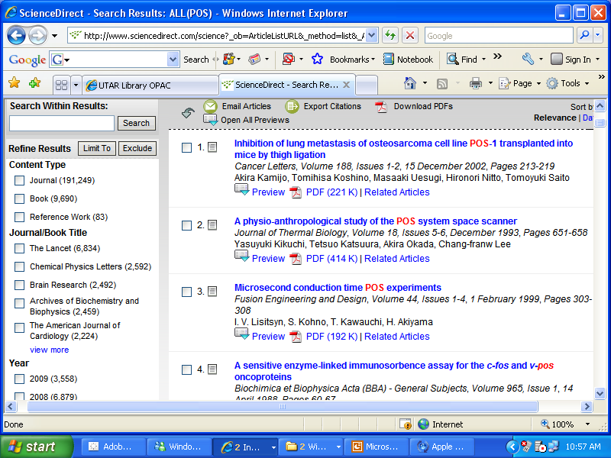
Search by “POS”

Slide 28
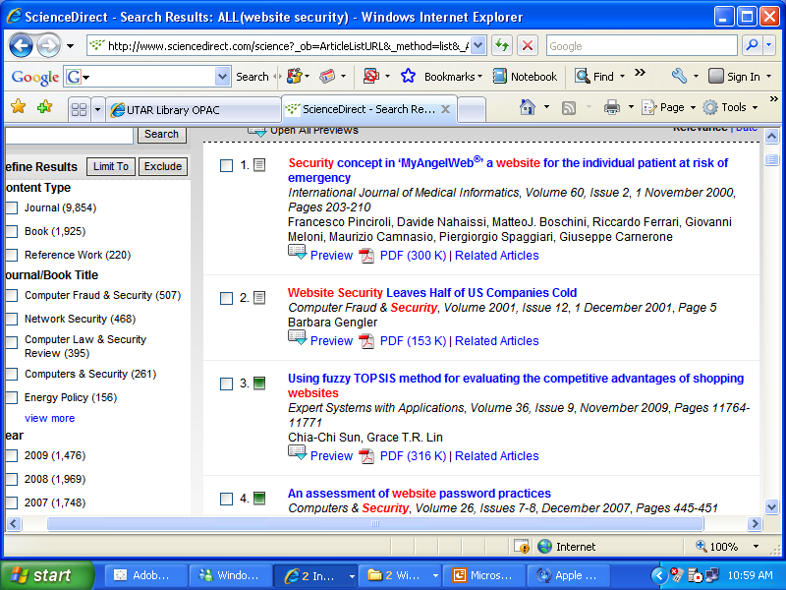
Search by “Website Security”

Slide 29
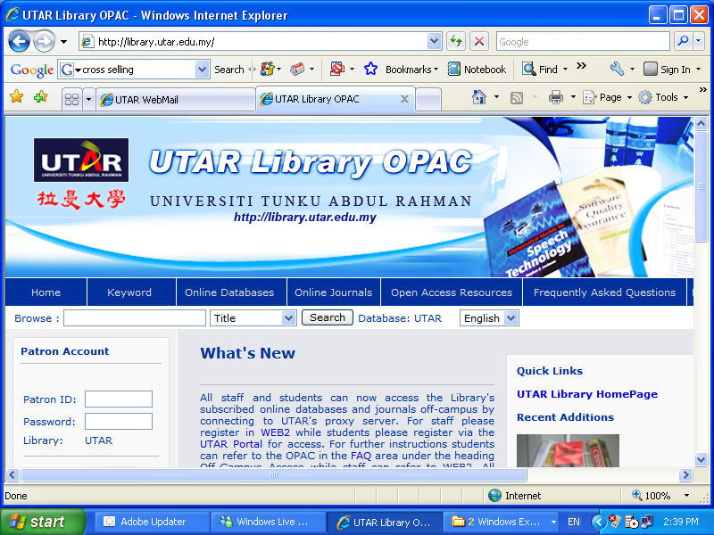

Slide 30
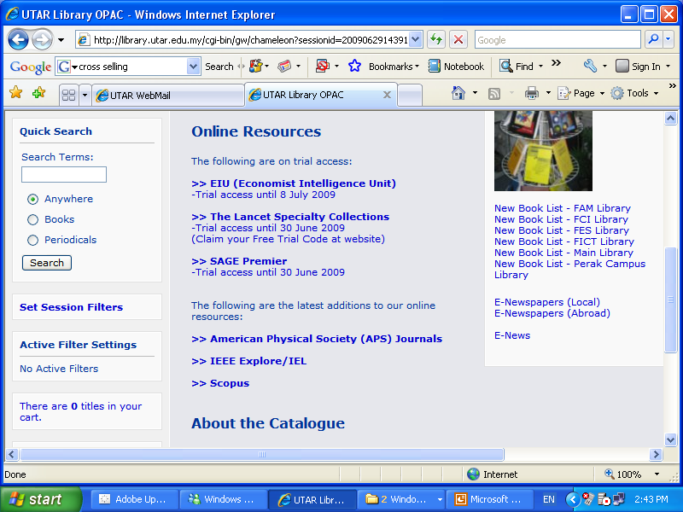

Slide 31
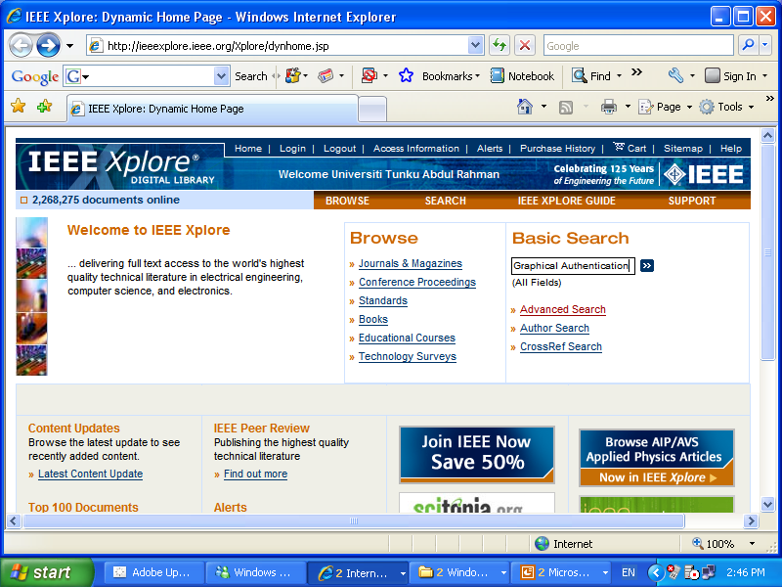

Slide 32
Conclusion
Finding usable literature:
Browse discipline-specific or area-specific reviews
Look through past several years of flagship journals
Use key terms to search electronic databases
Limit yourself to 10 or so items to actually review (varies by project), only about ½ of which you will actually read properly.
Reviewing the literature:
Don’t summarize the studies, evaluate them (don’t be too dismissive)
Look for key themes and issues running through them
Take a holistic view of the relevant literature to provide an overview of what it says

