Slide 1
Project Approach

Slide 2
Methodologies
eXtreme Programming (XP)
Unified Process (UP)
Scrum
Evolutionary Project Management (Evo)
Crystal
Lean Development (LD)
Adaptive Software Development (ASD)
Dynamic System development method(DSDM)
Feature Driven Development (FDD)

Slide 3
Proposed Methodology
Describe the specific activities that will take place to achieve the objectives, that is, what will occur from the time the project begins until it is completed.
Enable the reader to visualize the implementation of the project.
Match the stated objectives
Provide the order and timing for the tasks.
Defend your chosen methodology

Slide 4
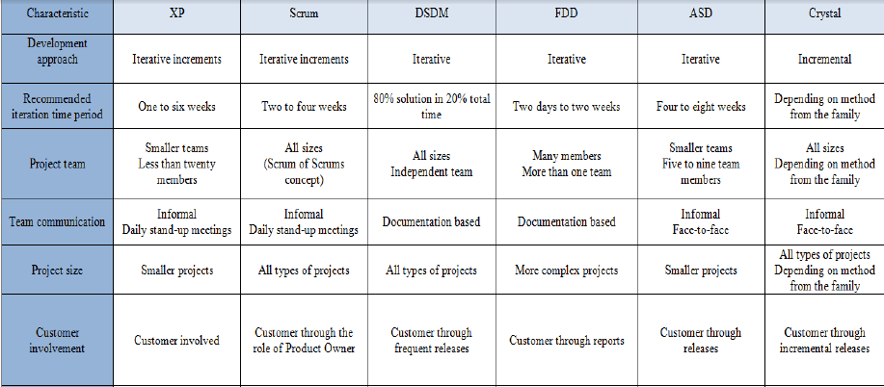
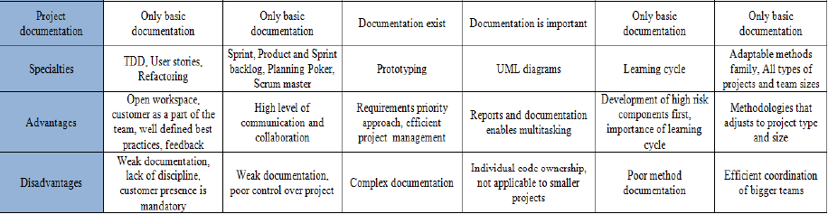
Notes:
Comparison of Agile Methodologies
Published on Jul 11, 2013
Agile Methodology in Software Development.
Sapna Sood, Business Development Manager

Slide 5
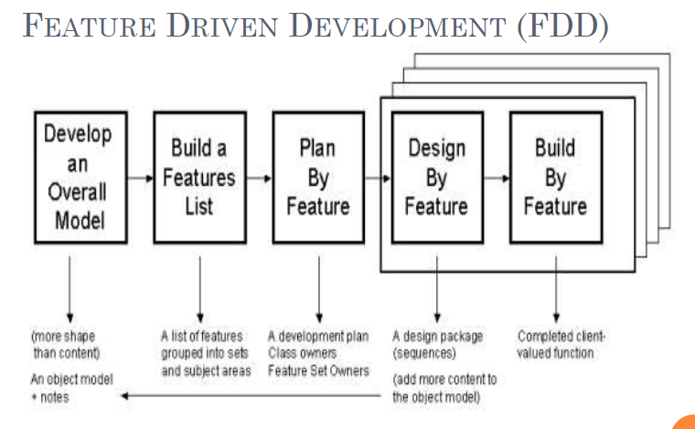

Slide 6
Project Management
To deliver an information system that is acceptable to users and is developed on time and within budget.
Effective PM helps ensure
  Meeting customer expectations
  Satisfying budget and time constraints

Slide 7
Project Management
95 % Of Today’s Software
INITIATION
PLANNING
EXECUTION
CONTROLLING
CLOSURE
Areas Of Deficiency
Feasibility Studies
Benefit-Cost Analyses
Criteria definition
Assumptions Defined
Evaluation Criteria
Risk Management
Behavioral Software
Lessons Learned
Best Practices
Library
Failure Analyses
Notes:
Perform reality checks on schedules.
Allow for contingencies.
Don’t plan for everyone to work at 100 percent capacity all the time.
Hold progress meetings with stakeholders and be clear and honest in communicating schedule issues.

Slide 8
Importance of Project Planning
Research methods and/or development tools
Resource justification
Project duration and time schedule
Milestones
Costs incurred in the project (budget)
… etc.
Notes:
Time and Cost Estimation
Project phases are clearly defined?
Milestones are clearly stated?

Slide 9
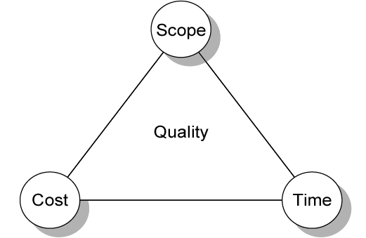
Project Management Trade-offs

Slide 10
Phases of Project Management Process
Phase 1: Initiation
Phase 2: Planning
Phase 3: Execution
Phase 4: Closedown

Slide 11
PM Phase 1: Project Initiation
Assess size, scope and complexity, and establish procedures.
Establish:
  Initiation team – select/decide on core project team members
  Relationship with customer – foster strong working relationship for better understanding of customer “needs” i.e. requirements
  Project initiation plan – defines the activities required to organize and kick-start the team members. E.g. SSR and Business Case etc is developed
  Management procedures – standard operating procedures is developed ensures project directions. E.g. Ensure SSR is in place before project planning
  Project management environment – to collect and organize the tools that you will use while managing the project and to construct the project workbook
  Project workbook – serves as a repository for all project correspondence, input, output, deliverables, procedures and standards

Slide 12
PM Phase 2: Project Planning
Define clear, discrete activities and the work needed to complete each activity
Tasks
  Define project scope (content & complexity), alternatives, feasibility
  Divide project into smaller manageable logically ordered tasks and subtasks using Work Breakdown Structure (WBS)
  Estimate resource requirements (H/W, S/W and personnel)
  Develop preliminary acceptable schedule – estimates project start and end dates using network diagram
  Develop communication plan among mgt, team members and customers
  Determine standards and procedures – provide guidelines and work routines
  Risk identification and assessment – identify sources of risks and consequences of those risks
  Create preliminary budget – Cost-benefit analysis outlining planned expenses and revenues
  Develop a statement of work – outlines work to be done and clearly describes project deliverables. It is a “Contract” between the IS staff and the customer regarding deliverables and time estimates for a system development project
  Set baseline project plan (BPP) – estimates project’s tasks and resource requirements as a guide to project execution. It contains estimates of scope, benefits, schedules, costs, risks, and resource requirements

Slide 13
Assessing Project Feasibility
Economic feasibility
Technical feasibility
Operational feasibility
Schedule feasibility
Legal and contractual feasibility
Political feasibility

Slide 14
Operational Feasibility
If the system is developed, will it be used?
Does management support the project?
Do users support the project?

Slide 15
Schedule Feasibility
How long will it take to get the technical expertise?
Given your technical expertise, are the project deadlines reasonable?
What are the real constraints on project deadlines?

Slide 16
Technical Feasibility
Is the proposed technology or solution practical?
What kinds of technology will we need?
Is the required technology available “in house”?

Slide 17
Technical Feasibility
Assessing the organization’s ability to construct the proposed system
Takes into account various project risk factors

Slide 18
Project Risk Factors
Project size
  Team size, organizational departments, project duration, programming effort
Project structure
  New vs. renovated system, resulting organizational changes, management commitment, user perceptions
Development group
  Familiarity with platform, software, development method, application area, development of similar systems
User group
  Familiarity with IS development process, application area, use of similar systems

Slide 19
Project Planning
Research methods and/or development tools
Resource justification
Project duration and time schedule
Milestones
Costs incurred in the project (budget)
… etc.

Slide 20
Tips on Project Planning
The "Project Planning" lays out your plan towards the accomplishment of your project.
To show that your project is well planned, you need to divide your main project objective into several subtasks and show that they are achievable with the time, budget, and resources that you are given.

Slide 21
Economic Feasibility
Cost-benefit analysis: identify all the financial benefits and costs associated with a project
Tangible vs. intangible benefits
Tangible vs. intangible costs
One-time vs. recurring costs

Slide 22
Economic Feasibility
Can the bottom line be quantified yet?
Cost and Benefit Analysis
Tangible Benefits
Intangible Benefits

Slide 23
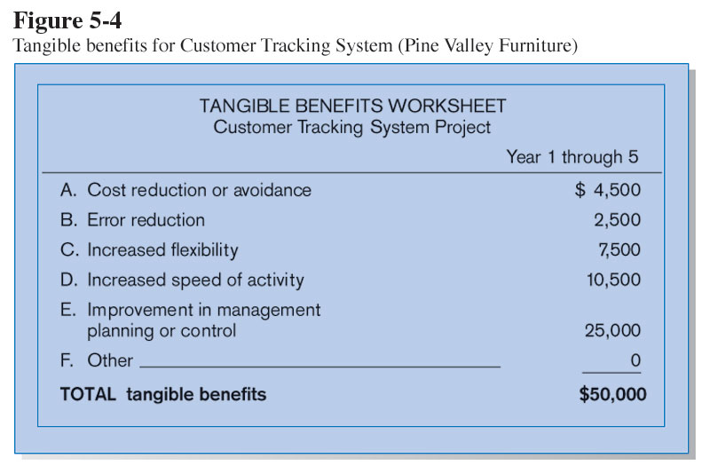
Tangible Benefits
Benefits that can be measured in dollars and with certainty

Slide 24
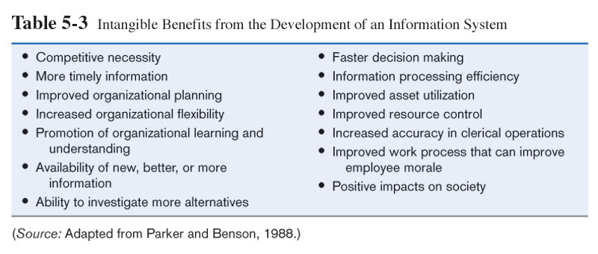
Benefits that cannot easily be measured in dollars or with certainty

Slide 25
Types of Costs
Tangible: can be measured in dollars and with certainty
Intangible: cannot easily be measured in dollars or with certainty
One-time: a cost associated with project start-up and development or systems start-up
Recurring: a cost associated with ongoing evolution and use of a system

Slide 26
Possible IS Project Costs
Procurement
  Consulting, equipment, site preparation, capital, management time
Start-up
  Operating systems, communications installation, personnel hiring, organizational disruption
Project-related
  Application software, software modification, personnel overhead, training, data analysis, documentation
Operating
  System maintenance, rental, asset depreciation, operation and planning

Slide 27
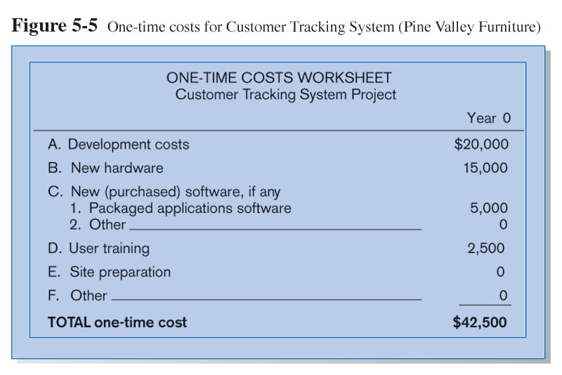
One-time Costs

Slide 28
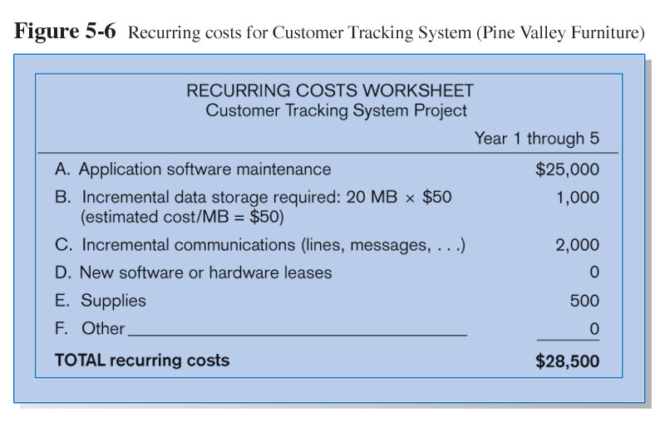
Recurring Costs

Slide 29
Other Feasibility Concerns
Operational
  Does the proposed system solve problems or take advantage of opportunities?
Schedule
  Can the project time frame and completion dates meet organizational deadlines?
Legal and Contractual
  What are legal and contractual ramifications of the proposed system development project?
Political
  How do key stakeholders view the proposed system?

Slide 30
Importance of Project Schedules
Managers often cite delivering projects on time as one of their biggest challenges.
Fifty percent of IT projects were challenged in the 2003 CHAOS study, and their average time overrun increased to 82 percent from a low of 63 percent in 2000.*
Schedule issues are the main reason for conflicts on projects, especially during the second half of projects.
Time has the least amount of flexibility; it passes no matter what happens on a project.
*The Standish Group, “Latest Standish Group CHAOS Report Shows Project Success Rates Have Improved by 50%,” (www.standishgroup.com) (March 25, 2003).

Slide 31
Schedule Development
Uses results of the other time management processes to determine the start and end dates of the project.
Ultimate goal is to create a realistic project schedule that provides a basis for monitoring project progress for the time dimension of the project.
Important tools and techniques include Gantt charts, critical path analysis, critical chain scheduling, and PERT analysis.
Schedule Milestones should be SMART:
  Specific , Measurable , Assignable, Realistic, Time-framed

Slide 32
Project Scheduling
Primary objectives of project scheduling:
  Best time
  Least cost
  Least risk
Secondary objective of project scheduling:
  Studying alternatives
  Developing an optimal schedule
  Using resource effectively
  Communication
  Refining the estimating criteria
  Obtaining good project control
  Providing for easy revisions

Slide 33
Reality Checks on Scheduling
Review the draft schedule or estimated completion date in the project charter.
Prepare a more detailed schedule with the project team.
Make sure the schedule is realistic and followed.
Alert top management well in advance if there are schedule problems.

Slide 34
Monitoring and Controlling
Project Work
Changes are inevitable on most projects, so it’s important to develop and follow a process to monitor and control changes.
Monitoring project work includes collecting, measuring, and disseminating performance information.
Two important outputs of monitoring and controlling project work include recommended corrective and preventive actions.

Slide 35
Project Monitoring and Controlling
Involves measuring progress toward project objectives, monitoring deviation from the plan, and taking corrective action to match progress with the plan.
Affects all other process groups and occurs during all phases of the project life cycle.
Outputs include performance reports, requested changes, and updates to various plans.

Slide 36
Milestones
A milestone is a significant event that normally has no duration.
It often takes several activities and a lot of work to complete a milestone.
Milestones are useful tools for setting schedule goals and monitoring progress.
Examples include completion and customer sign-off on key documents and completion of specific products.

Slide 37
Gantt Charts
Gantt charts provide a standard format for displaying project schedule information by listing project activities and their corresponding start and finish dates in a calendar format.
Symbols include:
  Black diamonds: Milestones
  Thick black bars: Summary tasks
  Lighter horizontal bars: Durations of tasks
  Arrows: Dependencies between tasks

Slide 38
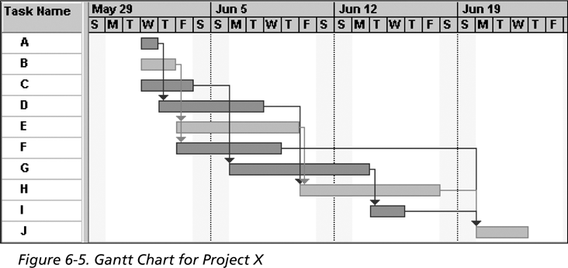
Gantt Chart
Note: In Project 2003 darker bars are red to represent critical tasks.

Slide 39
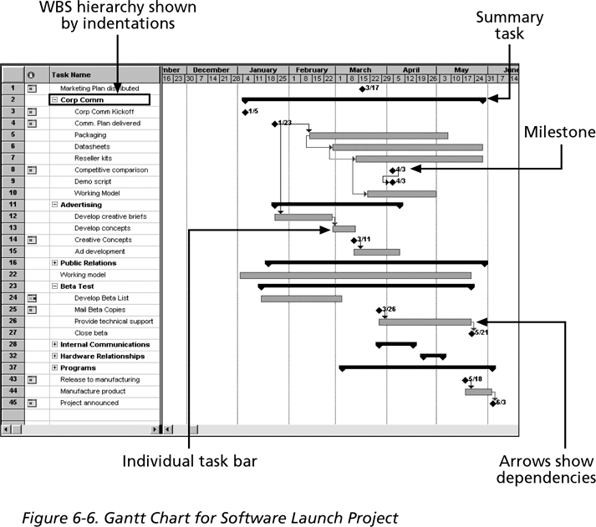
Gantt Chart for Software Launch Project

Slide 40
PM Phase 3: Project Execution
Plans created in prior phases are put into action.
Actions
  Execute baseline project plan – initiate the project activities, acquire and assign resources, keep project on schedule and ensure quality delivery
  Monitor progress against baseline plan – adjust resources, activities and budget as necessary if project ahead or slipped
  Manage changes in baseline plan – only approved changes are allowed and all changes MUST be reflected in the baseline plan and project workbook
  Maintain project workbook
  Communicate project status to team members (system developers, managers and customers)

Slide 41
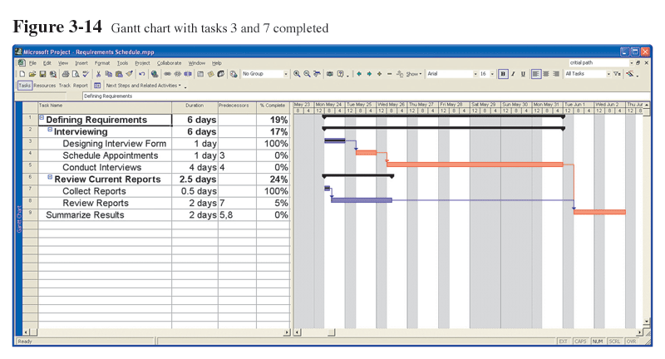
Monitoring Progress with a Gantt Chart
Red bars indicate critical path, lines through bars indicate percent complete.

Slide 42
Communication Methods
Project workbook
Meetings
Seminars and workshops
Newsletters
Status reports
Specification documents
Minutes of meetings
Bulletin boards
Memos
Brown bag lunches
Hallway discussions

Slide 43
PM Phase 4: Project Closedown
Bring the project to an end
Actions
  Close down the project – notify all interested parties for project completion and finalized all project documentation and financial records
  Conduct post-project reviews – what have done right, what have done wrong
  Close the customer contract – to gain agreement from customer that all contractual obligations have been met and further work is either their responsibility or covered under another SSR or contract

Slide 44
Tips on Project Planning (Con’t)
The project planning must demonstrate that you clearly understand your task, have a logical time plan for solving your problems, and have identified all the resources you need.
This section should answer:
  What are the tasks and sub-tasks identified to achieve your objectives?
  What materials and equipment will you need to carry out your project?
  What data are needed for the project and how will they be collected?
  What method or process will be used to analyze this data?
  What time frame do you think you will need to accomplish identified tasks or subtasks?
  If you are working on a team, which teammates will accomplish which parts?
  What costs do you anticipate the project will incur -- in other words, your budget?

Slide 45
Creating the Work
Breakdown Structure
Work Breakdown Structure (WBS)
  An hierarchical outline (map) that identifies the products and work elements involved in a project.
  Defines the relationship of the final deliverable (the project) to its subdeliverables, and in turn, their relationships to work packages.
  Best suited for design and build projects that have tangible outcomes rather than process-oriented projects.

Slide 46
How WBS Helps the Project Manager
WBS
  Facilitates evaluation of cost, time, and technical performance of the organization on a project.
  Provides management with information appropriate to each organizational level.
  Helps in the development of the organization breakdown structure (OBS). which assigns project responsibilities to organizational units and individuals
  Helps manage plan, schedule, and budget.
  Defines communication channels and assists in coordinating the various project elements.

Slide 47
Work Breakdown Structure: Online Karaoke System
  Identify real-time streaming protocols and tools
  Compare the advantages and disadvantages of different programming languages that support real-time services
  Write network programmes for text and video services
  Develop a simple client-server system for video streaming
  Create database to store songs and videos that can be retrieved and streamed anytime
  Create database for users to logon and logout
  Design user-friendly interface
  Solve the delay and jitter problems so that all clients can receive smooth real-time videos from the server and each other
  Compile all the modules into one system and fine tune it

Slide 48
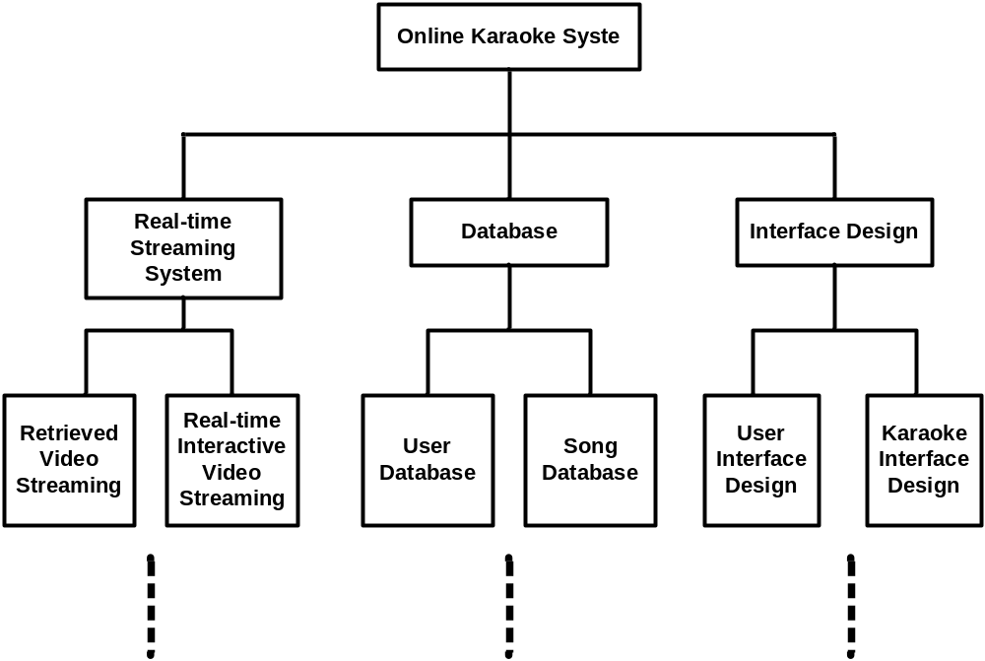
Example: Online Karaoke System (WBS)

Slide 49
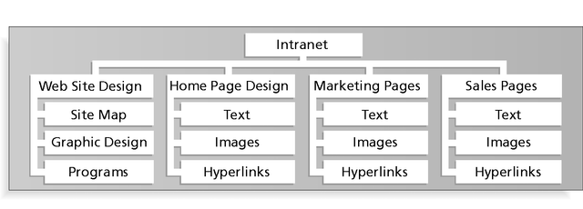
Figure 5-2: Sample Intranet WBS
Organized by Product
Information Technology Project Management, Fifth Edition, Copyright 2007

Slide 50
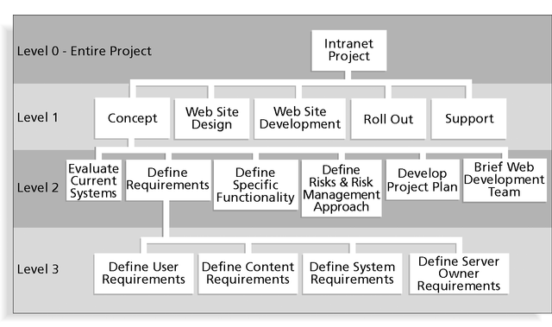
Figure 5-3: Sample Intranet WBS
Organized by Phase
Information Technology Project Management, Fifth Edition, Copyright 2007

Slide 51
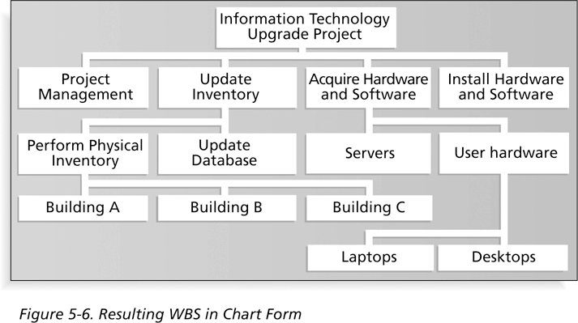
Figure 5-7: Resulting WBS in Chart Form
Information Technology Project Management, Fifth Edition, Copyright 2007

Slide 52
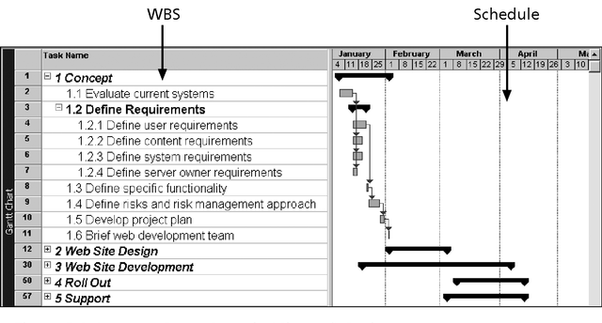
Figure 5-4: Intranet WBS and Gantt Chart in Microsoft Project
Information Technology Project Management, Fifth Edition, Copyright 2007

Slide 53
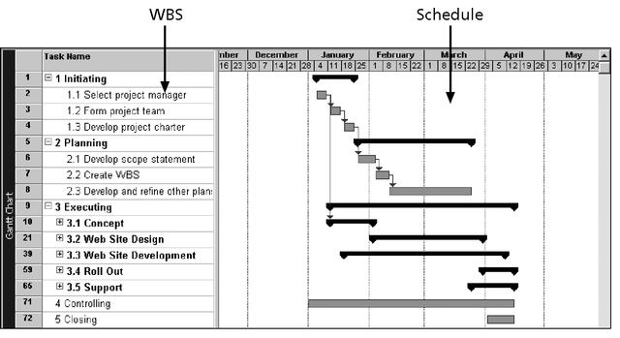
Figure 5-5: Intranet Gantt Chart Organized by Project Management Process Groups
Information Technology Project Management, Fifth Edition, Copyright 2007

Slide 54
Using Software to Assist in Project Scope Management
Word-processing software helps create several scope-related documents
Spreadsheets help to perform financial calculations and weighed scoring models, and develop charts and graphs
Communication software like e-mail and the Web help clarify and communicate scope information
Project management software helps in creating a WBS, the basis for tasks on a Gantt chart
Specialized software is available to assist in project scope management
Information Technology Project Management, Fifth Edition, Copyright 2007

