Slide 1
Outcome-Based Education (OBE)
Lee Kong Chian Faculty Engineering and Science
2018-01-03

Slide 2
Outline
What is OBE? – Concept
Why is OBE needed? – Paradigm Shift
How does OBE work? – OBE Mechanism
Continual Quality Improvement (P-D-C-A)
Self – Learning Time
eOBE2 / iCGPA
(Engineering Programme) Complex Engineering Problem, Complex Problem Activities and Knowledge Profile

Slide 3
What is OBE? – Concept
OBE is an approach that focuses on the attainment of intended learning outcomes where students develop behaviors that are authentic to their discipline and are assessed holistically within the context of their learning.
OBE clearly focuses and organizes everything in an educational system around what is essential for all students to be able to do successfully at the end of their learning experiences. This means starting with a clear picture of what is important for all students to be able to do, then organizing curriculum (outcome), instruction (activity), and assessment to make sure this learning ultimately happens” (Spady, 1994).

Slide 4
Why is OBE needed? – Paradigm Shift
Aspect | Conventional Education | Outcome-Based Education
Learner Attribute | Passive, rote learning, reliance on past years’ questions | Learn with purpose/outcome in mind
Instructional Planning Process | Mainly cognitive domain | Cognitive, affective and psychomotor
Curriculum Design and Delivery | Adhere to rigid syllabi and curriculum | Facilitate student’s learning to achieve CO
Assessment Method | Follow the norm and/or lecturer’s preference | Use appropriate tools/tasks to support CO attainment
Outcome Orientation | Produce learners with adherence to curriculum and delivery methods | Enhance active learning experience using assessment tasks with rubric

Slide 5
Requirement from Qualification Bodies / Professional Bodies
Undergraduate curriculum needs to be transformed into adopting OBE in accordance with requirements from:
Malaysian Qualifications Framework (MQF) of Malaysian Qualifications Agency (MQA)
Ministry of Higher Education (MoHE) Malaysia – Malaysia Education Blueprint (2015 – 2025) Higher Education (MEB – HE)
Engineering Accreditation Council (EAC), Board of Engineers Malaysia (BEM) (Malaysia is the signatory of Washington Accord in 2009)

Slide 6
How does OBE work? – OBE Mechanism
Questions:
What do you want the students to learn?
Why do you want them to learn it?
How can you best help students to learn it?
How will you know what they have learnt?
OBE’s approach to these questions:
Defining course outcomes to explicate what a student is expected to know, understand or do;
Providing learning activities that help students attain these outcomes;
Assessing the extent to which students these outcomes through the use of explicit assessment criteria as performance indicator.

Slide 7
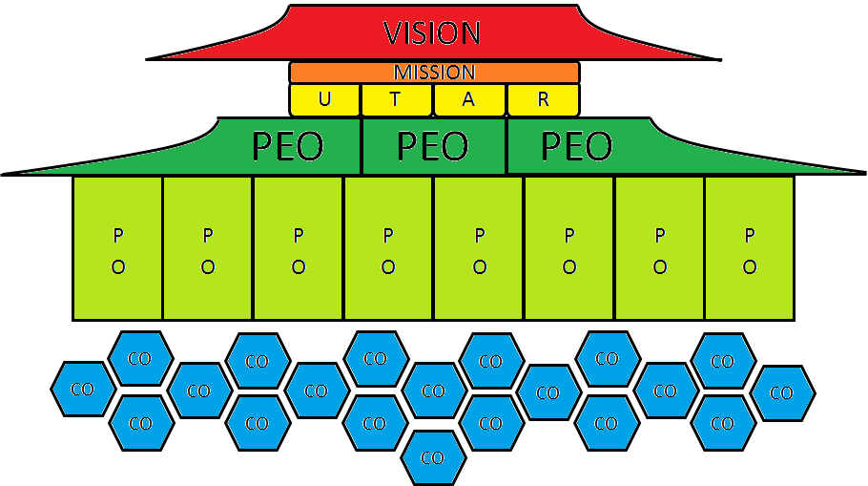
OBE Framework
Professional Level
Programme Level
Course Level

Slide 8

UTAR Vision and Mission

Slide 9
UTAR Six Educational Pillars
UTAR Six Educational Pillars
Virtue and Morality
Knowledge and Intellect
Physical and Mental Health
Sociality and Humanitarianism
Aesthetics and Harmony
Creativity and Innovation
UTAR Soft Skills Development Certification
7 Core Components:
Communication & Language Skills
Critical Thinking, Creative Thinking
& Problem Solving Skills
EQ & Teamwork Skills
Moral & Professional Ethics
Leadership Skills
Lifelong Learning & Information
Management
Entrepreneurship Skills
8 MQF Learning Outcomes Domains (LODs):
Knowledge
Practical Skills
Social Skills & Responsibilities
Values, Attitudes & Professionalism
Communication, Leadership & Team Skills
Problem-Solving & Scientific Skills
Information Management & Lifelong Learning Skills
Managerial and Entrepreneurial Skills
Extra-Curricular Activities/
Professional and External Activities

Slide 10
Programme Educational Objectives (PEO)
PEOs refer to specific goals consistent with the university’s mission and vision that are responsive to the expressed interest of programme stakeholders, in particular the requirements of professional bodies.
PEOs describe the expected achievements of graduates in their career and professional life a few years after graduation (3 – 5 years).
PEOs are assessed through Alumni Survey after 3 – 5 years of graduation.

Slide 11
PEO Assessment Indicators & Target
PEO | Domain | Assessment Indicators | Target
PEO 1 | Technical Competence (Cognitive) | 1) Work Domain 2) Functional Position 3) Monthly Wages | 50%
PEO 2 | Leadership / Communication (Affective) | 1) Leadership 2) Communication Proficiency | 30% 60%
PEO 3 | Professionalism/ Life Long Learning (Affective) | 1) Professional Membership 2) Professional/Technical Development | 50%

Slide 12
Programme Outcomes (PO)
Program Outcomes refer to statements that describe what the students should have achieved by graduation time; address Cognitive (C), Psychomotor (P), and Affective (A).
MQA’s 8 Learning Outcome Domains:
Knowledge (C)
Practical Skills (P)
Social Skills & Responsibilities (A)
Values, Attitudes & Professionalism (A)
Communication, Leadership & Team Skills (P & A)
Problem-Solving & Scientific Skills (C)
Information Management & Lifelong Learning Skills (P & A)
Managerial & Entrepreneurial Skills (P & A)

Slide 13
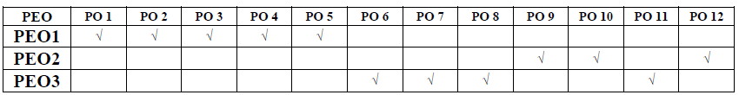
Mapping of PO to PEO

Slide 14
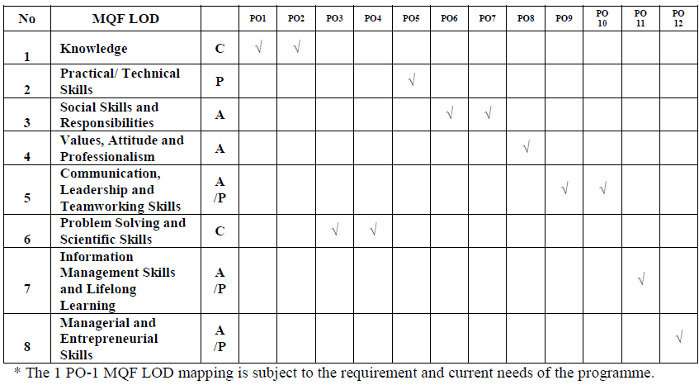
Mapping of 12 Engineering POs to 8 MQF LOD

Slide 15
Course Outcomes (CO)
Course Outcomes are statements that describe what students are expected to know and be able to perform or attain upon completion of a course.
S.M.A.R.T.
Specific: accurately states what a student is expected to achieve.
Measurable: open to assessment which accurately reflects whether or not the outcome has been achieved.
Attainable: should be within the range of abilities of a student
Relevant: should relate to the key content of a course
Time scaled: must be achievable within the duration of a trimester

Slide 16
Course Outcomes (CO)
Active verb (what students will be able to do) +
Object (noun or noun phrase describing what) +
Context (a phrase qualifying the context in which the action is done to the object)
Example:
To evaluate the strengths and weaknesses of current research literature and/or their own research using psychological research methodology

Slide 17
Course Outcomes (CO)
Do’s
Don’ts
Include three basic components, i.e. verb, object and context
Use ONE verb per CO
Must be measurable and assessable
Try to use more HOTS to challenge the students
Avoid vague term (e.g. know, understand, aware, familiar etc.)
Avoid complicated sentence
Avoid over-ambitious within limited time frame
Not listing the topic

Slide 18
Mapping of CO to PO
Each CO contributes to the achievement of PO via curriculum design, course delivery and assessment tasks that are most appropriate to attain that CO.
Each CO is mapped to one Domain only (Cognitive/ Affective/ Psychomotor)
Each CO is mapped to one PO only.

Slide 19
Constructive Alignment
Constructive Alignment principles require lecturers to align each CO to appropriate teaching and learning activities; and base assessment tasks on effective marking scheme and rubric.
‘Constructive’ refers to lecturer actively constructs and designs teaching activities and instructions than can enhance students’ learning experience.
‘Alignment’ means the lecturer carefully plans, designs and carries out learning activities in relation to students’ CO attainment.

Slide 20
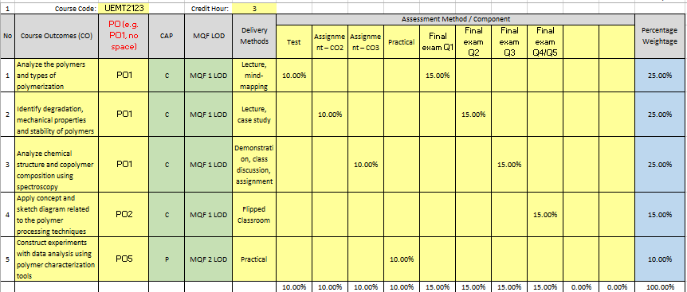
Constructive Alignment

Slide 21
Mapping of Assessment to CO
Each CO must be adequately assessed, regardless of students’ choice of answering optional questions in continuous assessment and the final examination.
Each assessment task / question* is mapped to one CO only.
*Assessment task / question refers to any coursework components such as each quiz, test, assignment, practical; as well as final examination or more specifically each final examination question asked.)

Slide 22
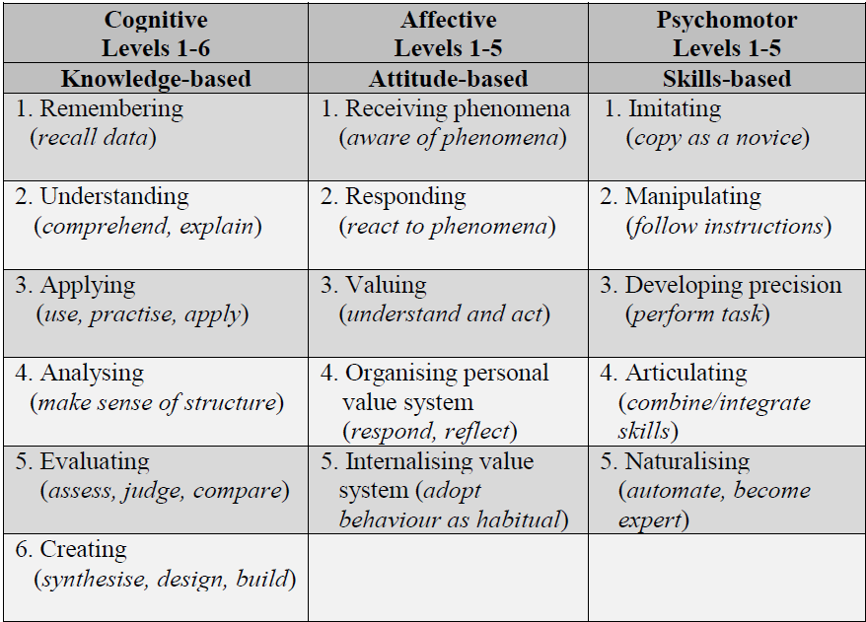
Bloom recommended three learning outcomes domains, i.e. Cognitive, Affective and Psychomotor as educational objectives (Bloom, Hastings & Madaus, 1971).

Slide 23
Cognitive Domain (Bloom’s Taxonomy Model)
Category | Key Words (verbs) | Example
C1 Remembering: Recall or retrieve previous learned information. | defines, describes, identifies, knows, labels, lists, matches, names, outlines, recalls, recognizes, reproduces, selects, states | Recite a policy. Quote prices from memory to a customer. Recite the safety rules.
C2 Understanding: Comprehending the meaning, translation, interpolation, and interpretation of instructions and problems. State a problem in one's own words. | comprehends, converts, defends, distinguishes, estimates, explains, extends, generalizes, gives an example, infers, interprets, paraphrases, predicts, rewrites, summarizes, translates | Rewrite the principles of test writing. Explain in one's own words the steps for performing a complex task. Translate an equation into a computer spreadsheet.
Resource: http://www.nwlink.com/~donclark/hrd/bloom.html

Slide 24
Cognitive Domain (Bloom’s Taxonomy Model)
Category | Key Words (verbs) | Example
C3 Applying: Use a concept in a new situation or unprompted use of an abstraction. Applies what was learned in the classroom into novel situations in the work place. | applies, changes, computes, constructs, demonstrates, discovers, manipulates, modifies, operates, predicts, prepares, produces, relates, shows, solves, uses | Use a manual to calculate an employee's vacation time. Apply laws of statistics to evaluate the reliability of a written test.
C4 Analyzing: Separates material or concepts into component parts so that its organizational structure may be understood. Distinguishes between facts and inferences. | analyzes, breaks down, compares, contrasts, diagrams, deconstructs, differentiates, discriminates, distinguishes, identifies, illustrates, infers, outlines, relates, selects, separates | Troubleshoot a piece of equipment by using logical deduction. Recognize logical fallacies in reasoning. Gathers information from a department and selects the required tasks for training.
Resource: http://www.nwlink.com/~donclark/hrd/bloom.html

Slide 25
Cognitive Domain (Bloom’s Taxonomy Model)
Category | Key Words (verbs) | Example
C5 Evaluating: Make judgments about the value of ideas or materials. | appraises, compares, concludes, contrasts, criticizes, critiques, defends, describes, discriminates, evaluates, explains, interprets, justifies, relates, summarizes, supports | Select the most effective solution. Hire the most qualified candidate. Explain and justify a new budget.
C6 Creating: Builds a structure or pattern from diverse elements. Put parts together to form a whole, with emphasis on creating a new meaning or structure. | categorizes, combines, compiles, composes, creates, devises, designs, explains, generates, modifies, organizes, plans, rearranges, reconstructs, relates, reorganizes, revises, rewrites, summarizes, tells, writes | Write a company operations or process manual. Design a machine to perform a specific task. Integrates training from several sources to solve a problem. Revises and process to improve the outcome.
Resource: http://www.nwlink.com/~donclark/hrd/bloom.html

Slide 26
Affective Domain (Bloom’s Taxonomy Model)
Category | Key Words (verbs) | Example
A1 Receiving Phenomena: Awareness, willingness to hear, selected attention. | acknowledge, asks, attentive, courteous, dutiful, follows, gives, listens, understands | Listen to others with respect. Listen for and remember the name of newly introduced people.
A2 Responds to Phenomena: Active participation on the part of the learners. Attend and react to a particular phenomenon. Learning outcomes may emphasize compliance in responding, willingness to respond, or satisfaction in responding (motivation). | answers, assists, aids, complies, conforms, discusses, greets, helps, labels, performs, presents, tells | Participates in class discussions. Gives a presentation. Questions new ideals, concepts, models, etc. in order to fully understand them. Know the safety rules and practice them.
Resource: http://www.nwlink.com/~donclark/hrd/Bloom/affective_domain.html

Slide 27
Affective Domain (Bloom’s Taxonomy Model)
Category | Key Words (verbs) | Example
A3 Valuing: The worth or value a person attaches to a particular object, phenomenon, or behavior. This ranges from simple acceptance to the more complex state of commitment. Valuing is based on the internalization of a set of specified values, while clues to these values are expressed in the learner's overt behavior and are often identifiable. | appreciates, cherish, treasure, demonstrates, initiates, invites, joins, justifies, proposes, respect, shares | Demonstrates belief in the democratic process. Is sensitive towards individual and cultural differences (value diversity). Shows the ability to solve problems. Proposes a plan to social improvement and follows through with commitment. Informs management on matters that one feels strongly about.
Resource: http://www.nwlink.com/~donclark/hrd/Bloom/affective_domain.html

Slide 28
Affective Domain (Bloom’s Taxonomy Model)
Category | Key Words (verbs) | Example
A4 Organization: Organizes values into priorities by contrasting different values, resolving conflicts between them, and creating an unique value system. The emphasis is on comparing, relating, and synthesizing values. | compares, relates, synthesizes | Recognizes the need for balance between freedom and responsible behavior. Explains the role of systematic planning in solving problems. Accepts professional ethical standards. Creates a life plan in harmony with abilities, interests, and beliefs. Prioritizes time effectively to meet the needs of the organization, family, and self.
Resource: http://www.nwlink.com/~donclark/hrd/Bloom/affective_domain.html

Slide 29
Affective Domain (Bloom’s Taxonomy Model)
Category | Key Words (verbs) | Example
A5 Internalizes Values (characterization): Has a value system that controls their behavior. The behavior is pervasive, consistent, predictable, and most important characteristic of the learner. Instructional objectives are concerned with the student's general patterns of adjustment (personal, social, emotional). | acts, discriminates, displays, influences, modifies, performs, qualifies, questions, revises, serves, solves, verifies | Shows self-reliance when working independently. Cooperates in group activities (displays teamwork). Uses an objective approach in problem solving. Displays a professional commitment to ethical practice on a daily basis. Revises judgments and changes behavior in light of new evidence. Values people for what they are, not how they look.
Resource: http://www.nwlink.com/~donclark/hrd/Bloom/affective_domain.html

Slide 30
Psychomotor Domain (Dave’s Taxonomy Model)
Category | Key Words (verbs) | Example
P1 Imitation: Observing and patterning behavior after someone else. Performance may be of low quality. | copy, follow, mimic, repeat, replicate, reproduce, trace | Copying a work of art. Performing a skill while observing a demonstrator
P2 Manipulation: Being able to perform certain actions by memory or following instructions. | act, build, execute, perform | Being able to perform a skill on one's own after taking lessons or reading about it. Follows instructions to build a model.
P3 Precision: Refining, becoming more exact. Performing a skill within a high degree of precision | calibrate, demonstrate, master, perfectionism | Working and reworking something, so it will be “just right.” Perform a skill or task without assistance. Demonstrate a task to a beginner.
Resource: http://www.nwlink.com/~donclark/hrd/Bloom/psychomotor_domain.html

Slide 31
Psychomotor Domain (Dave’s Taxonomy Model)
Category | Key Words (verbs) | Example
P4 Articulation: Coordinating and adapting a series of actions to achieve harmony and internal consistency. | adapt, constructs, combine, creates, customize, modifies, formulate | Combining a series of skills to produce a video that involves music, drama, color, sound, etc. Combining a series of skills or activities to meet a novel requirement
P5 Naturalization: Mastering a high level performance until it become second-nature or natural, without needing to think much about it. | create, design, develop, invent, manage, naturally | Maneuvers a car into a tight parallel parking spot. Operates a computer quickly and accurately. Displays competence while playing the piano. Michael Jordan playing basketball or Nancy Lopez hitting a golf ball.
Resource: http://www.nwlink.com/~donclark/hrd/Bloom/psychomotor_domain.html

Slide 32
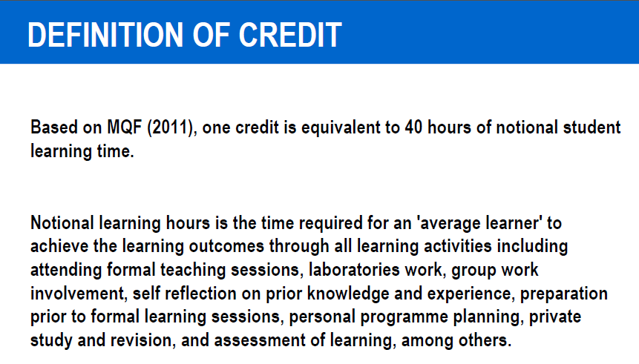
Self – Learning Time

Slide 33
Self – Learning Time
Teacher - centered
Student - centered
Learning Outcomes is the Learning Target
Mapping of learning outcomes necessary
Course Objective is the Learning Target
No mapping of learning outcomes
Student Independent Learning
Not Calculated
Contact hours
Reflects Credit value
Student independent Learning Time Calculated
Total SLT reflects Credit value

Slide 34
Self – Learning Time: General Guideline for LKCFES
1 Lecture hour ➔ 1 Independent SLT hour
1 Tutorial hour ➔ 1 Independent SLT hour
1 Practical hour ➔ ½ Independent SLT hour
No contribution for OTHERS and GUIDED Learning to SLT.

Slide 35
Continual Quality Improvement (CQI)
CQI is a system of regular reflection and refinement to improve processes and outcomes to provide quality education.
Programme owners continuously review and improve the quality of curriculum, relevance of course outcomes, revise the existing POs, course delivery methods, assessment and benchmark with other universities offering the same or similar programme.

Slide 36
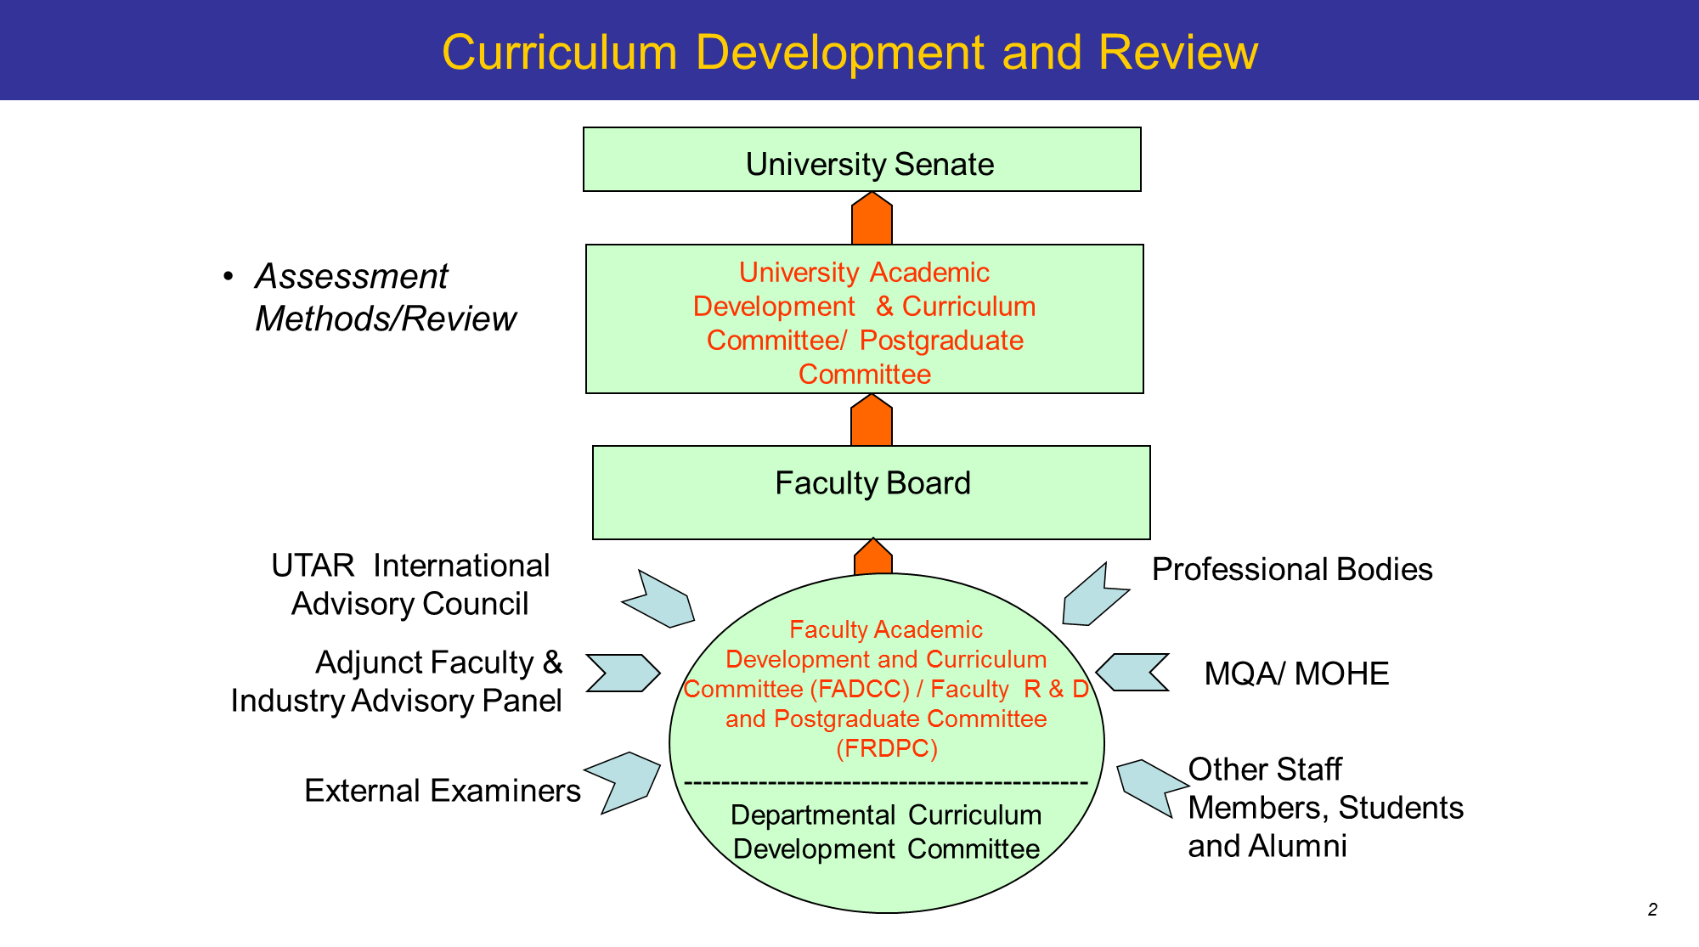

Slide 38
Every Trimester
P
D
C
A
Plan - Planning
Do - Implementing
Check - Evaluating
Act - Improving
Course Level
Course Planning
Teaching & Learning + Assessment
CO Attainment
Course Revision
Syllabus (Course Outcomes + CO-PO)
Teaching Plan (Delivery Method + Assessment)
Coursework Moderation
Final Exam Moderation
Student Results (eOBE2)
Student Survey
Course Report (CQI Action)
Time Frame
WEEK 0
WEEK 1 - 14
WEEK 15-18
WEEK 19-20

Slide 39
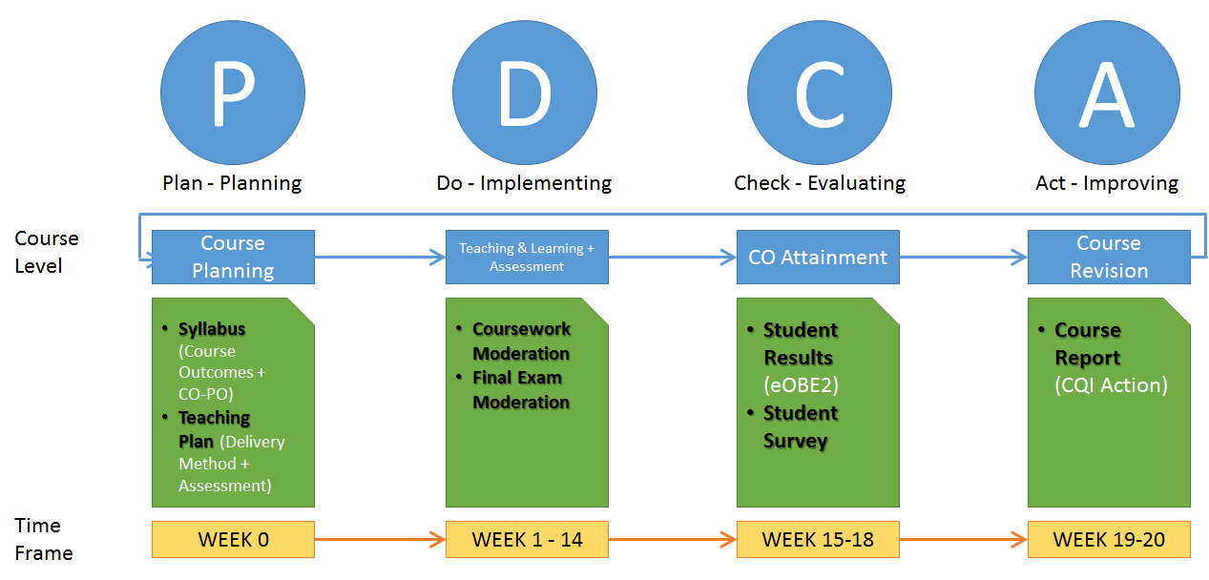
*APMR: Annual Programme Monitoring Report
Annually
P
D
C
A
Plan - Planning
Do - Implementing
Check - Evaluating
Act - Improving
Programme Level
Programme Planning
PO Attainment
APMR*
Programme Revision
PO Attainment is evaluated every trimester
Course Level
Time Frame
Trimester 1
Trimester 2
Trimester 3

Slide 40
P
D
C
A
Plan - Planning
Do - Implementing
Check - Evaluating
Act - Improving
PEO Statement Survey
Professional Level
PEO Planning
Alumni Survey
PO Statement Survey
Programme Level
Programme Planning
PO Attainment
Programme Revision
Course Level
Course Planning
Teaching & Learning + Assessment
CO Attainment
Course Revision

Slide 41
PEO / PO / CO Monitoring and Revision Cycle
Level | Outcomes | Assessment (Performance) | Monitoring Cycle | Revision Cycle | Stakeholder
Professional | PEO (Programme Educational Objectives) | Alumni Survey Employer Survey | Annually | Every 4 years | Alumni Employer IAP EE
Programme | PO (Programme Outcomes) | FYP Survey ITV Survey PO Attainment | Annually | Every 4 years | IAP EE Staff Student
Course | CO (Course Outcomes) | Final Exam Coursework CO Attainment | Every trimester | Annually | IAP EE Staff Student

Slide 42
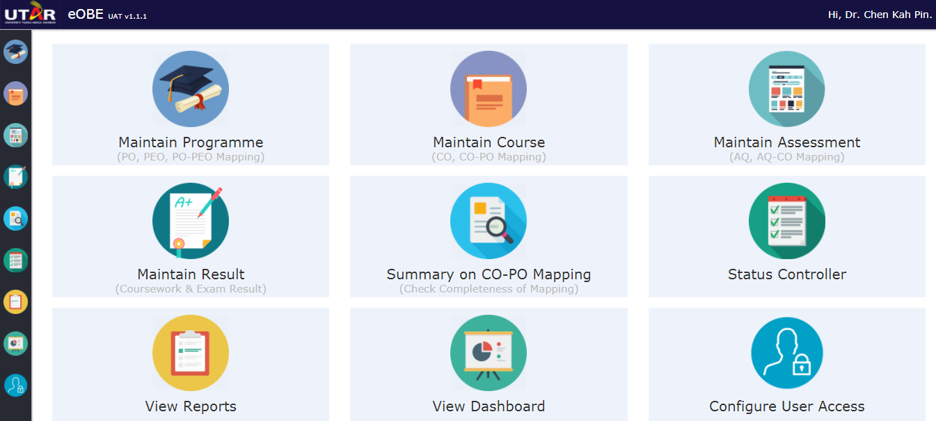
eOBE2
Refer to eOBE2 User Instruction Guide (Course Leader)_20171116

Slide 43
Example of CO / PO Attainment Calculation

Slide 44
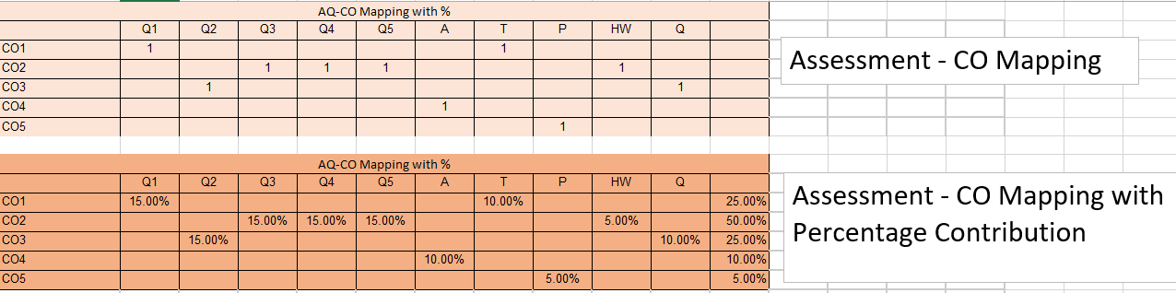
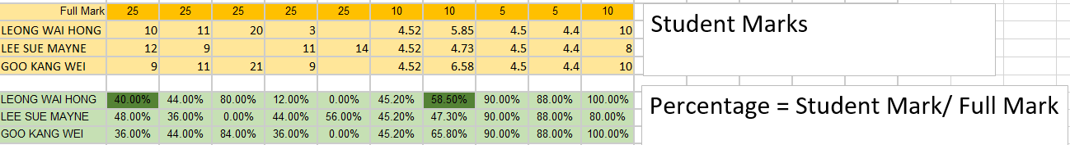
Student Mark (Out of FULL MARK)
Student Mark (in Percentage)

Slide 45
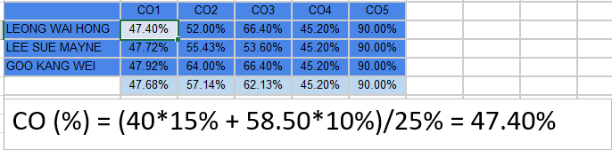
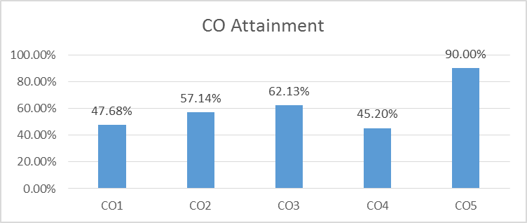
CO Attainment
Average CO attainment from whole class

Slide 46
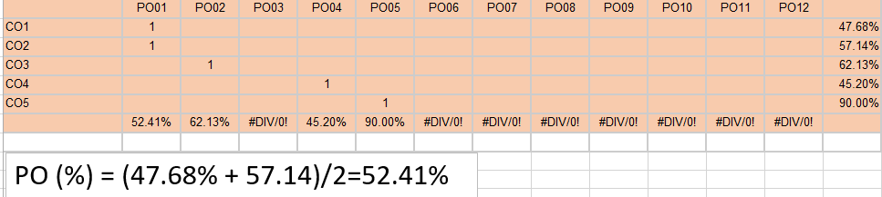
PO Attainment

Slide 47
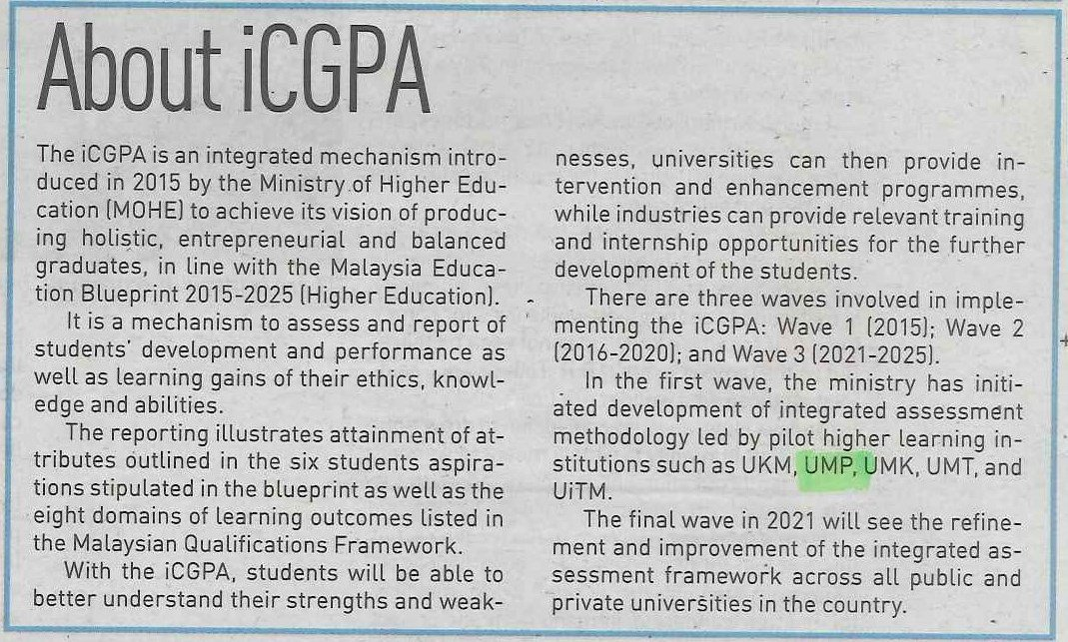

Slide 48
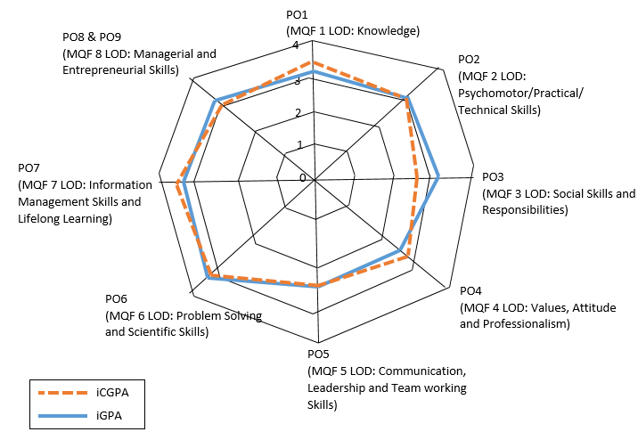
Spider Web

Slide 49
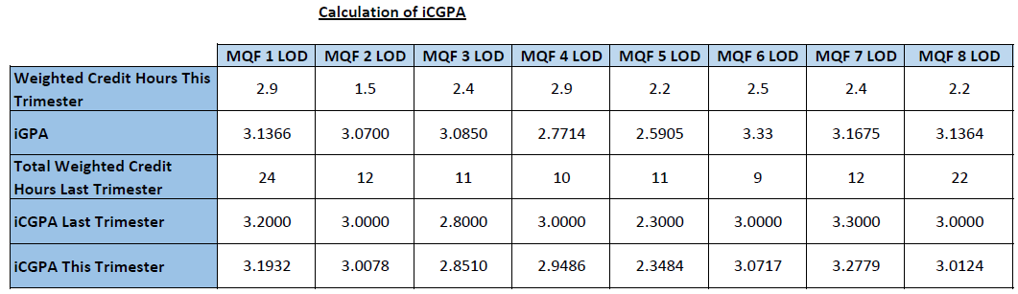
Calculation of iCGPA
[(2.9X3.1366)+(24X3.2000)]/(2.9+24)=3.1932

Slide 50
Complex Problem Solving (Need High Taxonomy Level)
Complex Engineering Problems have characteristic WP1 and some or all of WP2 to WP7, EP1 and EP2, that can be resolved with in-depth forefront knowledge
No | Attribute | Complex problems have characteristic WP1 and some or all of WP2 to WP7:
WP1 | Depth of Knowledge required | Cannot be resolved without in-depth engineering knowledge at the level of one or more of WK3, WK4, WK5, WK6 or WK8 which allows a fundamental-based, first principles analytical approach.
WP2 | Range of conflicting requirements | Involve wide-ranging or conflicting technical, engineering and other issues.
WP3 | Depth of analysis required | Have no obvious solution and require abstract thinking, originality in analysis to formulate suitable models.
WP4 | Familiarity of issues | Involve infrequently encountered issues
WP5 | Extent of applicable codes | Are outside problems encompassed by standards and codes of practice for professional engineering.
WP6 | Extent of stakeholder involvement and level of conflicting requirements | Involve diverse groups of stakeholders with widely varying needs.
WP7 | Interdependence | Are high level problems including many component parts or sub-problems.

Slide 51
Complex Problem Activities
Complex activities mean (engineering) activities or projects that have some or all of the following characteristics:
No | Attribute | Complex activities mean (engineering) activities or projects that have some or all of the following characteristics:
EA1 | Depth of Knowledge required | Involve the use of diverse resources (and for this purpose resources includes people, money, equipment, materials, information and technologies).
EA2 | Range of conflicting requirements | Require resolution of significant problems arising from interactions between wide ranging or conflicting technical, engineering or other issues.
EA3 | Depth of analysis required | Involve creative use of engineering principles and research-based knowledge in novel
EA4 | Familiarity of issues | Have significant consequences in a range of contexts, characterised by difficulty of prediction and mitigation.
EA5 | Extent of applicable codes | Can extend beyond previous experiences by applying principles-based approaches.

Slide 52
Knowledge Profile
A programme that builds this type of knowledge and develops the attributes listed below is typically achieved in 4 to 5 years of study, depending on the level of students at entry.
WK1 | A systematic, theory-based understanding of the natural sciences applicable to the discipline.
WK2 | Conceptually-based mathematics, numerical analysis, statistics and formal aspects of computer and information science to support analysis and modelling applicable to the discipline.
WK3 | A systematic, theory-based formulation of engineering fundamentals required in the engineering discipline.
WK4 | Engineering specialist knowledge that provides theoretical frameworks and bodies of knowledge for the accepted practice areas in the engineering discipline; much is at the forefront of the discipline.
WK5 | Knowledge that supports engineering design in a practice area.
WK6 | Knowledge of engineering practice (technology) in the practice areas in the engineering discipline.
WK7 | Comprehension of the role of engineering in society and identified issues in engineering practice in the discipline: ethics and the professional responsibility of an engineer to public safety; the impacts of engineering activity: economic, social, cultural, environmental and sustainability.
WK8 | Engagement with selected knowledge in the research literature of the discipline.

Slide 53
References
Handbook on Academic Matters
OBE – Staff 2018
eOBE2 User Instruction Guide (Course Leader)_20171116
EAC Manual 2017
Web2 – UTAR Policy – IAD
UTAR Guidelines on Outcome-Based Education (OBE)

