Slide 1

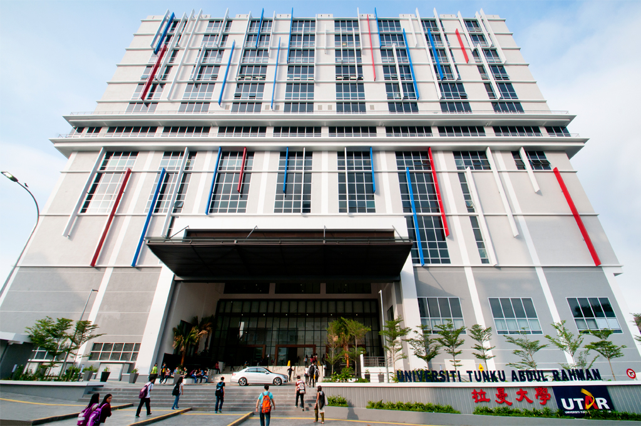
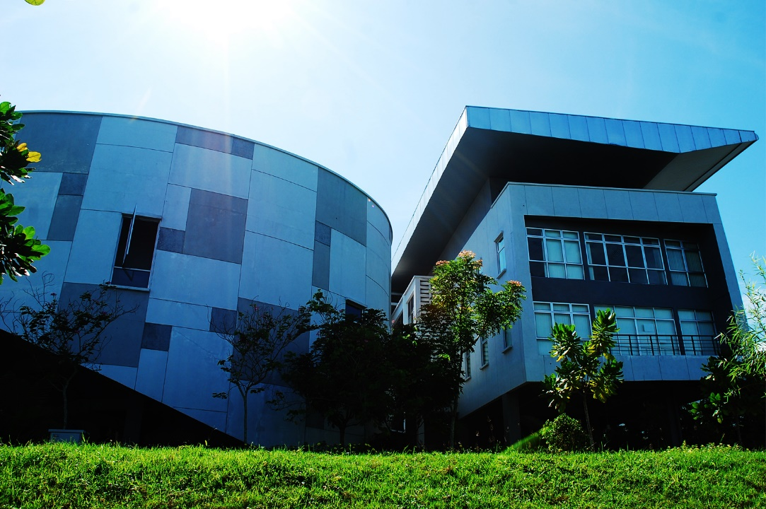
UTAR R&D 4.0

Slide 2

GLOBAL INITIATIVE & Revolution

Slide 3

UN Sustainable Development Goals
17 SDGs with 169 targets that are to be achieved by 2030

Slide 4
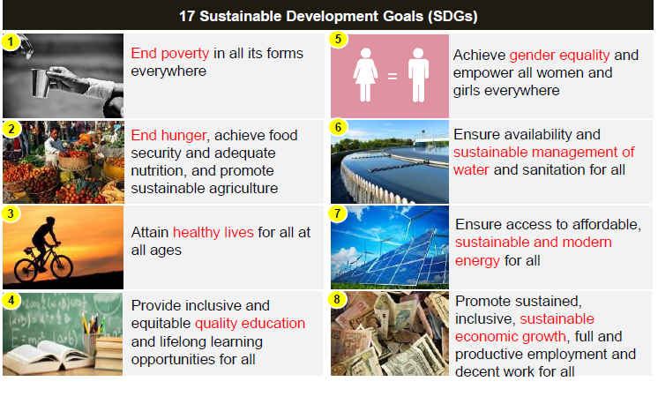
UN Sustainable Development Goals

Slide 5
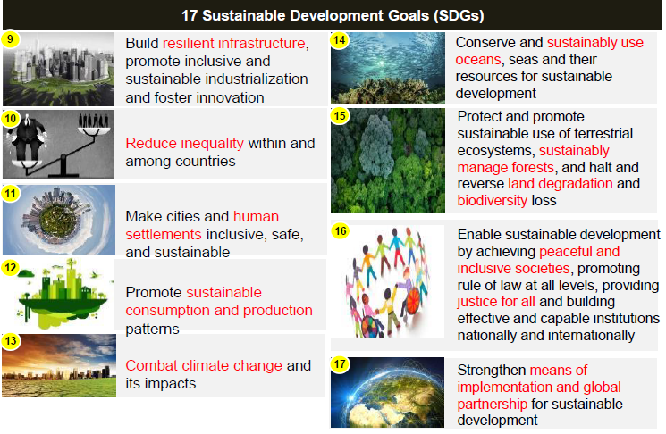
UN Sustainable Development Goals

Slide 6
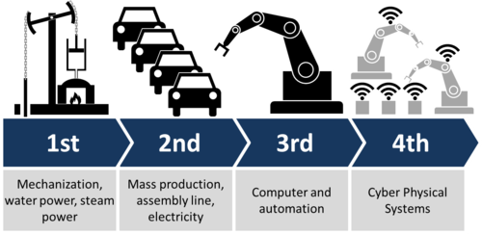
Industrial Revolution

Slide 7
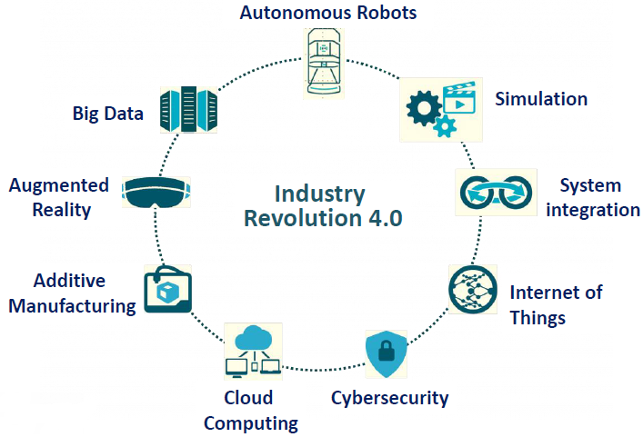
Pillars of Industry Revolution 4.0
Source: Industry 4.0 and its implications to SMEs by SME Corp (Jun 15, 2017)

Slide 8
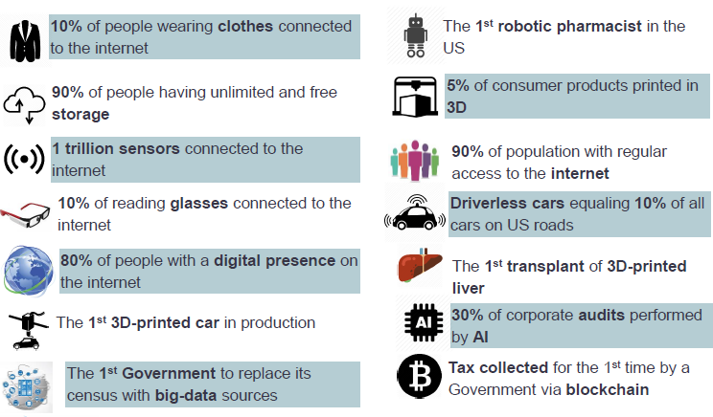
Technological Shift by 2025

Slide 9

NATIONAL INITIATIVE

Slide 10




National Transformation 2050 (TN50)

Slide 11
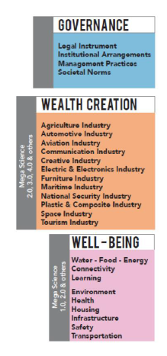
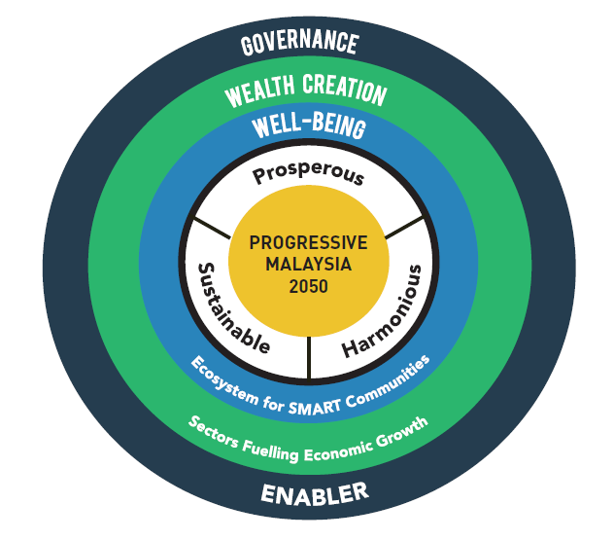
Sustainable Development Framework for Progressive Malaysia 2050

Slide 12
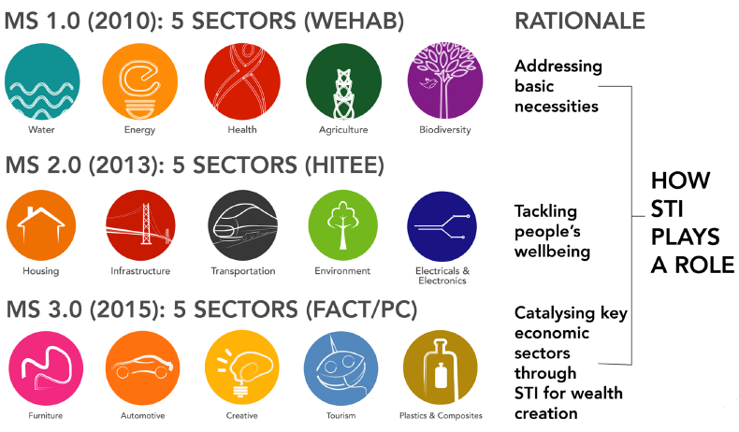
Mega Science – Wealth Creation & Well-Being

Slide 13
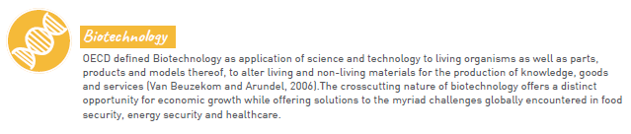
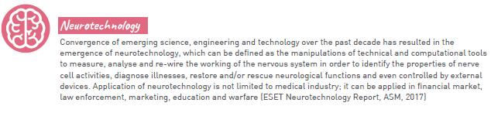
Science & Technology Foresight Malaysia 2050 Emerging Science, Engineering & Technology (ESET) Study 5 Technology Areas
Source: Science & Technology Foresight Malaysia 2050, Emerging Science, Engineering & Technology (ESET) Study Report

Slide 14
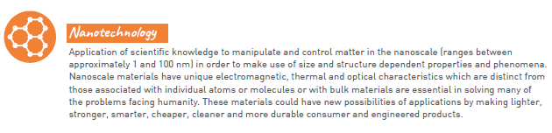
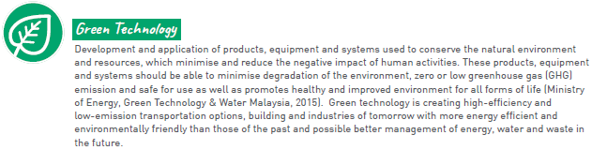
Science & Technology Foresight Malaysia 2050 Emerging Science, Engineering & Technology (ESET) Study 5 Technology Areas
Source: Science & Technology Foresight Malaysia 2050, Emerging Science, Engineering & Technology (ESET) Study Report

Slide 15
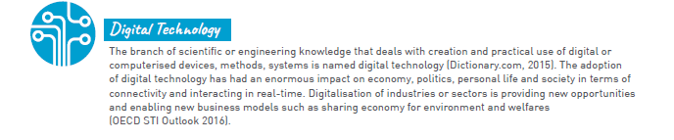
Science & Technology Foresight Malaysia 2050 Emerging Science, Engineering & Technology (ESET) Study 5 Technology Areas
Emerging technologies are defined as technologies that are being developed or projected to be developed over the next 5 – 10 years that would have significant impact on the economy and society.
Source: Science & Technology Foresight Malaysia 2050, Emerging Science, Engineering & Technology (ESET) Study Report

Slide 16
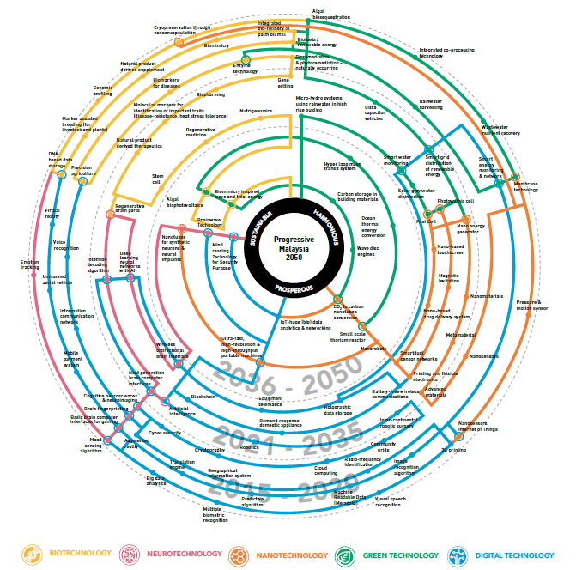
Malaysia’s Emerging Technology Timeline Towards 2050
Source: Science & Technology Foresight Malaysia 2050, Emerging Science, Engineering & Technology (ESET) Study Report

Slide 17
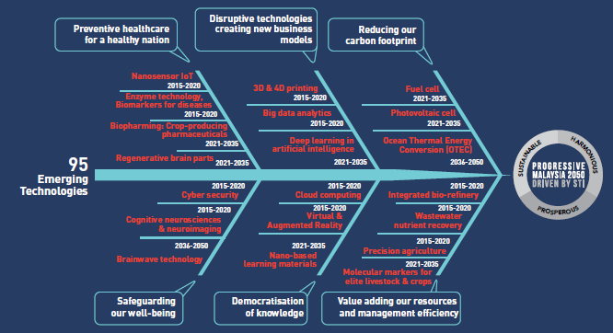
Impactful Emerging Technologies
Source: Science & Technology Foresight Malaysia 2050, Emerging Science, Engineering & Technology (ESET) Study Report

Slide 18

UTAR R&D FOCUS

Slide 19
UTAR Priority Area
Society & Sustainable Living
Global Warming and Environment
Natural Environment and Biodiversity
Sustainable Development
Social and Economic Wellbeing
Policy and Governance
Logistics and Transportation
Energy & Water Safety
Food Supply & Safety
Disaster Mitigation and Management
Social Diversity, Relationships & Nation Building
National Security
Human Capital Development
Education Policy & Implementation
Teaching & Learning Strategies
Human Capital Competency and Sufficiency
Lifelong Learning

Slide 20
UTAR Priority Area
Heritage & Culture Preservation
Linguistic and Literature
Culture & Society
ASIAN and Malaysian History
Architecture & Heritage
Healthcare, Medicine& Technology
Infectious & Tropical Diseases
Non-communicable Diseases
Complementary and Alternative Medicine
Stem Cell & Regenerative Medicine
Medical Diagnostic Equipment and Tools
Healthcare & Tourism
Healthcare for Aging Society

Slide 21
UTAR Priority Area
Internet & Intelligent Systems
Information and Communication Technology
Big Data
Society & Social Media
Internet of Things (IoT)
Sensor Technology
Advanced Manufacturing
Asset & Infrastructure Monitoring
Industry, Economy& International Relations
Regional & International Trade
Global Competiveness
Small & Medium Enterprises (SMEs)
Entrepreneurship Development

Slide 22
UTAR R&D 4.0
UTAR Priority Areas | SDG & Emerging Technologies (ET)
Society & Sustainable Living | SDG1, SDG2, SDG5, SDG6, SDG7, SDG11, SDG13, SDG14, SDG15, SDG16 ET1, ET4, ET5
Human Capital Development | SDG1, SDG4, SDG5 ET5
Heritage & Culture Preservation | SDG4, SDG11 ET5
Healthcare, Medicine & Technology | SDG3, SDG8 ET1, ET2, ET5
Internet & Intelligent Systems | SDG4, SDG7, SDG9, SDG12 ET2, ET3, ET5
Industry, Economy & International Relations | SDG1, SDG2, SDG8, SDG9 SDG10, SDG17 ET4, ET5

Slide 23
UTARRF Funding
Projects to be considered for UTARRF should be inline with:
UTAR priority areas mapped to the
Sustainable Development Goals
Science & Technology Foresight Malaysia 2050
Emerging Science, Engineering & Technology (ESET) Study

Slide 24

THE END

