Slide 1

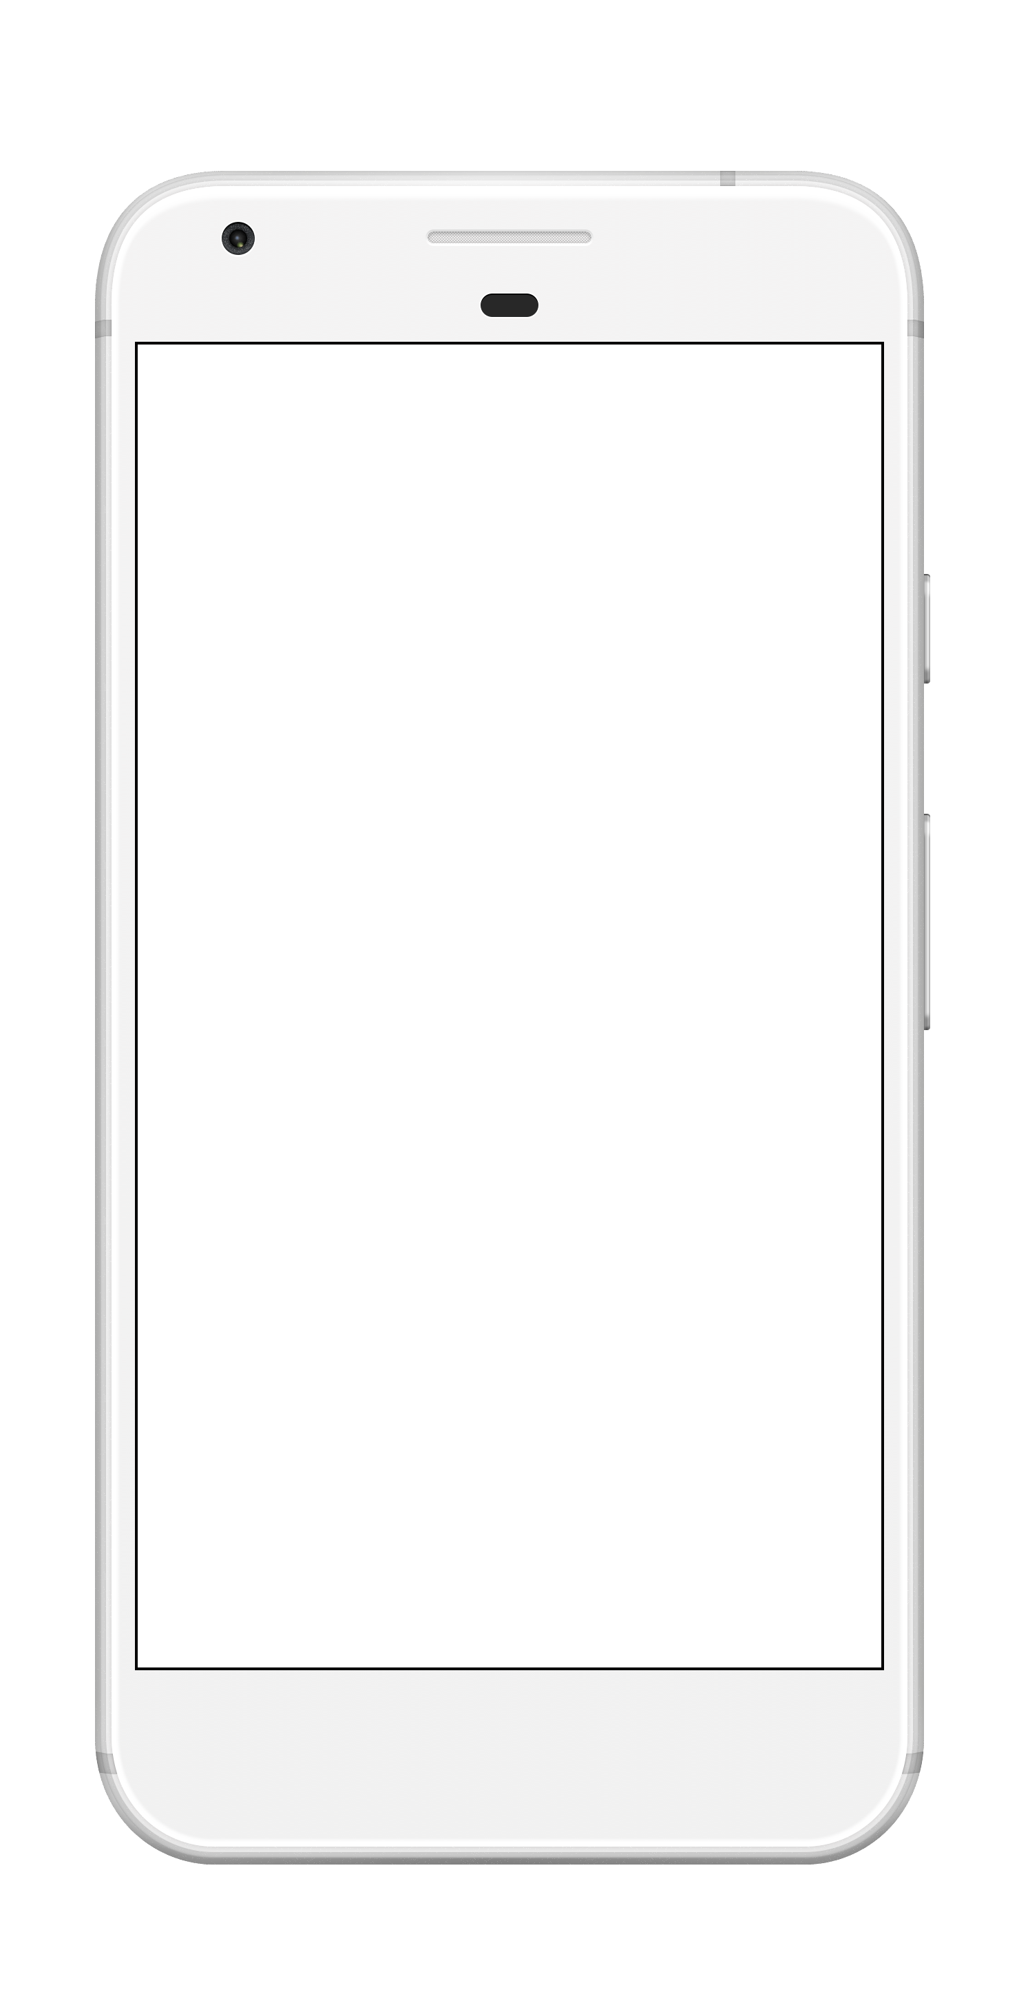
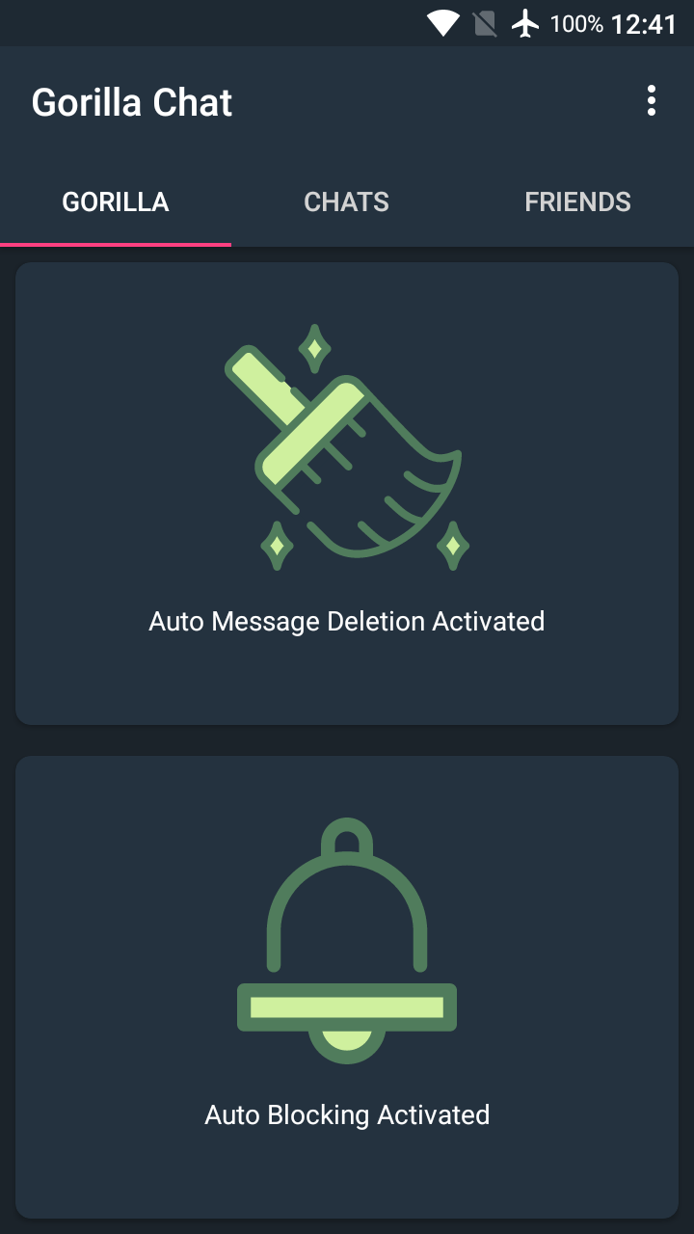
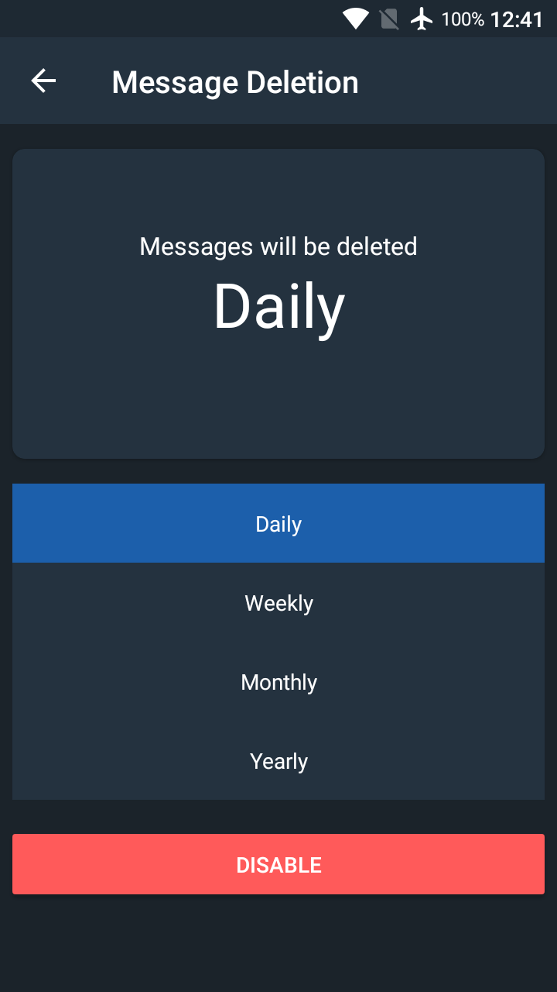
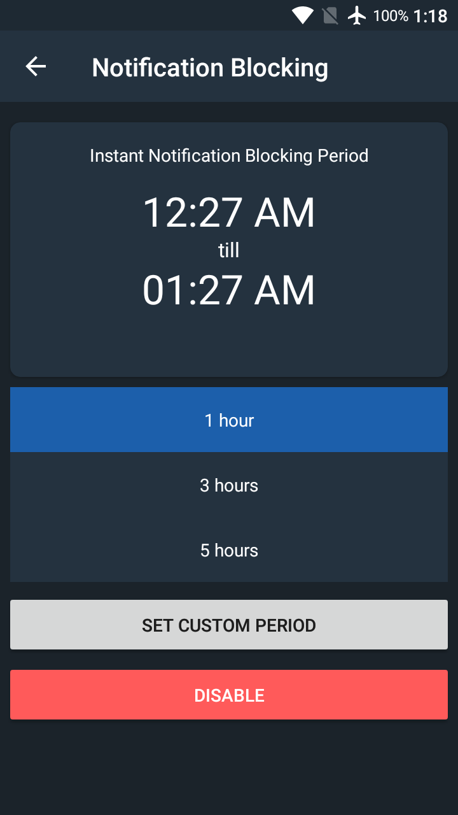
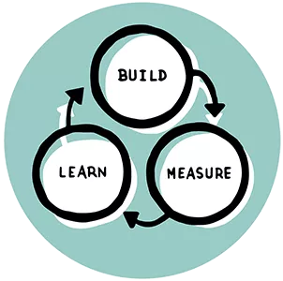

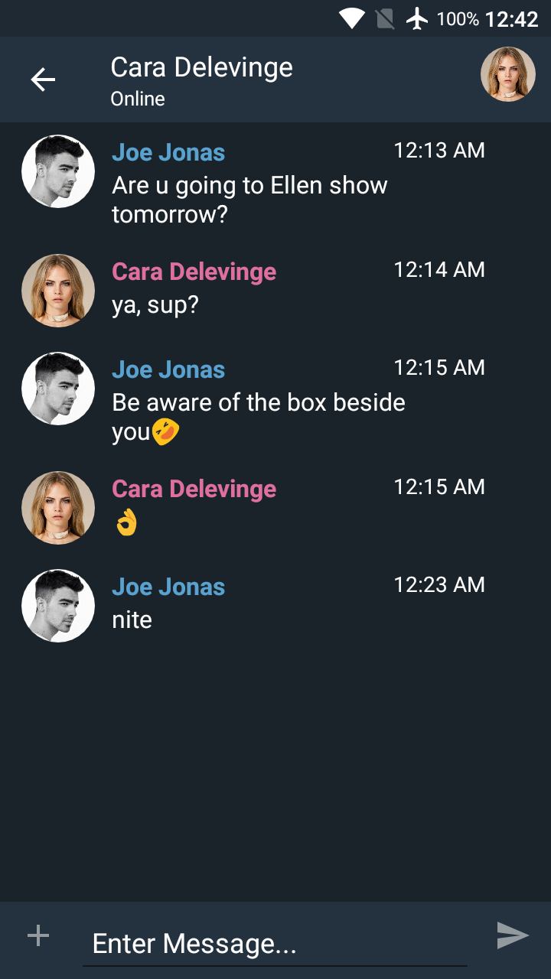
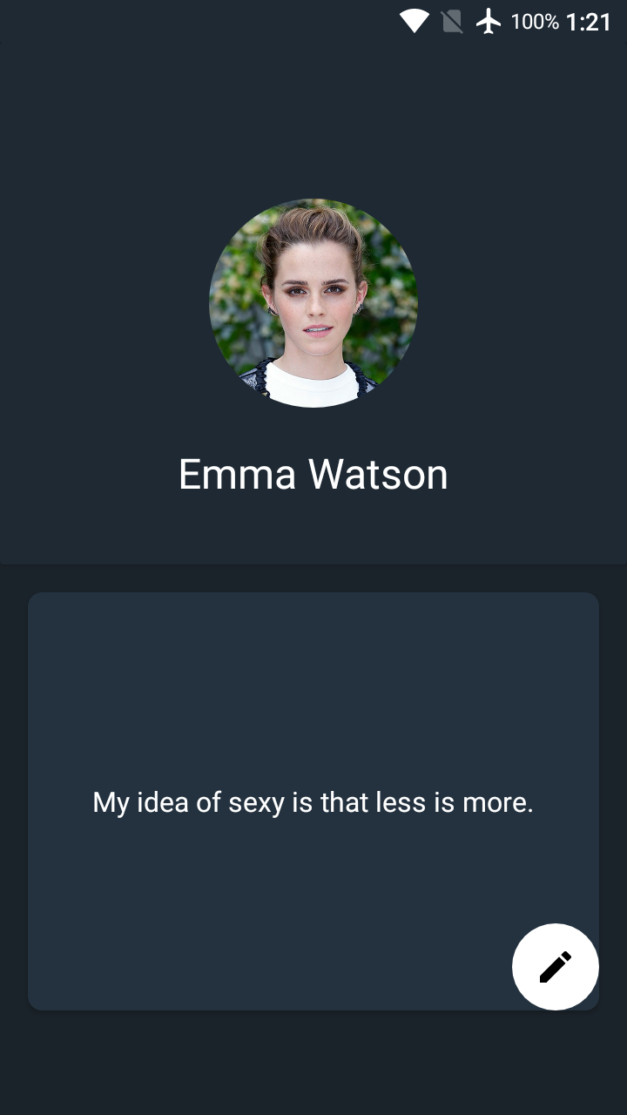




UNIVERSITI TUNKU ABDUL RAHMAN
Lee Kong Chian Faculty of Engineering & Science
AUTO BLOCKING AND HISTORY DELETION
MESSAGING APP
CHOW ZI XUAN · MR SOR KEAN VEE
Abstract
A messaging app that provide auto removing of your previous messages and auto blocking of phone incoming message notifications.
The purpose of the app is to reduce phone storage usage and decrease the frequency of message deletion manually by the user.
Objective
Prevent excessive storage usage.
Stop disruption by blocking notification.
Save user’s time spent in deleting messages.
Ease user to search for important messages.
Results and Discussion
Methodology
Lean Methodology
Creating more value for customer with fewer resources and improve product with Build-Measure-Learn cycle.
Settings
Auto Message Deletion
Auto
Notification Blocking
Development Tools
Chats
Conversation
Profile

