Slide 1
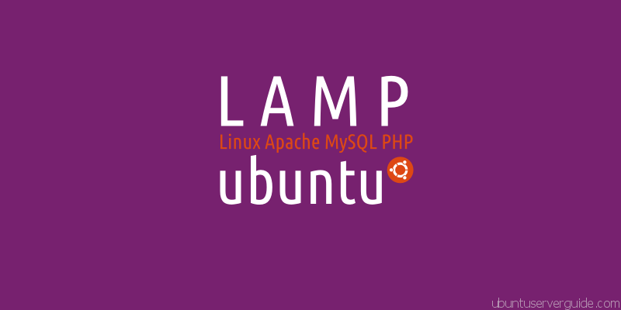
UEEN 3113 / 3413
Server Configuration and management

Slide 2

Course Outline
Introduction and Computer Systems topology
Network Operating Systems (NOS)
The Operating System Functions
Web Servers Management
Database and Web Servers Management
Network Traffic Monitoring
Distributed File Sharing
System Backup and Recovery
IT Governance

Slide 3
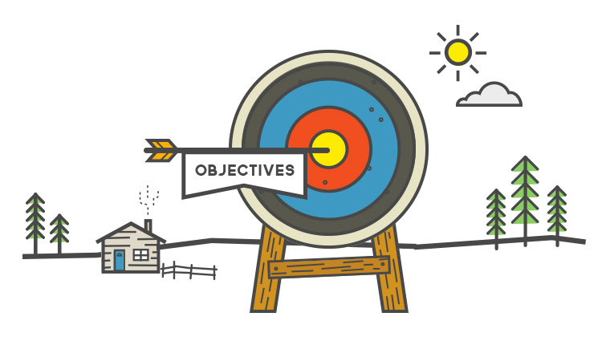
Course outcomes
Explain the roles of various servers and Network Operating Systems
Apply network management concepts on server administration
Make use of sniffing and diagnostic tools for analysing server traffic and protocol
Explain the importance of IT governance in implementing the right policies, monitoring mechanisms, and control practices in server management

Slide 4

Course Evaluation
Coursework 50%
Practical - 30%
Practical Test 1 - 15%
Practical Test 2 - 15%
Midterm Test - 15%
Quiz 5%
Final Exam 50%
Engineering Students Only
Compulsory pass for final exam.
49% and below for final exam considered fail
EAC requirement

Slide 5

Consultation
By appointment
016-2927502

Slide 6
Introduction
Client/Server
Client host
Client host
A Client is any process that requests specific services from the server process. Client and Server processes can reside in the same computer or in different computers linked by a network.
A Server is a process that provides requested services for the Client. Client and Server processes can reside in the same computer or in different computers linked by a network.
Server host

Slide 7
Why client server architecture?
Specialisation:
Clients specialise in user interface
Servers specialise in managing data and application logic
Sharing:
Many clients can be supported by few servers
Often data and logic are shared among applications and users
Solution
Many data management problems faced by modern organisations

Slide 8
How it Looks
“I want to access
some information”
“I want to
collaborate
with my
colleague”
Client
Server
Peer-to-peer

Slide 9
Types of Servers
File Server
All the files reside on the server machine.
Provides clients access to records within files from the server machine.
Useful for sharing files across a network among different client process requesting the services.
Examples:
UNIX: Network File Services (NFS)
Samba: An open Source/Free Software suite that provides seamless file and print services to SMB/CIFS clients

Slide 10
Types of Servers
Print Server
Manages user access to the shared output devices, such as printers.
The earliest type of servers.
Print services can run on a file server or on one or more separate print server machines.

Slide 11
Types of Servers
Application Server
Manages access to centralised application software.
Example, a shared database.
When user requests information from the database, the application server processes the request and returns the result to the user.

Slide 12
Types of Servers
Mail Server
This machine manages the flow of electronic mail, messaging, and communication with mainframe systems on large-scale networks.
Server
Client
Client
Email client sends message to server
Later, recipient’s email client retrieves message from server
Message is stored on POP server

Slide 13
Types of Servers
Fax Server
Provides the facility to send and receive the Faxes through a single network connection.
A workstation with an installed FAX board and special software
A specialized device dedicated and designed for Fax Services.
This machine manages flow of fax information to and from the network.
It is similar to the mail server.

Slide 14
Types of Servers
Directory Services Server
It is found on large-scale systems with data that is distributed throughout multiple servers.
An organization manager, keeping track of what is stored where, enabling fast and reliable access to data in various locations.

Slide 15
Types of Servers
Web Server
Stores and retrieves Internet (and intranet) data for the enterprise.
Some documents, data, etc., reside on web servers.
Web application provides access to documents and other data.
“Thin” clients typically use a web browser to request those documents. Such servers shares documents across intranets, or across the Internet (or extranets).

Slide 16
Types of Servers
Web Server
The most commonly used protocol is HTTP (Hyper Text Transfer Protocol).
Examples: Microsoft’s Internet Information Server (IIS), Netscape’s iPlanet (now Oracle iPlanet Web Server), IBM’s WebSphere, BEA’s WebLogic and Oracle Application Server.

Slide 17
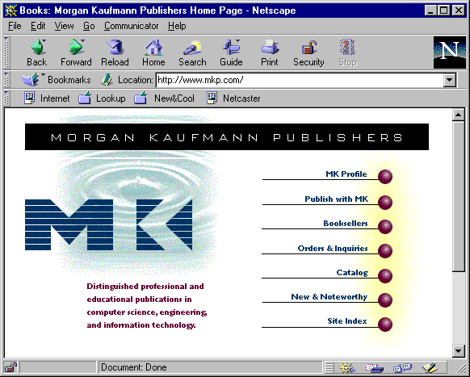
Types of Servers
Web Server
Client
Web
browser
Host architecture
Application partition
Web
server
Common
gateway
interchange
Application logic
Databases and DBMS

Slide 18
Types of Servers
Database Server
Data resides on server, in the form of a SQL database.
Database server provides access to data to clients, in response to SQL requests.
Shares the data residing in a database across a network.
Has more efficient protocol than File Server.
Receives SQL requests and processes them and returning only the requested data; therefore the client doesn’t have to deal with irrelevant data.

Slide 19
Types of Servers
Database Server
However, the client does have to implement SQL application code. Examples: Oracle9i database server, Microsoft SQL Server, DB2, MySQL, PostgreSQL, etc.

Slide 20
Types of Servers
Transaction Servers
The data and remote procedures reside on the server.
Access to high level functions and implements efficient transaction processing. It shares data and high level functions across a network.
Used to implement Online Transaction Processing (OLTP) in high-performance applications.
Utilises a more efficient protocol in comparison to a Database Server.

Slide 21
Types of Servers
Transaction Servers
Receives high-level function request from the clients and it implements that function.
Examples
TP-Light with Database Stored Procedures like Oracle, Microsoft SQL Server etc.
TP-Heavy with TP Monitors like BEA Tuxedo, IBM CICS/TX Series.
Notes:
TP: Transaction Processing

Slide 22
Types of Servers
Others
Game server
Proxy server
SaaS server???
Cloud server???
Notes:
SaaS: Software as a Service

Slide 23
Client-Server: Fat / Thin
How much of an application is placed at the client end vs. the server end?
Thin client conducts a minimum of processing on the client side.
Fat client carries a relatively larger proportion of processing load. Used in traditional of Client/Server models.
Fat server contains more application functionalities, provides more abstract, higher level services. Client is often using a fast web browser. Advantage: easier to manage because only the software on the servers needs to be changed.

Slide 24
Client-Server Topologies
Physical layout of the Client/Server network in which all the clients and servers are connected to each other.
Single client, single server
Multiple clients, single server
Multiple clients, multiple servers
Application logic
LAN
Note: many clients per
application server, several
application servers per data server
Shared data

Slide 25
Client-Server Classification
Two Tier
Client first tier, server second tier.
SQL statements are issued by the application and then handed on by the driver to the database for execution.
The results are then sent back via the same mechanism, but in the reverse direction. It is the responsibility of the driver (ODBC) to present the SQL statement.

Slide 26
Client-Server Classification
Two tier
Advantages:
Availability of well-integrated PC-based tools like, Power Builder, MS Access, 4 GL tools provided by the RDBMS manufacturer, remote SQL, ODBC.
Tools are relatively inexpensive.
Least complicated to implement.
Provides much more attractive graphical user interface (GUI) applications.

Slide 27
Client-Server Classification
Two tier
Disadvantages:
High maintenance cost of application, as well as client side tools.
Increased network load.
Application is bound to an individual PC, application logic cannot be reused.
Changes made to business processes/logic have to be implemented in all individual PCs.
Software distribution (to all PCs) procedure is complicated.
PCs are considered to be weak in terms of security.

Slide 28
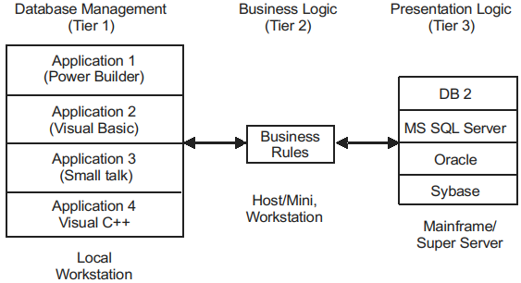
Client-Server Classification
Three tier: application responsibilities are divided into 3 logical categories:
Presentation (GUI) or user services:
Screen formatting
Windows management
Input editing
What-if analysis

Slide 29
Client-Server Classification
Three tier: application responsibilities are divided into 3 logical categories:
Application services or business rules:
Domain and range validation
Data dependency validation
Request/response architecture of Inter Process Communication level

Slide 30
Client-Server Classification
Three tier: application responsibilities are divided into 3 logical categories:
Database services or data server:
Data access
Data management
Data security
SQL parsing

Slide 31
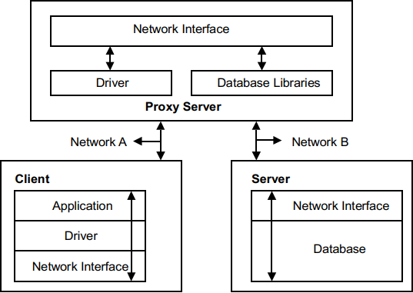
Client-Server Classification
Three tier
A third server is employed to handle requests from the client (acts as proxy for all client requests, create more secure environment for the database)
The Request is then passed off to the database server.

Slide 32
Client-Server Classification
Generally
First tier (client-tier) is to receive user events and to control the user interface and presentation of data.
The client is called “Thin Client”. Browser and presentation code resides on this tier.
Second tier (application-server-tier) contains complex application logic and available to the client tier on request from client. It can protect direct access of data.
Third tier (database-server-tier) is responsible for data storage, mostly operates on a relational database.

Slide 33
N-Tier Client-Server Model
Design components according to a business schema that represents entities, relationship, activities roles, and rules.
Distribute functionality across logical and physical tiers, allowing better utilization of hardware and platform resources.
Splitting may be between application logic components, security logic, and presentation logic, computational-intensive and I/O-intensive components.

Slide 34
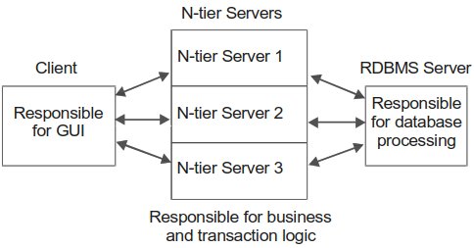
N-Tier Client-Server Model
Advantages:
Overall performance has been improved.
The business logic is centralized.
Enhanced security level is attained.

Slide 35
Advantages of Client-Server Model
Distributed workload improve performance
Back-end processing is done in the server whereas client workstation is running the front-end software.
Client workstation independence (any platform any operating system)
System interoperability.
Different type of components systems (client, network, server) can work together and any component can be changed.

Slide 36
Advantages of Client-Server Model
Scalability.
Client-server system may be replaced without affecting the rest of the system, E.g. upgrade / replace the hardware/ software.
Data integrity.
DBMS can provide data protection like encrypted storage, real time backup, disk mirroring (duplicate to another partition), disk duplexing (duplicate to another hard disk), keeps track changes made and corrects problems if the server crashes.

Slide 37
Advantages of Client-Server Model
Data accessibility.
Server holds data in centralized location, multiple users can access and work on the data simultaneously.
Centralised system administration.

Slide 38
Disadvantages of Client-Server Model
High maintenance cost.
High hardware and software cost.
High complexity (setting up, troubleshooting, etc. requires experience personnel or longer time / effort).

Slide 39
Distributed Systems
A collection of independent computers that appears to users as a single coherent system.
Hardware differences and communication methods are hidden from users.
Easier to expand or scale.
Users should not be able to notice that parts are being replaced / fixed or new parts being added.

Slide 40
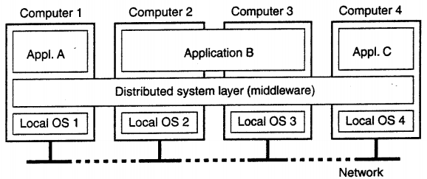
Distributed Systems
Distributed system is usually organised by layers.

Slide 41
Distributed Systems
The goals:
Resources sharing: allow users to access and share remote resources like printer, storage, supercomputer, etc.
Distribution transparency: hide the fact that the processes and resources are physically distributed across multiple computers. Might affect the performance.

Slide 42
Distributed Systems
The goals:
Openness: offer services according to the standard rules that describe the syntax and semantics of the services.
Example, rules in computer networks that govern the format, contents and meaning of messages.
Distributed systems services are specified through interfaces, defined in Interface Definition Language.
A complete interface specification enables
Interoperability: 2 implementations of systems can work together
Portability: application for system A can be executed on system B that implements the same interfaces without modification.

Slide 43
Distributed Systems
The goals:
Scalability
Easily add more users and resources.
Users and resources may lie far apart.
Easy to manage even the system spans many independent administrative organisations.
Drawback: loss of performance as the system scales up (centralised server), difficulty in geographical scaling due to synchronous communication

Slide 44


